Slide 1
Using ML improve Business of chains of plumbing services like Mr. rooter Plumbing
Department of Computer Science & Engineering
Presented By
Sahil Raj Verma
Aditya Rai
Sahil Gupta
Subrant Kumar Dang
Jitu Baro
26535024
26535001
26535023
25920036
26535016
Group No. : 5
GUIDED BY
Prof. Durga Toshniwal
IIT Roorkee· CSC - 505· 2026 - 27

Slide 2
Individual Contributions and Responsibilities
Enrolment No. | Module and Contribution | PPT Slides
26535001 | Developed the Plumbing Demand Forecasting module to estimate future service demand and evaluate forecasting performance against a baseline. | 5, 6, 7
26535023 | Developed the Strategic Resource Optimization module to investigate cancellation risk and budget-constrained allocation of interventions. | 8, 9
26535024 | Developed the Technician Scheduling and Duration Prediction module, including scheduling heuristics, duration prediction and schedule validation. | 10, 11, 12
25920036 | Developed the Water-Leak Detection module, including audio-data processing, feature extraction and leak-classification experiments. | 13, 14, 15
26535016 | Developed the Customer Feedback Analysis module to classify customer sentiment, feedback categories and complaint severity. | 16, 17

Slide 3
Project Overview
An Integrated Machine Learning System for Plumbing Service Operations
The five components are:
Detect potential water leaks from audio signals.
Forecast upcoming service demand.
Analyze customer feedback and complaint severity.
Estimate cancellation risk and explore resource allocation.
Predict service duration and optimize technician schedules.
Expected contribution
The project combines predictive analytics and optimization techniques to investigate how data-driven decisions can support plumbing service management.
Customer Request
Demand Forecasting
Resource Allocation
Technician Scheduling
Service Completion
Feedback Analysis

Slide 4













Proposed System Architecture
An Integrated Machine Learning System for Plumbing Service Operations
Data Input (Multiple Source)
Data Preparation (Preprocessing)
Machine Learning (Predictive Models)
Optimization (Decision Support)
Outputs (Applications and Insights)
Audio Recording
(Leak Detection)
Data Cleaning
Water-Leak Detection
Leak Classification
Historical Demand Records: Demand forecasting
Demand Forecasting
Demand Forecasts
Customer Feedback: Feedback analysis
Feature Extraction
Customer Feedback Analysis
Strategic Resource Optimization
Feedback Insights
Task and Technician Records: Resource optimization
Cancellation-Risk Prediction
Resource Allocation Recommendations
Data Transformation
Technician Scheduling Optimization
Task Details, Locations, Skills and Travel Data: Scheduling and duration prediction
Service Duration Prediction
Optimized Schedules
Train/Test Split

Slide 5
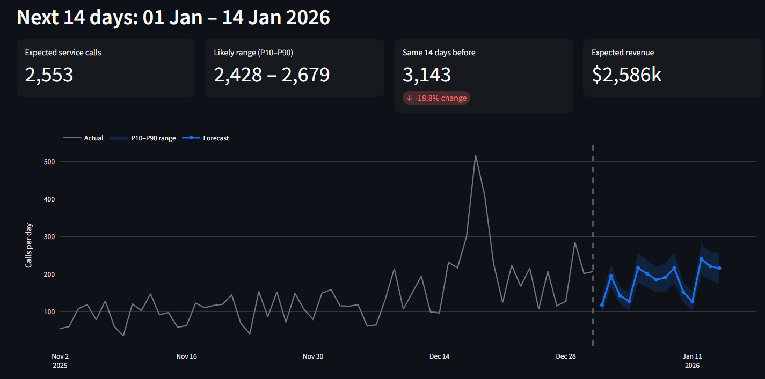
Plumbing Demand Forecasting
Predicting Future Service Demand Using Machine Learning
Problem Statement
Plumbing service demand varies by service type, branch and time. Accurate forecasting can help organizations plan staffing and allocate resources more effectively.
14-day demand forecasts of historical demand visualization with branch-wise and service-wise analysis, and expected and busy-day technician requirements.

Slide 6
Plumbing Demand Forecasting
Model Performance and Experimental Results
Branch-Level Daily Forecasting
Metric | LightGBM | Best Naive Baseline
WAPE | 18.9% | 24.9%
Bias | −1.8% | —
P10–P90 coverage | 73% | Target: 80%
Finding: LightGBM reduced WAPE by 6 percentage points, approximately a 24.1% relative reduction compared with the baseline.
Branch × Service × Day Forecasting
Model | WAPE | MAE | RMSE
LightGBM | 48.08% | 2.215 | 3.868
Naive baseline | 56.17% | 2.588 | 5.209
Finding: LightGBM outperformed the naive baseline on all three reported error metrics at the branch–service–day level.
Limitation: P10–P90 coverage was 73%, below the 80% target, indicating that prediction intervals require further calibration.

Slide 7
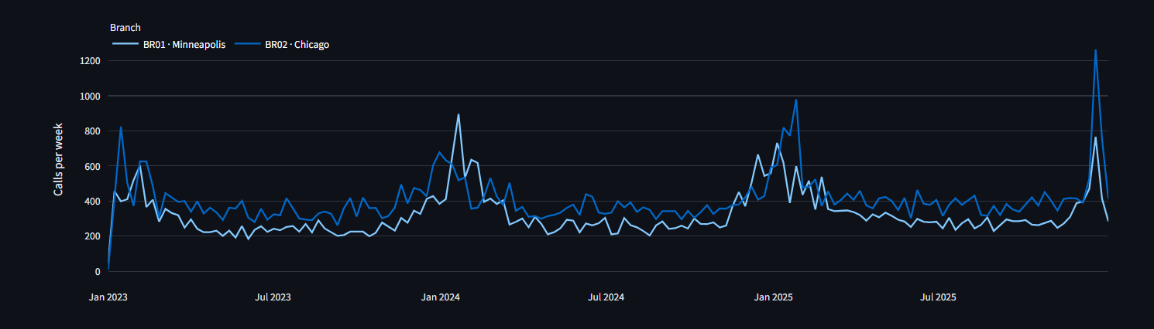
Plumbing Demand Forecasting
Tables and join keys
File | Grain | Rows | Join on
daily_demand.csv | branch × service × day (main forecasting table) | ~74k | date, branch_id
jobs.csv | one completed job | ~240k | branch_id, job_date
weather_daily.csv | branch × day | 8,768 | date, branch_id
marketing_daily.csv | branch × day | 8,768 | date, branch_id
calendar.csv | day | 1,096 | date
branches.csv | branch | 8 | branch_id
Historical Demand

Slide 8
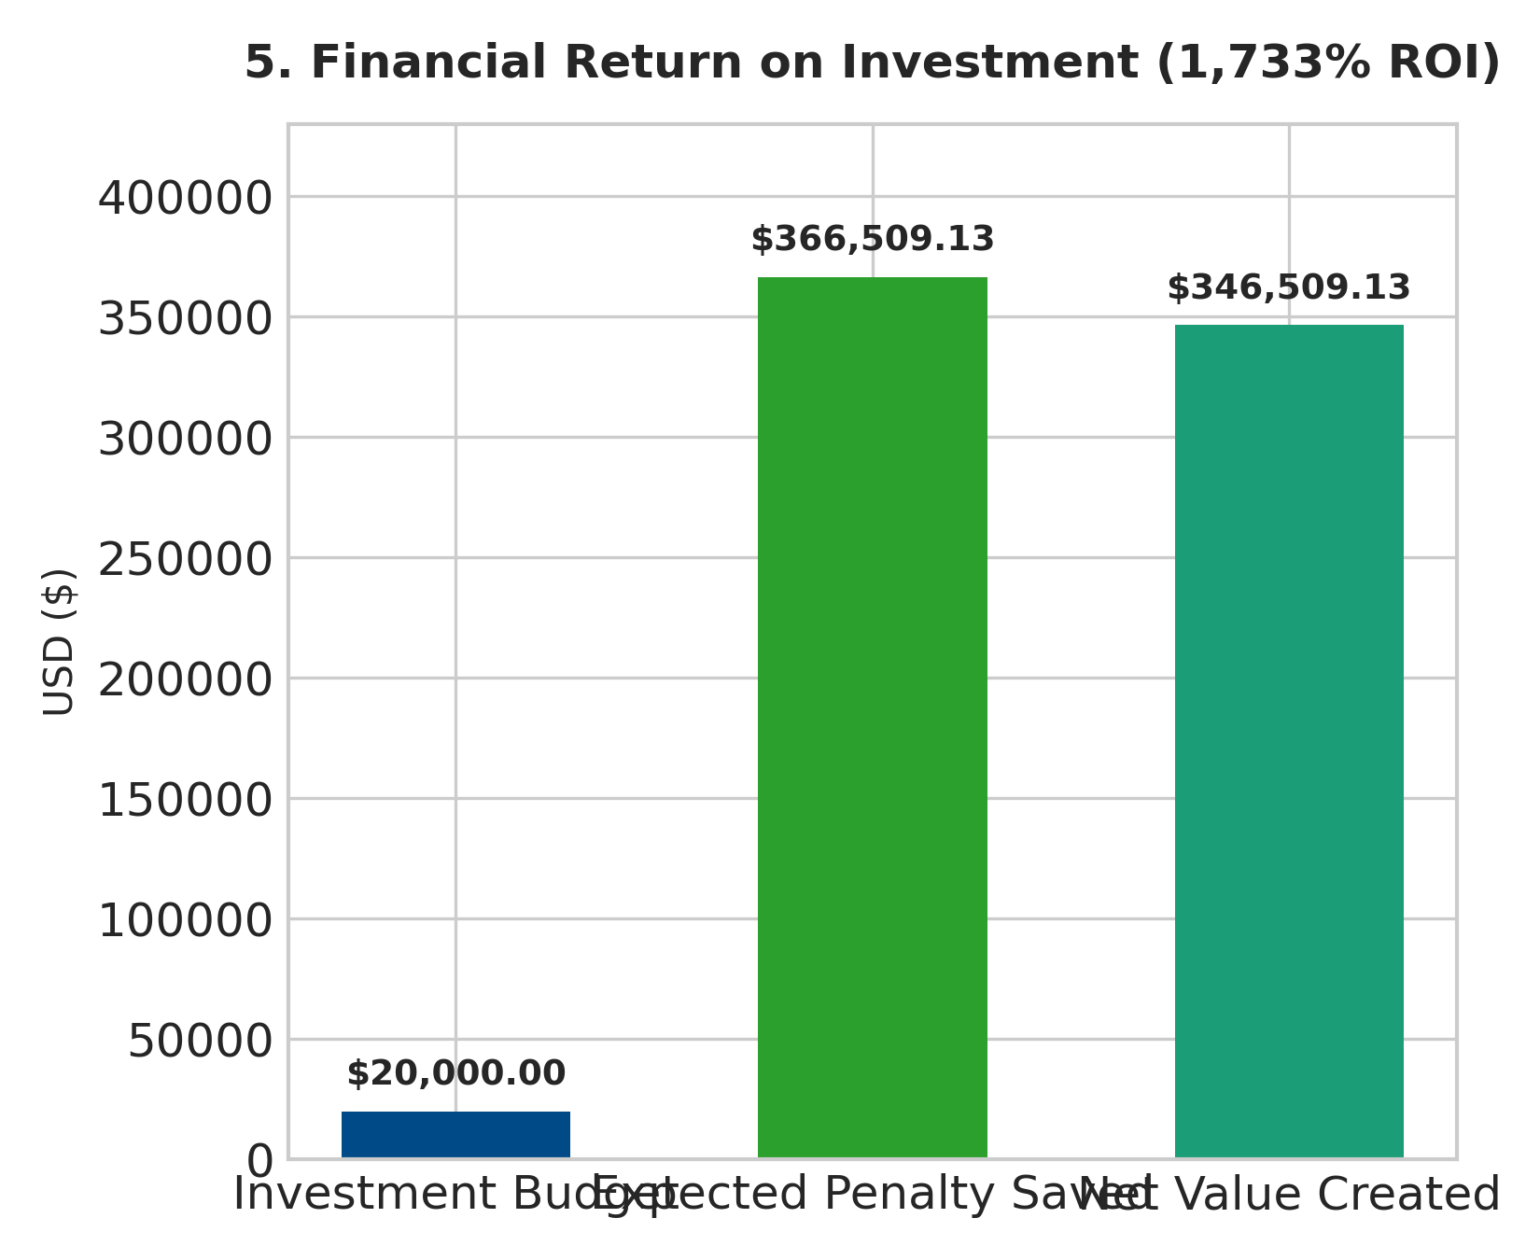
Strategic Resource Optimization
ML-Based Risk Prediction and Budget Allocation
Problem Statement
Limited budgets and technician resources make it important to identify high-risk service tasks and prioritize interventions.
Executive Summary: Transforming Dispatch Efficiency
2,677 Backlog Tasks Analyzed
0.7494 ROC-AUC Accuracy
$20,000 Capital Allocated across 114 Tasks
$366,509 Expected Penalties Saved
1,733% Return on Investment

Slide 9
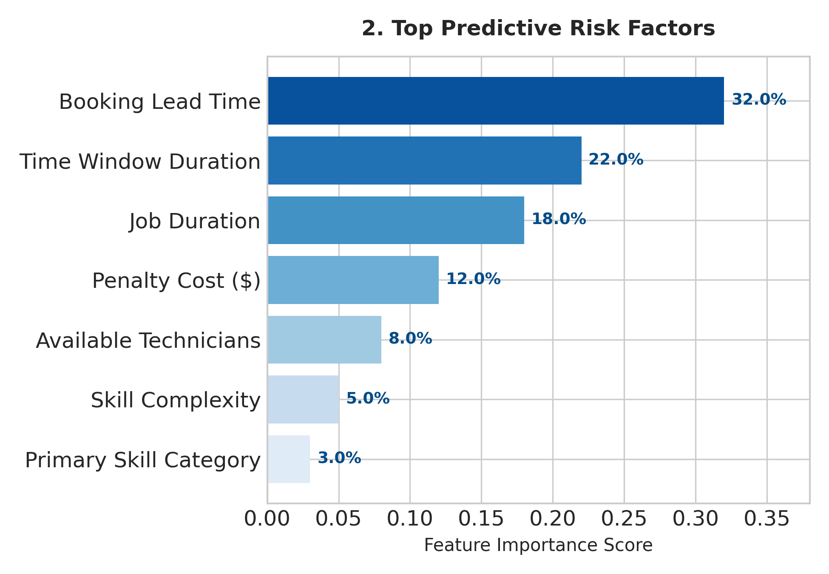
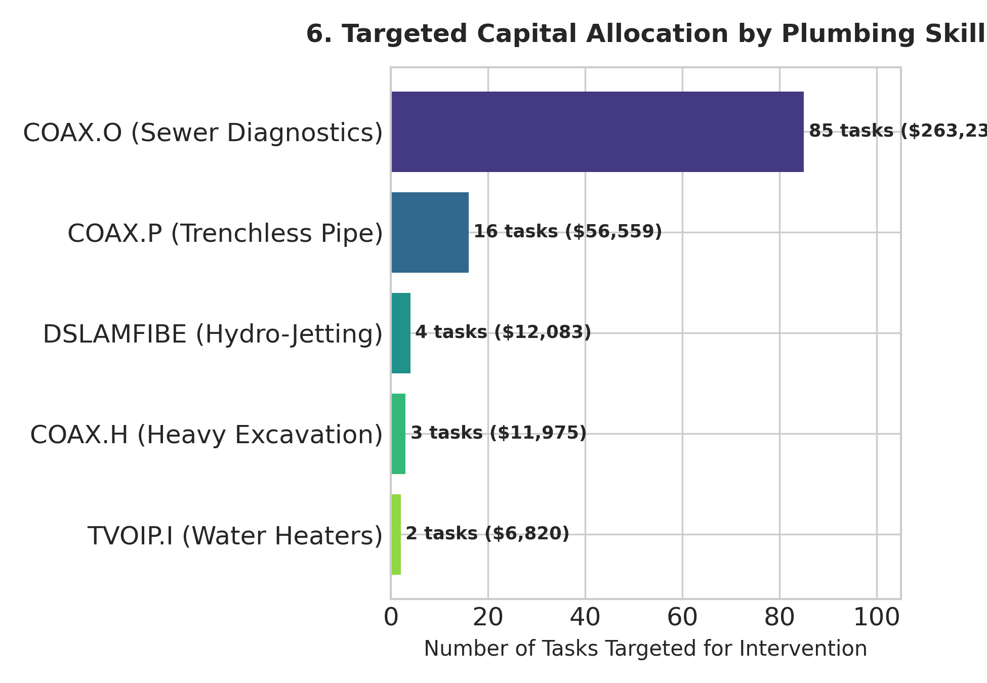
Strategic Resource Optimization
Predictive Risk Modeling: Key Failure Drivers
Targeted Skill Investment & ROI by Plumbing Skill
Executive Recommendations & Implementation Roadmap
Embed Machine Learning Risk Scoring in Dispatch CRM
Target Skill Training on Sewer Diagnostics (COAX.O) and Trenchless Repair (COAX.P)
Automated Proactive Re-confirmations for Long Lead Times (>48h)
Expand Capital Allocation Budget to $100k for $1.8M+ Penalty Prevention

Slide 10
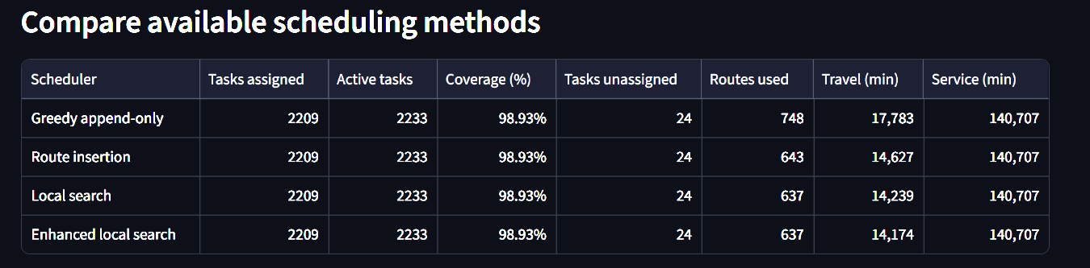
Technician Scheduling & Duration Prediction
Optimizing Technician Assignments and Reducing Travel Time
Problem Statement
Technician scheduling involves assigning service tasks while considering task duration, travel time and scheduling constraints. Inefficient scheduling can increase travel time and make resource utilization less effective.
Objectives
Predict service-task duration using machine learning.
Compare different technician scheduling algorithms.
Reduce estimated travel time while maintaining task coverage.
Validate generated schedules against operational constraints.
Methods Evaluated: Greedy Append-Only, Route Insertion, Local Search, Enhanced Local Search

Slide 11
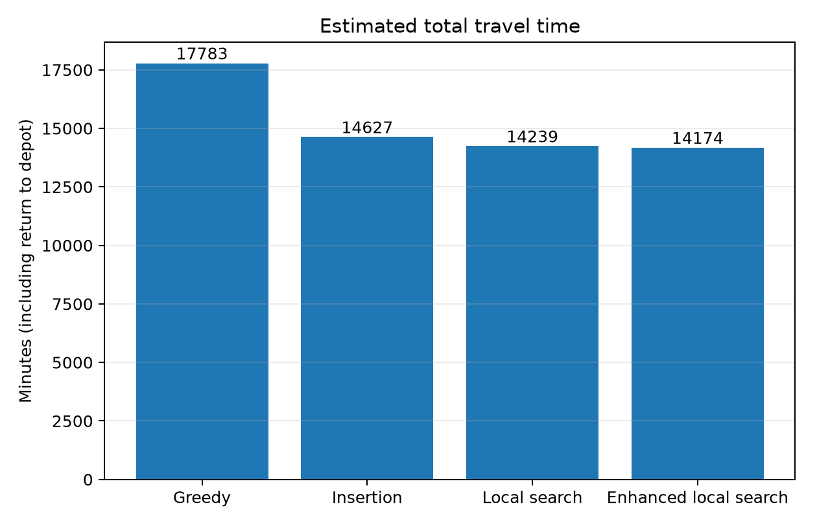
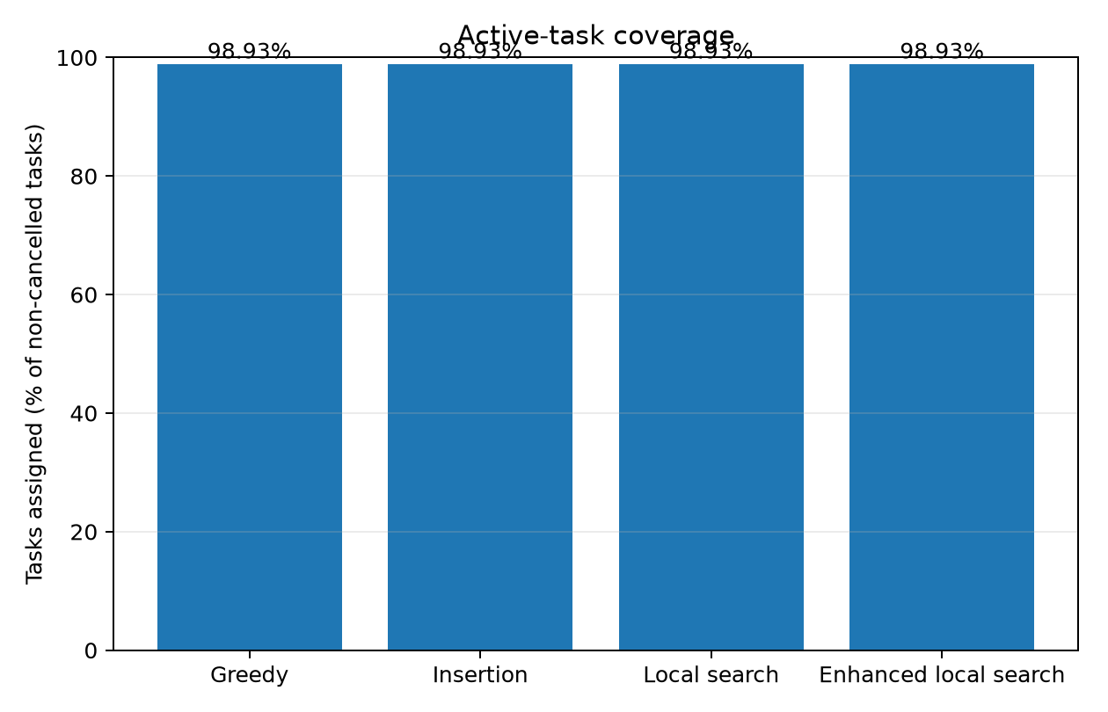
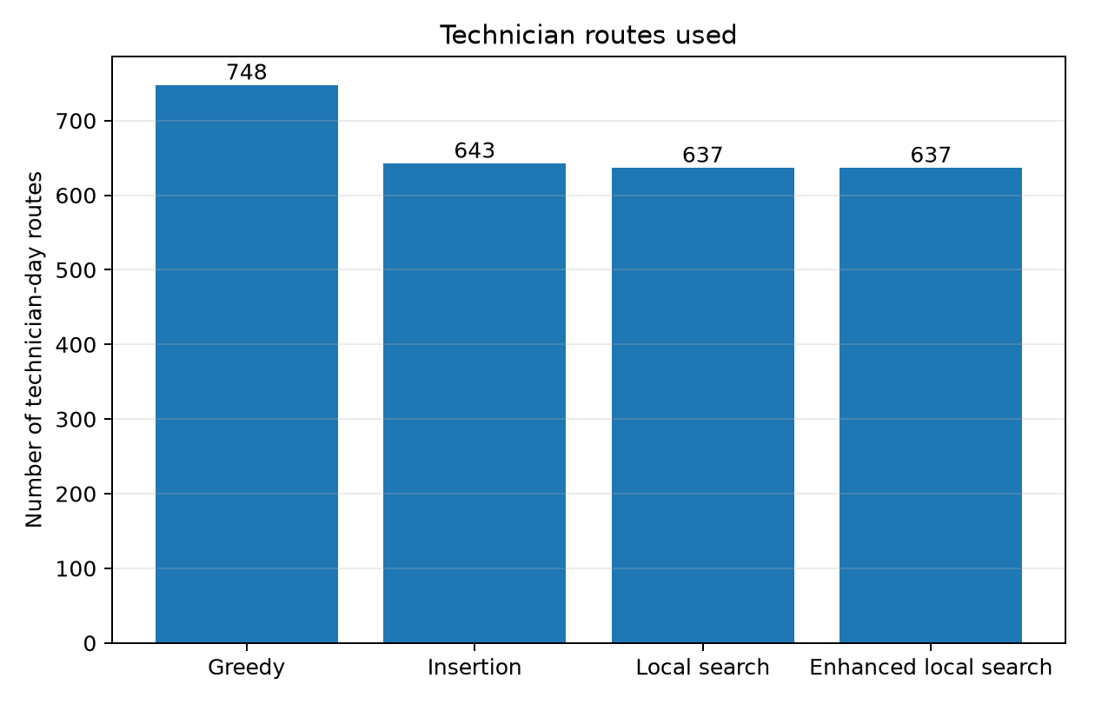
Technician Scheduling & Duration Prediction
Experimental Results and Performance Comparison
Task-Duration Prediction
Model | MAE
Median Baseline | 44.55 minutes
Ridge Regression | 25.83 minutes
Finding: Ridge Regression reduced mean absolute error by approximately 42.0% compared with the median baseline.
Travel Time: Enhanced Local Search reduced travel by 20.3%.
Task Coverage: All methods achieved 98.93% coverage.
Routes Used: Optimized methods reduced routes from 748 to 637.

Slide 12
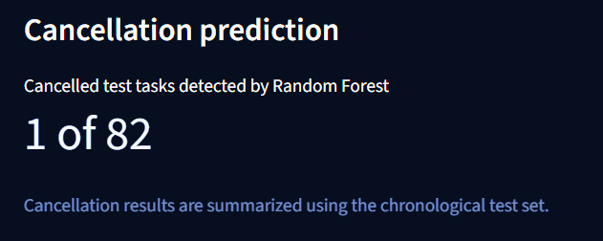
Technician Scheduling & Duration Prediction
Key Findings, Limitations and Conclusion
Key Findings
Enhanced Local Search achieved the lowest estimated travel time among the four evaluated scheduling methods.
Ridge Regression predicted task duration more accurately than the median baseline on the evaluated chronological test set.
The enhanced scheduling solution passed 28,261 validation checks with zero reported errors in the previously documented validation run.
Important Limitation
Recommendations
Improve cancellation detection using class-appropriate evaluation and threshold selection.
Validate duration predictions using representative plumbing-service data.
Evaluate scheduling performance under realistic technician availability and travel constraints.
Investigate the 24 unassigned tasks.
Test the complete workflow before claiming real-world operational savings.
Conclusion
Enhanced Local Search reduced estimated travel time by approximately 20.3% relative to Greedy Append-Only while maintaining 98.93% task coverage. Ridge Regression also improved task-duration prediction error compared with the median baseline. Further validation is needed before applying these results to live plumbing operations.

Slide 13
Water-Leak Detection
Dataset and preprocessing
Problem Statement
Water leakage can lead to water wastage and infrastructure damage. Detecting leaks from sensor signals can support faster identification of abnormal conditions.
Source recordings
Windowing
Final dataset
LO_NL_0.18 LPS_A1 — No Leak
LO_OL_0.18 LPS_A1 — Orifice Leak
I used non-overlapping windows of 25,600 samples and discarded incomplete tails.
70 windows total: 35 No Leak and 35 Orifice Leak.
Raw signals
Windowing
Feature extraction
Model inputs
1,826,571 samples
25,600 samples/window
9 descriptive features
7 selected features
Extracted: mean, standard deviation, RMS, centered RMS, peak-to-peak, absolute peak, crest factor, skewness and excess kurtosis.
2

Slide 14
Water-Leak Detection
Model and evaluation
Input features
Evaluation design
Classifier
Standard deviation, RMS, peak-to-peak, absolute peak, crest factor, skewness and excess kurtosis.
Stratified 70/15/15 train-validation-test split; 5-fold CV on training data.
Random Forest with 300 trees and balanced class weights.
1.00
1.00
1.00
1.00
Accuracy
Precision
Recall
F1-score
Test set: 11 windows (6 No Leak, 5 Orifice Leak); all 11 were classified correctly.

Slide 15
Water-Leak Detection
Business value, limitations and next steps
Potential business value
Main limitation
Next steps
• Rank locations for inspection
• Help schedule technicians
• Support earlier investigation
• Reduce avoidable visits if validated
All 70 windows came from only two original recordings—one per class. Window-level splitting may produce overly optimistic scores.
• Collect independent recordings
• Split data by recording
• Test other sensors and conditions
• Verify sampling frequency
• Validate field performance and costs
Illustrative scenario
If monthly visits fell from 1,000 to 800 at ₹800 per visit, estimated spend would drop from ₹8,00,000 to ₹6,40,000—a hypothetical ₹1,60,000/month saving, not a measured outcome.
Conclusion: I found promising separation in the selected recordings, but recording-level validation is essential before operational use.

Slide 16
Customer Feedback Analysis
Customer Feedback Analysis — Problem & Methodology
Problem Statement
Customer feedback contains valuable information about satisfaction and service quality.Manual analysis of large volumes of feedback is time-consuming.
Objectives
Analyze customer sentiment.
Classify feedback into relevant categories.
Identify complaint severity to support prioritization.
Key facts
Dataset: 12,800 reviews
64% positive, 23% negative, 14% neutral
Stars map to labels: 1–2 negative, 3 neutral, 4–5 positive
56% of reviews (7,206) contain no complaint
Imbalanced classes, so we use balanced class weights

Slide 17
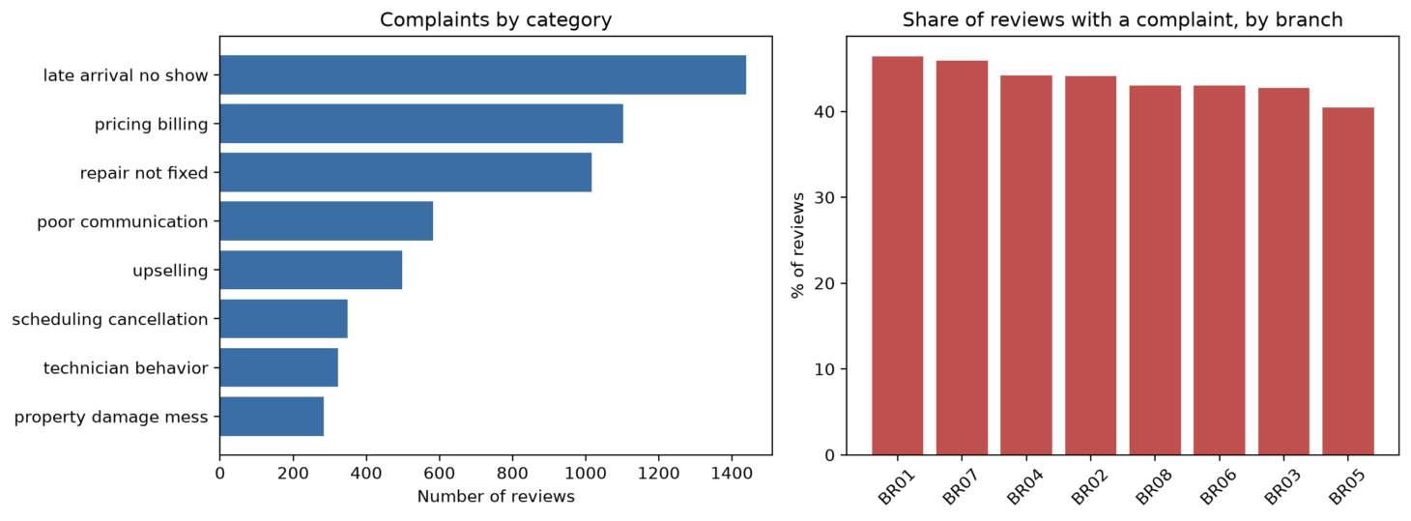
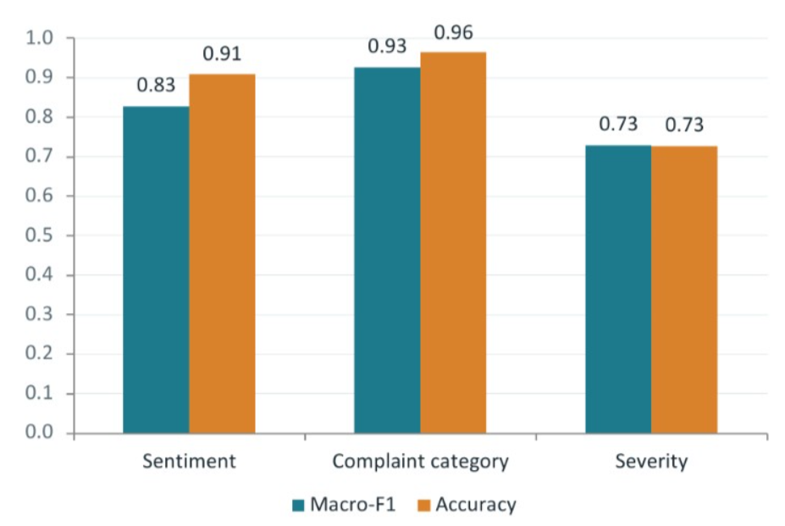
Customer Feedback Analysis
Model Development & Experimental Results
Complaints by Category: Late arrivals/no-shows are the most common complaints, followed by pricing/billing and unresolved repairs.

Slide 18
Integration, Limitations & Conclusion
Integration of Five Modules
Leak Detection: Identifies potential pipeline leaks.
Demand Forecasting: Predicts service demand.
Feedback Analysis: Classifies customer complaints.
Resource Optimization: Supports budget allocation.
Technician Scheduling: Optimizes schedules and reduces estimated travel time.
Limitations
Limited leak recordings and unverified generalization.
Forecast uncertainty and complaint severity require improvement.
Resource allocation needs real-world validation.
Scheduling data comes from telecommunications field service, not plumbing.
Conclusion & Recommendations
Integrates ML and optimization to support data-driven plumbing operations.
Collect representative plumbing data and test models on unseen data.
Improve model reliability and validate operational benefits before deployment.

Slide 19
References
Project Repository
GitHub: SRV30 — Plumbing ML Optimization
https://github.com/SRV30/plumbing-ml-optimization
Module Data & Implementations
Water-Leak Detection: Accelerometer dataset and Random Forest notebook — 25920036/
Demand Forecasting: Synthetic plumbing-demand dataset and forecasting implementation — 26535001/
Customer Feedback Analysis: Feedback classification and complaint-analysis implementation — 26535016/
Strategic Resource Optimization: Resource allocation dashboard and optimization implementation — combine/pages/04_26535023_Resource_Optimization.py
Technician Scheduling: Scheduling and duration-prediction implementation — 26535024/
External Dataset & Research Paper
Gamst, M. & Pisinger, D. — Decision Support for the Technician Routing and Scheduling Problem. Zenodo, 2023.
https://zenodo.org/records/7904015
Research paper DOI: https://doi.org/10.1002/net.22188
Note: The demand dataset is synthetic. The technician-routing dataset describes telecommunications field service, not plumbing.
12

Slide 20
Project Demo

