Slide 1
Using Machine Learning to Improve Business Operations
Predictive Task Risk Modeling & Constrained Capital Optimization for Mr. Rooter Plumbing

Slide 2
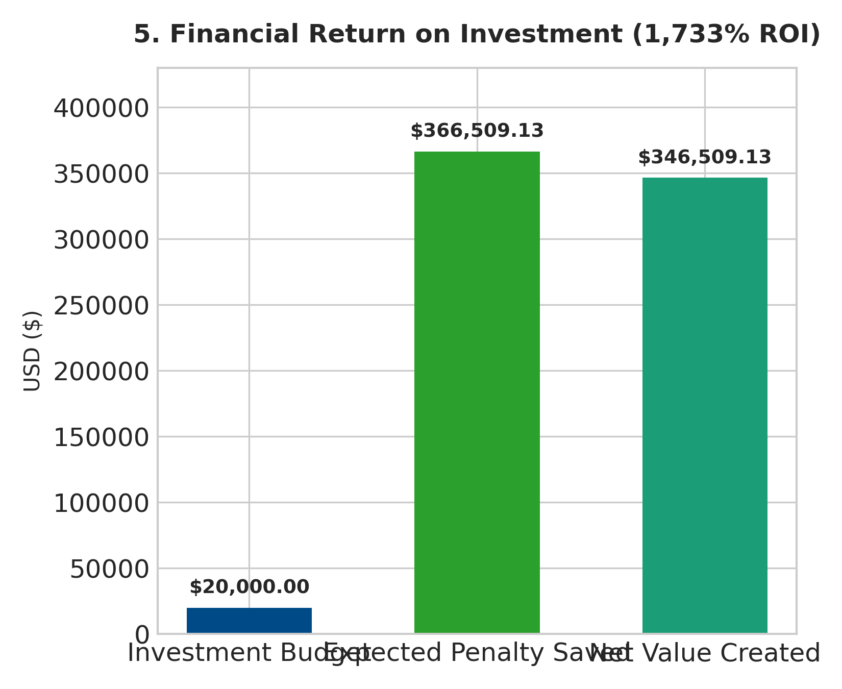
MR. ROOTER PLUMBING • ML OPTIMIZATION PROJECT
Executive Summary: Transforming Dispatch Efficiency
• 2,677 Backlog Tasks Analyzed
• 0.7494 ROC-AUC Accuracy
• $20,000 Capital Allocated across 114 Tasks
• $366,509 Expected Penalties Saved
• 1,733% Return on Investment

Slide 3
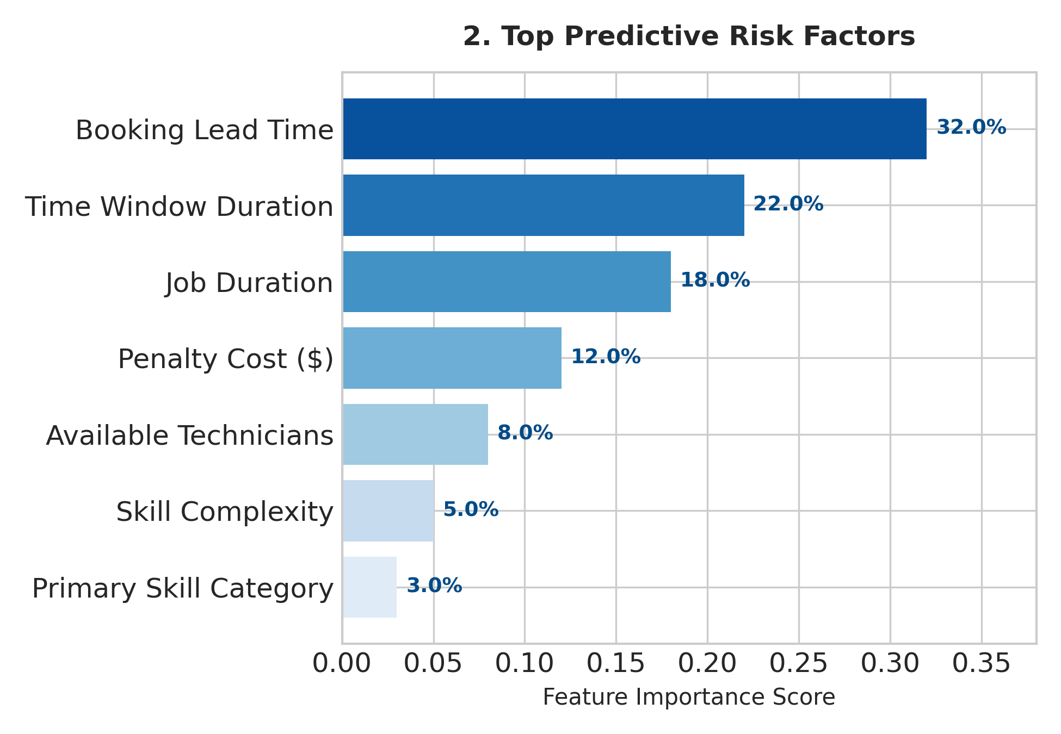
MR. ROOTER PLUMBING • ML OPTIMIZATION PROJECT
Predictive Risk Modeling: Key Failure Drivers

Slide 4
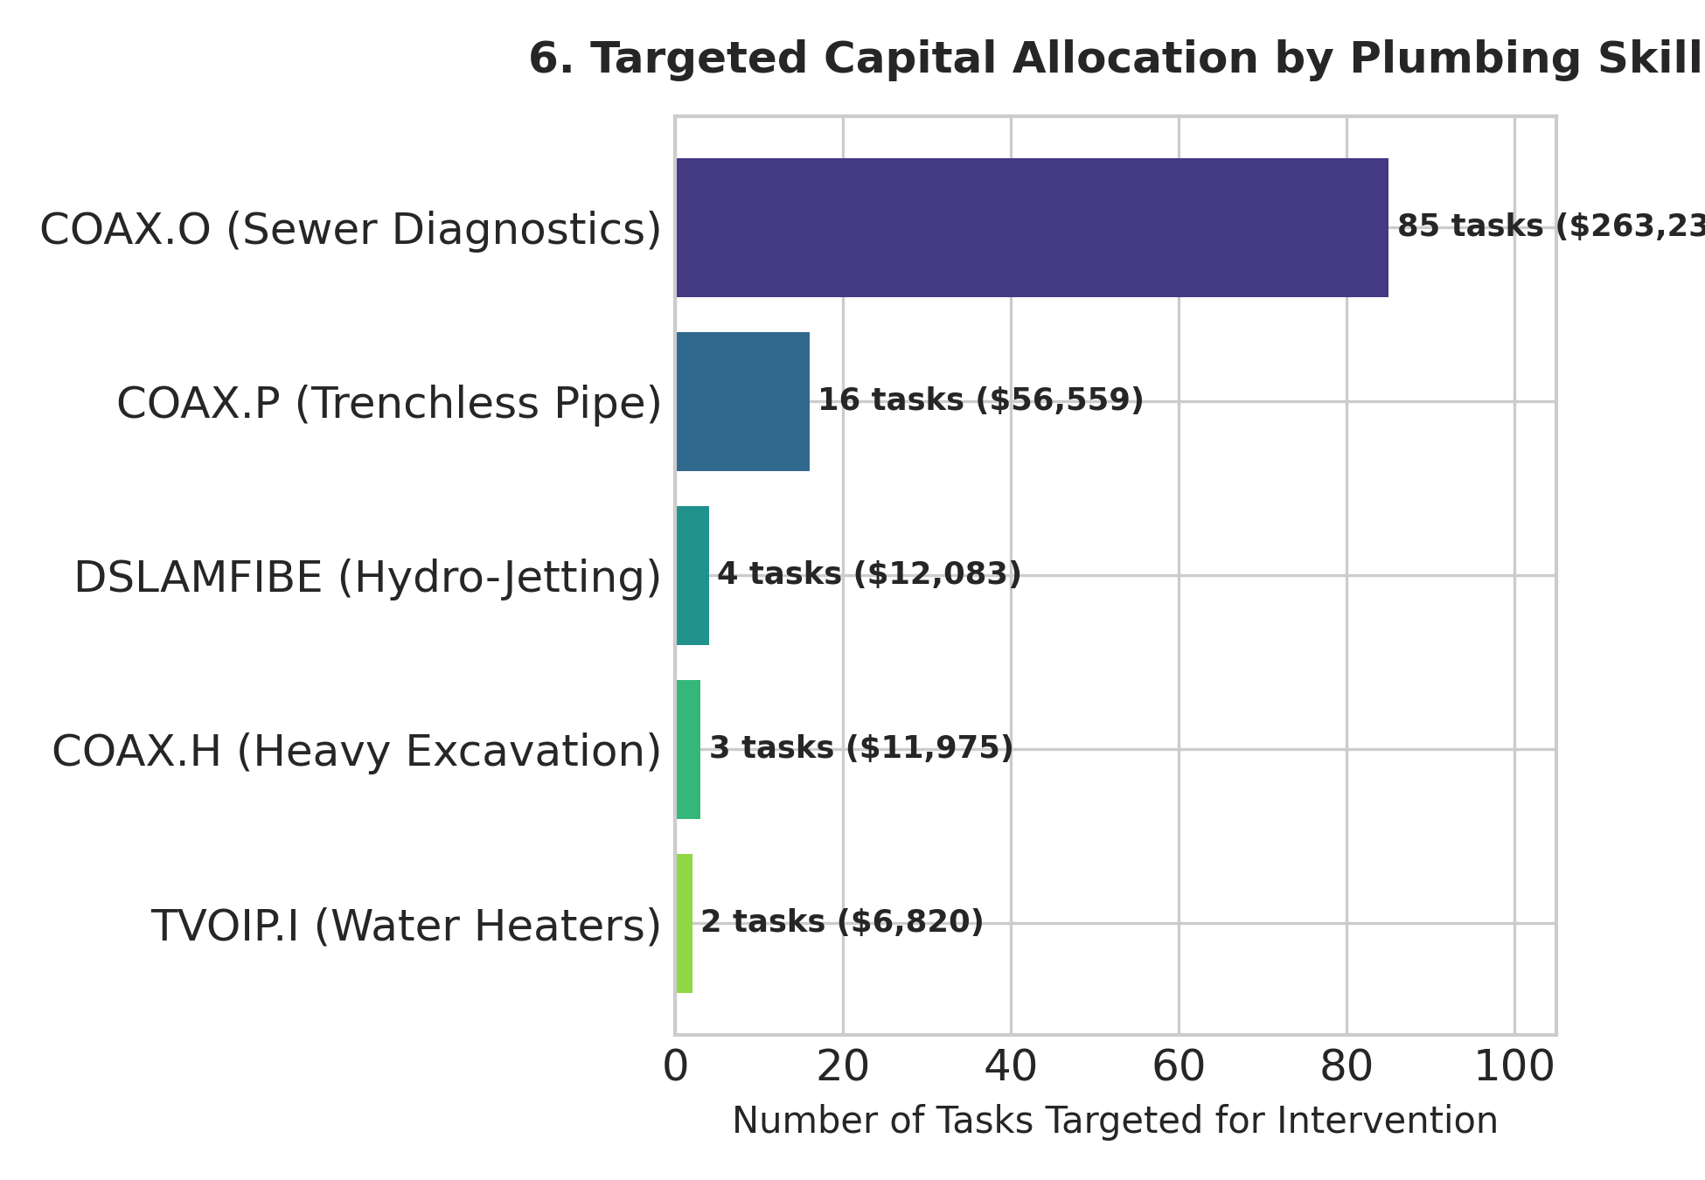
MR. ROOTER PLUMBING • ML OPTIMIZATION PROJECT
Targeted Skill Investment & ROI by Plumbing Skill

Slide 5
MR. ROOTER PLUMBING • ML OPTIMIZATION PROJECT
Executive Recommendations & Implementation Roadmap
1. Embed Machine Learning Risk Scoring in Dispatch CRM
2. Target Skill Training on Sewer Diagnostics (COAX.O) and Trenchless Repair (COAX.P)
3. Automated Proactive Re-confirmations for Long Lead Times (>48h)
4. Expand Capital Allocation Budget to $100k for $1.8M+ Penalty Prevention

