Slide 1

E-Learning System: Java GUI Application
This presentation outlines the development process of a comprehensive e-learning system using Java and a graphical user interface (GUI).

Slide 2
Introduction to the E-Learning System
1
Objective
2
Target Audience
3
Scope
The e-learning system aims to provide a user-friendly platform for online learning and education.
The system is designed for students, educators, and institutions seeking an interactive learning experience.
The system encompasses features like course management, student enrollment, and progress tracking.

Slide 3
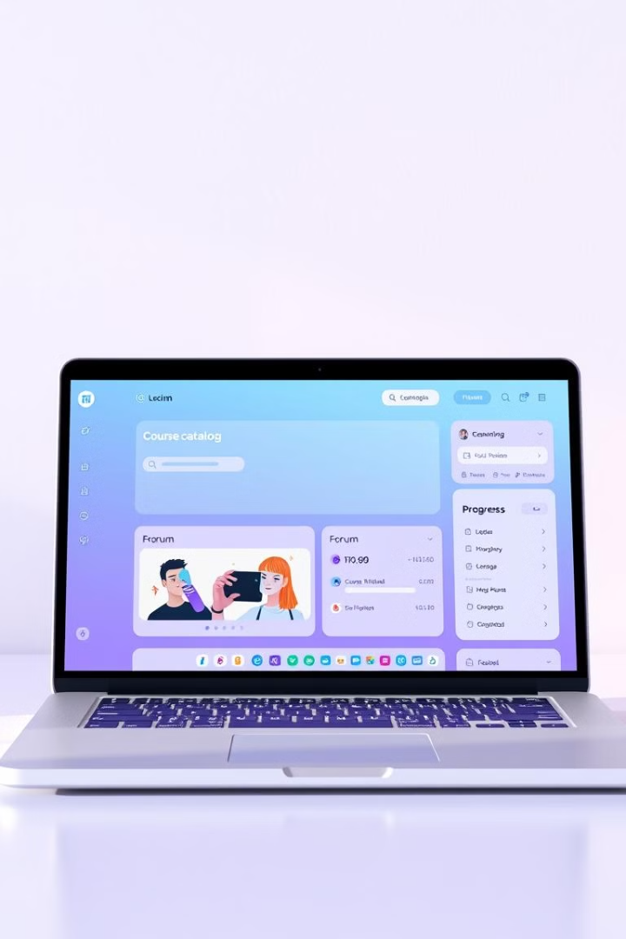
Key Features of the Application
Course Management
Content uploading, scheduling, and organization
Student Enrollment
Registration, course selection, and access control
Progress Tracking
Assessment submissions, performance monitoring, and personalized feedback
Communication Tools
Discussion forums, chat rooms, and messaging systems

Slide 4
Implementing the User Interface
Swing Framework
Design Principles
Java Swing provides rich components and flexibility for GUI development.
The UI is designed with user-centered principles for accessibility and ease of use.
Buttons
Clarity
Text Fields
Consistency
Drop-Down Lists
Responsiveness

Slide 5
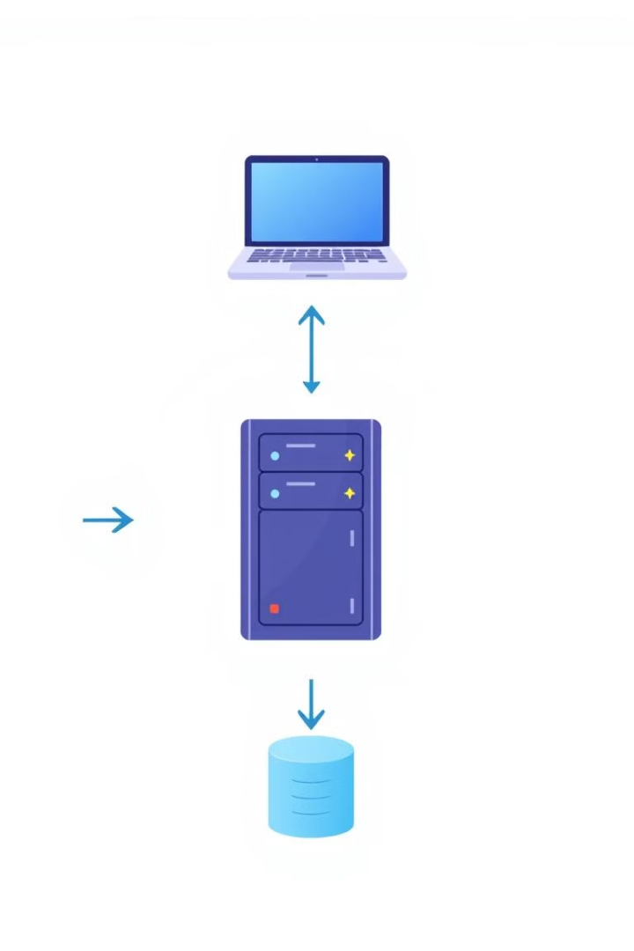



Integrating the Database and Backend
Database Selection
A relational database like MySQL or PostgreSQL is chosen for data storage.
Backend Development
Java servlets or Spring Boot framework are used to handle requests and data processing.
API Integration
The frontend interacts with the backend through RESTful APIs for data exchange.

Slide 6





Ensuring Security and Accessibility
Authentication
Authorization
Secure logins using usernames and passwords or two-factor authentication.
Restricting access to specific features based on user roles and permissions.
Accessibility
Data Privacy
Following web accessibility guidelines to accommodate users with disabilities.
Implementing measures to protect user data from unauthorized access.

Slide 7
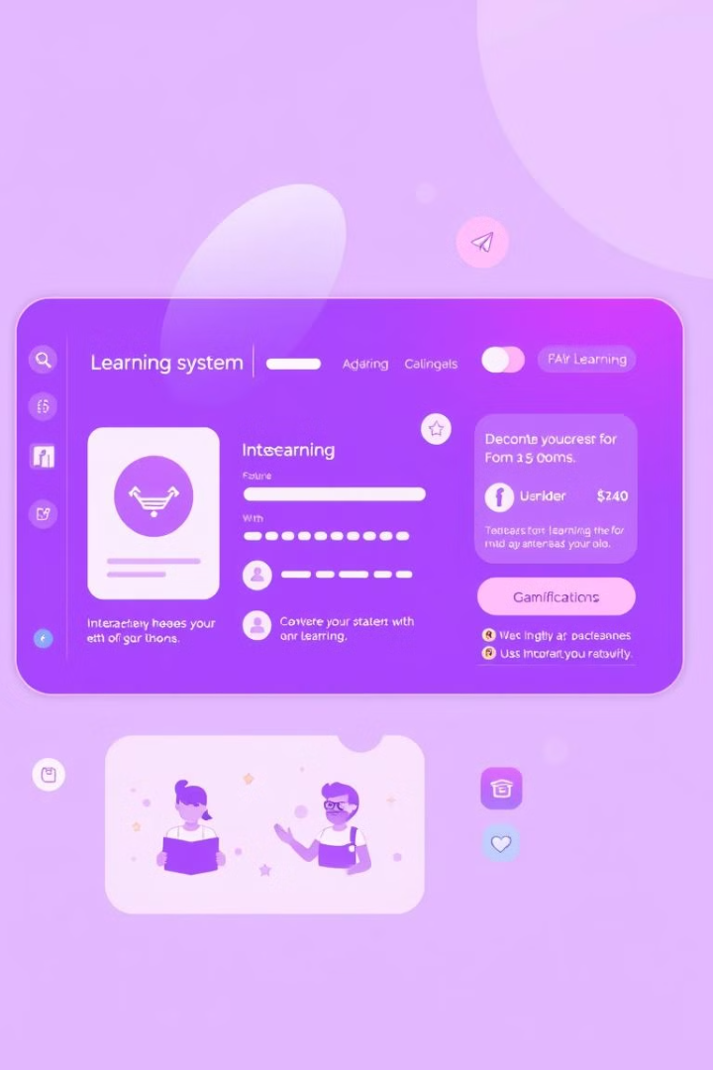
Conclusion and Future Enhancements
The e-learning system provides a robust platform for online learning. Future enhancements include integrating gamification elements and incorporating artificial intelligence for personalized learning experiences.

