Slide 1
Fortune Man 5000
Developer : Sean Radatz
ITCS 1950
Project 1

Slide 2
Characters
The Household cat
Exotic
Jim the private eye
Good at guessing numbers
The Brain
After world domination

Slide 3
Story/Premise
Play as a contestant on a Game show
Goal: Win as much money as possible
Kept simple for replay value

Slide 4
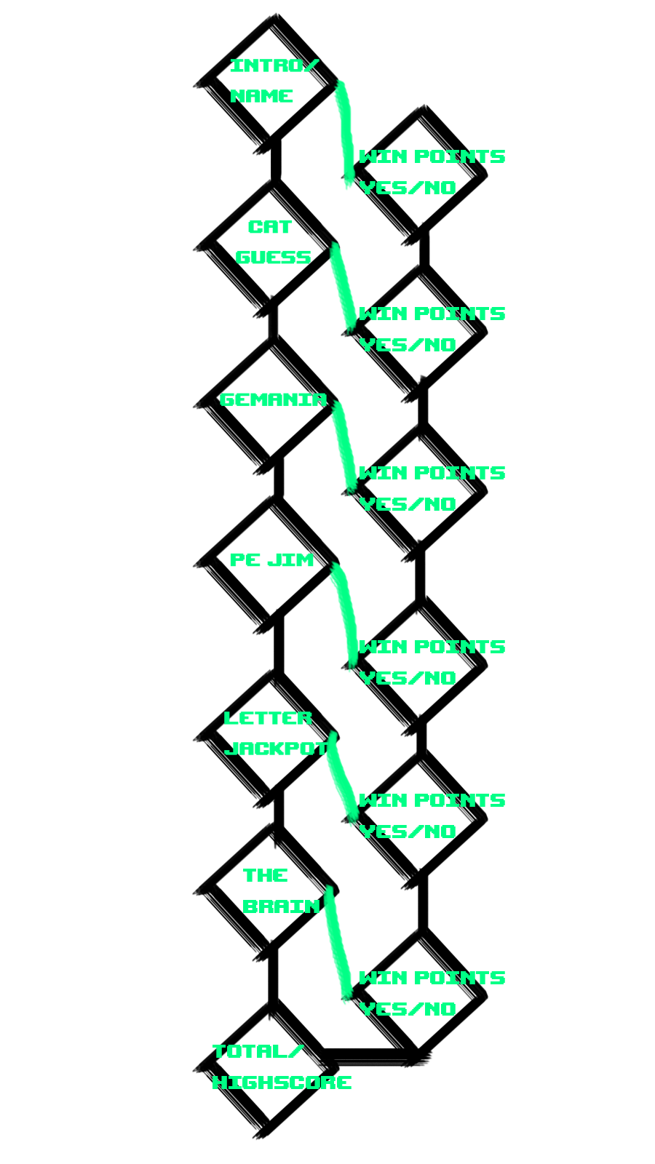
Game Map

Slide 5
What’s Unique about the game
Fast gameplay
Competitive
Replay value
Easily transferred to other platforms
ASCII Art

Slide 6
Why you should invest
Who doesn’t like winning money???

