Slide 1







SPACEX CAPSTONE PROJECT
RAM MOHITH
13/09/2023

Slide 2



OUTLINE
Executive Summary
Introduction
Methodology
Data Collection – API
Data Collection – Web Scrapping
Data Wrangling
EDA – SQLlite
EDA – Visualizations
Plotly Dashboard
Predictive Modelling
Results

Slide 3

EXECUTIVE SUMMARY
This end-to-end project aims to develop a data-driven modeling to predict successful landing of SpaceX Rocket
The methodologies used for this purpose are,
Data collection through web scraping
Cleaning and processing the data into usable format
Storing the data in SQL database and querying it in python
Analyzing and Visualizing the data using standard libraries
Building an interactive dashboard
Modelling of processed data using various machine learning algorithms
The overall results are listed below,
The success rate has increased over time. KSC LC-39A has highest success rate among landing sites
Most launch site are located nearer to the equator and along the coastlines
The various ML models created returned similar outcomes and performances.

Slide 4

INTRODUCTION
SpaceX is an American aerospace manufacturer and space transport services company founded in 2002.
SpaceX has developed reusable launch vehicles and spacecraft which have revolutionized space exploration by reducing the cost of space travel.
Reusable landers can will enable more frequent launches and missions, which is essential for advancing space exploration.
Data-driven predictions can help SpaceX identify and address potential problems before they cause a launch failure.
By understanding the factors that contribute to successful landings, SpaceX can make necessary adjustments to its rockets and landers to improve their chances of success.
Data-driven predictions can also help SpaceX plan its missions more effectively and reduce the risk of accidents.

Slide 5
Methodology

Slide 6

Data Collection - API
Data was collected using requests module and SpaceX API
Various helper functions were created to read and extract various information from response
Various information like Booster Version, Launch Site, Orbit, Payload Mass, etc. along with outcomes are collected
All the data is collected and stored into a dataframe using pandas
Null values of payload are replaced by mean
The data was filtered to get only data related to Falcon9 launches

Slide 7
Data Collection – Web Scrapping
For this part, data was scrapped from a Wikipedia page using beautiful soup library
Using soup functions the tables found from the scraped response
Various helper functions are created to extract data from the response
The data is collected using find_all() method in soup and using HTML tags for row and column
Using this various columns, similar to data collected by API, are collected and are stored into a dataframe

Slide 8
Data Wrangling
Data wrangling is process of transforming and mapping raw data into a format that is suitable for analysis and machine learning.
This includes cleaning, organizing, and enriching the data, as well as dealing with errors and inconsistencies.
The following points are inferred on doing data wrangling on the data collected,
Landing Pad has highest percent of missing values
CCAFS SLC 40 has the highest number of launchings
GTO has the highest occurrences in the orbit feature
True ASDS is the highest occurrence in Outcomes feature
All combinations of True (site) and False (site) outcomes are converted to just successful or failed landing

Slide 9
EDA - SQLlite
Worked with SQL using sqlalchemy library and magic commands in Jupyter notebook
Created a database instance to store the processed data into a table
The subsequent tasks are done by running different SQL queries,
Displaying the names of unique launch sites
Displaying the launch sites starting with ‘CCA’
Calculate total payload mass carried by NASA (CRS) booster
Display average payload mass carried by booster version F9 v1.1
Date when the first successful landing outcome in ground pad was achieved
Names of the boosters which have success in drone ship and have payload mass greater than 4000 but less than 6000
Names of the booster_versions which have carried the maximum payload mass using a subquery
Ranking the count of landing outcomes (such as Failure (drone ship) or Success (ground pad)) between given range of dates, in descending order

Slide 10
EDA - Visualizations
Feature Engineering has been performed. To be specific, one-hot encoding has been done on categorical features
Various visualizations have been created to understand different features and their dependencies. Few of them are listed in the coming slides
The visualizations help in getting few key insights of the data and the problem
Apart from matplotlib and seaborn, Folium is used to visualize plots based on geography. Folium is very helpful for plotting on geographical maps
As part of visualizations, all launch sites are plotted on a map and are marked with their respective successes and failures
An interactive dashboard has been created using plotly and is deployed as web application using dash.
The web dashboard contains a pie chart and scatter plot to visualize the launch records

Slide 11
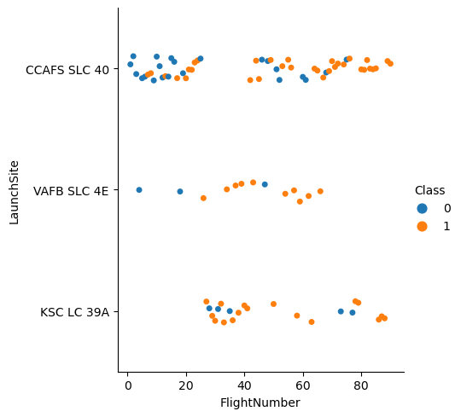
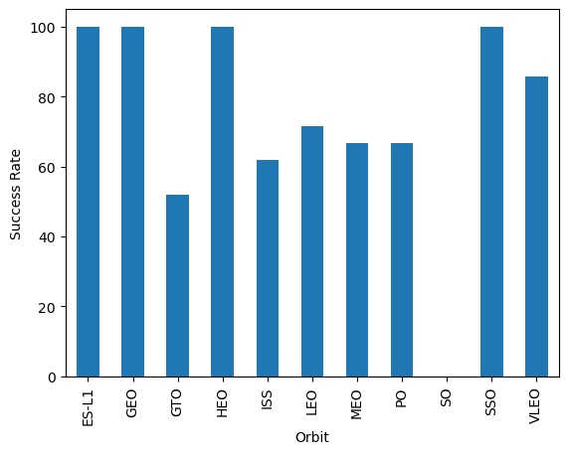
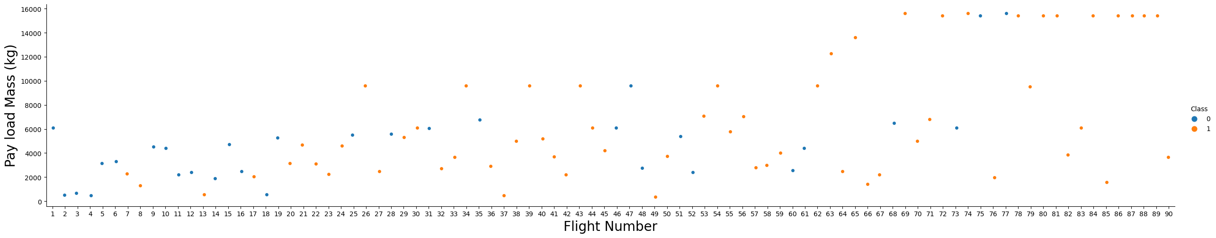

Slide 12
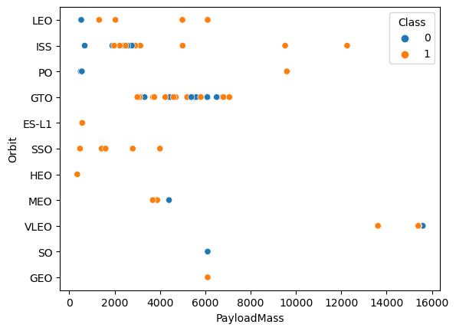
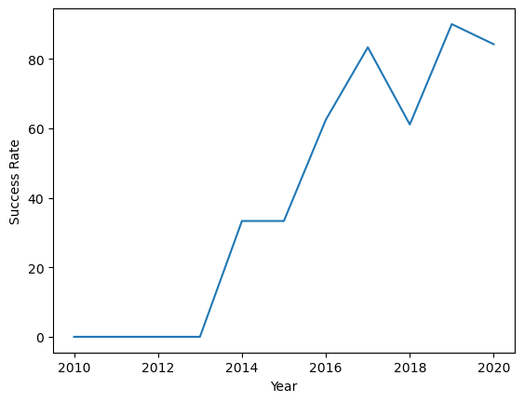
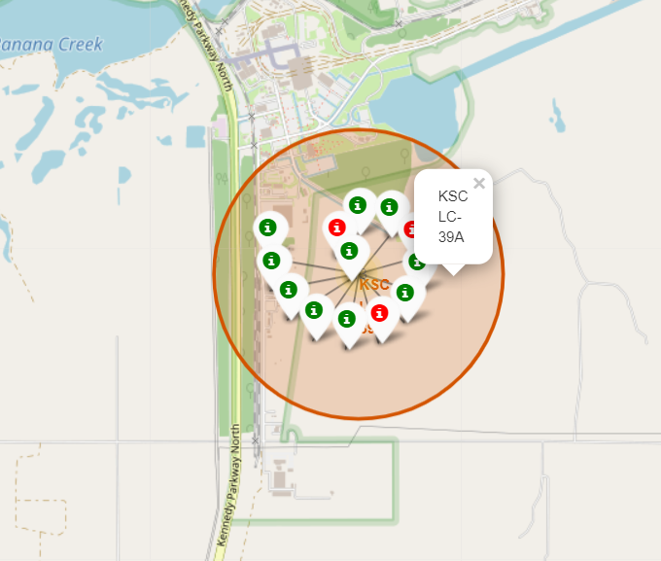

Slide 13
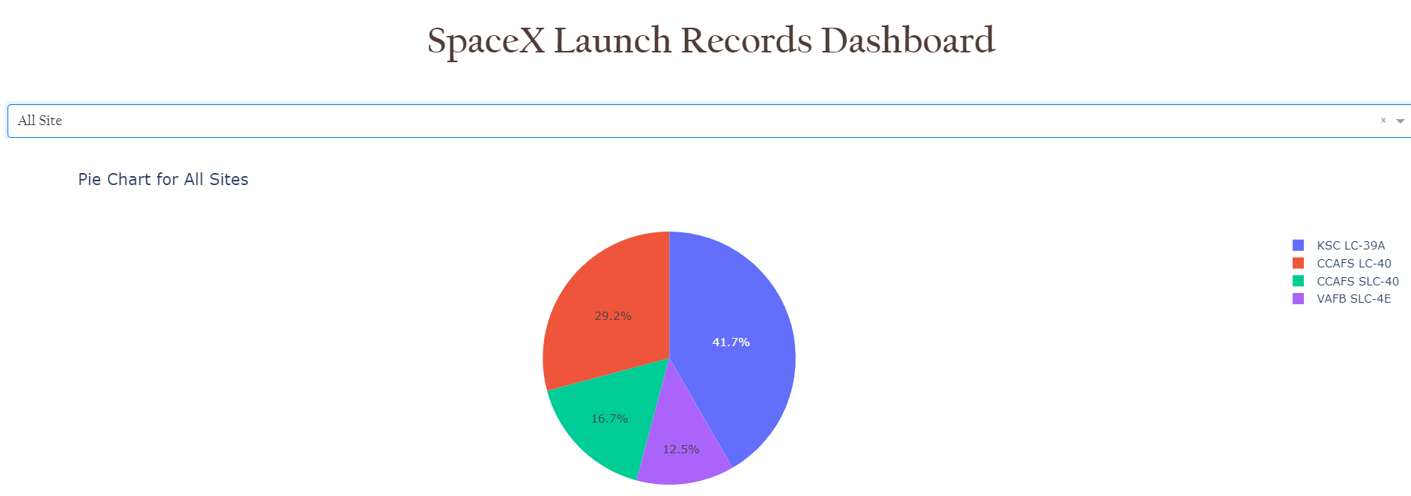
Dashboard using Plotly

Slide 14
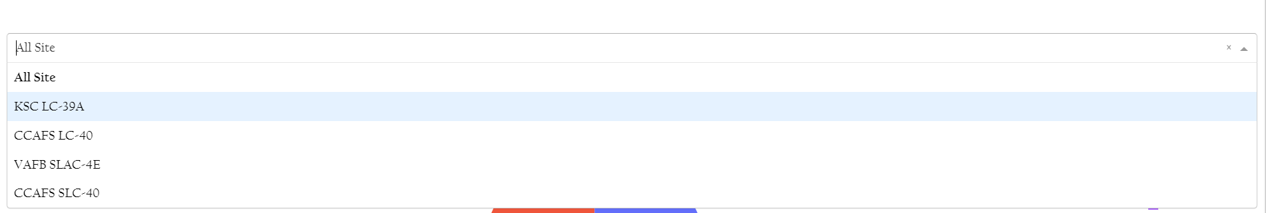
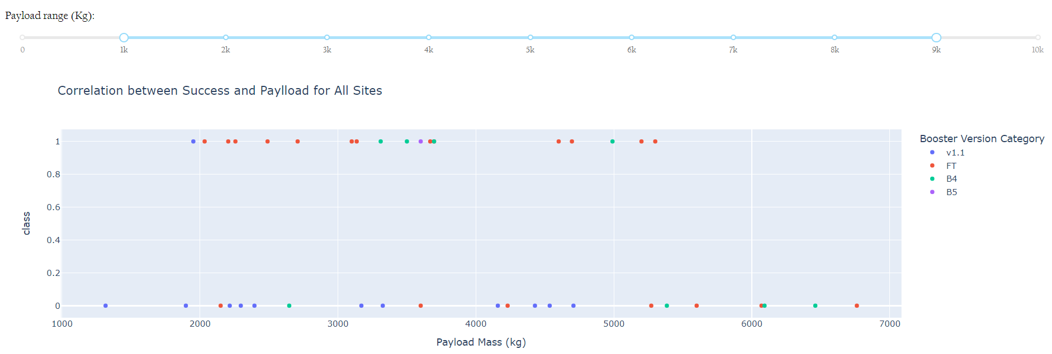

Slide 15
Predictive Modelling
The processed data (after encoding) is then used for modelling with different standard machine learning algorithms
The target feature (outcome) is separated as vector Y and the rest of the data is denoted by X
As some algorithms are distance affected, the data X is standardized as a first step
Next, the complete data is split into training and testing data with test size being 20% of total data
Then the following models are fitted using GridSearchCV method and training data. For each of them the best model is returned and evaluated with test data
Logistic Regression
Support Vector Machine
Decision Tree
K-Nearest Neighbors
While all models have returned same test accuracy, Decision trees has better training accuracy
Further modelling with Random Forest Classifier using Ada Boost has yielded better results

Slide 16
RESULTS
Here are the final results to be reported,
Launch success has improved over time
KSC LC-39A launch site has the highest success rate
Orbits ES-L1, GEO, HEO and SSO have 100% success rate
Most launch sites are close to the equator and are near coastline
Decision Trees is found to be the best model for the data. It can be further extended that Random Forest Classifier model will also be the best model for this case

