Slide 1
The Social Media Radio Innovation and Its Impact on University Students' Ratings
An Exploratory Study
Sherif Mohamed Abd Elmonem Rashwan
M.A. Defense Presentation | Media Innovations, Faculty of Mass Communication, Ahram Canadian University
Supervised by Dr. Engi Aboul-Ezz (Beni Suef University) and Dr. Mostafa El Banna (Ahram Canadian University) | November 2026

Slide 2
OVERVIEW
How this defense is organized
▪ Introduction: background, problem, importance, aim, objectives, questions, hypotheses
▪ Theory and platform: Epistemic Systems Theory and the LOKLOK design
▪ Methodology: three evidence layers, participants, instruments
▪ Results: headline contrast, decomposition, sensitivity, the trade-off, figures
▪ Robustness: randomized-assignment triangulation, controls, Gemini pilot
▪ Qualitative validation: an honest null result
▪ Answers, limitations, contribution, and future work
LOKLOK | Master's Defense | November 2026
2 / 36

Slide 3
INTRODUCTION
From internet radio to social media radio
▪ Internet radio added live audio, scheduling, and global reach to broadcasting
▪ Social platforms added algorithmic recommendation, audience metrics, and social circulation
▪ Social media radio = programmed live voice + platform logic + public-service expectations
▪ Egyptian context: university radio traditions, digital media literacy gaps, misinformation pressure
LOKLOK | Master's Defense | November 2026
3 / 36

Slide 4
INTRODUCTION
Why a radio-specific case, not generic social media
▪ Radio-like audio is voice-centered and temporally organized: a programmed stream, not an undifferentiated feed
▪ Broadcaster identity, vocal presence, sequence, and repair are directly observable
▪ Engagement has a behavioral referent: continued listening, replay, interaction
▪ Editorial, platform, and listener selection can be separated and varied as distinct levers
▪ Analytical generalization: the mechanism, not the medium, is the inferential target
LOKLOK | Master's Defense | November 2026
4 / 36

Slide 5
INTRODUCTION
Statement of the problem
▪ Platform design, audience measurement, and epistemic quality live in separate literatures
▪ Filter bubbles, misinformation diffusion, and engagement pressure are studied without a measurable audience rating
▪ No existing framework links platform architecture to how students judge what they hear
▪ Question: can a social media radio design improve epistemic judgment without losing the audience?
LOKLOK | Master's Defense | November 2026
5 / 36

Slide 6
INTRODUCTION
Importance of the study
▪ Joins platform design, audience measurement, and epistemic quality in one falsifiable framework (EST)
▪ Makes the core trade-off measurable: epistemic gain vs engagement cost
▪ Speaks to the Egyptian university media context with a public-service language for social audio
▪ Delivers a specified, testable design (LOKLOK) plus a plan for a real deployment
▪ Every claim is tiered and model-conditional: honesty as scientific practice
LOKLOK | Master's Defense | November 2026
6 / 36

Slide 7
INTRODUCTION
Aim of the study
▪ To propose Epistemic Systems Theory and the LOKLOK platform, and to test, with a calibrated in-silico experiment anchored in a measured student wave, whether the epistemic-first design raises evaluative and competence-format ratings without destroying engagement
▪ The measured wave anchors the model; the simulation tests what the specified design implies
▪ No live trial was possible; no field causal effect is claimed
LOKLOK | Master's Defense | November 2026
7 / 36

Slide 8
INTRODUCTION
Objectives
▪ Synthesize the literature into EST with four testable propositions
▪ Specify the LOKLOK architecture (BRS, MORE, ERIC, cooling, attention gate, measurement surface)
▪ Collect and analyze a measured wave of university students to anchor the model
▪ Build a reproducible calibrated in-silico experiment (500 personas, 8 cells, 18 sessions)
▪ Validate the qualitative codebook and apply the pre-set machine-coding gate
▪ Triangulate the contrast across four assignment designs
▪ Derive design implications and a plan for a real deployment
LOKLOK | Master's Defense | November 2026
8 / 36

Slide 9
INTRODUCTION
Research questions
▪ RQ1 Does platform architecture shape structural credibility and audience evaluation? (EST-P1)
▪ RQ2 Do diversity and cooling mechanisms constrain epistemic concentration? (EST-P2)
▪ RQ3 Can the proposed instruments meet basic psychometric accountability? (EST-P3)
▪ RQ4 Do the EST constructs integrate into a coherent measurement model? (EST-P4)
▪ RQ5 Which mechanisms and weights drive the model-based contrast?
▪ RQ6 What does a Gemini persona-agent pilot add to the comparison?
LOKLOK | Master's Defense | November 2026
9 / 36

Slide 10
INTRODUCTION
Hypotheses
▪ H1 Structural credibility: architecture shapes credibility and evaluation (EST-P1)
▪ H2 Diversity mechanism: diversity and cooling constrain epistemic concentration (EST-P2)
▪ H3 Psychometric validity: instruments meet psychometric accountability (EST-P3)
▪ H4 Integration: EST constructs form a coherent measurement model (EST-P4)
▪ H5 DeGroot conformity (exploratory); H6 scheduling and duration (exploratory)
▪ H7 Participatory performance: the educational test (prospective)
LOKLOK | Master's Defense | November 2026
10 / 36

Slide 11
FRAMEWORK
Epistemic Systems Theory (EST)
▪ EST-P1 Architecture is a structural condition of credibility
▪ EST-P2 Diversity and cooling constrain epistemic concentration
▪ EST-P3 Measurement is an accountability requirement
▪ EST-P4 Participation and evidence-based production are the educational test
▪ A falsifiable language for linking design choices to audience judgment, not a universal law
LOKLOK | Master's Defense | November 2026
11 / 36

Slide 12
PLATFORM
LOKLOK: six design components
▪ BRS Broadcaster Reputation Score
▪ MORE Recommendations constrained to keep viewpoints varied
▪ ERIC Moderation loop: reflect, invite, correct
▪ Echo Meter and Algorithmic Cooling
▪ Zewail-inspired attention gate (time-resolved attentional coherence)
▪ Built-in measurement surface: evaluative and competence-format student ratings
LOKLOK | Master's Defense | November 2026
12 / 36

Slide 13
METHODOLOGY
Three evidence layers, one honest hierarchy
▪ Measured 52 of 60 questionnaires, Uber riders in 6th of October City: anchors, not a causal test
▪ Qualitative FGD and self-report, 193 segments, 3 human coders: an assumption audit
▪ Modeling A calibrated in-silico experiment: what the specified design implies
▪ Mixed-methods integration through claim tiers: field, model, theory, prospective
LOKLOK | Master's Defense | November 2026
13 / 36

Slide 14
METHODOLOGY
Participants and instruments
▪ Participants: 60 questionnaires collected; 8 duplicate vectors removed; N = 52 university students using Uber in 6th of October City, Giza
▪ BRS: 11-item broadcaster-rating battery (alpha .957)
▪ PB: 5-item perceived-benefit battery (alpha .947, omega .962)
▪ Star rating, ride duration, interaction level, and context items
▪ NMLS: published 35-item media-literacy profile scored with GRM-IRT; 8-item MCS+PB battery
▪ Convenience sample: descriptive anchoring, not population inference
LOKLOK | Master's Defense | November 2026
14 / 36

Slide 15
METHODOLOGY
The measured wave in one slide
▪ Perceived benefit: M = 5.12, SD = 0.87 on a 7-point scale
▪ PB correlates with the star rating: rho = .67
▪ Reliability is high (alpha .957 and .947); the single-factor CFA fits poorly
▪ Therefore: reliability is reported, structural validity is not claimed
▪ The wave anchors the model level (G0 = 5.119) and the persona spread
LOKLOK | Master's Defense | November 2026
15 / 36

Slide 16
METHODOLOGY
Qualitative corpus and coding design
▪ FGD 160 segments; self-report 185 segments; 60 participant-observation accounts; 4,828 corpus documents
▪ 25-code codebook: 12 deductive mechanism codes (C01-C12), 13 inductive codes (I01-I13)
▪ Three independent human coders on 193 usable segments
▪ Machine comparators: local Qwen 7B (zero-shot and gold 5-fold) and a Claude first pass
▪ Pre-set usability gate: 8 positives, kappa at least .60, at most 5% fabrication
LOKLOK | Master's Defense | November 2026
16 / 36

Slide 17
QUALITATIVE VALIDATION
An honest null result
▪ Human agreement: pooled pairwise kappa .762, .852, .861; per-code median .28 (C02) to .95 (I07)
▪ Leave-one-out human micro-F1 about .99 (97% of code cells are negative)
▪ Qwen 7B: micro-F1 .193 zero-shot, .320 with gold exemplars; Claude first pass .452
▪ No mechanism code met the gate in either local pass
▪ The qualitative layer remains an assumption audit; E1 and E2 exploratory, E3 not run
LOKLOK | Master's Defense | November 2026
17 / 36

Slide 18
METHOD
The calibrated in-silico experiment
▪ 500 synthetic personas drawn from the debiased distribution of the 52 respondents (DML + IPW, spectral manifold)
▪ 8 cells (2³ A/B/C combinations), 18 sessions, eight mathematical filters
▪ GRM-IRT measurement: 35-item NMLS competence profile, 8-item MCS+PB battery
▪ G0 arm anchored to the measured PB mean (5.119)
▪ State-outcome weights are declared design assumptions, not estimates
LOKLOK | Master's Defense | November 2026
18 / 36

Slide 19
RESULTS
Headline contrast (500 personas, 18 sessions)
Outcome | Estimate | 95% interval | Test
Delta SR eval (1-7) | +0.827 | [0.779, 0.875] | t(499) = 33.93, d = 1.52
Delta SR comp (0-100) | +11.30 | [10.64, 11.95] | t(499) = 33.74, d = 1.51
Delta engagement (0-1) | -0.183 | [-0.188, -0.178] | t(499) = -74.41, d = -3.33
Intervals describe variation across generated personas, not human sampling precision.
LOKLOK | Master's Defense | November 2026
19 / 36

Slide 20
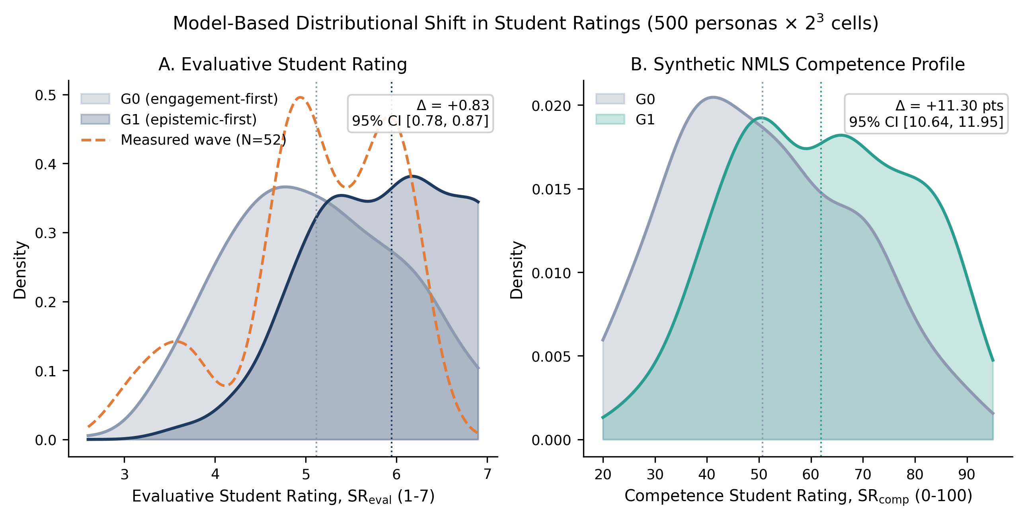
RESULTS
The evaluative shift inside the model
SR_eval distributions for G0, G1, and the measured wave (left); competence profile (right). The measured wave is an anchor, not a treatment arm.

Slide 21
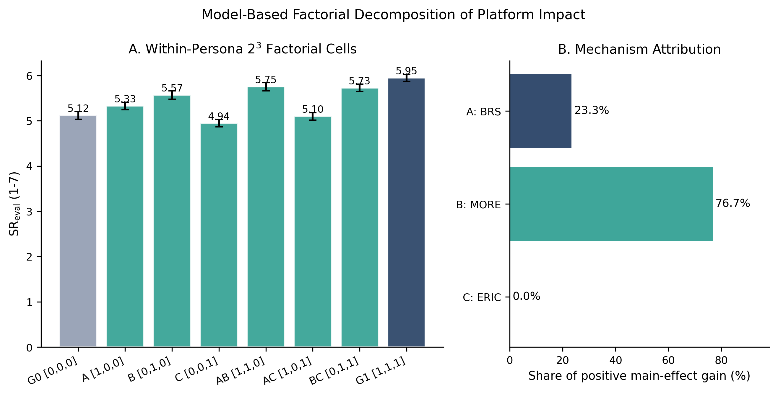
DECOMPOSITION
Eight cells, one dominant path
Eight cell means: B and BC stand out, A adds a smaller margin. B main +0.6265; B x C interaction +0.3791.

Slide 22
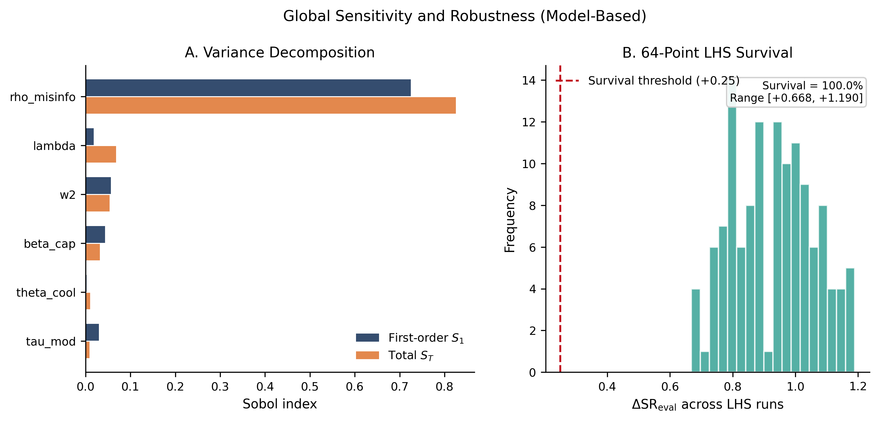
SENSITIVITY
The declared assumptions that matter
The 256-point sweep ranks the declared diversity-to-credibility weight first (PRCC +0.77). The contrast depends chiefly on this one declared link.

Slide 23
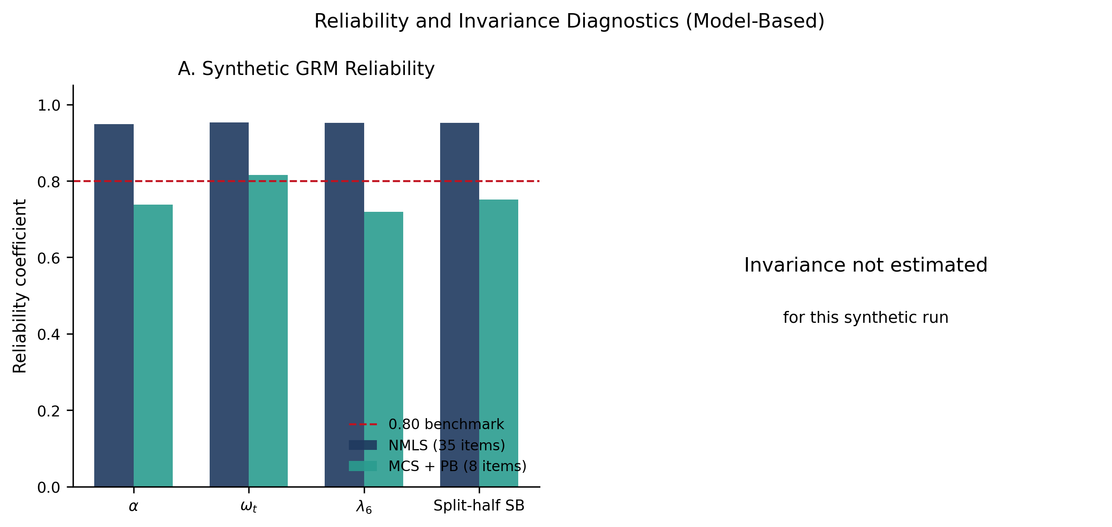
MEASUREMENT
GRM-IRT diagnostics
GRM-IRT scoring reproduces high internal consistency (NMLS alpha .948). This is the generating model, not human validation.

Slide 24
DECOMPOSITION
What drives the contrast
▪ B (diversity and cooling) carries most of it: main effect +0.6265
▪ A (BRS) adds +0.1905; C (ERIC) is near zero alone (-0.0121)
▪ B x C interaction +0.3791: nearly half of the total contrast
▪ 256-point joint sweep: 96.5% positive, median +0.567, range -0.244 to +1.810
▪ Top driver: the declared diversity-to-credibility weight (PRCC +0.77)
LOKLOK | Master's Defense | November 2026
24 / 36

Slide 25
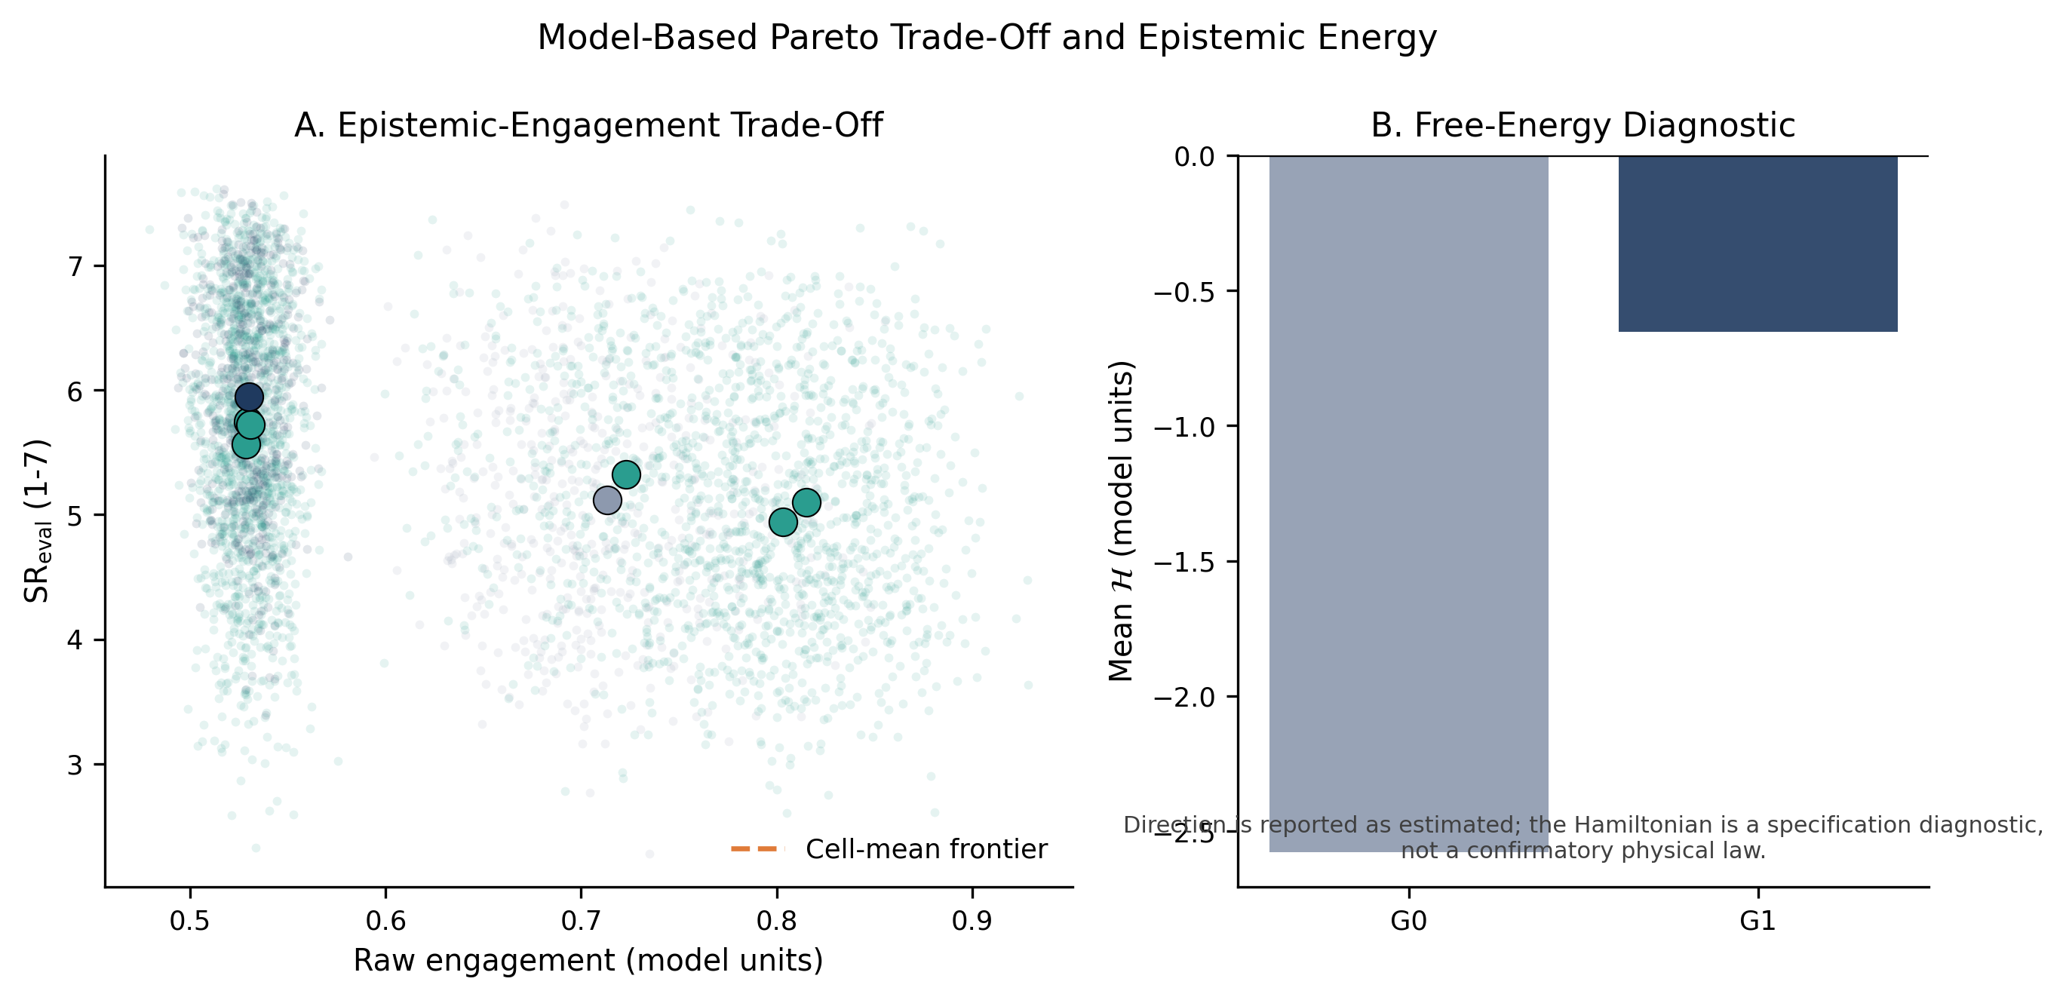
TRADE-OFF
The epistemic gain is not free
Pareto panel: no cell dominates G1 on both epistemic rating and engagement. The Hamiltonian is a specification diagnostic, not a physical law.

Slide 26
ROBUSTNESS
Randomized-assignment triangulation
Design | Worlds | Delta SR eval | Delta engagement
Within-persona | 1 | +0.827 | -0.217
Agent-randomized | 40 | +0.630 [0.384, 0.851] | -0.232
Design-based (no interference) | 400 | +0.807 [0.470, 1.109] | -0.217
Cluster-randomized | 20 | +0.659 [0.338, 0.948] | -0.226
B stays near +0.63 in every design; A collapses from +0.190 to +0.038 between agents, then recovers to +0.182 without interference. B x C stays positive (+0.379 to +0.430 in effect terms).
LOKLOK | Master's Defense | November 2026
26 / 36

Slide 27
ROBUSTNESS
Controls, stress tests, and topologies
▪ Placebo factor D (absent from the equations): -0.003 SR eval, -0.082 SR comp
▪ Pre-treatment negative controls: +0.001, -0.008, 0.000 across the A/B/C margins
▪ Mechanism checks: B raises chosen diversity +1.299; A raises BRS +0.019; B x C lowers echo -0.340
▪ Adversarial content stress (poor-content share 0.763): contrast +0.636, still positive
▪ 60-row sensitivity +0.808; 50 anchor bootstraps +0.839 (100% positive); ER/WS/BA topologies +0.827/+0.826/+0.832
LOKLOK | Master's Defense | November 2026
27 / 36

Slide 28
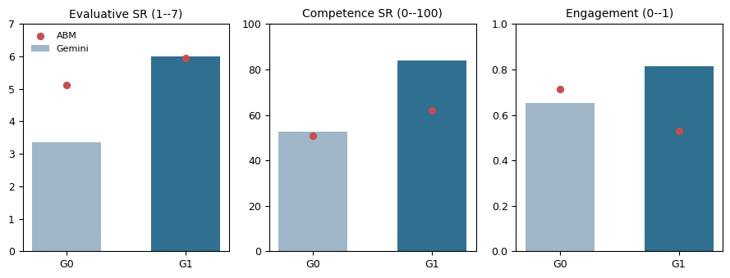
TRIANGULATION
Gemini persona-agent pilot
Gemini reproduces the direction but overstates the magnitude (+2.650) and reverses engagement (+0.163). Single-shot appraisal, not an 18-session simulation.

Slide 29
ANSWERS
Answering the research questions
▪ RQ1 architecture: partial support; measured associations plus the model BRS path; model-conditional
▪ RQ2 diversity and cooling: supported within the model; the topology check is network-independent
▪ RQ3 psychometrics: mixed; reliability high, structural validity not established
▪ RQ4 integration: not established; the constructs remain framework-level
▪ RQ5 drivers: cred_dbi +0.77, cred_brs +0.31, cred_echo -0.27; B main +0.6265
▪ RQ6 Gemini: direction only; magnitude and engagement sign are not reproduced
LOKLOK | Master's Defense | November 2026
29 / 36

Slide 30
ANSWERS
Hypothesis results
▪ H1 structural credibility: partial (model-conditional)
▪ H2 diversity mechanism: supported within the model
▪ H3 psychometric validity: mixed
▪ H4 integration: not established
▪ H5 conformity and H6 scheduling: exploratory; no confirmatory claim
▪ H7 participatory performance: prospective; untested
LOKLOK | Master's Defense | November 2026
30 / 36

Slide 31
ANSWERS
EST proposition verdicts
Proposition | Hypotheses | Evidence | Verdict
EST-P1 architecture and credibility | H1, H4, H5 | Measured PB-star and BRS associations; model BRS path | Partial; model-conditional
EST-P2 diversity and cooling | H2 | MORE/Lagrange dominant; topology-independent | Supported within the model
EST-P3 measurement | H3 | High consistency; poor CFA; no invariance test | Mixed
EST-P4 participation | H7 | Prospective task; no human task data | Untested; future work
Model-conditional statements are not human treatment effects.
LOKLOK | Master's Defense | November 2026
31 / 36

Slide 32
BOUNDARIES
What is deliberately not claimed
▪ No randomized field deployment; convenience sample; no causal claim
▪ Model weights are declared assumptions; the Bayesian check is a re-expression, not independent evidence
▪ No human NMLS validation; measurement invariance not estimated
▪ BRS is not validated as a consequential ranking instrument
▪ The engagement metric differs by convention: -0.183 session-average, -0.217 terminal; both reported
LOKLOK | Master's Defense | November 2026
32 / 36

Slide 33
CONTRIBUTION
What this thesis contributes
▪ EST: a falsifiable framework linking architecture, audience judgment, and measurement
▪ LOKLOK: a specified, testable platform design
▪ A reproducible calibrated in-silico experiment plus a plan for a real deployment
▪ A transparent reporting standard: assumption audit, claim tiers, and a pre-set machine-coding gate
LOKLOK | Master's Defense | November 2026
33 / 36

Slide 34
FUTURE WORK
From model to field
▪ Prospective platform experiment with frozen allocations and disclosed LLM-agent logs
▪ Longitudinal human NMLS validation and measurement invariance
▪ E3: respondent-level theme features vs BGE-PCA (requires the provenance pass)
▪ Optional model polish: per-code machine calls, threshold tuning, and a pre-set stop rule
▪ The next test is a real LOKLOK deployment, not another simulation
LOKLOK | Master's Defense | November 2026
34 / 36

Slide 35
DEFENSE READINESS
Three numbers, four expected questions
▪ Three numbers to remember: +0.827, -0.183, 96.5%
▪ Is this just MORE? Yes: diversity-seeking selection plus a declared credibility weight is the design claim
▪ Shuffled text gives the same answer? The data set the level and persona spread, not the contrast
▪ Why does the default sit at the 78th percentile of the sweep? Declared design values; the sweep brackets them
▪ Why is the baseline gate open only about 15% of the time? A strong attentional filter; the dephasing time is an assumption
LOKLOK | Master's Defense | November 2026
35 / 36

Slide 36
Thank you
Questions and discussion welcome
The Social Media Radio Innovation and Its Impact on University Students' Ratings

