Slide 1
Deep Learning Introduction
Adapted from DLP Book Chapter 1.

Slide 2
Course Overview
Focus on both theory and applications
Programming language: python + tensorflow (keras)
At the beginning of the semester, we will spend some time to finish up some leftover materials from machine learning
References:
Ian Goodfellow’s book on deep learning
Deep learning with Python by Francois Chollet

Slide 3
What is deep learning
Deep learning a brief history
Artificial intelligence:
Emerged in the 1950s; focused on the question of how to make computers think
Goal is to automate intellectual tasks commonly done by humans
It used to be believed that AI could be achieved using a set of detailed enough rules
This is called symbolic AI.

Slide 4
Machine Learning
A precursor for “machine” is what is called “analytical machine”
By Ada Lovelace and Charles Babbage (mid Victoria era).
A general purpose machine used to automate repetitive steps;
Turing machine is the beginning of modern computers.
In addition to being told the rules to repeat, could machine learn new rules.
This is what distinguishes programming language from a machine learning algorithm

Slide 5
Deep Learning and Machine Learning
Machine learning tries to learn useful ways to “represent” the input data so that it could be “transformed” to output that we want.
A toy example of ‘representing the data’.
Deep learning seeks to learn multiple layers of representation
“deep” means many layers.

Slide 6
Deep Learning Paradigm
The data transformation is stored in the weights
How well the transformation works is measured by the loss function
Weights can be updated to make the transformation better

Slide 7
Deep Learning’s Achievement So Far
There are many deep learning applications that are in our daily life now:
Things that DL do almost equally well as humans
Computer vision
Face recognition
Speech recognition/dictation
Translation
Autonomous driving
Things that DL do better than human
Playing GO
Pattern recognition
Medical image processing

Slide 8
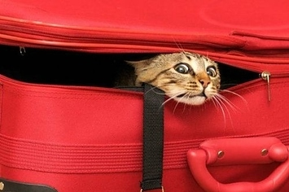
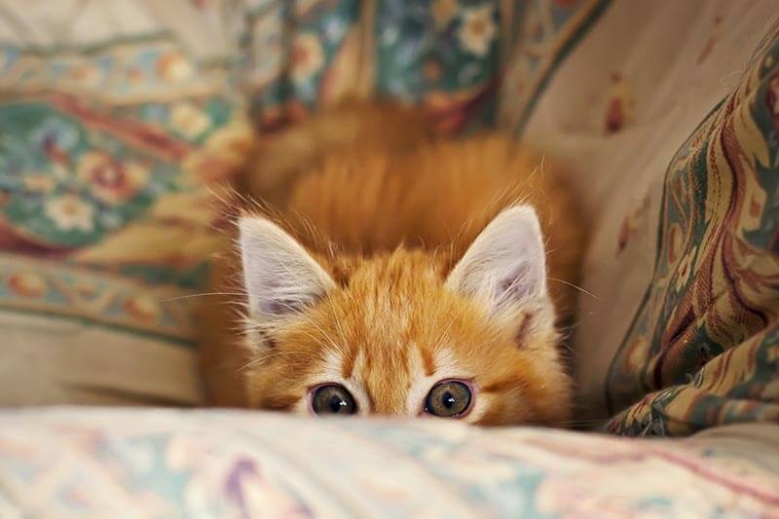
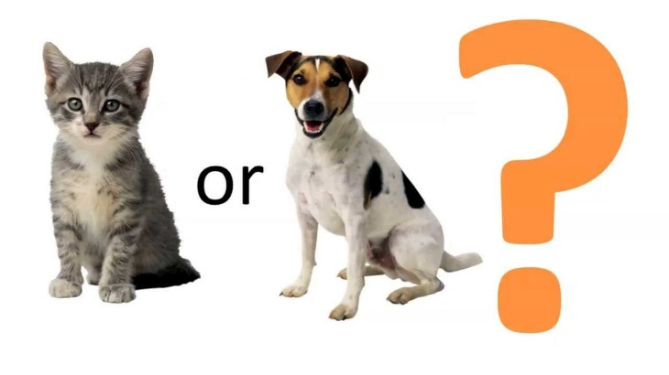
Computer Vision
Image classification
Cat or Dog
More challenging

Slide 9
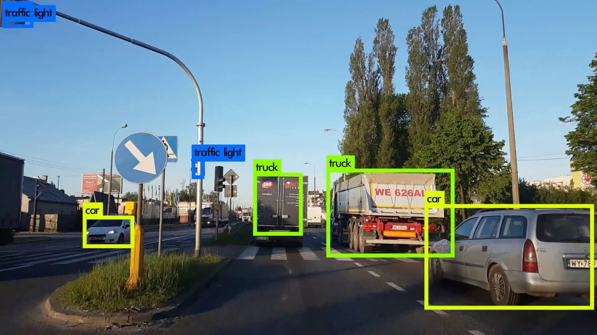
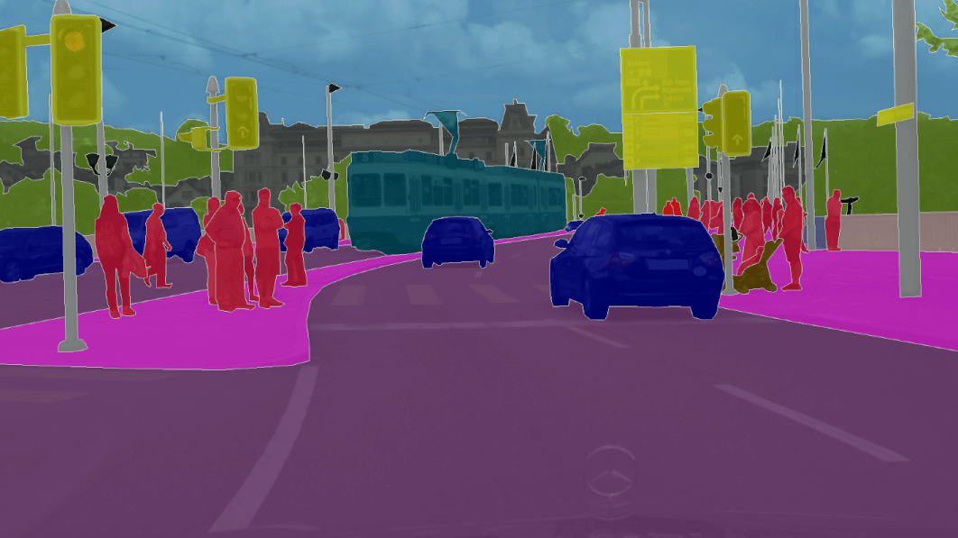
Computer Vision
Object detection (putting a box)
Image segmentation (including boundary detection as well)

Slide 10
Natural language processing
Translation
Language models
Captioning

Slide 11
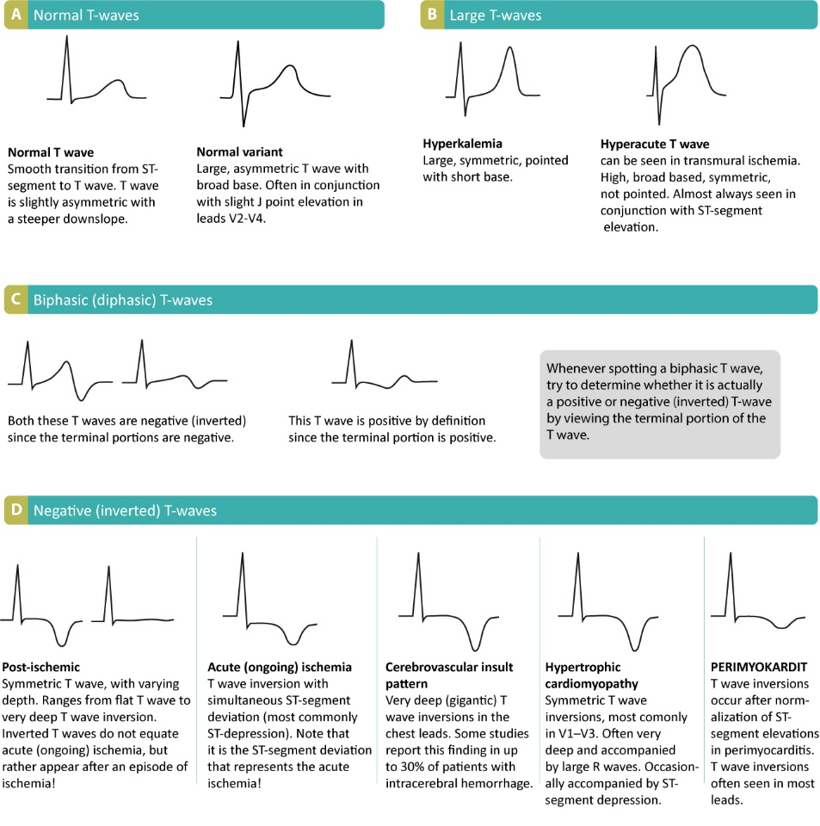
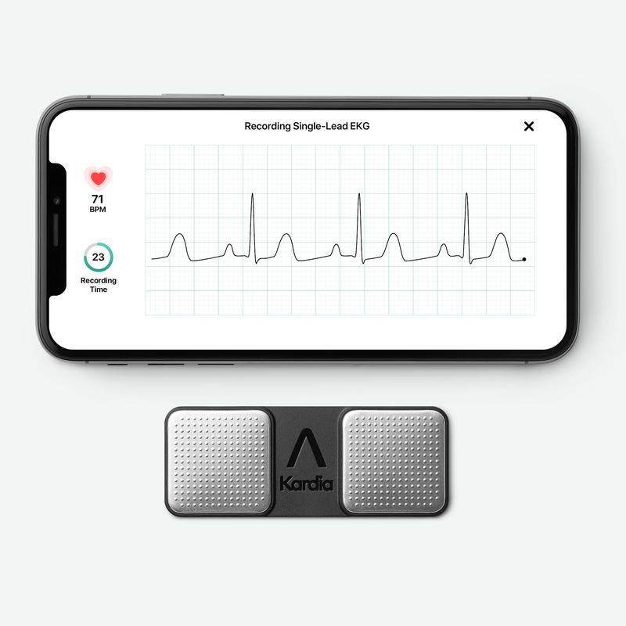
Medical applications
AliveCor from EKG T wave to potassium levels

Slide 12
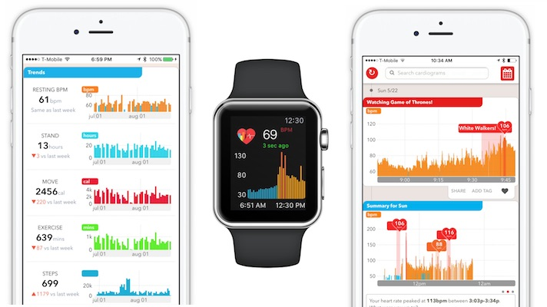
Apple watch and AF

Slide 13
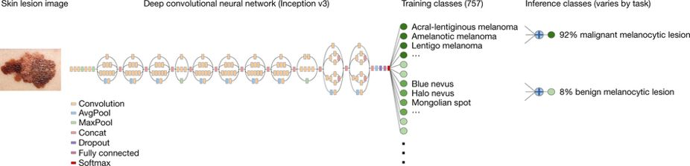
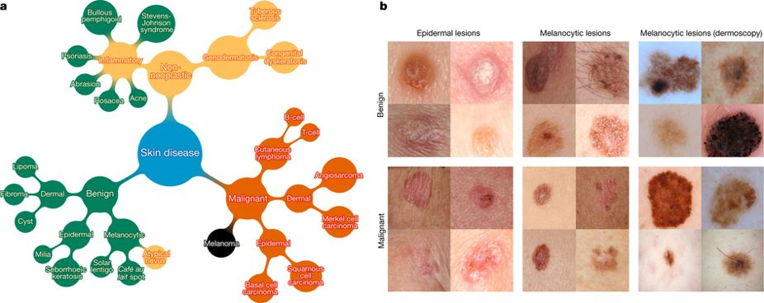
Medical Imaging

Slide 14
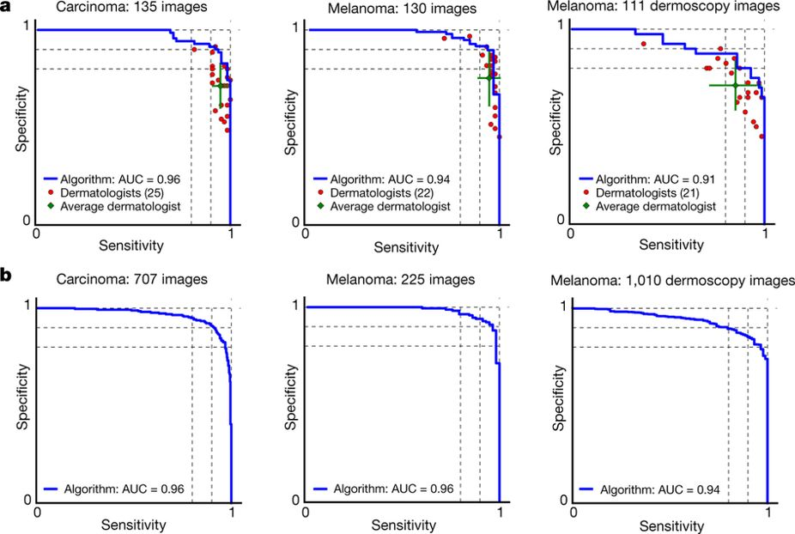

Slide 15
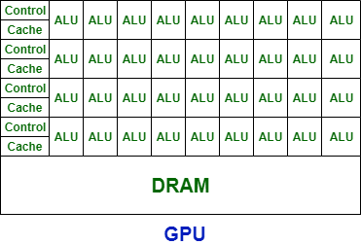
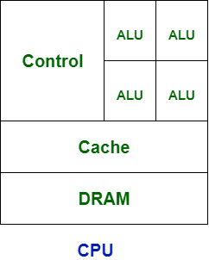
Why Deep Learning Works Now
Most of the algorithms exist since 1970s, and some in late 1990s.
Many of the algorithm remain unchanged ever since
E.g. LSTM
Three major advances make DL a cutting edge development
Hardware
GPU

Slide 16
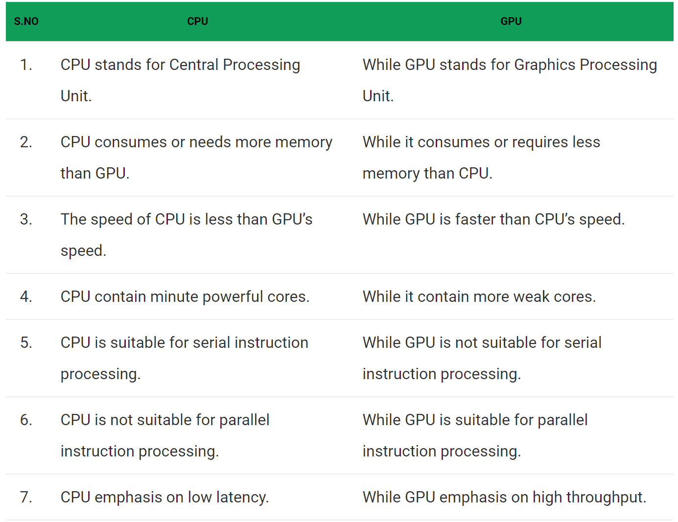
CPU vs. GPU

Slide 17
Why Deep Learning Works Better Now
Large collection of labelled data
ImageNet
Kaggle data mining challenge
Algorithms
Activation function (ReLU)
Algorithms that assists convergence
Adam
RMSProp
$$

Slide 18
Topics to be covered
Deep forward network
Convoluted neural networks
Mostly developed for imaging analysis
Sequence models
RNN
Deep generative models
GANs

