Slide 1
Deep Feedforward Network
PHS 597 Lecture
Bibo Jiang & Dajiang Liu

Slide 2
References
This lecture is based upon
Ian GoodFellow’s deep learning book Chapter 6
With additions from:

Slide 3
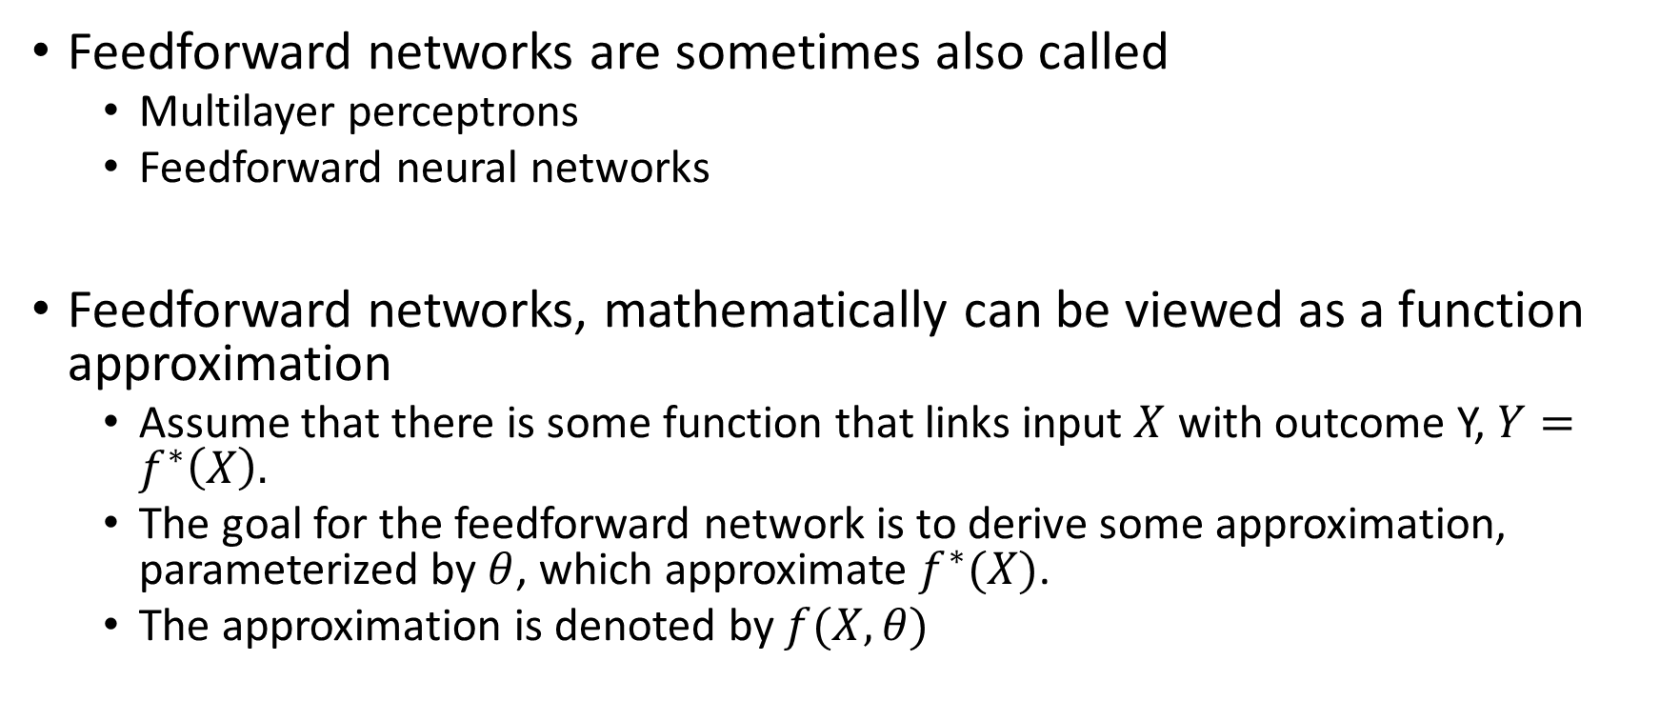
Feedforward Networks
Feedforward networks are sometimes also called
Multilayer perceptrons
Feedforward neural networks
Feedforward networks, mathematically can be viewed as a function approximation
Assume that there is some function that links input $X$ with outcome Y, $Y=f^{∗}\left(X\right).$
The goal for the feedforward network is to derive some approximation, parameterized by $θ$, which approximate $f^{∗}(X)$.
The approximation is denoted by $f(X,θ)$

Slide 4
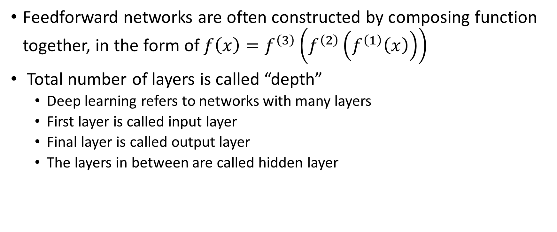


Feedforward Networks – Terminology
Feedforward networks are often constructed by composing function together, in the form of $f\left(x\right)=f^{\left(3\right)}\left(f^{\left(2\right)}\left(f^{\left(1\right)}\left(x\right)\right)\right)$
Total number of layers is called “depth”
Deep learning refers to networks with many layers
First layer is called input layer
Final layer is called output layer
The layers in between are called hidden layer
$$f^{(k)}(x)$$
$$f^{(1)}(x)$$

Slide 5
Feedforward Networks – Analogy to Neuroscience
The actual connection to neuroscience is quite minimal.
Each layer in the neural network is mathematically a vector-to-vector function
Equivalently, each layer can be thought of as multiple vector-to-scalar function that runs in parallel
This is in some sense similar to how neuron functions
Takes multitude of input, synthesize them and compute an output

Slide 6

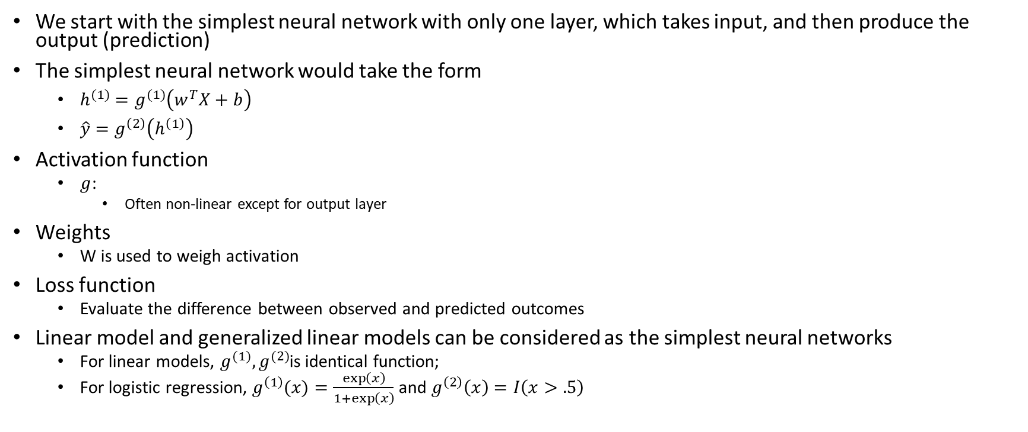



Basic Structures of Feedforward Network
We start with the simplest neural network with only one layer, which takes input, and then produce the output (prediction)
The simplest neural network would take the form
$h^{(1)}=g^{(1)}\left(w^{T}X+b\right)$
$\hat{y}=g^{\left(2\right)}\left(h^{\left(1\right)}\right)$
Activation function
$g$:
Often non-linear except for output layer
Weights
W is used to weigh activation
Loss function
Evaluate the difference between observed and predicted outcomes
Linear model and generalized linear models can be considered as the simplest neural networks
For linear models, $g^{(1)},g^{(2)}$is identical function;
For logistic regression, $g^{\left(1\right)}(x)=\frac{\exp\left(x\right)}{1+\exp\left(x\right)}$ and $g^{\left(2\right)}\left(x\right)=I\left(x>.5\right)$
$$g^{\left(1\right)}\left(w^{T}X+b\right)$$
$$g^{\left(2\right)}\left(h^{(1)}\right)$$
X
$$h^{\left(1\right)}$$
$$Y=±1$$

Slide 7
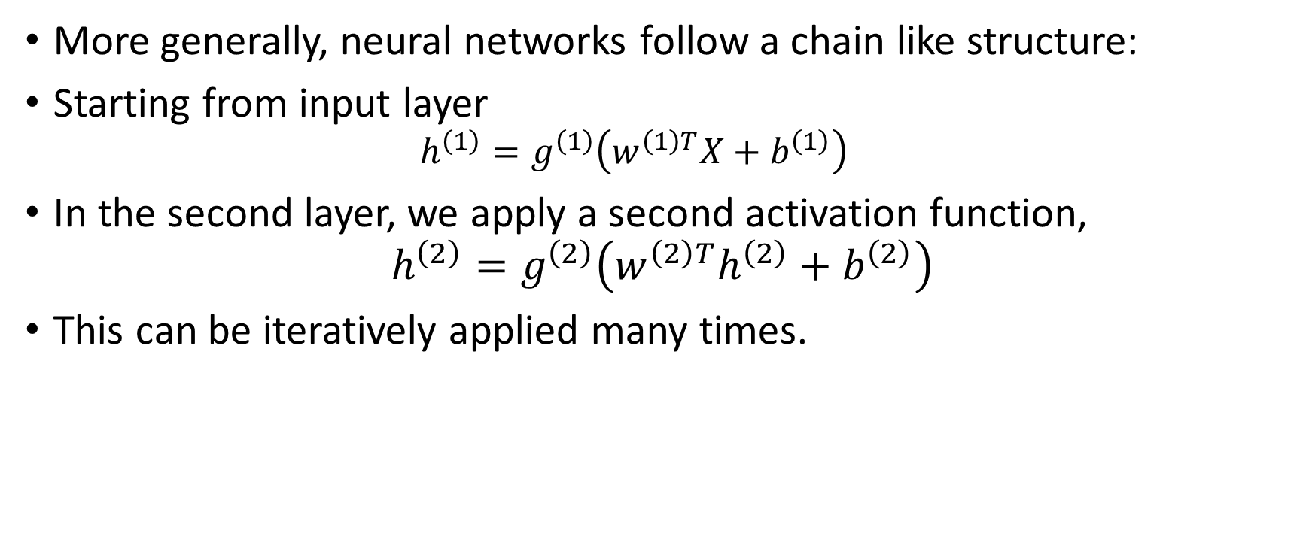
More General Neural Network Architecture
More generally, neural networks follow a chain like structure:
Starting from input layer
$$h^{\left(1\right)}=g^{\left(1\right)}\left(w^{\left(1\right)T}X+b^{\left(1\right)}\right)$$
In the second layer, we apply a second activation function,
$$h^{\left(2\right)}=g^{\left(2\right)}\left(w^{\left(2\right)T}h^{\left(2\right)}+b^{\left(2\right)}\right)$$
This can be iteratively applied many times.

Slide 8
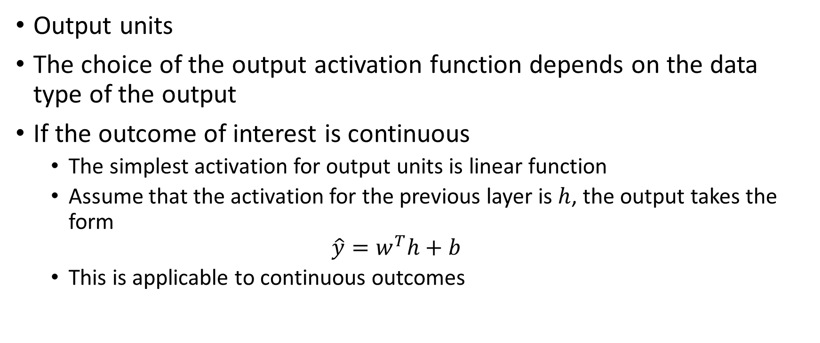
Choice of Activation Function
Output units
The choice of the output activation function depends on the data type of the output
If the outcome of interest is continuous
The simplest activation for output units is linear function
Assume that the activation for the previous layer is $h$, the output takes the form
$$\hat{y}=w^{T}h+b$$
This is applicable to continuous outcomes

Slide 9
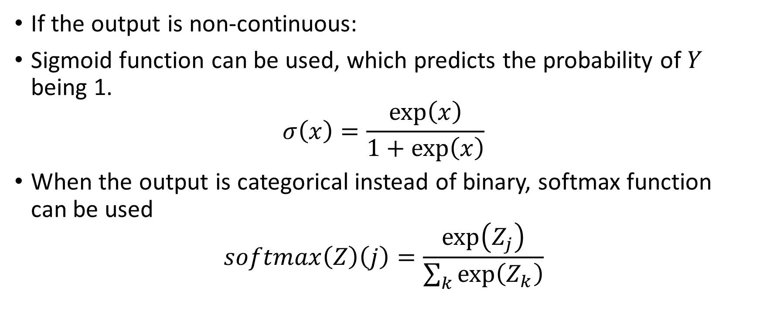
Choice of Output Unit Activation Function
If the output is non-continuous:
Sigmoid function can be used, which predicts the probability of $Y$ being 1.
$$σ\left(x\right)=\frac{\exp\left(x\right)}{1+\exp\left(x\right)}$$
When the output is categorical instead of binary, softmax function can be used
$$softmax\left(Z\right)\left(j\right)=\frac{\exp\left(Z_{j}\right)}{\sum_{k}{\exp\left(Z_{k}\right)}}$$

Slide 10
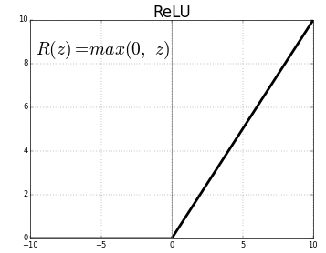
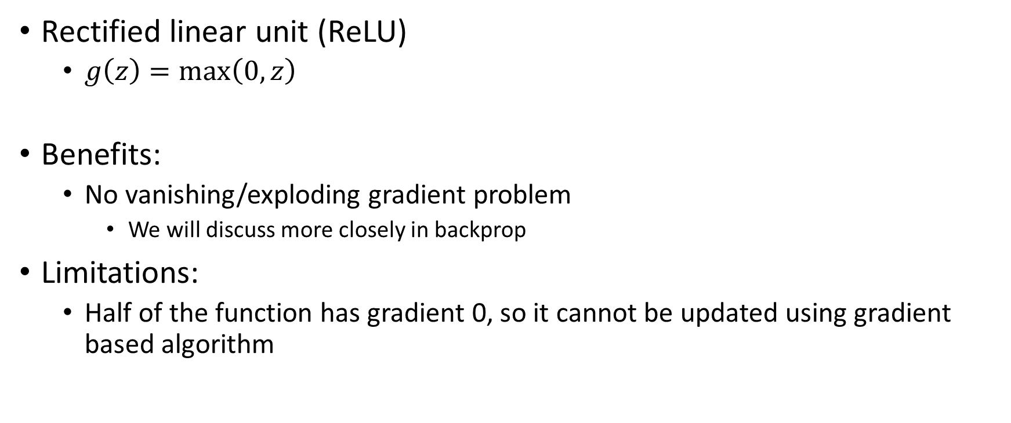
Choice of Hidden Unit Activation Function
Rectified linear unit (ReLU)
$g\left(z\right)=\max\left(0,z\right)$
Benefits:
No vanishing/exploding gradient problem
We will discuss more closely in backprop
Limitations:
Half of the function has gradient 0, so it cannot be updated using gradient based algorithm

Slide 11
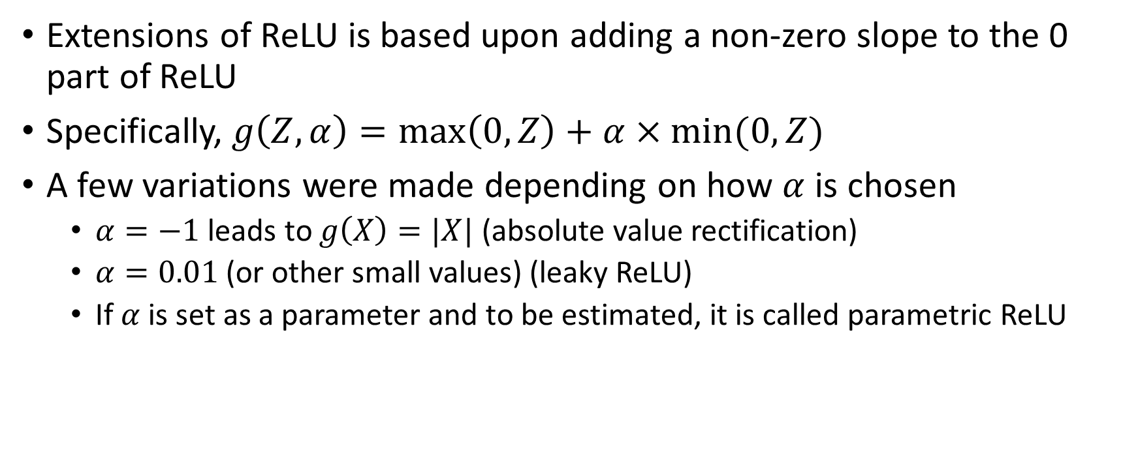
Choice of Hidden Unit Activation Function
Extensions of ReLU is based upon adding a non-zero slope to the 0 part of ReLU
Specifically, $g\left(Z,α\right)=\max\left(0,Z\right)+α×min⁡(0,Z)$
A few variations were made depending on how $α$ is chosen
$α=−1$ leads to $g\left(X\right)=|X|$ (absolute value rectification)
$α=0.01$ (or other small values) (leaky ReLU)
If $α$ is set as a parameter and to be estimated, it is called parametric ReLU

Slide 12
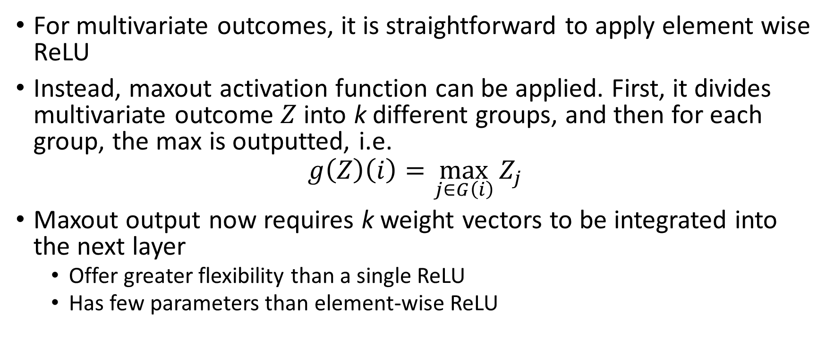
Further Extensions of ReLU
For multivariate outcomes, it is straightforward to apply element wise ReLU
Instead, maxout activation function can be applied. First, it divides multivariate outcome $Z$ into k different groups, and then for each group, the max is outputted, i.e.
$$g\left(Z\right)\left(i\right)=\max_{j∈G\left(i\right)}{Z_{j}}$$
Maxout output now requires k weight vectors to be integrated into the next layer
Offer greater flexibility than a single ReLU
Has few parameters than element-wise ReLU

Slide 13
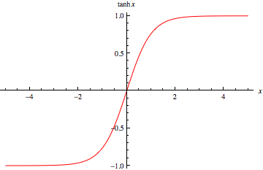
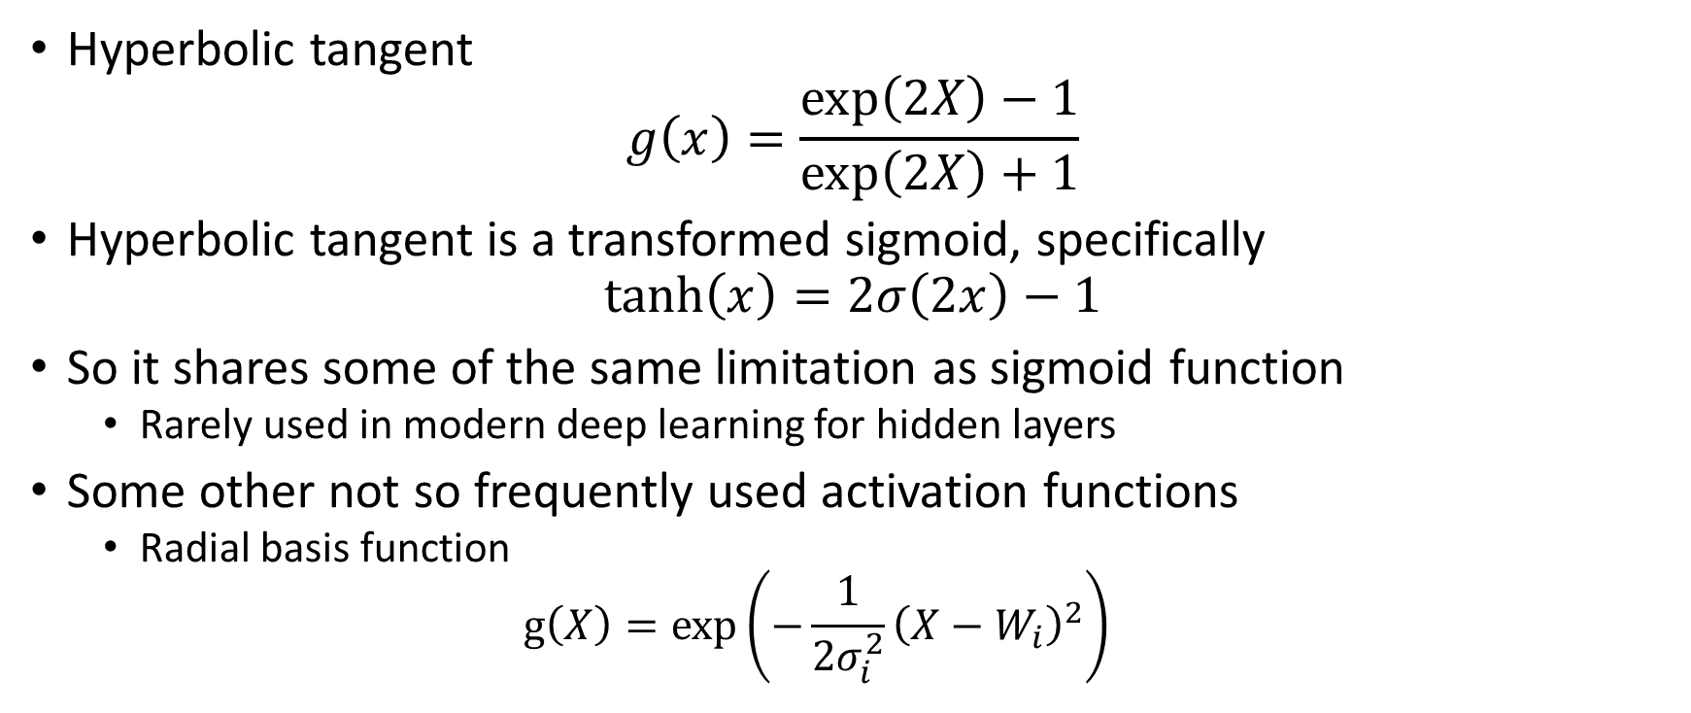
Other Activation Functions
Hyperbolic tangent
$$g\left(x\right)=\frac{\exp\left(2X\right)−1}{\exp\left(2X\right)+1}$$
Hyperbolic tangent is a transformed sigmoid, specifically
$$\tanh\left(x\right)=2σ\left(2x\right)−1$$
So it shares some of the same limitation as sigmoid function
Rarely used in modern deep learning for hidden layers
Some other not so frequently used activation functions
Radial basis function
$$g\left(X\right)=\exp\left(−\frac{1}{2σ_{i}^{2}}{\left(X−W_{i}\right)}^{2}\right)$$

Slide 14

Universal Approximation Theorem
The theorem states that a feed-forward network with a single hidden layer containing a finite number of neurons can approximate continuous functions on compact subsets of $R^{n}$, under mild assumptions on the activation function

Slide 15
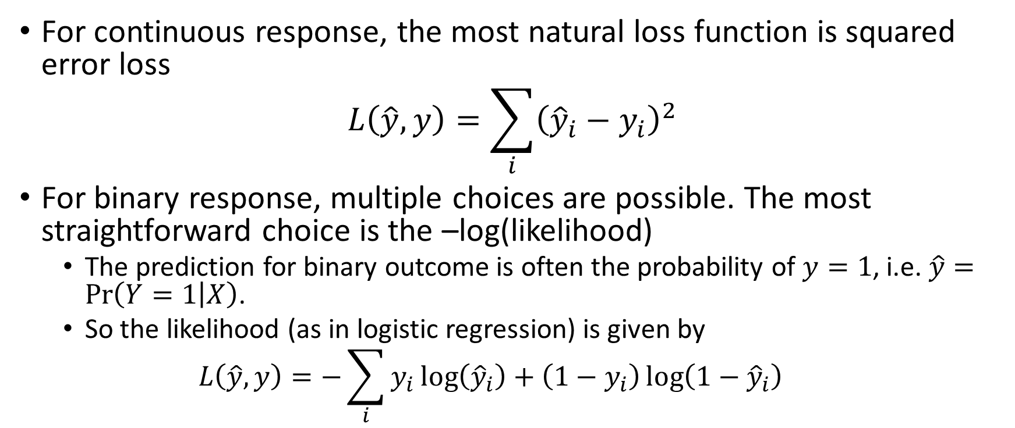
Choice of loss function
For continuous response, the most natural loss function is squared error loss
$$L\left(\hat{y},y\right)=\sum_{i}{{\left({\hat{y}}_{i}−y_{i}\right)}^{2}}$$
For binary response, multiple choices are possible. The most straightforward choice is the –log(likelihood)
The prediction for binary outcome is often the probability of $y=1$, i.e. $\hat{y}=\operatorname{Pr}\left(Y=1 | X\right)$.
So the likelihood (as in logistic regression) is given by
$$L\left(\hat{y},y\right)=−\sum_{i}{y_{i}\log\left({\hat{y}}_{i}\right)+\left(1−y_{i}\right)\log\left(1−{\hat{y}}_{i}\right)}$$

Slide 16
Computational Graph
Each node represent a variable
If variable Y can be obtained from variable X via an allowable operation, we draw an arrow from X to Y
Each operation leads to a single output (could be a multivariate output)
More generally, if Z can be obtained by X and Y
We draw an arrow from X to Z, and another one from Y to Z

Slide 17
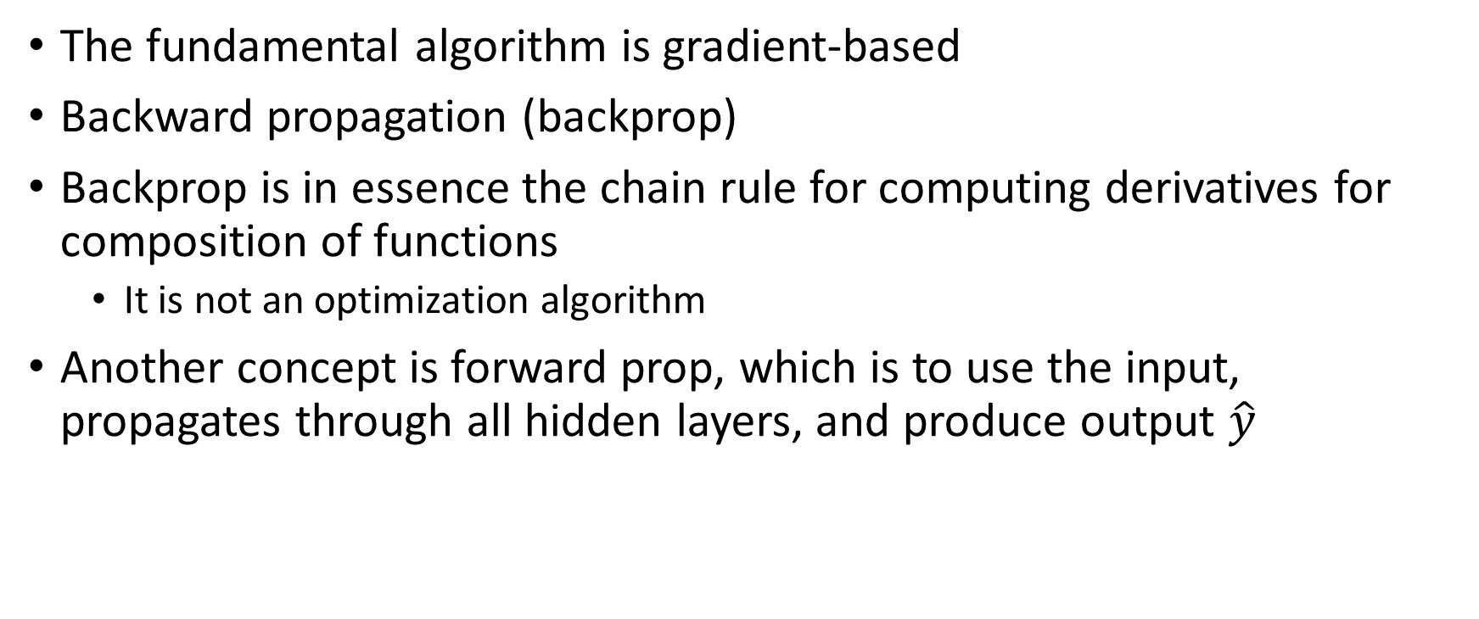
Algorithms for Fitting Neural Networks
The fundamental algorithm is gradient-based
Backward propagation (backprop)
Backprop is in essence the chain rule for computing derivatives for composition of functions
It is not an optimization algorithm
Another concept is forward prop, which is to use the input, propagates through all hidden layers, and produce output $\hat{y}$

Slide 18
Forward Prop Algorithm

Slide 19
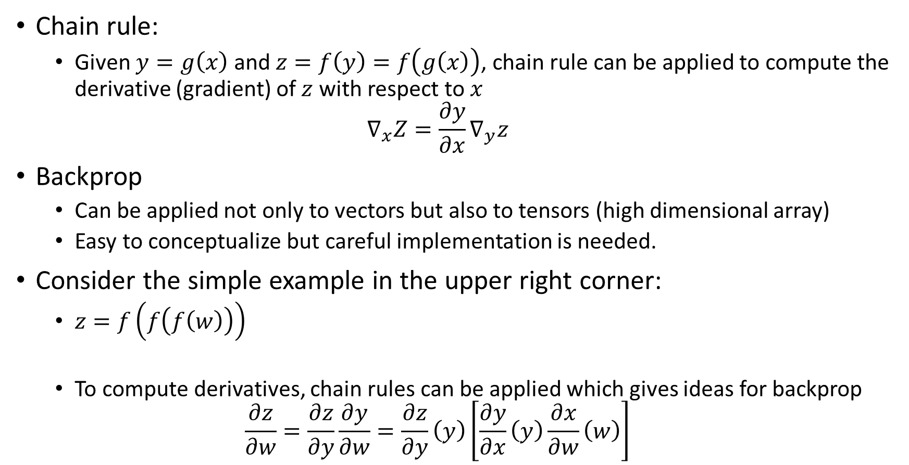
Backprop
Chain rule:
Given $y=g\left(x\right)$ and $z=f\left(y\right)=f\left(g\left(x\right)\right)$, chain rule can be applied to compute the derivative (gradient) of $z$ with respect to $x$
$$∇_{x}Z=\frac{∂y}{∂x}∇_{y}z$$
Backprop
Can be applied not only to vectors but also to tensors (high dimensional array)
Easy to conceptualize but careful implementation is needed.
Consider the simple example in the upper right corner:
$z=f\left(f\left(f\left(w\right)\right)\right)$
To compute derivatives, chain rules can be applied which gives ideas for backprop
$$\frac{∂z}{∂w}=\frac{∂z}{∂y}\frac{∂y}{∂w}=\frac{∂z}{∂y}\left(y\right)\left[\frac{∂y}{∂x}\left(y\right)\frac{∂x}{∂w}\left(w\right)\right]$$

Slide 20
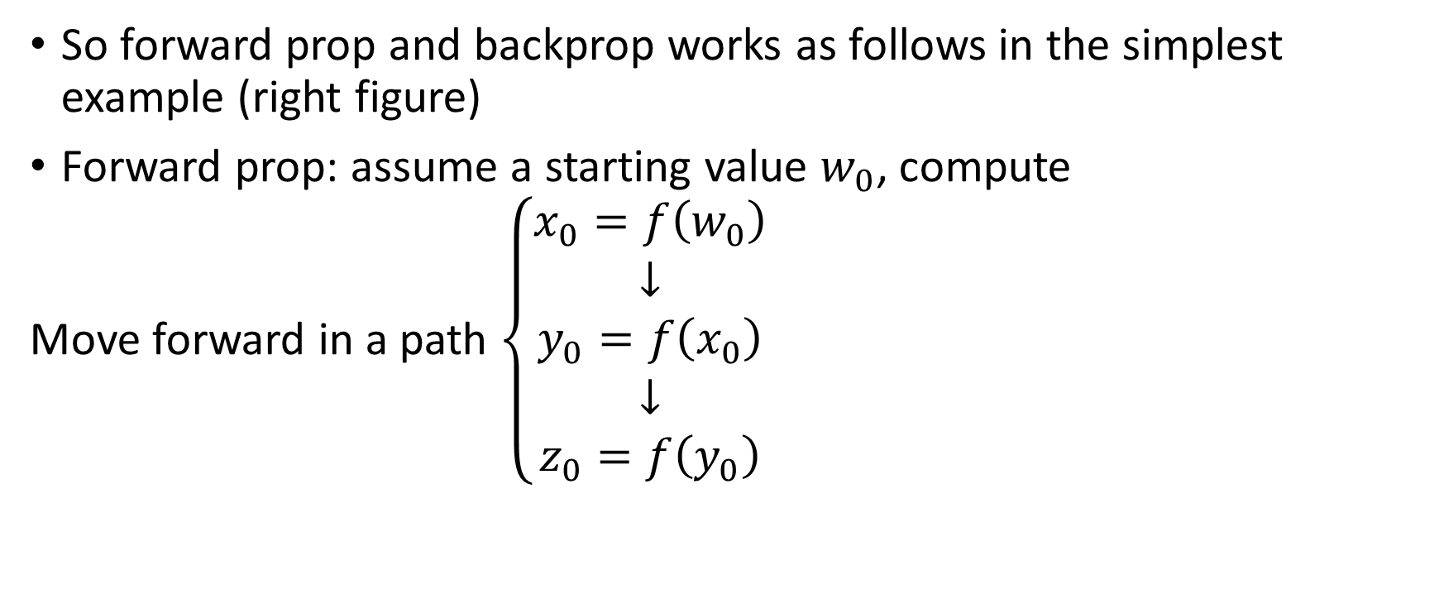
Forward and Backward Prop – A Simple Example
So forward prop and backprop works as follows in the simplest example (right figure)
Forward prop: assume a starting value $w_{0}$, compute
Move forward in a path $\left\{\begin{aligned}x_{0}=f\left(w_{0}\right) \\ ↓ \\ y_{0}=f\left(x_{0}\right) \\ ↓ \\ z_{0}=f\left(y_{0}\right)\end{aligned}\right.$

Slide 21
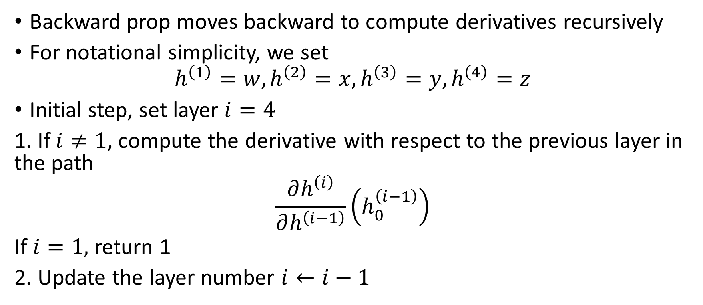
Forward and Backward Prop – A simple Example
Backward prop moves backward to compute derivatives recursively
For notational simplicity, we set
$$h^{\left(1\right)}=w,h^{\left(2\right)}=x,h^{\left(3\right)}=y,h^{\left(4\right)}=z$$
Initial step, set layer $i=4$
1. If $i≠1$, compute the derivative with respect to the previous layer in the path
$$\frac{∂h^{\left(i\right)}}{∂h^{\left(i−1\right)}}\left(h_{0}^{\left(i−1\right)}\right)$$
If $i=1,$ return 1
2. Update the layer number $i←i−1$

Slide 22
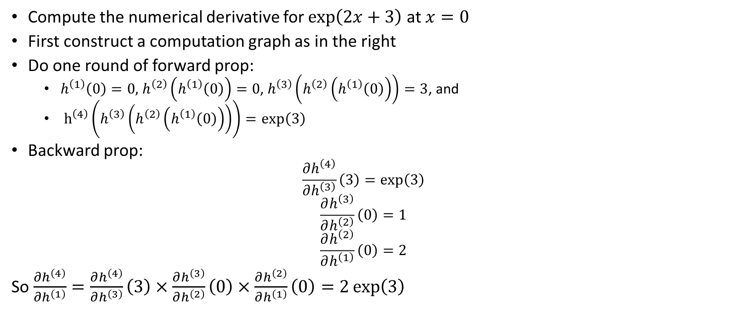
Example
h⁽⁴⁾ =exp(2x+3)
Compute the numerical derivative for $\exp\left(2x+3\right)$ at $x=0$
First construct a computation graph as in the right
Do one round of forward prop:
$h^{\left(1\right)}\left(0\right)=0,$ $h^{\left(2\right)}\left(h^{\left(1\right)}\left(0\right)\right)=0$, $h^{\left(3\right)}\left(h^{\left(2\right)}\left(h^{\left(1\right)}\left(0\right)\right)\right)=3$, and
$h^{\left(4\right)}\left(h^{\left(3\right)}\left(h^{\left(2\right)}\left(h^{\left(1\right)}\left(0\right)\right)\right)\right)=\exp\left(3\right)$
Backward prop:
$$\frac{∂h^{\left(4\right)}}{∂h^{\left(3\right)}}\left(3\right)=exp\left(3\right)$$
$$\frac{∂h^{\left(3\right)}}{∂h^{\left(2\right)}}\left(0\right)=1$$
$$\frac{∂h^{\left(2\right)}}{∂h^{\left(1\right)}}\left(0\right)=2$$
So $\frac{∂h^{\left(4\right)}}{∂h^{\left(1\right)}}=\frac{∂h^{\left(4\right)}}{∂h^{\left(3\right)}}\left(3\right)×\frac{∂h^{\left(3\right)}}{∂h^{\left(2\right)}}\left(0\right)×\frac{∂h^{\left(2\right)}}{∂h^{\left(1\right)}}\left(0\right)=2\exp\left(3\right)$
h⁽³⁾ = 2x+3
h⁽²⁾ =2x
h⁽¹⁾ =X

Slide 23
A More Complicated Example with Multiple Paths
In the previous example, there is only one path in the computational graph, leading from input to the output
In practice, the computational graph can be more complicated and involve multiple paths
Backprop can be done to multiple paths as well
As suggested by the chain rule formula on the right

Slide 24
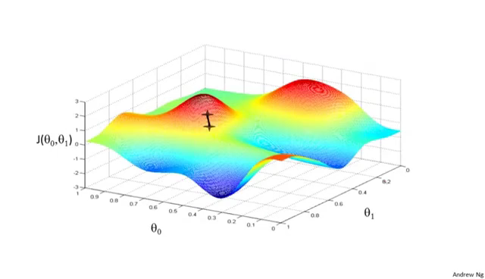
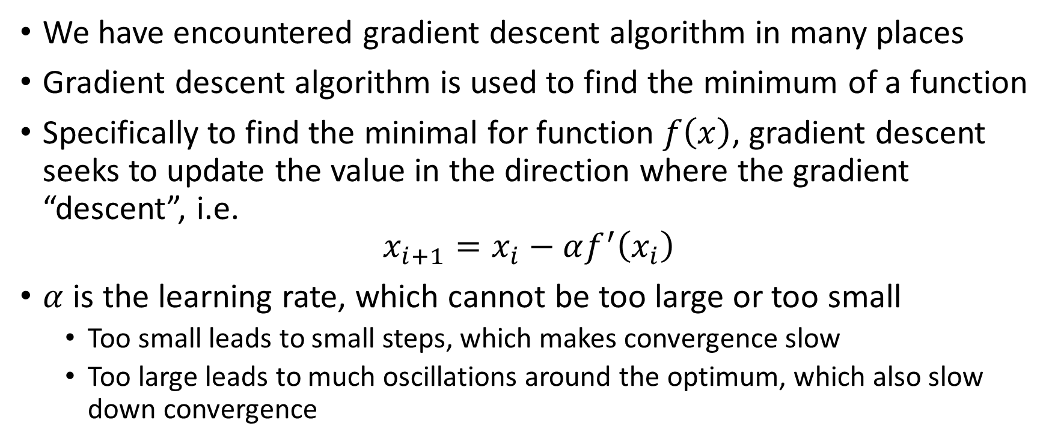
Gradient Descent Algorithm
We have encountered gradient descent algorithm in many places
Gradient descent algorithm is used to find the minimum of a function
Specifically to find the minimal for function $f\left(x\right)$, gradient descent seeks to update the value in the direction where the gradient “descent”, i.e.
$$x_{i+1}=x_{i}−αf^{′}\left(x_{i}\right)$$
$α$ is the learning rate, which cannot be too large or too small
Too small leads to small steps, which makes convergence slow
Too large leads to much oscillations around the optimum, which also slow down convergence

Slide 25
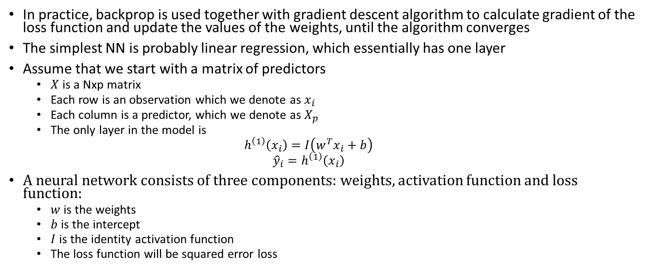
Forward and Backward Prop in Fitting a Single Layer Neural Network
In practice, backprop is used together with gradient descent algorithm to calculate gradient of the loss function and update the values of the weights, until the algorithm converges
The simplest NN is probably linear regression, which essentially has one layer
Assume that we start with a matrix of predictors
$X$ is a Nxp matrix
Each row is an observation which we denote as $x_{i}$
Each column is a predictor, which we denote as $X_{p}$
The only layer in the model is
$$h^{\left(1\right)}\left(x_{i}\right)=I\left(w^{T}x_{i}+b\right)$$
$${\hat{y}}_{i}=h^{\left(1\right)}\left(x_{i}\right)$$
A neural network consists of three components: weights, activation function and loss function:
$w$ is the weights
$b$ is the intercept
$I$ is the identity activation function
The loss function will be squared error loss

Slide 26
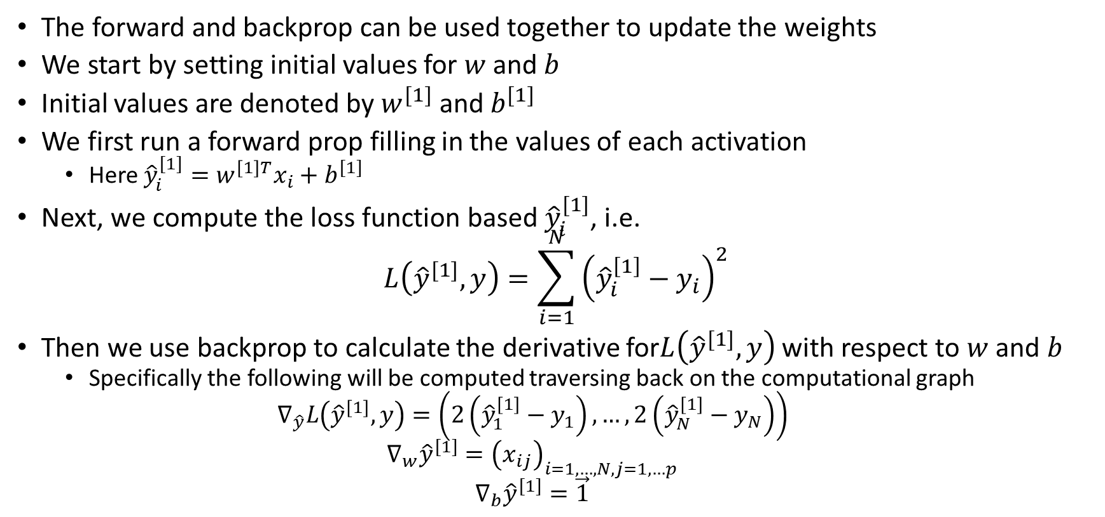
Forward and Backward Prop in Fitting a Single Layer Neural Network
The forward and backprop can be used together to update the weights
We start by setting initial values for $w$ and $b$
Initial values are denoted by $w^{[1]}$ and $b^{[1]}$
We first run a forward prop filling in the values of each activation
Here ${\hat{y}}_{i}^{[1]}=w^{\left[1\right]T}x_{i}+b^{[1]}$
Next, we compute the loss function based ${\hat{y}}_{i}^{[1]}$, i.e.
$$L\left({\hat{y}}^{[1]},y\right)=\sum_{i=1}^{N}{{\left({\hat{y}}_{i}^{\left[1\right]}−y_{i}\right)}^{2}}$$
Then we use backprop to calculate the derivative for$L\left({\hat{y}}^{[1]},y\right)$ with respect to $w$ and $b$
Specifically the following will be computed traversing back on the computational graph
$$∇_{\hat{y}}L\left({\hat{y}}^{\left[1\right]},y\right)=\left(2\left({\hat{y}}_{1}^{\left[1\right]}−y_{1}\right),…,2\left({\hat{y}}_{N}^{\left[1\right]}−y_{N}\right)\right)$$
$$∇_{w}{\hat{y}}^{[1]}={\left(x_{ij}\right)}_{i=1,…,N,j=1,…p}$$
$$∇_{b}{\hat{y}}^{[1]}=\vec{1}$$

Slide 27
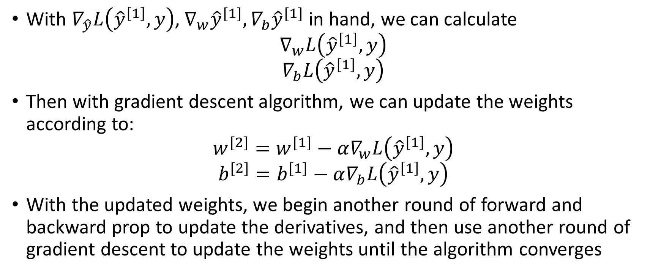
Forward and Backward Prop in Fitting a Single Layer Neural Network
With $∇_{\hat{y}}L\left({\hat{y}}^{\left[1\right]},y\right)$, $∇_{w}{\hat{y}}^{[1]}, ∇_{b}{\hat{y}}^{[1]}$ in hand, we can calculate
$$∇_{w}L\left({\hat{y}}^{\left[1\right]},y\right)$$
$$∇_{b}L\left({\hat{y}}^{\left[1\right]},y\right)$$
Then with gradient descent algorithm, we can update the weights according to:
$$w^{[2]}=w^{[1]}−α∇_{w}L\left({\hat{y}}^{\left[1\right]},y\right)$$
$$b^{[2]}=b^{[1]}−α∇_{b}L\left({\hat{y}}^{\left[1\right]},y\right)$$
With the updated weights, we begin another round of forward and backward prop to update the derivatives, and then use another round of gradient descent to update the weights until the algorithm converges

