Slide 1
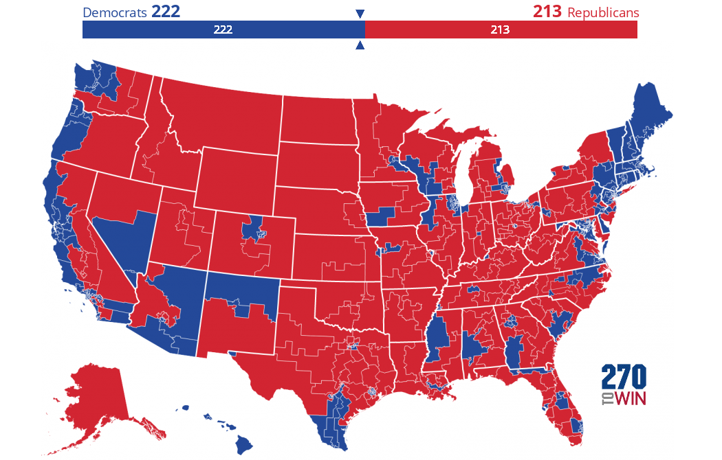
Targeted Ad Spending
Samuel Robbins

Slide 2
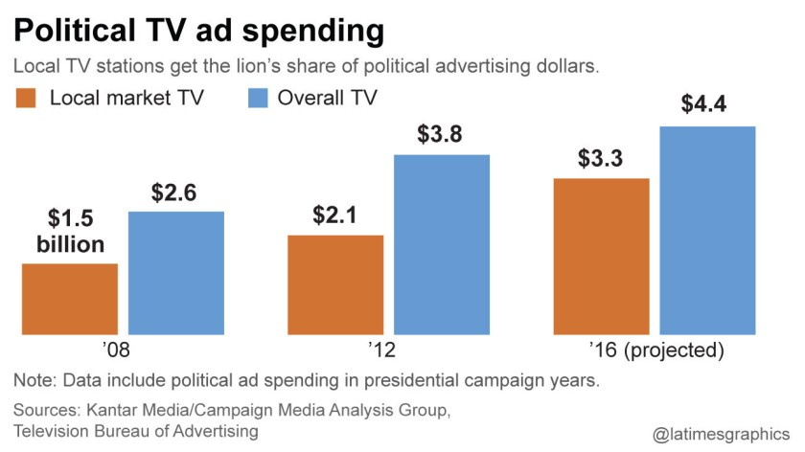
Election spending is on the rise
The 2019-2020 election cycle saw $8.5 billion in advertising spending across TV, radio, and digital media.

Slide 3
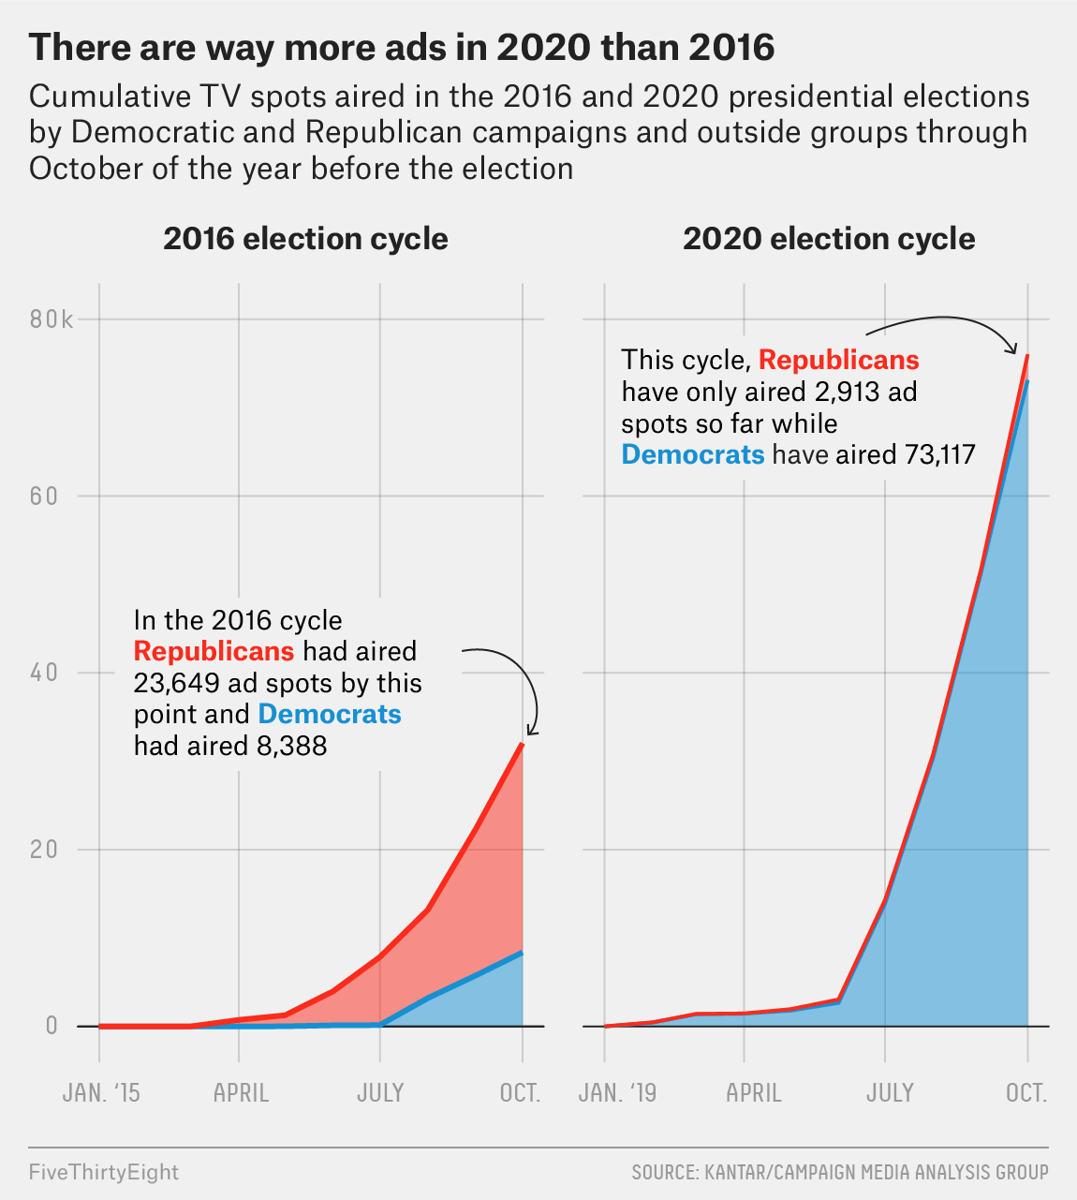
Opportunity
Ad volume is increasing along with price.
More targeted advertising is crucial to overcoming the deluge of ads that potential voters are faced with everyday.
Need to decide which races are the most winnable and the most cost-effective to finance.

Slide 4

Project Goals
Goal: Determine best house districts to direct limited campaign dollars towards using
Election results
2018 cycle advertising data
Solution Path
Identify competitive house districts
Calculate average ad spend for each house district

Slide 5
Methodology
FUTURE WORK
Election Results
(2012-2020)
Exploratory Data
Analysis
Add data about ad content to build regression model
Micro-targeting with smaller geographic divides
Build the Perfect Ad
Determine partisan lean of each congressional district
Average cost of ads in each district
Calculate partisan trajectory of each district
Determine number of potential swing voters
Election Ad Spending Data
Regression Analysis

Slide 6
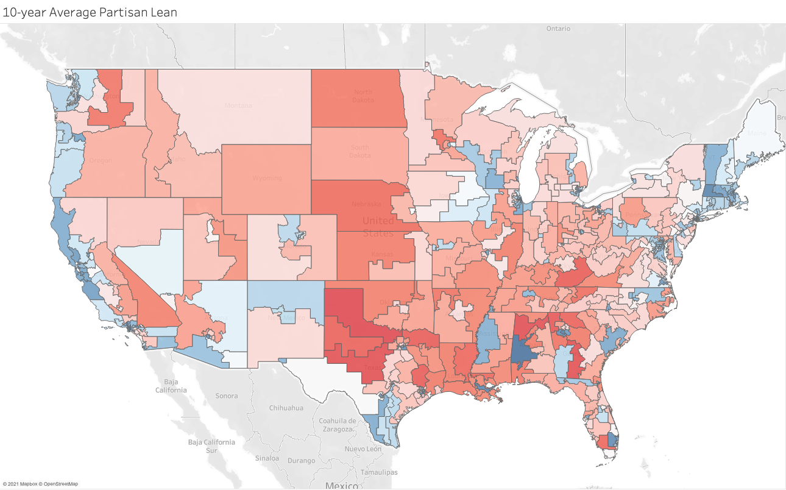
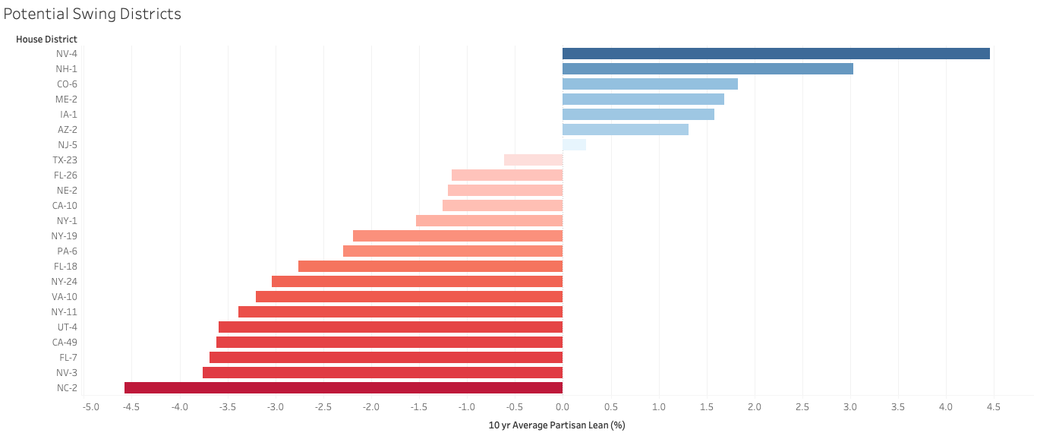
Insights
23 swing districts based on 10-yr average partisan lean

Slide 7
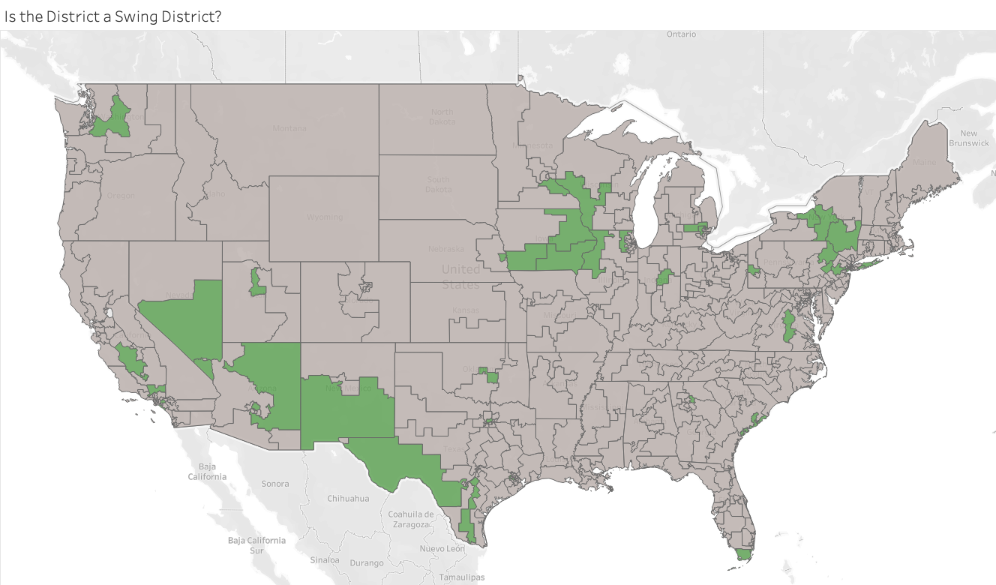
Insights
Generally between 15 and 45 swing districts each election

Slide 8
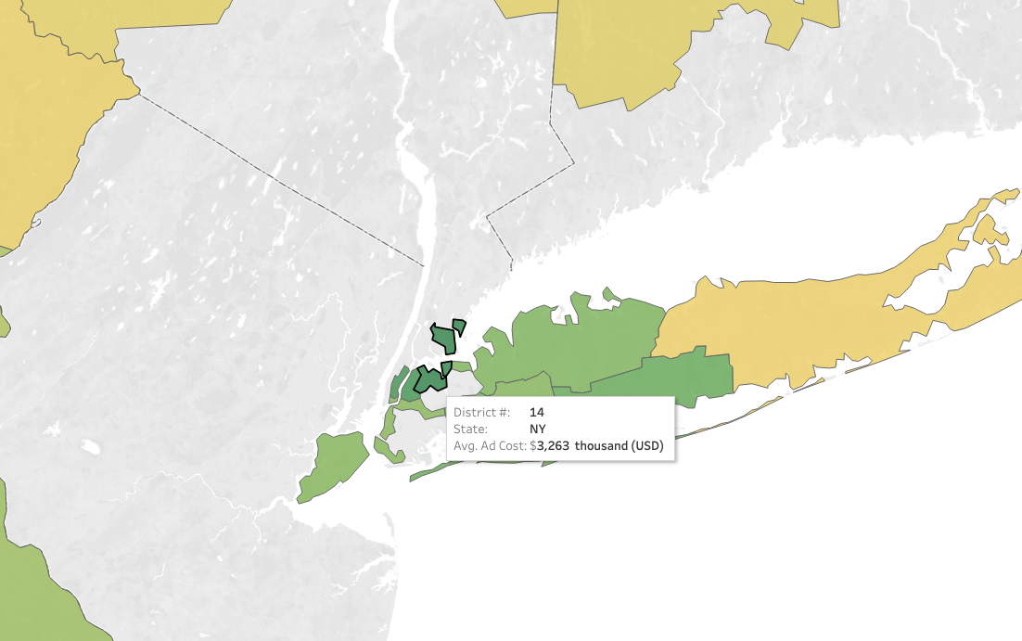
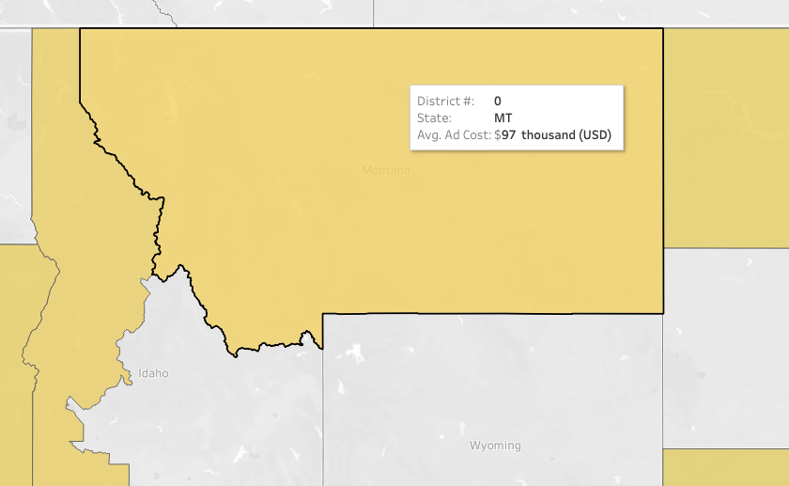
Insights
Hypothesis correct in that larger media markets are more expensive.

Slide 9
Action Items
Districts to Flip
House District | Avg Ad Spend ($1000 USD) | Avg Cost/sec ($1000 USD) | R Advantage
NY1 | $161.27 | $5.38 | -3.766
NY24 | $209.06 | $6.94 | -2.382
CA21 | $251.57 | $8.39 | -0.894
IA1 | $256.67 | $8.77 | -2.533
IA2 | $293.53 | $9.78 | -0.001
I recommend focusing on these specific districts first, and then potentially expanding out from there.
Districts to Keep
House District | Avg Ad Spend ($1000 USD) | Avg Cost/sec ($1000 USD) | D Advantage
PA8 | $199.57 | $6.65 | 3.555
NY19 | $272.86 | $9.35 | 4.537
IL17 | $363.38 | $12.11 | 4.051
IA3 | $421.46 | $14.05 | 1.347
AZ1 | $734.13 | $24.47 | 3.220

Slide 10
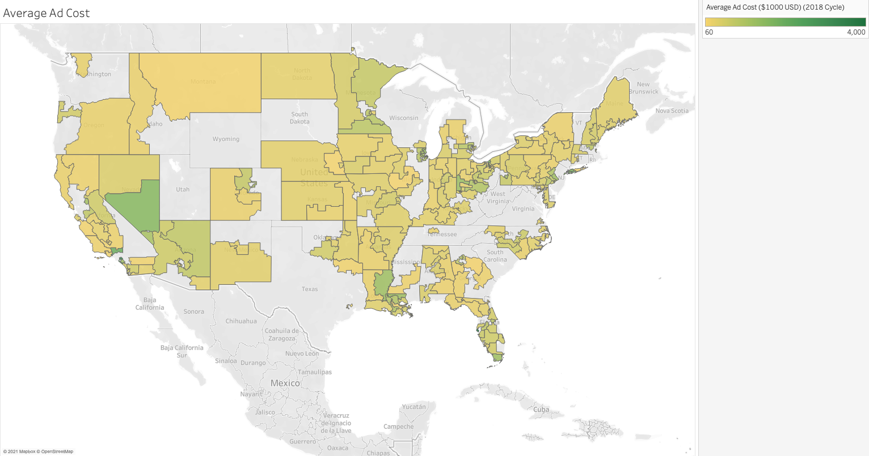
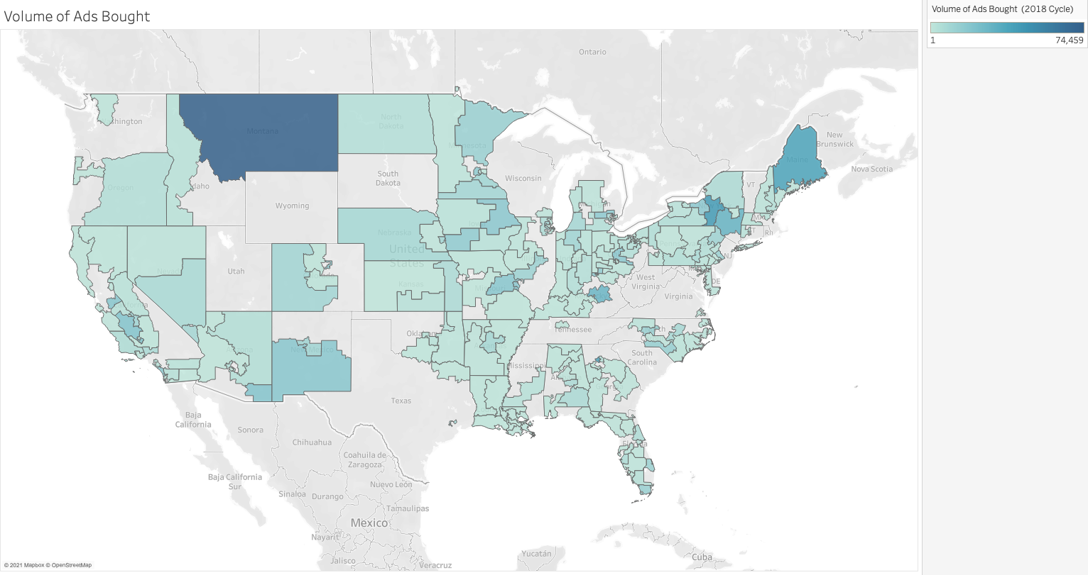
Next Steps
Advertising Data has features for:
Content
Tone
Issues mentioned
Politicians mention
And much more!
that could be used for a robust regression model to make the best ad for that district.
More specific voter/location data could also be used to more precisely target potential voters.

Slide 11

Thank You!
Happy to take any Questions

