Slide 1
Winning the Message Battle: A Twitter Case Study
Presented by Samuel Robbins
December 2021 | METIS

Slide 2
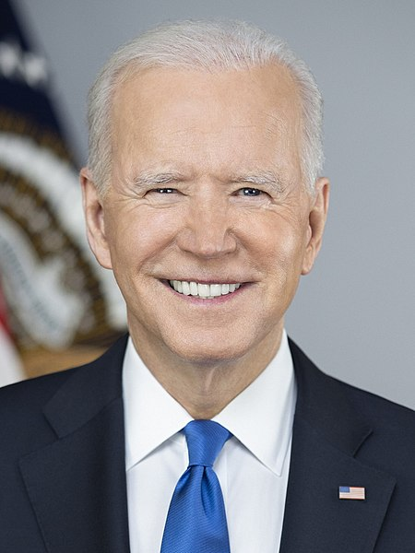
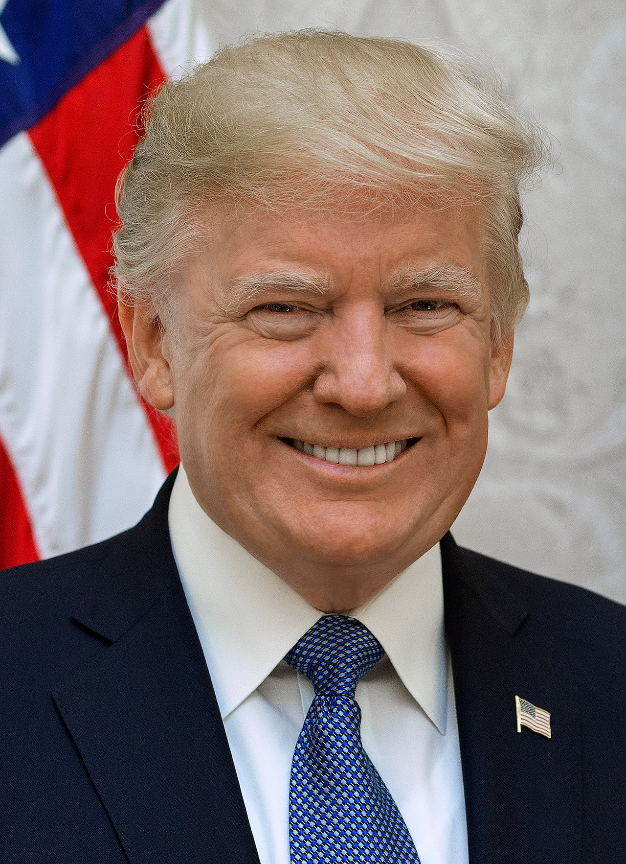
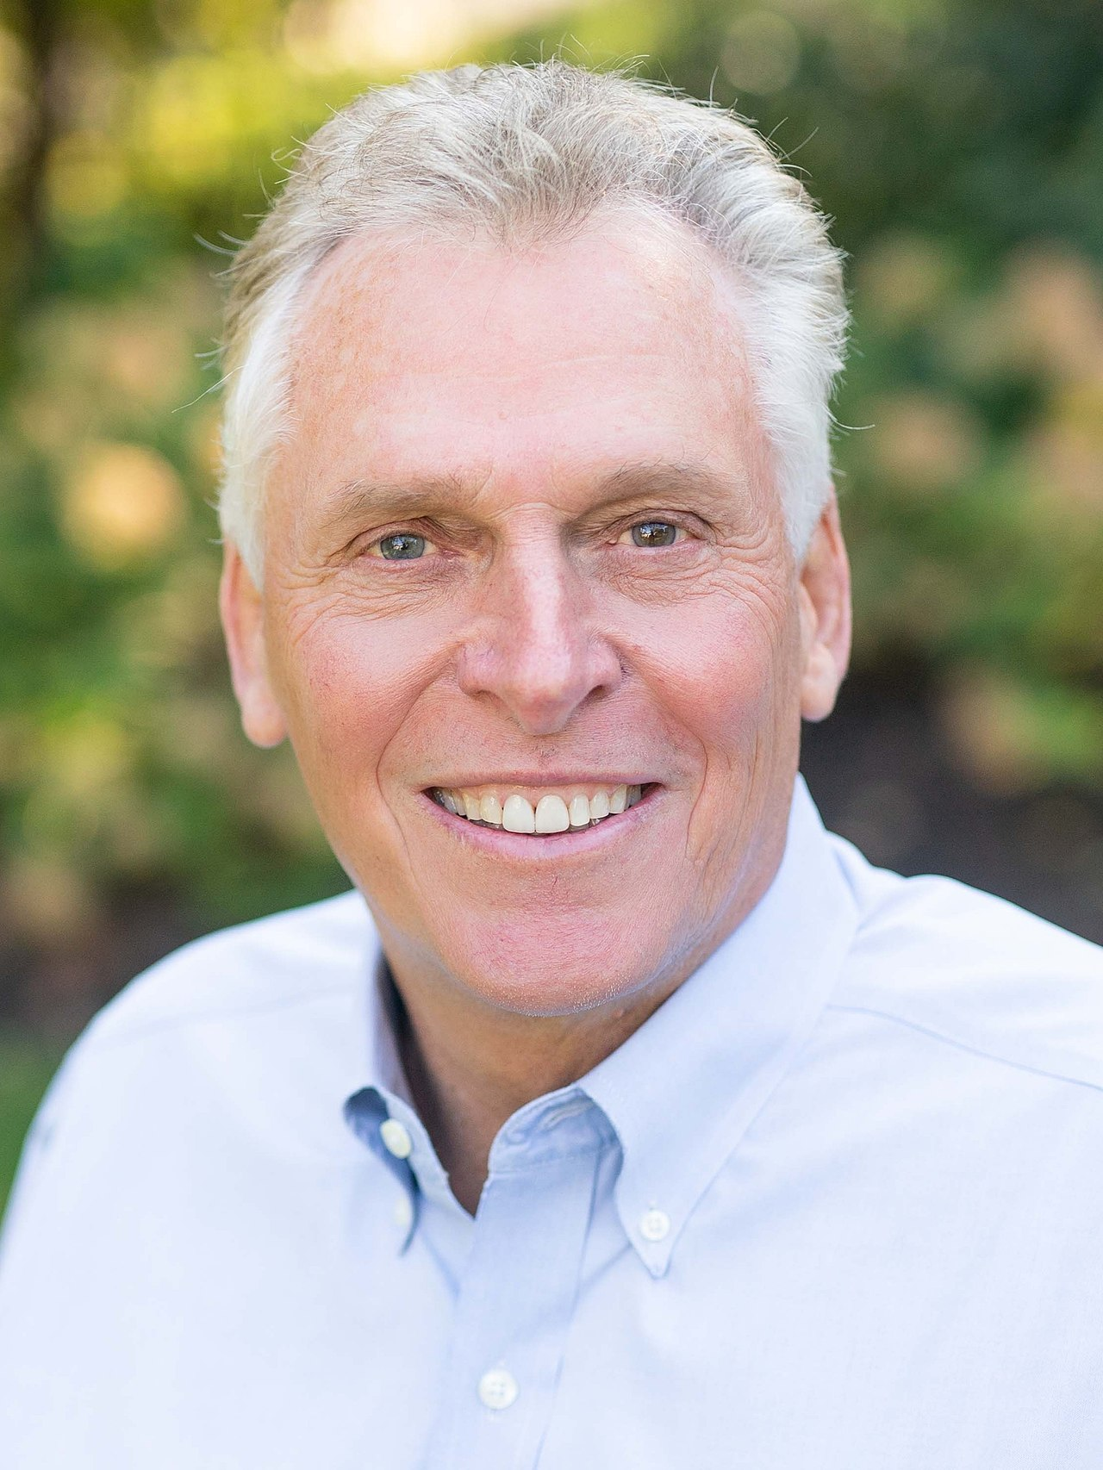
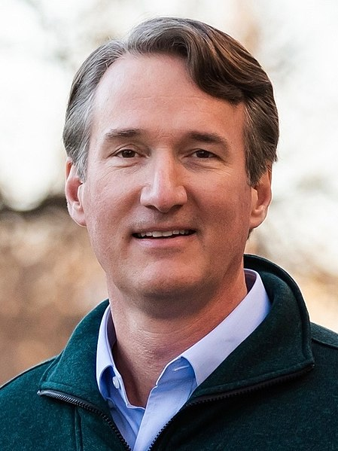
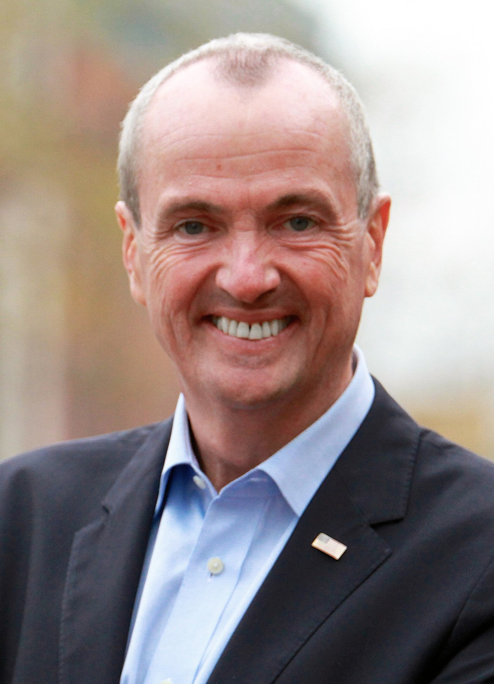
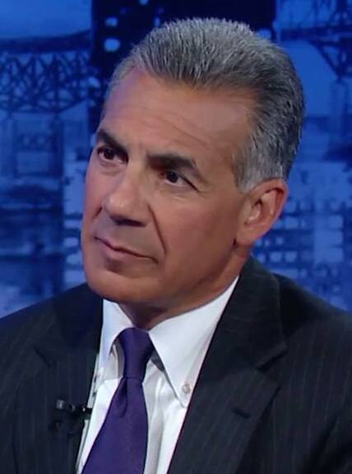
2020 vs. 2021 Election Results
Joe Biden (D)
Votes in VA: 2,413,568 (54.1% - D+10)
Votes in NJ: 2,608,335 (57.3% - D+16)
Donald Trump (R)
Votes in VA: 1,962,430 (44.0%)
Votes in NJ: 1,883,274 (41.4%)
Terry McAuliffe (D)
Votes: 1,600,116 (48.6%)
Glenn Youngkin (R)
Votes: 1,663,596 (50.6% - R+2)
~ 12 pt swing towards Republicans in Virginia
Phil Murphy (D)
Votes: 1,339,471 (51.2% - D+3)
Jack Ciattarelli (R)
Votes: 1,255,185 (48.0%)
~ 13 pt swing towards Republicans in New Jersey

Slide 3
Guiding Question:
What is driving the swing toward Republicans in the electorate and how can Democratic candidates counteract this swing in their messaging?

Slide 4
Project Objective
Explore the social media messaging strategies of the candidates in the VA and NJ Gubernatorial Elections in 2021
Areas of Interest:
What issues are the candidates focusing on?
Is the candidate primarily using positive or negative messaging strategies?
E.g. positive message about their own candidacy vs. negative message about their opponent
Do the social media networks of the candidates overlap, and if so how much?

Slide 5

Data
Queried the Twitter API for the user timelines of each candidate from January 1, 2021-November 3, 2021 (election day)
Results: 4 datasets with ~1500-3500 unique tweets each.
Attempted to query the API for all tweets related to the VA and NJ elections within the last year, but limited by API permissions

Slide 6



Tools and Libraries
Tweepy and Twitter API
SpaCy/SpaCyTextBlob and NLTK for language processing and sentiment analysis
sklearn for topic modeling and engagement regressions
matplotlib, seaborn for visualization

Slide 7
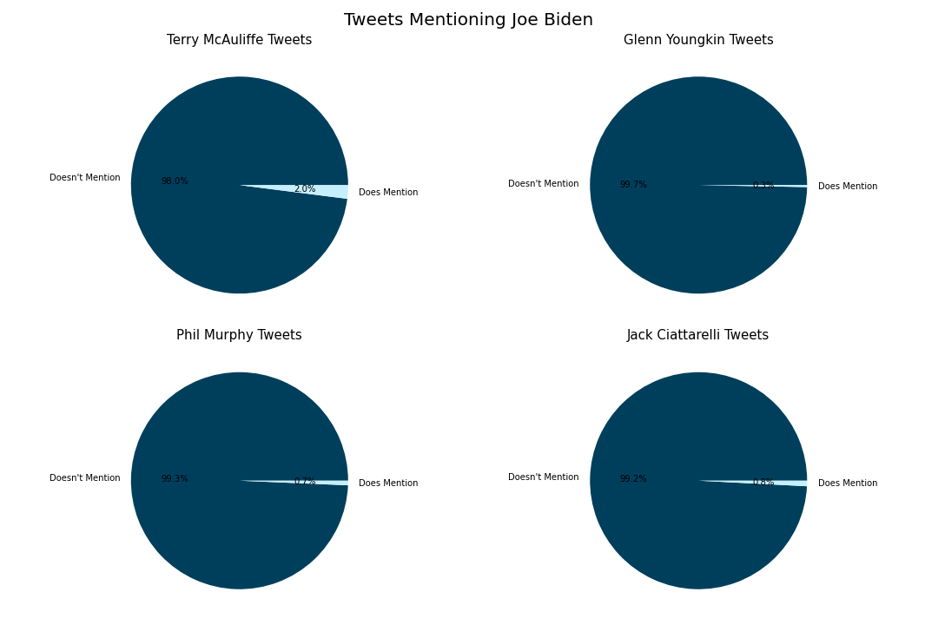
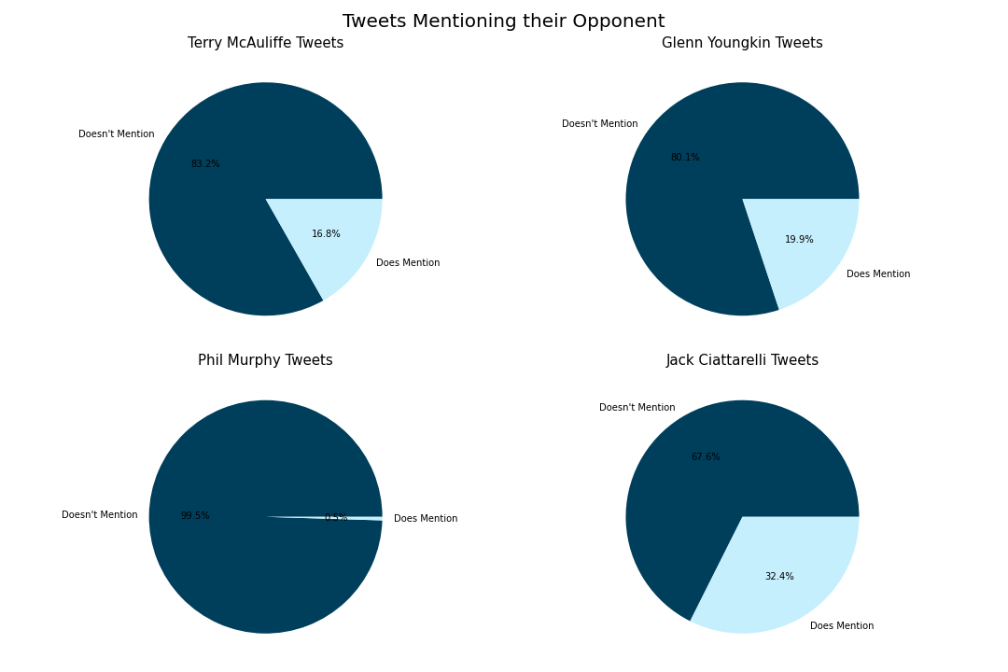
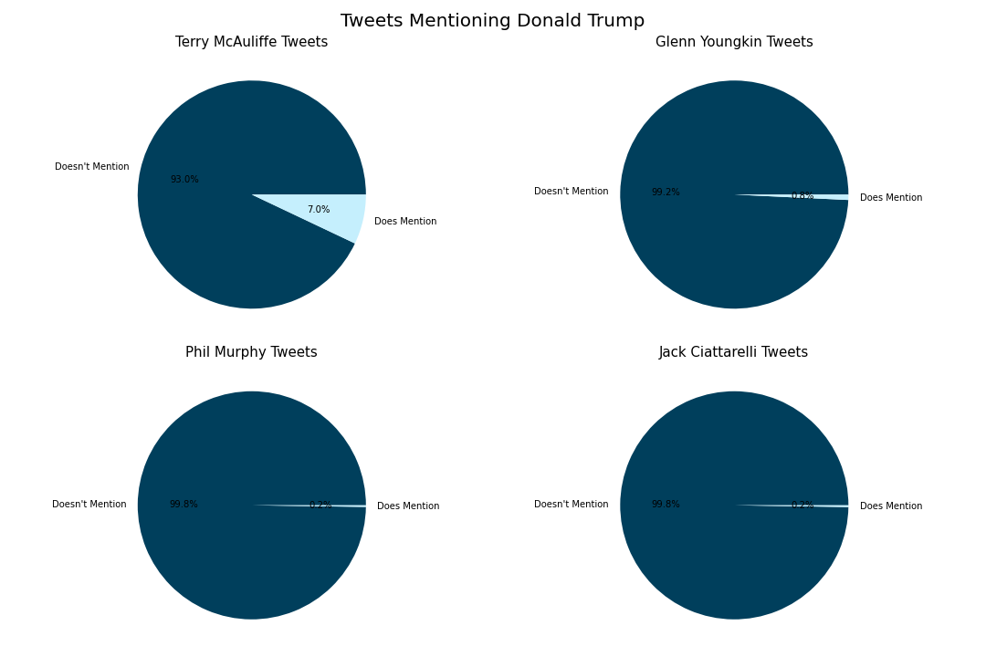
Insights from Virginia
Terry McAuliffe mentioned Trump in his messaging more than any other candidate, in particular his opponent
McAuliffe and

Slide 8
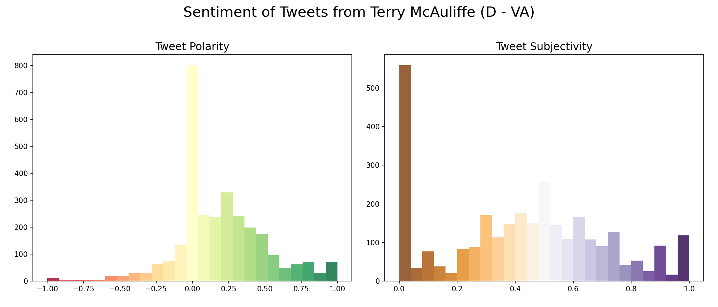
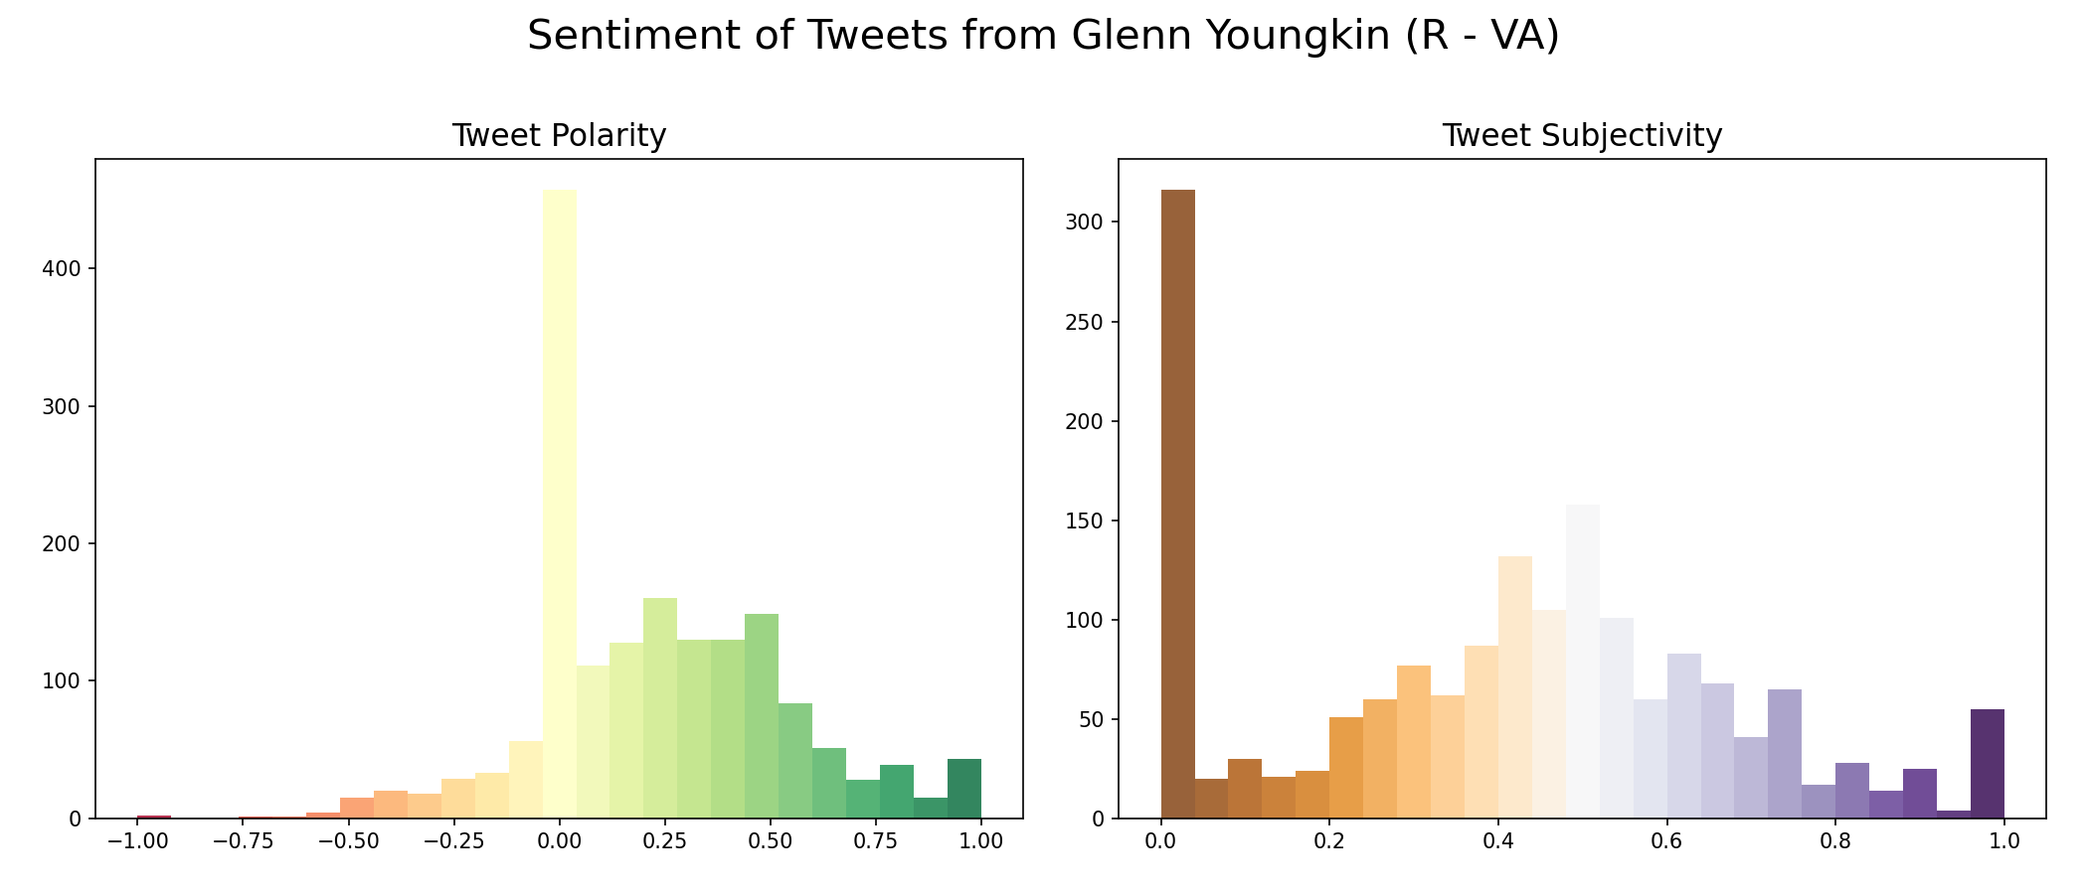
Insights from Virginia

Slide 9
Insights from New Jersey
Ciattarelli mentioned his opponent significantly more than vice versa
Both Murphy and Ciattarelli mentioned Trump/Biden a trivial amount

Slide 10
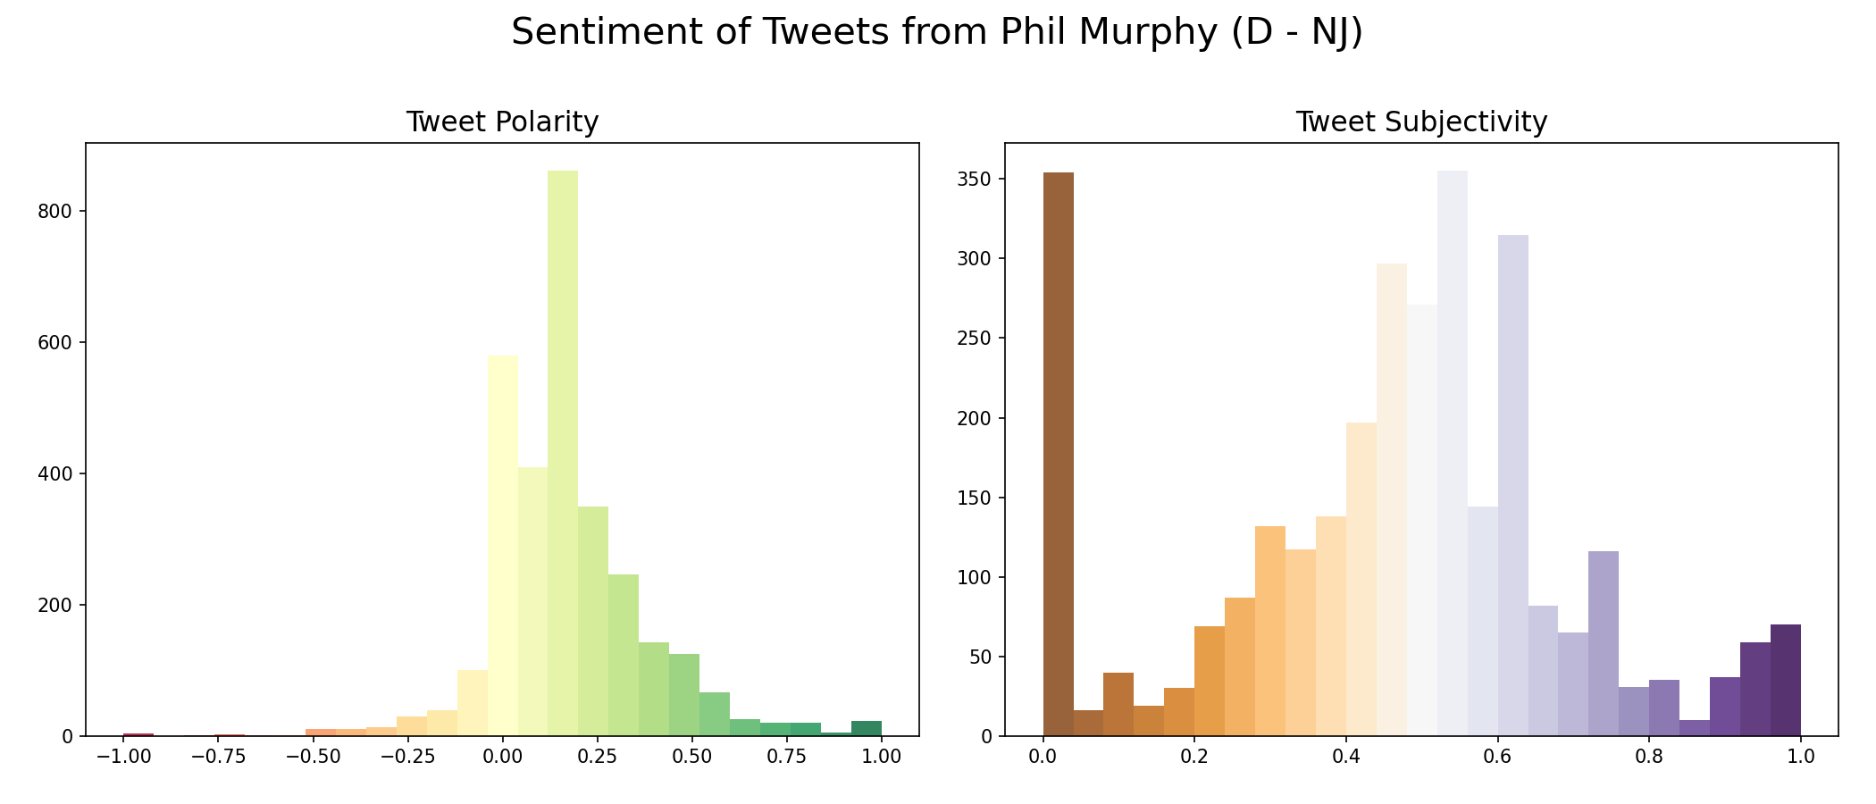
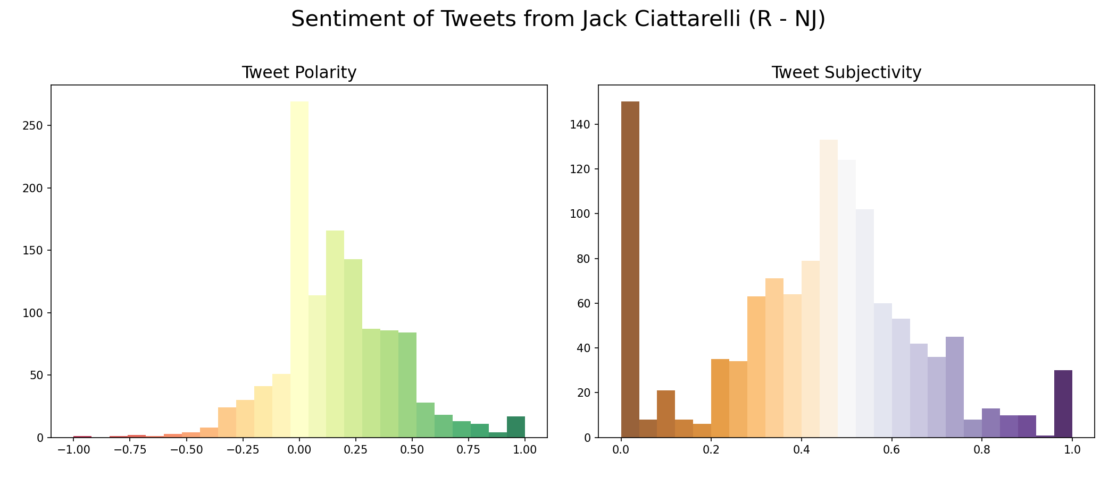
Insights from New Jersey

Slide 11
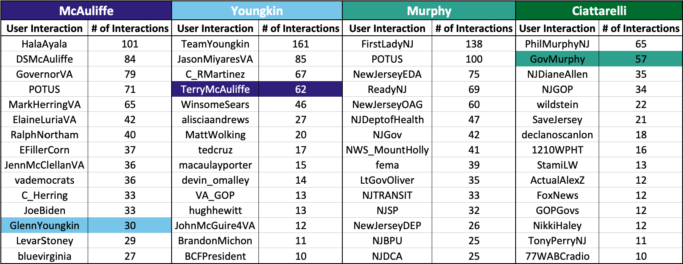
Candidate Interactions
Only Phil Murphy (D – NJ) did not have his opponent in his top 15 interactions.
There is NO overlap in the top interactions among the candidates.

Slide 12
Engagement Modeling

Slide 13
Who Benefits from this type of Analysis?
Pull Public Tweets that match specified search query
Campaigns!
Integrate workflow into overall messaging strategy
Check if modeled engagement matches real engagement
Determine prominent topics of discussion
Adjust candidate messaging strategy based on topics

Slide 14
THANKS!

Slide 15
ALTERNATIVE RESOURCES

