Slide 1
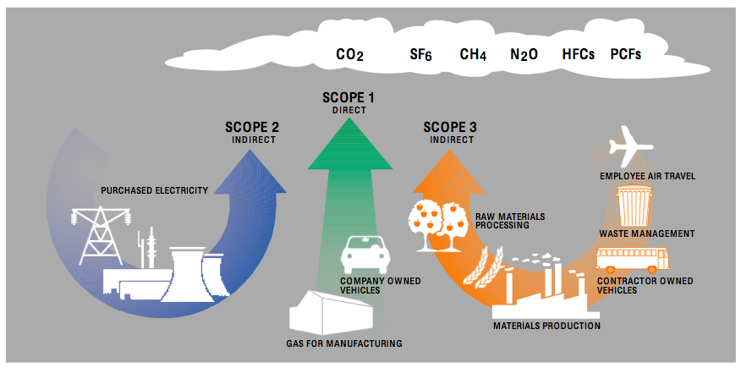
Greenhouse Gas Emissions Regression Analysis
Presented by Samuel Robbins
METIS | September 2021
Notes:
(intro) - hiya my name is sam, background in the earth sciences so I chose to perform a regression analysis on GHG emissions across various industry sectors.

Slide 2
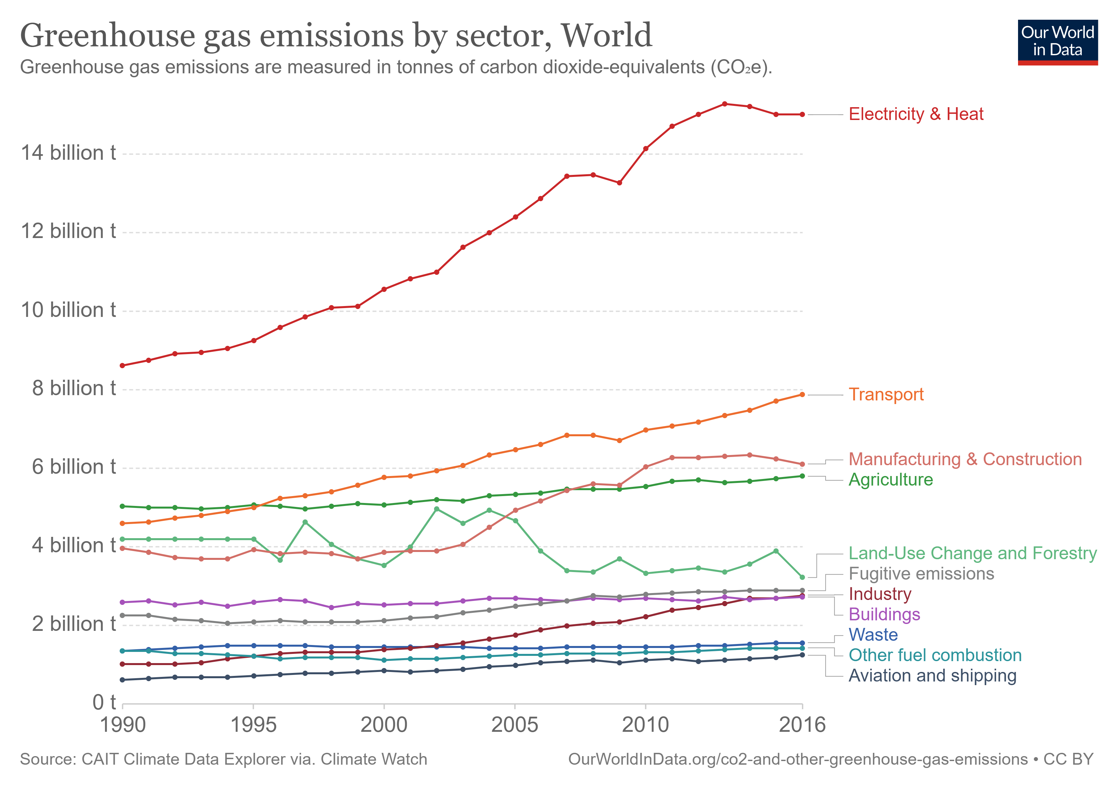
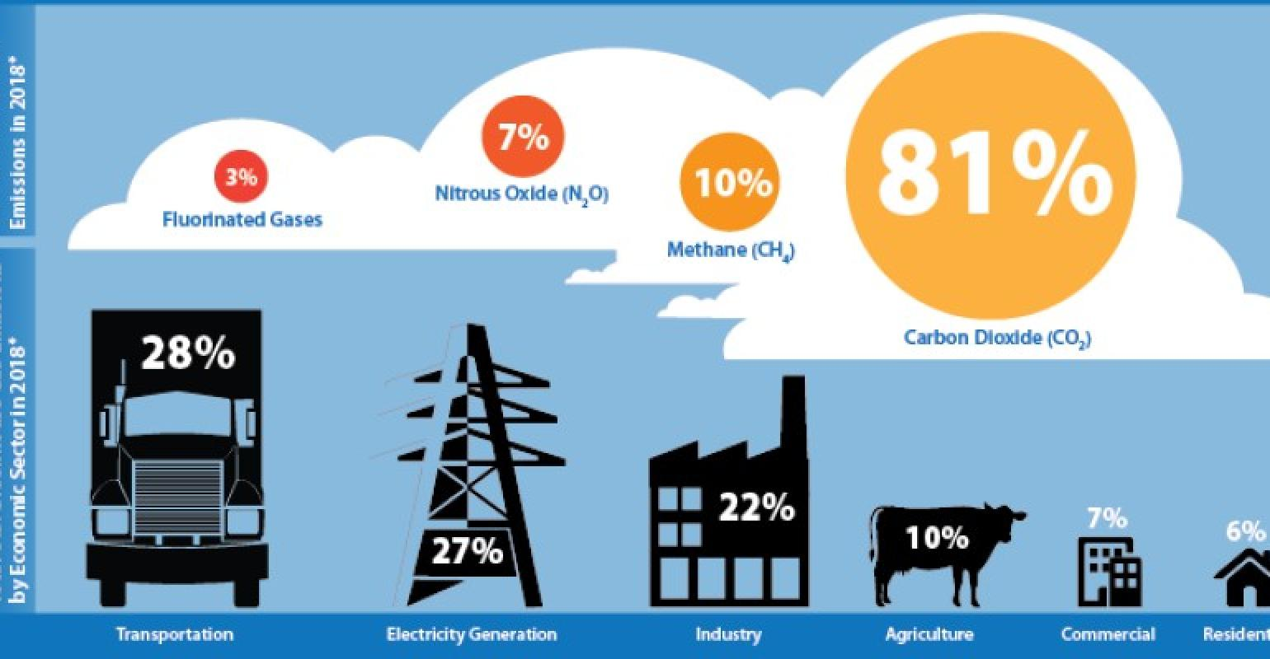
Project Premise
Greenhouse Gases (GHG) contribute significantly to ongoing climate change and are key factors when considering the magnitude of future warning
The premise behind this regression analysis is to model GHG emissions as a function of company size, industry, location, and other key features
Societal Goal: predict the largest emitters based on the given criteria to target legislative, activist, and social lobbying campaigns
Notes:
The overriding premise motivating my project is the fact that increasing – or not decreasing – GHG emissions are a significant driver of continued and worsening climate change. While technology works to develop new techniques to decrease overall emissions in the future and capture what’s already out there, the goal of this analysis is to predict which facilities are likely to be heavy emitters, based on their industry, size, location, etc. with the intention of focusing regulatory action on those emerging heavy emitters.

Slide 3
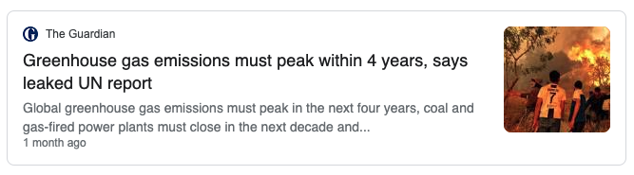
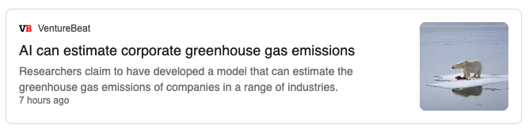
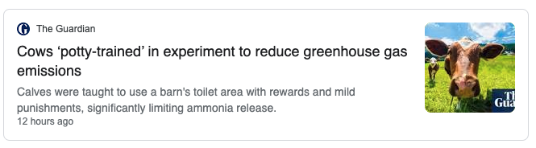
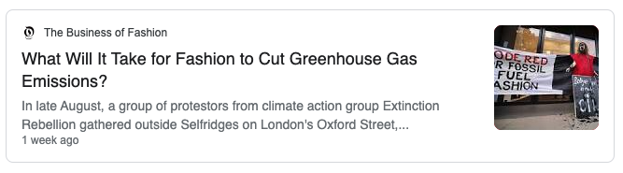
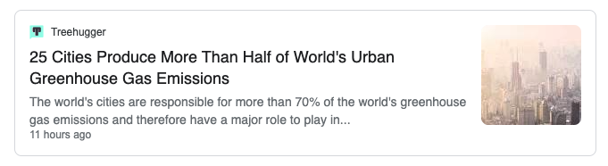
Why Model Greenhouse Gas Emissions?
Notes:
GHG’s have been in the zeitgeist lately so this is clearly a very deep drive to understand emission levels and what/who the largest contributors. This last article I didn't stumble across until I was putting this ppt together, and im not sure I’m quite to AI level yet but this will hopefully be an interesting first look.

Slide 4
Data Model

Slide 5
Final Dataset
Notes:
So this is the final dataset, with GHG_total being the target of the analysis, 3 categorical variables culled down to distinct groups from very large variety categorical feature.

Slide 6
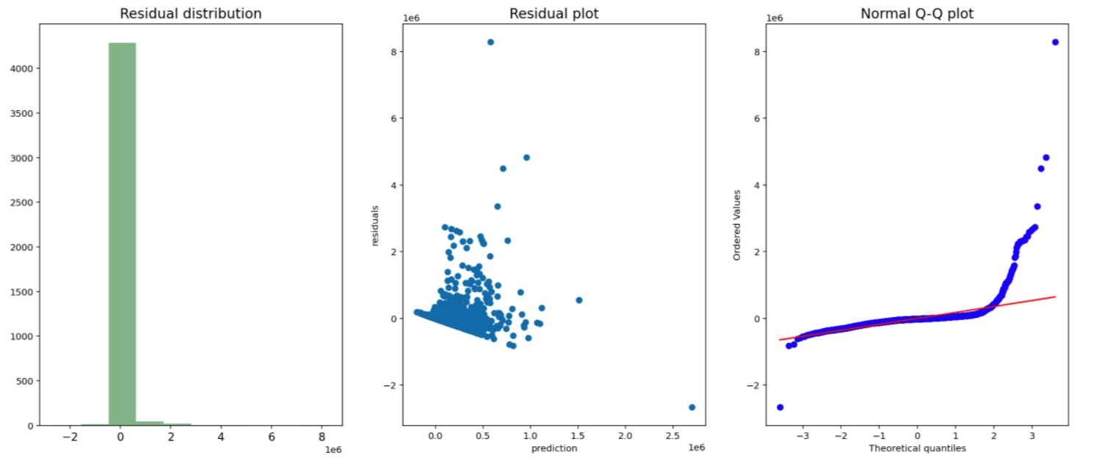
Modeling and Feature Transformations
Baseline R² = .209
Notes:
So to get into modeling, after making dummy variables I was left with about a 30 feature model, and a baseline model with an r2 of .209 and we some clearly non-normal behavior in the residuals. Also from the correlation matrix we see strong correlations between all of the company financial values so that tells us we’re going to have to drop some of those to deal with multicollinearity. Interestingly, when I ran the models with only categorical or numerical values the categorical variables actually had a better r2 value.

Slide 7
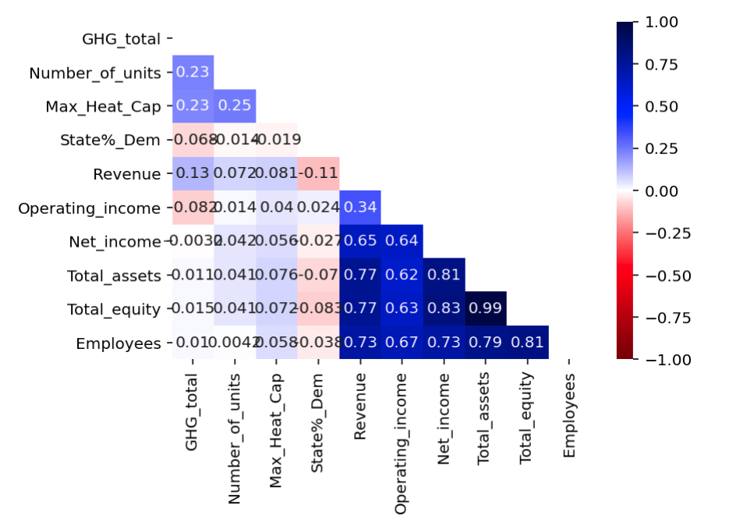
Modeling and Feature Transformations
Strong correlations within company financials
Need to deal with multicollinearity issues
Notes:
So to get into modeling, after making dummy variables I was left with about a 30 feature model, and a baseline model with an r2 of .209 and we some clearly non-normal behavior in the residuals. Also from the correlation matrix we see strong correlations between all of the company financial values so that tells us we’re going to have to drop some of those to deal with multicollinearity. Interestingly, when I ran the models with only categorical or numerical values the categorical variables actually had a better r2 value.

Slide 8
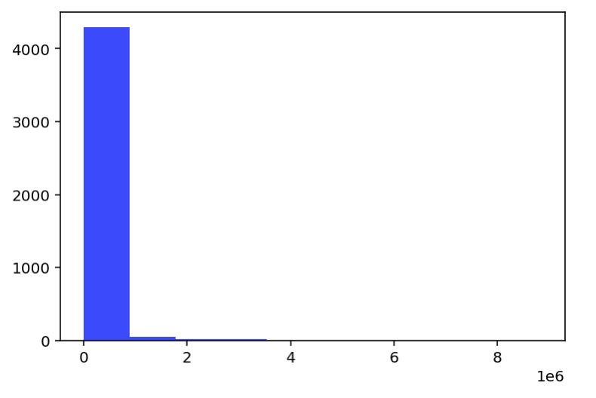
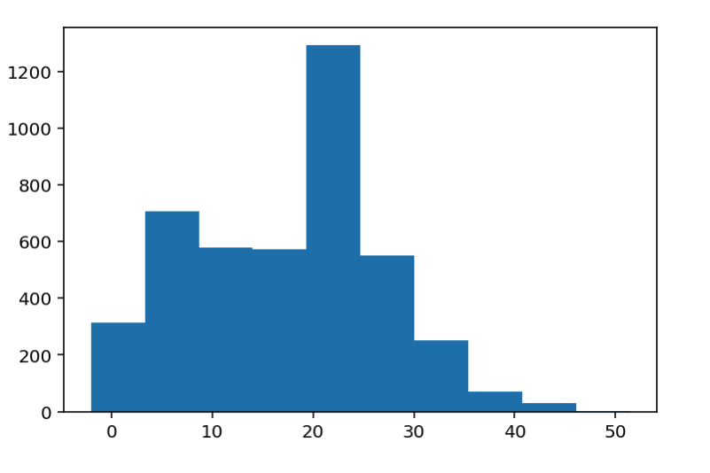
Modeling and Feature Transformations
New Target
Distribution
Original Target Distribution
Box-Cox Transformation
Notes:
So to fix some of the issues and low r2 of our baseline model, I did some transformations on both the target and features and the best for the target ended up being a box-cox transformation which clearly gives us a much better target distrubution moving forward. I also tried log and sqrt on some of the features but those largely didn’t perform as well

Slide 9
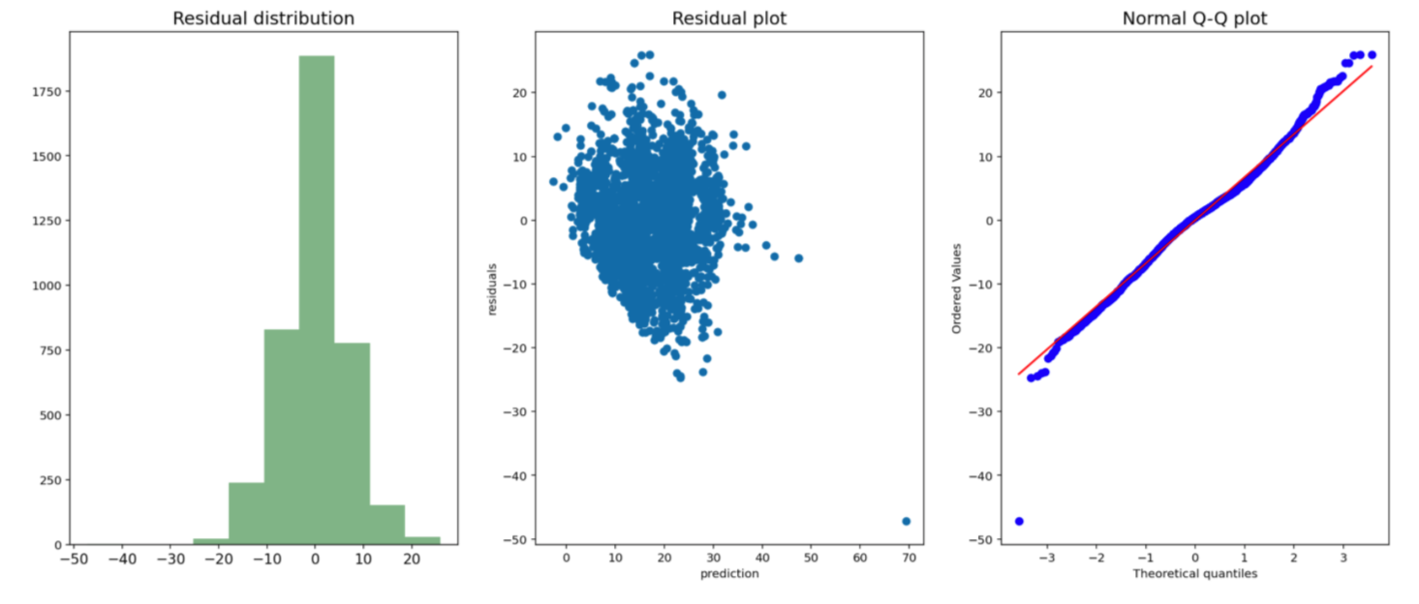
Final Model
Raised R² from baseline of 0.2099 to 0.4815 (LR) or 0.458 (RR)
Model parameters:
dropped columns for Operating Income, Total Equity, and Net Income due to their multicollinearity
Transformed y via box-cox transformation
Another good model was the log of financial with a box-cox transformation on y
Notes:
So the final model I arrived at, was transforming the target via a box-cox transformation, dropping Operating Income, Net income, and total equity, and performing a ridge regression. It dramatically improves the distribution of the residuals and the only deviation we see in the normal Q-Q plot is on the tails and a much smaller magnitude than the original model.

Slide 10
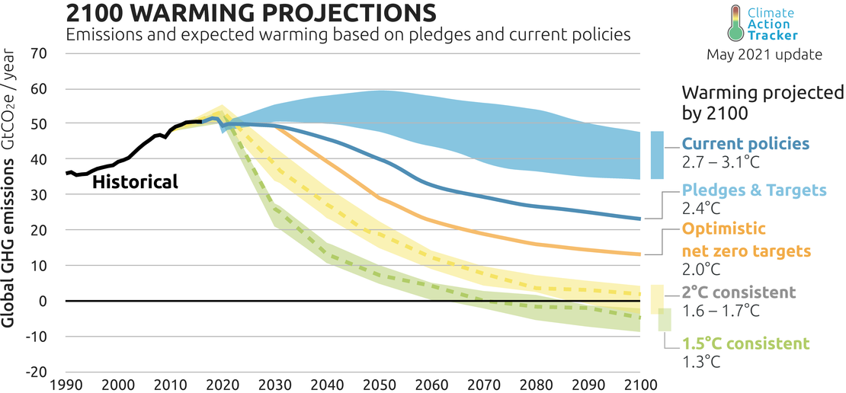
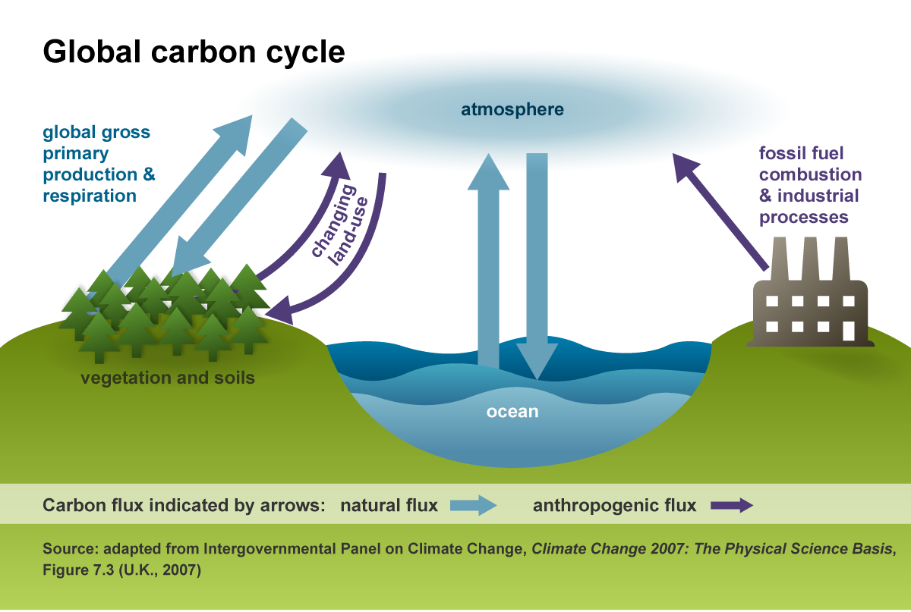
Closing Thoughts
Difficult problem to model given inherent messiness of real world data
Possible future work: narrow parent companies down to subsidiaries
EX. Berkshire Hathaway (Warren Buffets company) is a giant multinational corporation so that financial data is being trickled down to even their smallest facility
Notes:
More data sets – get subsidiaries of parent companies, more facility by facility information.

Slide 11
Appendix

Slide 12


References
https://www.epa.gov/ghgreporting/ghg-reporting-program-data-sets
Reported Parent Companies (xls)
Emissions by Unit and Fuel Type (zip)
https://en.wikipedia.org/wiki/{ExxonMobil}
Parent Company Financial Data
https://en.wikipedia.org/wiki/{2000}_United_States_presidential_election#Results
Election Results since 2000

Slide 13
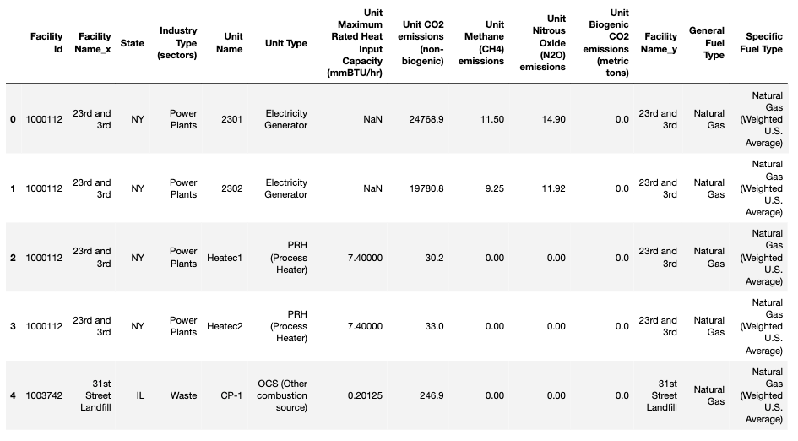
Datasets
Notes:
So moving onto the data sets I used, the first was a detailed look GHG emitters organized by facility and unit/fuel type – good for grouping of categorical variables down the line. And as this talk continues the total GHG im referring to is the sum of CO2, methane, nitrous oxide, and biogenic CO2 emitted by a unit at these facilities.

Slide 14
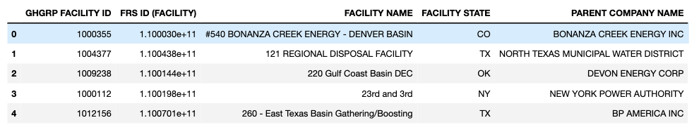
Datasets
Notes:
The next data set linked each facility to its parent company

Slide 15
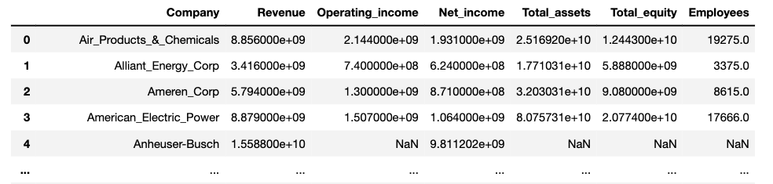
Datasets
Notes:
Which allowed me to build a web scraping pipeline to extract financial information – like revenue, operating income, assets, and number of employees – for each parent company of a GHG emitting facility. To make the dataset more manageable I limited the data to only those facilities that are owned by the top 100 parent companies – defined by the number of facilities under their control. This brought the dataset from a size of >20,000 entries to around 5,000, so still a very thorough dataset.

Slide 16
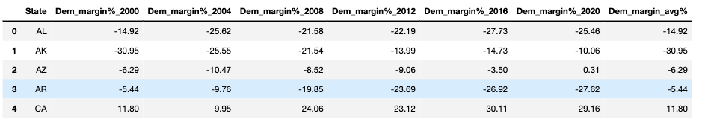
Datasets
Notes:
And the final data set I extracted, also via web scraping, was the election swing from every election since 2000. The purpose of this is to map onto the state of the facilities, with the idea being that states that swing more democratic are likely to have more restrictive emission regulations. So each state will be mapped to its average swing toward the democratic party, taking a 50 category variable and turning it into a continuous numeric value for modeling.

