Slide 1
Greenhouse Gas Emissions Regression Analysis
By Samuel Robbins

Slide 2
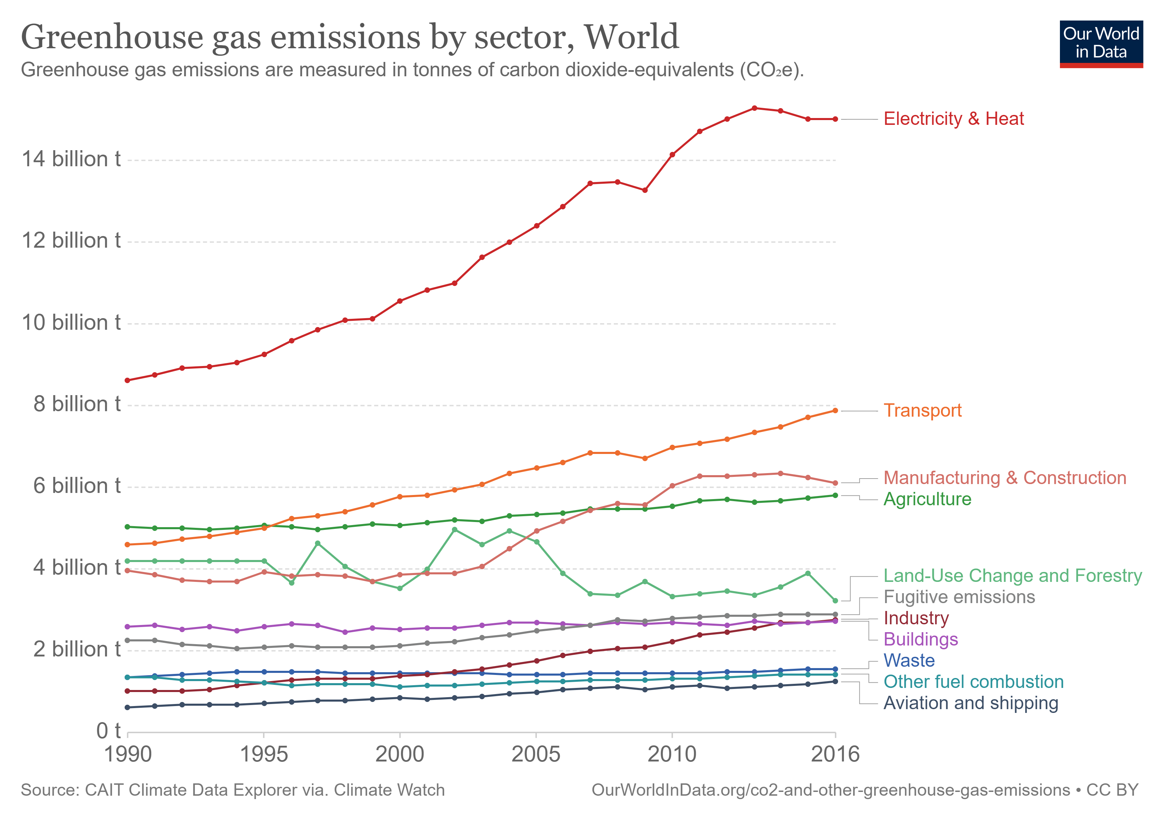
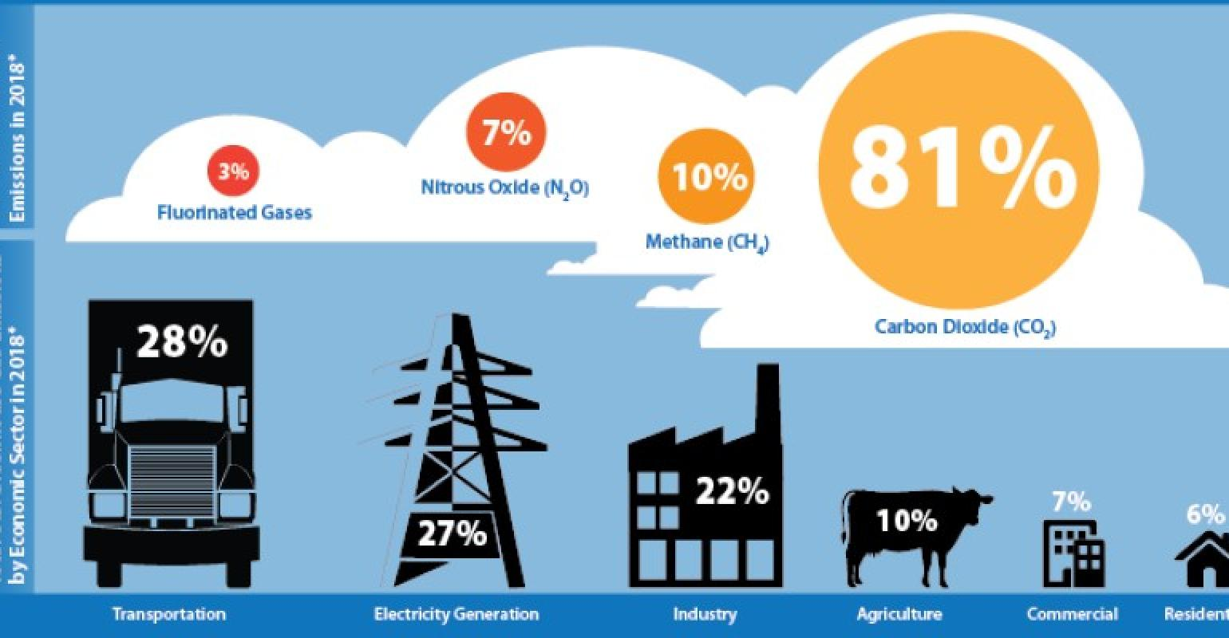
Project Premise
Greenhouse Gases (GHG) contribute significantly to ongoing climate change and are key factors when considering the magnitude of future warning
The premise behind this regression analysis is to model GHG emissions as a function of company size, industry, location, and other key features
Societal Goal: predict the largest emitters based on the given criteria to target legislative, activist, and social lobbying campaigns

Slide 3

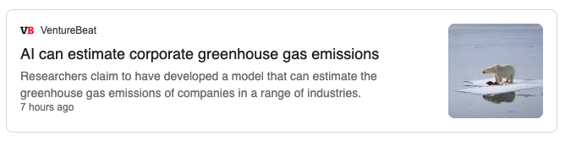



Why Model Greenhouse Gas Emissions?

Slide 4
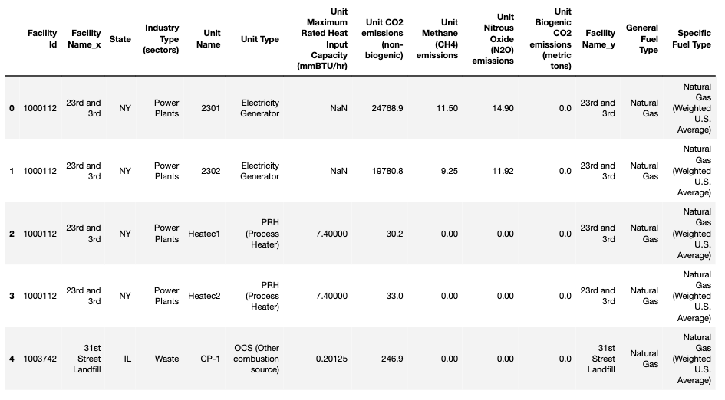
Datasets

Slide 5
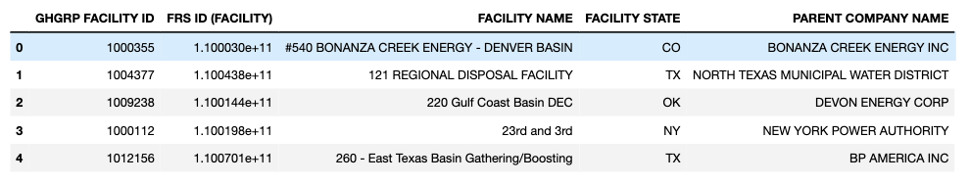
Datasets

Slide 6
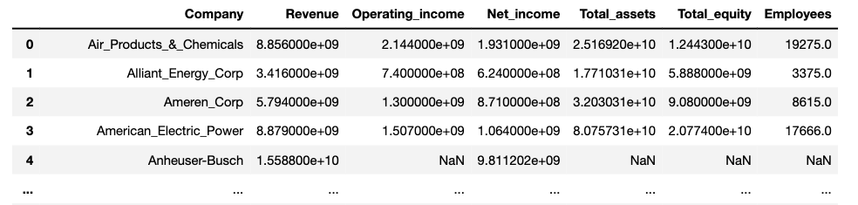
Datasets

Slide 7
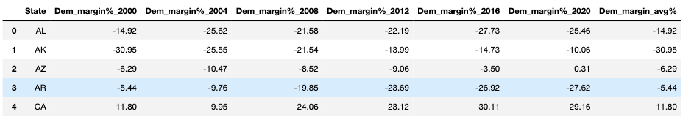
Datasets

Slide 8
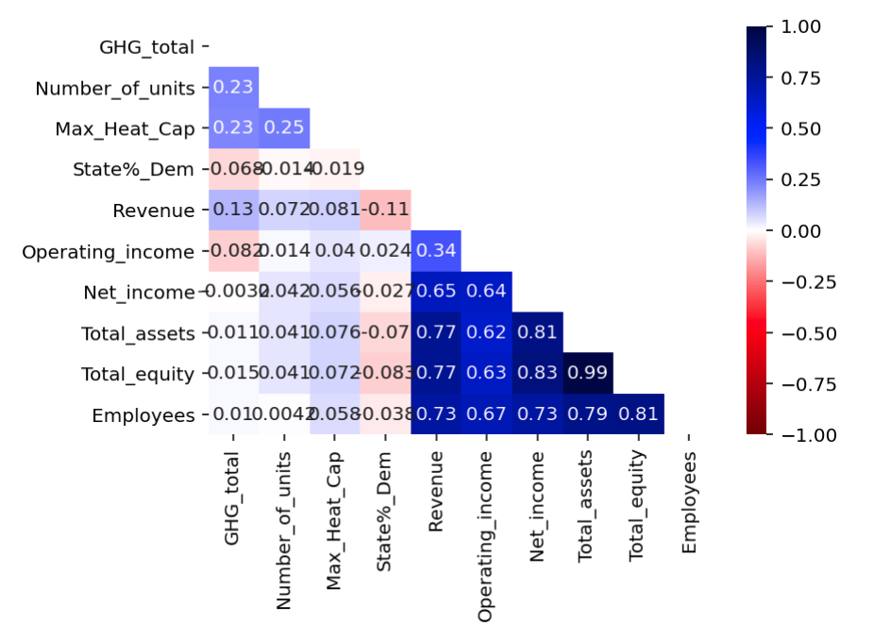
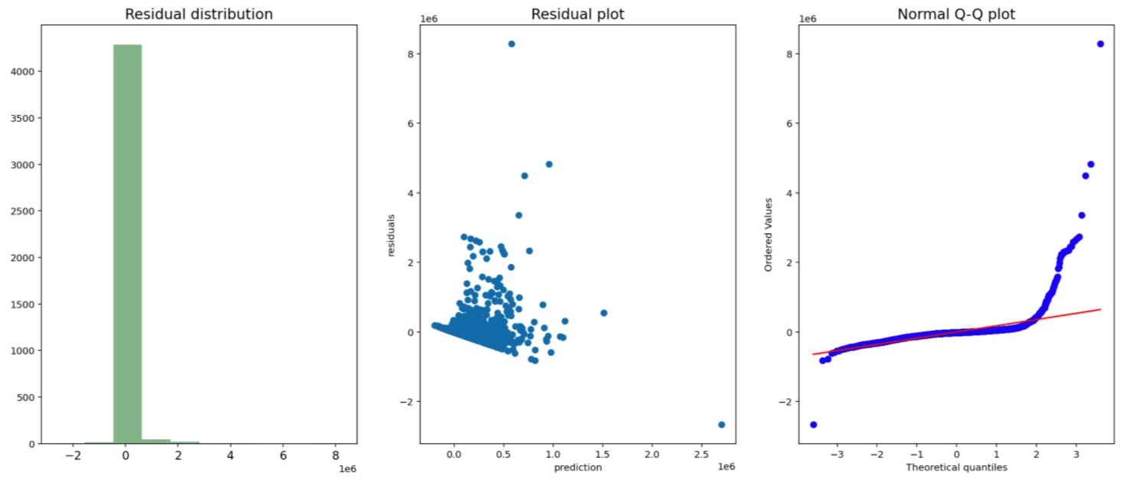
Modeling and Feature Transformations

Slide 9
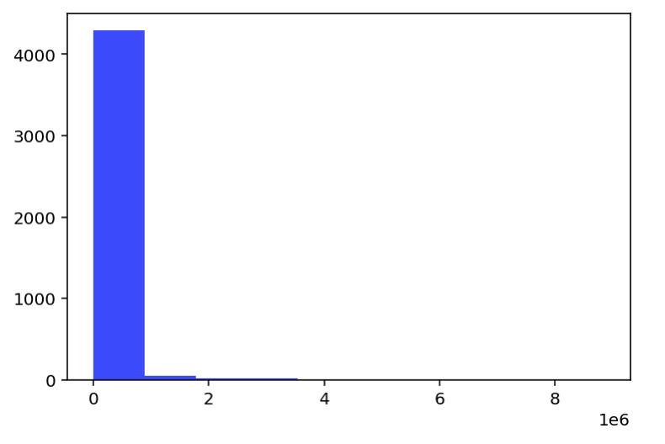
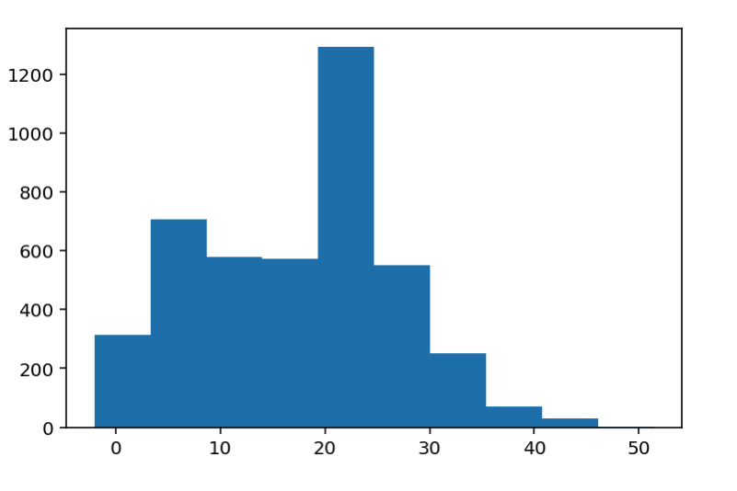
Modeling and Feature Transformations
New Target
Distribution
Original Target Distribution
Box-Cox Transformation

Slide 10
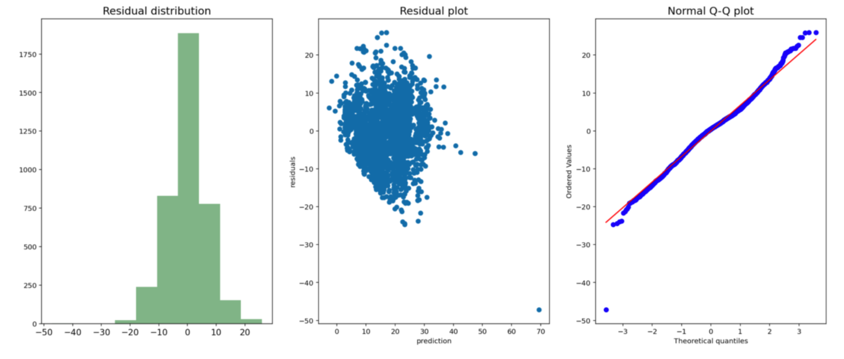
Final Model
Raised R2 from baseline of 0.2099 to 0.4815
Model parameters:
dropped columns for Operating Income, Total Equity, and Net Income due to their multicollinearity
Transformed y via box-cox transformation
Another good model was the log of financial with a box-cox transformation on y

Slide 11
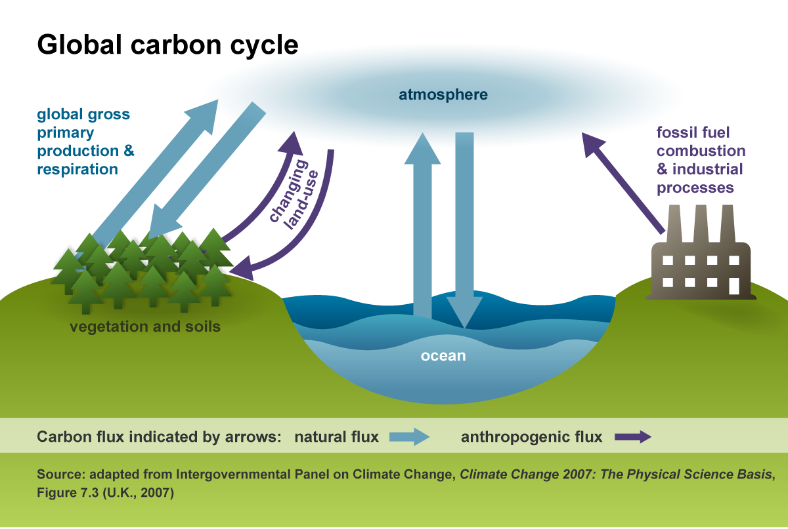
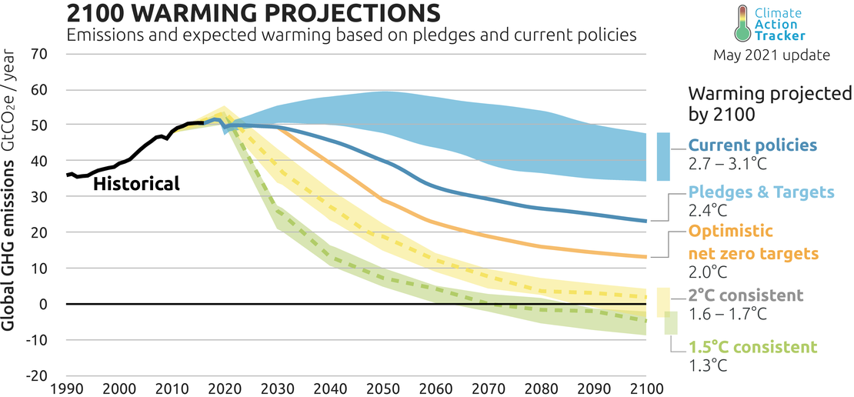
Closing Thoughts
Very difficult problem to model
Possible future work: narrow parent companies down to subsidiaries
EX. Berkshire Hathaway (Warren Buffets company) is a giant multinational corporation so that financial data is being trickled down to even their smallest facility

Slide 12


References
https://www.epa.gov/ghgreporting/ghg-reporting-program-data-sets
Reported Parent Companies (xls)
Emissions by Unit and Fuel Type (zip)
https://en.wikipedia.org/wiki/{ExxonMobil}
Parent Company Financial Data
https://en.wikipedia.org/wiki/{2000}_United_States_presidential_election#Results
Election Results since 2000

Slide 13
Appendix

