Slide 1
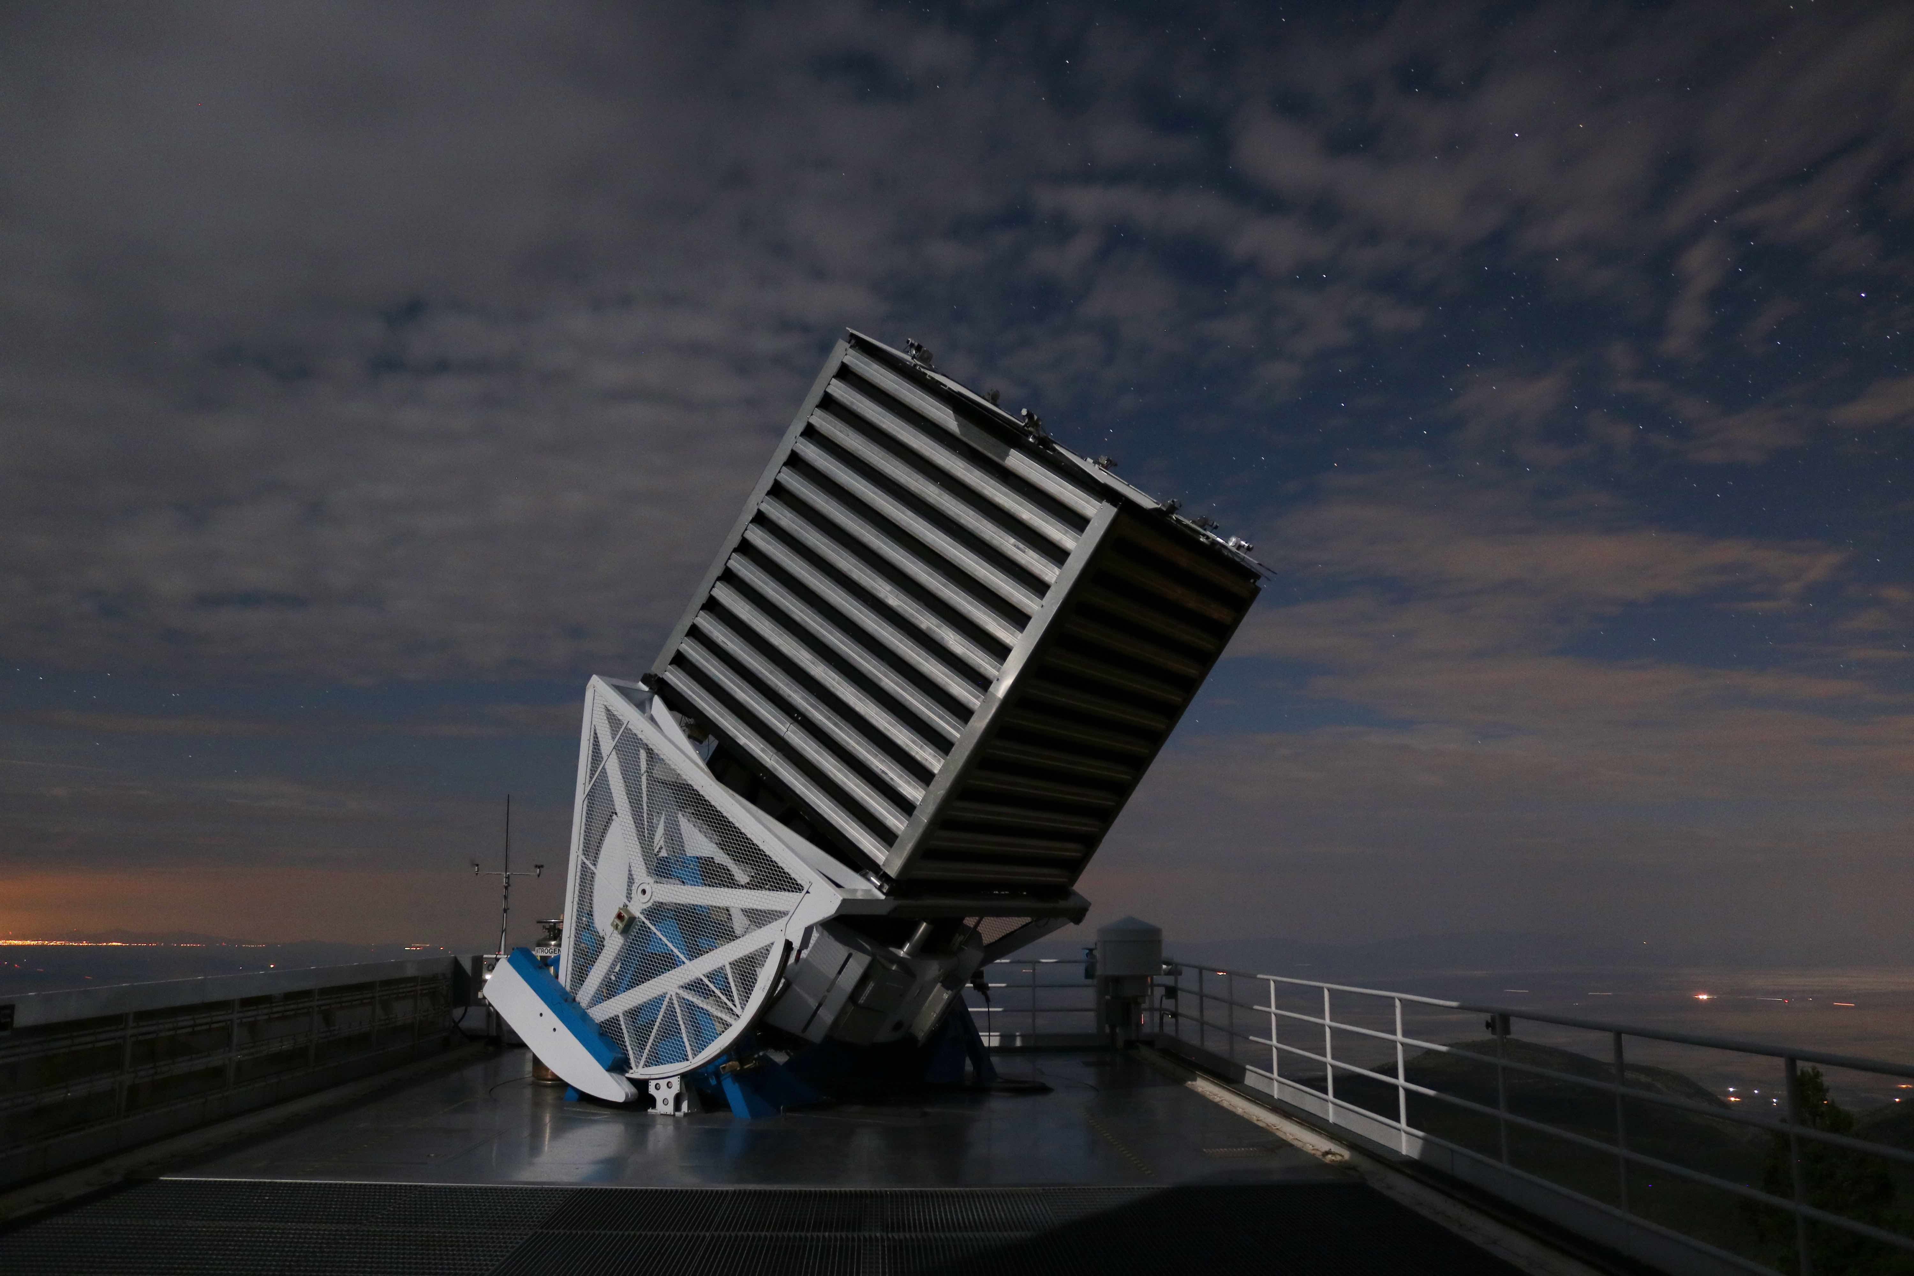

SDSS Classification: Predicting the Nature of Celestial Bodies
Samuel Robbins

Slide 2
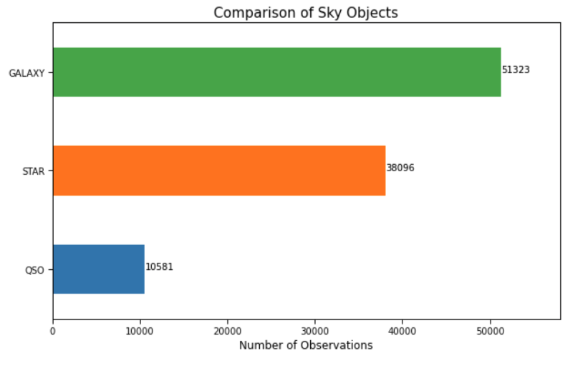
Project Objective
Multi-class problem using spectral and imaging data from the Sloan Digital Sky Survey
Predict the nature of celestial objects
Evaluation metric = classification rate (accuracy)

Slide 3
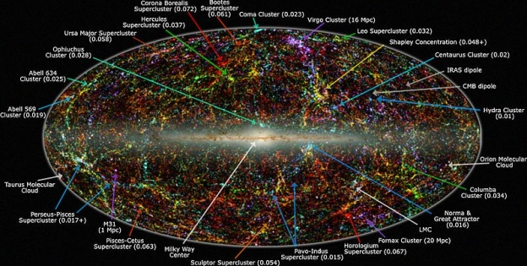
Data - SDSS Survey
FEATURES
Objid
ra
dec
u-band
g-band
r-band
i-band
z-band
run
rerun
camcol
field
specobjid
class
redshift
plate
mjd
fiberid
Sloan Digital Sky Survey – Data release 16
“The Sloan Digital Sky Survey has created the most detailed three-dimensional maps of the Universe ever made, with deep multi-color images of one third of the sky, and spectra for more than three million astronomical objects.”

Slide 4
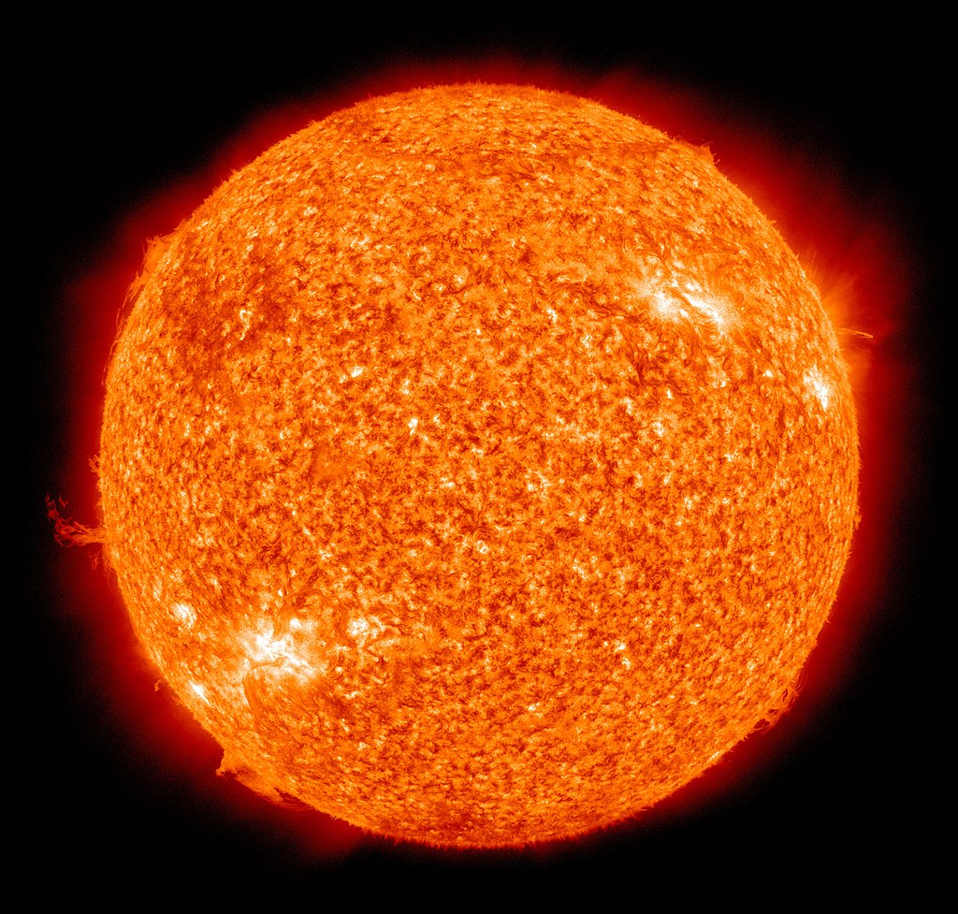
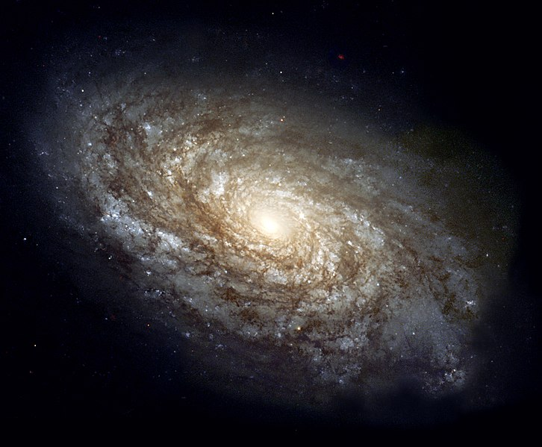
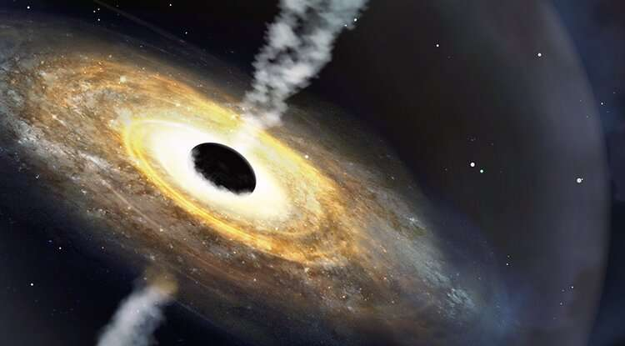
Data
FEATURES
Objid
ra
dec
u-band
g-band
r-band
i-band
z-band
run
rerun
camcol
field
specobjid
class
redshift
plate
mjd
fiberid
Classification Target – Class
Galaxy
Star
Quasar Object

Slide 5
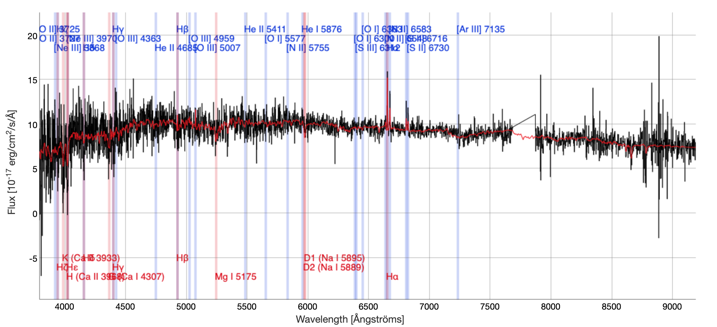
Data
FEATURES
Objid
ra
dec
u-band
g-band
r-band
i-band
z-band
run
rerun
camcol
field
specobjid
class
redshift
plate
mjd
fiberid
Classification Features
Image/Identification Data
Ex. run, rerun, and camcol describe a field within an image
NOT used in classification model

Slide 6
Data
FEATURES
Objid
ra
dec
u-band
g-band
r-band
i-band
z-band
run
rerun
camcol
field
specobjid
class
redshift
plate
mjd
fiberid
Classification Features
Image/Identification Data
Ex. run, rerun, and camcol describe a field within an image
NOT used in classification model
Spectral Data
Object specific data

Slide 7
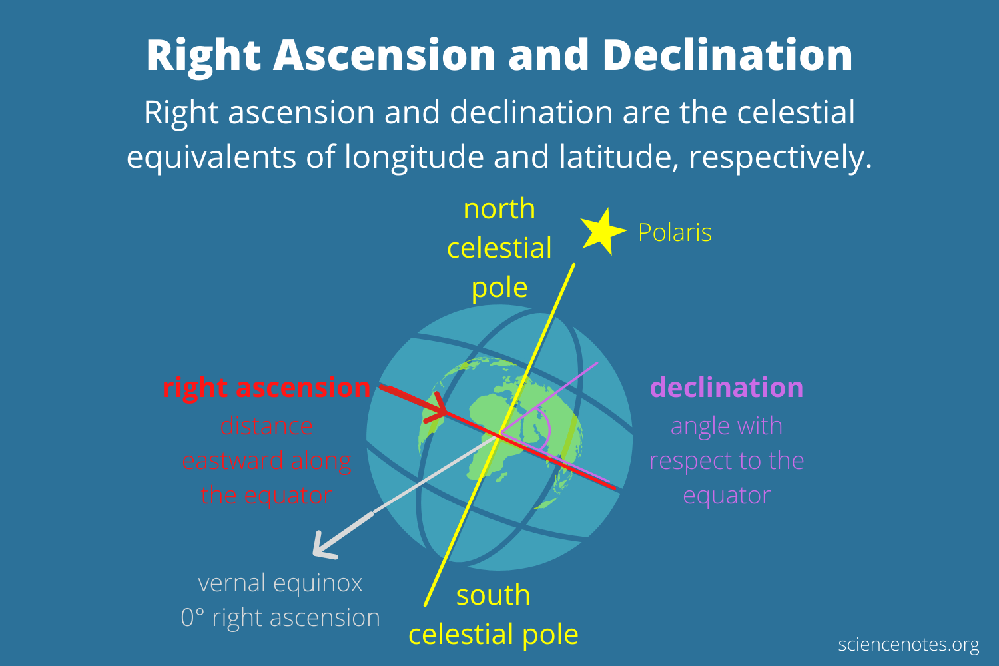
Data
FEATURES
Objid
ra
dec
u-band
g-band
r-band
i-band
z-band
run
rerun
camcol
field
specobjid
class
redshift
plate
mjd
fiberid
Classification Features
Image/Identification Data
Ex. run, rerun, and camcol describe a field within an image
NOT used in classification model
Spectral Data
Object specific data
Right ascension/declination

Slide 8
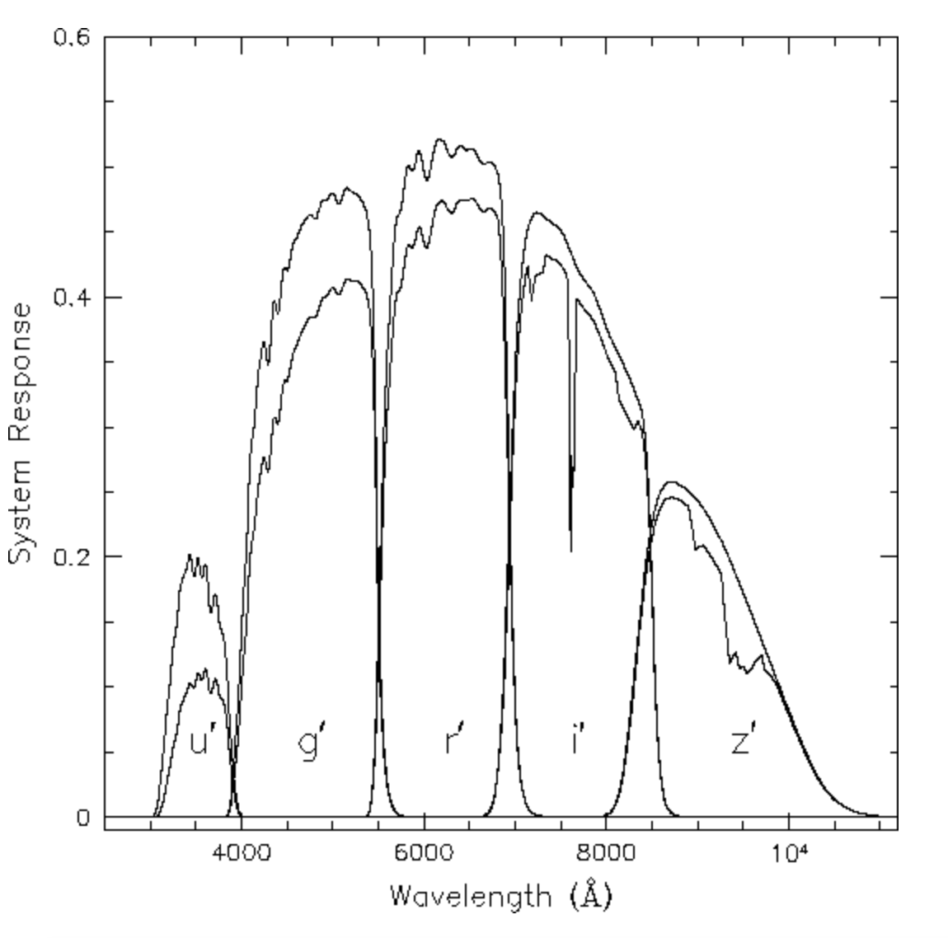
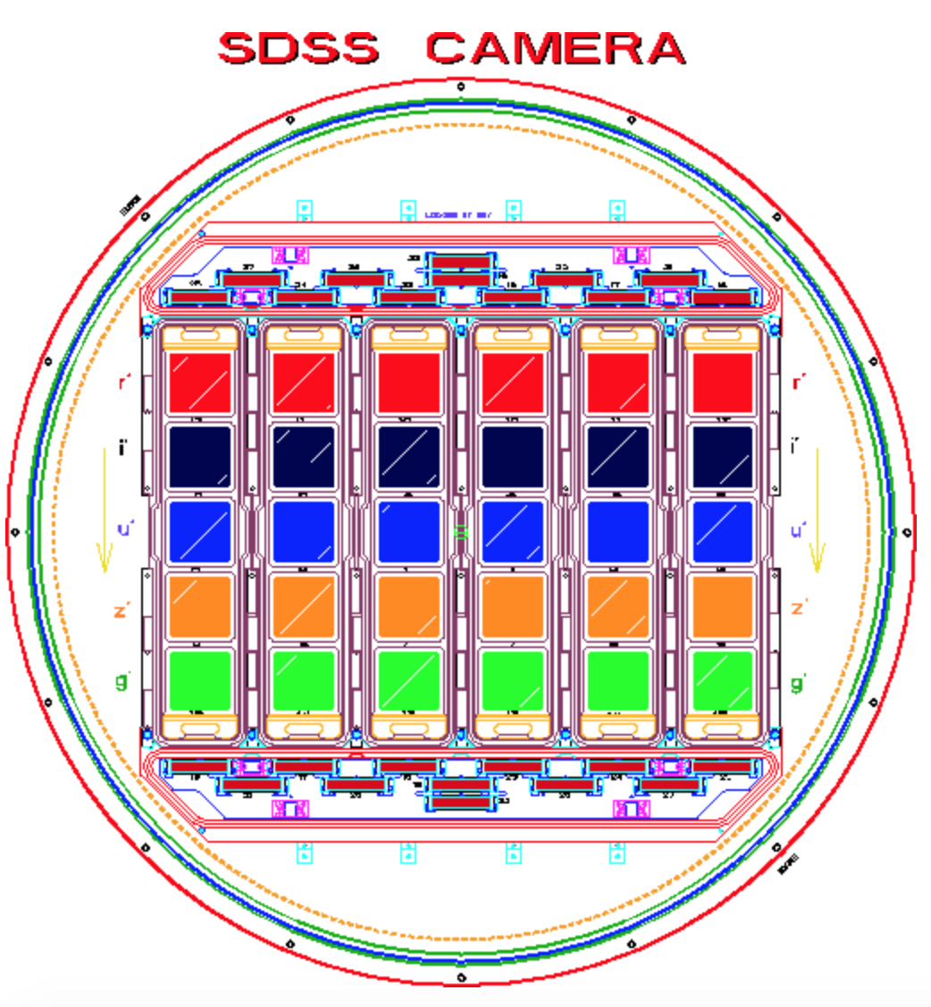
Data
FEATURES
Objid
ra
dec
u-band
g-band
r-band
i-band
z-band
run
rerun
camcol
field
specobjid
class
redshift
plate
mjd
fiberid
Classification Features
Image/Identification Data
Ex. run, rerun, and camcol describe a field within an image
NOT used in classification model
Spectral Data
Object specific data
Right ascension/declination
5-color photometric color system

Slide 9
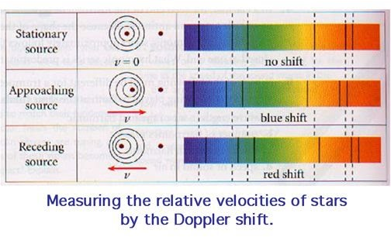
Data
FEATURES
Objid
ra
dec
u-band
g-band
r-band
i-band
z-band
run
rerun
camcol
field
specobjid
class
redshift
plate
mjd
fiberid
Classification Features
Image/Identification Data
Ex. run, rerun, and camcol describe a field within an image
NOT used in classification model
Spectral Data
Object specific data
Right ascension/declination
5-color photometric color system
Redshift

Slide 10
Data
FEATURES
Objid
ra
dec
u-band
g-band
r-band
i-band
z-band
run
rerun
camcol
field
specobjid
class
redshift
plate
mjd
fiberid
Classification Features
Image/Identification Data
Ex. run, rerun, and camcol describe a field within an image
NOT used in classification model
Spectral Data
Object specific data
5-color photometric color system
Redshift
Used in classification model
Classification Target – Class
Galaxy
Star
Quasar Object

Slide 11
Data
FEATURES
Objid
ra
dec
u-band
g-band
r-band
i-band
z-band
run
rerun
camcol
field
specobjid
class
redshift
plate
mjd
fiberid
Classification Features
Image/Identification Data
Ex. run, rerun, and camcol describe a field within an image
NOT used in classification model
Spectral Data
Object specific data
5-color photometric color system
Redshift
Used in classification model
Classification Target – Class
Galaxy
Star
Quasar Object

Slide 12
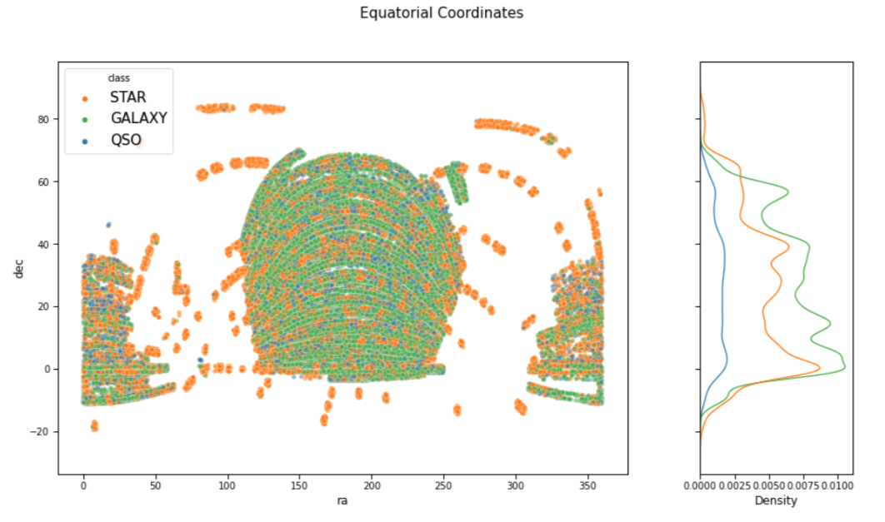
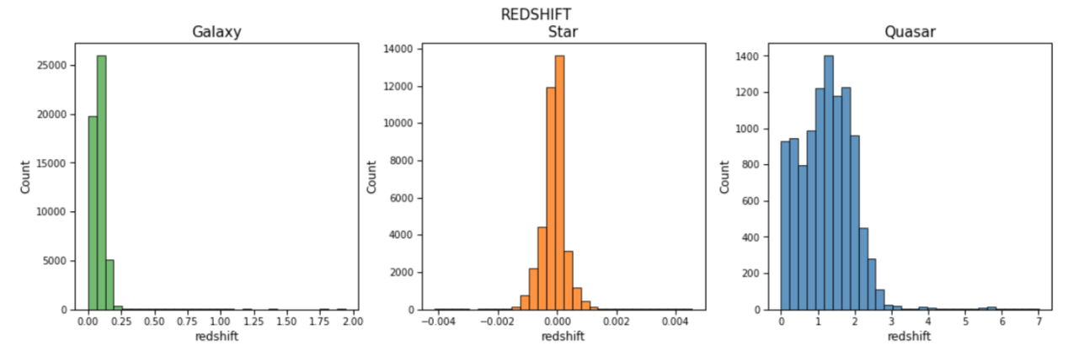
Exploratory Analysis
Is position in the sky a distinct feature for the three class types?
Redshift is the most characteristic feature for the different classes.

Slide 13
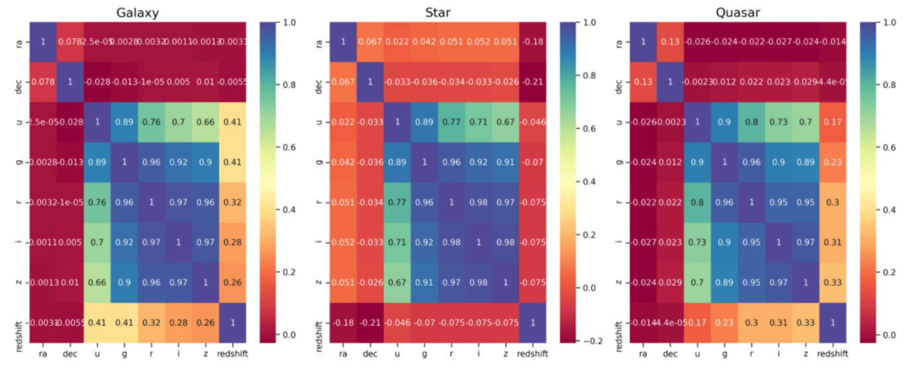
Exploratory Analysis
Photometric color band data is the most correlated within the dataset.

Slide 14
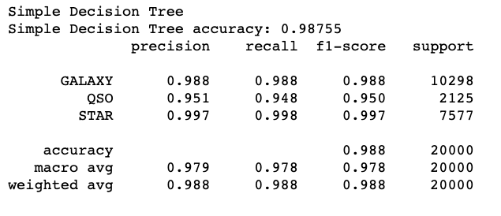
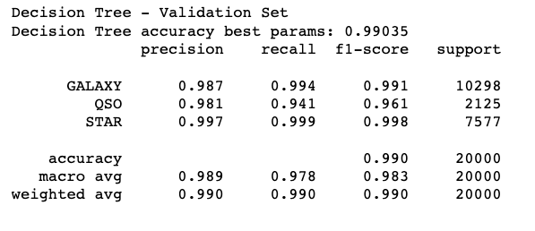
Algorithms and Final Model
Logistic Regression
K-Nearest Neighbors
Decision Trees – best model
Random Forests
Computationally expensive to tune hyperparameters
Naïve Bayes

Slide 15
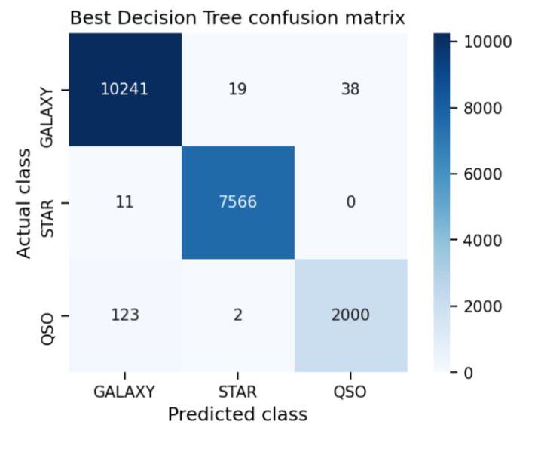
Algorithms and Final Model
Logistic Regression
K-Nearest Neighbors
Decision Trees – best model
Random Forests
Computationally expensive to tune hyperparameters
Naïve Bayes

Slide 16
Appendix

Slide 17
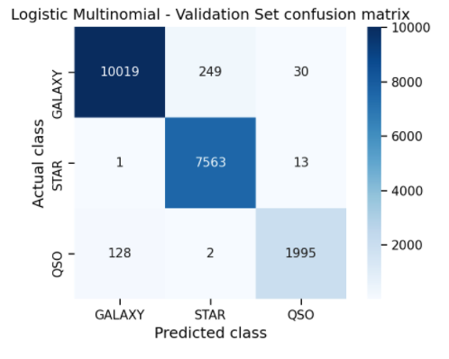
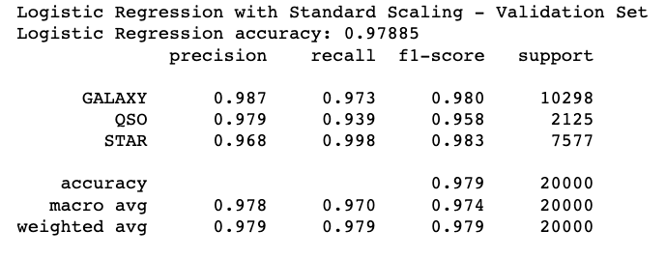
Logistic Regression

Slide 18
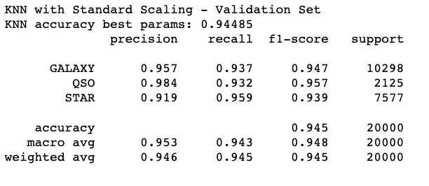
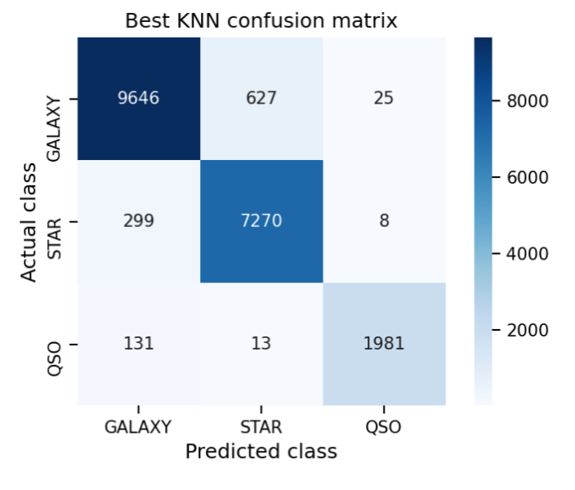
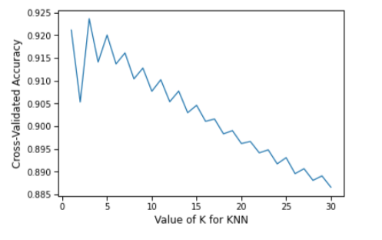
K-Nearest Neighbor

Slide 19
Decision Tree

Slide 20
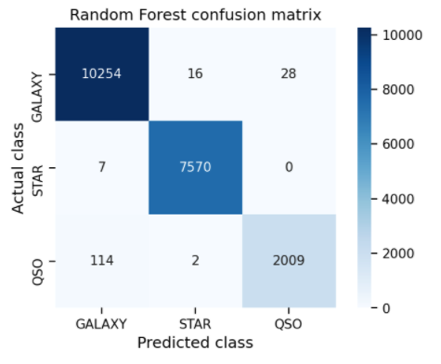
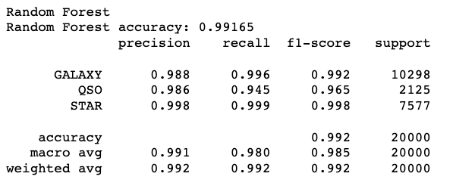
Random Forests

Slide 21
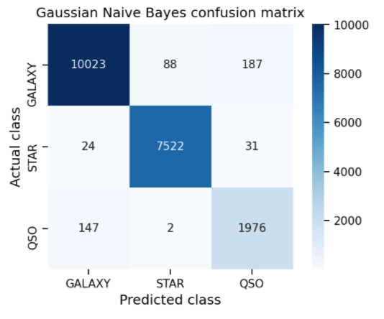
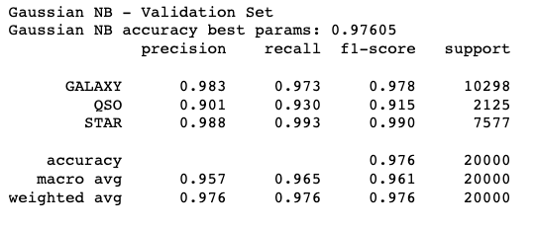
Naïve Bayes

