Slide 1

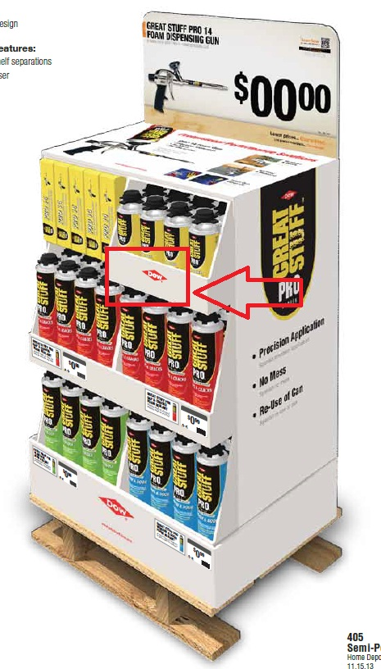
Great Stuff Pro Buy 3 Gun Free Combo Qp
Finance
Total Event Buy (Units #) | 112,800
Total Event Buy (Dollars $) | $1,476,839
Projected Sell Through (%) | 100%
Core (Y or N) | N
Non-Core Exit Strategy: (Markdown, Future Event, MAP, Etc.) | Return to Run
Interconnected
Will this be available online during Event (Y/N) | N
Is this BOPIS eligible during Event (Y/N) | N
IPR
General Information
Min # of stores
Does Item have Switch outs (Y/N) | N
EDLP, NLP, Special Buy | Special Buy
Ad Retail ($) | $17.48
Cost ($)
Is this a Special Cost (Y/N) | N
Replenish Item (Y or N) | N
Import/Domestic | Domestic
Display Configuration / Merchandise in Store (Pallet/QP/Case Stack Out , Etc.) | Quarter Pallet - Multi SKU
Units on Each: (Pallet/QP/Case Stack Out , Etc.) | 42
Department | 22 - Building Materials
Merchant | Arianna Jackson
SKU # | TBD - Great Stuff Half Pallet Rollup
Event Name | Q4 2016 Pro Black Friday
Advantage Home Depot
 | A | B | C | D | E | F
Load In | 42 | 42 | 42 | 42 | 42 | 42
Pres Min | 0 | 0 | 0 | 0 | 0 | 0
02/13/2016 07:28:26, Request ID 22314

Slide 2
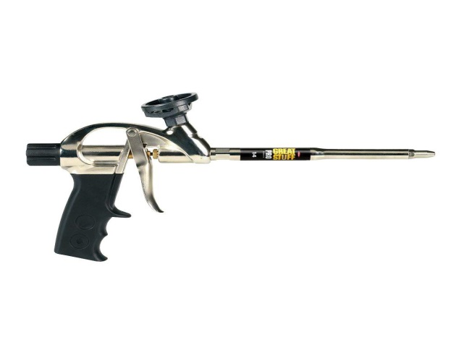
Great Stuff Pro Buy 3 Gun Free Combo Qp
Finance
Total Event Buy (Units #) | 12,000
Total Event Buy (Dollars $) | $461,529
Projected Sell Through (%) | 100%
Core (Y or N) | N
Non-Core Exit Strategy: (Markdown, Future Event, MAP, Etc.) | Return to Run
Interconnected
Will this be available online during Event (Y/N) | N
Is this BOPIS eligible during Event (Y/N) | N
IPR
General Information
Min # of stores
Does Item have Switch outs (Y/N) | N
EDLP, NLP, Special Buy | Special Buy
Ad Retail ($) | $6.98
Cost ($) | $40.8339
Is this a Special Cost (Y/N) | N
Replenish Item (Y or N) | N
Import/Domestic | Domestic
Display Configuration / Merchandise in Store (Pallet/QP/Case Stack Out , Etc.) | Quarter Pallet - Multi SKU
Units on Each: (Pallet/QP/Case Stack Out , Etc.) | 6
Department | 22 - Building Materials
Merchant | Arianna Jackson
SKU # | 569-349 - Great Stuff Pro 14 Dispensing Gun
Event Name | Q4 2016 Pro Black Friday
Advantage Home Depot | • -X6 Great Stuff PRO allows for a bead flow control from 1/8" to 3" (0.3 cm to 8 cm) - Great Stuff Pro can be started and stopped allowing maximum foam use and minimal waste.
 | A | B | C | D | E | F
Load In | 12 | 12 | 12 | 12 | 12 | 12
Pres Min | 5 | 5 | 5 | 5 | 5 | 5
02/13/2016 07:29:45, Request ID 22314

Slide 3

Great Stuff Pro Buy 3 Gun Free Combo Qp
Finance
Total Event Buy (Units #) | 64,000
Total Event Buy (Dollars $) | $442,000
Projected Sell Through (%) | 100%
Core (Y or N) | N
Non-Core Exit Strategy: (Markdown, Future Event, MAP, Etc.) | Return to Run
Interconnected
Will this be available online during Event (Y/N) | N
Is this BOPIS eligible during Event (Y/N) | N
IPR
General Information
Min # of stores
Does Item have Switch outs (Y/N) | N
EDLP, NLP, Special Buy | Special Buy
Ad Retail ($) | $10.98
Cost ($) | $7.2570
Is this a Special Cost (Y/N) | N
Replenish Item (Y or N) | N
Import/Domestic | Domestic
Display Configuration / Merchandise in Store (Pallet/QP/Case Stack Out , Etc.) | Quarter Pallet - Multi SKU
Units on Each: (Pallet/QP/Case Stack Out , Etc.) | 12
Department | 22 - Building Materials
Merchant | Arianna Jackson
SKU # | 532-953 - Great Stuff Pro Gaps & Cracks 24oz
Event Name | Q4 2016 Pro Black Friday
Advantage Home Depot | • -X6 Great Stuff PRO allows for a bead flow control from 1/8" to 3" (0.3 cm to 8 cm) - Great Stuff Pro can be started and stopped allowing maximum foam use and minimal waste.
 | A | B | C | D | E | F
Load In | 96 | 96 | 96 | 96 | 96 | 96
Pres Min | 24 | 24 | 24 | 24 | 24 | 24
02/09/2016 11:55:25, Request ID 22314

Slide 4
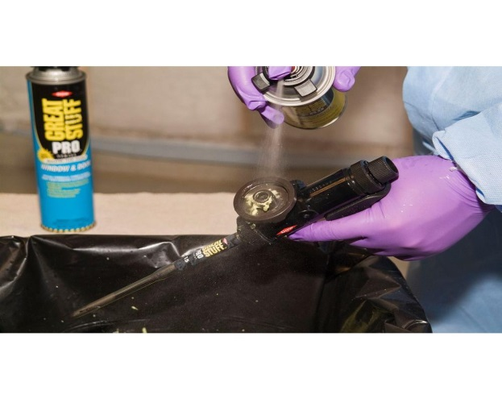
Great Stuff Pro Buy 3 Gun Free Combo Qp
Finance
Total Event Buy (Units #) | 2,300
Total Event Buy (Dollars $) | $160,000
Projected Sell Through (%) | 100%
Core (Y or N) | N
Non-Core Exit Strategy: (Markdown, Future Event, MAP, Etc.) | Return to Run
Interconnected
Will this be available online during Event (Y/N) | N
Is this BOPIS eligible during Event (Y/N) | N
IPR
General Information
Min # of stores
Does Item have Switch outs (Y/N) | N
EDLP, NLP, Special Buy | Special Buy
Ad Retail ($) | $39.98
Cost ($) | $5.9207
Is this a Special Cost (Y/N) | N
Replenish Item (Y or N) | N
Import/Domestic | Domestic
Display Configuration / Merchandise in Store (Pallet/QP/Case Stack Out , Etc.) | Quarter Pallet - Multi SKU
Units on Each: (Pallet/QP/Case Stack Out , Etc.) | 12
Department | 22 - Building Materials
Merchant | Arianna Jackson
SKU # | 105-798 - Great Stuff Pro Tool Cleaner 12oz
Event Name | Q4 2016 Pro Black Friday
Advantage Home Depot | • -X6 Great Stuff PRO allows for a bead flow control from 1/8" to 3" (0.3 cm to 8 cm) - Great Stuff Pro can be started and stopped allowing maximum foam use and minimal waste.
 | A | B | C | D | E | F
Load In | 48 | 48 | 48 | 48 | 48 | 48
Pres Min | 12 | 12 | 12 | 12 | 12 | 12
02/09/2016 11:55:25, Request ID 22314

Slide 5
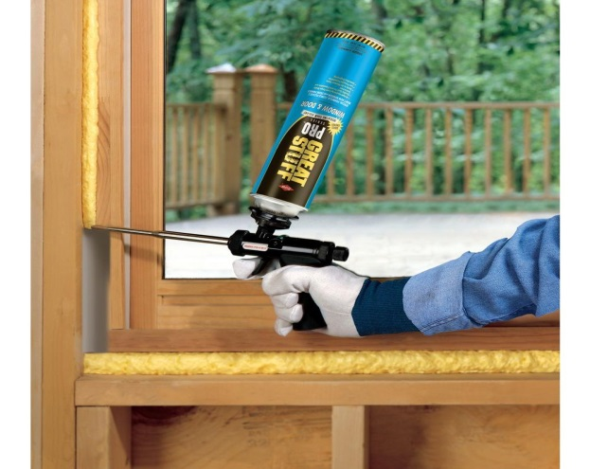
Great Stuff Pro Buy 3 Gun Free Combo Qp
Finance
Total Event Buy (Units #) | 34,500
Total Event Buy (Dollars $) | $413,310
Projected Sell Through (%) | 100%
Core (Y or N) | N
Non-Core Exit Strategy: (Markdown, Future Event, MAP, Etc.) | Return to Run
Interconnected
Will this be available online during Event (Y/N) | N
Is this BOPIS eligible during Event (Y/N) | N
IPR
General Information
Min # of stores
Does Item have Switch outs (Y/N) | N
EDLP, NLP, Special Buy | Special Buy
Ad Retail ($) | $11.98
Cost ($) | $9.3810
Is this a Special Cost (Y/N) | N
Replenish Item (Y or N) | N
Import/Domestic | Domestic
Display Configuration / Merchandise in Store (Pallet/QP/Case Stack Out , Etc.) | Quarter Pallet - Multi SKU
Units on Each: (Pallet/QP/Case Stack Out , Etc.) | 12
Department | 22 - Building Materials
Merchant | Arianna Jackson
SKU # | 105-090 - Great Stuff Pro Window & Door 20oz
Event Name | Q4 2016 Pro Black Friday
Advantage Home Depot | • -X6 Great Stuff PRO allows for a bead flow control from 1/8" to 3" (0.3 cm to 8 cm) - Great Stuff Pro can be started and stopped allowing maximum foam use and minimal waste.
 | A | B | C | D | E | F
Load In | 72 | 72 | 72 | 72 | 72 | 72
Pres Min | 24 | 24 | 24 | 24 | 24 | 24
02/09/2016 11:55:25, Request ID 22314

Slide 6

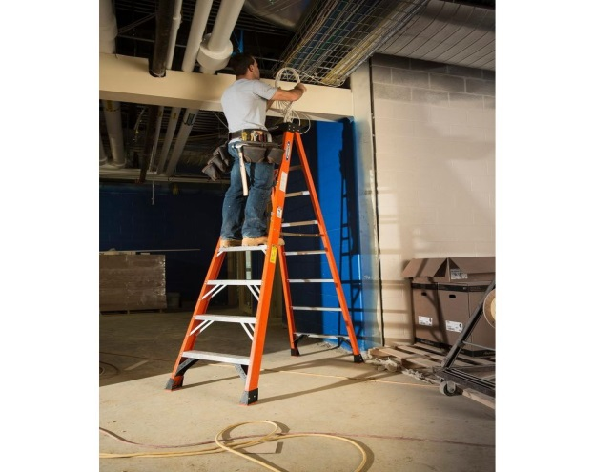
2016 Werner Pro Black Friday
Finance
Total Event Buy (Units #) | 15,000
Total Event Buy (Dollars $) | $1,207,800
Projected Sell Through (%) | 100%
Core (Y or N) | Y
Non-Core Exit Strategy: (Markdown, Future Event, MAP, Etc.) | Future Event
Interconnected
Will this be available online during Event (Y/N) | N
Is this BOPIS eligible during Event (Y/N) | Y
IPR
General Information
Min # of stores
Does Item have Switch outs (Y/N) | N
EDLP, NLP, Special Buy | NLP
Ad Retail ($) | $99.98
Cost ($) | $80.5200
Is this a Special Cost (Y/N) | N
Replenish Item (Y or N) | N
Import/Domestic | Domestic
Display Configuration / Merchandise in Store (Pallet/QP/Case Stack Out , Etc.) | Pallet - 1 SKU
Units on Each: (Pallet/QP/Case Stack Out , Etc.) | 18
Department | 22 - Building Materials
Merchant | Michael Newsome
SKU # | 768-915 - 8' Fg Step Ladder Tia 300lb
Event Name | Q4 2016 Pro Black Friday
Advantage Home Depot
 | A | B | C | D | E | F
Load In | 36 | 18 | 18 | 18 | 18 | 18
Pres Min | 36 | 18 | 18 | 18 | 18 | 18
02/13/2016 07:09:12, Request ID 22824

Slide 7
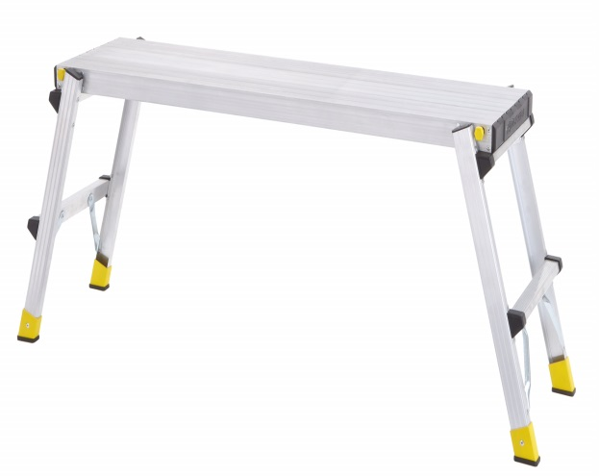
2016 Tricam Pro Black Friday
Finance
Total Event Buy (Units #) | 35,000
Total Event Buy (Dollars $) | $962,500
Projected Sell Through (%) | 90%
Core (Y or N) | Y
Non-Core Exit Strategy: (Markdown, Future Event, MAP, Etc.) | Markdown
Interconnected
Will this be available online during Event (Y/N) | N
Is this BOPIS eligible during Event (Y/N) | Y
IPR
General Information
Min # of stores
Does Item have Switch outs (Y/N) | N
EDLP, NLP, Special Buy | Special Buy
Ad Retail ($) | $27.88
Cost ($)
Is this a Special Cost (Y/N) | N
Replenish Item (Y or N) | N
Import/Domestic | Import
Display Configuration / Merchandise in Store (Pallet/QP/Case Stack Out , Etc.) | Each
Units on Each: (Pallet/QP/Case Stack Out , Etc.) | 1
Department | 22 - Building Materials
Merchant | Michael Newsome
SKU # | TBD - Heavy Duty Pro Slim Fold Aluminum Pl
Event Name | Q4 2016 Pro Black Friday
Advantage Home Depot
 | A | B | C | D | E | F
Load In | 40 | 32 | 22 | 16 | 12 | 12
Pres Min | 8 | 8 | 6 | 6 | 4 | 4
02/13/2016 07:22:12, Request ID 22825

