Slide 1


K.RAMAKRISHNAN COLLEGE OF TECHNOLOGY
(AUTONOMOUS), TRICHY
STOCK MANAGEMENT SYSTEM
PRESENTED BY SUPERVISOR
ROHITH S Ms.S.Uma Maheswari M.E.,
2303811720521042 AP/CSE.

Slide 2
PRESENTATION OVERVIEW
Objective
Project Introduction
Problem Statement
Methodologies (Programming concepts relevant to problem statement)
Architecture of the proposed system
List of Modules
7. Merits
8. Results and Discussion
9. Queries

Slide 3
OBJECTIVE
Stock Management System, integrating core concepts such as OOP (Encapsulation), multithreading, file handling, and AWT GUI. It manages an inventory of products, allowing users to add, update stock, place orders, and view inventory. Products are stored in a file (inventory.dat) to ensure data persistence. The system features automatic saving every 30 seconds using a daemon thread.

Slide 4
PROJECT INTRODUCTION
The Stock Management System is a Java-based application designed to efficiently manage product inventories for businesses. It allows users to add new products, update stock quantities, place customer orders, and display the current inventory. The system ensures data persistence through file handling and automatically saves the inventory every 30 seconds using multithreading.

Slide 5
PROBLEM STATEMENT
Managing inventory efficiently is a critical challenge for businesses, especially when dealing with large quantities of products. Manual tracking of stock levels, updating quantities, and processing orders can lead to errors, inefficiencies, and data loss. There is a need for an automated system that can handle inventory operations seamlessly and ensure data persistence.

Slide 6
METHODOLOGIES
Encapsulation: Product class
Inheritance: StockManagementSystem extends Frame
AWT (Abstract Window Toolkit): Button, FlowLayout
Event Handling: ActionListener, WindowAdapter
File Handling: ObjectInputStream and ObjectOutput
StreamSwing: JOptionPane
Exception Handling: IOException, ClassNotFoundException, and NumberFormatException
Polymorphism: Method overriding (toString in Product class)

Slide 7
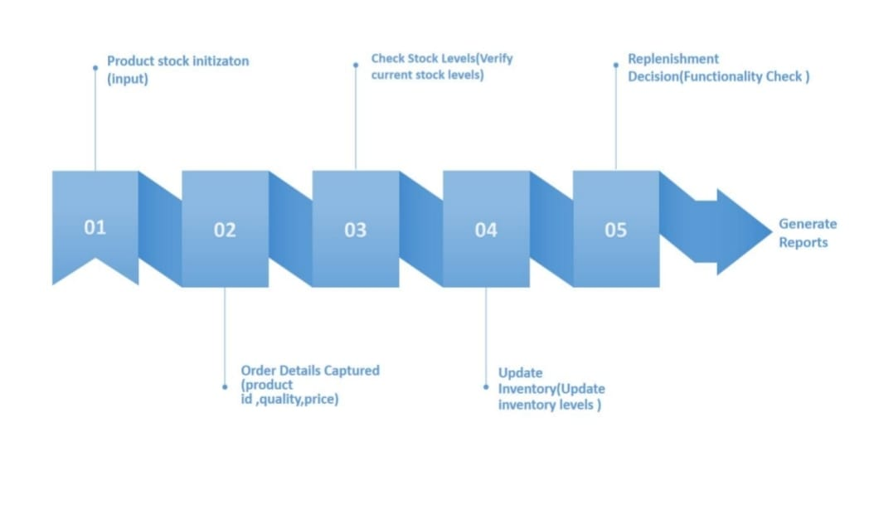
ARCHITECTURE OF THE PROPOSED SYSTEM

Slide 8
LIST OF MODULES
Product Management: Defines the Product class to store product details using encapsulation.
Inventory Management: Manages product addition, stock updates, and order placement.
File Handling: Saves and loads inventory data using serialization for data persistence.
Multithreading: Implements auto-save functionality with a daemon thread.
GUI: Provides a user-friendly interface using AWT components for interaction.
Event Handling: Manages user actions with ActionListener and WindowAdapter.

Slide 9
MERITS
User-Friendly GUI: AWT provides an intuitive interface for easy interaction.
Modular Design: Separate modules for user, inventory, order, and customer management ensure maintainability.
Efficient Data Handling: Uses HashMap and ArrayList for fast data storage and retrieval.
Real-Time Feedback: Immediate system responses improve user experience.
Secure and Reliable: Encapsulation protects sensitive data like user credentials.
Customizable and Scalable: Easy to add features and handle growing data.
Platform Independence: Runs on any system with Java support.
Educational Value: Demonstrates OOP, GUI programming, and event handling concepts.

Slide 10
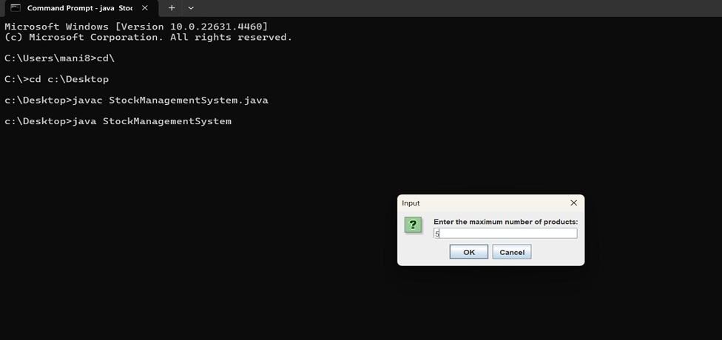
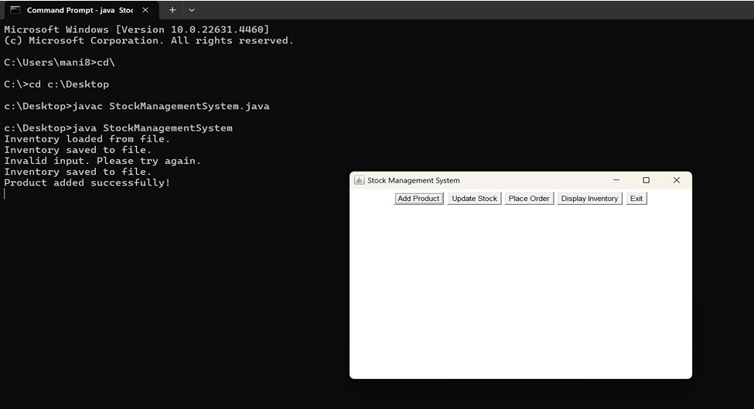
RESULTS AND DISCUSSION

Slide 11

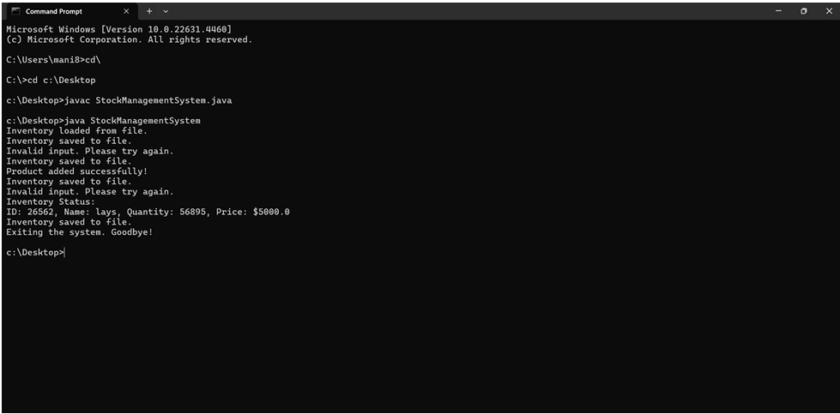
RESULTS AND DISCUSSION

Slide 12
QUERIES
ANY QUERIS?

