Slide 1


APRIORI ALGORITHM
BY
International School of Engineering
We Are Applied Engineering
Disclaimer: Some of the Images and content have been taken from multiple online sources and this presentation is
intended only for knowledge sharing but not for any commercial business intention

Slide 2

OVERVIEW
DEFNITION OF APRIORI ALGORITHM
KEY CONCEPTS
STEPS TO PERFORM APRIORI ALGORITHM
APRIORI ALGORITHM EXAMPLE
MARKET BASKET ANALYSIS
THE APRIORI ALGORITHM : PSEUDO CODE
LIMITATIONS
METHODS TO IMPROVE APRIORI’S EFFICIENCY
APRIORI ADVANTAGES/DISADVANTAGES
VIDEO OF APRIORI ALGORITHM

Slide 3
DEFINITION OF APRIORI ALGORITHM
The Apriori Algorithm is an influential algorithm for mining frequent itemsets for boolean association rules.
Apriori uses a "bottom up" approach, where frequent subsets are extended one item at a time (a step known as candidate generation, and groups of candidates are tested against the data.
Apriori is designed to operate on database containing transactions (for example, collections of items bought by customers, or details of a website frequentation).

Slide 4
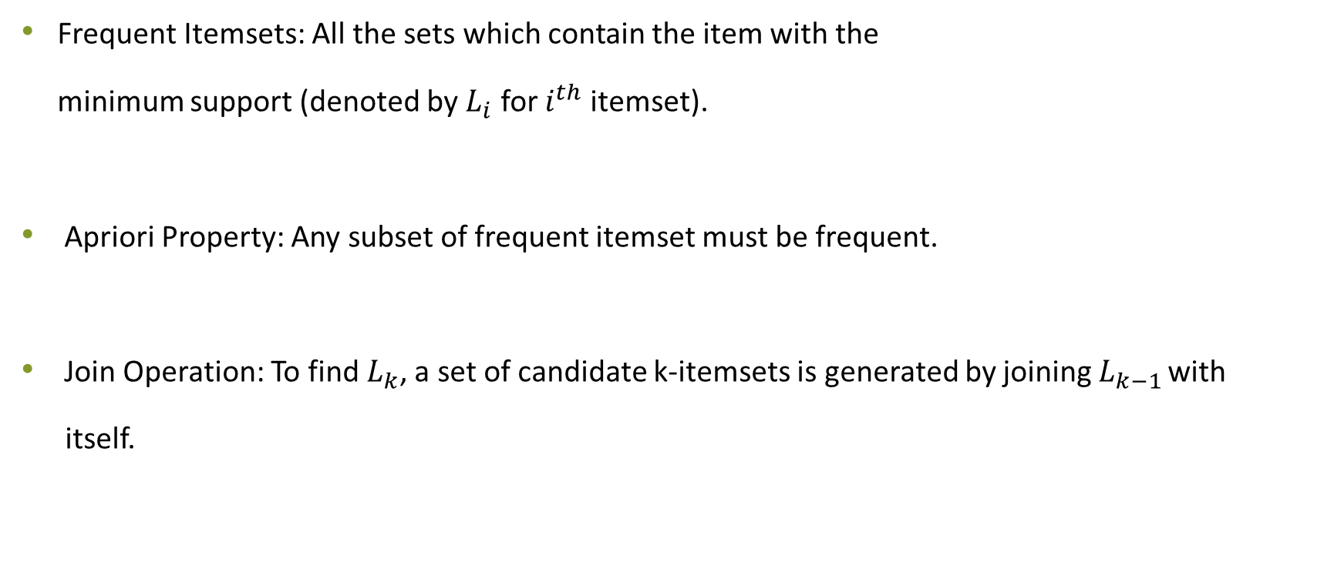
KEY CONCEPTS
Frequent Itemsets: All the sets which contain the item with the
minimum support (denoted by $L_{i}$ for $i^{th}$ itemset).
Apriori Property: Any subset of frequent itemset must be frequent.
Join Operation: To find $L_{k}$, a set of candidate k-itemsets is generated by joining $L_{k−1 }$with
itself.

Slide 5
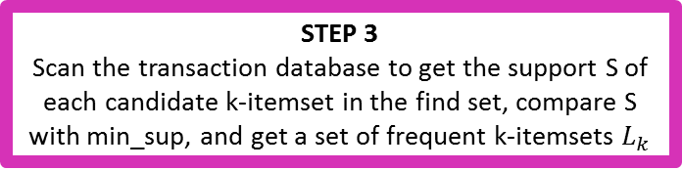
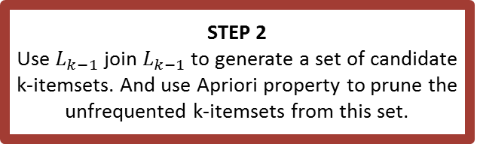
STEPS TO PERFORM APRIORI ALGORITHM
STEP 1
Scan the transaction data base to get the support of S each 1-itemset, compare S with min_sup, and get a support of 1-itemsets, L1
STEP 3
Scan the transaction database to get the support S of each candidate k-itemset in the find set, compare S with min_sup, and get a set of frequent k-itemsets $L_{k}$
STEP 2
Use $L_{k−1}$ join $L_{k−1}$ to generate a set of candidate k-itemsets. And use Apriori property to prune the unfrequented k-itemsets from this set.
STEP 4
The candidate set = Null
NO
STEP 6
For every nonempty subset s of 1, output the rule “s=>(1-s)” if confidence C of the rule “s=>(1-s)” (=support s of 1/support S of s)’ min_conf
YES
STEP 5
For each frequent itemset 1, generate all nonempty subsets of 1

Slide 6

APRIORI ALGORITHM EXAMPLE
Market basket

Slide 7
MARKET BASKET ANALYSIS
Provides insight into which products tend to be purchased together and which are most amenable to promotion.
Actionable rules
Trivial rules
People who buy chalk-piece also buy duster
Inexplicable
People who buy mobile also buy bag

Slide 8
APRIORI ALGORITHM EXAMPLE
Database D
Minsup = 0.5
C₁
L₁
Scan D
L₂
C₂
C₂
Scan D
L₃
C₃
Scan D

Slide 9
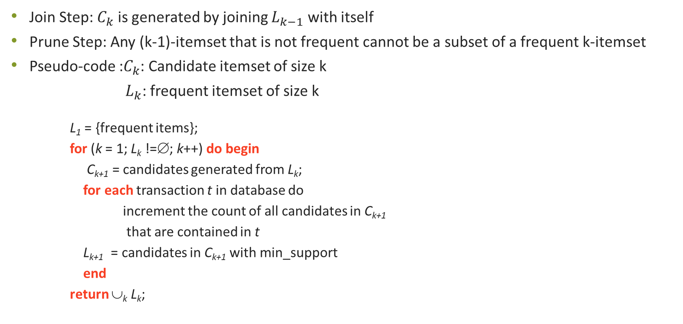
The Apriori Algorithm : Pseudo Code
Join Step: $C_{k}$ is generated by joining $L_{k−1}$ with itself
Prune Step: Any (k-1)-itemset that is not frequent cannot be a subset of a frequent k-itemset
Pseudo-code :$C_{k}$: Candidate itemset of size k
$L_{k}$: frequent itemset of size k
L₁ = {frequent items};
for (k = 1; L_{k} !=∅; k++) do begin
C_{k+1} = candidates generated from L_{k};
for each transaction t in database do
increment the count of all candidates in C_{k+1}
that are contained in t
L_{k+1} = candidates in C_{k+1} with min_support
end
return ∪_{k} L_{k};

Slide 10
LIMITATIONS
Apriori algorithm can be very slow and the bottleneck is candidate generation.
For example, if the transaction DB has 10⁴ frequent 1-itemsets, they will generate 10⁷
candidate 2-itemsets even after employing the downward closure.
To compute those with sup more than min sup, the database need to be scanned at every level. It needs (n +1 ) scans, where n is the length of the longest pattern.

Slide 11
METHODS TO IMPROVE APRIORI’S EFFICIENCY
Hash-based itemset counting: A k-itemset whose corresponding hashing bucket count is below the threshold cannot be frequent
Transaction reduction: A transaction that does not contain any frequent k-itemset is useless in subsequent scans
Partitioning: Any itemset that is potentially frequent in DB must be frequent in at least one of the partitions of DB.
Sampling: mining on a subset of given data, lower support threshold + a method to determine the completeness
Dynamic itemset counting: add new candidate itemsets only when all of their subsets are estimated to be frequent

Slide 12
APRIORI ADVANTAGES/DISADVANTAGES
Advantages
Uses large itemset property
Easily parallelized
Easy to implement
Disadvantages
Assumes transaction database is memory resident.
Requires many database scans

Slide 13
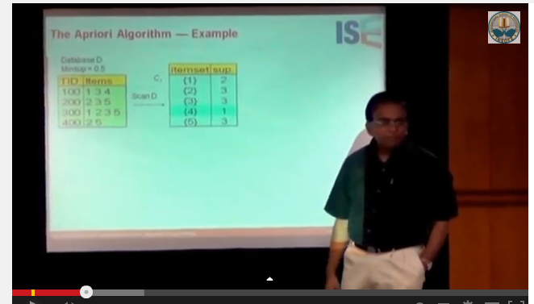
For Detailed Description of APRIORI ALGORITHM
Check out our video on

Slide 14
International School of Engineering
Plot no 63/A, 1st Floor, Road No 13, Film Nagar, Jubilee Hills, Hyderabad-500033
For Individuals (+91) 9502334561/62
For Corporates (+91) 9618 483 483
Facebook: www.facebook.com/insofe
Slide share: www.slideshare.net/INSOFE

