Slide 1


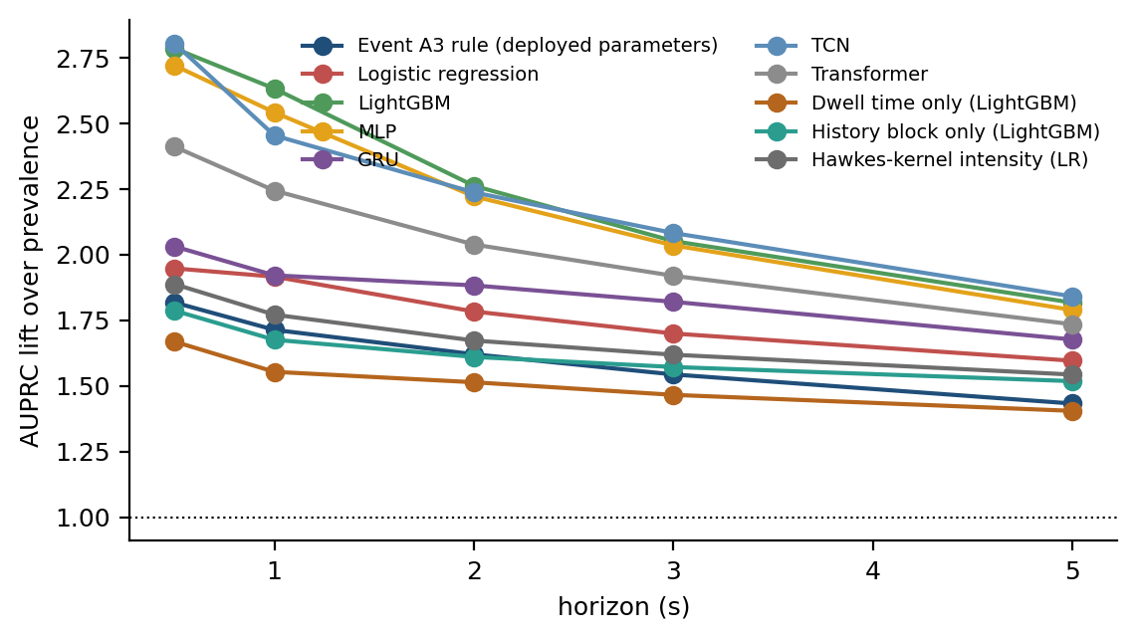
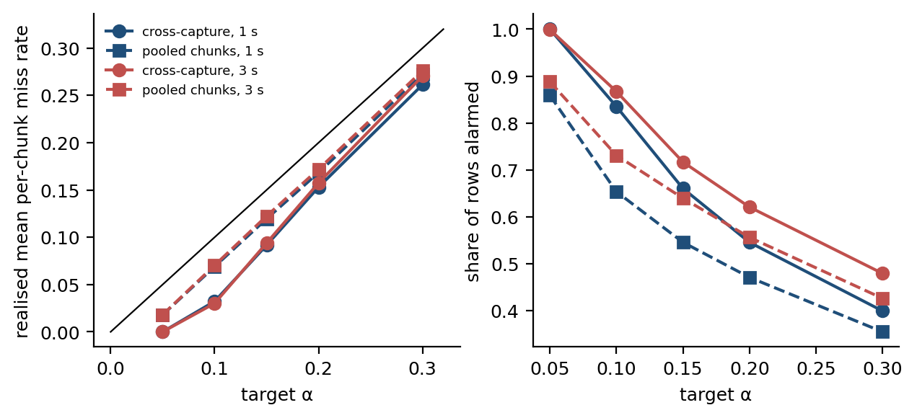
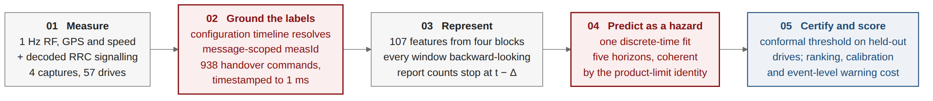
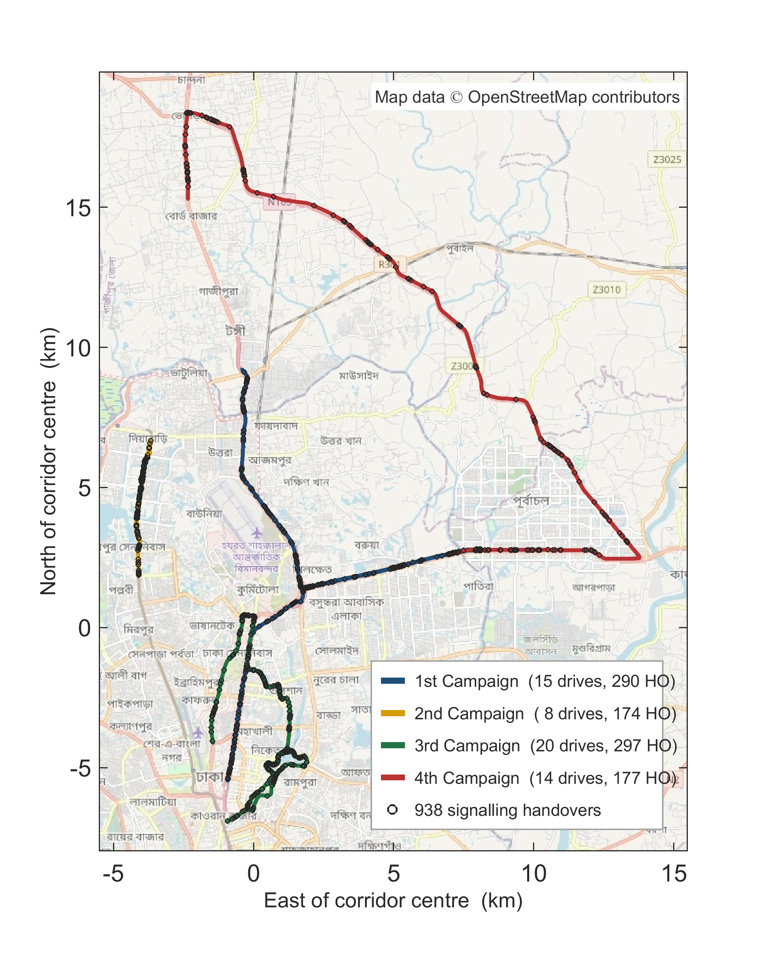
CONFORMALIZED DISCRETE-TIME HAZARD MODELING FOR MULTI-HORIZON HANDOVER FORECASTING IN CELLULAR NETWORKS
Students: Saadman Sakib (210021110) | Adhnan Kalim (210021308) | Evan Ashfaque (210021335)
Supervisor: Dr. Mohmmad Tawhid Kawser, Professor
Department of Electrical and Electronic Engineering, Islamic University of Technology (IUT)
ABSTRACT
KEY OUTCOMES/RESULTS
• Problem: LTE handovers operate reactively via Event A3, initiating target cell preparation only after link degradation has already occurred. This causes radio-link failure (RLF) during rapid channel drops and induces high ping-pong rates.
• Logging Artifact Discovery: Physical alignment audit reveals that standard 1 Hz diagnostic logs write post-handover cell state before the RRC command in 76% of events. Failing to lag features produces a spurious +235% AUPRC inflation (0.179 -> 0.600) prevalent in un-audited literature.
• Hazard Formulation: Framing handover forecasting as discrete-time survival analysis with a single gradient-boosted tree model guarantees coherent multi-horizon ordering without post-hoc heuristics, reaching AUPRC 0.179 at 1 s (2.6x over baseline) and 0.475 at 5 s.
• Risk Guarantees: Conformal Risk Control certifies an early-warning alarm threshold that strictly bounds per-drive miss rate <= 0.20 (realised 0.168 at 47% alarm rate). Over handovers, 36.4% of events are fundamentally bounded by the 2 s post-handover blanking policy limit.
• Predictive Superiority: Discrete-time LightGBM hazard achieves AUPRC 0.179 at 1 s (2.6x over 6.8% base rate), 0.252 at 2 s, and 0.475 at 5 s, outperforming deployed Event A3 baseline (0.116 at 1 s) and deep sequence models (GRU: 0.158, Transformer: 0.155).
• 100% Horizon Monotonicity: Hazard formulation yields exactly 0.0% horizon ordering violations, whereas independent binary classifiers produce 40.2% contradictory violations across horizons.
• Conformal Risk Verification: At target alpha = 0.20, certified warning threshold achieves realised mean per-unit loss of 0.168 (47% alarm rate) under exchangeable pooling and holds in 83% of cross-campaign holdout rotations.
• Network Operating Realities: 74.8% of A3 handovers fire under positive offset (+1 dB dominant). Between 63% and 73% of triggered A3 episodes are declined by the eNodeB without a handover command.
BACKGROUND
• 3GPP LTE Mobility Mechanism: Handover decisions are governed by RRC MeasurementReport messages. Event A3 fires when neighbor RSRP exceeds serving by an offset (Mn - Ofn > Ms + Ofs + Off) for a continuous Time-To-Trigger (TTT), creating an unavoidable delay.
• Signalling Inefficiencies: In dense urban topologies, 26.3% to 43.8% of handovers return to the source cell within 15 seconds, expending unnecessary signaling load, radio resource control overhead, and UE battery consumption.
• Literature Evaluation Pitfalls: Audit of 22 published models indicates widespread data leakage: random row-level splitting across continuous drive tests inflates AUPRC by up to 48% and misranks models relative to cluster-safe cross-campaign splits.
OBJECTIVES
• O1 - Alignment Audit: Identify and correct physical logging/export latency between handset traces and decoded RRC event clock.
• O2 - Leakage-Free Benchmarking: Establish a rigorous Leave-One-Campaign-Out (LOCO) protocol that prevents temporal and spatial information leakage.
• O3 - Monotone Multi-Horizon Forecasting: Develop a discrete-time survival/hazard framework guaranteeing mathematically ordered cumulative incidence (0.5 s to 5 s).
• O4 - Distribution-Free Risk Control: Formulate Conformal Risk Control (CRC) on clustered drive units to certify operational alarm thresholds with statistical bounds.
• O5 - Operational Characterization: Decode live RRC signaling timelines to quantify Event A3 conversion efficiency and ping-pong sensitivity under live deployments.
PROPOSED METHODOLOGY
• Signalling Decoding: Replay RRC connection reconfiguration timelines under TS 36.331; ground truth extracted from mobilityControlInfo with 100% confirmed completion.
• Causal Feature Engineering: 112 strictly causal features: 89 Radio (serving RF + projected neighbor RSRP via zero-order hold), 17 Mobility (GPS speed, acceleration, bearing), 6 History (dwell time, recent handover count). All export features lagged 1 row.
• Hazard Formulation: Single LightGBM model estimates interval hazard lambda_k(x_t). Cumulative incidence derived via product-limit identity F_k(x_t) = 1 - prod_{j=1}^k (1 - lambda_j(x_t)), guaranteeing monotonic ordering without heuristics.
• Conformal Risk Control: Certify threshold lambda* on calibration sessions such that expected per-unit loss satisfies E[L] <= alpha with distribution-free validity.
NOVELTY/SIGNIFICANT CONTRIBUTIONS
• 1. Diagnostic Alignment Audit: First systematic demonstration that commercial diagnostic 1 Hz exports suffer a write-before-read logging artifact, removing spurious results and establishing a reproducibility standard.
• 2. Coherent Hazard Framework: First unified discrete-time survival formulation applied to multi-horizon mobility prediction, eliminating horizon incoherence by construction.
• 3. Clustered Conformal Risk Guarantees: First deployment of Conformal Risk Control on drive-test sessions, testing exchangeability across routes and revealing the 36.4% evaluation policy limit under post-handover blanking.
• 4. 22-Model Meta-Audit: Screened 108 papers and audited 22 models, demonstrating that random-row evaluation inflates scores by up to 48% and corrupts comparative leaderboards.
EXPERIMENTAL DESIGN
• Measurement Testbed: Commercial live LTE network across Dhaka and Gazipur, Bangladesh, captured using an instrumented vehicle with XCAL diagnostic drive-test hardware.
• Four Continuous Campaigns: Campaign 1 (Urban Arterial, 45 min, 39.1 km/h), Campaign 2 (Urban Loop, 24 min, 25.0 km/h), Campaign 3 (Dense Urban, 60 min, 21.4 km/h), Campaign 4 (Highway, 42 min, 50.9 km/h).
• Corpus Scale: 96 km total distance, 10,260 1-Hz measurement rows (8,586 usable modelling rows after 2-second blanking & quality control), 957 confirmed handover commands, and 341 RRC re-establishments.
COMMERCIAL VIABILITY
• Zero Hardware Changes: Purely software-based inference executable on handset baseband chipsets or integrated as an auxiliary background telemetry daemon.
• Open-RAN (O-RAN) xApp Compatibility: Easily packaged as a near-Real-Time RIC xApp or non-RT rApp, receiving standard E2 measurement reports to guide proactive Traffic Steering (TS) and QoS optimization.
• Signalling Overhead & Energy Reduction: Early target cell preparation mitigates user-plane interruption and eliminates up to 26.3% wasteful ping-pong executions, saving base-station capacity and UE power.
OBE ATTRIBUTES
POs | Tick | Ks | Tick | Ps | Tick | As | Tick
PO1 | ✓ | K3 | ✓ | P1 | ✓ | A1 | ✓
PO2 | ✓ | K4 | ✓ | P2 | ✓ | A2 | ✓
PO3 | ✓ | K5 | ✓ | P3 | ✓ | A3 | ✓
PO4 | ✓ | K6 | ✓ | P4 | ✓ | A4 | ✓
PO5 | ✓ | K7 | ✓ | P5 | ✓ | A5 | ✓
PO6 | ✓ | K8 | ✓ | P6 | ✓
PO7 | ✓ |  |  | P7 | ✓
PO8 | ✓
PO9
PO10 | ✓
PO11 | ✓
PO12
• PO3 / PO4 / PO5: Design of experiments on live operator LTE network; rigorous multi-campaign data analysis; modern machine learning and diagnostic toolchain.
• PO6 / PO7 / PO8: Operator anonymity preserved; societal impact through signaling energy waste characterization; professional ethics in reporting negative results.
• PO10 / PO11: Exhaustive documentation across 7 chapters; engineering management and resource allocation over two academic terms.
• K3 / K4 / K5 / K6: Mathematical survival analysis fundamentals; specialized RRC decoding under 3GPP TS 36.331; causal feature design; live-network instrumentation.
• K7 / K8: Societal role of mobile broadband; critical synthesis of 108 papers and 22 audited models.
• Complex Problems (P1-P7, A1-A5): Resolution of conflicting alarm-vs-miss trade-offs; non-standard evaluation procedures; integration across radio propagation, survival theory, and cellular control plane.
REFERENCES
[1] G. Ke, Q. Meng, T. Finley, T. Wang, W. Chen, W. Ma, Q. Ye, and T.-Y. Liu, "LightGBM: A highly efficient gradient boosting decision tree," in Advances in Neural Information Processing Systems (NeurIPS), vol. 30, pp. 3146–3154, 2017.
[2] A. N. Angelopoulos, S. Bates, C. Candès, M. I. Jordan, and L. Lei, "Learn then test: Calibrating predictive algorithms to satisfy risk bounds," Biometrika, 2024.
[3] 3GPP, "Evolved Universal Terrestrial Radio Access (E-UTRA); Radio Resource Control (RRC); Protocol specification," 3rd Generation Partnership Project (3GPP), Technical Specification (TS) 36.331, Rel. 16, 2020.
[4] A. Ghoshal, P. V. Mekala, B. B. B. Dantu, and J. Erman, "Understanding LTE handover dynamics in the wild," in Proc. ACM Internet Measurement Conference (IMC), pp. 696–709, 2020.
[5] S. V. R. Mandapati, "Meta-continual mobility forecasting for proactive handover prediction," arXiv preprint arXiv:2512.11841, 2025.
[6] N. Amirova, T. Taleb, and H. Flinck, "Data-driven machine learning analysis of handover behavior in operational mobile networks," Future Internet, vol. 18, no. 6, p. 290, 2026.
[7] S. Sakib, A. Kalim, E. Ashfaque, and M. T. Kawser, "Conformalized Discrete-Time Hazard Modeling for Multi-Horizon Handover Forecasting in Cellular Networks," B.Sc. Thesis, Dept. of Electrical and Electronic Engineering, Islamic University of Technology (IUT), 2026.
• OPEN-SOURCE BENCHMARK & REPRODUCIBILITY ARTIFACTS
• Causal Signalling & Telemetry Pipeline: Complete Python framework, millisecond-precision 3GPP TS 36.331 RRC protocol decoders, 112 strictly causal radio and mobility feature builders, and automated verification testbenches.
• Conformal Calibration & Model Checkpoints: Production LightGBM hazard models, Leave-One-Campaign-Out cross-validation harnesses, and distribution-free CRC calibration algorithms open-sourced under Apache-2.0.

