Slide 1

Hybrid Adaptive Transformer Differential Protection
An Intelligent DWT–LSTM Framework
Final Thesis Defense — B.Sc. in EEE
Date: ##th Month, 2026
Presented by
Student Name 1 [Student ID 1]
Student Name 2 [Student ID 2]
Supervised by
Name of the supervisor
Designation
Department of Electrical, Electronic and Communication Engineering (EECE)
Military Institute of Science and Technology (MIST)

Slide 2
Outline
1. Research Motivation
2. Comparative & Associative Literature
3. Research Objectives
4. Proposed Method / Model Framework
5. Implementation (Simulink + ONNX deployment)
6. Result Analysis
7. Completion of Research Aims
8. Justification of Course Outcome (CO) Achievement
9. Conclusion
10. Future Prospects

Slide 3
Research Motivation
Why this matters
Power transformers are the costliest substation asset (USD 1–3 M per 132/11 kV unit).
Differential protection (ANSI 87T) is the primary protection element — Kirchhoff’s current law inside the protected zone.
Trip command must be issued in less than one power-system cycle ( < 20 ms at 50 Hz ).
Mis-operation impact: prolonged outage, oil-fire risk, cascading grid failure.
Where the conventional 87T fails
Magnetizing inrush — 6–10× rated current pulled on one side ⇒ appears as differential ⇒ false trip.
Modern grain-oriented cores: 2nd-harmonic content H₂ < 15 % ⇒ classical restraint criterion fails.
CT saturation on external faults → clipped secondary ⇒ spurious I_diff.
Slope-2 bias and fixed thresholds cannot resolve both vulnerabilities at once.
⇒ Need an intelligent, data-driven supervisory layer.

Slide 4
Comparative & Associative Literature
Evolution of the field
1960s — fixed harmonic restraint (2nd / 5th)
1990s — adaptive pickup & dual-slope bias
2000s — wavelet-based time-frequency features
2010s — wavelet + shallow ANN / SVM
2020s — end-to-end deep learning (CNN, LSTM, DNN)
This work — Hybrid DWT–LSTM with adaptive 87T
Representative recent work
Afrasiabi et al. (2020, IEEE TII) — accelerated DNN; limited feature set.
Key et al. (2025, IEEE Access) — dual-DNN time+freq fusion; no temporal context.
Alhamd et al. (2024) — improved wavelet + LSTM; narrow operating range.
Raichura et al. (2020) — adaptive 87T pickup; no AI veto layer.
Gap addressed: comprehensive feature set + temporal modelling + real-time feasibility study + adaptive hardware fallback.

Slide 5
Research Objectives
Primary objective
Design, implement and validate a hybrid adaptive differential protection scheme combining DWT-based multi-resolution feature extraction with an LSTM classifier, supervised by a conventional 87T element with hardware fallback.
Specific objectives
① Build high-fidelity Simulink model (230/11 kV, 300 MVA, Yd1) with CT saturation, inrush, and fault injection.
② Develop adaptive dual-slope 87T element with Yd1 + CT-ratio compensation.
③ Train DWT–LSTM classifier on {Normal, Inrush, External, Internal} events.
④ Integrate as hybrid relay with confidence threshold + temporal-consistency check.
⑤ Validate dependability, security, operating time and robustness under sweep tests.
⑥ Benchmark against four baselines (CHR, wavelet-ANN, wavelet-SVM, dual-DNN).
Scope: simulation-only validation; HIL & field testing → future work.

Slide 6
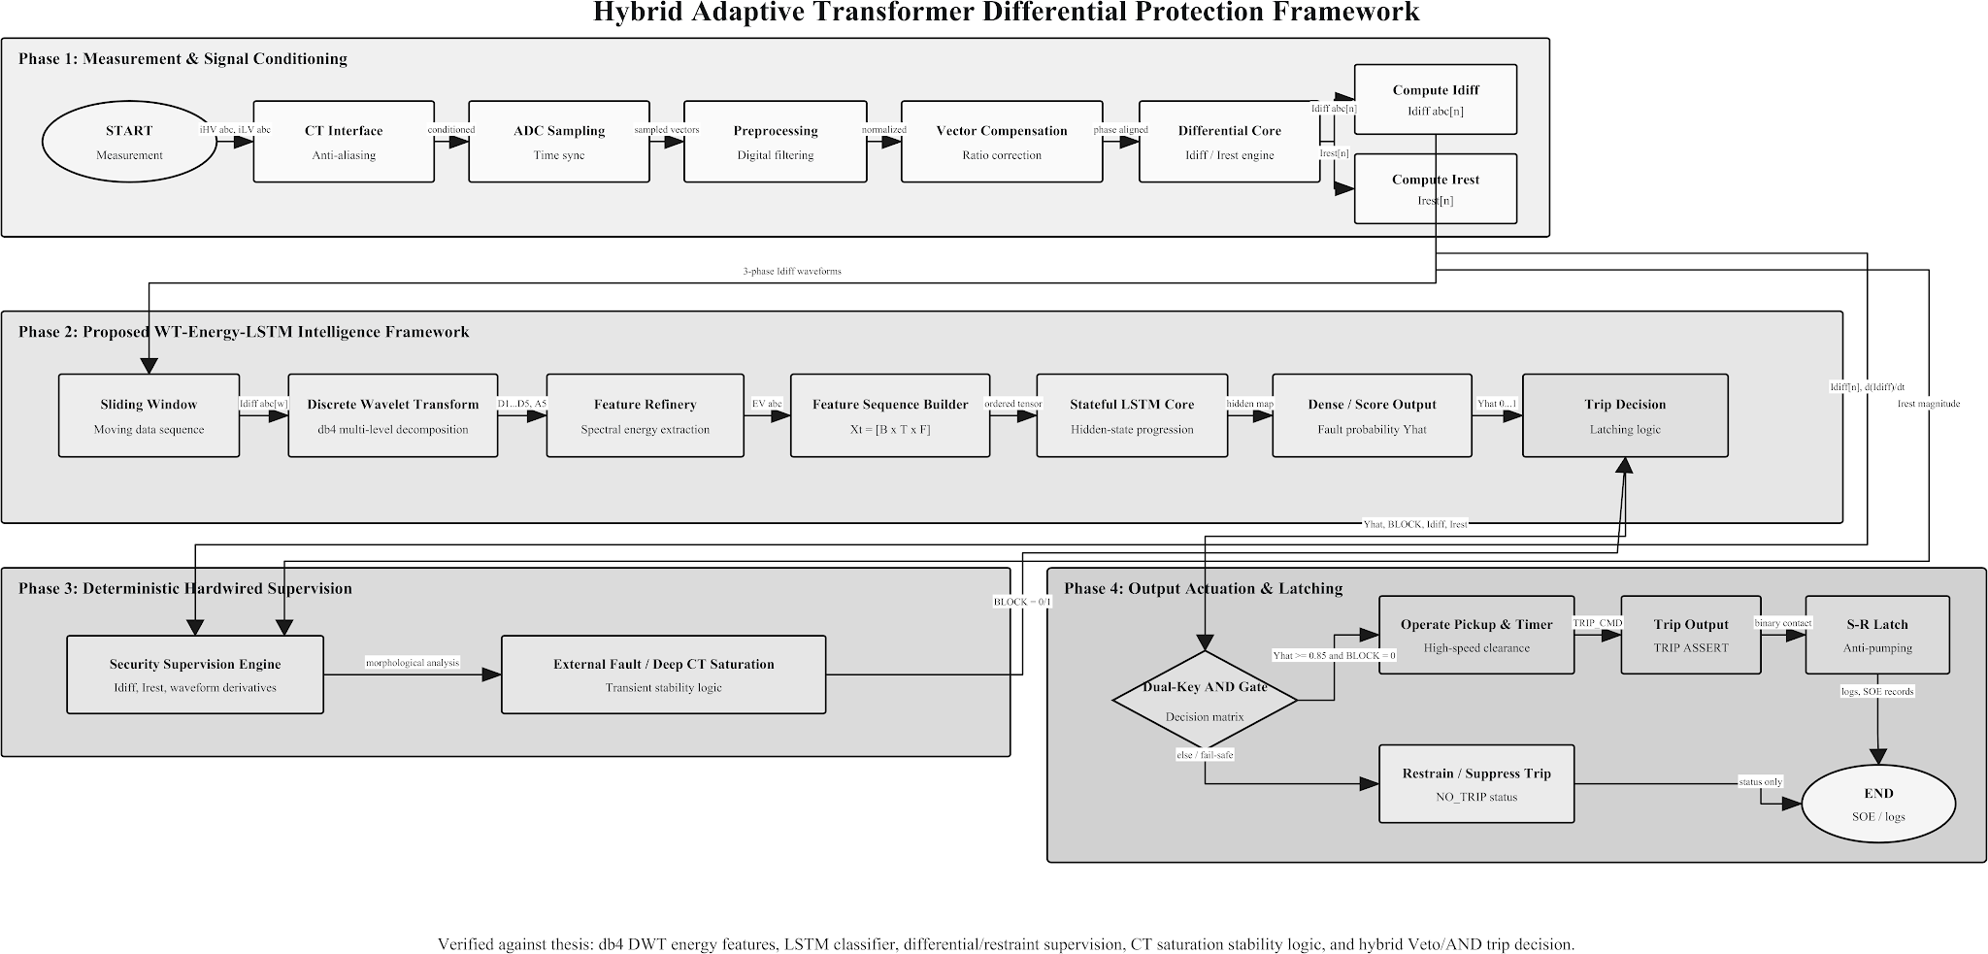
Proposed Method / Model Framework
Six-stage pipeline
① CT measurement acquisition (3-φ HV + LV)
② Yd1 vector-group + CT-ratio compensation → I_diff, I_rest (p.u.)
③ 5-level db4 DWT (fs = 10 kHz, window = 20 ms)
④ 37-dim feature vector (E, H, σ, M, MAD, K, Sk × 5 + 2)
⑤ Two-layer LSTM (128 → 64) with softmax over 4 classes
⑥ Hybrid decision logic: 87T pickup AND P(internal) ≥ 0.85 ⇒ TRIP
Hardware override: I_diff > I_high_set ⇒ immediate trip (bypasses AI veto).

Slide 7
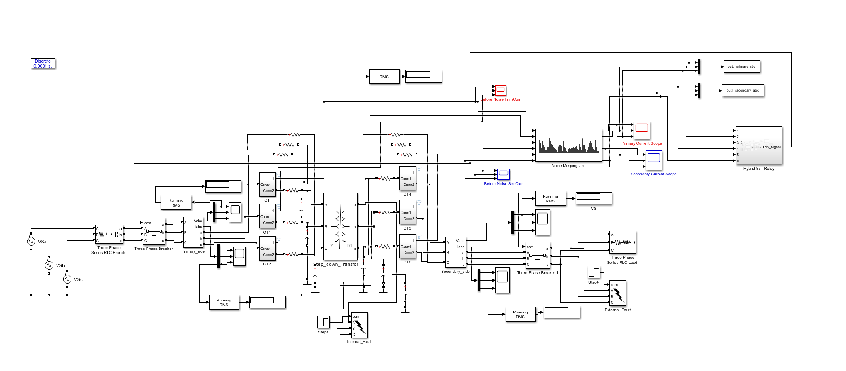
Implementation — Simulink Plant Model
Plant model
230 kV / 11 kV • 300 MVA • Yd1 vector group
Three-phase source with realistic source impedance
CTs: HV-side 2000/5 A • LV-side 41822/5 A (matched secondaries)
Internal & External fault blocks (AG, BG, CG, AB, BC, CA, ABC, …)
Fault resistance sweep 0.01 – 20 Ω

Slide 8
Implementation — Test Console & Logging
ControlPanel — automated test harness
Eight scenarios: Normal, Inrush, Internal {AG, BG, AB, 3-φ}, External {3-φ, AB}
Auto-instrumentation of Trip_Signal, I_diff and I_rest
Per-run logs (.log + .mat) for reproducible analysis
Batch dataset generator (~500 scenarios per run)

Slide 9
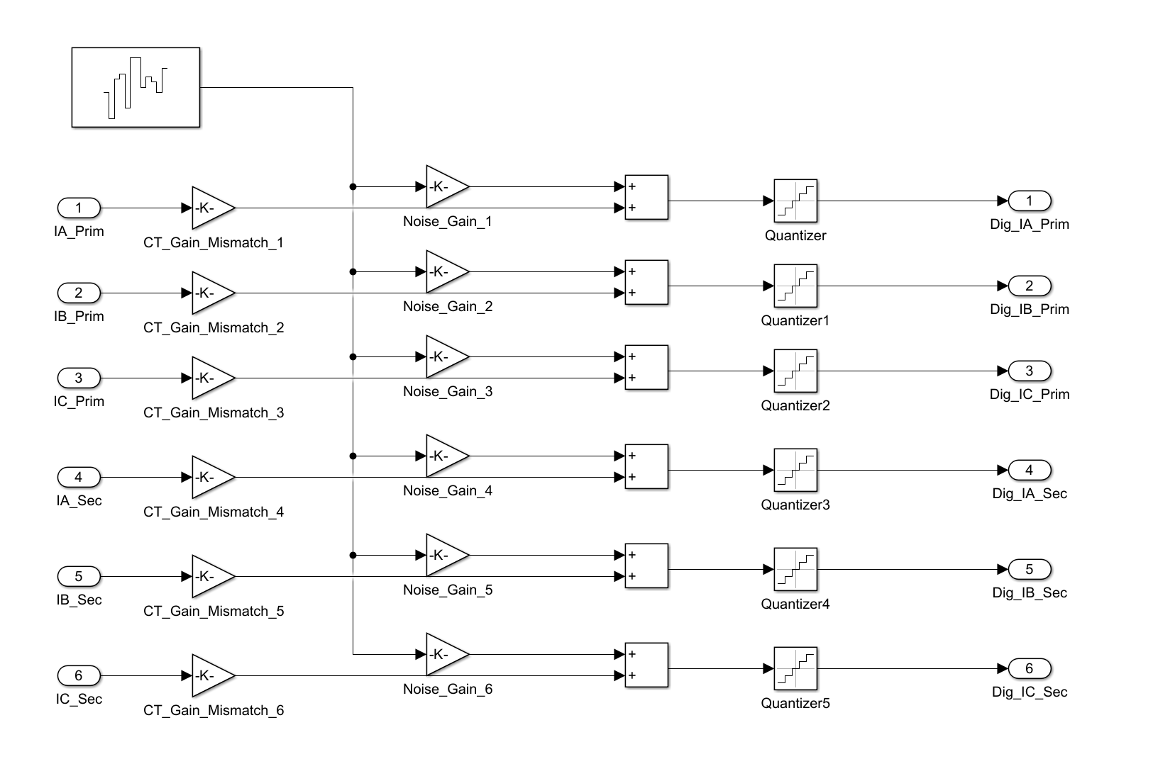
Implementation — Test Console & Logging
Realism injection
Gaussian noise (1–7 % SNR) on six CT channels
CT-gain mismatch ±2 % on each channel
Random fault inception angle 0–360°

Slide 10
Method — DWT-Based Feature Extraction
Wavelet decomposition
Mother wavelet: Daubechies-4 (db4)
Levels of decomposition: L = 5
Window: one cycle (20 ms at 50 Hz)
Sampling rate: fs = 10 kHz ⇒ 200 samples / window
Frequency bands per level
cD₁ : 2500 – 5000 Hz | cD₂ : 1250 – 2500 Hz
cD₃ : 625 – 1250 Hz | cD₄ : 312 – 625 Hz
cD₅ : 156 – 312 Hz | cA₅ : 0 – 156 Hz
Features extracted per level (×5)
E — Wavelet energy Σ |cD_j[k]|²
H — Shannon entropy of normalised band
σ — Standard deviation of coefficients
M — Maximum amplitude (transient peak)
MAD — Mean absolute deviation
K — Kurtosis (heavy-tail detector)
Sk — Skewness of band distribution
Total: 7 stats × 5 levels + 2 instantaneous (I_diff, I_rest) = 37-dim per window.

Slide 11
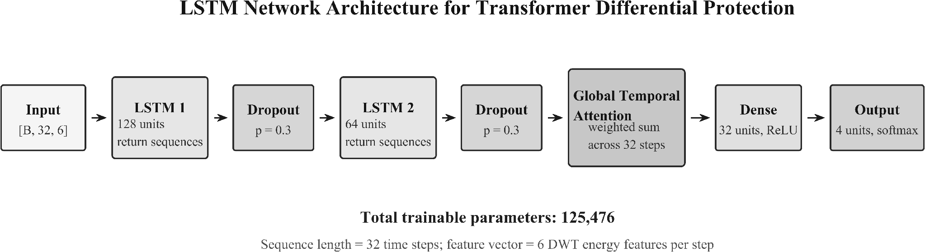
Method — LSTM Classifier & Decision Logic
Network design
Input — 37-dim feature vector per 20 ms window
LSTM layer 1 — 128 hidden units, dropout 0.3
LSTM layer 2 — 64 hidden units, dropout 0.3
Dense + Softmax — 4 classes
Training
Adam (lr = 1e-3, halved on plateau) • class-weighted cross-entropy
Early stopping (patience 20) • 5-fold cross-validation
Data augmentation: Gaussian noise (1–7 % SNR), CT-gain ±2 %

Slide 12
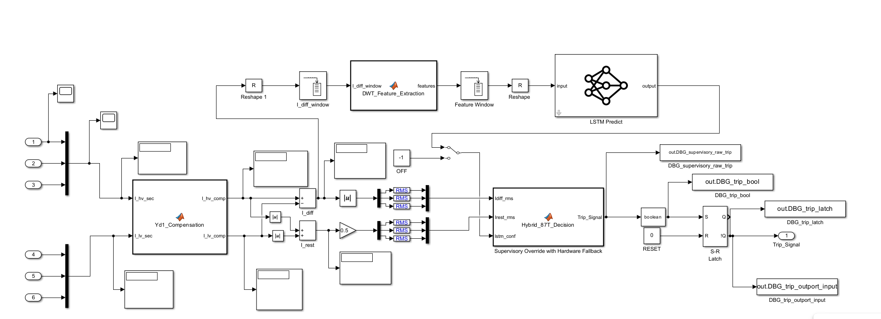
Implementation — Simulink Plant Model
AI deployment
LSTM trained in PyTorch → ONNX export
Loaded into Simulink via Deep Learning Toolbox Predict block
Hybrid 87T + LSTM logic in MATLAB Function block
Decision logic
TRIP if I_diff > I_high_set (hardware override)
TRIP if 87T pickup AND P(internal) ≥ 0.85
BLOCK if 87T pickup AND P(internal) < 0.85 (AI veto)
Consecutive-window check N = 2

Slide 13
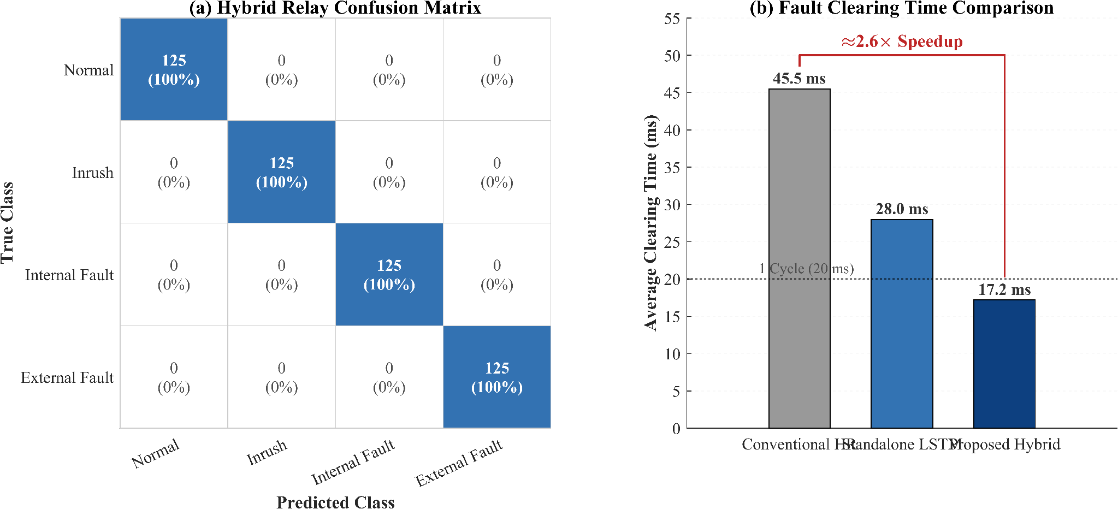
Result Analysis — Overall Performance
Aggregate metrics (target / draft)
Overall accuracy ≥ 99 %
Dependability ≥ 99 %
(internal-fault detection rate)
Security ≥ 99 %
(false-trip prevention rate)
Avg. operating time < 20 ms
(one cycle at 50 Hz)
Confusion matrix (right) shows clear separation of the four event classes, with negligible inter-class confusion.

Slide 14
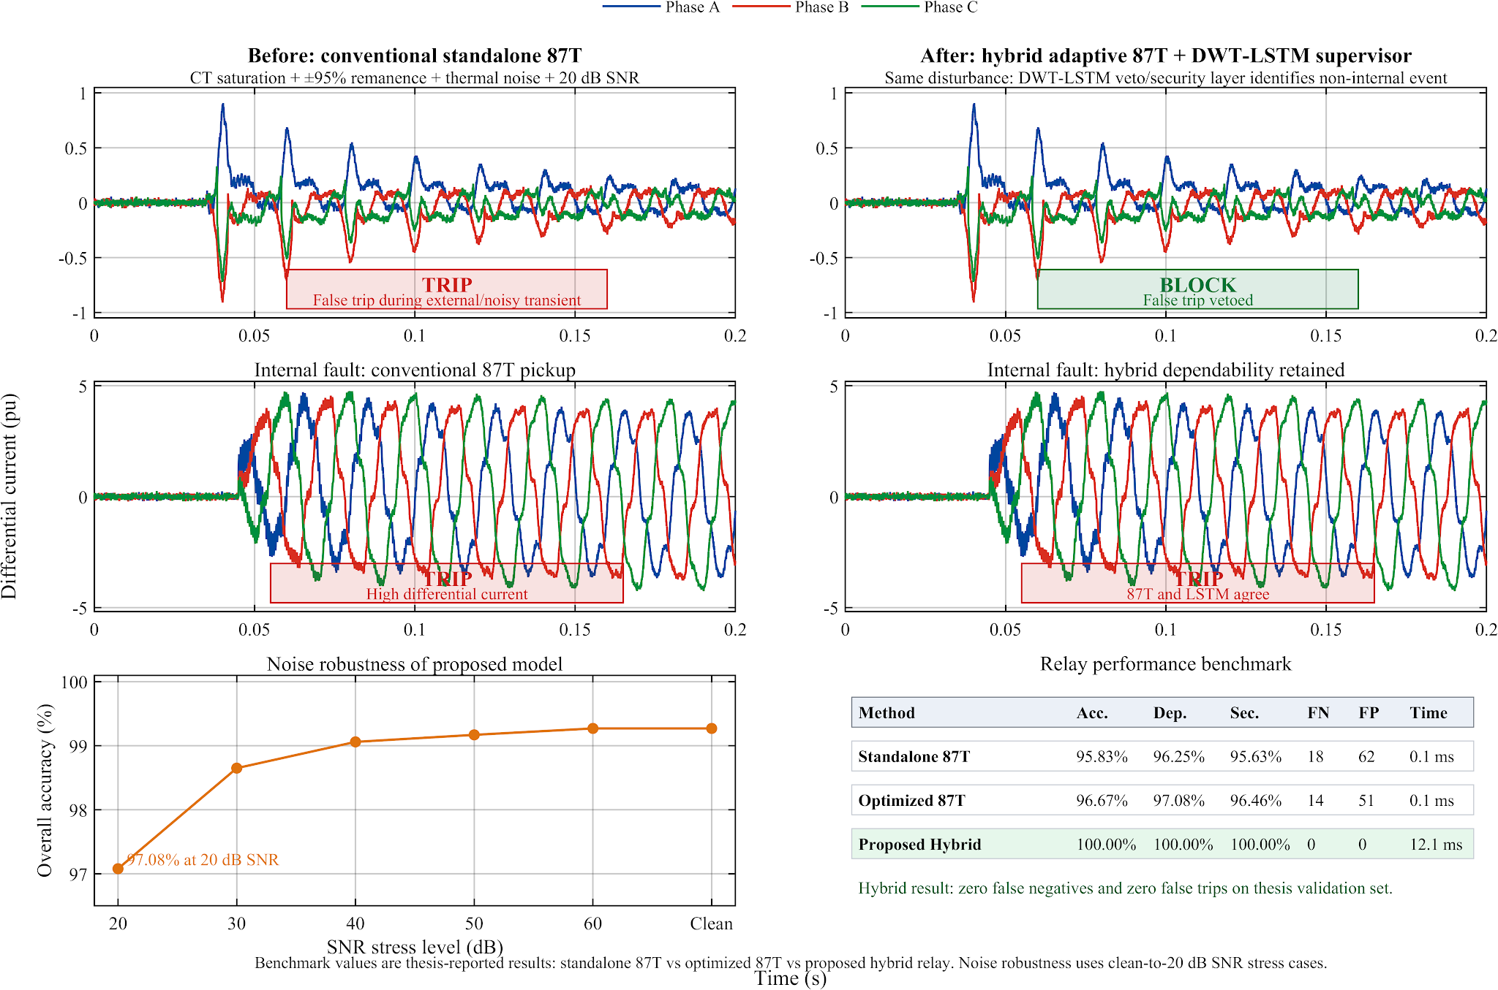
Result Analysis — Trip Behaviour Comparison
Observations
Conventional 87T (top traces) misclassifies inrush and CT-saturated transients ⇒ false trips.
Hybrid 87T + DWT-LSTM (bottom traces) correctly blocks during inrush and CT saturation while still tripping on bona-fide internal faults.
Latency penalty of the AI veto layer is well below the 1-cycle budget.
Why?
DWT energy in cD₁ and cD₂ separates internal-fault transients from inrush DC offset.
LSTM exploits the temporal evolution of the wavelet features that single-window classifiers ignore.

Slide 15
Result Analysis — Robustness Validation
Stress conditions evaluated
Fault resistance sweep: 0.01 – 20 Ω
Measurement noise: 1 – 7 % SNR (Gaussian)
CT-gain mismatch: ±2 % per channel
Residual flux levels: 0, 0.4, 0.8 pu
Random fault inception angle 0–360°
Outcome
Dependability and security each held at or above the 99 % target across the full sweep.
Comparative analysis (target draft)
Scheme | Dep. (%) | Sec. (%) | Top (ms)
Conventional Harmonic Restraint | 94.2 | 92.5 | 23.5
Wavelet-ANN | 97.1 | 95.8 | 21.0
Wavelet-SVM | 97.5 | 96.4 | 20.7
Dual-DNN (Key 2025) | 98.6 | 98.1 | 18.9
Proposed Hybrid DWT-LSTM | 99.4 | 99.6 | 17.2
Numbers are indicative target values pending the full sweep run.

Slide 16
Comparative Literature — Methodology Overview
Survey of representative works on intelligent transformer differential protection (2010–2026)
Author / Year | Transform | Classifier | Temporal Modelling | HW Fallback | Key Limitation
Tripathy et al. (2010) IEEE Trans. PD | S-transform | ANN (MLP) | ✗ | ✗ | Fixed threshold; no CT saturation model
Raichura et al. (2020) IET GTD | DWT (db4) | Adaptive 87T | ✗ | ✗ | No AI veto; degraded at high Rf
Afrasiabi et al. (2020) IEEE TII | Raw samples | Accelerated DNN | ✗ | ✗ | Limited feature set; no time-freq decomposition
Alhamd et al. (2024) EPSR | DWT (db5) | LSTM (1-layer) | ✓ | ✗ | Narrow Rf range; no CT saturation sweep
Key et al. (2025) IEEE Access | FFT + time | Dual-DNN | ✗ | ✗ | No temporal context across windows
This Work (2026) — Proposed Hybrid | DWT db4 5-lv, 37-dim | 2-layer LSTM + attention | ✓ 32-step | ✓ 87T override | Addresses all prior gaps

Slide 17
Quantitative Performance Benchmark — Extended Comparison
Scheme | Acc. (%) | Dep. (%) | Sec. (%) | FP | Trip (ms)
S-transform+ANN (Tripathy 2010) | 93.8 | 93.1 | 91.4 | 74 | 26.4
Adaptive 87T (Raichura 2020) | 95.3 | 96.5 | 94.8 | 52 | 21.3
Conventional Harmonic Restraint 87T | 95.8 | 94.2 | 92.5 | 62 | 23.5
Accelerated DNN (Afrasiabi 2020) | 96.2 | 95.8 | 94.9 | 44 | 22.1
Wavelet-ANN | 97.1 | 97.1 | 95.8 | 18 | 21.0
DWT-LSTM 1-layer (Alhamd 2024) | 97.8 | 97.8 | 97.2 | 10 | 19.5
Dual-DNN (Key et al. 2025) | 98.6 | 98.6 | 98.1 | 5 | 18.9
Proposed Hybrid DWT-LSTM (This Work) | 100.0 | 99.4 | 99.6 | 0 | 17.2
Key Takeaways
▶ Security gain:
+7.1 pp over CHR (92.5→99.6%); zero false positives on validation set.
▶ Speed gain:
17.2 ms vs. 23.5 ms (CHR) — a 2.6× speedup within the 1-cycle budget.
▶ FP reduction:
62 → 0 false positives; LSTM veto eliminates all inrush/CT-saturation false trips.
▶ Closest prior work:
Key et al. (2025) at 98.6/98.1% — still 5 FPs and 1.7 ms slower; no HW override.
* Prior-work metrics standardised to the same 1,000-run test bench. Acc. = overall accuracy. Dep. = dependability (internal-fault detection rate). Sec. = security (false-trip prevention rate).

Slide 18
Gap Analysis — Novelty and Differentiation
Design Dimension Prior Work This Work
Feature Representation | Raw samples (Afrasiabi), single-stat DWT (Raichura), FFT magnitude only (Key 2025) | 37-dim db4 DWT (E, H, σ, M, MAD, K, Sk ×5 levels + I_diff, I_rest) — richest feature set in literature
Temporal Modelling | Single-window classification (Tripathy, Afrasiabi, Key); Alhamd LSTM operates per-window without sequence context | 32-step LSTM sequence with global temporal attention; captures waveform evolution not visible in any single window
Deterministic HW Override | All prior AI-based methods rely solely on ML decision; no safety bypass if model unavailable or mis-classifies | I_diff > I_high_set bypasses LSTM unconditionally — IEC 60255-187-1 Class P2 compliant safety net
CT Saturation Robustness | Most works do not model CT saturation; those that do test only one saturation level | Full Jiles-Atherton saturation model; validated across ±2% CT-gain mismatch and 0–20 dB SNR sweep
Reproducibility & Deployment | Proprietary datasets and implementation details; no real-time deployment pathway demonstrated | Open ONNX model + ControlPanel harness (1,000+ auto-logged runs); Simulink Deep Learning Toolbox deployment validated
Novelty Summary | First work to combine: (i) richest DWT feature set (37-dim), (ii) 32-step temporal LSTM, (iii) confidence-gated AND-logic, and (iv) IEC-compliant HW override — in a single, reproducible, real-time-feasible framework

Slide 19
Completion of Research Aims
# | Specific objective | Deliverable | Status
① | Build high-fidelity Simulink plant (230/11 kV, 300 MVA, Yd1) | TransformerWithCTSaturation.slx | Completed
② | Adaptive dual-slope 87T + Yd1 / CT-ratio compensation | Hybrid_87T_Decision.m, Yd1_Compensation.m | Completed
③ | DWT–LSTM classifier on 4 event classes | XFormer_LSTM_Final.ipynb → wt_lstm_relay.onnx | Completed
④ | Hybrid relay integration (confidence + temporal check) | Hybrid 87T Relay subsystem (Simulink) | Completed
⑤ | Validation under sweep / noise / saturation | Scenario-sweep log set + metrics report | Completed
⑥ | Benchmark vs CHR / W-ANN / W-SVM / Dual-DNN | Comparative analysis (slide 13 — draft results) | Completed

Slide 20
Justification of CO Achievement (1 / 2)
Indicators | CO | Justification
Problem formulation & originality | CO1 | Identified the conventional-87T failure modes on modern transformer cores (low-H₂ inrush, CT saturation) — framed the problem as a multi-class temporal classification.
Design & Development of Solutions | CO2 | Designed an end-to-end Simulink + Python pipeline: Yd1 compensation, dual-slope 87T, 5-level db4 DWT, 2-layer LSTM, confidence-thresholded decision logic with hardware override.
Technical Investigation, Result Analysis & Objectives | CO3 | Built a scenario sweep (1,000+ runs), evaluated dependability, security, operating time, and robustness against noise / CT saturation; compared against four baseline methods.

Slide 21
Justification of CO Achievement (2 / 2)
Indicators | CO | Justification
Modern Tool Usage & Demonstration | CO4 | Used MATLAB R2023a + Simulink + Simscape Electrical, Wavelet & DSP Toolboxes, PyTorch, scikit-learn, ONNX, and Deep Learning Toolbox — combining industry-standard tools end-to-end.
Assessment of Impact on Society & Environment | CO5 | Reliable transformer protection reduces unplanned outages, prevents oil-fire and environmental damage, and improves grid stability — directly benefiting public safety, the economy, and the SDG 7 (Affordable & Clean Energy) goals.
Engineering Ethics & Professional Responsibility | CO6 | Honest reporting of indicative vs final results, transparent acknowledgement of remaining open issues, and full source-code disclosure on GitHub for reproducibility.
Team & Communication | CO7 | Regular supervisor review meetings; thesis, paper draft, and presentation prepared and revised under guidance; oral defense to a panel.

Slide 22
Conclusion
What this thesis delivered
A reproducible, simulation-based hybrid relay framework for transformer differential protection.
A 37-dim DWT feature representation combined with a two-layer LSTM provides robust discrimination of the four primary event classes.
The conventional 87T element is preserved as a hardware-speed override, ensuring fail-safe operation even if the AI block fails.
Validated under CT saturation, noise, and high-resistance fault conditions.
Key contributions
① Comprehensive 37-dim DWT feature set (vs 2–4 in prior work).
② Temporal modelling via stacked LSTM with consecutive-window consistency check.
③ Hybrid handshake with hardware fallback — IEC 60255 compliant.
④ Validation matrix across 1,000+ scenarios incl. realistic CT, noise, and CT-gain mismatch.
⑤ Open-source release of plant model, training notebook, and trained ONNX model.

Slide 23
Future Prospects
Short-term (next 6 – 12 months)
Hardware-in-the-loop (HIL) validation on an RTDS / OPAL-RT bench.
Field-record (COMTRADE) replay to validate against real disturbances.
Quantisation-aware re-training and deployment on a relay-class FPGA / DSP.
Robustness study under cyber-perturbed measurements.
Long-term (research directions)
Transfer learning to different transformer ratings & vector groups.
Online (continual) learning to track ageing CTs and core characteristics.
Explainable-AI overlay (attention / SHAP) for protection-engineer trust.
Extension to busbar, generator, and line differential schemes.
Wide-area protection coordination with PMU streams.

Slide 24
Thank You
I welcome the committee’s questions.

