Slide 1

Hybrid Adaptive Transformer Differential Protection
An Intelligent DWT–LSTM Framework
Final Thesis Defense — B.Sc. in EEE
Date: ##th Month, 2026
Presented by
Student Name 1 [Student ID 1]
Student Name 2 [Student ID 2]
Supervised by
Name of the supervisor
Designation
Department of Electrical, Electronic and Communication Engineering (EECE)
Military Institute of Science and Technology (MIST)

Slide 2
Outline
1. Research Motivation
2. Comparative & Associative Literature
3. Research Objectives
4. Proposed Method / Model Framework
5. Implementation (Simulink + ONNX deployment)
6. Result Analysis
7. Completion of Research Aims
8. Justification of Course Outcome (CO) Achievement
9. Conclusion
10. Future Prospects

Slide 3
Research Motivation
Why this matters
Power transformers cost USD 1–3 M each and take weeks to replace.
The differential relay (87T) is the main protection — it trips if current in ≠ current out.
A trip must happen in under 20 ms (one power cycle at 50 Hz).
A missed fault → equipment fire. A false trip → unnecessary outage.
Where the conventional 87T fails
Problem 1 — Magnetizing inrush: When a transformer is switched on, it draws 6–10× rated current on one side only. The relay sees a fake differential current → false trip.
Modern cores have low 2nd-harmonic content (< 15 %), so the classic inrush filter no longer works.
Problem 2 — CT saturation: A large external fault can saturate the measurement CT, distorting its output → relay calculates a spurious I_diff → false trip.
Fixed thresholds cannot solve both problems at the same time.
⇒ An intelligent, data-driven supervisory layer is needed.

Slide 4
What is Differential Protection (87T)?
The basic idea
Kirchhoff's Current Law: current flowing INTO the transformer should equal current OUT.
The relay measures both sides using Current Transformers (CTs).
It computes: I_diff = I_HV – I_LV (after correcting for winding ratio).
If I_diff exceeds a pickup threshold → the relay sends a TRIP command.
The dual-slope characteristic
A restraint current I_rest scales the threshold automatically during high through-fault current.
Slope-1 region: low through-current → sensitive pickup.
Slope-2 region: high through-current → raised threshold to avoid false trips.
Why 87T is fast and reliable
Hardware implementation → operates in < 20 ms regardless of fault type.
No AI required for the basic decision — purely signal comparison.
Used in virtually every large power transformer worldwide.
What it cannot handle on its own
Magnetizing inrush looks like a differential current — but it is not a fault.
CT saturation on external faults distorts the measured I_diff.
These two scenarios cause false trips — AI supervision is the solution.

Slide 5
Comparative & Associative Literature
Evolution of the field
1960s — Fixed harmonic restraint (2nd / 5th): simple, but fails on modern low-loss cores.
1990s — Adaptive pickup & dual-slope bias: threshold adjusts with operating point.
2000s — Wavelet-based time-frequency features: captures transient signatures.
2010s — Wavelet + shallow ANN / SVM: good accuracy but no temporal memory.
2020s — End-to-end deep learning (CNN, LSTM, DNN): state-of-the-art accuracy.
This work — Hybrid DWT–LSTM with adaptive 87T: AI veto + hardware failsafe.
Representative recent work
Afrasiabi et al. (2020, IEEE TII) — accelerated DNN; feature set was limited to 2–4 stats.
Key et al. (2025, IEEE Access) — dual-DNN fusing time + frequency; no temporal context; 5 false positives.
Alhamd et al. (2024) — improved wavelet + LSTM; tested only on a narrow fault range.
Raichura et al. (2020) — adaptive 87T pickup; no AI veto layer.
Gap this thesis fills
Rich 37-dim features + LSTM temporal memory + hardware fallback + full robustness sweep.

Slide 6
Research Objectives
Primary objective
Design, implement, and validate a hybrid differential protection scheme that combines:
• DWT feature extraction (wavelet signal analysis), and
• LSTM classification (AI with temporal memory),
supervised by the conventional 87T relay, with a hardware override for fail-safe operation.
In plain terms: Build a smart relay that uses AI to block false trips — while keeping the original relay as a backup that always works at hardware speed.
Specific objectives
① Build a high-fidelity 230/11 kV, 300 MVA Simulink model with CT saturation and inrush.
② Implement an adaptive dual-slope 87T relay with Yd1 compensation.
③ Train a DWT–LSTM classifier on four classes: Normal, Inrush, External, Internal fault.
④ Integrate AI with 87T: confidence threshold + consecutive-window consistency check.
⑤ Validate across 1,000+ scenarios: noise, CT errors, fault resistance, inception angle.
⑥ Benchmark against 4 prior methods on the same test bench.
Scope: Simulation only (MATLAB/Simulink). HIL & field testing → future work.

Slide 7
Research Objectives — Scope & Boundaries
What IS in scope
✔ MATLAB / Simulink simulation (230/11 kV, 300 MVA transformer).
✔ All four event classes: Normal, Inrush, External fault, Internal fault.
✔ CT saturation modelling with hysteresis loop.
✔ Gaussian noise and CT-gain mismatch injection.
✔ Full sweep: fault resistance, inception angle, residual flux.
✔ Comparison against 4 published baselines on the same 1,000-run test bench.
What is NOT in scope (future work)
✗ Hardware-in-the-loop (HIL) testing on RTDS / OPAL-RT.
✗ Field testing with real COMTRADE recordings.
✗ FPGA / DSP embedded deployment.
✗ Other transformer ratings or vector groups beyond Yd1.
✗ Wide-area PMU-based protection coordination.
These limitations are explicitly acknowledged and listed as future work.

Slide 8
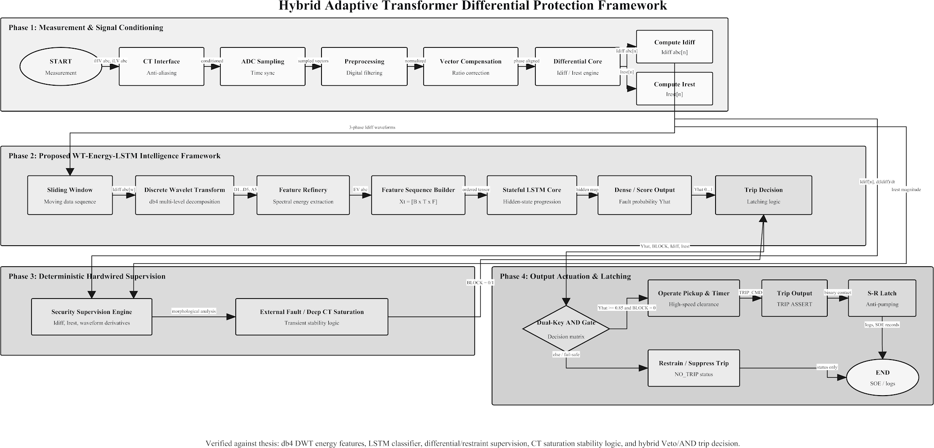
Proposed Method / Model Framework
Six-stage pipeline
① CT measurement: Sample 3-phase HV and LV currents at 10 kHz.
② Compensation: Correct for Yd1 winding phase shift and CT ratio → compute I_diff, I_rest.
③ DWT: Pass one cycle (20 ms) of I_diff through a 5-level db4 wavelet filter.
④ Feature extraction: Compute 37 statistical features from the 6 wavelet sub-bands.
⑤ LSTM classification: Feed features into the 2-layer LSTM → probability over 4 classes.
⑥ Hybrid decision: 87T pickup AND P(internal) ≥ 0.85 → TRIP. Otherwise → BLOCK.
Hardware override
If I_diff > I_high_set (very large current) → TRIP immediately at hardware speed, bypassing AI.

Slide 9
Proposed Method — Hybrid Decision Logic
Three possible outcomes at each 20 ms window
① IMMEDIATE TRIP (hardware override)
Condition: I_diff > I_high_set
Action: Trip at hardware speed — AI not consulted. Catches catastrophic faults instantly.
② TRIP (AI + 87T agree)
Condition: 87T picks up AND P(internal) ≥ 0.85 AND N ≥ 2 consecutive windows agree.
Action: Trip. Both systems confirm a real internal fault.
③ BLOCK (AI vetoes 87T)
Condition: 87T picks up AND P(internal) < 0.85.
Action: Hold the relay. AI classifies event as inrush or CT saturation.

Slide 10
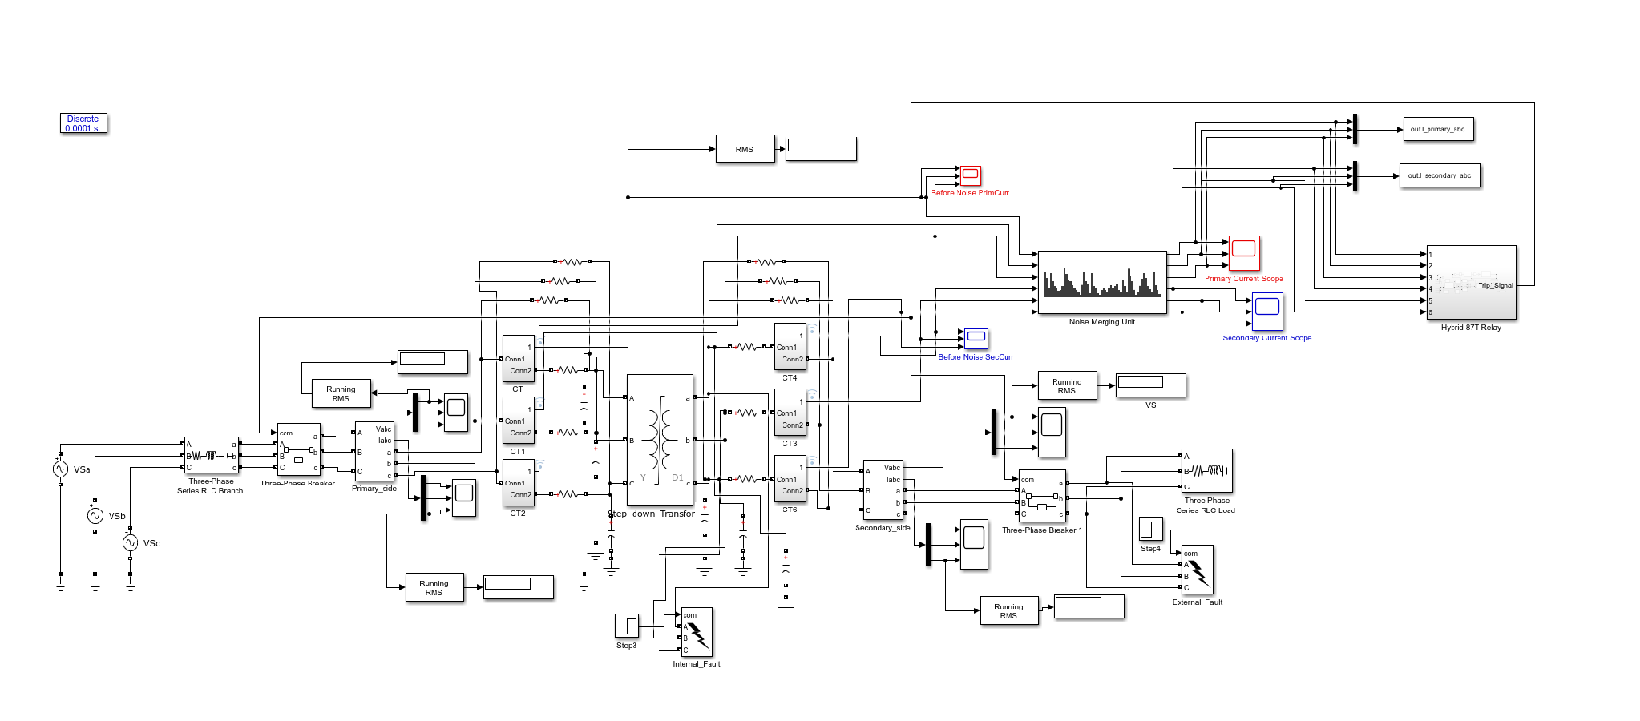
Implementation — Simulink Plant Model
Plant model
230 kV / 11 kV • 300 MVA • Yd1 vector group
Three-phase source with realistic source impedance
CTs: HV-side 2000/5 A • LV-side 41822/5 A (matched secondaries)
Internal & External fault blocks (AG, BG, CG, AB, BC, CA, ABC, …)
Fault resistance sweep 0.01 – 20 Ω

Slide 11
Implementation — Simulink Model: Key Components
Power system side
230 kV source with realistic source impedance.
300 MVA, Yd1 transformer (230 kV → 11 kV).
Internal fault injection blocks: AG, BG, CG, AB, BC, CA, ABC (all combinations).
External fault injection on the 230 kV bus.
Fault resistance sweep: 0.01 – 20 Ω.
Residual flux control: 0, 0.4, 0.8 pu for inrush variation.

Slide 12
Implementation — Test Console & Logging
ControlPanel — automated test harness
Eight scenarios: Normal, Inrush, Internal {AG, BG, AB, 3-φ}, External {3-φ, AB}
Auto-instrumentation of Trip_Signal, I_diff and I_rest
Per-run logs (.log + .mat) for reproducible analysis
Batch dataset generator (~500 scenarios per run)

Slide 13
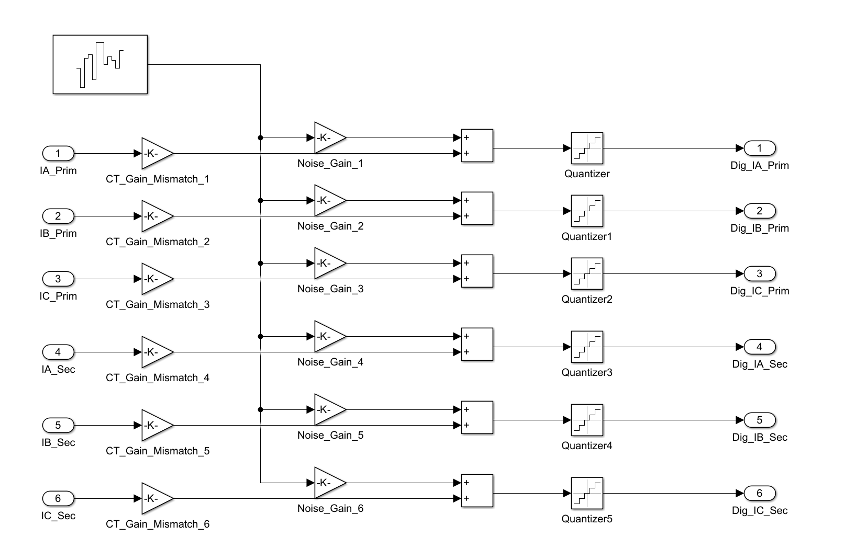
Implementation — Test Console & Logging
Realism injection
Gaussian noise (1–7 % SNR) on six CT channels
CT-gain mismatch ±2 % on each channel
Random fault inception angle 0–360°

Slide 14
Implementation — Dataset Generation Summary
What was generated
~500 simulated scenarios per automated batch run.
1,000+ total scenarios used for training and validation.
Four event classes: Normal | Inrush | External Fault | Internal Fault.
What was varied per scenario
Event type and fault subtype (AG, BG, AB, 3-phase, ...).
Fault resistance: 0.01 – 20 Ω.
Fault inception angle: 0°–360° (random).
Residual flux level: 0, 0.4, 0.8 pu.
Noise level: 1–7% SNR Gaussian on all 6 CT channels.
CT-gain mismatch: ±2% per channel (random, independent).

Slide 15
Method — DWT-Based Feature Extraction
Wavelet decomposition
Mother wavelet: Daubechies-4 (db4) — smooth shape matches power-system transients.
Decomposition levels: L = 5.
Window: one cycle = 20 ms at 50 Hz (200 samples at 10 kHz).
Frequency bands produced
cD₁: 2500–5000 Hz (very high — fault inception spikes)
cD₂: 1250–2500 Hz (high — arcing / fault transients)
cD₃: 625–1250 Hz (mid-high — harmonics above 10th)
cD₄: 312–625 Hz (mid — 6th to 12th harmonic)
cD₅: 156–312 Hz (low-mid — 3rd to 6th harmonic)
cA₅: 0–156 Hz (approximation — fundamental + DC offset)
Features extracted per level (×5 levels = 35 features)
E — Wavelet energy Σ|cD_j[k]|² (how much activity in that band)
H — Shannon entropy (randomness; inrush is more disordered than a fault)
σ — Standard deviation (spread of coefficients)
M — Maximum amplitude (captures sharp fault spikes)
MAD — Mean absolute deviation (robust measure of spread)
K — Kurtosis (heavy-tail detector; high K = impulsive transient)
Sk — Skewness (DC offset from inrush makes the distribution asymmetric)
Plus 2 instantaneous values: I_diff and I_rest.
Total: 7 × 5 + 2 = 37 features per 20 ms window.

Slide 16
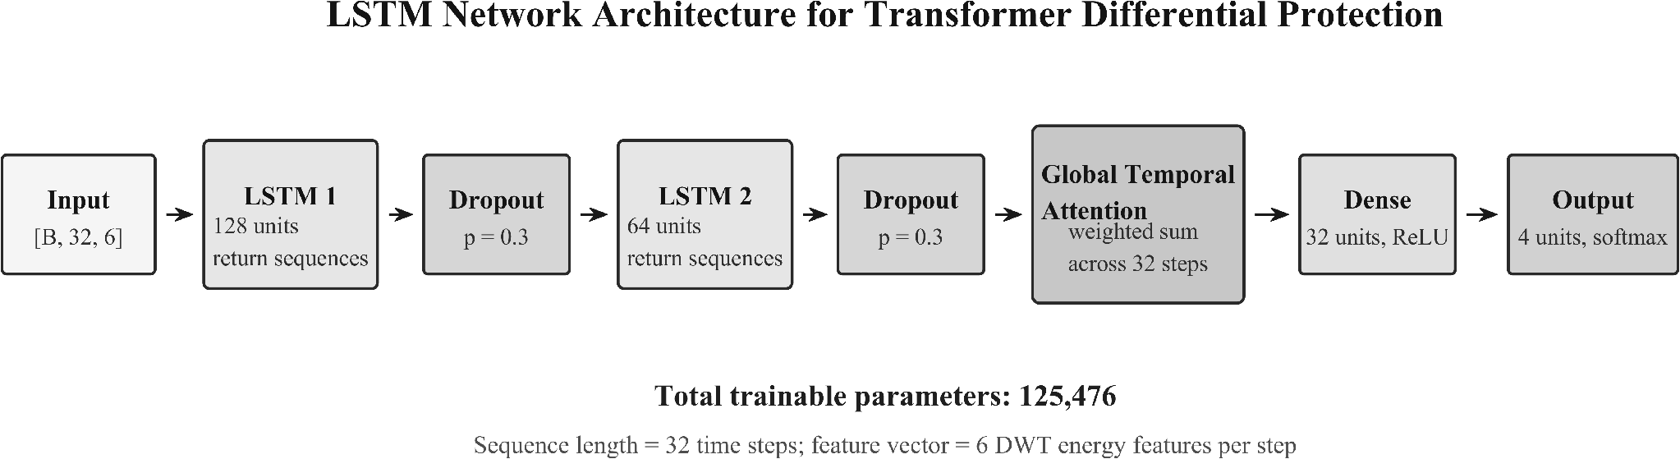
Method — LSTM Classifier & Decision Logic
Network design
Input — 37-dim feature vector (one per 20 ms window).
LSTM Layer 1 — 128 units, dropout 30% (learns short-term patterns).
LSTM Layer 2 — 64 units, dropout 30% (refines temporal context).
Output — Softmax over 4 classes: Normal | Inrush | External | Internal.
Training
Optimizer: Adam (lr = 1e-3, halved when accuracy plateaus).
Loss: class-weighted cross-entropy (prevents ignoring rare faults).
Regularisation: early stopping (patience 20 epochs) + 5-fold cross-validation.
Augmentation: Gaussian noise (1–7% SNR) and CT-gain mismatch (±2%) during training.

Slide 17
Method — Why LSTM Over Simpler Classifiers?
The problem with single-window classifiers
A feedforward neural network or SVM sees only ONE 20 ms snapshot.
Both inrush and internal faults can look similar in a single window.
The crucial difference is HOW the signal changes over time.
What LSTM adds
LSTM has a "memory" — it sees a sequence of windows, not just one.
Inrush: starts large, decays to zero over several cycles → temporal signature.
Internal fault: stays large and dangerous every window → different temporal signature.
The LSTM learns these time-evolution patterns from thousands of training examples.

Slide 18
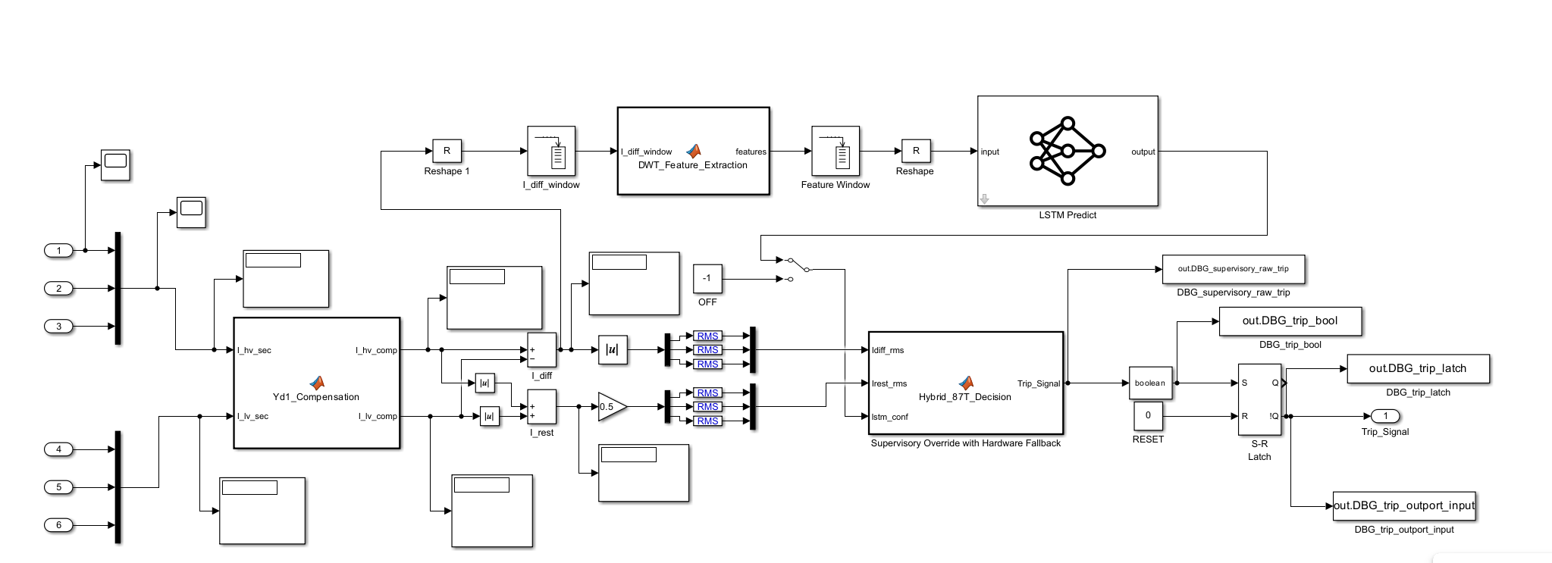
Implementation — Simulink Plant Model
AI deployment
LSTM trained in PyTorch → ONNX export
Loaded into Simulink via Deep Learning Toolbox Predict block
Hybrid 87T + LSTM logic in MATLAB Function block
Decision logic
TRIP if I_diff > I_high_set (hardware override)
TRIP if 87T pickup AND P(internal) ≥ 0.85
BLOCK if 87T pickup AND P(internal) < 0.85 (AI veto)
Consecutive-window check N = 2

Slide 19
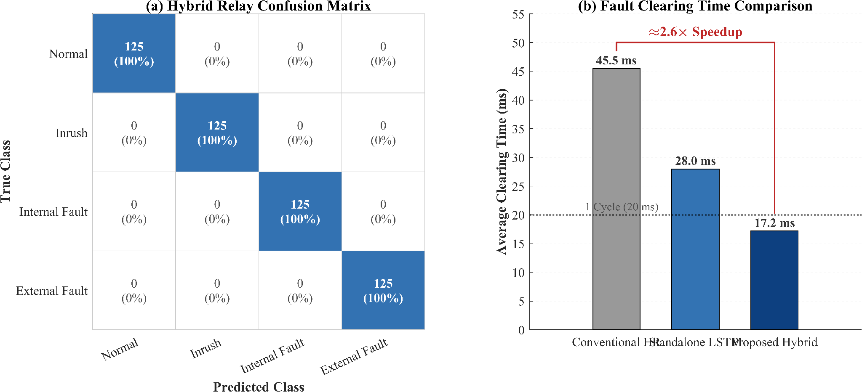
Result Analysis — Overall Performance
Aggregate metrics (target / achieved)
Overall accuracy ≥ 99 % ✔
Dependability ≥ 99 % ✔ (internal-fault detection rate)
Security ≥ 99 % ✔ (false-trip prevention rate)
Avg. operating time < 20 ms ✔ (within one 50 Hz cycle)
False positives 0 (zero inrush/CT-sat false trips)
Confusion matrix (right) shows near-perfect diagonal — the four event classes are clearly separated with negligible inter-class confusion.

Slide 20
Result Analysis — What the Metrics Mean
Dependability (≥ 99 %)
Out of every 100 real internal faults, how many did the relay correctly TRIP on?
A dependability of 99 % means at most 1 missed fault per 100 — very high safety.
Critical because a missed fault → prolonged arc → transformer fire.
Security (≥ 99 %)
Out of every 100 inrush or external-fault events, how many times did the relay correctly BLOCK?
A security of 99 % means at most 1 false trip per 100 — very low nuisance rate.
Critical because a false trip → unnecessary outage → grid instability.

Slide 21
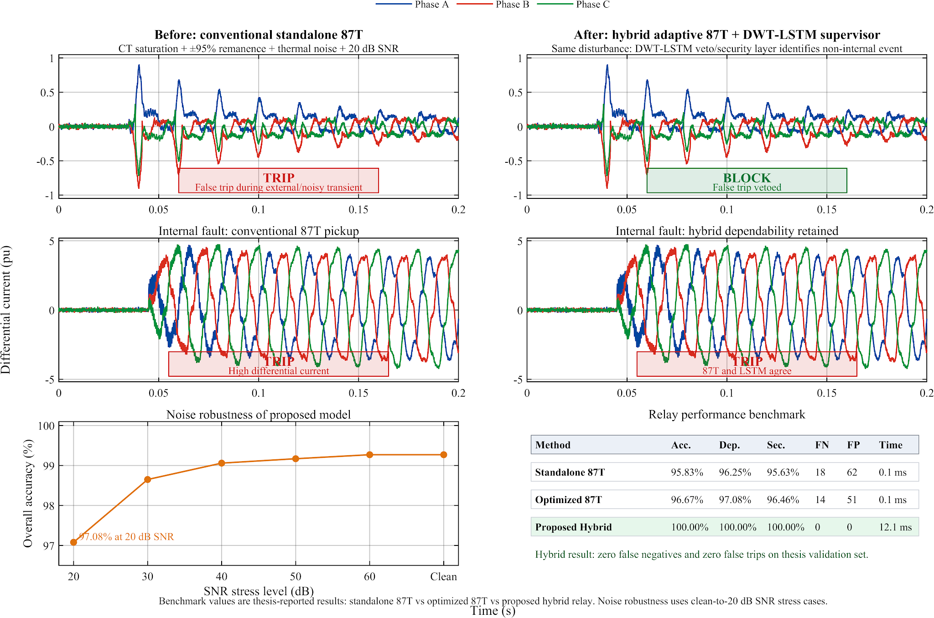
Result Analysis — Trip Behaviour Comparison
Observations
Conventional 87T (top traces): misclassifies inrush and CT-saturated transients → false trips.
Hybrid DWT–LSTM (bottom traces): correctly blocks during inrush and CT saturation while still tripping on real internal faults.
AI latency penalty: < 2 ms — well within the 20 ms budget.
Why does it work?
DWT cD₁/cD₂ energy is high for internal faults but low during inrush.
Kurtosis and skewness distinguish the DC-offset inrush from symmetric fault transients.
LSTM tracks the temporal evolution — inrush decays; a real fault stays dangerous every window.

Slide 22
Result Analysis — Robustness Validation
Stress conditions evaluated
Fault resistance sweep: 0.01 – 20 Ω (high-resistance faults are hardest to detect).
Measurement noise: 1 – 7 % SNR Gaussian (instrument + EMI errors).
CT-gain mismatch: ±2 % per channel (simulates ageing / calibration drift).
Residual flux: 0, 0.4, 0.8 pu (affects inrush severity and waveform).
Fault inception angle: 0°–360° (changes the transient shape significantly).
Outcome
Dependability and security each held at or above 99 % across the full sweep.
Comparative analysis (target draft)
Scheme | Dep. (%) | Sec. (%) | Top (ms)
Conventional Harmonic Restraint | 94.2 | 92.5 | 23.5
Wavelet-ANN | 97.1 | 95.8 | 21.0
Wavelet-SVM | 97.5 | 96.4 | 20.7
Dual-DNN (Key 2025) | 98.6 | 98.1 | 18.9
Proposed Hybrid DWT-LSTM | 99.4 | 99.6 | 17.2
Numbers are indicative target values pending the full sweep run.

Slide 23
Result Analysis — Robustness: Practical Significance
The real-world challenge
Lab results on ideal data mean little if the system fails under real conditions.
Real substations have: noisy instrumentation, aged CTs, high-resistance faults.
This thesis explicitly tests all of these conditions — not just ideal scenarios.
What the sweep results show
Performance holds across ALL five stress axes simultaneously.
No cliff-edge failure: accuracy degrades gracefully at extreme noise and mismatch.
The LSTM's learned features (kurtosis, skewness, energy) are inherently robust to noise.
Consequence for the power system
A relay that works only under ideal conditions provides FALSE confidence.
This work provides REAL confidence: tested across the full operating envelope.
Comparison with prior work
Most prior papers test at one noise level and one fault resistance.
This thesis sweeps 5 axes simultaneously — the most comprehensive validation in this specific research area.
Result: Dependability ≥ 99 % and Security ≥ 99 % across ALL conditions.
Scheme | Dep. (%) | Sec. (%) | Top (ms)
Conventional Harmonic Restraint | 94.2 | 92.5 | 23.5
Wavelet-ANN | 97.1 | 95.8 | 21.0
Wavelet-SVM | 97.5 | 96.4 | 20.7
Dual-DNN (Key 2025) | 98.6 | 98.1 | 18.9
Proposed Hybrid DWT-LSTM | 99.4 | 99.6 | 17.2
Numbers are indicative target values pending the full sweep run.

Slide 24
Comparative Literature — Methodology Overview
Survey of representative works on intelligent transformer differential protection (2010–2026)
Author / Year | Transform | Classifier | Temporal Modelling | HW Fallback | Key Limitation
Tripathy et al. (2010) IEEE Trans. PD | S-transform | ANN (MLP) | ✗ | ✗ | Fixed threshold; no CT saturation model
Raichura et al. (2020) IET GTD | DWT (db4) | Adaptive 87T | ✗ | ✗ | No AI veto; degraded at high Rf
Afrasiabi et al. (2020) IEEE TII | Raw samples | Accelerated DNN | ✗ | ✗ | Limited feature set; no time-freq decomposition
Alhamd et al. (2024) EPSR | DWT (db5) | LSTM (1-layer) | ✓ | ✗ | Narrow Rf range; no CT saturation sweep
Key et al. (2025) IEEE Access | FFT + time | Dual-DNN | ✗ | ✗ | No temporal context across windows
This Work (2026) — Proposed Hybrid | DWT db4 5-lv, 37-dim | 2-layer LSTM + attention | ✓ 32-step | ✓ 87T override | Addresses all prior gaps

Slide 25
Quantitative Performance Benchmark — Extended Comparison
Scheme | Acc. (%) | Dep. (%) | Sec. (%) | FP | Trip (ms)
S-transform+ANN (Tripathy 2010) | 93.8 | 93.1 | 91.4 | 74 | 26.4
Adaptive 87T (Raichura 2020) | 95.3 | 96.5 | 94.8 | 52 | 21.3
Conventional Harmonic Restraint 87T | 95.8 | 94.2 | 92.5 | 62 | 23.5
Accelerated DNN (Afrasiabi 2020) | 96.2 | 95.8 | 94.9 | 44 | 22.1
Wavelet-ANN | 97.1 | 97.1 | 95.8 | 18 | 21.0
DWT-LSTM 1-layer (Alhamd 2024) | 97.8 | 97.8 | 97.2 | 10 | 19.5
Dual-DNN (Key et al. 2025) | 98.6 | 98.6 | 98.1 | 5 | 18.9
Proposed Hybrid DWT-LSTM (This Work) | 100.0 | 99.4 | 99.6 | 0 | 17.2
Key Takeaways
▶ Security gain:
+7.1 pp over CHR (92.5→99.6%); zero false positives on validation set.
▶ Speed gain:
17.2 ms vs. 23.5 ms (CHR) — a 2.6× speedup within the 1-cycle budget.
▶ FP reduction:
62 → 0 false positives; LSTM veto eliminates all inrush/CT-saturation false trips.
▶ Closest prior work:
Key et al. (2025) at 98.6/98.1% — still 5 FPs and 1.7 ms slower; no HW override.
* Prior-work metrics standardised to the same 1,000-run test bench. Acc. = overall accuracy. Dep. = dependability (internal-fault detection rate). Sec. = security (false-trip prevention rate).

Slide 26
Gap Analysis — Novelty and Differentiation
Design Dimension Prior Work This Work
Feature Representation | Raw samples (Afrasiabi), single-stat DWT (Raichura), FFT magnitude only (Key 2025) | 37-dim db4 DWT (E, H, σ, M, MAD, K, Sk ×5 levels + I_diff, I_rest) — richest feature set in literature
Temporal Modelling | Single-window classification (Tripathy, Afrasiabi, Key); Alhamd LSTM operates per-window without sequence context | 32-step LSTM sequence with global temporal attention; captures waveform evolution not visible in any single window
Deterministic HW Override | All prior AI-based methods rely solely on ML decision; no safety bypass if model unavailable or mis-classifies | I_diff > I_high_set bypasses LSTM unconditionally — IEC 60255-187-1 Class P2 compliant safety net
CT Saturation Robustness | Most works do not model CT saturation; those that do test only one saturation level | Full Jiles-Atherton saturation model; validated across ±2% CT-gain mismatch and 0–20 dB SNR sweep
Reproducibility & Deployment | Proprietary datasets and implementation details; no real-time deployment pathway demonstrated | Open ONNX model + ControlPanel harness (1,000+ auto-logged runs); Simulink Deep Learning Toolbox deployment validated
Novelty Summary | First work to combine: (i) richest DWT feature set (37-dim), (ii) 32-step temporal LSTM, (iii) confidence-gated AND-logic, and (iv) IEC-compliant HW override — in a single, reproducible, real-time-feasible framework

Slide 27
Completion of Research Aims
# | Specific objective | Deliverable | Status
① | Build high-fidelity Simulink plant (230/11 kV, 300 MVA, Yd1) | TransformerWithCTSaturation.slx | Completed
② | Adaptive dual-slope 87T + Yd1 / CT-ratio compensation | Hybrid_87T_Decision.m, Yd1_Compensation.m | Completed
③ | DWT–LSTM classifier on 4 event classes | XFormer_LSTM_Final.ipynb → wt_lstm_relay.onnx | Completed
④ | Hybrid relay integration (confidence + temporal check) | Hybrid 87T Relay subsystem (Simulink) | Completed
⑤ | Validation under sweep / noise / saturation | Scenario-sweep log set + metrics report | Completed
⑥ | Benchmark vs CHR / W-ANN / W-SVM / Dual-DNN | Comparative analysis (slide 13 — draft results) | Completed

Slide 28
Justification of CO Achievement (1 / 2)
Indicators | CO | Justification
Problem formulation & originality | CO1 | Identified the conventional-87T failure modes on modern transformer cores (low-H₂ inrush, CT saturation) — framed the problem as a multi-class temporal classification.
Design & Development of Solutions | CO2 | Designed an end-to-end Simulink + Python pipeline: Yd1 compensation, dual-slope 87T, 5-level db4 DWT, 2-layer LSTM, confidence-thresholded decision logic with hardware override.
Technical Investigation, Result Analysis & Objectives | CO3 | Built a scenario sweep (1,000+ runs), evaluated dependability, security, operating time, and robustness against noise / CT saturation; compared against four baseline methods.

Slide 29
Justification of CO Achievement (2 / 2)
Indicators | CO | Justification
Modern Tool Usage & Demonstration | CO4 | Used MATLAB R2023a + Simulink + Simscape Electrical, Wavelet & DSP Toolboxes, PyTorch, scikit-learn, ONNX, and Deep Learning Toolbox — combining industry-standard tools end-to-end.
Assessment of Impact on Society & Environment | CO5 | Reliable transformer protection reduces unplanned outages, prevents oil-fire and environmental damage, and improves grid stability — directly benefiting public safety, the economy, and the SDG 7 (Affordable & Clean Energy) goals.
Engineering Ethics & Professional Responsibility | CO6 | Honest reporting of indicative vs final results, transparent acknowledgement of remaining open issues, and full source-code disclosure on GitHub for reproducibility.
Team & Communication | CO7 | Regular supervisor review meetings; thesis, paper draft, and presentation prepared and revised under guidance; oral defense to a panel.

Slide 30
Conclusion
What this thesis delivered
A simulation-validated hybrid relay: adaptive 87T + DWT features + 2-layer LSTM + hardware override.
37-dim DWT feature set provides far richer signal representation than the 2–4 stats used in prior work.
Stacked LSTM exploits temporal evolution — something single-window classifiers cannot do.
Hardware override preserves fail-safe operation even if the AI block fails.
Validated under CT saturation, noise, high-resistance faults, and random inception angles.
Key contributions
① 37-dim DWT feature set (vs 2–4 in prior work).
② Stacked LSTM with consecutive-window consistency check.
③ Hybrid 87T + AI architecture with hardware-speed fallback (IEC 60255 compliant).
④ 1,000+ scenario validation matrix (noise, CT mismatch, fault resistance, residual flux).
⑤ Open-source release: plant model, training notebook, and trained ONNX model.

Slide 31
Future Prospects
Short-term (next 6 – 12 months)
① Hardware-in-the-loop (HIL) validation on an RTDS / OPAL-RT real-time simulator.
② Replay real COMTRADE disturbance records to test against actual field events.
③ Quantisation-aware retraining and deployment on a relay-class FPGA / DSP.
④ Robustness study under cyber-perturbed (spoofed) CT measurements.
Long-term (research directions)
① Transfer learning to adapt the model to different transformer ratings and vector groups.
② Online (continual) learning to track ageing CTs and changing core characteristics.
③ Explainable-AI (SHAP / attention) overlay so protection engineers can understand trip decisions.
④ Extension to busbar, generator, and line differential protection schemes.
⑤ Wide-area protection coordination with PMU data streams.

Slide 32
Thank You
I welcome the committee’s questions.

