Slide 1






IPO ANALYSIS
National Stock Exchange (NSE India)
Sanjana Stephen

Slide 2


INVESTMENT THESIS
NSE is India’s largest stock exchange and a global leader in derivatives trading
Dominant, near monopoly like position in the F&O segment
Highly profitable, asset light model with strong operating leverage
IPO provides liquidity and price discovery for long-term investors
Expected to attract strong institutional demand

Slide 3


INDUSTRY OVERVIEW
Rapid growth in Indian capital markets driven by retail participation
Structural shift toward electronic and derivatives trading
India is among the fastest growing equity markets globally
Strong regulatory ecosystem under SEBI

Slide 4



COMPANY OVERVIEW
National Stock Exchange (NSE)
Founded in 1994 — India’s first electronic exchange
Among the largest derivatives exchanges globally (by volume)
Core services: Trading, clearing, settlement, and market data
Revenue mix:
Transaction fees (~67%)
Listing & data services

Slide 5


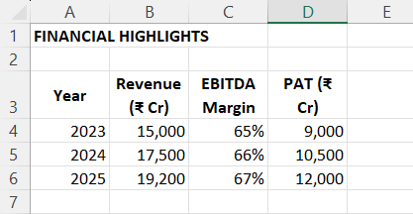
FINANCIAL HIGHLIGHTS

Slide 6


VALUATION
Comparable Analysis
Peer: BSE Ltd
BSE P/E: ~50–60x
NSE Implied P/E: ~35–40x
Implied Valuation:
₹4.5 – ₹5.8 Lakh Cr
Key Assumptions:
Sustainable profit growth
Premium for market leadership + scale
High-margin, capital-light structure

Slide 7

IPO DETAILS
Expected Timeline: 2026
Structure: Offer for Sale (OFS)
Stake Sale: ~4–4.5%
No fresh capital issuance
Use of IPO:
Liquidity for existing shareholders
Enhanced transparency & governance
Public market valuation discovery

Slide 8

RISKS
Regulatory overhang (past SEBI related delays)
Revenue dependence on trading volumes
Competition from BSE and global exchanges
Sensitivity to market cycles & volatility

Slide 9
KEY INSIGHT (DIFFERENTIATOR)
NSE is not a typical company
It operates core financial infrastructure
Earnings scale with market activity
Acts as a proxy for India’s capital markets growth

Slide 10
RECOMMENDATION
SUBSCRIBE (Long Term)
Strong fundamentals
Market dominance
High profitability
Structural growth tailwinds

