Slide 1

Trends Dashboard
Group 4 – Project 3 – Team
Caroline Grant, Helena Chen, Jancel Dawn Adiong, Priyavarthani Somangili Subramanian

Slide 2
To conduct a comprehensive analysis of YouTube channel performance, content engagement, and audience demographics to optimize content strategy, increase viewer engagement, and grow the channels subscribe
OBJECTIVE

Slide 3
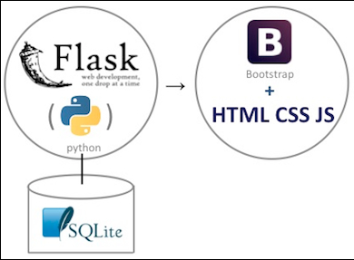
🖥️ Development Workflow
Data source: Kaggle.com(CSV File) https://www.kaggle.com/datasets/nelgiriyewithana/global-youtube-statistics-2023
Backend: Creates multiple APIs, converts the SQLite database to Json format and returns to API calls(FLASK, Python,SQLite)
Frontend: Make API request to the backend to retrieve data for the visualization. Web development (HTML,CSS,JS)

