Slide 2
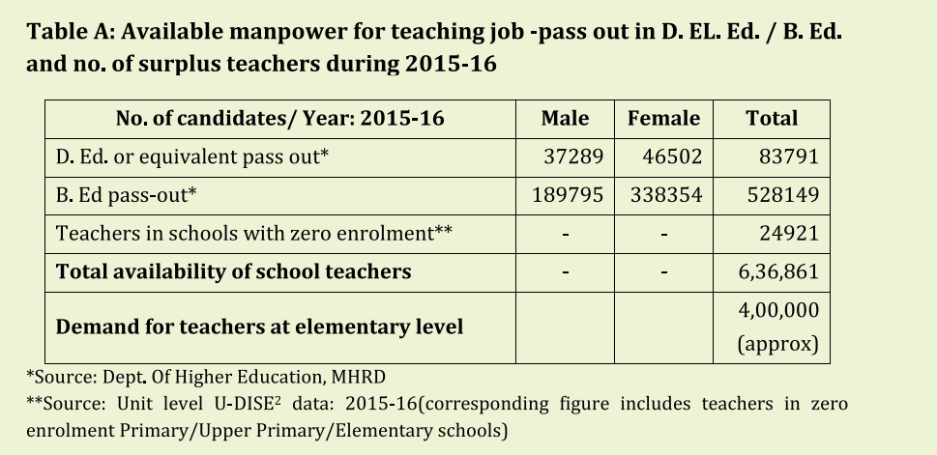
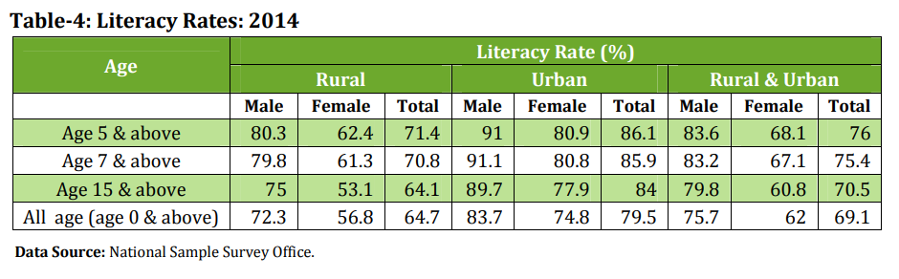
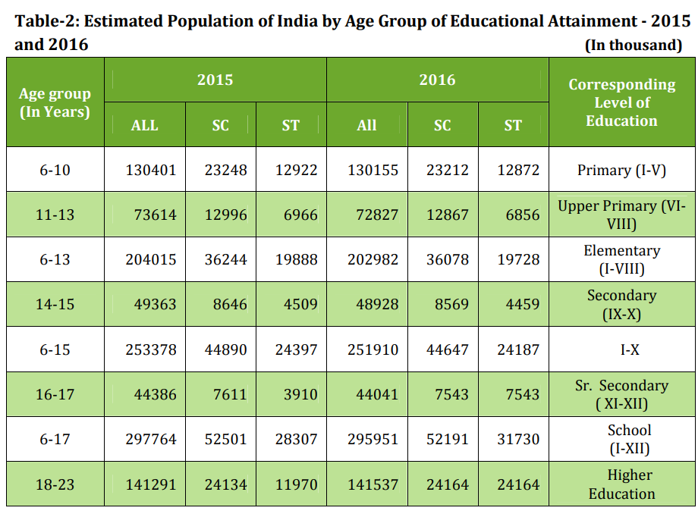

Slide 3
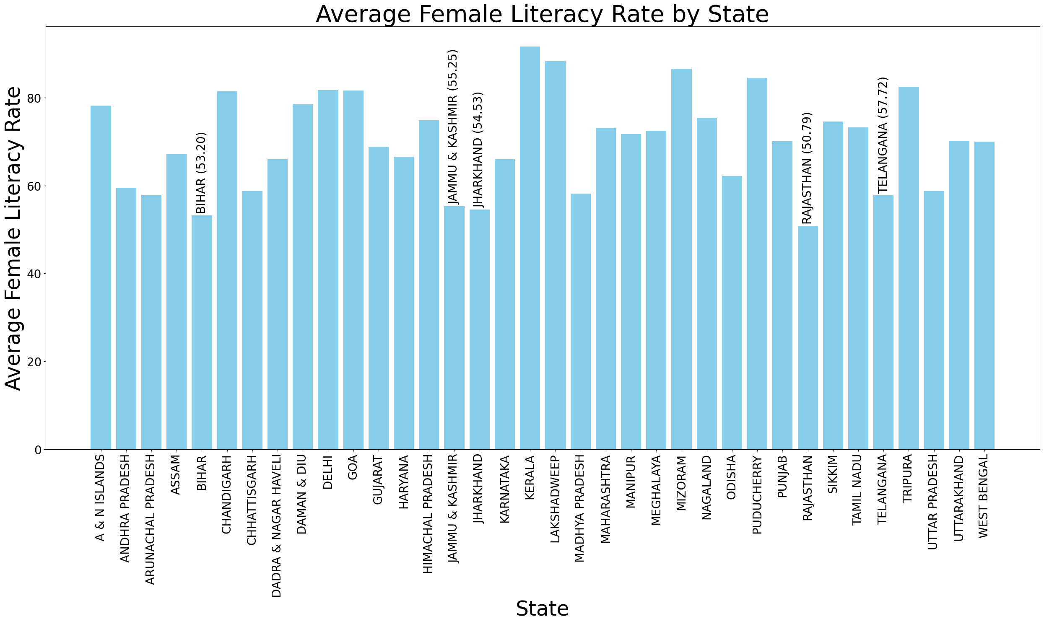
What‘s the literacy status of the country?
States with lowest literacy:
For Females:
Rajashthan
Bihar
Jharkhand
J & K
Telangana
For Males:
Arunachal Pradesh
Bihar
Telangana
Andhra Pradesh
Meghalaya
Focusing on these states for further analysis !

Slide 4
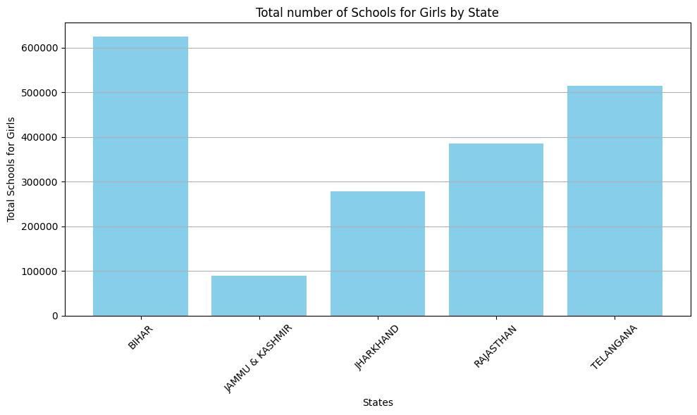
How is the school situation in these states?
To further screen the data for J & K, one needs to look at the socio-political situation of the state
NGO can contact local officials to further screen the matter
Does this stats rule out the necessity of more schools in Bihar?

Slide 5
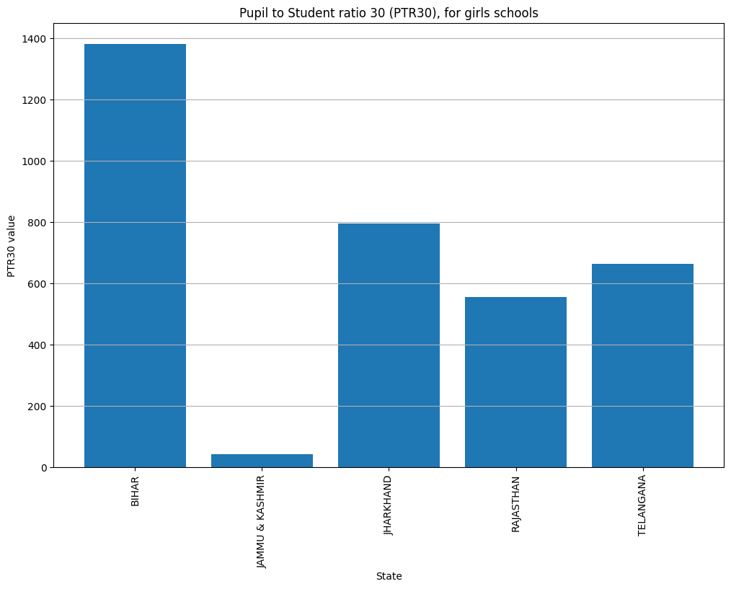
How is the situation of the schools in context to PTR30 and SCR30?
PTR30 defines the pupil (30) to Teacher (1) ratio
Bihar !!!

Slide 6
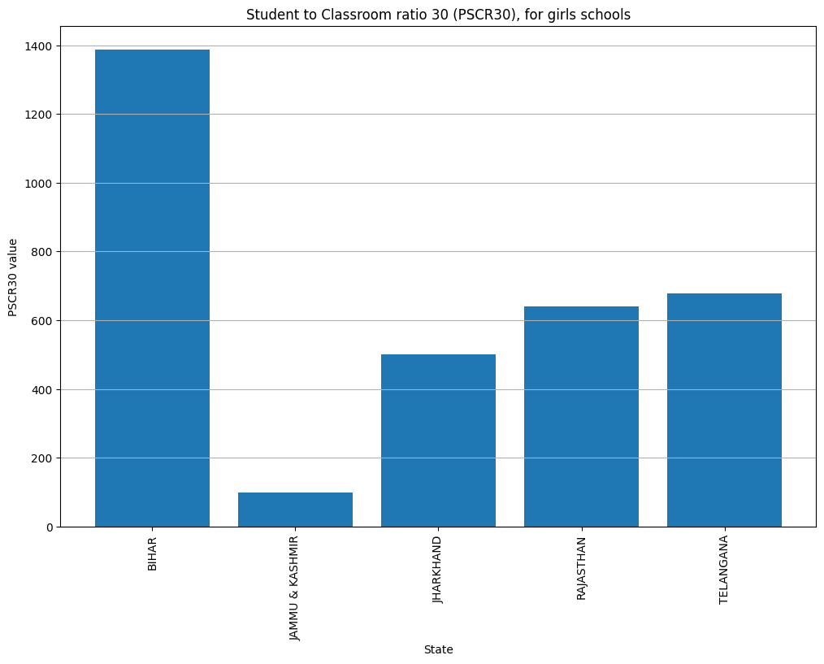
How is the situation of the schools in context to PTR30 and SCR30?
CSR30 defines the student (30) to classroom (1) ratio
Bihar !!!

Slide 8

Thank you for listening!!!

