Slide 1
Introduction to r programming
Ifeanyi Edochie (iedochie@worldbank.org)

Slide 2
Overview of R as a programming language
R is a powerful language widely used for statistical computing and data analytics.
R provides a rich set of built-in functions and packages for various data manipulation, visualization and statistical analysis tasks.
It supports a wide range of data types, including numeric, character, logical and more specialized types like factors and dates.
R is highly extensible, allowing users to create their own functions and packages to extend its functionality.

Slide 3
Brief History of R
Development at Bell Laboratories (1990s):
R originates from the S programming language developed at Bell Labs (formerly part of AT & T) in the 1976 by John Chambers
In the 1990s, statisticians Ross Ihaka and Robert Gentleman began developing R as an open-source, free alternative to S
Released of R in 1995
Growth of the R community and Packages
Large vibrant & enthusiastic community of users and developers (stackoverflow) developed many R packages (found on CRAN and/or github)
Continuous development of R and RStudio – object-oriented programming (OOP), functional programming and other programming paradigms

Slide 4
Brief History of R (continued)
Popularity and Adoption
Used extensively in academia, research institutions, industry for data analytics and modelling.
Expanded use into dashboard development (RShiny, Flexdashboards) and other tools beyond statistical analytics
The Applications of R Programming language includes:
Statistical Computing
Machine Learning
Data Science

Slide 5
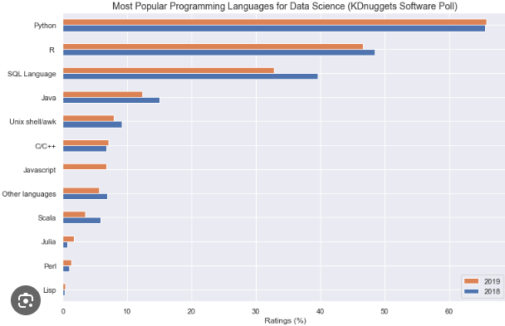
The Popularity of R Language in Data Science

Slide 6
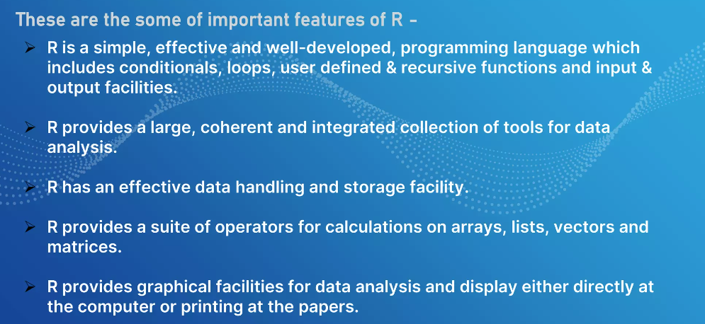
Features of R

Slide 7
Why Use R for Poverty Mapping
R allows for general purpose programming even beyond statistics. This allows for:
automating analyses workflows
creating new functions and extending language features
R is an open-source software with a large user community. A lot of new functions from prominent statisticians in the field, with citations in prominent academic journals
Poverty Mapping tools are almost exclusively R based. Most (if not all) of the developments in SAE methodology are implemented in R.

Slide 8
Why Use R for Poverty Mapping
Data wrangling – 80% of poverty mapping work involves data manipulation. R has dataframe, datatable and dplyr packages which surpass Python’s pandas in efficiency and handling large datasets
Data visualization – ggplot2 is one of the best data visualization tools.
Machine learning (beyond our scope for the moment!)
Compatibility with ChatGPT (no programmer is an island!)

Slide 9
RStudio: Introduction
RStudio is an Integrated Development Environment (IDE) designed specifically for R.
It provides a user-friendly interface with various tools to facilitate R programming and data analysis.
RStudio includes a code editor, console, workspace browser, and plot viewer, among other features.
The IDE offers seamless integration with R, making it easier to write, execute and debug R code.
Please go ahead and install R and RStudio if you have not already!

Slide 10
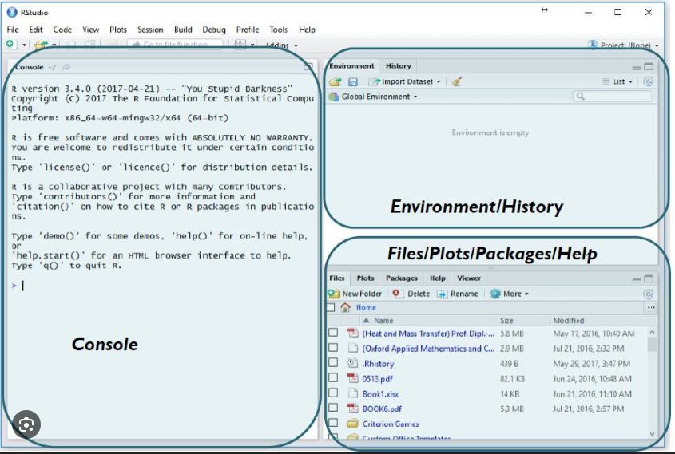
RStudio: Basic Features (show and tell time!)

Slide 11
Next …..
DATA & WORKFLOW MANAGEMENT WITH GITHUB AND RSTUDIO FOR TEAMS AND COLLABORATION

