Slide 1
Github Hands-on Tutorial
Ifeanyi Edochie
(iedochie@worldbank.org)

Slide 2
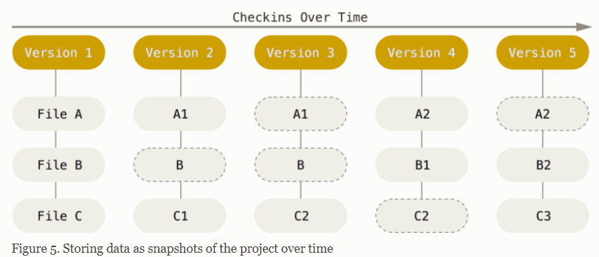
What is Git?
A distributed version control system that tracks in any sets of files used for coordinating work amongst programmers who are collaborating developing code during their development process

Slide 3
Key Features of Git
Version Control: Allows you to keep track of changes made to files over time, enabling you to revert to previous versions if needed.
Branching and Merging: Git enables developers to work on multiple features simultaneously by creating branches, and later merging those changes back into the main branch
Collaboration: Git facilitates collaboration among team members by providing mechanisms for sharing changes and resolving conflicts
Security: Git ensures the integrity of your data through cryptographic hashing, making it difficult to tamper with project data and history.

Slide 4
Benefits of Using Git
Workflow Efficiency: Git streamlines the development workflow by providing tools for tracking changes, managing versions, and collaborating with others.
Error Recovery: With Git, you can easily recover from errors or mistakes by reverting to previous states of your project
Team Collaboration: Git fosters collaboration among team members by providing a centralized repository for sharing code and coordinating efforts
Code Quality: Git encourages best practices such as atomic commits and code reviews, leading to higher code quality and maintainability.

Slide 5
So, what is Github then??
GitHub is the web-based hosting service for version control using Git.
It provides the platform for developers to collaborate on projects, share code and manage software development workflows.

Slide 6
Key Features & Benefits of GitHub
Remote Repository Hosting: GitHub serves as a centralized platform for hosting Git repositories, allowing developers to store and manage their project code online
Collaboration Tools: GitHub offers features such as issue tracking, pull requests, and code review tools to facilitate collaboration among team members
Visibility and Transparency: GitHub enables developers to showcase their projects to the wider community, making it easy to discover and contribute to open-source projects. ZamStats can decide what, how, how much and when to share it’s work with the community of statisticians if it so desires.
Documentation: GitHub allows developers to create and maintain project documentation, wikis and README files to provide context and guidance for users and contributors. (quick show and tell!)

Slide 7
Using Github with R & RStudio
Integrating Git with RStudio:
Rstudio provides seamless integration with Github, allowing users to manage version control directly within the Rstudio environment.
By configuring Git with Rstudio, users can perform version control operations such as committing changes, pushing to remote repos, and resolving conflicts

Slide 8
Using Github with R & RStudio
Steps to Integrate Git with RStudio:
Install Git (here)
RStudio (the organization, now called Posit) created a detailed tutorial for setting up Git, Github and RStudio (https://happygitwithr.com). I will walk you through this, if we have time but it is easy to follow on your own!
GitHub Desktop (Let’s install this here)
We will now get hands on with all of this.

Slide 9
Github Exercise of the Day
By now, you have installed Git and you GitHub Desktop as your GUI (i.e. Graphical User Interface).
Do the following to familiarize yourself with Github:
Create a repository from RStudio, call it: “RProgrammingIsFun”
Create two folders called “Scripts” and “Data”
In the folder called “Scripts”, create an R file called “hello.R”.
In “hello.R”, just add a line “#### this is my hello script”
Then add a second line, y <- rnorm(0.5, 500)
Save the script
Now, you will commit all your changes, and push to the remote repository i.e. github online.
You should see all of this on your github account
One of your colleagues will invite you to their repo. Create a different branch as different from “main”. Call it whatever you want and commit and push anything you want unto that branch.

