Slide 1
Credit Debit Memo Request (CDMR)
Siva Sajjala

Slide 2
Problem Statement
Build an automated approval tool for giving a customer credit or debit for their invoices with out manual intervention

Slide 3
Business Objectives
The objective of the CDMR project is:
To improve the efficiency of back office business processes by enabling the initiation, approval workflow and insertion of a credit debit memo request for customers
To provide consistency in the CDMR process that will lead to greater predictability in levels of response to customers
A means to configure and track customer, invoice and CDMR information in a central repository

Slide 4
Scope & requirements
Provide user interface to create a credit/debit request by sales reps
Search facility for all users (TM, DSM and FM) to view the requisitions and their status
Provide inbox to list all tasks waiting for approval
User interface for approvers to approver or reject a requisition
Automate work flow approvals

Slide 5
Out of scope
Provide admin functionality for maintaining user/approvers set up (optional – future release)
Update customer account with credit/debit charges

Slide 6
Workflow & Hierarchy
Create CDMR
Review/Approve CDMR
Update Customer Account
TM
DSM
AP (Accounts Payables)
FM

Slide 7
Conceptual Integration Diagram

Slide 8
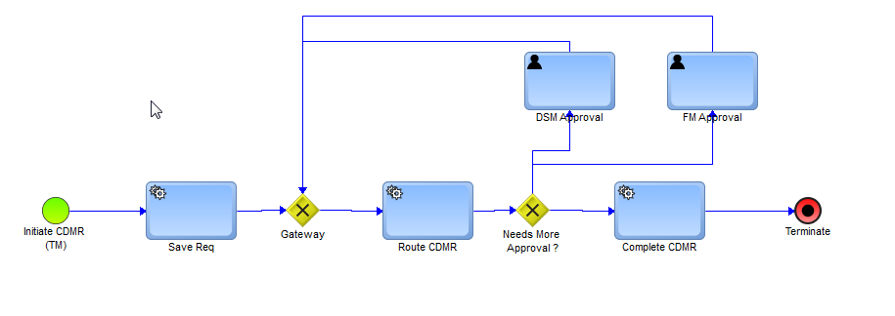
Work Flow

Slide 9
Users and Roles
Initiator
TM – Territory Manager (Sales Rep)
Approver
DSM – Divisional Sales Manager
FM – Finance Manager (Final approver)

Slide 10
How It Works?
TM initiates the CDMR for his/her customer
Application routes to DSM for first level of approval
DSM can either approve or reject requisition
If it is approved, route engine assigns the task to next approver – FM
Again FM gets a chance to approve or reject it
Once its approved, customer would get the credit/debit

Slide 11
Technology Stack
UI –
JSP
HTML
css
Services
Java 1.8 EE
Hibernate
Scripting
JS
JQUERY
Database
MySQL
Web app container
TomEE
Testing
Junit
Selenium web driver (for UI test automation)

Slide 12
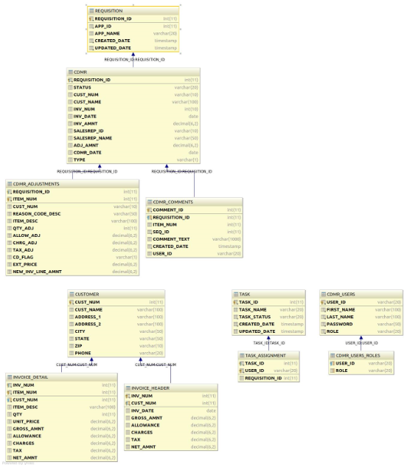
DB Model

Slide 13
Difficulties, findings & learning points
Implementing jQuery scripts for actions on dynamic html table
Had to spend more time researching
Deploying and running the app on digital ocean
Firebug browser plugin was helpful in finding the xPaths, console logs for UI test
Selenium was a good learning topic

Slide 14
Demo time !!!

