Slide 1
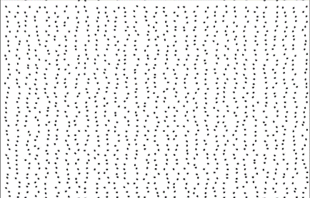
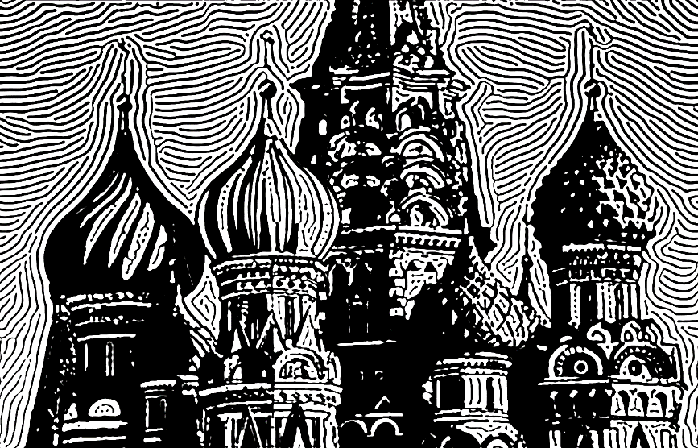
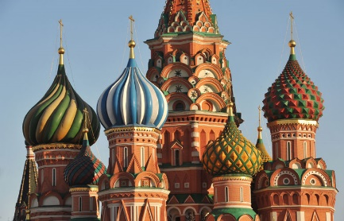
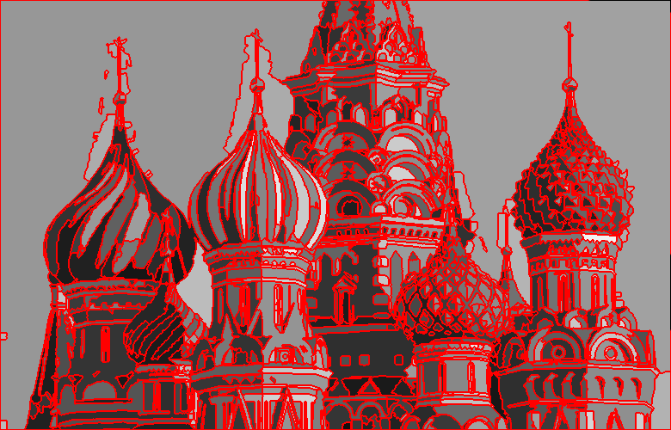
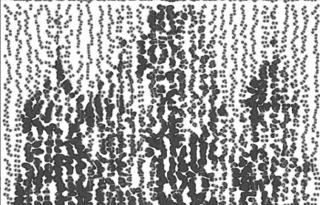
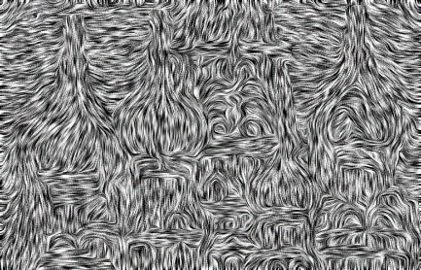
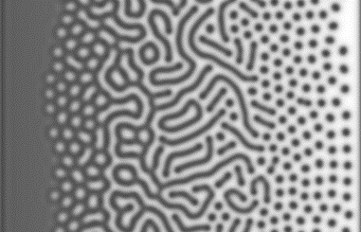
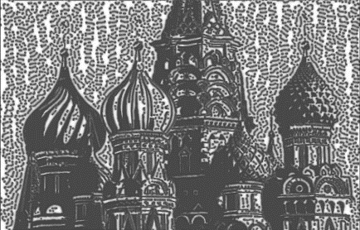
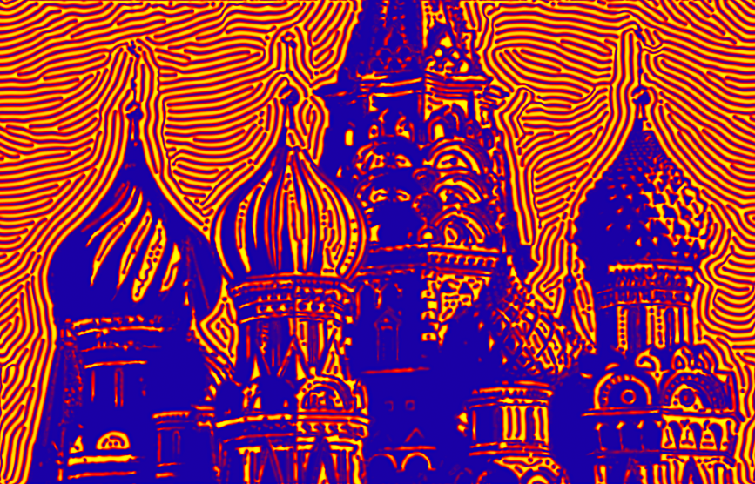

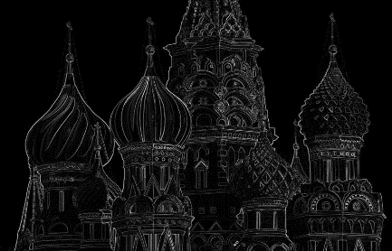
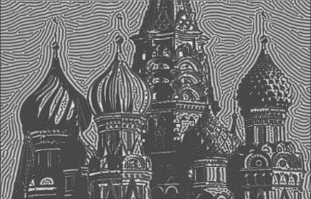
Input image
Segmentation
Thresholding
ETF
Parameter
Edge
Color mapping
Input
Style selection
Reaction diffusion
Post processing

Slide 2






$$(0.06,0.03)$$
$$F$$
$$(0.0, 0.03)$$
$$k$$
$$(0.0,0.07)$$

Slide 3


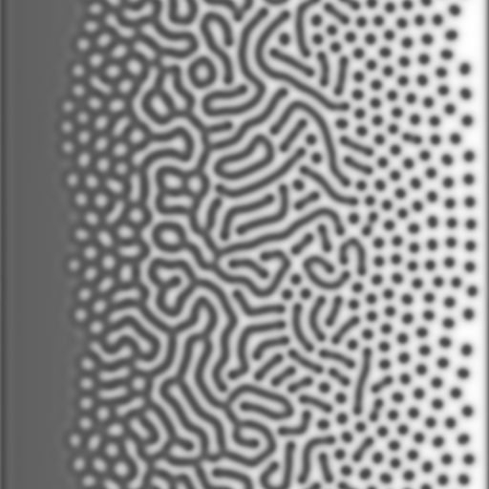
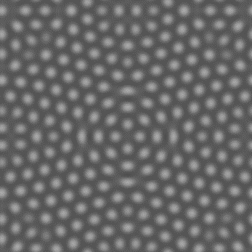
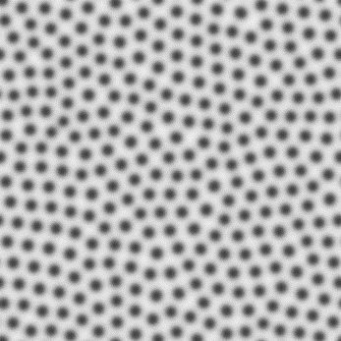
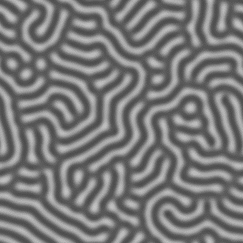
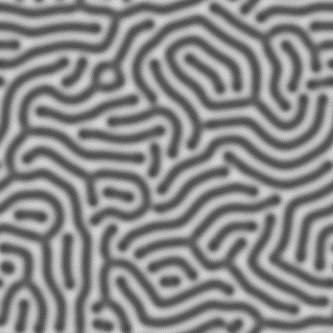
type $B$: black
type $R$: white
$$F=0.0375$$
type $δ$: hole
type $λ$: spot
$$0.056$$
$$k$$
$$0.066$$
type $θ$: maze
type $κ$: stripe

Slide 4
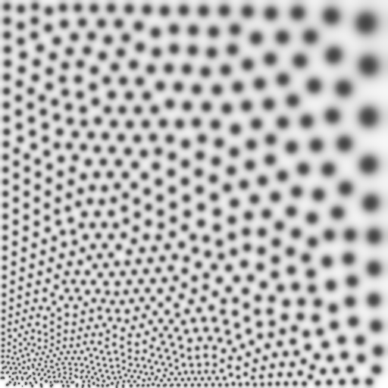
$$1.0$$
$$S_{D}$$
$$0.1$$
$$1.0$$
$$S_{R}$$
$$0.1$$

Slide 5
$$θ$$
$$θ$$
$$r$$
$$r$$

Slide 6
$$θ$$
$$θ$$
$$r$$
$$r$$

Slide 7
$$V$$
$$V$$
$$w$$
$$w$$
$$h$$
$$h$$

Slide 9
(a)
(b)
(c)

Slide 10
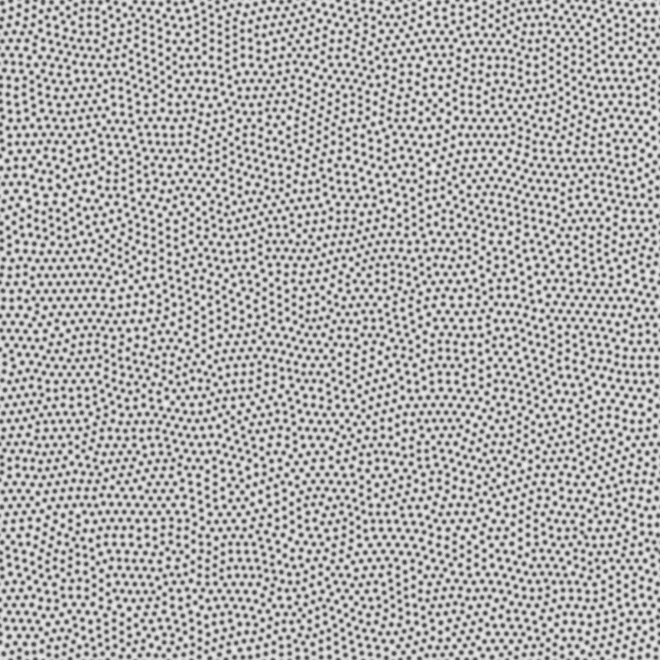
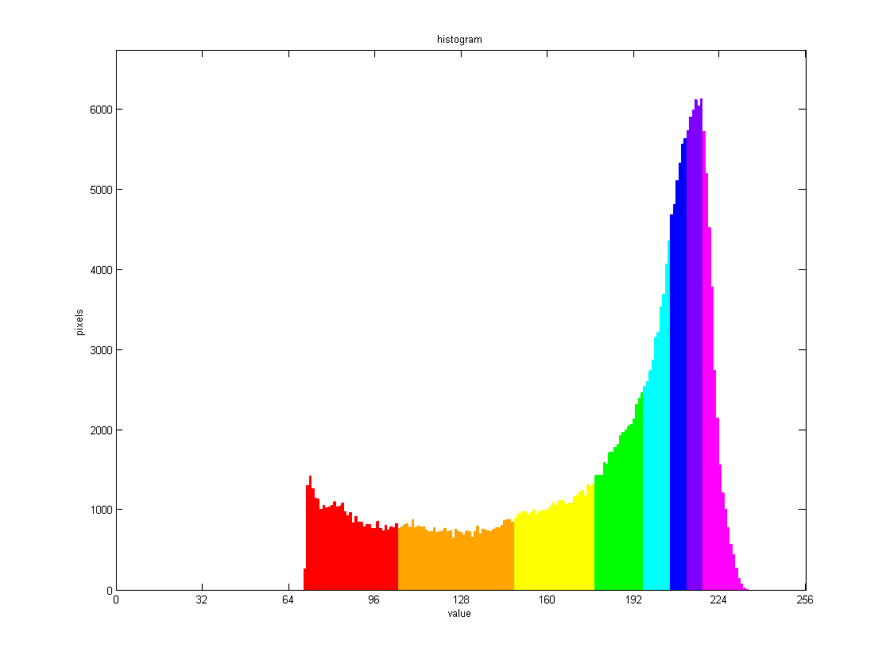

Source pattern
Mapping of thresholding value

Slide 11
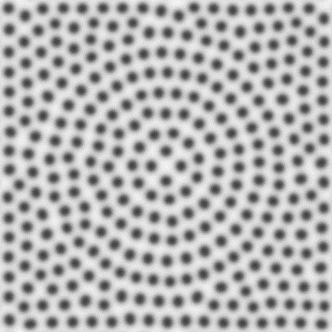
$$v_{g}^{i}$$
$$p_{i}$$
$$θ_{i}$$
$$v_{f}^{i}$$
$$r_{i}$$
$$v_{f}^{i}$$
$$p_{i}$$
$$v_{g}^{i}$$

Slide 12
$$r_{i}$$
$$θ_{i}$$
$$r_{i}$$
$$θ_{i}$$

