Slide 1

Using the Secure Electronic Records Express Web Site
Social Security Administration
ssa.gov/ere

Slide 2
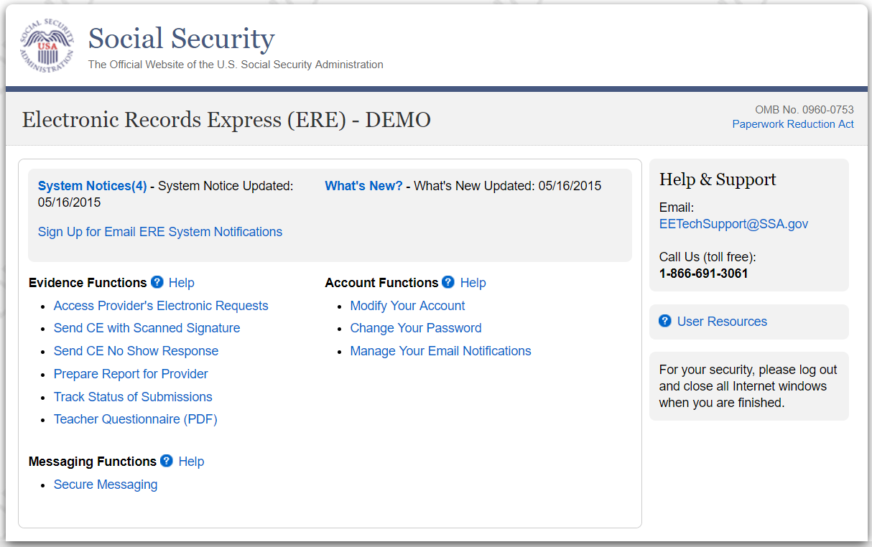

Electronic Request for Medical Records

Slide 3
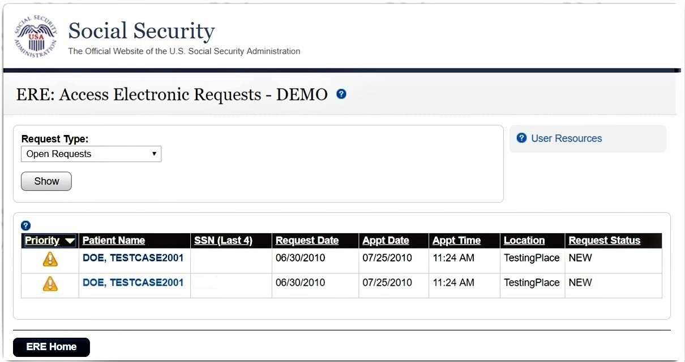
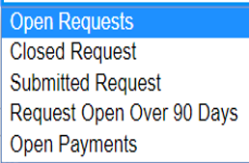

Slide 4
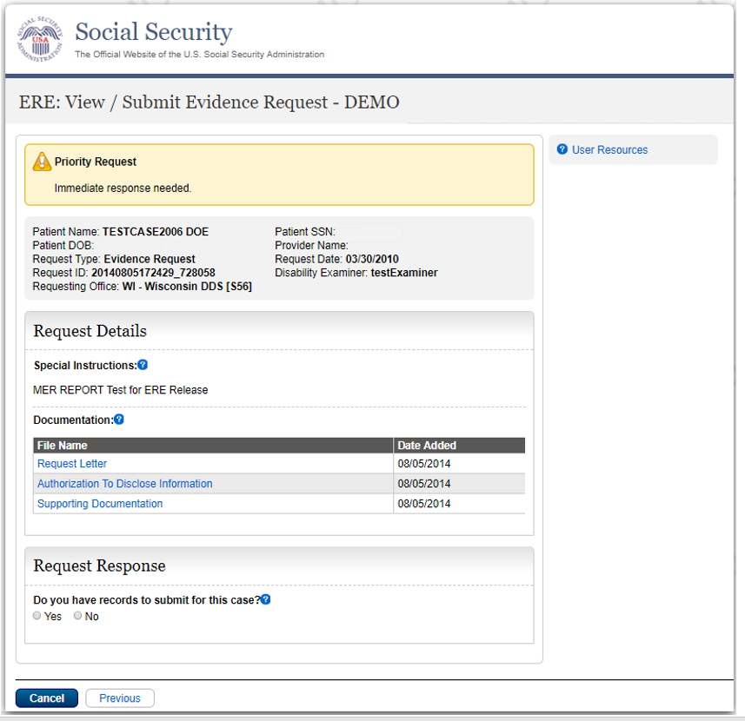

Slide 5
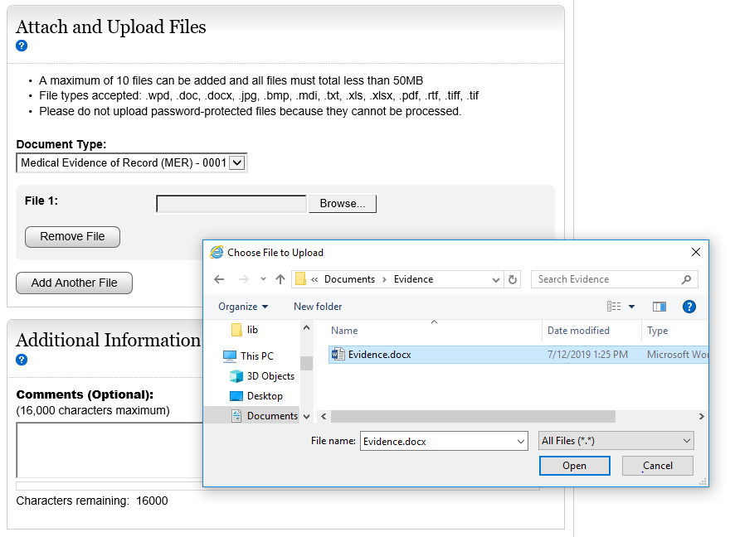

Slide 6
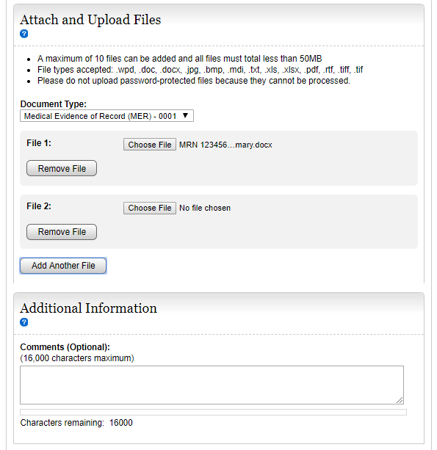

Slide 7
