Slide 1
Digital Transformation Office
CIO all-staff

Slide 2



Things we get up to
Cloud
Automation
DevOps
1
2
3

Slide 3

1
Cloud

Slide 4
What is cloud
Another companies network, computers and services
Cost is based on home much power and storage you use
Like a utility company, for computing

Slide 5
Why go cloud
Faster service delivery
Ability to scale with demand
Enables modern service delivery

Slide 6
How cloud works
Different service models
You build on the cloud provider
Least control and effort
SaaS
Software
PaaS
Platform
IaaS
Infrastructure
Most control and effort

Slide 7
GC Accelerators
Open source templates for creating cloud services
TBS security and cloud guidelines baked-in
Avoids re-inventing the wheel
Foster collaboration amongst GC departments
Developed with the CTO

Slide 8
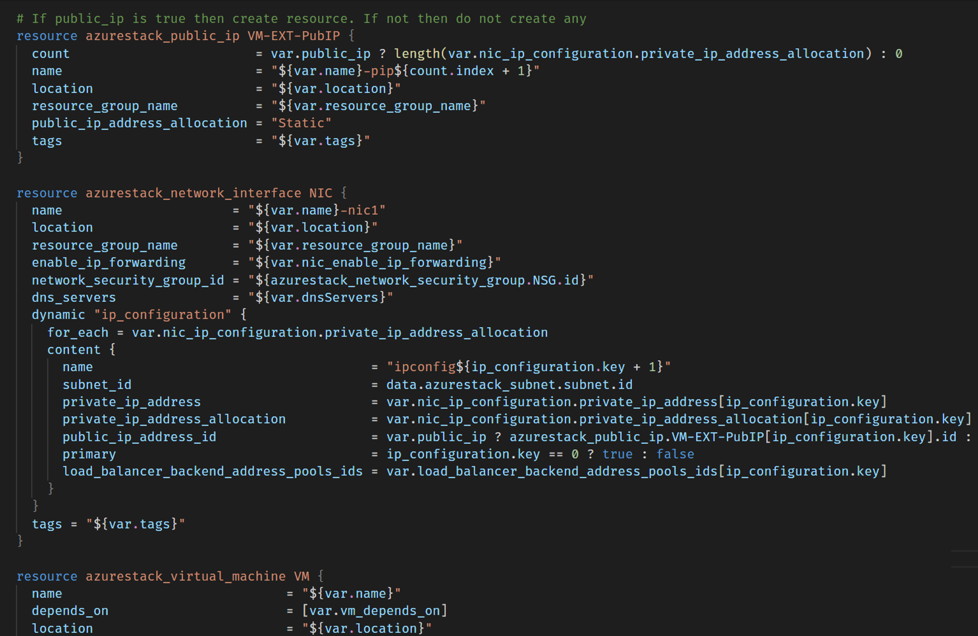
2
Automation

Slide 9
Automation
Power of cloud is unlocked through automation
Allows you to express your infrastructure as code
Repeatable and fast creation of services

Slide 10
Movie of Ansible command running Split screen – show script running in ½, resources being created in other half

Slide 11

3
DevOps

Slide 12
DevOps
Essential for delivering modern digital services
CI/CD pipelines are the backbone
1
2
3
4
Version Control
Continuous Integration
Continuous
Delivery
Continuous
Deployment
The project’s history
Build and test changes
Deploy to test environments
Deploy to production
Monitor and report

Slide 13






What we’re using
Cloud
Automation
Version control

Slide 14






Digital Task Force
…
Crowdsource
a list of challenges
Discover cause & potential mission
Collaborate on a partnership agreement
Do the thing together, in iterations
Share what we’ve done
Evaluate the mission; extend OR move on

Slide 15

Get in touch
Philippe.Lefebvre2@canada.ca
Brittany.Hurley@canada.ca
github.com/dtf-ein

