Slide 1
Digital Transformation Office
CIO all-staff

Slide 2
Who are we
Digital Transformation Office
Philippe
Cloud Team
Bernard & John
Digital Task Force
Britt, Jess, Oli, Pat & Sarah

Slide 3
Our goals
Help SSC start using cloud
Explore new ways of delivering services
Work towards SSC 3.0

Slide 4

Cloud

Slide 5
What is cloud?
Another companies network, computers and services
Cost is based on home much power and storage you use
Like a utility company, for computing

Slide 6
How does cloud work?
Different service models you can pick from
You build on the cloud platform
IaaS
PaaS
SaaS
Infrastructure
Platform
Service
Most control & effort
Least control & effort

Slide 7
GC Accelerators
Open source templates for creating cloud services
TBS security and cloud guidelines baked in
Avoids re-inventing the wheel
Support for multiple cloud providers

Slide 8
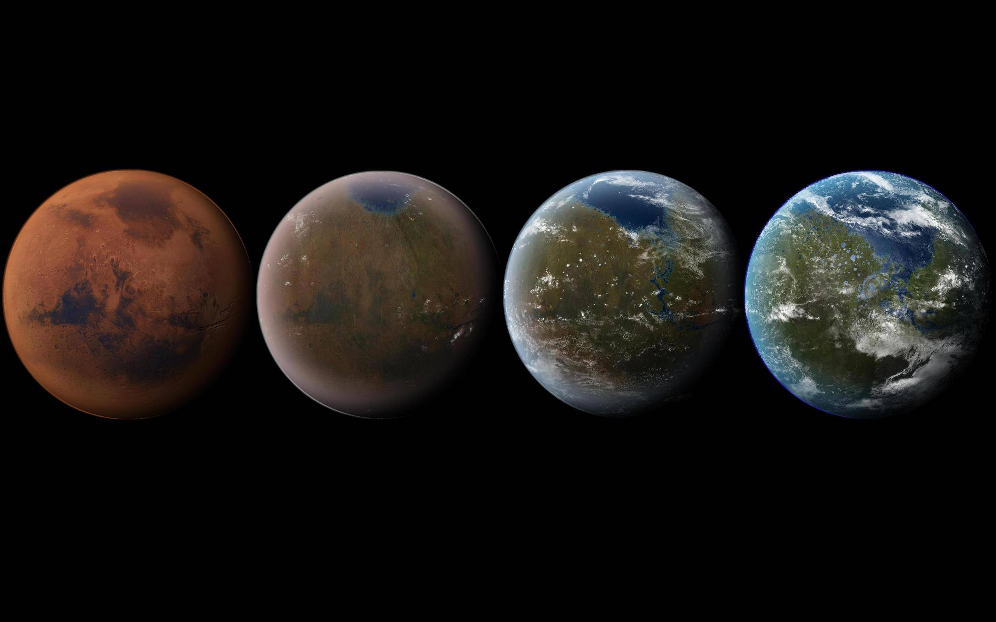
Terraform

Slide 9
Movie of Terraform command running

Slide 10




Terraform
Allows you to express your infrastructure as code
Repeatable, automated creation of services in the cloud
PLAN
APPLY
Terraform
Build
Cloud providers
New servers

Slide 11






Digital Task Force
…
Crowdsource
a list of challenges
Discover cause & potential mission
Collaborate on a partnership agreement
Do the thing together, in iterations
Share what we’ve done
Evaluate the mission; extend OR move on

Slide 12
What have we done so far
Learned about SSC
Created our team presence on GitHub
Ansible playbooks for building services

Slide 13


GitHub
A bit like Facebook for nerds
Allows for collaborative programming between strangers
Branch
Merge
Test
Make changes

Slide 14
DevOps
Essential for delivery a modern digital service
Continuous integration, delivery, deployment and testing

Slide 15
Movie of pipeline/automated tests running

Slide 16

Ansible

Slide 17
Movie of Ansible command running

Slide 18
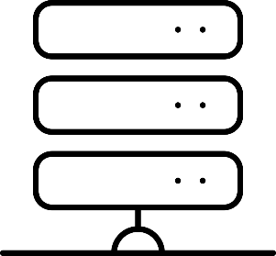
Ansible
Allows you to define your configuration as code
Repeatable, automated configuration of services
PLAY
Ansible
Build
Configured service
New servers

Slide 19

Get in touch
Philippe.Lefebvre2@canada.ca
Brittany.Hurley@canada.ca
github.com/dtf-ein

