Slide 1
Cloud automation
Digital hour

Slide 2



What we’ll cover
Cloud
Automation
DevOps
1
2
3

Slide 3

Cloud
1

Slide 4
What is cloud
Another companies network, computers and services
Cost is based on home much power and storage you use
Like a utility company, for computing

Slide 5
Why go cloud
Faster service delivery
Ability to scale with demand
Enables modern service delivery

Slide 6
How cloud works
You build on the cloud provider
Different service models
Least control / effort
SaaS
Software
PaaS
Platform
IaaS
Infrastructure
Most control / effort

Slide 7
GC Accelerators
Open source templates for creating cloud services
TBS security and cloud guidelines baked-in
Avoids re-inventing the wheel
Foster collaboration amongst GC departments
Developed with the CTO

Slide 8
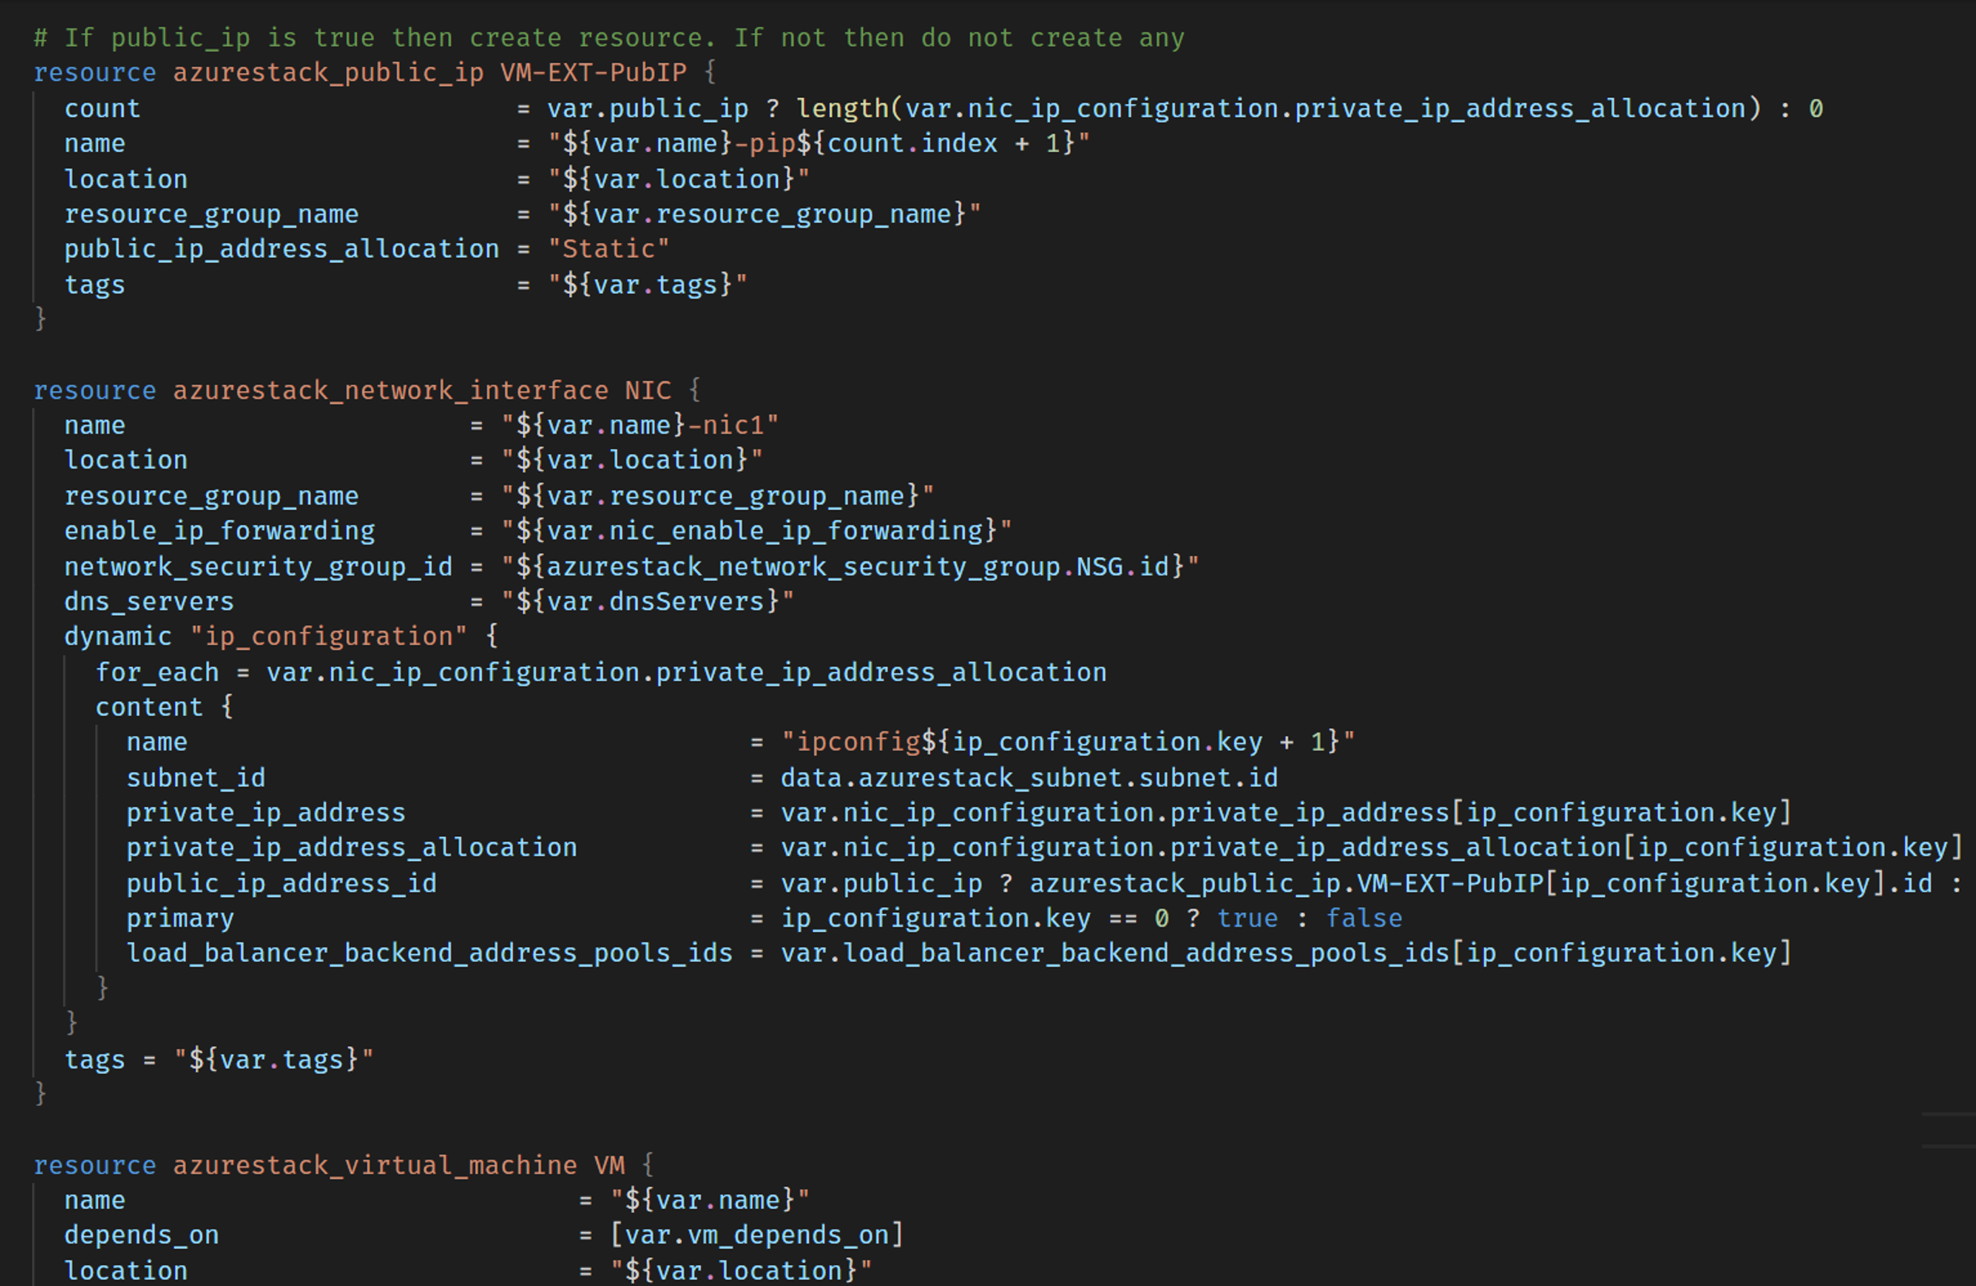
Automation
2

Slide 9
Automation
Power of cloud is unlocked through automation
Allows you to express your infrastructure as code
Repeatable and fast creation of services

Slide 10



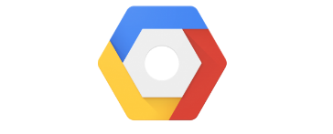
Terraform
Create cloud resources like virtual machines and storage
PLAN
APPLY
Terraform
Build
Cloud providers
Cloud resources

Slide 11
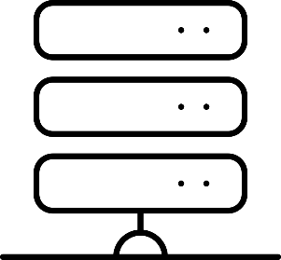
Ansible
Install and configure services on cloud resources
PLAY
Ansible
Build
Configured service
Cloud resources

Slide 12

DevOps
3

Slide 13
DevOps
Essential for delivering modern digital services
CI/CD pipelines are the backbone
1
2
3
4
Version Control
Continuous Integration
Continuous
Delivery
Continuous
Deployment
The project’s history
Build and test changes
Deploy to test environments
Deploy to production
Monitor and report

Slide 14


GitHub
A bit like Facebook for nerds
Allows for collaborative programming between strangers
Create a
branch
Merge changes
Test
Make changes
in branch

Slide 15






What we’re using
Cloud
Automation
Version control

Slide 16

Get in touch
Bernard.Maltais@canada.ca
Patrick.Heard@canada.ca
github.com/dtf-ein

