Slide 1
Digital Transformation Office
CIO all-staff

Slide 2
Who are we
Digital Transformation Office
Philippe
Cloud Team
Bernard & John
Digital Task Force
Britt, Jess, Oli, Pat & Sarah

Slide 3
Our goals
Help SSC start using cloud
Explore new ways of delivering services
Work towards SSC 3.0

Slide 4

Cloud

Slide 5
What is cloud?
Another companies network, computers and services
Cost is based on home much power and storage you use
Like a utility company, for computing

Slide 6
How does cloud work?
Different service models
You build on the cloud platform
IaaS
PaaS
SaaS
Infrastructure
Platform
Software
Most control & effort
Least control & effort

Slide 7
GC Accelerators
Open source templates for creating cloud services
TBS security and cloud guidelines baked in
Avoids re-inventing the wheel
Support for multiple cloud providers

Slide 8
Cloud automation
Power of cloud is through automation
Allows you to express your infrastructure as code
Repeatable, automated creation of services
Terraform & Ansible

Slide 9
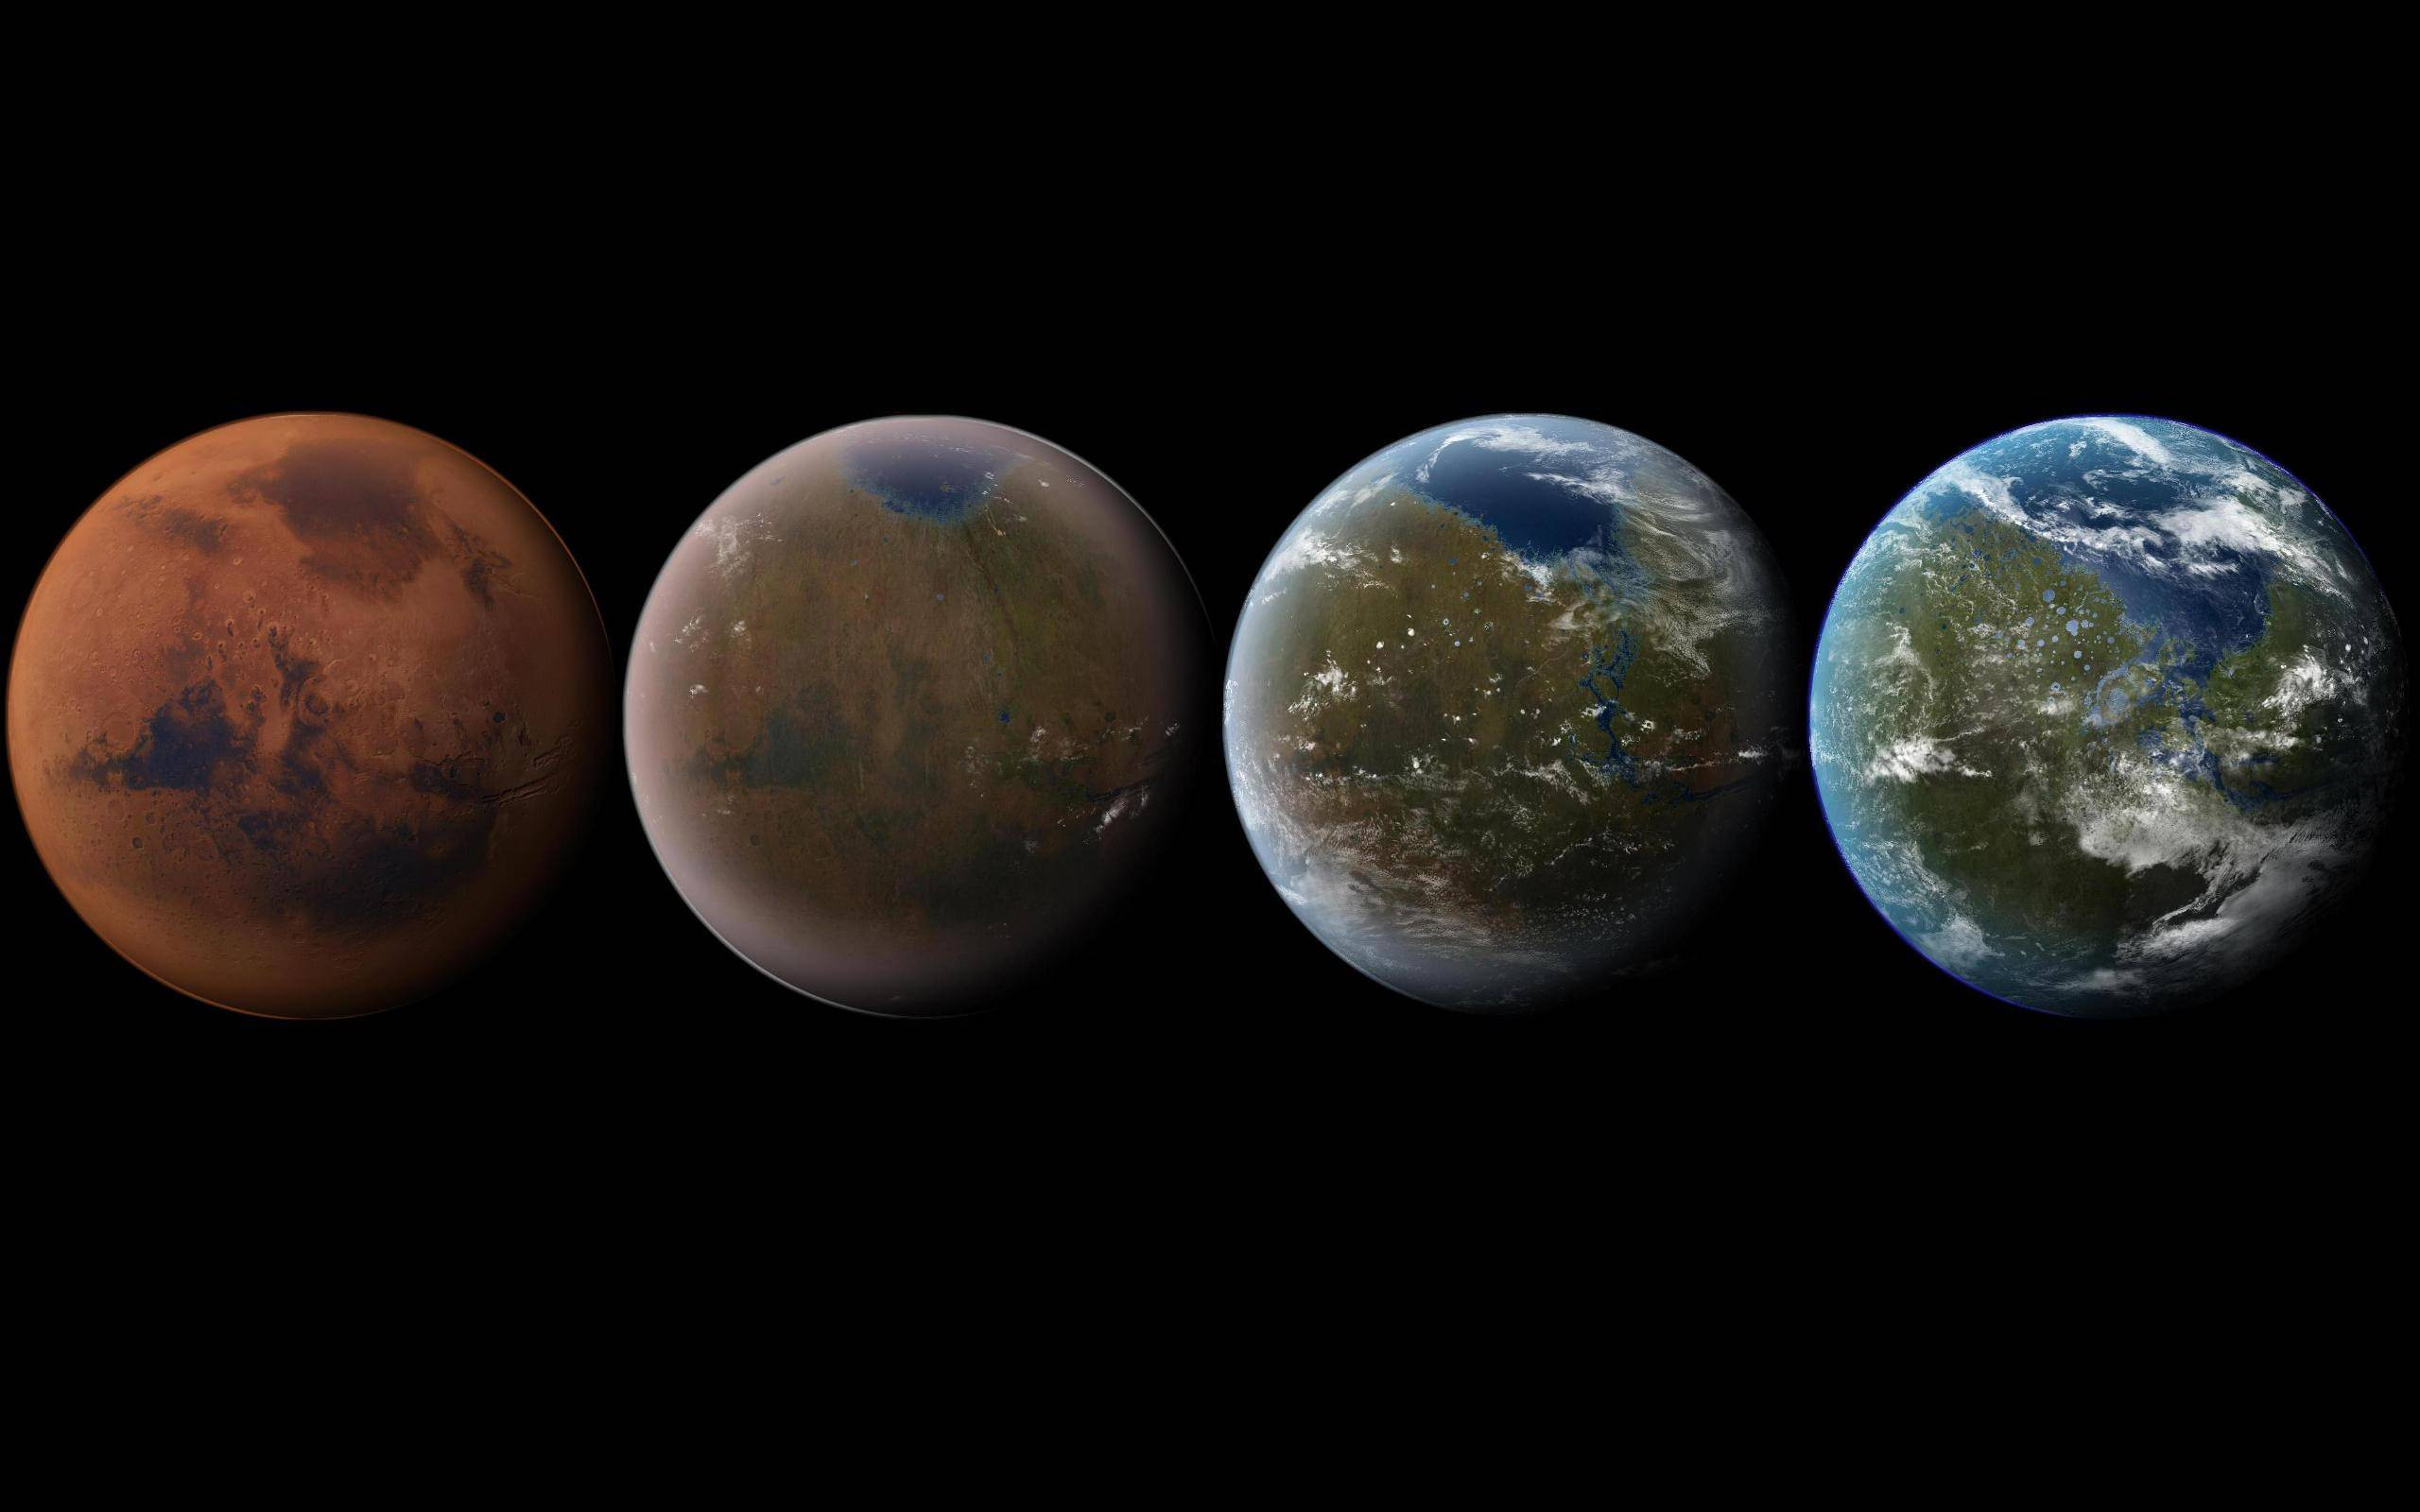
Terraform

Slide 10
Movie of Terraform command running

Slide 11




Terraform
Create cloud resources like virtual machines and storage
PLAN
APPLY
Terraform
Build
Cloud providers
Cloud resources

Slide 12

Ansible

Slide 13
Movie of Ansible command running

Slide 14
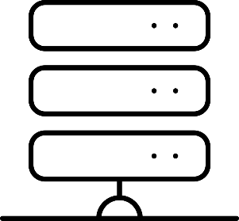
Ansible
Install and configure services on cloud resources
PLAY
Ansible
Build
Configured service
Cloud resources

Slide 15






Digital Task Force
…
Crowdsource
a list of challenges
Discover cause & potential mission
Collaborate on a partnership agreement
Do the thing together, in iterations
Share what we’ve done
Evaluate the mission; extend OR move on

Slide 16
What have we done so far
Learned about SSC
Created our team presence on GitHub
Ansible playbooks for building services

Slide 17


GitHub
A bit like Facebook for nerds
Allows for collaborative programming between strangers
Create a
branch
Merge changes
Test
Make changes
in branch

Slide 18
DevOps
Essential for delivering modern digital services
Essential for agile
1
2
3
4
Version Control
Continuous Integration
Continuous
Delivery
Continuous
Deployment
The project’s history
Build and test changes
Deploy to test servers
Release new versions
Monitor and test

Slide 19
Movie of pipeline/automated tests running

Slide 20

Get in touch
Philippe.Lefebvre2@canada.ca
Brittany.Hurley@canada.ca
github.com/dtf-ein

