Slide 2
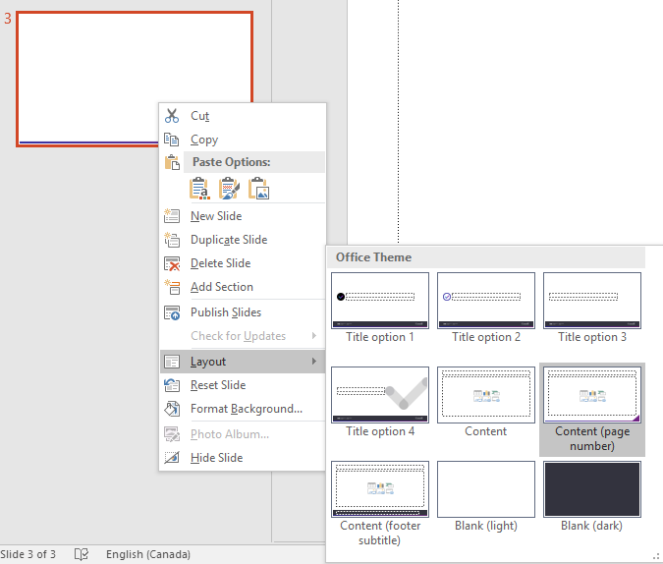
Select a slide layout
Right click a slide.
Select “Layout” and pick a layout.

