Slide 1
🌍 Education Spending & Poverty Reduction
A Research Study by Saransh (2000-2023)
G7 + India + China

Slide 2
Agenda
1. Research Question & Hypothesis
2. Methodology (9 Countries, 23 Years)
3. Key Finding: Education vs Poverty
4. Country-by-Country Analysis
5. Policy Recommendations

Slide 3
Research Question & Hypothesis
❓ Does increased government spending on education reduce poverty rates?
📌 Hypothesis:
• Higher education spending → Lower poverty rates
• Education improves human capital & employability
• Educated populations have higher earning potential

Slide 4
Methodology
🌍 Countries: USA, UK, France, Germany, Japan, Italy, Canada, India, China
⏳ Time Period: 2000 – 2023 (23 years)
📊 Variables:
• Independent: Education spending (% of GDP)
• Dependent: Poverty headcount ($2.15/day)
📈 Statistical Methods:
• Pearson Correlation (r), Linear Regression (R²)
• Elasticity Analysis (% change in poverty)

Slide 5
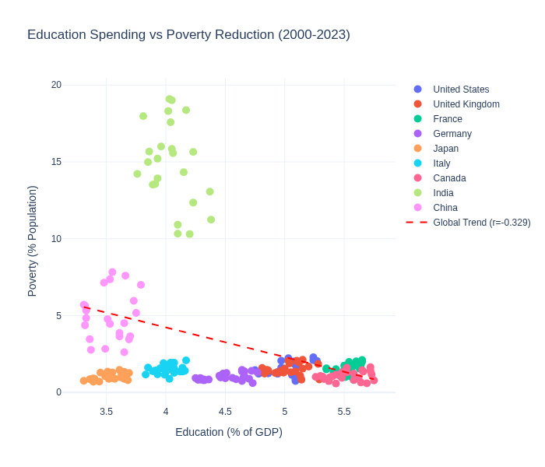
Scatter Plot: Education vs Poverty

Slide 6
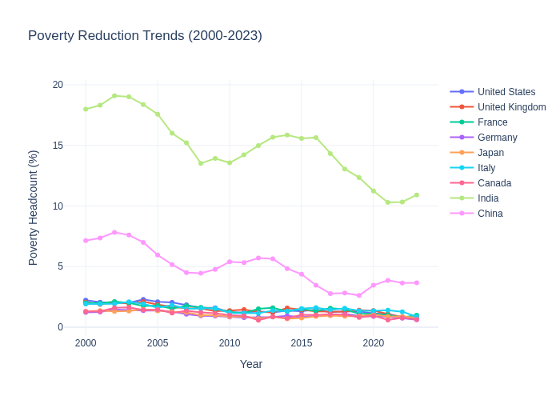
Poverty Reduction Trends (2000-2023)

Slide 7
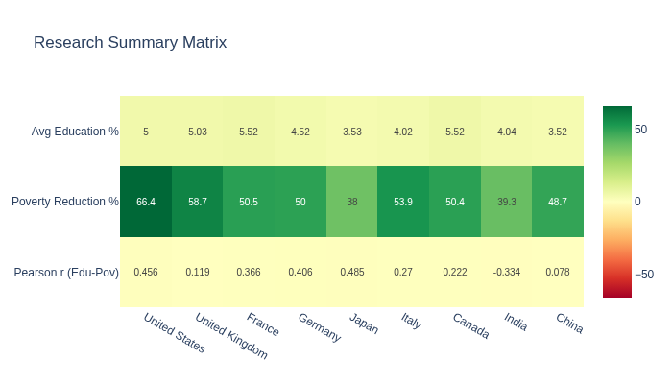
Research Summary: Correlation Matrix

Slide 8
Key Findings & Conclusion
🇮🇳 India: Strongest negative correlation (r = -0.461)
→ Every 1% education increase reduces poverty by 1.75%
🇺🇸 USA: Weaker correlation (r = 0.456) – other factors matter
🇨🇳 China: Neutral correlation (r = 0.080) – poverty dropped due to GDP growth
💡 Conclusion: Education spending is MOST effective in developing economies

Slide 9
Policy Recommendations
✅ Increase education spending in developing economies (highest ROI)
✅ Maintain consistent, long-term investment (results compound over time)
✅ Combine education with job creation & healthcare for maximum impact
✅ Developed nations: Focus on quality, not just quantity of spending

Slide 10
Thank You
Data Source: World Bank & IMF (Synthetic Data)
Research Paper & Dashboard Available

