Slide 1
The SSD Institute Web App
System Design Presentation
Team JAST
Presenters: Justin Maga, Austin Pringle, Stuart Krueger, Thom Mondeaux

Slide 2
Project Overview & Stakeholders
The SSD Institute Web App
What it Is: The SSD Institute Web App is a centralized web application designed to inform the American public about SSD Institute's core beliefs, political strategies, and civic contributions.
Key Stakeholders:
Business: SSD Institute Leaders
Users: The General Public (Civic Voters)
Technical: Collaborators and IT Professionals

Slide 3
The Problem Statement
The SSD Institute Web App
The Challenge: Citizens lack a centralized, user-friendly repository for public information.
Current Pain Points:
Information is scattered across fragmented, outdated, or biased sources.
Difficulty navigating legal updates (Local, State, Federal) and court decisions.
Inability to track newly passed legislation.
The Result:
Low voter turnout.
Disconnection between communities and policymakers.
Weak civic engagement undermining the democratic process.

Slide 4
Proposed System & Capabilities
The SSD Institute Web App

Slide 5
Proposed Solution
The SSD Institute Web App
Core Solution: A hosted Flask Web Application (The Hub).
Key Capabilities:
Centralized Repository: One site for documentation, legal updates, and governance concepts.
Empowerment: Tools to help citizens track developments affecting their specific community.
Informed Action: Enables evidence-based voting and decision-making.

Slide 6
Key System Features
The SSD Institute Web App
Governance Concepts:
Collaborative Veto: Tracking local support and legislative impact.
Multi-choice Voting: Visualizing approval totals via Bar Charts.
Supreme Court Veto: State-level Choropleth maps (26+ state objection tracking).
Minimum Amount of Space: GIS/Density visualizations for resource allocation.
Data Access: Search functionality for Local, State, and Federal policy history.

Slide 7
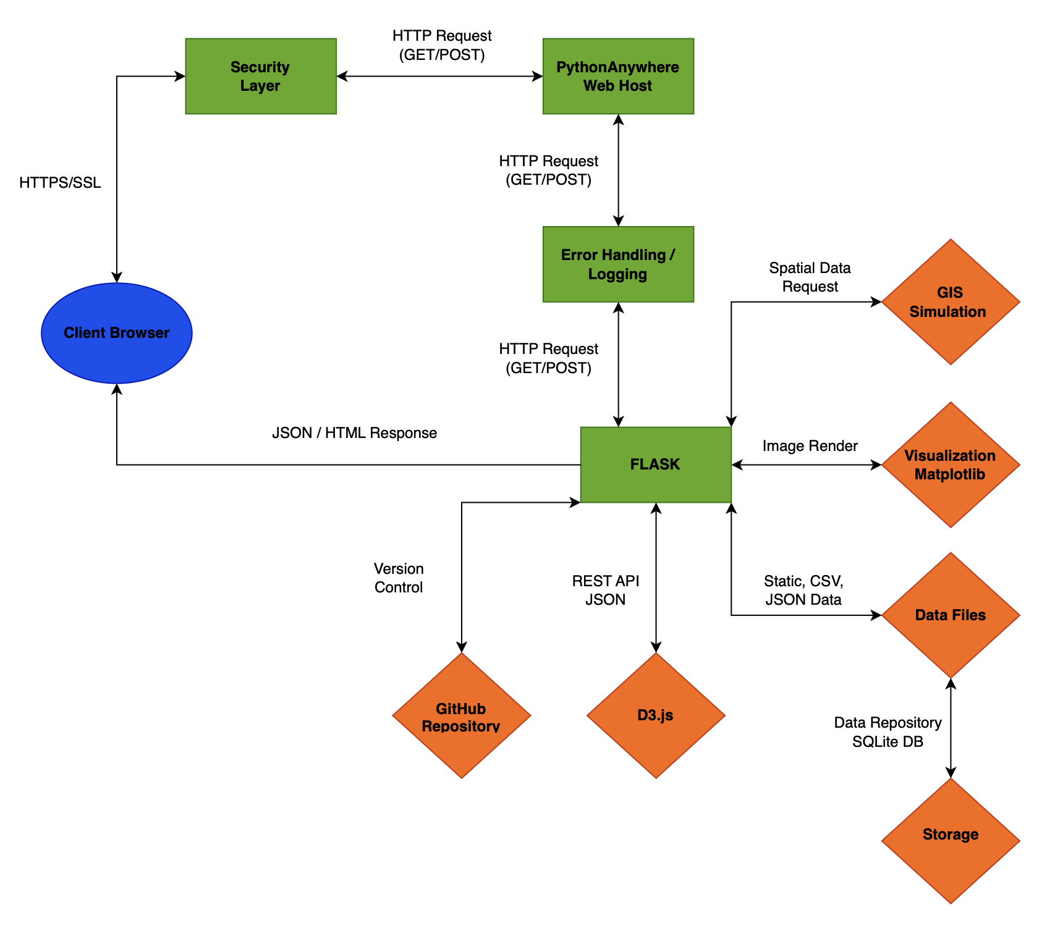
System Topology & Architecture
The SSD Institute Web App
Client Access & Security:
Secure HTTPS/SSL connection from Client Browser.
Requests routed through PythonAnywhere Web Host and a dedicated Error Handling/Logging layer before reaching the application.
Core Application Logic:
Flask serves as the central orchestration engine.
Delivers JSON/HTML responses back to the client.
Visualization Ecosystem:
GIS Simulation: Handles complex spatial data requests.
Matplotlib: Performs server-side image rendering.
D3.js: Consumes REST API JSON for interactive front end charts.
Data & Storage:
Hybrid approach using Static/CSV/JSON Data Files.
Backed by an SQLite Database repository for persistent storage.
Development:
GitHub integration for version control.

Slide 8
Context Diagram & DFD
The SSD Institute Web App

Slide 9
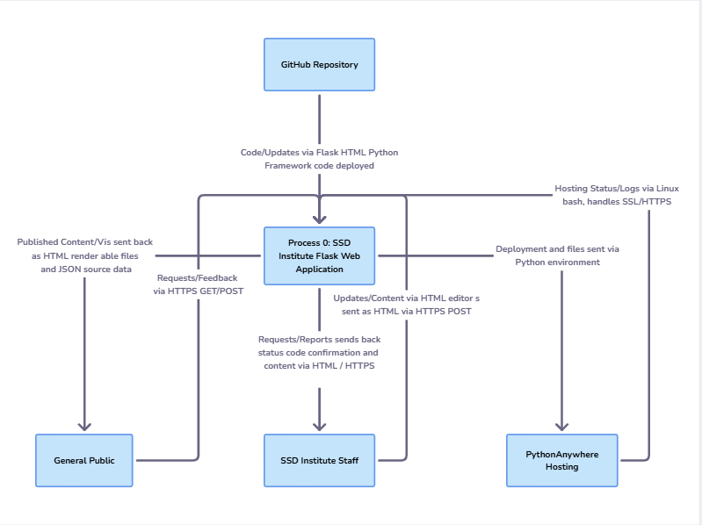
DFD Level 0
The SSD Institute Web App
System Boundary (Process 0):
SSD Institute Flask Web Application: The central process handling all logic and data routing.
User Interactions:
General Public: Sends HTTPS GET/POST requests and feedback; receives rendered HTML content, visualizations, and JSON source data.
SSD Institute Staff: Submits content updates via HTML editors (HTTPS POST); receives status confirmations and reports.
Infrastructure & Deployment:
GitHub Repository: Pushes framework code and updates into the application.
PythonAnywhere Hosting: Receives deployment files via the Python environment; provides hosting status, Linux bash logs, and SSL/HTTPS handling.

Slide 10
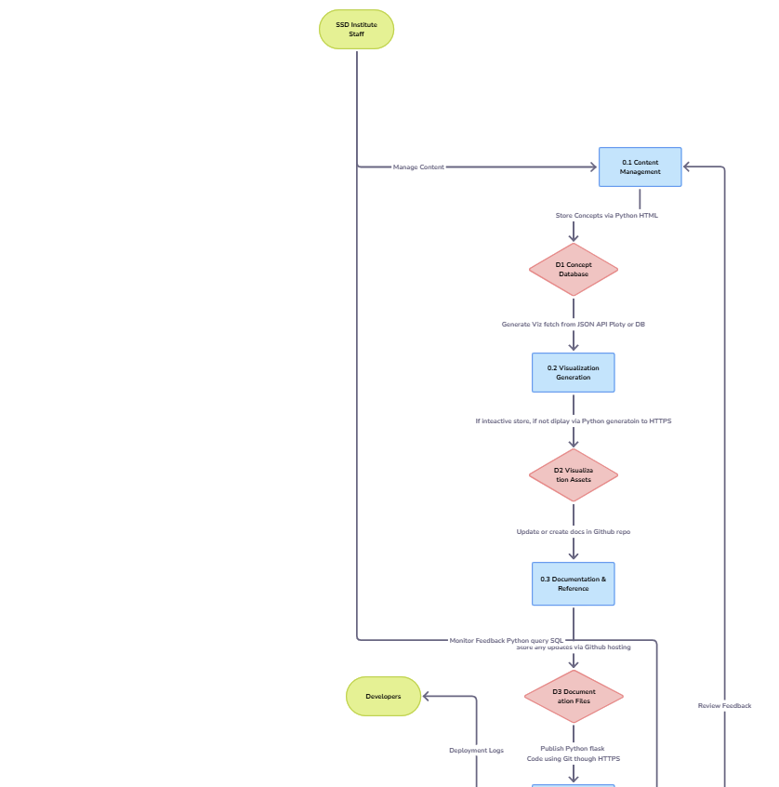
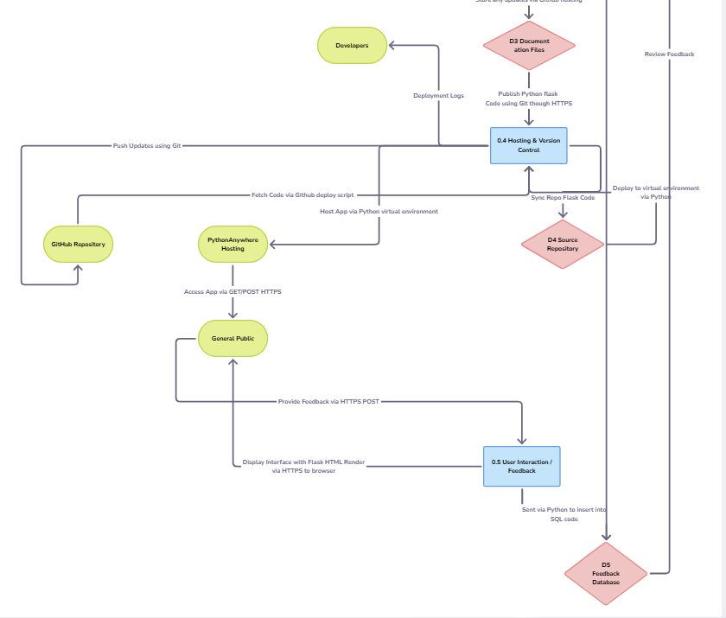
DFD Level 1
The SSD Institute Web App
Breakdown of major functional modules.
Content Management:
SSD Staff manages content, which is stored in the Concept Database (D1).
Receives user feedback loop from the Feedback Database (D5).
Visualization Generation:
Fetches data from D1 or JSON APIs.
Generates Plotly visualizations and stores assets in Visualization Assets (D2).
Documentation & Reference:
Updates documentation in the GitHub repo and stores files in Documentation Files (D3).
Hosting & Version Control:
The central deployment hub. It pushes updates via Git (HTTPS) to the GitHub Repository and syncs with the Source Repository (D4).
Manages deployment logs for Developers and coordinates with PythonAnywhere Hosting.
User Interaction / Feedback:
Captures HTTPS POST requests from the General Public.
Inserts data via Python SQL into the Feedback Database (D5) for staff review.

Slide 11
Entity Relationship Diagram
The SSD Institute Web App

Slide 12
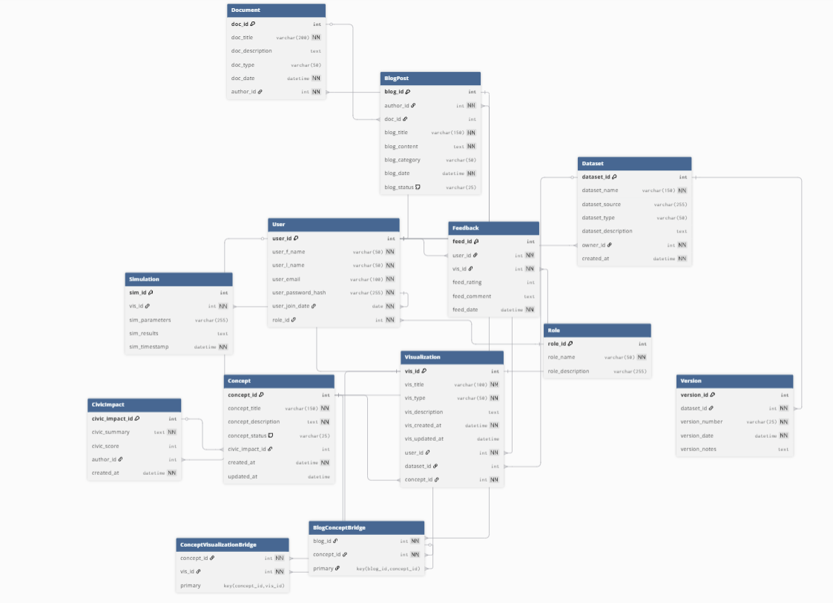
Database Architecture (ERD)
The SSD Institute Web App
Overview: Our ERD represents the relational schema supporting the Flask application, centered around User interaction with data-driven Concepts.
User & Access Control:
User & Role: Manages authentication (Admins vs. Public) and permissions.
Core Logic & Governance:
Concept: The central entity (e.g., Veto, Voting) linking to Civic Impact scores.
BlogPost & Document: Supports the educational narrative and reference materials.
Data & Visualization:
Dataset & Version: Tracks raw source data and version history to ensure accuracy.
Visualization & Simulation: Stores parameters and results for the interactive charts.
Bridge Tables: Uses Concept Visualization Bridge to handle complex many-to-many relationships.
Engagement:
Feedback: Captures user input directly linked to specific Datasets or Visualizations.

Slide 13
Screen Sequence Walkthrough
The SSD Institute Web App

Slide 14
Conclusion
The SSD Institute Web App

