Slide 1




Cogmont Project
Azat – Lucas – Matthieu - Etienne
Adeline Leclercq Samson
Marie-Caroline Croset

Slide 2
Table of contents
Context
Protocol
First analysis
Azat Aleksanyan - Lucas Chabeau - Matthieu François - Etienne Hamard
Adeline Leclercq Samson - Marie-Caroline Croset

Slide 3
3
Context
Protocol
First analysis
The need
Weak Mathematics level in France
Search of alternatives pedagogies
Montessori pedagogy
Azat Aleksanyan - Lucas Chabeau - Matthieu François - Etienne Hamard
Adeline Leclercq Samson - Marie-Caroline Croset

Slide 4
4
Context
Protocol
First analysis
Montessori pedagogy
Created by Maria Montessori in 1907
Respect of kid’s natural approach
Multi-age classes
Azat Aleksanyan - Lucas Chabeau - Matthieu François - Etienne Hamard
Adeline Leclercq Samson - Marie-Caroline Croset

Slide 5
5
Context
Protocol
First analysis
Project proposed by
Institut des sciences cognitives – Marc Jeannerod
Neuroscience laboratory
Interested in educations
In collaboration with didactitians
Azat Aleksanyan - Lucas Chabeau - Matthieu François - Etienne Hamard
Adeline Leclercq Samson - Marie-Caroline Croset

Slide 6
6
Context
Protocol
First analysis
Set up
1st year : 2013
2nd year : 2012
3rd year : 2011
1st year : 2014
2nd year : 2013
3rd year : 2012
1st year : 2015
2nd year : 2014
3rd year : 2013
2016 - 2017
2017 - 2018
2018 - 2019
Azat Aleksanyan - Lucas Chabeau - Matthieu François - Etienne Hamard
Adeline Leclercq Samson - Marie-Caroline Croset

Slide 7
7
Context
Protocol
First analysis
Set up
1 public preschool REP+
50% Montessori classes
50% Traditionnal classes
90 kids per group
1 private preschool
100% Montessori classes
60 kids
Azat Aleksanyan - Lucas Chabeau - Matthieu François - Etienne Hamard
Adeline Leclercq Samson - Marie-Caroline Croset

Slide 8
8
Context
Protocol
First analysis
Set up
1 public preschool REP+
50% Montessori classes
50% Traditionnal classes
90 kids per group
Azat Aleksanyan - Lucas Chabeau - Matthieu François - Etienne Hamard
Adeline Leclercq Samson - Marie-Caroline Croset

Slide 9
9
Context
Protocol
First analysis
Evaluation
26 questions
Mathematicals skills
Questions could be grouped by competence
Many levels for each question
Same test each year
Azat Aleksanyan - Lucas Chabeau - Matthieu François - Etienne Hamard
Adeline Leclercq Samson - Marie-Caroline Croset

Slide 10
10
Context
Protocol
First analysis
How many tokens do you see ?
Success
End of the question
Fail
Azat Aleksanyan - Lucas Chabeau - Matthieu François - Etienne Hamard
Adeline Leclercq Samson - Marie-Caroline Croset

Slide 11
11
Context
Protocol
First analysis
Our goals
Compare the efficiency between Montessori pedagogy the « traditional » pedagogy
Use several stastistics methods
Azat Aleksanyan - Lucas Chabeau - Matthieu François - Etienne Hamard
Adeline Leclercq Samson - Marie-Caroline Croset

Slide 12
12
Context
Protocol
First analysis
Planning
Numéro tâche | Intitulé tâche | Date début | Date fin
1 | Analyse descriptive du jeu de données | Début décembre 2018 | Fin décembre 2018
2 | Présentation de notre projet en anglais | Début décembre 2018 | 18 décembre 2018
… | … | … | …
4 | Rendu final 1 | A définir | Fin avril
5 | Rendu final 2 | A définir | Fin avril
Azat Aleksanyan - Lucas Chabeau - Matthieu François - Etienne Hamard
Adeline Leclercq Samson - Marie-Caroline Croset

Slide 13
14
Context
Protocol
First analysis
A global approach with MCA
Summary the data global information
With it we can represent all our dimension in 2 or 4
Study any correlation between variables
Azat Aleksanyan - Lucas Chabeau - Matthieu François - Etienne Hamard
Adeline Leclercq Samson - Marie-Caroline Croset

Slide 14
15
Context
Protocol
First analysis
Modality Graph on the main plan
Success
Failure
Azat Aleksanyan - Lucas Chabeau - Matthieu François - Etienne Hamard
Adeline Leclercq Samson - Marie-Caroline Croset

Slide 15
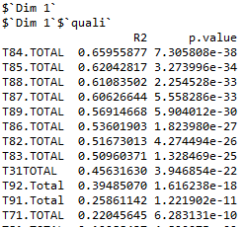
16
Context
Protocol
First analysis
First dimension description
Mainly about questions number 8
No correlation with the pedagogy
Question 3.1 – 9 – 7.1 and 8 seem define your success
Azat Aleksanyan - Lucas Chabeau - Matthieu François - Etienne Hamard
Adeline Leclercq Samson - Marie-Caroline Croset

Slide 16
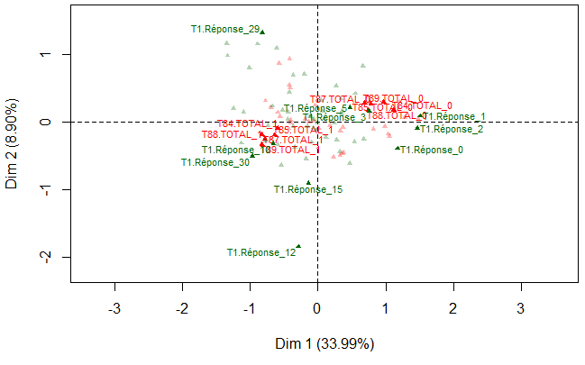
17
Context
Protocol
First analysis
Modality Graph on the main plan with the best representation quality
Success
Failure
Azat Aleksanyan - Lucas Chabeau - Matthieu François - Etienne Hamard
Adeline Leclercq Samson - Marie-Caroline Croset

Slide 17
Thanks for your attention.
Have you got any questions?
Azat Aleksanyan - Lucas Chabeau - Matthieu François - Etienne Hamard
Adeline Leclercq Samson - Marie-Caroline Croset

