Slide 1
What is a Milestone?

Slide 2
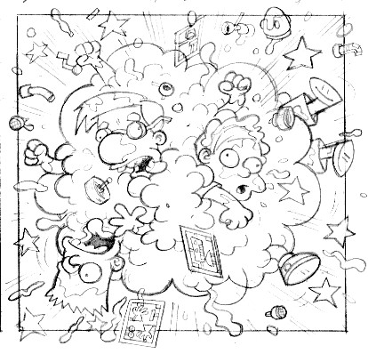


Why Milestones?
Your Development Team
Manager
we're working!
Customer

Slide 3

Milestones Provide Visibility
Your Development Team
Manager
Work Product
Plans
Customer
Failed Products

Slide 4
Major Milestones
Shows definite progress toward completing the project.
Tangible to manager and customer.
Verifiable -- can objectively test whether its been done.
Establishes a new baseline for work products.
Frequency: at least 1 per iteration

Slide 5
Major Milestones
Inception Vision & Scope reviewed and accepted by customer and management.
Decision made whether project is worth investing the effort to undertake EL1.
Elaboration 1
a) "UC1: Vote for Project" designed, implemented, tested, and demonstrated.
b) Domain Model written, documented, and verified against requirements. All documents and diagrams committed to project repository.

Slide 6
Steve McConnell suggests...
Use Binary Milestones
(100% Done or Not Done)
Avoid fuzzy, mushy milestones
A Milestone is either "100% done" or "100% not done."
Allowing a little step from "100% done" to "90% done" has historically been found to reduce the quality of the status information from "very good" to "awful."

Slide 7
Other Goals
These probably don't qualify as Milestones:
Logging framework selected, convention for logging levels documented, and implemented in code.
Configuration Management plan documented and explained to team.
  Includes what to put in CM, what not to put in CM, directory layout, criteria for submitting work.
Coding and documentation standard documented and explained to team. (PPQA responsible)

Slide 8
Minor Milestones
Purpose: visible evidence that iteration is on track.
Track a project's progress.
Tangible to team and manager.
Verifiable -- can objectively test whether its done.

Slide 9
Get Out of Inception

Slide 10
How to get out of the Inception Phase
Goals / Deliverables / Work Products
Vision + Mock-up
Business Case
  risk assessment or S.W.O.T. analysis
Glossary
Initial requirements
  S.R.S.
  Use Cases
  Supplementary Specification (non-functional req.)
High level candidate architecture
  recommendation of what to build or buy or get free

Slide 11
Out of Inception (continued)
Prototype
  proof-of-concept: explore technical issues
  U.I. prototype of verify vision of functional requirements
Decision:
Is this project worth investing time/resources into further investigation?

