Slide 1
Exponential Random Graph Models for Social Networks
ERGM Introduction
Carter T. Butts
Department of Sociology and
Institute for Mathematical Behavioral Sciences
University of California, Irvine
2011 Political Networks Conference
June 15, 2011
Ann Arbor, MI
http://polnet2011.statnet.org/

Slide 2
From Description to Modeling
Ultimately, want to do more than describe networks
Network modeling: predict the formation and structure of social networks
Many examples
  Conditional uniform graphs, Bernoulli graphs
  Holland and Leinhardt's p₁
  Degree distribution models, growth models, etc.
ERGM: a general representation for such models
  Draws on theory of statistical exponential families
  Not really a "type" of model (in a scientific sense), but a way of representing and working with new and existing models!

Slide 3
Initial Intuition: Factors in Tie Formation
All ties are not equally probable
  Chance of an (i,j) edge may depend on properties of i and j
  Can also depend on other (i,j) relationships
Some examples:
  Homophily
  Propinquity
  Multiplexity

Slide 4
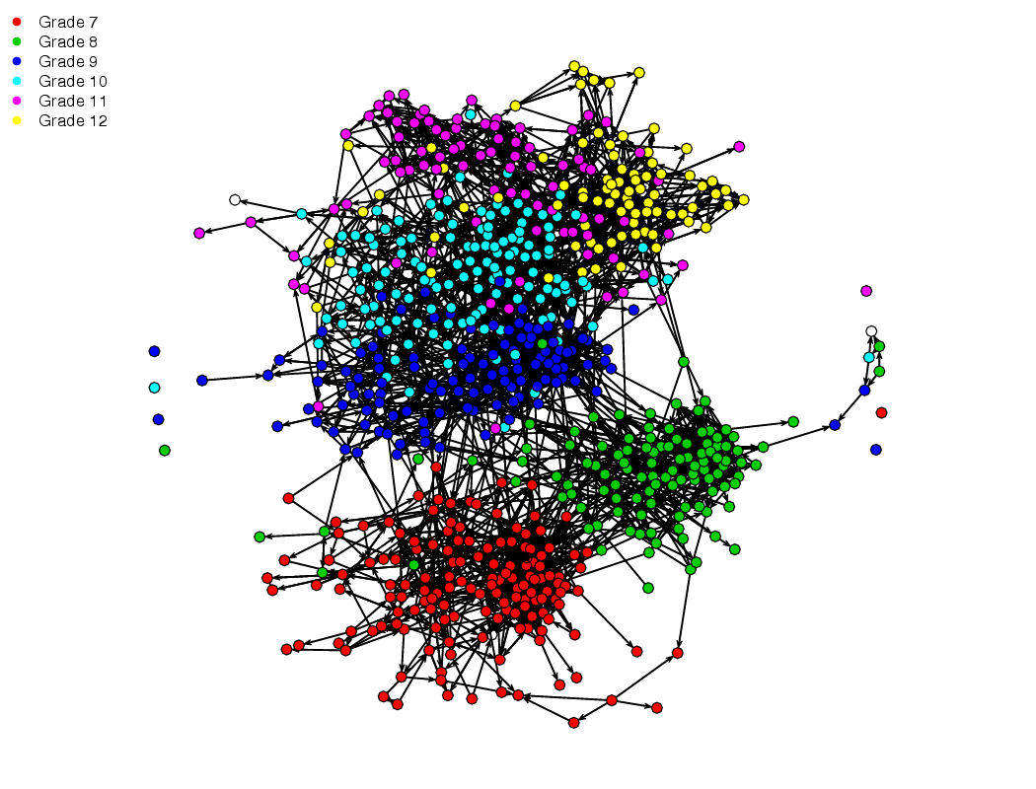
AddHealth Friendship Network, by Grade

Slide 5
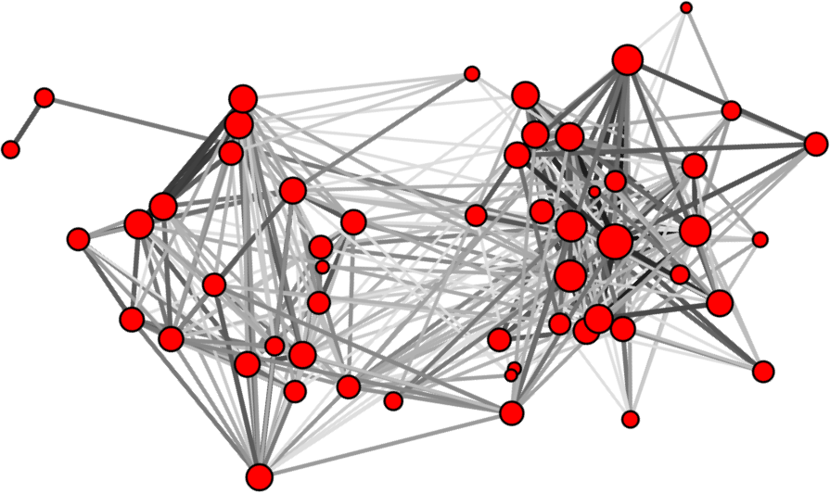
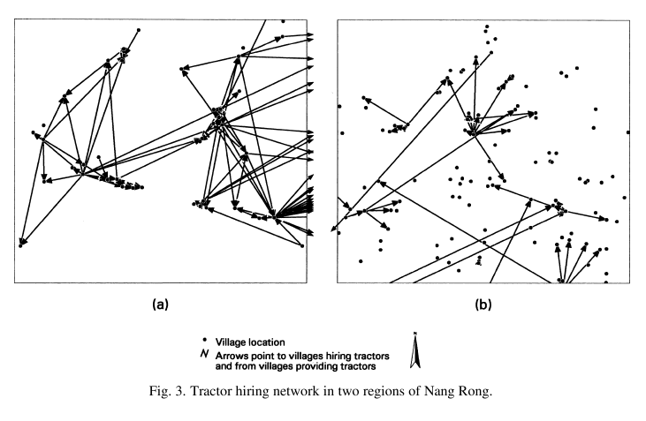
Freeman et al. (1988)
Faust et al. (1999)

Slide 6
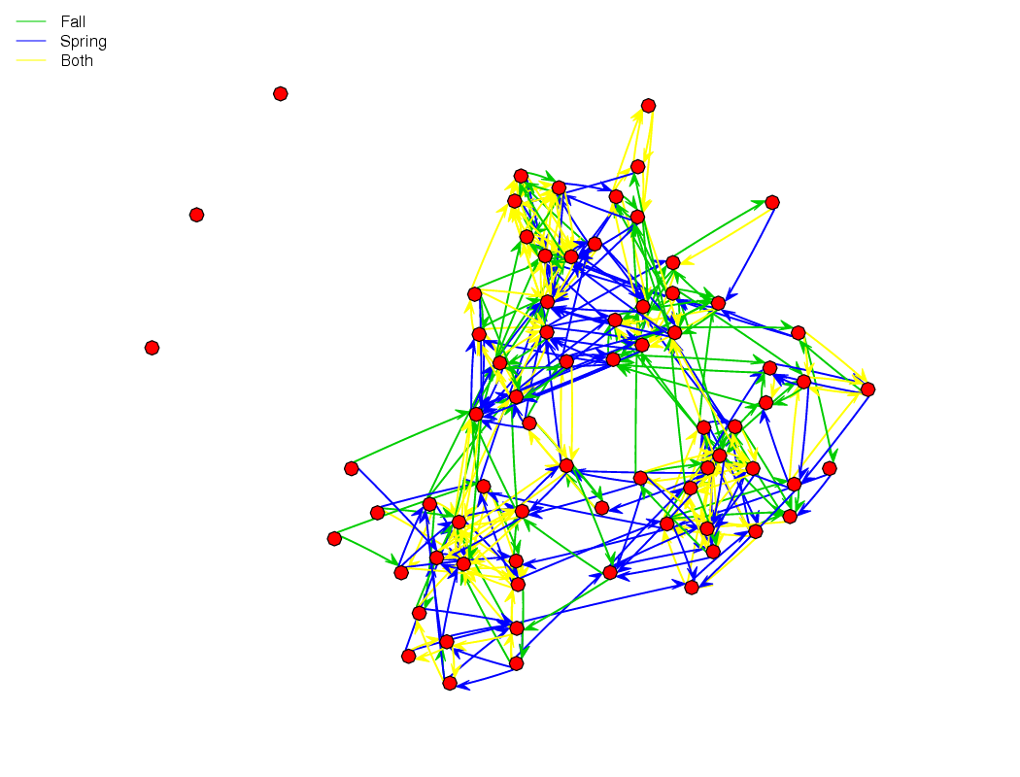
Boy's School Friendship Network (Coleman, 1964)

Slide 7
Logistic Network Regression
A classic starting point: why not treat edges as independent, w/log-odds as a linear function of covariates?
  Special case of standard logistic regression
  Dependent variable is a network adjacency matrix
Model form:
  where Y_{ij} is the value of the edge from i to j on the dependent relation, X_{ijk} is the value of the kth predictor for the (i,j) ordered pair, and ₁,...,_{m} are coefficients
    log(p/(1-p))=logit(p), maps (0,1) to (-,)

Slide 8
Moving Beyond the Logistic Case
The logistic model can be quite powerful, but still very limiting
  No way to model conditional dependence among edges
    E.g., true triad closure bias, reciprocity
  Cannot handle exotic support constraints
    What if your network must be transitive (e.g., sports contests, entailments), an interval graph (e.g., life history graphs), etc?
A more general framework: discrete exponential families
  Very general way of representing discrete distributions
  Turns up frequently in statistics, physics, etc.

Slide 9
Exponential Families for Random Graphs (w/Covariates)
For random graph G w/countable support G and covariate set X, pmf can be written in ERG form:
  θ^{T}t: linear predictor
    t:G→ℝ^{m}: vector of sufficient statistics
    θ∈ℝ^{m}: vector of parameters
    ∑_{g'G}exp(θ^{T}t(g',X)): normalizing factor
Intuition: ERG placed more/less weight on structures with certain features, as determined by t, θ
  Framework is complete for pmfs on G, few constraints on t

Slide 10
Exponential Families for Random Graphs (w/Covariates)
For random graph G w/countable support G and covariate set X, pmf can be written in ERG form:
  θ^{T}t: linear predictor
    t:G→ℝ^{m}: vector of sufficient statistics
    θ∈ℝ^{m}: vector of parameters
    ∑_{g'G}exp(θ^{T}t(g',X)): normalizing factor
Intuition: ERG placed more/less weight on structures with certain features, as determined by t, θ
  Framework is complete for pmfs on G, few constraints on t
Source of great
difficulty!

Slide 11
Equivalent Expression: Modeling the Adjacency Matrix
For adjacency matrix Y w/countable support Y and covariate set X, any pmf can be written in ERG form:
  θ^{T}t: linear predictor
    t:y→ℝ^{m}: vector of sufficient statistics
    θ∈ℝ^{m}: vector of parameters
    ∑_{y'y}exp(θ^{T}t(y',X)): normalizing factor
Additional notation:
  y⁺_{ij},y⁻_{ij}: y w/ijth cell set to 1 or 0 (respectively)
  y^{c}_{ij}: all elements of y other than the ijth

Slide 12
ERGs and Conditional Odds of an Edge
Can easily specify the conditional odds of an edge:

Slide 13
ERGs and Conditional Odds of an Edge
Can easily specify the conditional odds of an edge:

Slide 14
ERGs and Conditional Odds of an Edge
Can easily specify the conditional odds of an edge:
  Log-odds depend on the changescore, Δ_{ij}=t(y⁺_{ij},X)-t(y⁻_{ij},X)
  Useful implication: each unit change in t_{k} for (i,j) edge present (versus absent) increases the conditional log-odds of (i,j) by _{k}
    Important: this is only conditionally true! The marginal log-odds of an (i,j) edge can depend on a complex way on other aspects of the graph

Slide 15
Conditional Edge Probability
From the above, we can also determine conditional edge probability using fact that prob=odds/(1+odds):

Slide 16
Conditional Edge Probability
From the above, we can also determine conditional edge probability using fact that prob=odds/(1+odds):

Slide 17
Conditional Edge Probability
From the above, we can also determine conditional edge probability using fact that prob=odds/(1+odds):

Slide 18
Conditional Edge Probability
From the above, we can also determine conditional edge probability using fact that prob=odds/(1+odds):

Slide 19
Conditional Edge Probability
From the above, we can also determine conditional edge probability using fact that prob=odds/(1+odds):

Slide 20
Conditional Edge Probability
From the above, we can also determine conditional edge probability using fact that prob=odds/(1+odds):

Slide 21
Conditional Edge Probability, Cont.
So, the conditional probability of an (i,j) edge is simply the inverse logit of θ^{T}Δ_{ij}
  Obvious idea: to find θ, why not set this up as a logistic network regression problem (regressing y on Δ)?
    This is an “autologistic regression,” and the resulting estimator is known as a pseudolikelihood estimator (Besag, 1975)
  Problem: the probability here is only conditional – can use for any one ij, but joint likelihood of y is not generally the product of Pr(Y_{ij}=y_{ij}|Y^{c}_{ij}=y^{c}_{ij})
    Another view: y appears on both sides – can't regress w/out accounting for the “feedback” (i.e., dependence) among edges
    Does work iff edges are independent – i.e., the logistic case
Still, useful aid in interpretation
  Can consider probability of y_{ij} under various scenarios to understand local model behavior

Slide 22
Fitting ERGs to Data
After positing a model, generally want to estimate parameters from data
  Benefit of the framework: standardized inferential framework
Most common current method: maximum likelihood estimation
  Find θ* that maximizes Pr(Y=y_{obs}|t,θ*,Y )
    Exists for regular model so long as observed data is “non-extreme” (in a specific sense to be discussed later); always unique
    Also has first order interpretation: E_{θ*}t(Y)=t(y_{obs})
  Approximate standard errors based on Hessian of maximized likelihood
    Not guaranteed, but simulation studies suggest to be reasonable
Older method: maximum pseudo-likelihood estimation
  Based on autologistic approximation; don't use unless you have to – can be very bad (and you can't tell)

Slide 23
ERG Fitting Using ergm
Dedicated statnet package for fitting, simulating models in ERG form
Basic call structure: ergm(y~term1(arg)+term2(arg))
  y: network object
  term1, term2, etc.: terms to use (see ?”ergm-terms”)
    arg: where relevant, arguments to the term functions
Output: ergm object
  Summary, print, and other methods can be used to examine it
  simulate command can also be used to take draws from the fitted model

Slide 24
ERG Parameterization
ERG form is just a way of writing models – to use it, we must choose a set of terms (t)
Some basics (dyad independence terms):
  Edge term: ∑_{i}∑_{j}y_{ij}
    Captures overall tendency of ties to form/not (density effect)
  Row-sum term: ∑_{i}y_{ij}
    Captures net tendency to send ties (sender/expansiveness effect)
  Col-sum term: ∑_{j}y_{ij}
    Captures net tendency to receive ties (receiver/popularity effect)
  Mutuality term: ∑_{i}∑_{j>i}y_{ij}y_{ji}
    Captures tendency of ties to reciprocate one another (reciprocity effect)
  Linear covariates: ∑_{i}∑_{j}y_{ij}X_{ij}
    Captures tendency of y_{ij} edges to covary with X_{ij} (covariate effect)

Slide 25
Some Basic Families
Several familiar and/or famous model families can be built from the above terms...
  N,p: edge term only
  U|man: edge and reciprocity terms
  netlogit: any terms other than mutuality (can rewrite as covariates using dummies)
  p₁: edge, row-sum, col-sum, and mutuality (or any subset thereof)
    Can also add covariates; this was done early on for block density (selective mixing) effects
Generally flexible, and can be fit using a multinomial logit approach
  However, no dependence among dyads allowed...

Slide 26
Beyond Independence: the Star Terms
Simple subgraph census terms
  k-stars: number of subgraphs isomorphic to K_{1,k}
  k-in/out/mixed-stars: number of subgraphs isomorphic to orientations of K_{1,k}
Interpretations
  Tendency of edges to “stick together” on endpoints (“edge clustering”)
  Fixes moments of the degree distribution
    1-stars fix mean degree, 2-stars fix variance
Stars
Out-stars
In-stars
Undirected
Directed

Slide 27
Another Way to See Stars: Degree Terms
Natural reparameterization of the star terms
  ith degree term: number of vertices of degree i
    Likewise for indegree, outdegree terms
  Can be derived from the full set of star terms (and vice versa)
Interpretation
  Non-parametric model for the degree distribution
  Note: do not confuse with sender/receiver terms!
    Latter refer to specific vertices, do not create dependence among edges
d₀=0, d₁=5, d₂=2, d₃=0, d₄=2, d₅=1, d₆=0, d₇=0, d₈=0, d₉=0

Slide 28
Triad Census Terms
Most basic terms for endogenous clustering
  Each term counts subgraphs isomorphic to triads of a given type (i.e., elements of the triad census)
  In practice, triangles, cycles, and transitives most often used
Interpretation
  Tendencies towards transitive closure, cycles, etc.
  Transitivity can be an indicator of latent hierarchy
  Cyclicity can be an indicator of extended reciprocity

