Slide 1
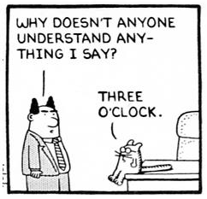

Slide 2
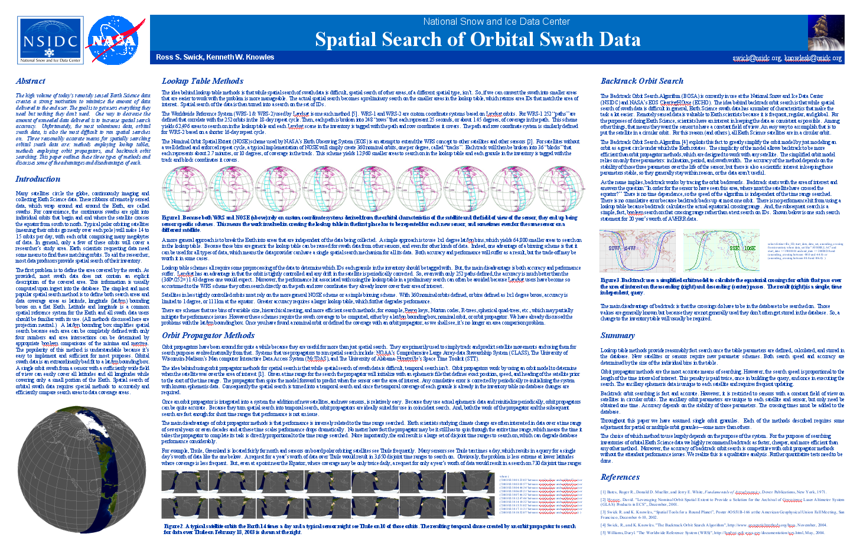
Spatial Search of Orbital Swath Data
Ross S. Swick, Kenneth W. Knowles
National Snow and Ice Data Center
Notes:
Here’s the poster that you all saw yesterday at the poster session. It’s mostly just the paper with a few extra images. I thought I’d use the presentation time to show a few more images to take adavantage of the medium.

Slide 3
Weird Shape
Notes:
The main problem is this. I was at a workshop about nine years ago and there was a woman who stood up and said “we have data that has this really weird shape.” Then she drew this picture on the whiteboard. And she said “we have this data that has all these holes in it, and it’s curvy, and it’s just a really weird shape.”
It took me a full five minutes to figure out what she was talking about. I couldn’t imagine the instrument that would create such weird data. And the reason I had trouble is I was imagining the rectangle represented the boundaries of the data, but actually the circles are the boundaries of the data, the rectangle is the Earth.

Slide 4
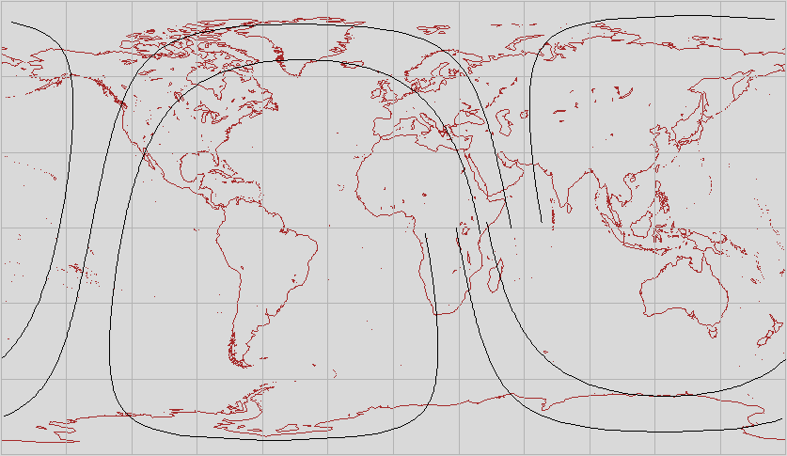
Full Orbit - Coverage
Notes:
What she was drawing was this. This is a full orbit on a Flat Earth. And it is a weird shape. But it’s only a weird shape if you think the Earth is flat. In fact the orbit itself isn’t a weird shape – the planet is.

Slide 5
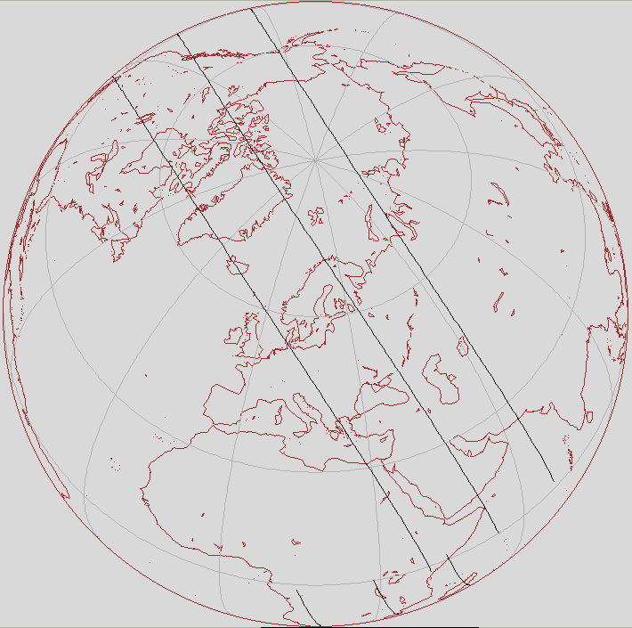
Full Orbit - Coverage
Notes:
On a round Earth orbits have this very ordinary, very predictable, very banal shape. In fact the only complicating factor is that pesky rotation thing. If the Earth didn’t rotate this would just be a ribbon around a sphere.
And this data is difficult to do spatial search on, but it’s also important to get it right. Level 0, level 1, and level 2 remotely sensed data is all this spatial type. So in terms of data volume easily 75% of the available data is this.

Slide 6
Full Orbit - LLBox
Notes:
The coverage of a lat/lon bounding box isn’t very helpful, you might as well not even do spatial search. So this is a difficult spatial type to runs searches on.

Slide 7
Full Orbit - Coverage
Notes:
Another way to do it is to just define this polygon. But even though modern RDBMSs can handle spherical polygons on a round Earth that advance in the technology doesn’t help much in this case. Representing this shape as a spherical polygon is difficult – and the heuristics used by the RDBMSs to search on spherical polygons break down when confronted with a polygon like this one, which will cause a performance hit.
So we need an alternate method.

Slide 8
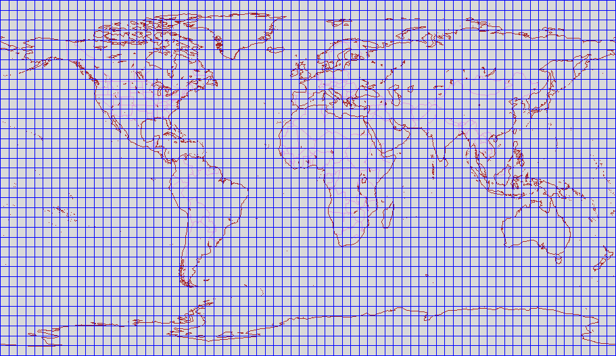
Binning/Lookup Tables
Notes:
Simple binning is another option, the most common method being lat/lon binning. You chop the Earth up into 1x1 degree bins that define the coverage of every orbit as a list of the bins it includes. These are actually 5x5 degree bins but you get the idea

Slide 9
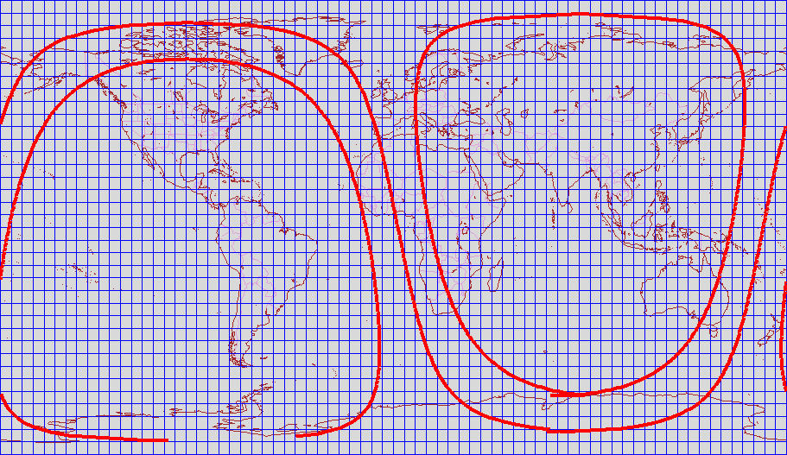
Full Orbit – Lat/Lon bins
Notes:
That turns spatial search into a list compare. This orbit covers about 7.5% of the Earth, more like 10% of the bins. That’s over 5000 bin labels per orbit. And you have to know something about the orbit to create the list of bin labels in the first place, so why not just use that “something” in the search.

Slide 10
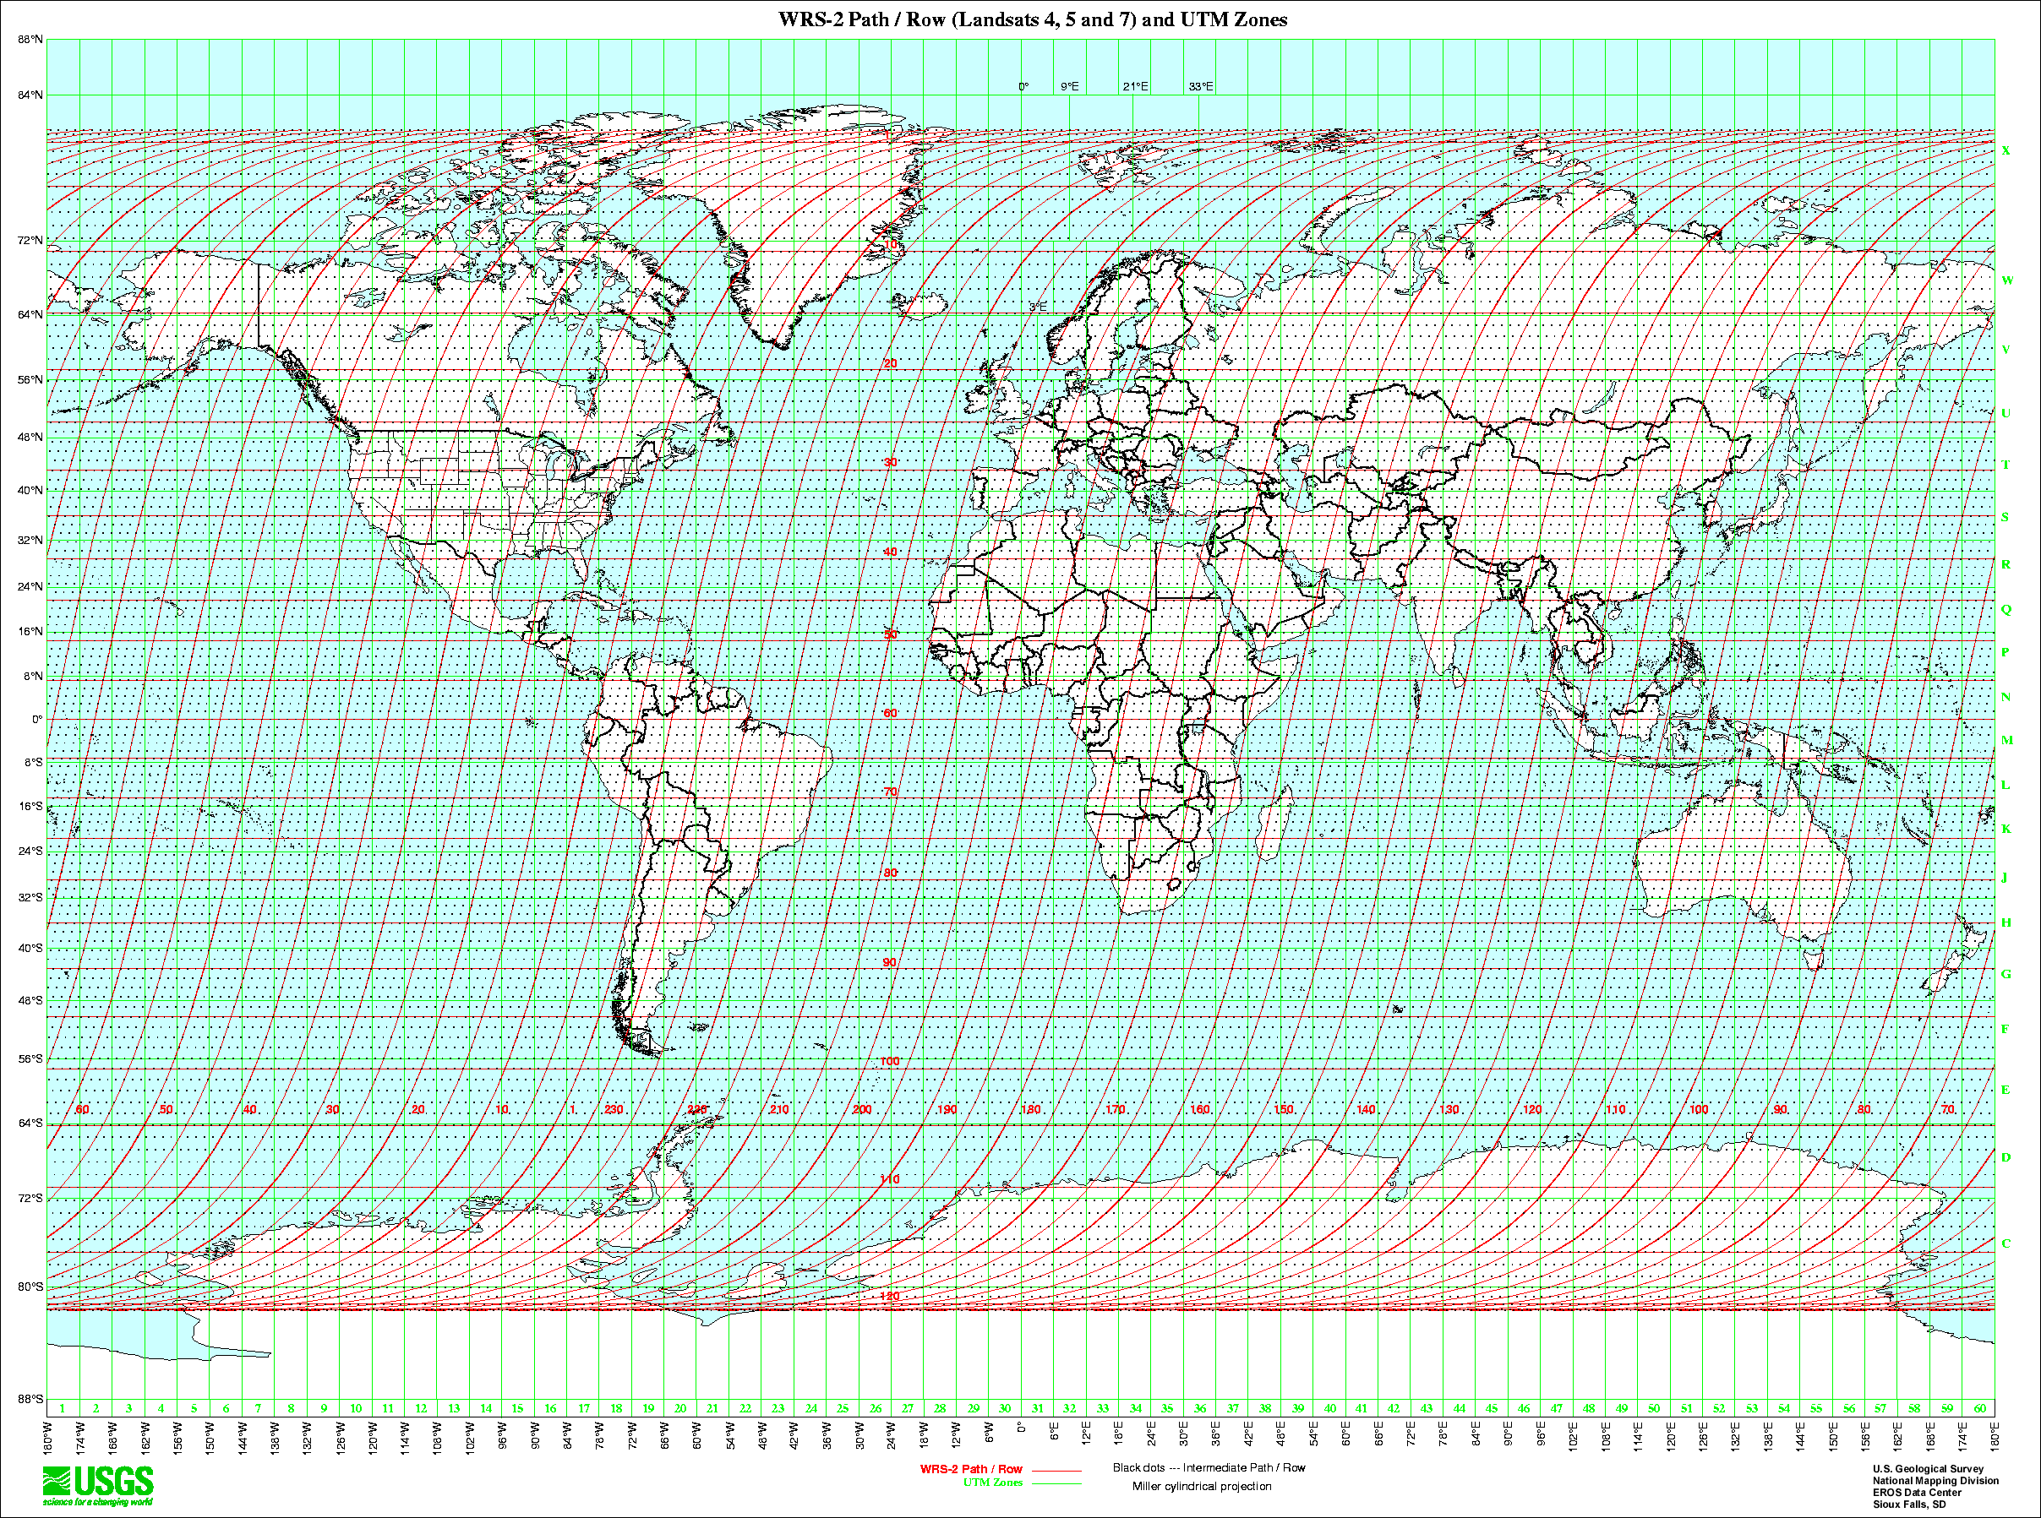
Worldwide Reference System
Notes:
Landsat satellites are in a tightly controlled orbit, and there are only 233 of them. So for landsat they can define the coverage of every orbit just by defining the coverage of 233 orbits. So a lookup table isn’t a bad option. And every landsat is in the same orbit so the lookup table is reusable.

Slide 11
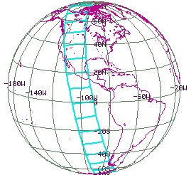
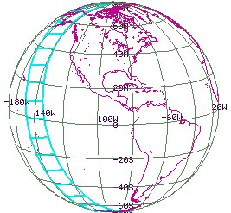
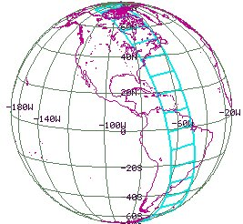
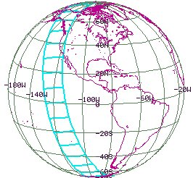
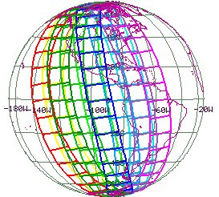
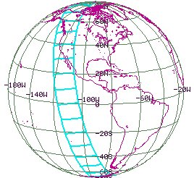
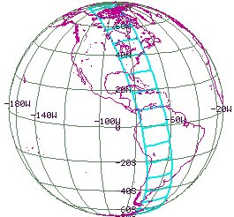
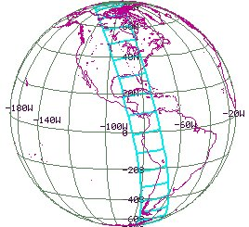
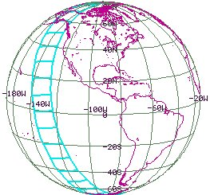
Nominal Orbit Spatial Extent
Notes:
But most Earth Science satellites aren’t in that tightly controlled an orbit. The Nominal Orbit Spatial Extent scheme is a generalization of WRS. They define 1 nominal orbit per degree. But that means they have to create nominal orbits that are one degree wider than the actual orbit, which can lead to 5-10% false positives in the search results.
The search on 13000 sperical quadralaterals is slow.
Swath width is a factor so each sensor needs it’s own lookup table.
Creating each lookup table is expensive.
And, again, you have to know something about the orbit to create the lookup table in the first place – why not just use that “something” for the search

Slide 12
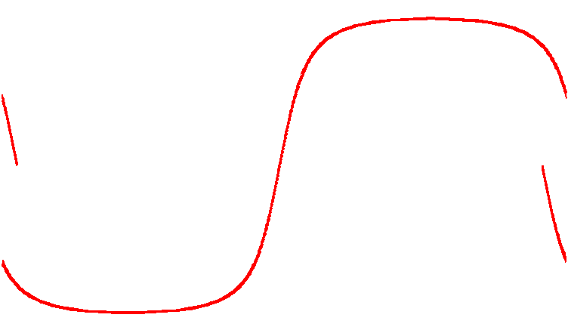
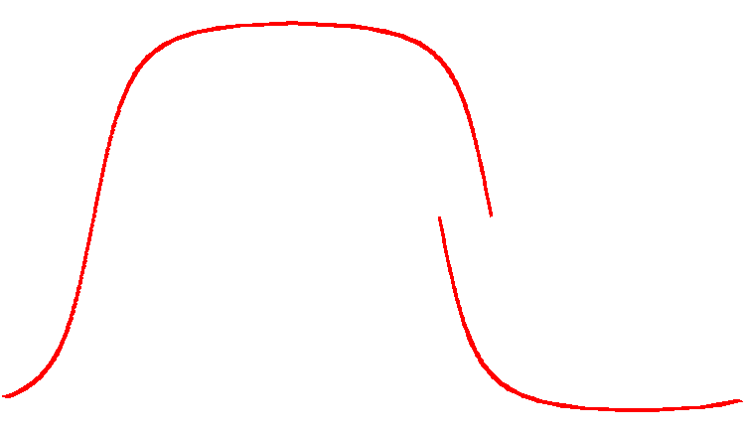
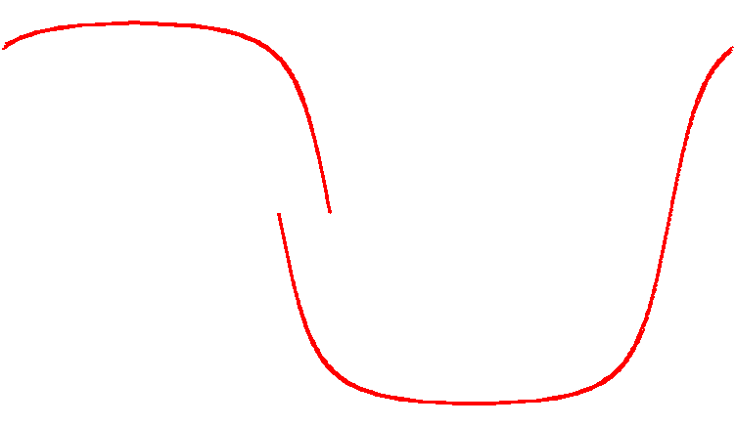
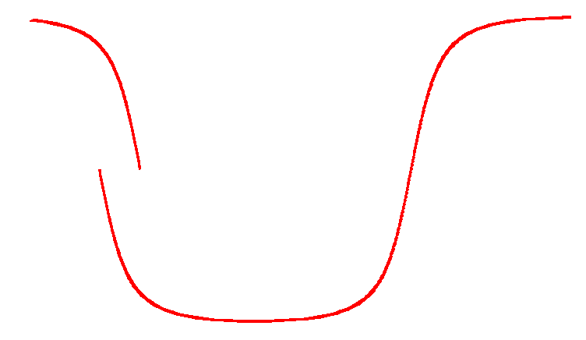
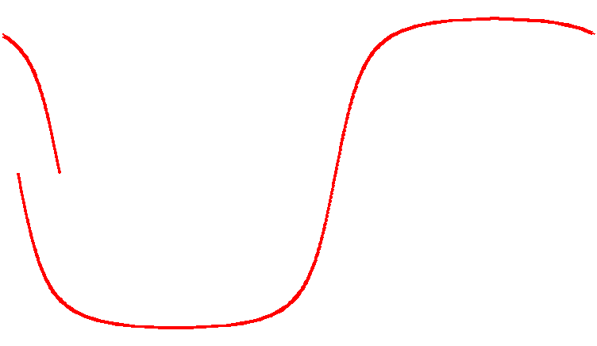
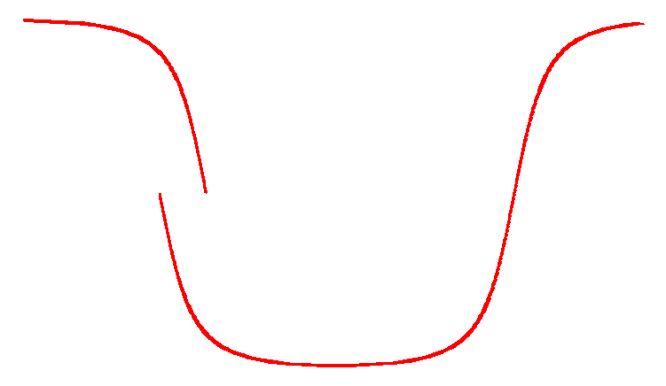
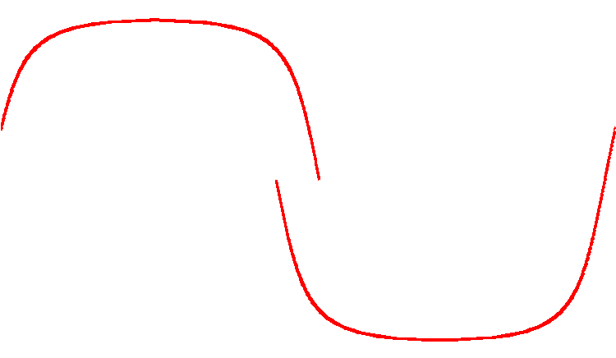
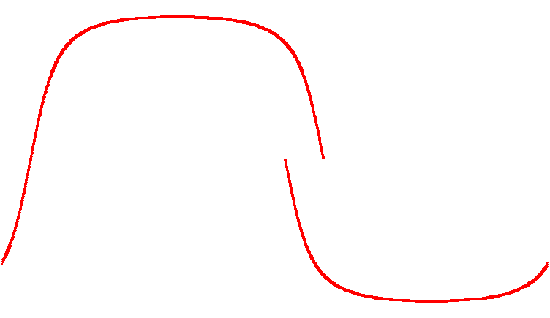
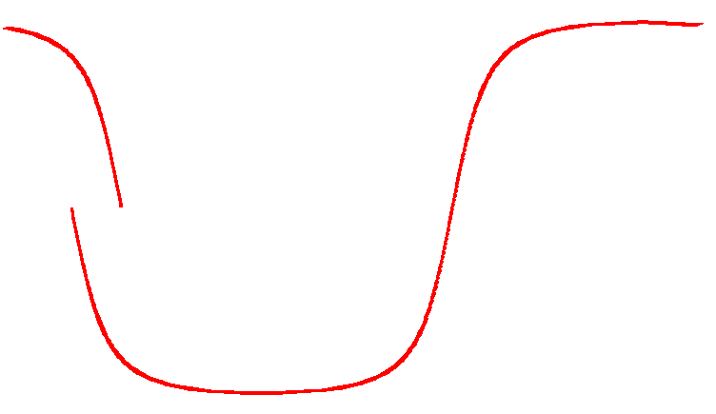
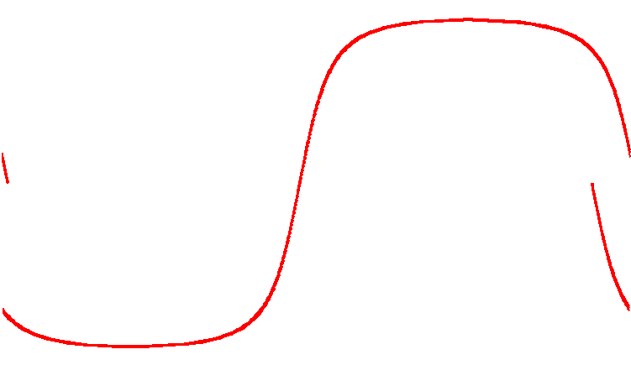
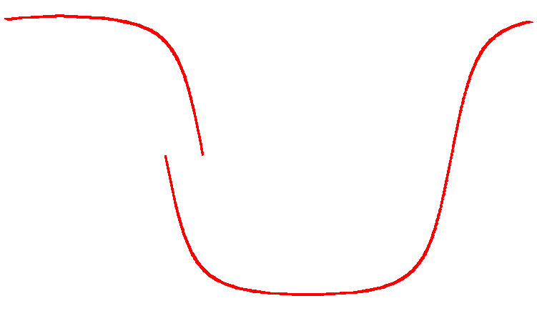
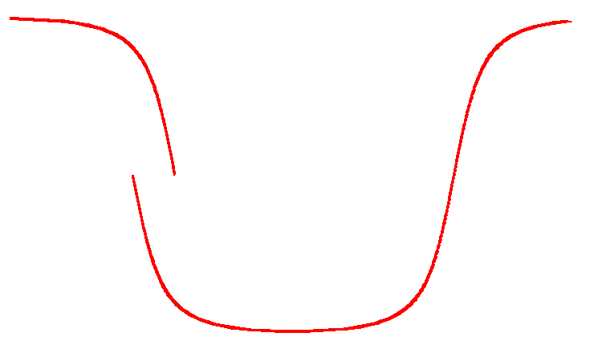
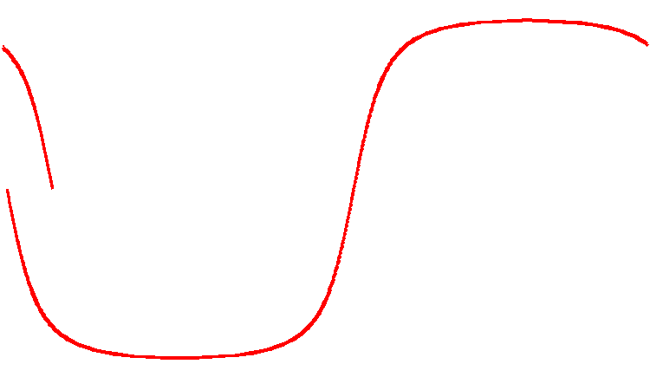
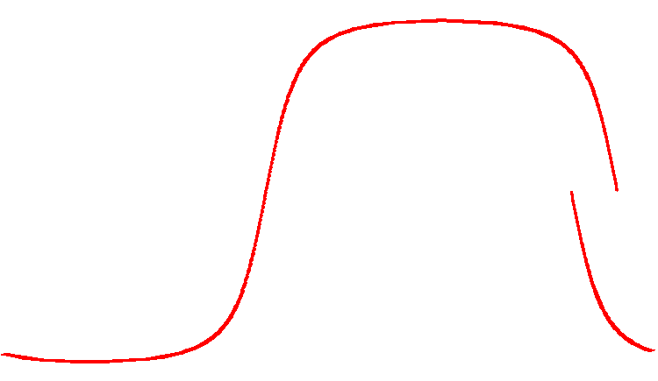
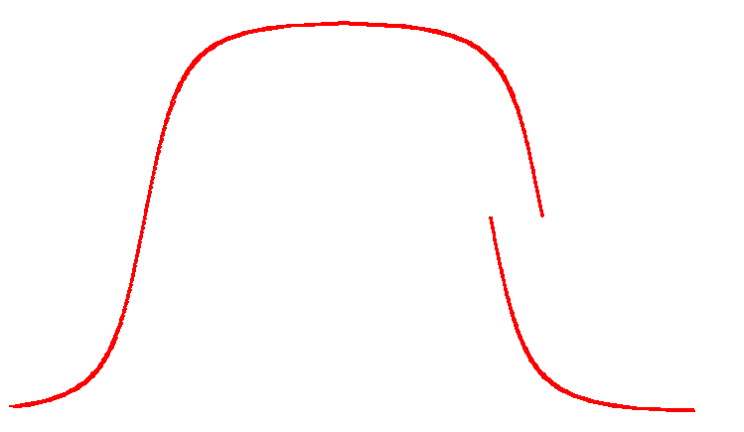
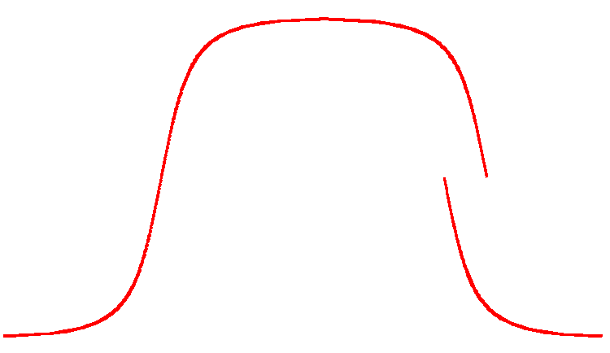
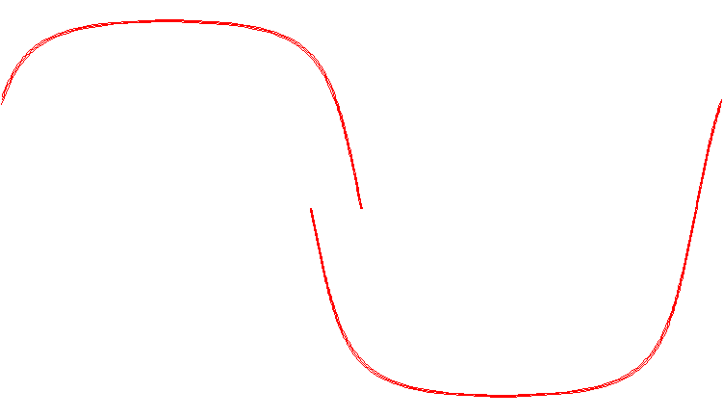
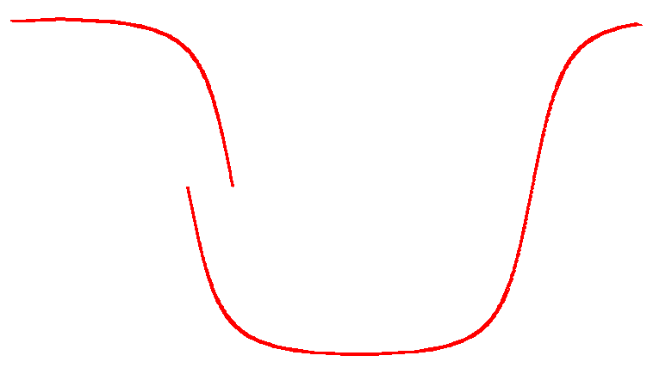
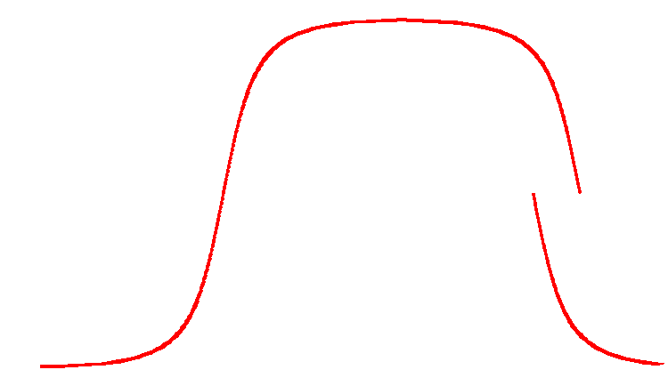
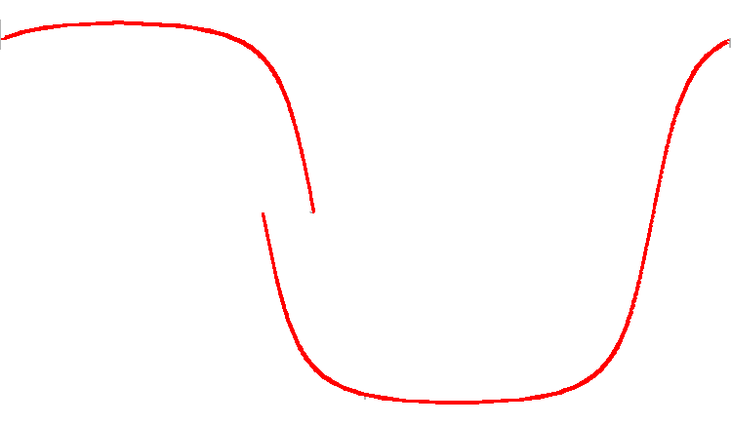
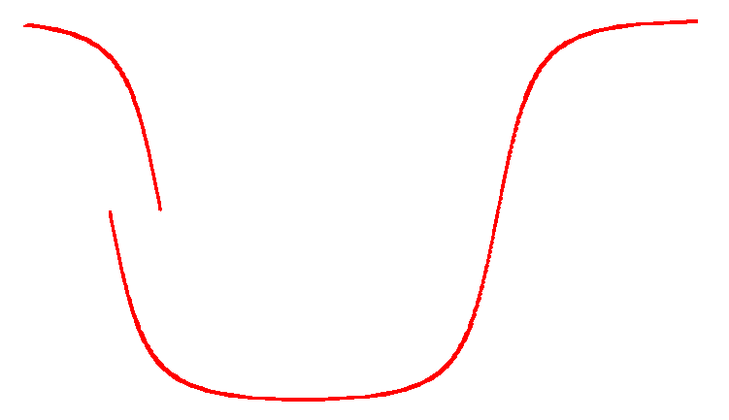
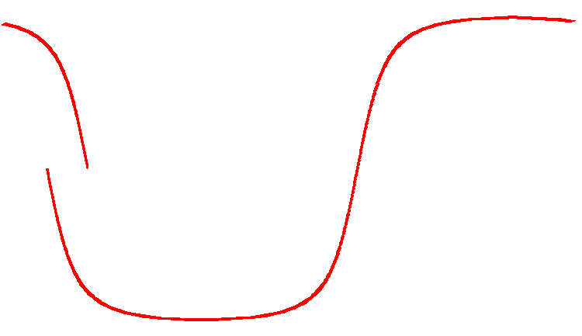
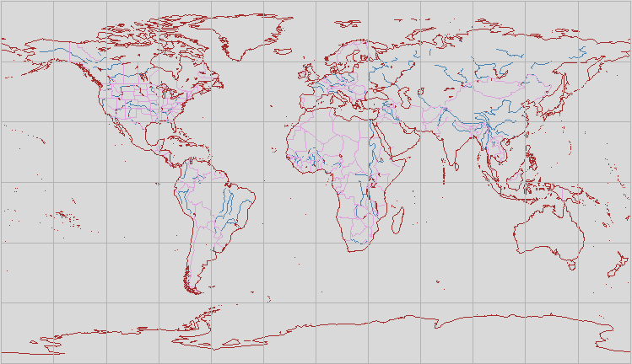
Predict – Orbit Propagator
2003/02/18 07:46:08
2003/02/19 07:51:54
2003/02/18 07:43:21
2003/02/19 07:47:33
Notes:
Another method is to predict the orbit using an orbit propagator. CLASS is one system that uses a propagator.
The way propagators work is they start with an area of interest…
(click)
… and an ephemeris file so they know where the satellite was at a given time, and where it was headed. Then the propagate the orbit forward to predict when the sensor would be over the area of interest.
(click)
No hit – continue
(click)
No hit
(click)
No hit, but close.
(click)
And there’s a hit. So take note of the time
(click)
And continue…
For purposes of this example I’m not taking the swath width into account. But propagators do and this would be a hit on the descending side.
(click)
And the next would be a hit as well
(click)
And you keep going till the next day – we get another hit. Note the time and continue.
(click)
And on an on…
I’m not trying to be disparaging – I just trying to explain how this works. All this happens fairly quickly and its a good system. The net effect is it turns a spatial search into a temporal search – and the times are already in the database, or they ought to be. So this works with no database changes.
The only problem is you end up with queries like this:

Slide 13
Predict SQL – Thule – one day
where (
('2003/02/18 01:23:03' between startDateTime and endDateTime) or
('2003/02/18 03:03:57' between startDateTime and endDateTime) or
('2003/02/18 04:44:34' between startDateTime and endDateTime) or
('2003/02/18 06:05:21' between startDateTime and endDateTime) or
('2003/02/18 07:46:32' between startDateTime and endDateTime) or
('2003/02/18 12:47:46' between startDateTime and endDateTime) or
('2003/02/18 14:10:32' between startDateTime and endDateTime) or
('2003/02/18 15:51:02' between startDateTime and endDateTime) or
('2003/02/18 17:11:31' between startDateTime and endDateTime) or
('2003/02/18 18:52:07' between startDateTime and endDateTime)
)
Notes:
Propagators turn spatial search into temporal search and end up with a temporal query with lots or “or”s. And this is a fine query – not a problem at all. But this is one day over Thule. I put this example in the paper.

Slide 14
Predict SQL – Thule – Two Weeks
where (
('2003/02/18 01:23:03' between startDateTime and endDateTime) or ('2003/02/18 03:03:57' between startDateTime and endDateTime) or ('2003/02/18 04:44:34' between startDateTime and endDateTime) or
('2003/02/18 06:05:21' between startDateTime and endDateTime) or ('2003/02/18 07:46:32' between startDateTime and endDateTime) or ('2003/02/18 12:47:46' between startDateTime and endDateTime) or
('2003/02/18 14:10:32' between startDateTime and endDateTime) or ('2003/02/18 15:51:02' between startDateTime and endDateTime) or ('2003/02/18 17:11:31' between startDateTime and endDateTime) or
('2003/02/18 18:52:07' between startDateTime and endDateTime) or ('2003/02/19 01:23:03' between startDateTime and endDateTime) or ('2003/02/19 03:03:57' between startDateTime and endDateTime) or
('2003/02/19 04:44:34' between startDateTime and endDateTime) or ('2003/02/19 06:05:21' between startDateTime and endDateTime) or ('2003/02/19 07:46:32' between startDateTime and endDateTime) or
('2003/02/18 12:47:46' between startDateTime and endDateTime) or ('2003/02/19 14:10:32' between startDateTime and endDateTime) or ('2003/02/19 15:51:02' between startDateTime and endDateTime) or
('2003/02/18 17:11:31' between startDateTime and endDateTime) or ('2003/02/19 18:52:07' between startDateTime and endDateTime) or ('2003/02/20 01:23:03' between startDateTime and endDateTime) or
('2003/02/20 03:03:57' between startDateTime and endDateTime) or ('2003/02/20 04:44:34' between startDateTime and endDateTime) or ('2003/02/20 06:05:21' between startDateTime and endDateTime) or
('2003/02/20 07:46:32' between startDateTime and endDateTime) or ('2003/02/20 12:47:46' between startDateTime and endDateTime) or ('2003/02/20 14:10:32' between startDateTime and endDateTime) or
('2003/02/20 15:51:02' between startDateTime and endDateTime) or ('2003/02/20 17:11:31' between startDateTime and endDateTime) or ('2003/02/20 18:52:07' between startDateTime and endDateTime) or
('2003/02/21 01:23:03' between startDateTime and endDateTime) or ('2003/02/21 03:03:57' between startDateTime and endDateTime) or ('2003/02/21 04:44:34' between startDateTime and endDateTime) or
('2003/02/21 06:05:21' between startDateTime and endDateTime) or ('2003/02/21 07:46:32' between startDateTime and endDateTime) or ('2003/02/21 12:47:46' between startDateTime and endDateTime) or
('2003/02/21 14:10:32' between startDateTime and endDateTime) or ('2003/02/21 15:51:02' between startDateTime and endDateTime) or ('2003/02/21 17:11:31' between startDateTime and endDateTime) or
('2003/02/21 18:52:07' between startDateTime and endDateTime) or ('2003/02/22 01:23:03' between startDateTime and endDateTime) or ('2003/02/22 03:03:57' between startDateTime and endDateTime) or
('2003/02/22 04:44:34' between startDateTime and endDateTime) or ('2003/02/22 06:05:21' between startDateTime and endDateTime) or ('2003/02/22 07:46:32' between startDateTime and endDateTime) or
('2003/02/22 12:47:46' between startDateTime and endDateTime) or ('2003/02/22 14:10:32' between startDateTime and endDateTime) or ('2003/02/22 15:51:02' between startDateTime and endDateTime) or
('2003/02/22 17:11:31' between startDateTime and endDateTime) or ('2003/02/22 18:52:07' between startDateTime and endDateTime) or ('2003/02/23 01:23:03' between startDateTime and endDateTime) or
('2003/02/23 03:03:57' between startDateTime and endDateTime) or ('2003/02/23 04:44:34' between startDateTime and endDateTime) or ('2003/02/23 06:05:21' between startDateTime and endDateTime) or
('2003/02/23 07:46:32' between startDateTime and endDateTime) or ('2003/02/23 12:47:46' between startDateTime and endDateTime) or ('2003/02/23 14:10:32' between startDateTime and endDateTime) or
('2003/02/23 15:51:02' between startDateTime and endDateTime) or ('2003/02/23 17:11:31' between startDateTime and endDateTime) or ('2003/02/23 18:52:07' between startDateTime and endDateTime) or
('2003/02/24 01:23:03' between startDateTime and endDateTime) or ('2003/02/24 03:03:57' between startDateTime and endDateTime) or ('2003/02/24 04:44:34' between startDateTime and endDateTime) or
('2003/02/24 06:05:21' between startDateTime and endDateTime) or ('2003/02/24 07:46:32' between startDateTime and endDateTime) or ('2003/02/24 12:47:46' between startDateTime and endDateTime) or
('2003/02/24 14:10:32' between startDateTime and endDateTime) or ('2003/02/24 15:51:02' between startDateTime and endDateTime) or ('2003/02/24 17:11:31' between startDateTime and endDateTime) or
('2003/02/24 18:52:07' between startDateTime and endDateTime) or ('2003/02/25 01:23:03' between startDateTime and endDateTime) or ('2003/02/25 03:03:57' between startDateTime and endDateTime) or
('2003/02/25 04:44:34' between startDateTime and endDateTime) or ('2003/02/25 06:05:21' between startDateTime and endDateTime) or ('2003/02/25 07:46:32' between startDateTime and endDateTime) or
('2003/02/25 12:47:46' between startDateTime and endDateTime) or ('2003/02/25 14:10:32' between startDateTime and endDateTime) or ('2003/02/25 15:51:02' between startDateTime and endDateTime) or
('2003/02/25 17:11:31' between startDateTime and endDateTime) or ('2003/02/25 18:52:07' between startDateTime and endDateTime) or ('2003/02/26 01:23:03' between startDateTime and endDateTime) or
('2003/02/26 03:03:57' between startDateTime and endDateTime) or ('2003/02/26 04:44:34' between startDateTime and endDateTime) or ('2003/02/26 06:05:21' between startDateTime and endDateTime) or
('2003/02/26 07:46:32' between startDateTime and endDateTime) or ('2003/02/26 12:47:46' between startDateTime and endDateTime) or ('2003/02/26 14:10:32' between startDateTime and endDateTime) or
('2003/02/26 15:51:02' between startDateTime and endDateTime) or ('2003/02/26 17:11:31' between startDateTime and endDateTime) or ('2003/02/26 18:52:07' between startDateTime and endDateTime) or
('2003/02/27 01:23:03' between startDateTime and endDateTime) or ('2003/02/27 03:03:57' between startDateTime and endDateTime) or ('2003/02/27 04:44:34' between startDateTime and endDateTime) or
('2003/02/27 06:05:21' between startDateTime and endDateTime) or ('2003/02/27 07:46:32' between startDateTime and endDateTime) or ('2003/02/27 12:47:46' between startDateTime and endDateTime) or
('2003/02/27 14:10:32' between startDateTime and endDateTime) or ('2003/02/27 15:51:02' between startDateTime and endDateTime) or ('2003/02/27 17:11:31' between startDateTime and endDateTime) or
('2003/02/27 18:52:07' between startDateTime and endDateTime) or ('2003/02/28 01:23:03' between startDateTime and endDateTime) or ('2003/02/28 03:03:57' between startDateTime and endDateTime) or
('2003/02/28 04:44:34' between startDateTime and endDateTime) or ('2003/02/28 06:05:21' between startDateTime and endDateTime) or ('2003/02/28 07:46:32' between startDateTime and endDateTime) or
('2003/02/28 12:47:46' between startDateTime and endDateTime) or ('2003/02/28 14:10:32' between startDateTime and endDateTime) or ('2003/02/28 15:51:02' between startDateTime and endDateTime) or
('2003/02/28 17:11:31' between startDateTime and endDateTime) or ('2003/02/28 18:52:07' between startDateTime and endDateTime) or ('2003/03/01 01:23:03' between startDateTime and endDateTime) or
('2003/03/01 03:03:57' between startDateTime and endDateTime) or ('2003/03/01 04:44:34' between startDateTime and endDateTime) or ('2003/03/01 06:05:21' between startDateTime and endDateTime) or
('2003/03/01 07:46:32' between startDateTime and endDateTime) or ('2003/03/01 12:47:46' between startDateTime and endDateTime) or ('2003/03/01 14:10:32' between startDateTime and endDateTime) or
('2003/03/01 15:51:02' between startDateTime and endDateTime) or ('2003/03/01 17:11:31' between startDateTime and endDateTime) or ('2003/03/01 18:52:07' between startDateTime and endDateTime) or
('2003/03/02 01:23:03' between startDateTime and endDateTime) or ('2003/03/02 03:03:57' between startDateTime and endDateTime) or ('2003/03/02 04:44:34' between startDateTime and endDateTime) or
('2003/03/02 06:05:21' between startDateTime and endDateTime) or ('2003/03/02 07:46:32' between startDateTime and endDateTime) or ('2003/03/02 12:47:46' between startDateTime and endDateTime) or
('2003/03/02 14:10:32' between startDateTime and endDateTime) or ('2003/03/02 15:51:02' between startDateTime and endDateTime) or ('2003/03/02 17:11:31' between startDateTime and endDateTime) or
('2003/03/02 18:52:07' between startDateTime and endDateTime) or ('2003/03/03 01:23:03' between startDateTime and endDateTime) or ('2003/03/03 03:03:57' between startDateTime and endDateTime) or
('2003/03/03 04:44:34' between startDateTime and endDateTime) or ('2003/03/03 06:05:21' between startDateTime and endDateTime) or ('2003/03/03 07:46:32' between startDateTime and endDateTime) or
('2003/03/03 12:47:46' between startDateTime and endDateTime) or ('2003/03/03 14:10:32' between startDateTime and endDateTime) or ('2003/03/03 15:51:02' between startDateTime and endDateTime) or
('2003/03/03 17:11:31' between startDateTime and endDateTime) or ('2003/02/18 18:52:07' between startDateTime and endDateTime) )
Notes:
This one is not in the paper. This is two weeks over Thule. So you see where I’m going.
Predict methods are really good for short time spans. But they begin to suffer a performance problem as the time rage gets longer. CLASS has an upper limit of 160 days on their search capability and I’m not positive but I suspect that is for this reason. 160 days over Thule would result in a query with 1,600 time ranges or’d together. That ends up being a query with more than 96,000 characters in it, and some databases have a 100K character limit.
If you are a scientist doing climate change work odds are good you want a long time series, years or decades long, and this query can easily get out of hand. A year over Thule would be 3,650 time ranges, a decade would be 36,500. Running the propagator for that long is going to take a while, and I’m not sure a search that size is even possible. Surely it’s not a reasonable thing to do even if you can.

Slide 15
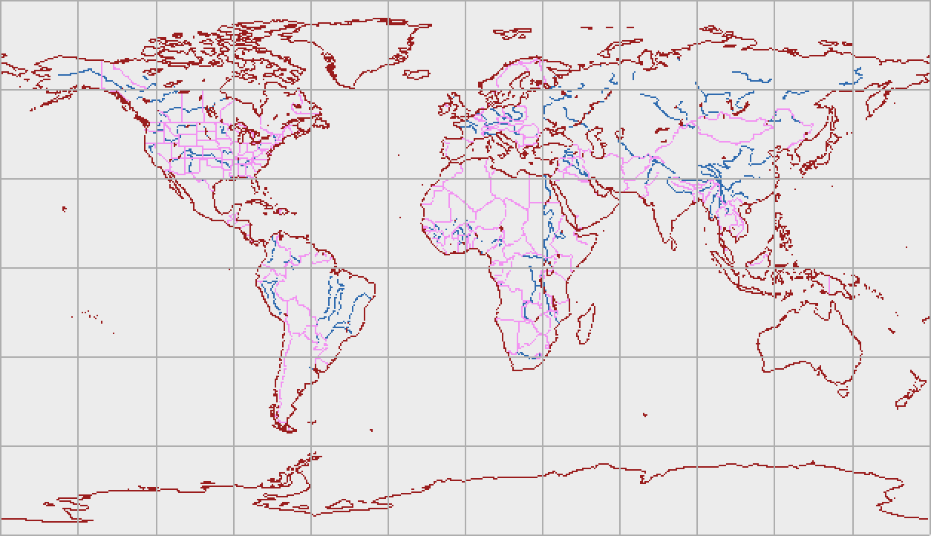

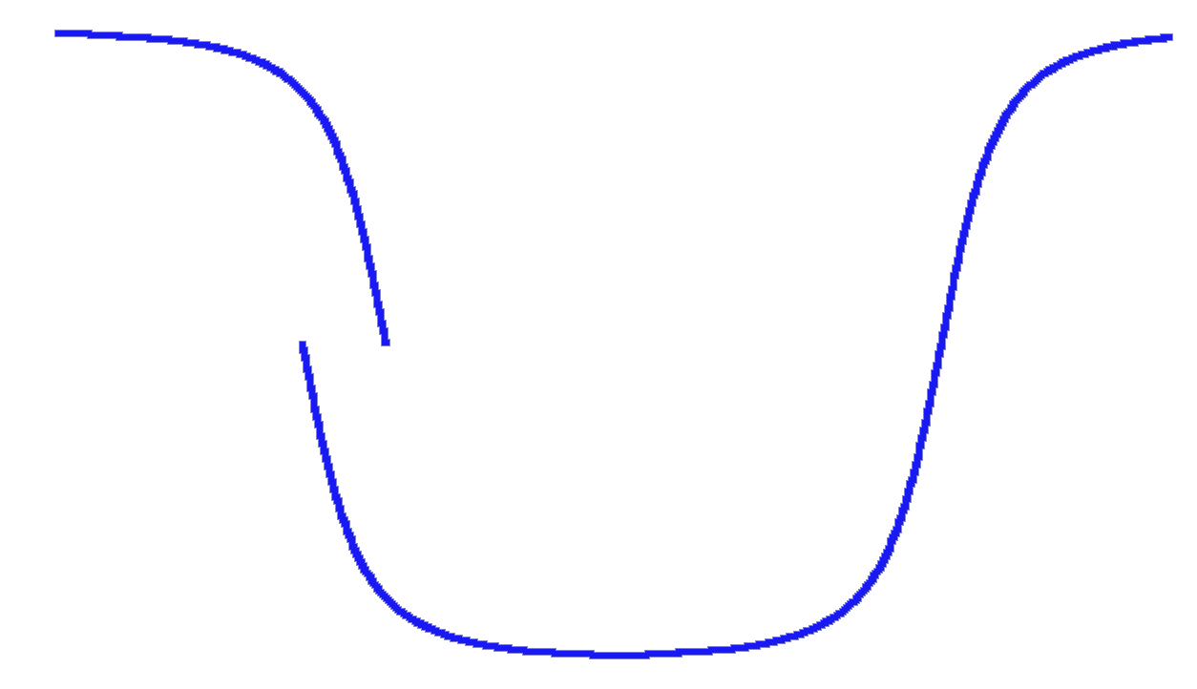
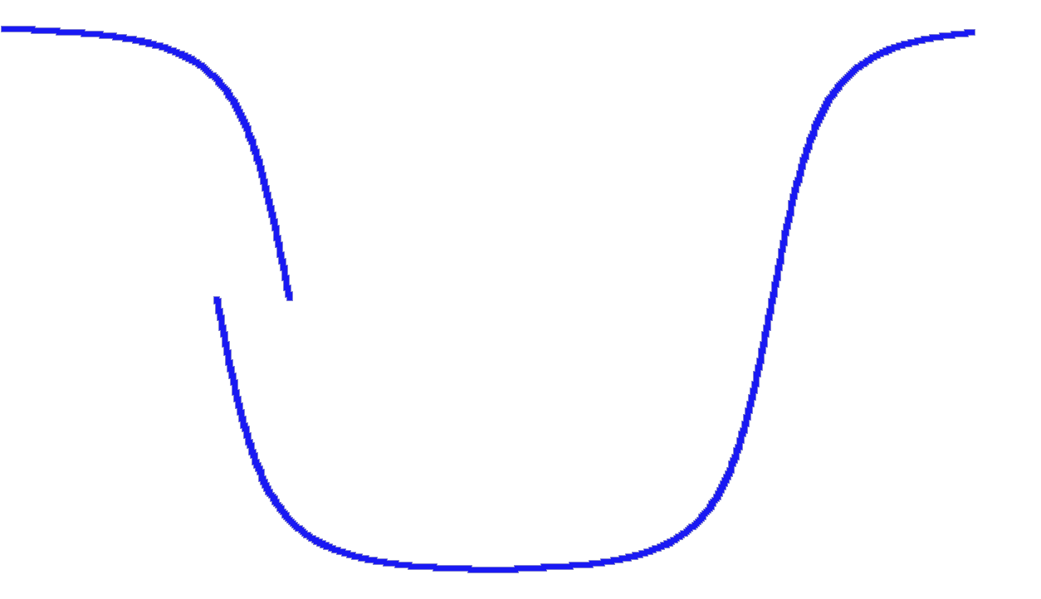
Backtrack (Ascending)
End Circular Lat = 49N
Start Circular Lat = 39N
80W
64W
Notes:
Another method is called Backtrack. This is the system we use at NSIDC, and ECHO is currently implementing it.
Like Orbit propagator methods Backtrack starts with the area of interest. But instead of predicting the orbit Backtrack assumes the sensor saw the area and looks to see what the orbit must have been like to make that happen. Backtrack runs backwards to see where the satellite must have crossed the equator.
(click)
So the user picks their area of interest and the database server figures out the range of nodal crossings for orbits that inevitably cross over that area.
(click)
In this case orbits with a nodal crossing of 64W will just nip the northwest corner of the area on the ascending pass so at least half the swath is in the area.
(click)
And orbits with a crossing of 80W hit the southeastern corner. So we have a range of nodal crossings to check for. You’re guaranteed that any full orbit with nodal crossings in that range covers the area of interest. But for partial orbits or scenes we have to worry about the start and end latitudes.
(click)
For the ascending pass the area of interest starts at about 39 degrees.
(click)
And ends at about 49 degrees.

Slide 16
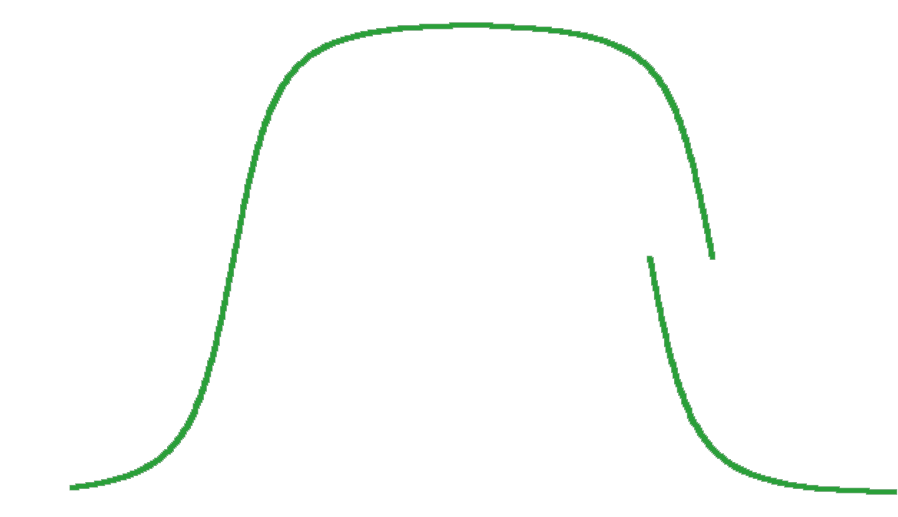
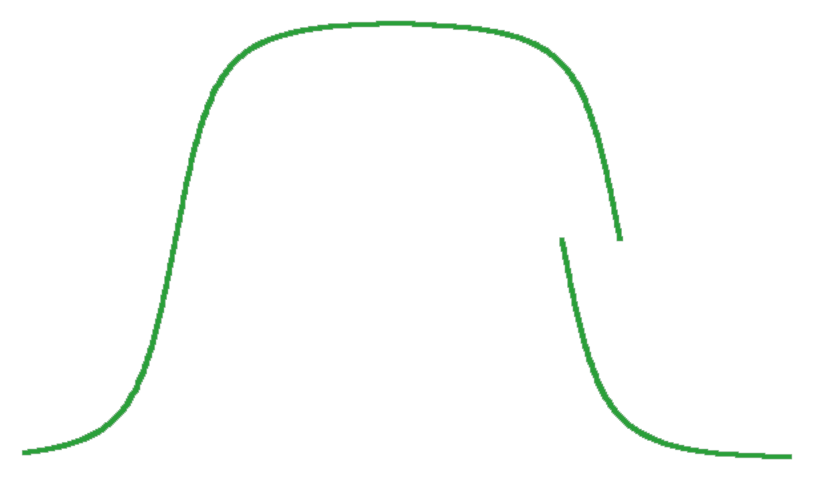
Bactrack (Descending)
Stop
Start Circular Lat = 131
Start
End Circular Lat = 141
80W
64W
88E
106E
Notes:
The procedure is the same for orbits with descending passes covering the area of interest.
(click)
In this case orbits with a nodal crossing of about 106E will nip the southeast corner of the area.
(click)
And orbits with a nodal crossing at about 88E will nip the northwest corner of the area.
(click)
For partial orbits or scenes the area starts at about 131 degrees.
(click)
And ends at about 141 degrees.

Slide 17
Backtrack Parameters
Stop
Start
Start
Stop
80W
64W
88E
106E
Notes:
And that’s all computationally expensive but it only has to be done once for the user’s area of interest, and comes up with these parameters for the spatial search. And the code to do this is already written so there’s a minimal development effort required.
Note this could be done with a lookup table. But by doing it mathematically we avoid querying the database twice, and we have a more flexible system cause we don’t have to create new lookup tables for every sensor.

Slide 18
Backtrack SQL
select distinct file_ID, start_date, data_set, ascending_crossing
from inventory where data_set like "AVHRR_LAC" and
start_date >= 19800101 and end_date <= 20000218 and
( ( ( (start_clat between 39.0 and 49.0) or
(end_clat between 39.0 and 49.0) or
(start_clat < 39.0 and end_clat > 49.0) ) and
( ascending_crossing between -80.0 and -64.0) ) or
( (start_clat between 131.0 and 141.0) or
(end_clat between 131.0 and 141.0) or
(start_clat < 131.0 and end_clat > 141.0) ) and
(ascending_crossing between 88.0 and 106.0) ) ) )
Notes:
Which results in an SQL query like this one. It’s all Boolean, so it’s fast, and there’s no post processing of the results. The blue portion returns any orbits or partial orbits that cross over the area of interest on the ascending pass. The green portion returns any orbits or partial orbits that cross over the area of interest on the descending pass. And this is the entire query for 20 years worth of data.
The main problem with this search is that it does require that the ascending crossing and start/end clat information be in the database, which means you have to plan a head a little bit. But that information is normally available, it’s just that it’s not often included in the metadata and the database.
So we prefer Backtrack as it seems a good hybrid of the other two systems. It requires a little prep work but nowhere near as much as NOSE. And it’s almost as accurate as propagator methods without the performance hit for long time series.

Slide 19
References
Bates, Roger R., Donald D. Mueller, and Jerry E. White, Fundamentals of Astrodynamics, Dover Publications, New York, 1971.
Heroux, David. "Leveraging Nominal Orbit Spatial Extent to Provide a Solution for the Archival of Geoscience Laser Altimeter System (GLAS) Products in ECS",, December, 2001.
Swick R. and K. Knowles, “Spatial Tools for a Round Planet”, Poster #OS51B-166 at the American Geophysical Union Fall Meeting, San Francisco, December 6-10, 2002.
Swick, R., and K. Knowles. "The Backtrack Orbit Search Algorithm", http://www.geospatialmethods.org/bosa, November, 2004.
Williams, Daryl. "The Worldwide Reference System (WRS)", http://landsat.gsfc.nasa.gov/documentation/wrs.html, May, 2004.
Notes:
And that’s it.
Any questions?

Slide 20
ECHO vs. ECS
Or
Backtrack vs. NOSE
Notes:
One of the reviewers objected that we hadn’t actually done any studies to prove some of the things we assert, and that’s a fair point. We didn’t actually have to ability to run such a study until this month when the version of ECHO that implements Backtrack became available for test. So we finally have two systems with identical holdings and different s orbital search methods. So we ran a rough preliminary test to see if backtrack really does perform better than NOSE.

Slide 21
ECHO using Backtrack:
Data: AMSR L2A
Period: 98.8 minutes
Inclination: 98.2 degrees
Swath Width: 1445 km.
ECS using NOSE
Data: AMSR L2A
Period 98.8 minutes
Inclination: 98.2 degrees
Swath Width: 1600 km.
Tracks: 720 half orbits
Blocks: 18 per track
Because NOSE uses nominal orbits the swath width has to be inflated so all the actual orbits represented by the nominal orbit fit. Using a NOSE implementation of one nominal orbit per degree means inflating the swath width by at least one degree, or 110 km. In this case they were actually inflated by 155 km.
Notes:
So this was the test. NOSE has to have a larger swath width, and that’s why we’d expect backtrack to give more accurate results.

Slide 22
Search:
Temporal: May 1, 2005 – May 25, 2005
Spatial: Lat {40, 65}, Lon {-80, -50}
Results:
ECHO: 130 granules
66 Ascending with crossings in {-77.64, -11.22}
64 Descending with crossings in {-118.57, -52.15}
ECS: 157 granules
80 Ascending with crossings in {-80.79, -5.04}
77 Descending with crossings in {-126.35, -49.07}
Notes:
We only ran the test over 25 days because that’s all the data overlap we had in the test system. Turned out we didn’t even have that much.
ECS using NOSE did return more results, as expected.

Slide 23
Analysis:
Given the wider swath width of the NOSE scheme we would expect NOSE to generate (155/1445) = 10.7% more results.
Instead we got (27/130) = 20.8% more results.
ECS/NOSE found 7 granules that ECHO/Backtrack “should” have found. This test was rather preliminary and when we checked ECHO we found the metadata for those 7 granules wasn’t in ECHO.
The other 20 “extra” granules had crossings outside the range returned by ECHO/Backtrack
A more controlled test can take place once ECHO 6.0 is operational

Slide 24
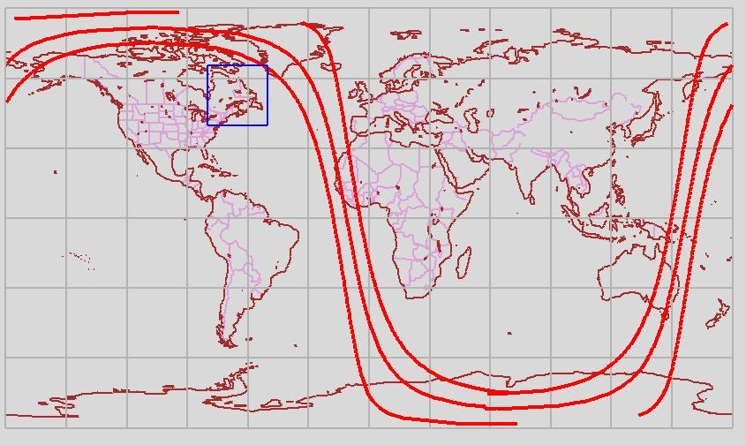
ECHO/Backtrack Maximum ascending crossing at -11.22 degrees

Slide 25
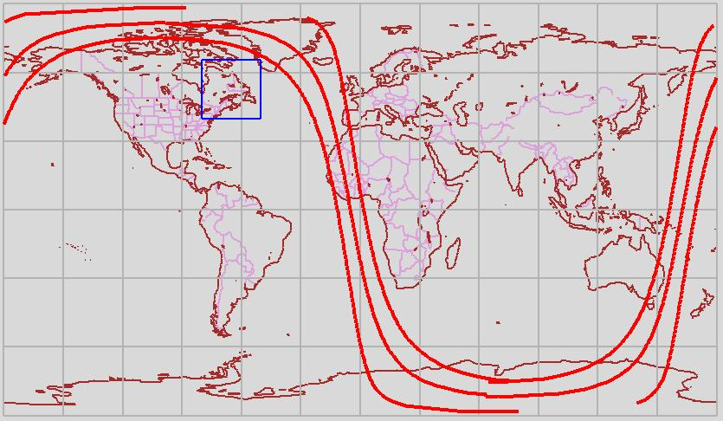
ECS/NOSE Maximum ascending crossing at -5.04 degrees

Slide 26
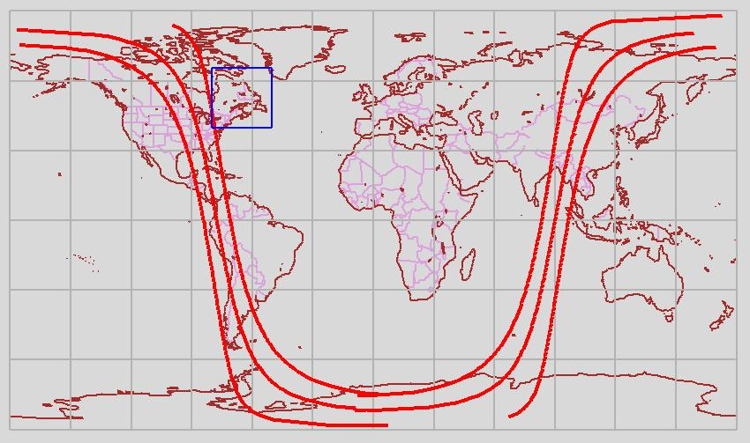
ECHO/Backtrack Minimum ascending crossing at -77.64 degrees

Slide 27
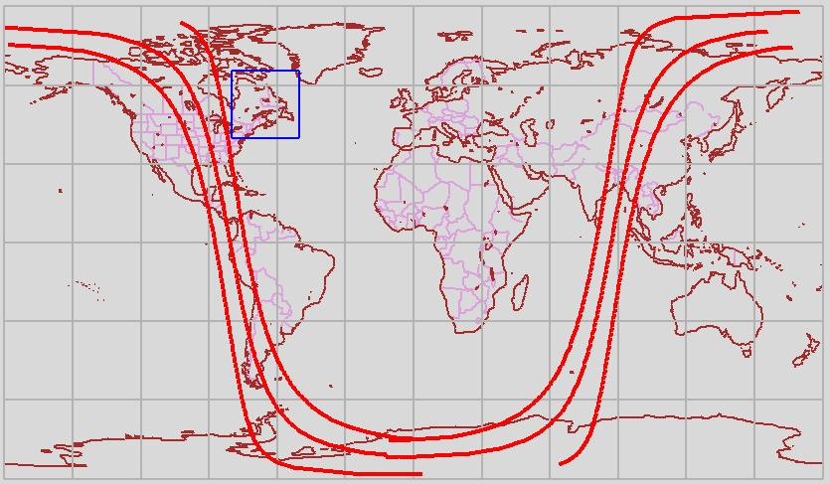
ECS/NOSE Minimum ascending crossing at –80.79 degrees

Slide 28
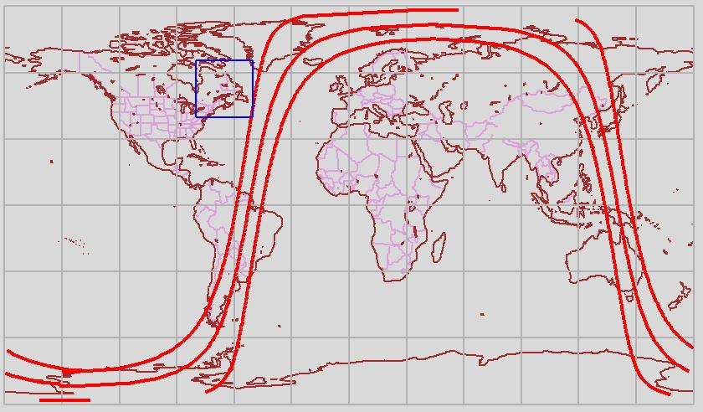
ECHO/Backtrack Maximum descending crossing at -52.15 degrees

Slide 29
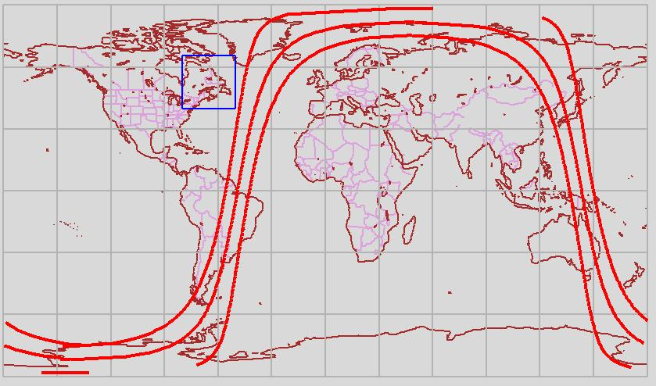
ECS/NOSE Maximum descending crossing at -49.07 degrees

Slide 30

ECHO/Backtrack Minimum descending crossing at -118.57 degrees

Slide 31

ECS/NOSE Minimum descending crossing at -126.35 degrees

