Slide 1
An Information Theoretic Model for Database Alignment
Patrick Pantel, Andrew Philpot and Eduard Hovy
Digital Government Research Center
USC Information Sciences Institute
{pantel,philpot,hovy}@isi.edu

Slide 2
DGRC Past Research Projects
Major research focus: integration of data from disparate sources:
  EIA project: Energy price data (EIA, CENSUS, BLS, etc.)
    integrated over 50,000 data tables under central data model, accessible to user via NL interface in English and Spanish
  ARGOS project: transportation / freight flow data integration, with different government partners
We’ve learned several lessons:
  1. Do not waste the gov partner’s time!
  2. Do not make overblown promises about system functionality — this is research!
  3. Respect the gov partner’s need for data privacy!

Slide 3
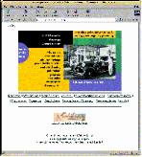
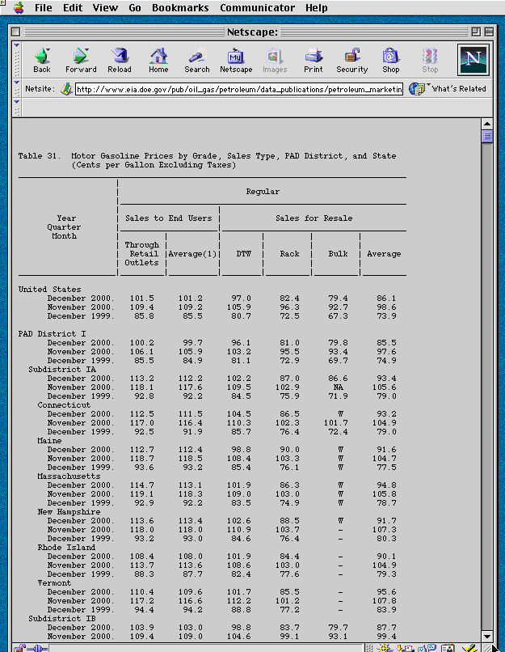
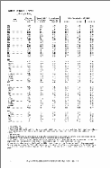
Fitting into NEISGEI
Wrappers
Applications
Inventories
Ontologies
GIS display
Data analysis
and many
others…
Access planners
Our goal: Enable people to compare and link together data from different sources, by discovering data alignments

Slide 4
Data Consolidation Problem
Massive data heterogeneity in Government data as well as in large organizations
  Data is split in many ways and is collected at different times by different people
  Problems:
    Staff and public cannot effectively locate, share or compare data
    Cannot achieve computational data interoperability
We require (semi)-automatic methods for integrating data sources

Slide 5
Automated Database Integration
Our goal
  Develop (semi-)automated methods to speed up the data alignment and database integration process:
Our data:
  EPA’s Air Quality Management Districts:
    35 in California, each collecting its own emissions inventory databases its own way, using its own standards
    CARB in Sacramento integrates this data annually and passes it to US-EPA, who integrates it with other states’ data
Our approach:
  Focus on the human-centered process of identifying semantic equivalence between source and target data sets
  Develop a suite of tools to map, transform, and re-aggregate data from one schema to another:
    Leverage statistical techniques of human language technology
    Address issues of scalability and maintenance
  Work with others to develop sophisticated visualization tools
  Eventually integrate toolkit into NEISGEI framework

Slide 6
Previous Related Work
Information Integration
  Build a central model integrating the metadata for each data source
    Global-as-view vs. Local-as-view vs. Ontology
Object Identification/Instance matching
  Domain independent vs. domain dependent rules
Information Retrieval
Machine-learning based Database Schema Matching
  Labels, labeled data, data-driven
  Rule-based vs. learner based vs. multiple learners
Problem: current methods do not handle well large and noisy data sources
Key Idea: Pointwise mutual information – look for a small subset of interesting/important data values on which to match

Slide 7
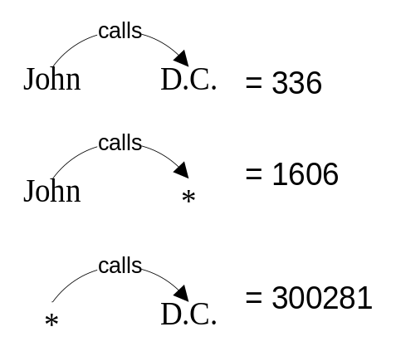
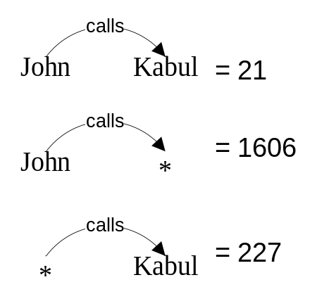
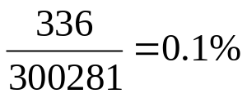
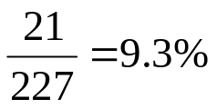
Pointwise Mutual Information
Phone calls placed by John Doe:
L.A. 571
D.C. 336
Hamburg 234
Culver City 199
Anaheim 103
Leipzig 59
Mosul 51
Toronto 38
Boston 34
Ventura 33
St. Louis 31
Kabul 21
Hollywood 21
Covina 20
Long Beach 16
Carson 16
Compton 16
Hamburg 234
Leipzig 59
Mosul 51
Kabul 21

Slide 8
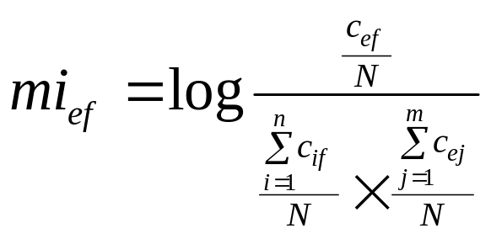
Pointwise Mutual Information
Phone calls placed by John Doe… sorted by MI:
Kabul 7.88
Mosul 7.05
Leipzig 5.78
Hamburg 5.58
Culver City 5.48
L.A. 4.77
D.C. 4.60
Anaheim 4.46
Ventura 4.38
Toronto 4.36
Boston 4.31
Covina 2.91
Compton 2.86
St. Louis 2.40
Long Beach 2.03
Carson 1.62
Hollywood 1.43
Kabul 7.88
Mosul 7.05
Leipzig 5.78
Hamburg 5.58
Joint probability
Assuming independence
  measures the strength of association between the feature and the element
  it is the reduction in uncertainty of one event due to knowing about another
  (Pantel 2003; Church and Hanks 1989)

Slide 9
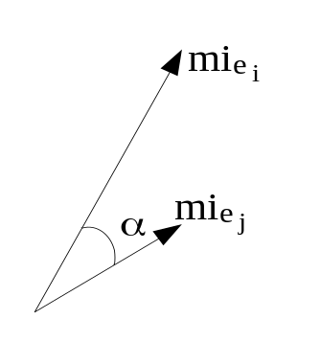
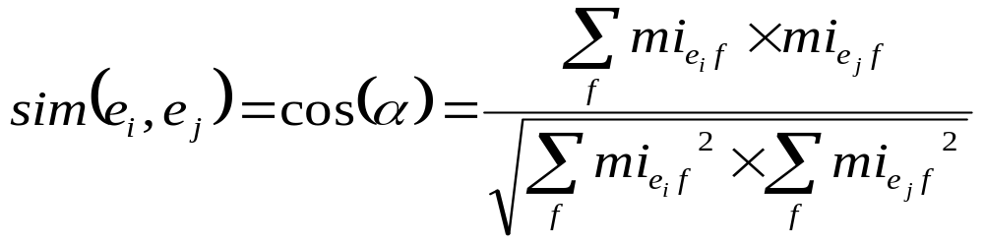
Similarity Model
Cosine coefficient
  Commonly used metric in spaces where matching observations are more indicative of similarity than missing observations are indicative of dissimilarity
  Measures the cosine of the angle between the two feature vectors of two columns e_{i} and e_{j}:
  (Salton and McGill 1983)

Slide 10
Approach: Aligning Columns from Databases A and B
Prepare data collections
Compute pointwise mutual information vectors for each column of A and B
  Vector dimensions can be:
    1) Cell values (e.g. ‘90292’, ‘30609-1123’ …)
    2) Preprocessed domain classifiers that append the class of data to the cell value (e.g. ‘zip5:90292’, ‘zip5:30609’, ‘zip4:1123’ …)
Compute the similarity between each vector representation in A with those in B
Align each column from in A with its most similar column in B
Evaluation: Compare against hand-build gold standard

Slide 11
Data Sources
Source:
  Provided by Santa Barbara County Air Pollution Control District (SBCAPCD) and Ventura County Air Pollution Control District (VCAPCD)
  Both provided emissions inventory for 2001 and 2002
    covering facilities, devices, processes, permitting history, as well as criteria and toxic emissions
Target:
  Provided by the California Air Resources Board (CARB)
  Statewide emissions inventories for 2001 and 2002

Slide 12
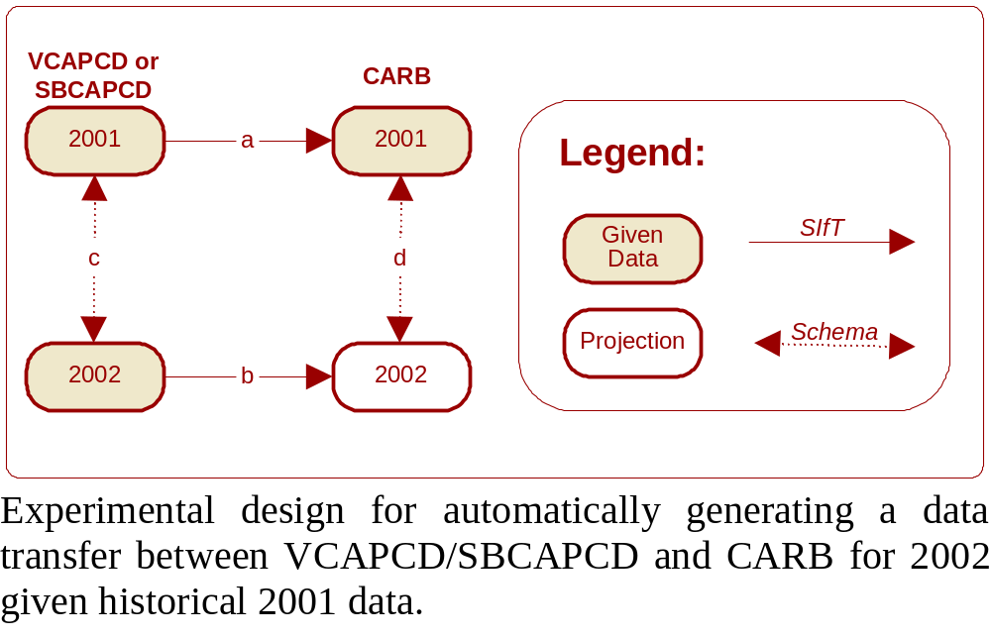
Experimental Architecture
We experimented with:
  alignment
  projection

Slide 13
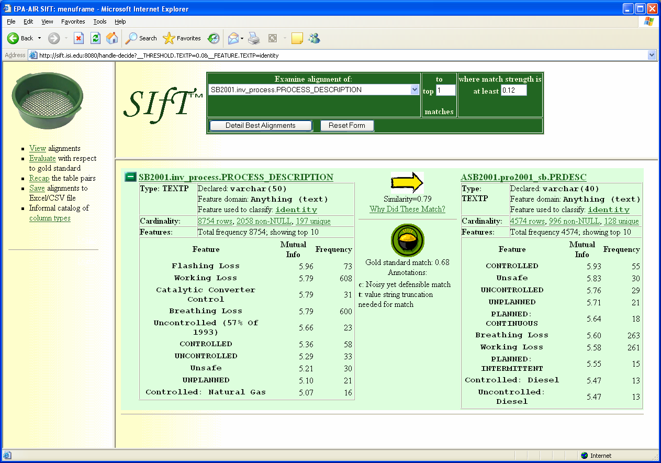
Example alignment
A correct alignment discovered by SIfT between the Process Description columns in the SBCAPCD and CARB databases.
Why did these align??

Slide 14
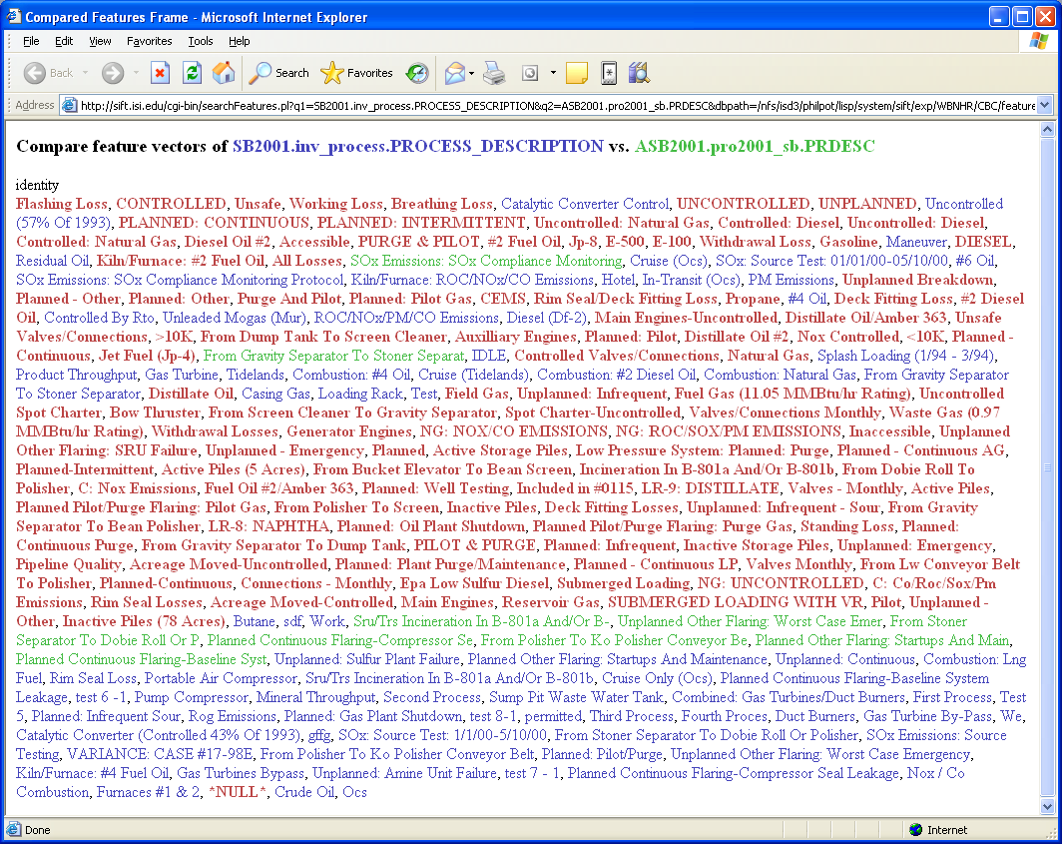
Example alignment
A view of the feature vectors for the Process Description columns in the SBCAPCD and CARB databases. The features are sorted in descending order of mutual information. Red features are shared by both columns whereas blue features are solely from the SBCAPCD column and green features are solely from the CARB column.

Slide 15
Experimental Results: Alignment

Slide 16
Experimental Results: Alignment
Gold standard:
  We manually aligned the SBCAPCD and CARB emissions inventories from year 2001
    Difficult and only partial matching of inter-source column associations

Slide 17
Evaluation Metrics
PRECISION: Given candidate alignment system has found, how often is it correct?
  “nothing but the truth”
RECALL: Relative to all known correct alignments, how often does system find given alignment?
  “the whole truth”
F-measure = harmonic mean of P & R
  1/F = 1/P + 1/R, or F = 2PR/(P+R)
  If either P or R is small, F is small

Slide 18
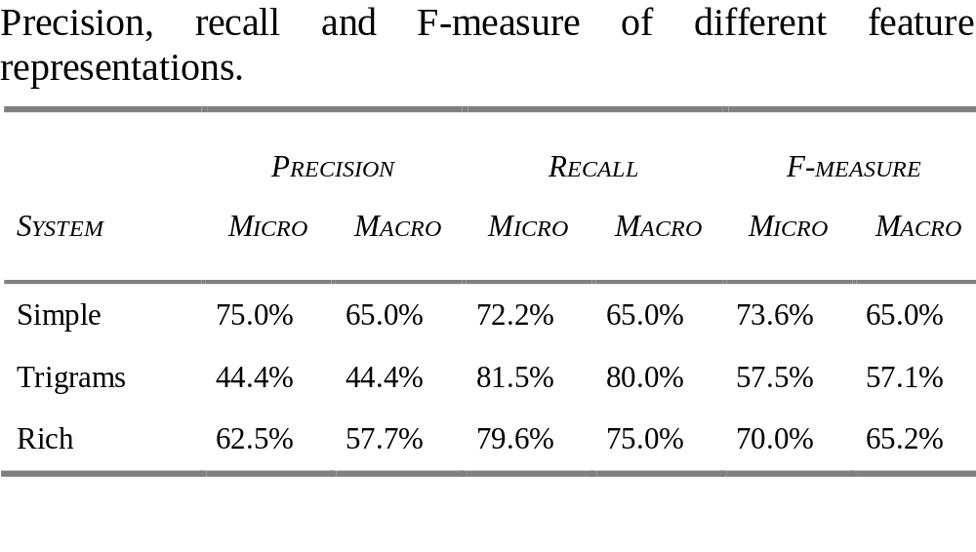
Experimental Results: Alignment
Surprise: Simple representation outperforms the others
Lesson: unless feature extraction is very accurate, let mutual-information automatically discover the key values of a particular data domain

Slide 19
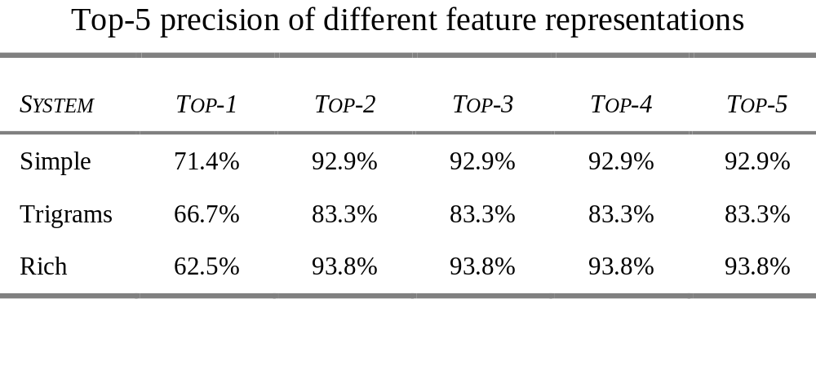
Experimental Results: Alignment
Surprise: if the system can find a correct alignment for a given column, then the alignment will be found in the first two returned candidate alignments
Impact: Greatly reduce human search time by only looking at two candidate alignments per column

Slide 20
Experimental Results: Projection

Slide 21
Experimental Results: Projection
We automatically integrated 2002 VCAPCD and 2002 SBCAPCD databases with CARB’s 2002 database using historical 2001 data
Gold standard:
  since CARB provided us with their 2002 databases, we have a true gold standard against which to compare our integration
Evaluation:
  We randomly sampled 50 columns in the automatically integrated CARB 2002 databases
  A human judge was asked to classify each aligned column as correct, partially correct, or incorrect:

Slide 22
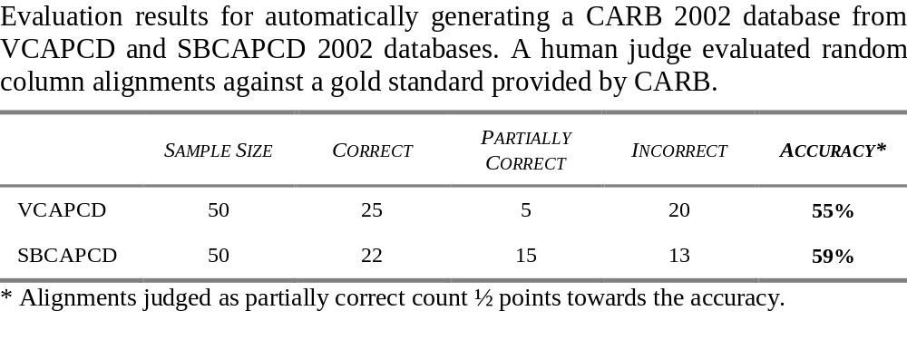
Experimental Results: Projection
Particularly bad at aligning binary (Yes/No or 0/1) columns
  MI not useful since binary values are shared by many columns

Slide 23
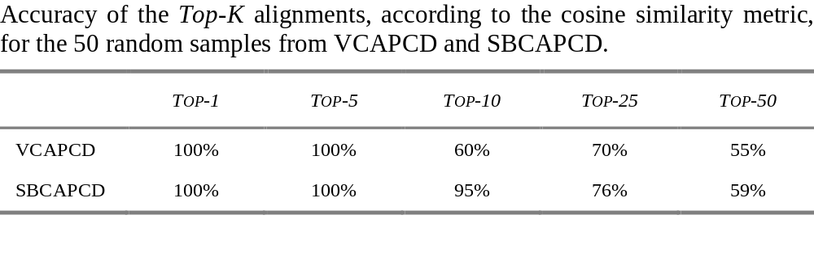
Experimental Results: Projection
System’s similarity score gives a confidence in alignment decisions
The higher the confidence, the higher the chances that this alignment is correct

Slide 24
Conclusion
We proposed an information theoretic model for performing data-driven column alignments.
We aligned 2001 SBCAPCD and VCAPCD with CARB data sets and projected the alignment to 2002
  75% precision and 72.2% recall on the column alignment task
  55% - 59% accuracy on the projection task
Potential to significantly reduce the amount of human labor on aligning multiple heterogeneous databases
Future Direction: Use the same model to find aliases/duplicates (record linkage)

Slide 25
Thank You!

Slide 26
Pointwise Mutual Information
Calls originating from a SoCal city… sorted by MI:
Kabul 7.88
Mosul 7.05
Leipzig 5.78
Hamburg 5.58
Culver City 5.48
L.A. 4.77
D.C. 4.60
Anaheim 4.46
Ventura 4.38
Toronto 4.36
Boston 4.31
Covina 2.91
Compton 2.86
St. Louis 2.40
Long Beach 2.03
Carson 1.62
Hollywood 1.43
Kabul 7.88
Mosul 7.05
Leipzig 5.78
Hamburg 5.58
Joint probability
Assuming independence
  measures the strength of association between the feature and the element
  it is the reduction in uncertainty of one event due to knowing about another
  (Pantel 2003; Church and Hanks 1989)

Slide 27
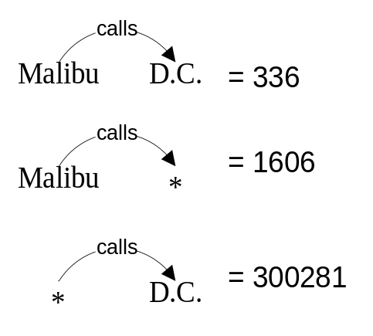
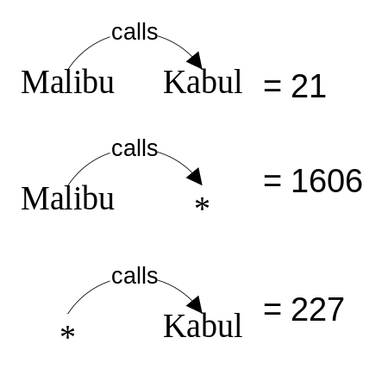
Magic Bullet: Pointwise Mutual Information
Phone calls originating from a SoCal city:
L.A. 571
D.C. 336
Hamburg 234
Culver City 199
Anaheim 103
Leipzig 59
Mosul 51
Toronto 38
Boston 34
Ventura 33
St. Louis 31
Kabul 21
Hollywood 21
Covina 20
Long Beach 16
Carson 16
Compton 16
Hamburg 234
Leipzig 59
Mosul 51
Kabul 21
Notes:
Database of telecommunications – one table per Southern California city

Slide 28
Global-as-View (GAV)
Each mediator relation is defined as a view over source relations.
MovieActor(title,actor) ← DB1(id,title,actor,year)
MovieActor(title,actor) ← DB2(title,director,actor,year)
MovieReview(title, review) ← DB1(id,title,actor,year) ^ DB3(id,review)

Slide 29
Local-as-View (LAV)
Each source relation is defined as a view over mediator relations
V1(title, year, director) → Movie(title,year,director,genre) ^ American(director) ^ year ≥1960 ^ genre = ‘Comedy’
V2 (title, review) → Movie(title,year,director,genre) ^ year≥1990 ^ MovieReview(title, review)
⊆
⊆

Slide 30
LAV vs. GAV
See [Ullman,ICDT-1997] for a detailed comparison.
Local-as-View:
  Easier to add sources: specify the query expression.
  Easier to specify constraints on contents of the sources: they are part of the query expression describing them.
Global-as-View:
  Easier query reformulation
GLAV combines both (Friedman & Millstein 1999)

Slide 31
Previous Approaches to Data Integration
Manual wrappings (significant effort):
Automatic integration:
  Textual data
    Search for matches in documents (Information Retrieval like Google)
  Conventional databases
    Build a central model integrating the metadata for each data source
      Global-as vs. Local-as vs. Ontology
    Schema-based mappings (metadata level)
      E.g. A::zip_code matches B::zip_code or C::zip
    Instance-based matching (data driven)
      E.g. The values in A::zip_code mostly match the values in B::post_code
Problem: current methods do not handle well large and noisy data sources
  Magic Bullet: Pointwise mutual information – look for a small subset of interesting/important data values on which to match

