Slide 1
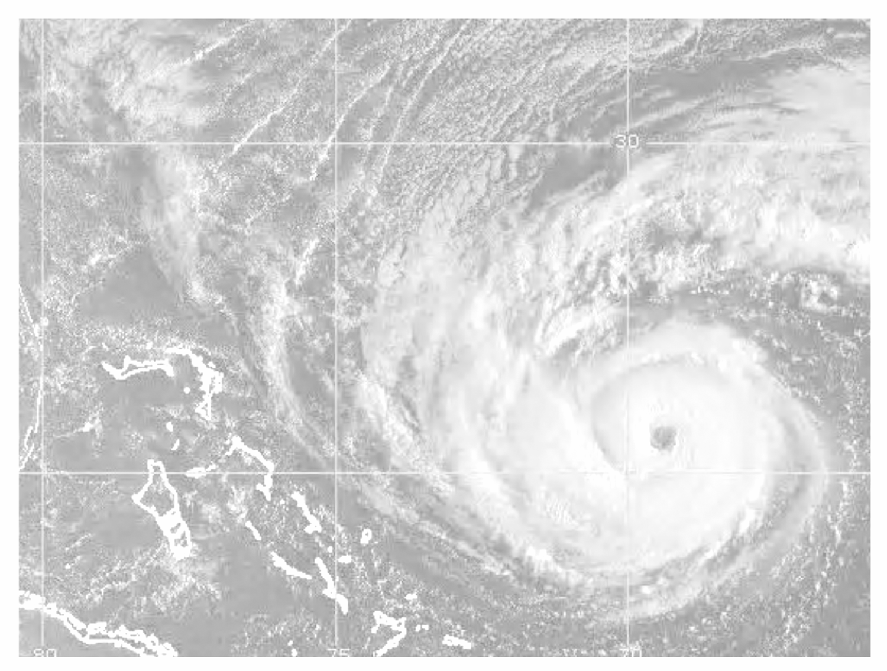





Understanding Joint METOC Databases and Broker Language Access
JMCDM, JMBL, Weather Parameter Table, Physical Database Segments and more
(with notes pages for details)
Joe Wood, ESC/BMSW-WE
Jason Mathews, ESC/BMSW-WE
March 25, 2005
Approved for public release; Distribution Unlimited; Case #05-0724
Integrity - Service - Excellence
©2005-The MITRE Corporation. All rights reserved.
Notes:
These slides have been put together as a stand-alone primer on the Joint METOC (Meteorological and Oceanographic) Conceptual Data Model (JMCDM), logical/physical Joint METOC database segments, and the Joint METOC Broker Language (JMBL). Developing a detailed understanding is beyond the scope of this presentation, but sources for more detailed information are included for reference.

Slide 2

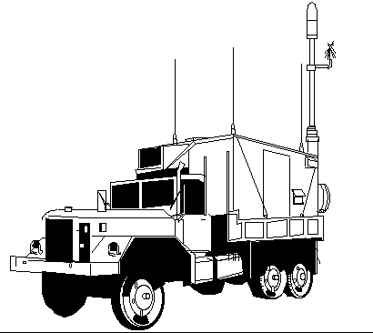

Operational View: AFW Enterprise
Relevant/Timely Support to All Levels
National Command Authority to
Air Force and Army Units
Integrated Aerospace Capabilities
(Terrestrial and Space)
Data Available Globally
Same Ops - Peace and War
Tiered Production
Collaboration Among Weather and C2 Nodes
Strategic Center
Global Data Collection
Global Analyses/Forecasts
Global Dissemination
Global/Mission Tailored Apps
AFWA-Offutt
(Aerospace Weather)
Analysis
Forecasting
AFCCC
Theater Data Collection
Theater/Regional Analyses/Fcasts
Theater/Regional Dissemination
Theater/Mission Tailored Apps
9 OWSs Worldwide
Warfighter
USAFE OWS
Sembach AB, Germany
•
Mission Information
First-in/Small Footprint
Mission Tailored Applications
Mission Tailored Wx Support
Local Weather Sensing
Local Dissemination
~200 CWTs Worldwide
AF, Army,
Special Operation Forces
Mission Exploitation/Impacts
Mission
Tailoring
Aviano AFB
16 AF/South
Weather Data/Products
Command Posts
Base Ops
Fixed and Deployed Ops
Notes:
The JMCDM and JMBL were developed to support a Joint operational architecture, such as the AF architecture depicted here. The Navy has a similar operational picture, where METOC units closest to the users are engaged in tailoring information for the specific needs of their users, while upstream strategic-level data producers build the broad-scope information. Today, these processes largely rely upon forecasters to build products for their clients, but the DoD is beginning a transition to a more automated capability, which will minimize the human dependencies in the system. JMBL was developed for use in the automated target architecture.
Depicts As-Is Air Force Weather Weapons System (AFWWS) Enterprise View.
To-Be view includes ~400 Combat Weather Team (CWT) locations.

Slide 3

AFWWS System’s Approach is Data Centric
Overview
Analysis
Private Storage:
Stores which will
not be shared
Public Storage:
Stores which will
be shared
Private
Storage
Private
Storage
Forecasting
Private
Storage
Private
Storage
Tailoring
Private
Storage
Private
Storage
I
N
G
E
S
T
D
I
S
S
Ingest Writes
to the
Data Cloud
Data
Cloud
(Shared Enterprise
Data)
Dissemination
Reads From
the Data Cloud
Many Users Access the Same Shared, Standardized Data
Notes:
Again using the Air Force as an illustration, the Air Force Weather Weapon System (AFWWS) is designed to be a data centric solution. METOC inputs are ingested and stored to the “data cloud,” which is comprised of the Joint METOC logical database segments, and all information provided to customers is derived from the data cloud. All inputs of data and products from outside a site should be ingested, prepared for, and written to the data cloud following the joint data model structure. All outputs of data to the outside should be retrieved from the data cloud and prepared for dissemination.

Slide 4
“Data Strategy” Today
DoD standard (Joint) METOC data model
  Ensures data interoperability
  AFWA, AFCCC, OWSs, CWTs, C2
Common DBMS (SQL-based)
  AFWA, AFCCC, OWSs, CWTs
Construction of Weather “Data Cloud”
Joint METOC Broker Language (JMBL)
  C2, Weather subsystem access to data
Standard Catalog
  Visibility of weather products / data to users
Notes:
Representation of data using a common data model ensures terminology, formats, and attribution is understood across DoD METOC. Air Force and Army systems will employ physical database segments based on the Joint METOC logical segments, while the Navy systems will ensure their data is mapped to the same standard. The physical storage schema will be separated from the data users by use of web services accessed via JMBL. This degree of separation insulates METOC customers from changes to physical storage structures.

Slide 5
Joint METOC Conceptual Data Model (JMCDM)
Individual UserView
Air
Temperature
Atmospheric
Turbulence
Cloud
Observation
125
Conceptual (Total)
Data Entity (Table) Defin.
600
Data Element Definitions . . .
3000+
Mappings: Views to Data Entities
Data Entities to Database Segments
Physical
. . .
10
JMPLAT
JMOBS
JMAN
JMGRID
Notes:
Overview of DoD-wide Joint METOC Data Standards Working Group (DSWG) approach. Approach taken is analogous to ANSI/SPARC Framework for COTS DBMS implementation (User Views – Centralized, Standard Definitions with Mappings – Physical Storage). User Views, Data Tables and Definitions took several years to flush out. The User Views overlap. Each one is represented by an IDEF1X data model. A central repository defines each data table and data element. In the above drawing, everything above the dotted blue line is considered part of the JMCDM.
The physical data models have been derived from the JMCDM. These physical data models are shown below the dotted blue line. They continue to evolve, keeping mostly ahead of AF acquisition programs which are implementing them in Oracle. Key goal is DoD-wide data interoperability.

Slide 6
Joint METOC Physical Data Model
JMCAT
Owner, User/Subscriber
Security/Access Control
JMSEC
JMCOM
gener-
ates
JMPLAT
Fixed Mobile
JMGRID
Metadata
Wx Model
JME
Effects
locates
initializes
JMOBS
“Conventional”
Surface Upper Air
JMSAT
Raw &
Proc. METSAT
generates
initializes
overlays
JMIM
Finished
Imagery
JMR-SOBS
High Volume
Remote Sensors
comprises
supplements
contributes to
JMAN
Forecasts Warnings
contributes to
JMSESS
Space Solar
contributes to
JMCLIM
Terrestrial Space
Air Force is first DoD organization to implement
Notes:
The set of JMDB physical data models are being implemented by AFW acquisition programs as database segments, following standardization by the Joint METOC DSWG.
JMCAT: Catalog of Weather data, products resident in a physical instantiation of the JMDB. Identification of user subscribers, points of contact.
JMPLAT: Platforms. Weather stations, both fixed and mobile.
JMOBS: “Conventional” observations. Low to moderate volume.
JMR-SOB: Remote-sensed observations. High volume.
JMSESS: Space Environment and Solar Segment
JMSEC: Security (actually part of JMCOM). JMCOM: Common tables.
JMGRID: Weather data / models in gridded format.
JME: Weather effects (on military missions, weapon systems, …)
JMSAT: Meteorological Satellite data. JMIM: Finished imagery.
JMAN: Alphanumeric messages, bulletins.
JMCLIM: Climatology products.
JMVEC: Vector products.
JMOC: Oceanographic data.

Slide 7
C2 System Access (M2M) to
Joint METOC Database
C2 System
Weather Parameter List
JMBL
Request
JMBL
Parameter
Name
Database
Element
Name
Table
Look Up
JMBL
Weather
Parameter
Name
Physical DB
. . .
JMOBS
JMAN
JMGRID
JMPLAT
Notes:
A Weather Parameter List table supports run-time access to physical Joint METOC database segments from incoming JMBL requests. The JMBL requests carry standard weather parameter names. AFWWS data access layer software matches each parameter name in the request with parameter name table entries, and picks up the physical database segment’s data element name associated with each of the JMBL request’s weather parameters.
The Weather Parameter List also contains the JMCDM long data element name associated with each parameter. Software developers can access the JMCDM web site, with its search engine, to obtain detailed definitions of each weather data element. See https://www.cnmoc.navy.mil/da/jmcdm.htm . The Weather Parameter List table is also documented here.
Public access is also supported to http://pao.cnmoc.navy.mil/scripts/public_JMCDM/home_pwd.pl .

Slide 8
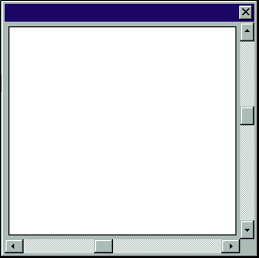
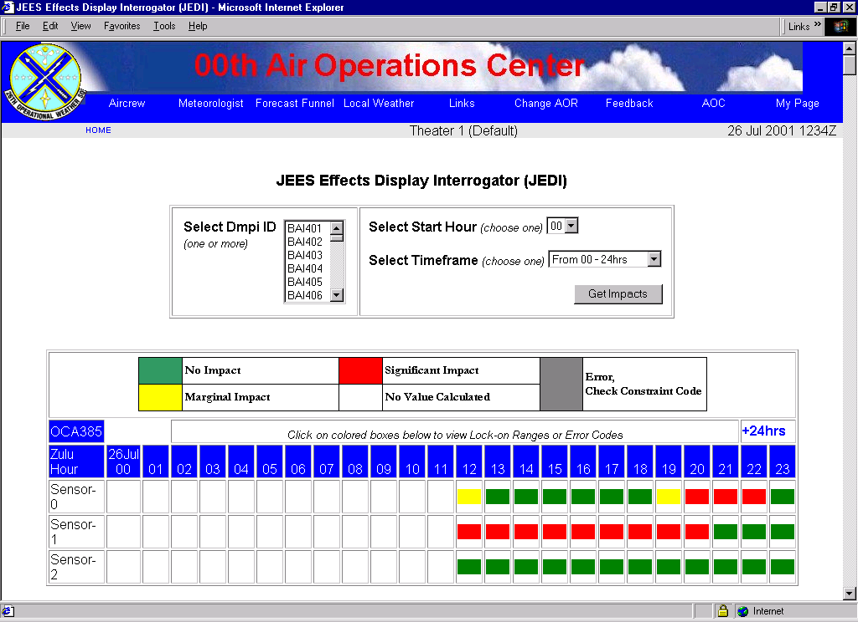
AFWWS Data Management Scope
- Database Segment Reuse, Common Access Software
Strategic View
AFWA
AFCCC
JMBL
JMBL
JMCAT
JMPLAT
JMOBS
JMCLIM
JMGRID
JMCAT
JMPLAT
JMOBS
JMGRID
JMAN
JMR-SObs
JMIM
JMSESS
JMCLIM
. . . . . .
JMBL
Regional View
OWS
Mission View
Mission View
AFCCC Apps
Atmospheric
Weather
Model
Climo Products
JMCAT
JMPLATJMOBS
JMAN
JMGRID
. . . . . .
C2 &
Msn
.Plan.
CWTs
JMCAT
JME
JMOBS
. . . . . .
AFWA Applications
A/N, METSAT Ingest . . .
Global Wx Forecast Models
C2 Decision Apps
Air Battle Planning
Mission Planning
Time Critical Tgt
CWT Applications
Product Tailoring
Wx impacts on missions
OWS Applications
Regional Wx Forecasts
METWATCH
TAFs . . .
A complex “mega-system”
Notes:
Joint METOC compliant database segments are being stood up across the Air Force Weather Weapon System. The AFWA Strategic Center is expected to install all segments. Subsets will be installed at other nodes.

Slide 9
Joint METOC Broker Language
(JMBL)
An XML specification for a standard language that will broker the exchange of information between User Applications and METOC data providers (Web Services wrapped over METOC databases).
Notes:
The catalyst that brought about JMBL was a need to move beyond having distinct interfaces for every possible combination of User Applications and METOC data provider systems.

Slide 10
Joint METOC Broker Language
server
client
REQUEST
RESPONSE
Notes:
JMBL is the METOC Community’s request/response broker language. It offers a syntax with standardized terms for user applications to request METOC information and for METOC data providers to respond to such requests.

Slide 11
Joint METOC Broker Language - Request Structure
PROVIDER
Who?
DATA TYPE
What?
REQUEST
LOCATION
Where?
TIME
When?
FORMAT
How?
Notes:
REQUEST
Who: Center (AFWA, FNMOC, …)
What: Observations (Temperature, Wind Speed, …); Forecast Model (Cloud Cover, Humidity, …)
Where: Geographic Area
When: Time
Format: Presentation of Data (for Imagery – JPEG, GIF, …); (for Forecast Model – Resolution).

Slide 12
Joint METOC Broker Language - Response Structure
PROVIDER
Who?
DATA
What?
STATUS
LOCATION
Where?
RESPONSE
+
DATA ITEM
TIME
When?
FORMAT
How?
Notes:
RESPONSE
Status of Request.
What: Actual data.

Slide 13
METOC XML Schema Development
metocTypes.xsd
include
Global Attributes
and Elements
metocAtts.xsd
include
metocElements.xsd
Global Attributes
Across Schemas
jmimAtts.xsd
jmgridAtts.xsd
include
include
jmobsAtts.xsd
jmrsobAtts.xsd
jmplatAtts.xsd
jmanAtts.xsd
include
jmim.xsd
jmgrid.xsd
include
include
include
jmobs.xsd
jmrsob.xsd
jmplat.xsd
jman.xsd
JMGRID
JMIM
JMOBS
JMRSOB
JMPLAT
JMAN
Notes:
There is one XML schema for each physical DB segment. The physical DB segments share global properties and their XML representations similarly share globally defined items. JMIBL uses the above schemas. JMBL is an abstraction of these schemas. The Joint METOC Data Standards Working Group controls the baselines for JMBL and the physical data models.
Global data types, attributes and elements:
metocTypes.xsd
metocAtts.xsd
metocElements.xsd
AlphaNumeric Text (JMAN)
Analysis/Forecast (JMGrid)
Catalog (JMCat)
Climatology (JMClim)
Imagery (JMIm)
Observations (JMObs)
Platform (JMPlat)
Remote-Sensed Obs (JMRSOb)
Space Weather (JMSess)

Slide 14
METOC XML Namespace Status
Established Tags and Schemas for
    JMObs
    JMGrid
    JMPlat
    JMAN
METRICS
  225 Element Tags
  1127 Attribute Tags
  19 XML Schemas
JMRSOb
JMIm
JMCat
JMSess
Submitted to DISA XML Registry

Slide 15
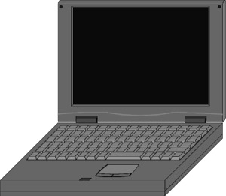
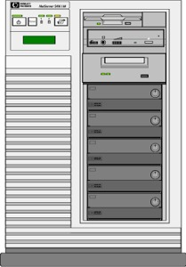
JMBL Execution Path
Client
METOC Data Server
1
3
App
Server
2
Data Access
APIs
APIs
Legacy Databases
Joint METOC DB
Web Services
Notes:
Client sends SOAP msg to App Server. Web Services on App Svr. (SOAP handler knows JMBL XML. Generates Call to DB Server.) Data Access layer on DB Server includes EJB – API software to invoke Oracle DBMS.

Slide 16
Standards
JMCDM
  IDEF1X (FIPS 184)
  DDM, DDDS
JMBL
  XML (JTA mandated)
  SOAP
  WSDL
  UDDI
  TCP/IP
  HTTP
Recommended by W3C and WS-I (JMBL 3.0 is compliant with WS-I Basic Profile 1.1)
Notes:
Web Services – Interoperability (WS-I) body governs best practices. (Sun, IBM, W3C, …). W3C controls the standards upon which JMBL rests. Joint METOC DSWG controls JMBL and JMCDM baselines.

Slide 17
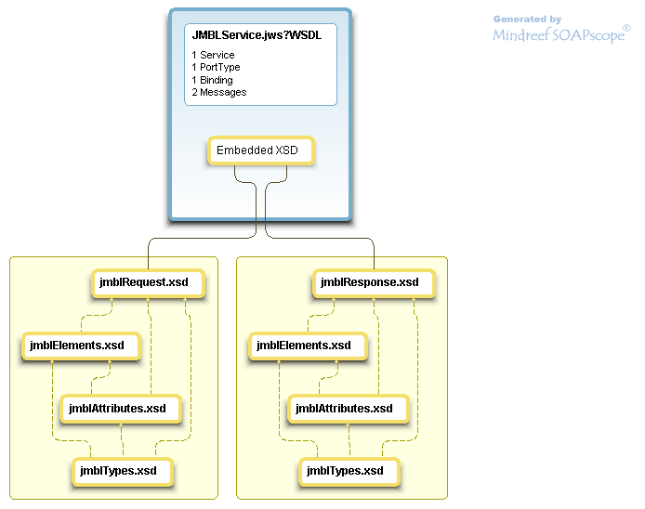
JMBL Web Service Description Language (WSDL)
Notes:
Sample JMBL web service as implemented by the Joint Weather Impacts System (JWIS). JWIS 2.0.4 implementing JMBL 2.19
Note that JWIS & WDAC JMBL 3.0 implementation (as of JWIS 2.0.5) merges the separate schemas into a single schema (jmblSchema30.xsd) for interoperability with .NET and other platforms that have problems importing nested XML Schemas.
The structure of a Web Service includes the service, port type, binding, and messages. The XML schema components for JMBL are shown in the lower portion of the diagram.

Slide 18
JMBL Status
JMBL XML Schema version 2.x
  Top-level request/response message schemas
  Common global types + elements + attributes subschemas
  JMBL version 2.19 implemented in JWIS and WDAC systems
JMBL XML Schemas version 3.x
  Address subscription pub-sub services
  Adopt strict XML naming conventions and industry best practices
    Ease of use
    Consistency
    Interoperability
  Baseline JMBL 3.0 Schema approved July 2004 by DSWG
  Latest JMBL 3.1 Approved 3/24/05
  Shared schema and definitions with UK weather community to promote standards across coalition forces
JWIS: Joint Weather Impacts System
WDAC: Weather Data Analysis Capability
Notes:
The Joint METOC Broker Language (JMBL) is a set of XML Schemas and common WSDL which defines an XML representation for describing and exchanging METOC data products. JMBL defines the structure of the XML messages clients use to request METOC data from a JMBL server and that of the generated response. JMBL provides an abstraction layer together with a mapping table to the Joint METOC physical databases.
Joint METOC Data Standards Working Group (DSWG) controls the JMBL specification baseline.

Slide 19
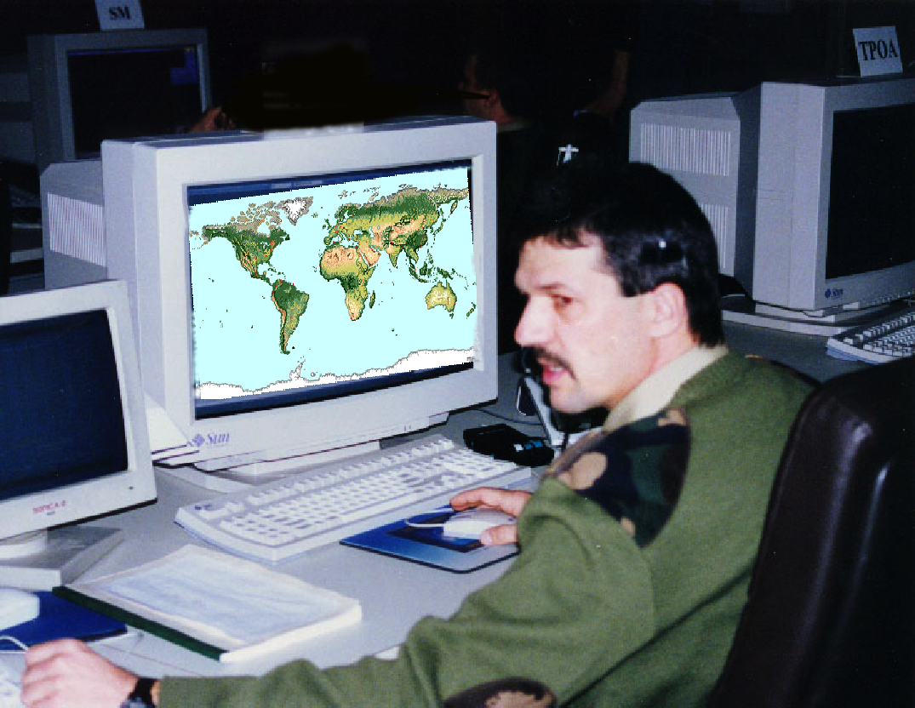
Technical Architecture:
Information Services and C2 Interoperability
AFW Node (e.g., OWS, CWT)
Application Server
Machine-Human
C2 Decision Maker
Portal Server
HTML Web Browser
Web Information
Services Examples
Mission Impact
HTML,
JSP,
Applets
etc.
Weather Information
Subscription
Mission Information
Service
Information
Push / Pull
Alerting
(Compliant with/
part of AF Portal)
Situational awareness, Conditions, and Pre-Flight
(
Service
Dissem
-
ination
)
Web Server
Other AFW Nodes
Machine-Machine
Remote Application Execution
DB
APIs
Weather
AF/Army
C2 Decision Apps
Information
WSDL
Service
Mission Impact
Incoming
(SOAP)
Security
XML
(e.g., TAPS)
Service
Request
Weather Information
(JMBL / SOAP)
C2 Mission Services
Weather
Outgoing
Impact
XML
xyz
xyz
xyz
xyz
xyz
Request
Mission Information
xyz
xyz
xyz
xyz
xyz
Service
xyz
xyz
xyz
xyz
xyz
xyz
xyz
xyz
xyz
xyz
xyz
xyz
xyz
xyz
xyz
(SOAP)
xyz
xyz
xyz
xyz
xyz
AF/Army XML-Based
Systems/Applications
Realization of AFW web-enabled information producer/consumer…true C2 integration Realization of small forward footprint
Rev 2
Notes:
This diagram depicts how AFW Nodes facilitate the bidirectional communications with generalized loosely-coupled connections for external C2 Systems (machine-to-human in a web environment and machine-to-machine for XML-based information exchange) and more tightly-coupled connections for internal weather functions interactions.
An AFW node will have weather applications/services, a database to store weather information, and APIs that interface with the database. The point is that applications/services within a AFW node is tightly coupled using the APIs to interact with the database management system, whereas the applications/services intended for external C2 applications are generalized loosely coupled connections using XML based interfaces, not the APIs used for internal interactions. Only the interfaces for weather specific web/information services are made available to applications in other nodes. This will reduce the dependency of outside applications upon the database schema. Flexibility to change database schemas in the future without affecting users outside of the weather community will be achieved.
As shown in the diagram, weather information and mission impact can be displayed within a web browser through a Portal Server or can be sent as pure data back to querying applications in response to incoming XML requests from C2 systems. Similarly, mission information from C2 can be displayed within a web browser or received as a response to outgoing XML requests from AFW in order to provide correct information needed for the requesting application. All information exchange across nodal boundaries will be formatted in XML and that XML messages will be transferred using SOAP, a XML-based messaging protocol in combination with the underlying protocol HTTP, or other type of bindings (e.g., Java Message Service). By using WSDL, which describes the interface for a web service in XML, the web/information services will have the ability to be designed and implemented using a variety of programming languages. Applications can be designed using J2EE, Microsoft .Net, or any other integration framework regardless of computer language, operating system, or hardware platform. Web/information services will be scaleable and self-contained modular services that can be published, located, and invoked across the network. Web/information services can be added for some nodal locations while removed at other nodal locations. These web/information services running on the Application Server can also be quickly migrated to another Applications Server with minimal effort.
Under this technology vision, it is anticipated that the AFW will structure and provide web-enabled information services/applications distributed in n-tiers node-to-node architecture (e.g., content staging of weather applications/database) for information exchange with C2 nodes, thus a realization of AFW-C2 interoperability and integration.

