Slide 1
A Robust, Low-Cost Virtual Archive for Science Data
Christopher Lynnes
Bruce Vollmer
Mike Theobald
Goddard Earth Sciences
Data and Information Sciences Center

Slide 2
What Good Are Virtual Products?
Reduced reliance on tape archives
On-demand reprocessing
  Current campaigns proceed according to fixed schedules over 1-2 years
  On-demand reprocessing allows users to get any time period
Easier Technology Refreshment/Migration
  Migrations to new tape drives are replaced by (easier) migrations to new platforms or operating systems

Slide 3
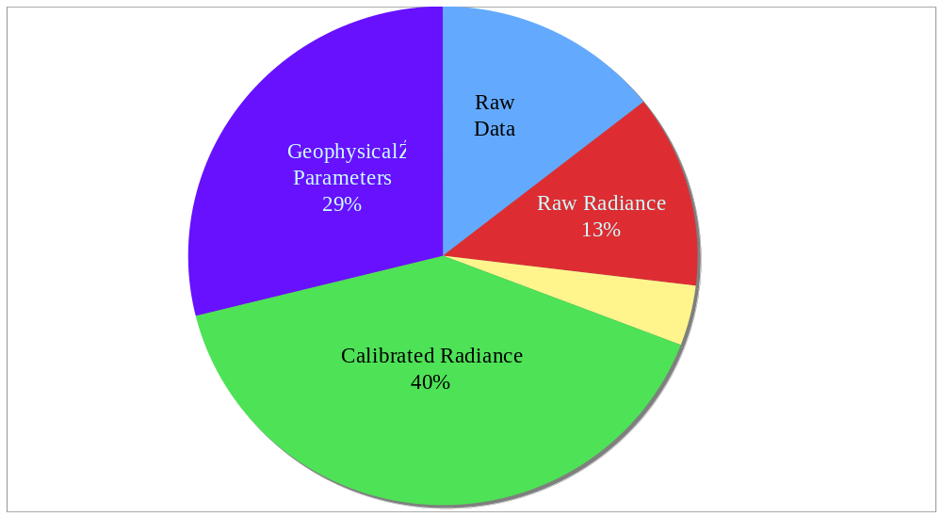
MODIS* Archive Volumes
Percentage of Volume Archived
*Moderate Resolution Imaging Spectroradiometer

Slide 4
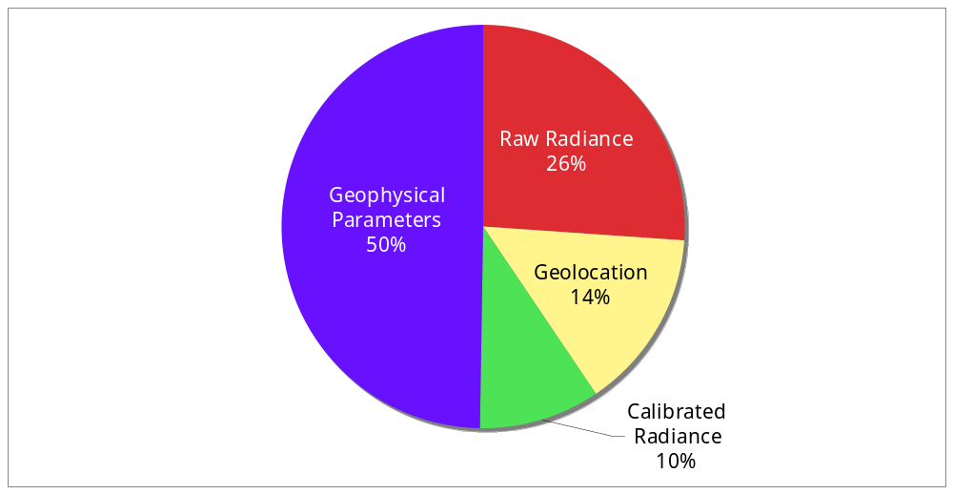
MODIS Distribution to Users
Percentage of Files Distributed

Slide 5
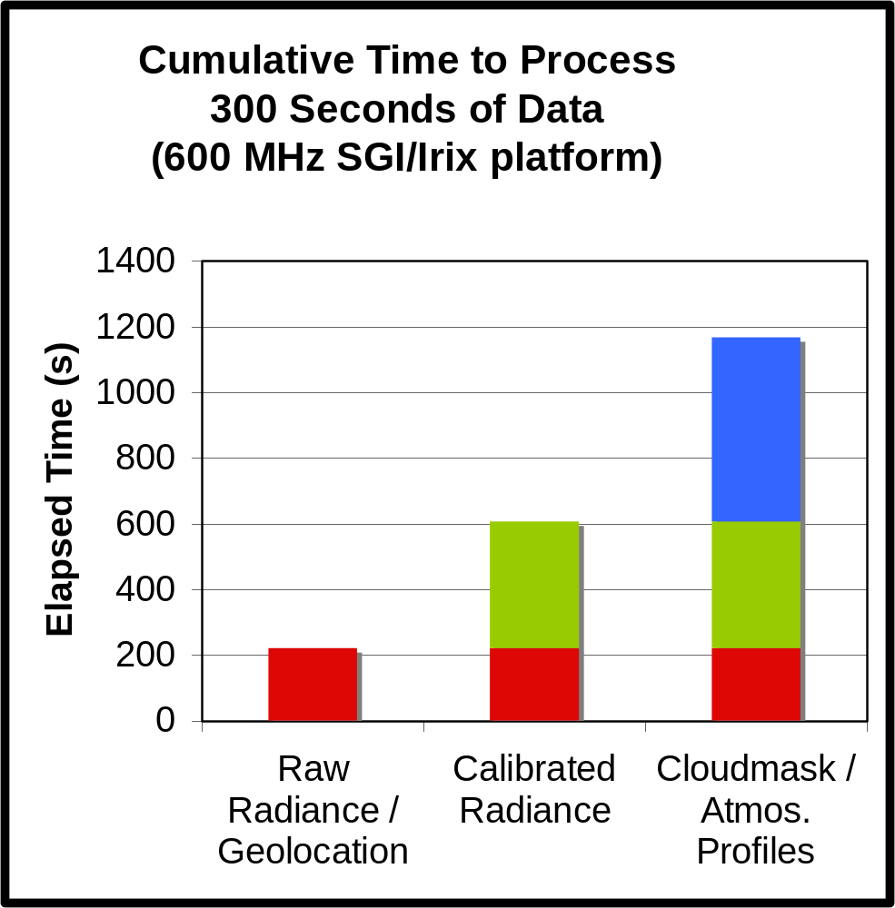
Processing Requirements
Due to algorithm dependencies, raw radiance and geolocation are “easiest” to make, followed by calibrated radiance, and then geophysical parameters such as cloudmask
Cloudmask
& Atmos. Profiles
Calibrated Radiance
Raw Radiance
& Geolocation
Raw data

Slide 6
Virtualizing Archived Products
“Virtualize” calibrated radiance
  Takes up lots of space
  Moderately easy to recompute
  Moderate demand
Process forward stream, but only to rotating cache
Move raw data online and process data for retrospective orders on-demand
Reuse existing assets as much as possible to contain cost
  On-demand processing system (S4PMViP)
  Search/order interface (EOSDIS Data Gateway)
  Hardware (Office PCs)

Slide 7

Request / Processing Scenario
Users search virtual “daily radiance granules” for time periods of interest.
Inventory
Database
search by time
EOSDIS Data Gateway
virtual metadata
Users then order spatial subsets of selected days
spatial “subset” request
calibrated radiance data
On-Demand Subsetting
System
data request info
calibrated radiance data
Office PCs provide means to run algorithms, host inexpensive disk for raw data, and sidestep heat/power/floorspace issues

Slide 8
Robustness: Data Quality
Nightmare Scenario: Run the science algorithm incorrectly and provide bad data to the scientist.
Solution: Save subsampled product during routine processing…
…and check on-demand products against subsampled data
raw data
Routine
Processing
subsampled radiance
online archive
subsampled radiance
PC disk
Quality
Check
raw data
On-Demand
Processing
calibrated radiance
And now, a true story…

Slide 9
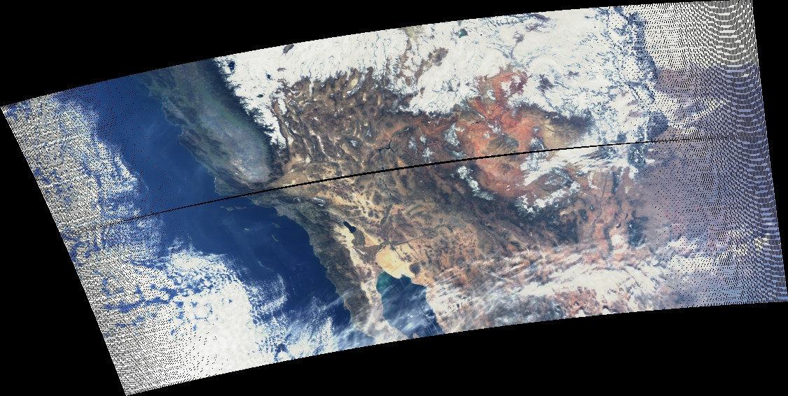
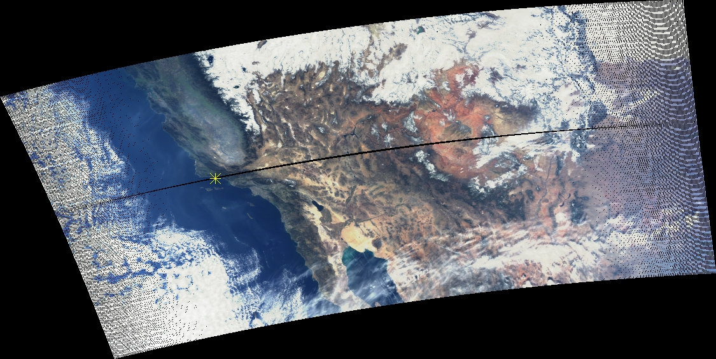
Example: 12-02-2004
You are here

Slide 10

Example Redux

Slide 11
Robustness: Data Protection
Nightmare Scenario: Internet worm invades network and deletes all the raw data, forever.
Air-gap/offline Backups of Raw Data
backup to external disks and take offline when full
raw data
distribution
point
primary
backup

Slide 12
Robustness: Availability
Autonomic “Pulse” to Monitor Health of PCs
On-Demand
System
“Pulse” of PC
Disk & memory usage
CPU performance
“Mini-mental status test”

Slide 13
Conclusion
Working (mostly) prototype shows that a virtual science data archive is workable and affordable…
…but achieving robustness equivalent to an actual science data archive requires extra care

