Slide 1
Incorporating Semantics in Scientific Workflow Authoring
Chad Berkley¹
Shawn Bowers²
Matthew Jones¹
Bertram Ludäscher^{2,3}
Mark Schildhauer¹
Jing Tao¹
1) National Center for Ecological Analysis and Synthesis, UCSB
2) UC Davis Genome Center
3) Department of Computer Science, UC Davis

Slide 2
Kepler Scientific Workflows
Problem: Design and Reuse
Kepler targets domain scientists, not typical programmers
Users not familiar with programming need additional help authoring workflows and locating workflow components
Large libraries of components exist but it can be hard to locate and connect needed components
Our Solution: Semantic mediation
Notes:
Problem: Design and Reuse
Large libraries of components already exist, including statistical analyses, ecological models and data transformations. Scientists currently face the problem of (a) discovering suitable components, and (b) composing them to form desired scientific workflows. In addition, few approaches exist that facilitate the conceptual design and validation of scientific workflows.
Our Approach: Semantic Typing
Kepler provides a novel approach for extending scientific workflow components (data and services) with semantic types (annotations relative to an ontology). Workflow designers can use Kepler to semantically describe components, check that a given workflow is both semantically and structurally well-typed, and perform ontology based browsing and search.

Slide 3
Semantic Mediation
Components are annotated with semantic information
Component I/O ports are also annotated
Allows potential connections between components to be identified in an automated way
Components can be searched by their classification in the ontology instead of just a keyword search
Semantic mediation system can help users build workflows as well as check for semantic errors within the workflow

Slide 4
Semantics in Kepler
Kepler allows users to semantically annotate components
Kepler allows users to search components with semantic terms
Kepler allows users to semantically verify their workflows
Allows integration of multiple ontologies for multiple domains

Slide 5
Ontologies in Kepler
OWL-DL (Web Ontology Language-Description Logic) Ontologies
Jena Semantic Web Framework
Added semantic properties to MoML (Modeling Markup Language)

Slide 6
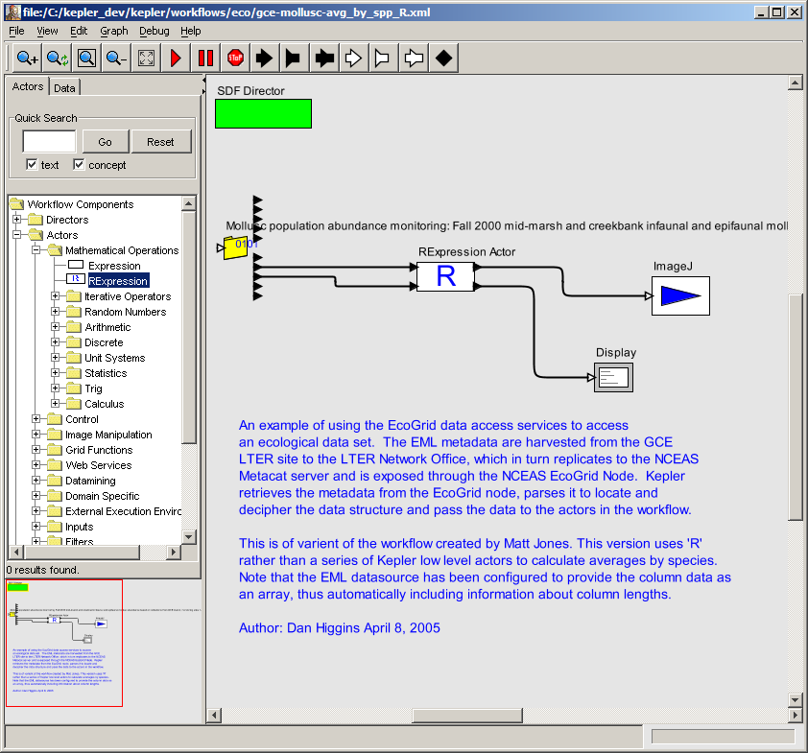
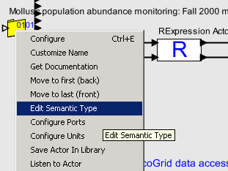
Annotating a Component

Slide 7
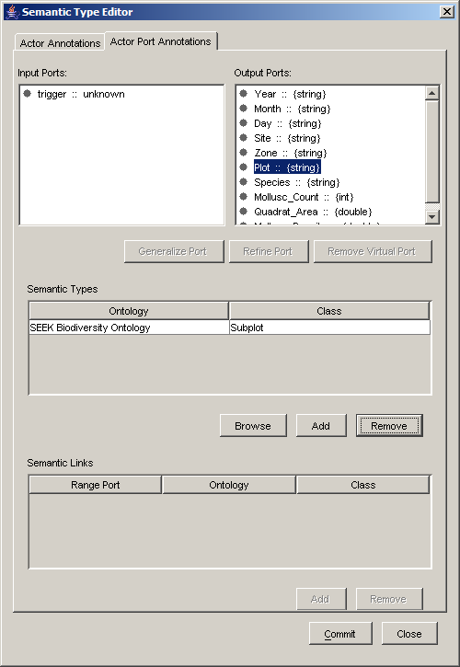
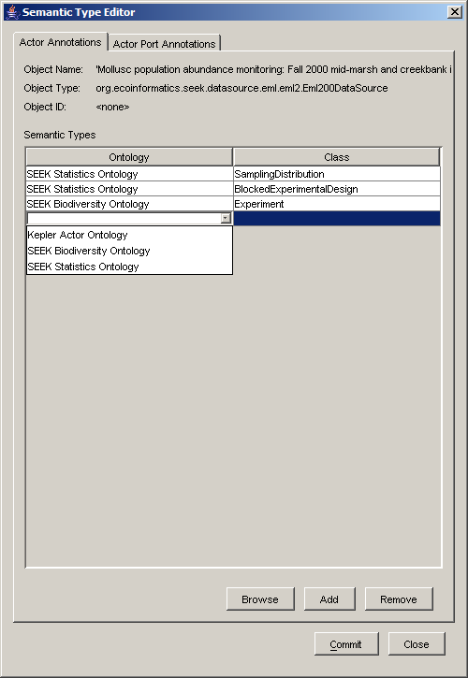
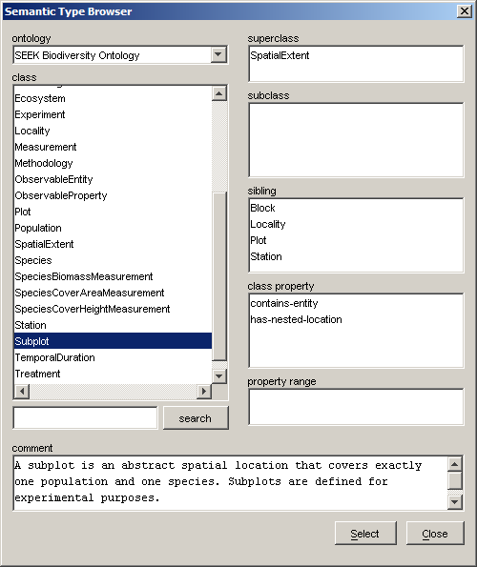
Annotating a Component

Slide 8
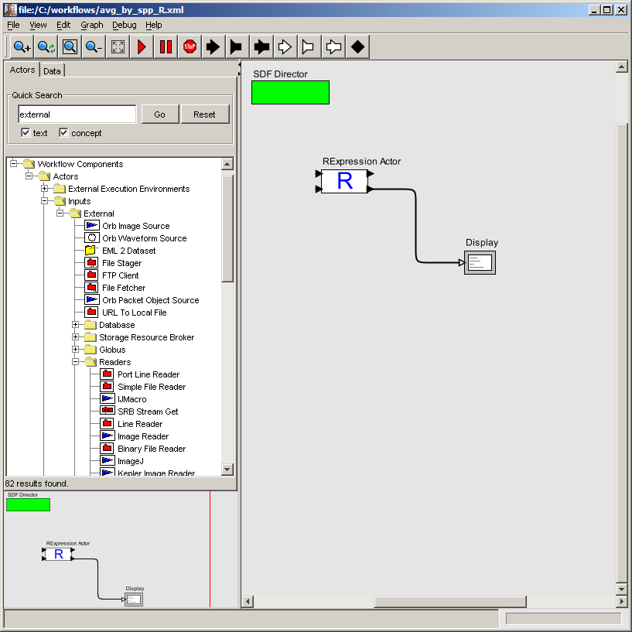
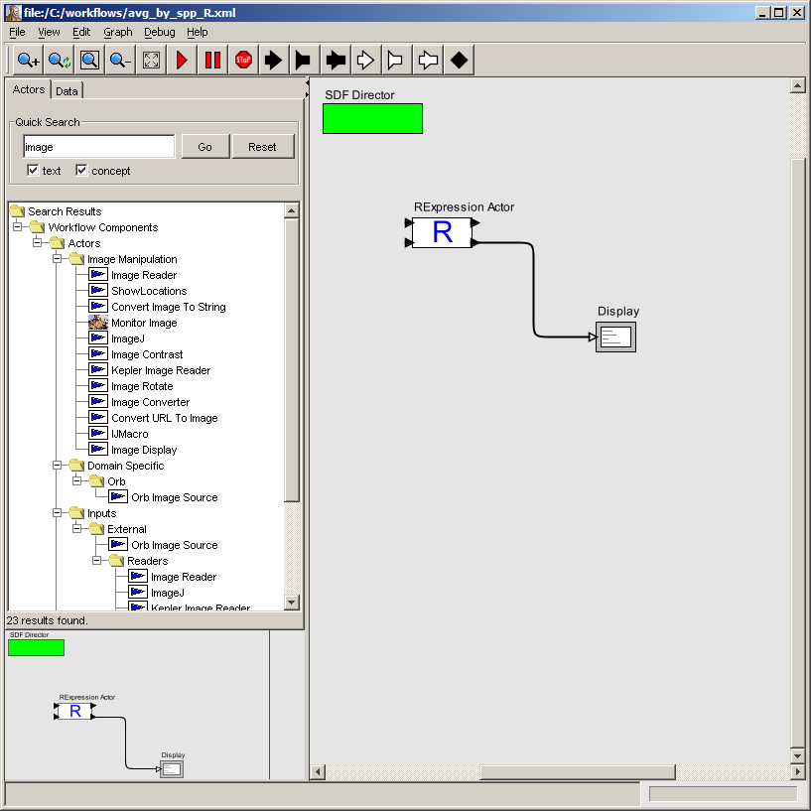
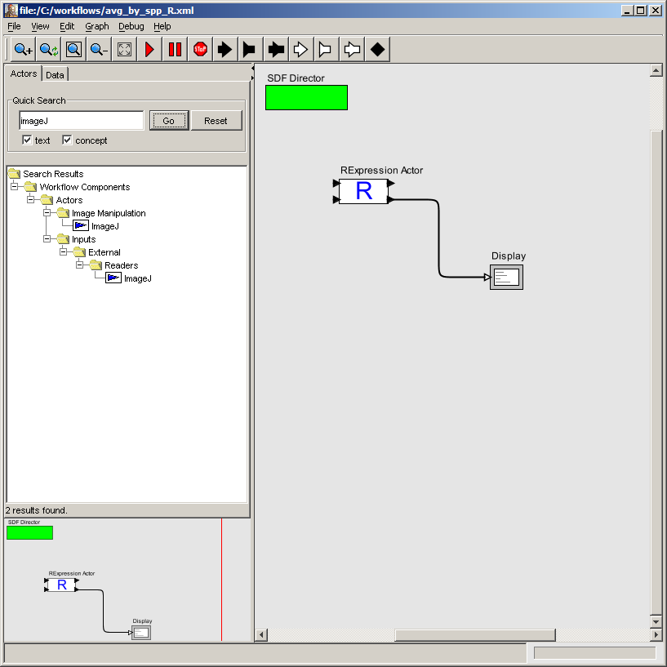
Searching with Semantics

Slide 9
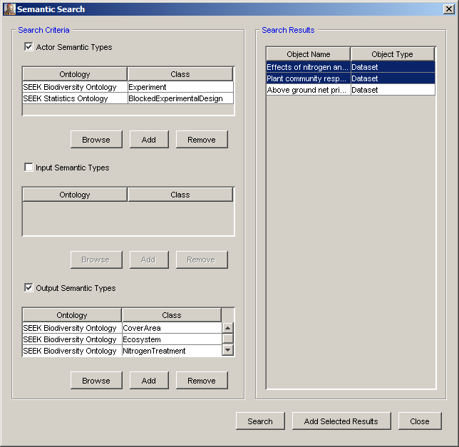
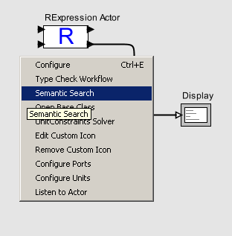
Searching with Semantics

Slide 10

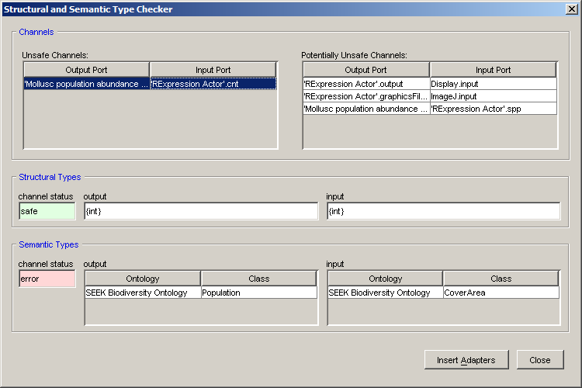
Semantic Type Verification

Slide 11
Continuing Research
Automated workflow creation
Better UI for showing users semantic matches/mismatches
Distributed cataloging of semantically annotated workflow components and workflows

Slide 12
Thanks
Download and get more information on Kepler at
http://kepler-project.org
Kepler supported by:
Kepler is based upon the Ptolemy II (http://ptolemy.eecs.berkeley.edu
source code base.

