Slide 1

Efficient Scheduling and Execution of Scientific Workflow Tasks
Laura Bright
David Maier
Portland State University

Slide 2
Introduction
Scientific workflow tasks may produce/consume large volumes of data
Large input files (100s of MB)
Multiple tasks may process same files
Workflows run at regular intervals
Opportunities for concurrent task execution on dedicated Grid

Slide 3
Motivation: CORIE
Environmental Observation and Forecasting System for Columbia River Estuary and surrounding regions
Multiple daily forecast workflow runs
  Up to 8GB of data per forecast
Frequent hindcast runs
  Up to 20GB per hindcast
Occasional special workflows

Slide 4
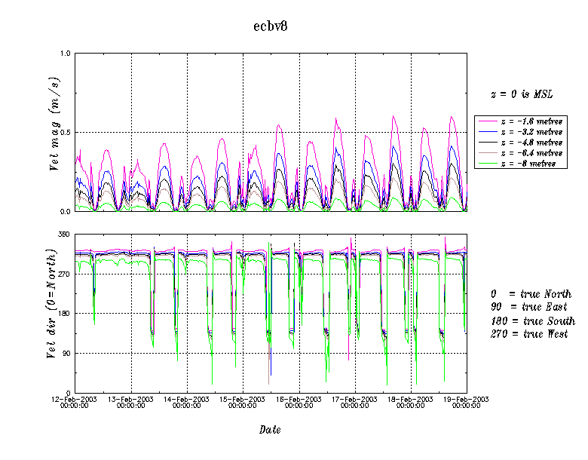
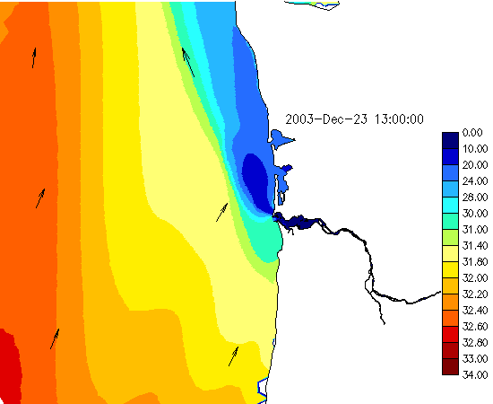
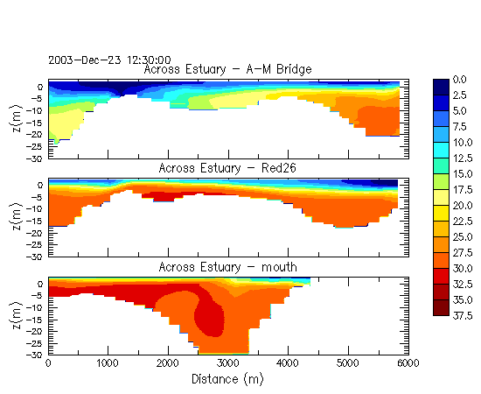
CORIE Workflow
Data
Products
Simulation
Run
Simulation
Outputs
(>300 MB)
Data Product
Tasks
Model
stations
salt
ELCIRC
Simulation
Model
Isolines
salt
temp
Isolines
temp
vert
Transects
temp

Slide 5
Challenges
Varying node speeds
Task running times may be input dependent
Dynamic workflows and nodes
Data transfer overhead
Precedence constraints

Slide 6
Contributions
Scheduling algorithms to minimize end-to-end running time (makespan) of a workflow
Algorithms consider data movement and location
Robust to variations in task running times and node speeds
Adapts automatically – no need to explicity reassign a set of tasks to nodes

Slide 7
Outline
Introduction
CORIE Overview
Existing Implementation and Prototype
Scheduling Algorithms
Experiments
Conclusions and Future Work

Slide 8
CORIE Overview
Daily forecast workflows
  Predict near-term conditions on Columbia River and surrounding coastal regions
  30 different forecasts in near future
  Plans to eventually cover coastal regions of entire United States
Frequent hindcast workflows
  Extended set of simulations covering 1 year
Special workflows as needed

Slide 9
CORIE Forecast Workflows
Simulations model physical properties of river (e.g., temperature, salinity, velocity)
Simulation outputs large (multiple files over 300MB each)
Data products generated from simulation outputs
  Isolines – horizontal slices of river
  Transects – vertical slices
  Model Stations – conditions at different stations along river

Slide 10
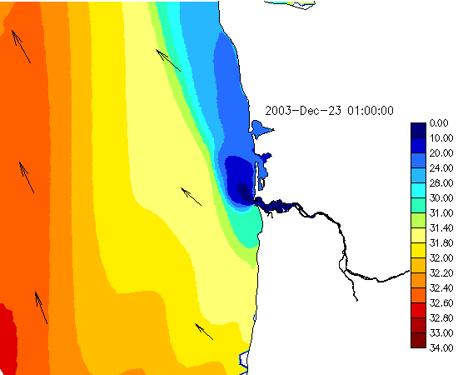
Example: Isolines

Slide 11
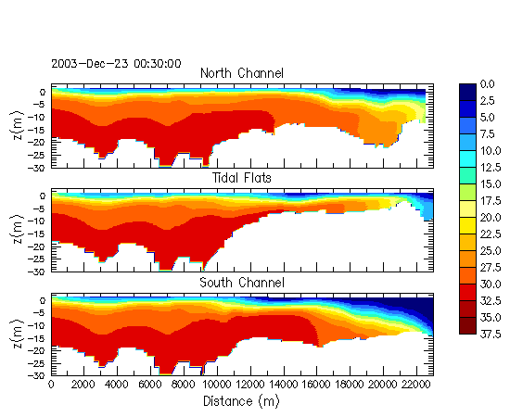
Example: Transects

Slide 12
Isolines and Transects Details
Isolines – horizontal slices at varying depths
  Process 11 large files independently
  Different animations generated for each
Transects – vertical slices on varying paths
  Process 4 files independently (4 of the inputs to Isolines)
  Different animations for each
To exploit concurrency, divide Isolines into 11 independent subtasks, Transects into 4 subtasks

Slide 13
Model Stations Details
Station Extraction task processes 5 input files together and generates 146 output files (one per station)
Each output serves as input to Plot Model Stations
Can process each file separately
Precedence constraint
Task assignments sensitive to small variations in node speeds

Slide 14
File Sizes
File | Size | Workflows
hvel.64 | 655 MB (~ 1 minute download time) | Isolines, Transects, Model Stations
salt.63, vert.63, temp.63 | 334 MB each (~30 seconds download time) | Isolines, Transects, Model Stations
wind.62 | 35 MB | Isolines
*.61 (7 files) | 23 MB each | Isolines

Slide 15
Task | Typical Running Time (sec) | Input Files
isolines {airt,fllu,fllu,flsu, pres,radd,radu,srad}.61 | 25 | {airt,fllu,fllu,flsu,pres, radd,radu,srad} .61
isolines salt | 70 | salt.63, wind.62
isolines vert | 33 | vert.63, wind.62
isolines temp | 10 | temp.63, wind.62
isolines hvel | 73 | hvel.64, wind.62
transects salt | 202 | salt.63
transects vert | 15 | vert.63
transects temp | 197 | temp.63
transects hvel | 185 | hvel.64
do station extraction | 60 | salt.63, vert.63, temp.63, hvel.64, elev.61
plot model stations | 30 | xxx.dat (146 files)

Slide 16
Outline
Introduction
CORIE Overview
Existing Implementation and Prototype
Scheduling Algorithms
Experiments
Conclusions and Future Work

Slide 17
Existing CORIE Implementation
Dedicated Grid
  All nodes used exclusively for CORIE workflows
  Scientists will use all available node capacity
All workflows run on shared filesystem
  May miss opportunities to execute tasks concurrently
  No easy way to coordinate workflows among multiple nodes

Slide 18
Experimental Prototype/Platform
Built using Thetus™
  commercial product for scientific data management
Facilities for automatically launching scientific workflow tasks
Central Publisher manages storage of data inputs/outputs
Multiple Task Servers execute workflow tasks
Support for multiple scheduling algorithms

Slide 19

System Architecture
input files
Thetus Publisher
Data stores
data products
& executables
inputs & executables
data products
Task Server Nodes

Slide 20
Simulator
Event-based simulator modeled after prototype implementation
Enables experiments with new scheduling algorithms, adding new nodes, etc.
Also useful for calibrating implementation parameters

Slide 21
Outline
Introduction
CORIE Overview
Existing Implementation and Prototype
Scheduling Algorithms
Experiments
Conclusions and Future Work

Slide 22
Scheduler Architecture
Common Queue
Task Server
Queues
Nodes
Tasks
Scheduler

Slide 23
Round Robin (RR)
Thetus default
Immediately assign task to a Task Server Queue as soon as ready to execute
Fixed order, round robin
Task waits in Task Server Queue until all earlier tasks completed on the node
Straightforward to implement
May assign multiple long running tasks to same node

Slide 24
Dynamic
Tasks ready to execute remain in Common Queue
Assign first task in Common Queue to a Task Server whenever task server becomes idle
Robust in the absence of accurate statistics
Does not consider task inputs

Slide 25
Offline
Approximate an optimal assignment of tasks to nodes to minimize makespan
Adapted MULTIFIT bin packing algorithm
Pack a set of tasks into N bins to minimize size of largest “bin”
Assign tasks with common inputs to same node when possible
Nodes
Tasks

Slide 26
Hybrid
Idea: Assign “large” tasks using Offline algorithm to balance load and exploit overlapping data inputs
Assign “small” tasks using Dynamic to fill in gaps
Task is large if
(task run time)/(max task run time) > Threshold
Else, task is small
Threshold = 0 is Offline algorithm
Threshold = 1 is Dynamic algorithm

Slide 27
Outline
Introduction
CORIE Overview
Existing Implementation and Prototype
Scheduling Algorithms
Experiments
Conclusions and Future Work

Slide 28
Simulator Results
Modeled segment of Isolines, Transects, and Model Stations Workflows
3 Nodes
Studied effect of varying Theshold from 0 to 1
Compared against Round Robin, Offline (Threshold =0), Dynamic (Threshold = 1)

Slide 29
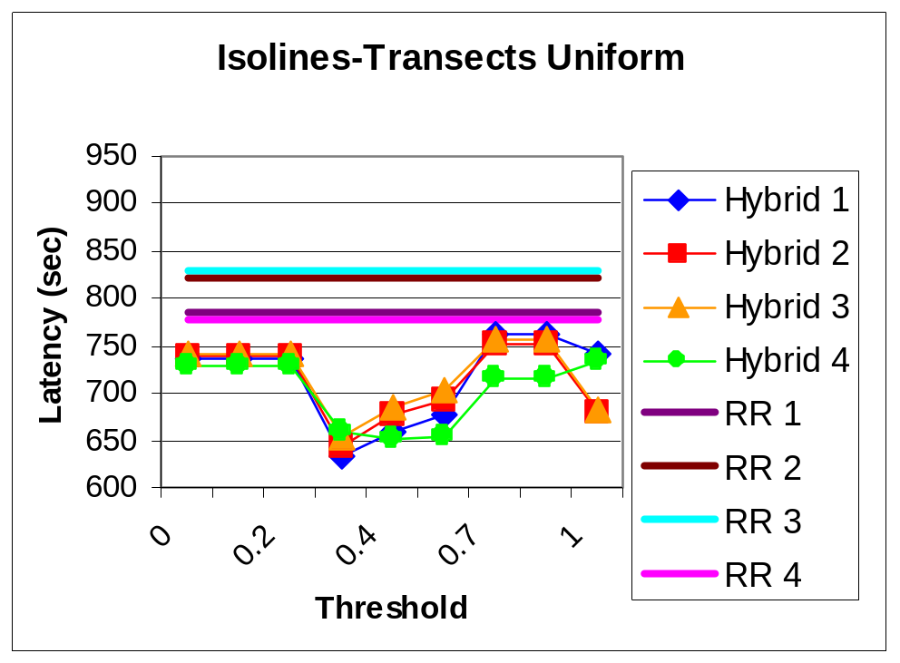
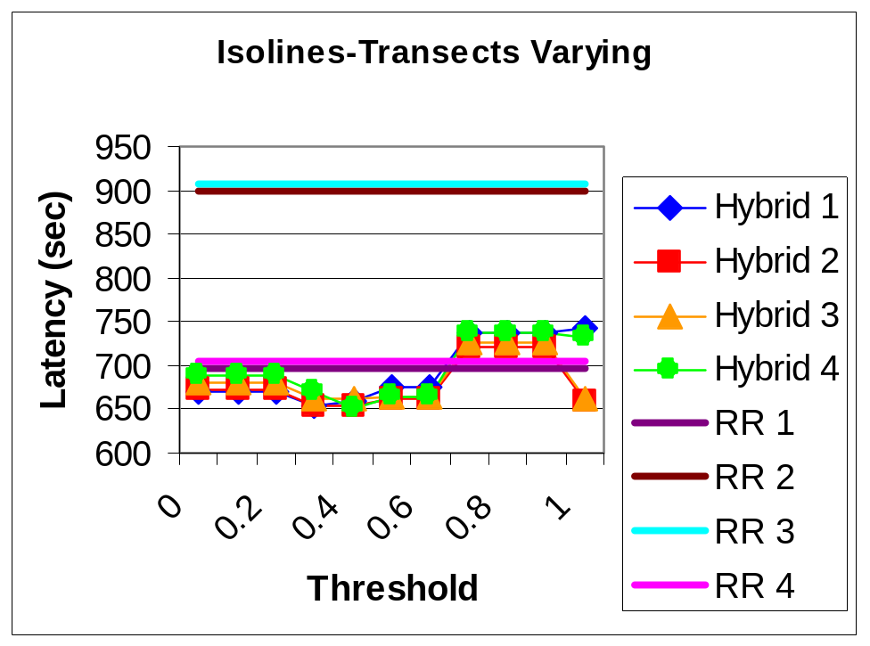
Isolines-Transects
Uniform node speeds
Differing node speeds

Slide 30
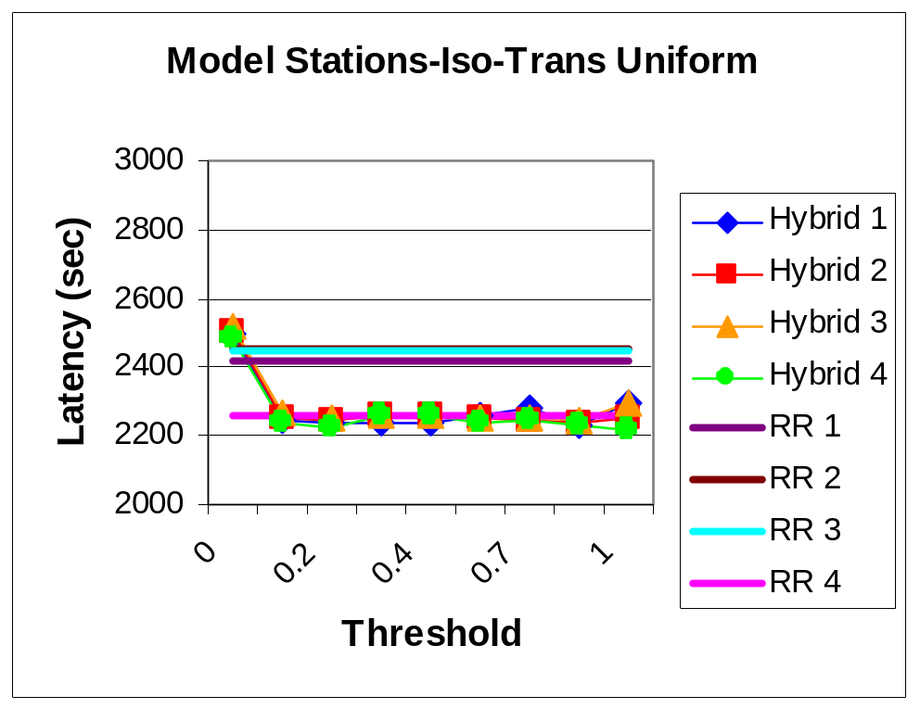
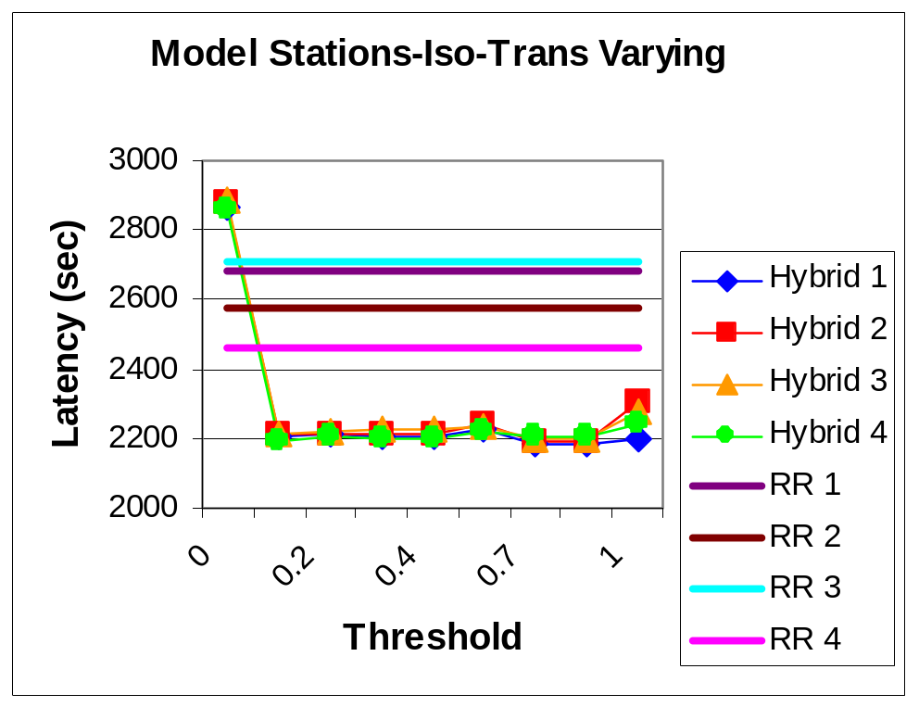
Model Stations-Isolines-Transects
Uniform node speeds
Differing node speeds

Slide 31
Implementation Results
Used our Thetus prototype
Modeled Isolines and Transects workflow on 3 nodes
Varied order files were uploaded

Slide 32
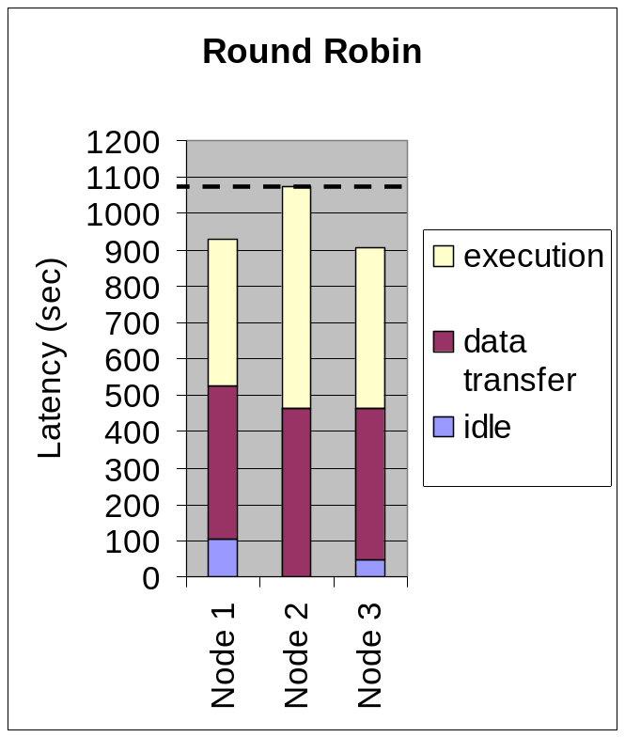
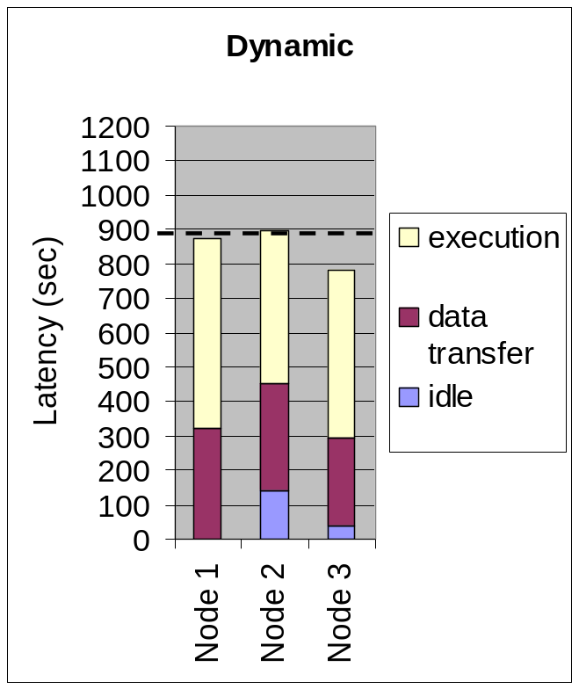
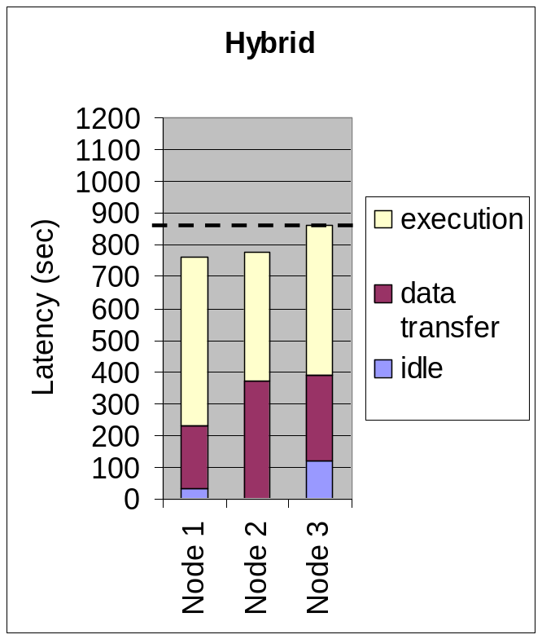
Isolines-Transects

Slide 33
Outline
Introduction
CORIE Overview
Existing Implementation and Prototype
Scheduling Algorithms
Experiments
Conclusions and Future Work

Slide 34
Related Work
Grid computing
  e.g., Globus, Condor
Grid replica management
Workflow specification and execution
  e.g., Chimera, Zoo, GridDB, Kepler
Assigning workflow tasks to nodes
  e.g., Pegasus, GrADS

Slide 35
Conclusions
Efficiently executing tasks on dedicated Grid important to generate data products quickly and maximize resource utilization
Robust algorithms to minimize data transfer, adapt to variations, and reduce scheduling overhead

Slide 36
Future Work
Precedence contraints
  Data location, prioritization
Supporting multiple workflows
  Prioritization
  Allocating nodes to workflows
  Use of simulator for prediction
Incremental computation
Other resource managers e.g., Torque/Maui

Slide 37
Acknowledgments
CORIE team
Thetus corporation
National Science Foundation

