Slide 1

SciFloTM: Scientific Knowledge Creation on the Grid Using a Semantically-Enabled Dataflow Execution Environment
Brian Wilson, Tom Yunck, Elaine Dobinson, Benyang Tang, Gerald Manipon, Dominic Mazzoni, Amy Braverman, and Eric Fetzer
Jet Propulsion Laboratory
Do multi-instrument science by authoring a dataflow doc. for a reusable operator tree. Access scientific data by naming it.

Slide 2
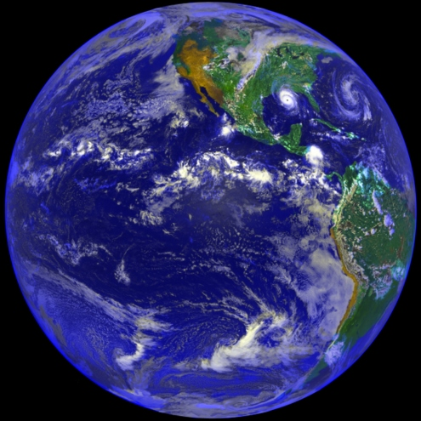
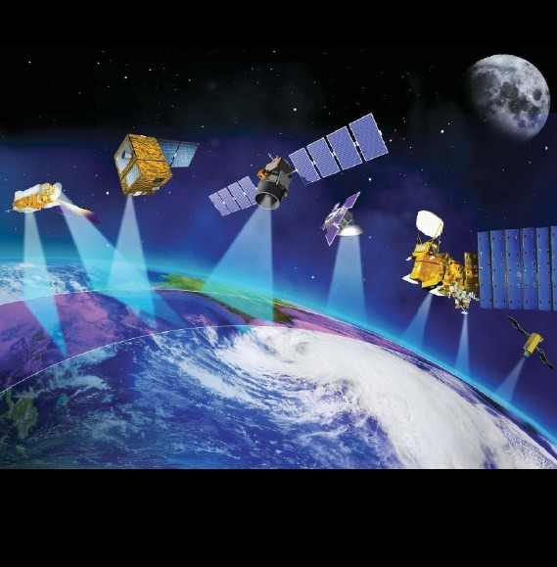
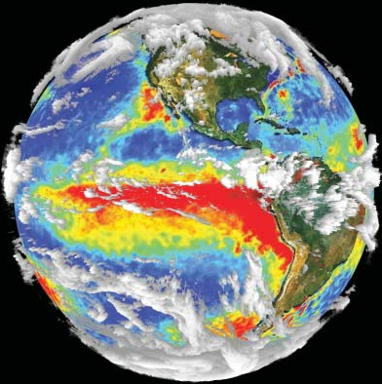
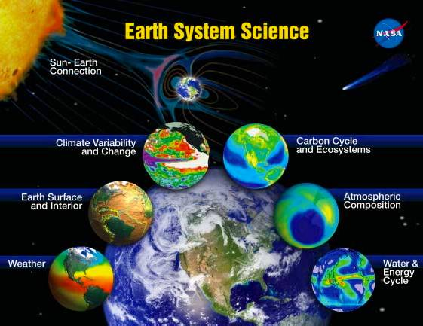

GENESIS Project: Multi-Instrument Atmospheric Science
Characterize Earth’s varied behavior
Understand
the Earth as an integrated system
Predict
Earth’s response to complex forcings

Slide 3
Outline???
Enabling Technologies
  Web Services: SOAP
  Grid Services: WSRF & Globus v4
  Parallel dataflow engines
  Semantic Web: OWL inference using metadata
SciFlo Distributed Dataflow System
  Loosely-coupled distributed computing using Web (SOAP) and Grid services
  Specifying a processing stream as an XML document
  Dataflow engine for automated execution and load balancing
Multi-Instrument Earth Science
  Motivating Example: Compare the temperature & water vapor profiles retrieved from AIRS (Atmospheric Infrared Sounder) swaths and GPS limb soundings.
Carbon Cycle

Slide 4
Goal: Large-scale Science
Measurement-Based Atmospheric Science:
  Combine years (terabytes) of atmospheric data from multiple EOS instruments – AIRS, MODIS, MISR, and GPS – to produce calibrated, long-term climate records (means, variability, correlations) of atmospheric temperature, water vapor, cloud properties, aerosols, etc.
  Publish merged, co-registered, multi-instrument datasets
Problems:
  Huge data volume, located in multiple archives, varied formats
  Lack of verifiable, reusable scientific data fusion algorithms
Potential IT Solution: Grid Workflow
  Distributed data processing via dataflow engine
  Leverage Web Services standards, open source
  But can it be lightweight? Globus toolkit is not.

Slide 5
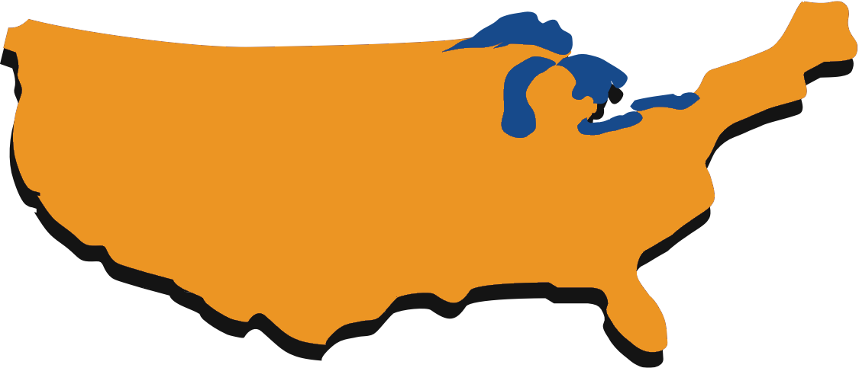

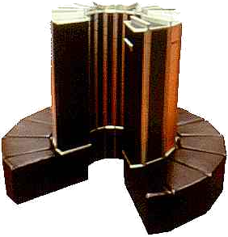




“The Grid” Concept
“On-Demand”
Virtualization
Scientist
Portal
Data
Storage
CPU
Algorithms
Networks

Slide 6
GENESIS SciFlo Engine
iEarth: Enabled by the open-source SciFlo Engine.
Automate large-scale, multi-instrument science processing by authoring a dataflow document that specifies a tree of executable operators.
  iEarth Visual Authoring Tool
  Distributed Dataflow Execution Engine
  Move operators (executables) to the data.
  Built-in reusable operators provided for many tasks such as subsetting, co-registration, regridding, data fusion, etc.
  Custom operators easily plugged in by scientists.
  Leverage convergence of Web Services (SOAP) with Grid Services (Globus v4).
Hierarchical namespace of objects, types, & operators.
  sciflo.data.EOS.AIRS.L2.atmosphericParameters
  sciflo.operator.EOS.coregistration.PointToSwath
Carbon Cycle

Slide 7
Web Services “Stack”
Metadata: XML and XML schema
Messaging: Simple Object Access Protocol (SOAP)
Service interfaces: Web Service Description Language (WDSL) and OWL-S
Service registries: Universal Description, Discovery and Integration (UDDI)
Semantic Web: Ontologies or “concept maps” in Resource Description Framework (RDF) and Ontology Web Language (OWL)
Grid Workflow: Many dataflow engines
  Kepler, Pegasus, Triana, SciFlo, etc.
  Business Process Execution Language (BPEL) - IBM
Carbon Cycle

Slide 8
What is Simple Object Access Protocol (SOAP)?
Distributed Computing by Exchange of XML Messages
  Lightweight, Loosely-Coupled API
  Programming language independent (unlike Java RMI)
  Transport protocol independent
Multiple Transport Protocols Possible
  HTTP or HTTPS (HTTP using SSL encryption) POST
  Email (SMTP), Instant Messaging (MQSeries, Jabber)
  Store & Forward Reliable Messaging Services (Java JMS)
  Even Peer-to-Peer (P2P) protocols or LambdaRail
SOAP Toolkits for all languages
  Apache Axis for Java, modules for python/perl, Visual C# .Net.
Web Service Description Language (WSDL)
  Generate call to a service automatically from WSDL document.
  Data types and formats expressed in XML schema.
  Publish services in UDDI catalogs for automated discovery.
Carbon Cycle

Slide 9
Technology Trends
Pervasive use of XML – metadata & messaging
Lightweight distributed computing – XML/SOAP messaging
High performance binary data transfer – GridFTP or OpenDAP-g over optical fibers
Google search – update index via crawler
Scalable Peer-to-Peer (P2P) Networks
Distributed queries & file sharing -- Napster
Collaboration Networks – wiki, Friendster
Semantic Web – meaningful ontologies in RDF & OWL

Slide 10
Technical Challenge
Can one exploit all of these technologies and create a Grid Workflow system with the following features?
  Lightweight, open source, user-installable (not root)
  Runs on common platforms: Windows laptop to Linux cluster
  P2P scalable network: goal of thousands of nodes
  Each node generates & serves new, fused datasets
  Distributed queries to discover newly generated data
  Connect both remote services & local operators into a dataflow
  Declare the dataflow in a simple XML document (not scripting)
  Visual Programming (if desired, but not required)
  Parallel execution with automatic load balancing, scheduling
  Move algorithms/operators to the data
  Publish & exchange scientific algorithms (dataflow docs.)
  Preserve data provenance
  Semantic annotations added to all products
  Collaboration environment, shared web pages
  Personal science notebook, personal data center

Slide 11
What is the SciFlo Network?
“SciFlo” stands for Scientific Dataflow
A Peer-to-Peer Network of Grid Workflow nodes
  Author dataflow documents in XML
  Tie together a series of operators into a complex dataflow: SOAP services, local executables or scripts, and python codes
  Distributed dataflow execution engine
    Choreographs parallel execution, can use many nodes
    Data & operator movement is done by the engine
    Each node serves data & operators, executes SciFlo documents, and is a client of other nodes.
Leverages & reuses many XML technologies
  Metadata described in XML and XML schema
  Distributed computing via XML messaging (SOAP)
  Service & operator interfaces described in XML (WSDL)
  Ontologies & namespaces in XML (RDF & OWL)

Slide 12
SciFlo is Multi-Purpose
Each SciFlo client/server node is multi-functional:
  Provides pre-configured SOAP services (e.g. GeoRegionQuery)
  Serves data via an OpenDAP server and ftp or GridFTP
  Provides a Redirection server: translate objectID -> file URL’s
  Contains metadata in a relational database (mysql)
  Contains an XQuery-able XML document store (dbxml)
  Executes SciFlo documents (dataflow execution engine)
  Serves flow results on private & shared web pages (wiki)
SciFlo Software Bundle
  All Open Source, Push-Button Install on Linux & Windows
  Installable by each user, root/admin privileges not required
  One install provides pre-configured: SOAP services, OpenDAP server, redirection, ftp, mysql, dbxml, dataflow engine, & wiki.
Personal Data Center for each scientist
  Electronic scientific notebook (personal, configurable)
  Collaborate by sharing wiki pages & exchanging SciFlo docs.

Slide 13
Technology Integration
SciFlo is a deep integration of multiple IT’s:
  XML standards: schema, SOAP, WSDL, UDDI, RDF, OWL
  Distributed computing via XML messaging
  Fine-grained, on-demand, binary data transfer via OpenDAP
  Metadata in XML and relational databases
  Grid Workflow: WS-ResourceFramework, WS-* standards
  The Grid concept: Compute & storage resources as a utility
Not Six, But Thousands of Nodes (P2P)
  Distributed Systems are Replacing Centralized Systems
  New Paradigm: Lightweight, Loosely-Coupled, Distributed
  Challenge: Globus toolkit is not lightweight
  For now, use only pieces of Globus: Security (GSI), GridFTP
  Add more from WS version of Globus (v4) as they mature

Slide 14
SciFlo SOAP Services
Time & Geolocation Querying for multiple datasets
  GeoRegionQuery(timeRange, latLonRegion)
  Same SOAP interface & web form for GPS, AIRS, MODIS, MISR
  Query returns a list of unique object ID’s (granules)
Redirection/Caching Server for multiple datasets
  GetDataById: Translates object ID’s into list of on-line locations in DataPools or any SciFlo node (FTP or OpenDAP URL’s)
  DataPools & SciFlo P2P network are “crawled” to update redirection tables
  No need to publish presence of data, continuously discovered
  Distributed cache for scientific datasets: SciFlo engine automatically moves & caches datasets as required during dataflow executions
  Can stage/cache input & generated datasets on local node

Slide 15
GeoRegionQuery for GPS, AIRS, MODIS
GeoRegionQuery
MODIS Terra
Carbon Cycle
GeoRegionQuery
GPS
GeoRegionQuery
AIRS
GeoRegionQuery
MODIS Aqua
Plot Data
Locations
FindDataById
GPS
FindDataById
AIRS
FindDataById
MODIS Terra
FindDataById
MODIS Aqua
OpenDAP URL’s
GPS
OpenDAP URL’s
AIRS
OpenDAP URL’s
MODIS Terra
OpenDAP URL’s
MODIS Aqua

Slide 16
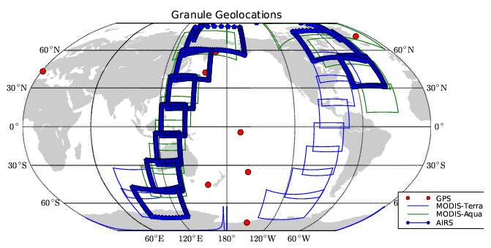
GeoRegionQuery for GPS, AIRS, MODIS
Carbon Cycle

Slide 17
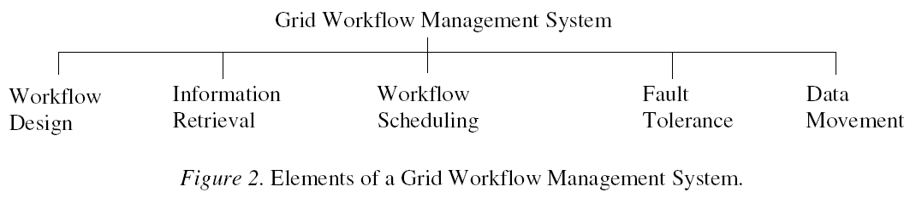
Taxonomy of Grid Workflow Systems
Paper by J. Yu and R. Buyya (eprint arXiv:cs/0503025)
Carbon Cycle
Describe detailed taxonomy
Survey existing systems
  DAGMan, Pegasus, Triana, ICENI, Taverna, GridAnt
  GrADS, GridFlow, UNICORE, Gridbus

Slide 18
SciFlo’s Niche in the Taxonomy
Workflow Structure
  Emphasize DAG: functional programming style
  But can be non-DAG: sequence/parallel, choice, & iteration
  Operators written in “accumulator” style
Abstract workflow documents
  Same doc. can be abstract or concrete
  Missing steps and operator bindings allowed
  Missing conversion operators inserted by resolving type & semantic “kind” constraints
  But types/kinds are optional, inferred from flow
Workflow Composition
  Visual programming tool to draw graph, but not required
  XML format simple enough to author directly
  Graph is implicit in the input/output dependencies
QoS Constraints
  Time & resource limits for each step in a flow, by user
Carbon Cycle

Slide 19
SciFlo’s Niche (2)
Information Retrieval
  Datasets & Operators discovered by distributed queries
  Object/file ID’s translated to on-line URL’s (data grid)
  Generic names for datasets & physical variables
Scheduling Architecture & Planning
  Decentralized, hierarchical, dynamic
  Predict execution times from previous behavior
  Monitor performance at run time, trial computations
Data Movement
  Automatic, peer-to-peer, implicit
  Check performance of available pathways at run time
Operator Movement
  Automatic, peer-to-peer, implicit
  Exchange signed scripts & executables
  Restricted execution in a sandbox
  Easily Wrap Matlab, IDL, R, & python codes
Carbon Cycle

Slide 20
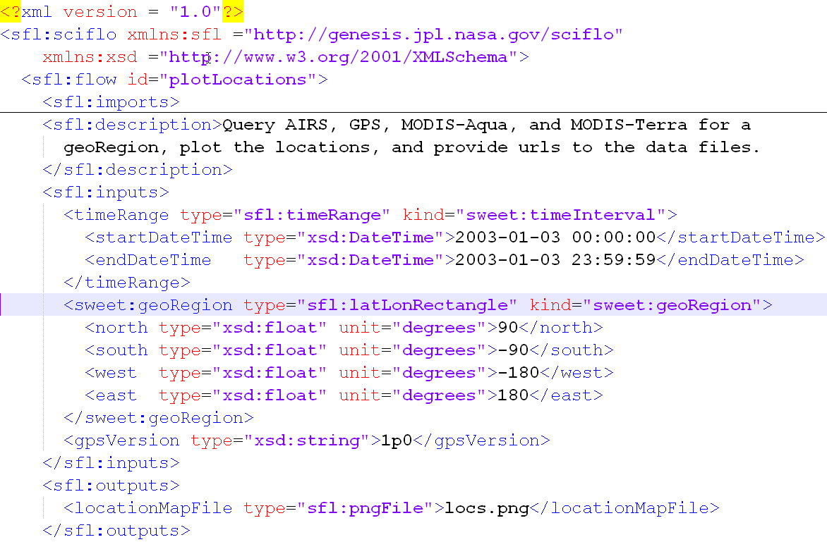
SciFlo Document
Carbon Cycle

Slide 21
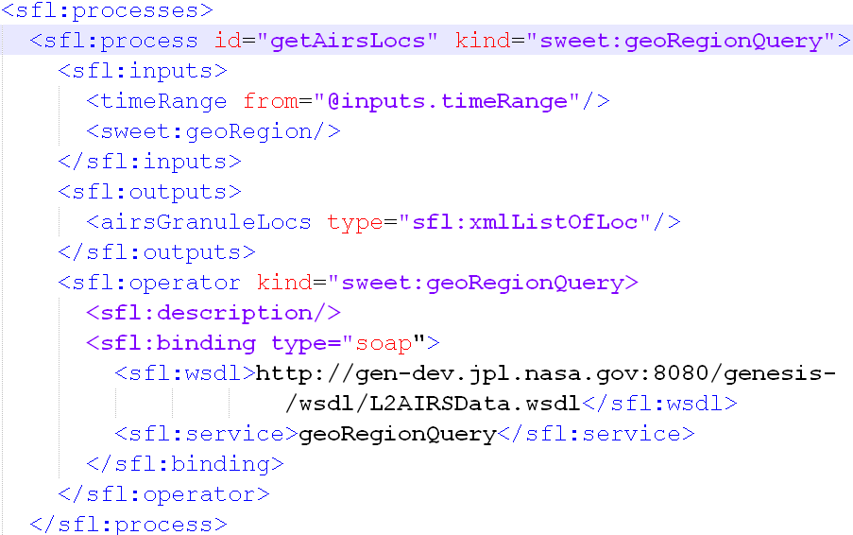
SciFlo Document (2)
Carbon Cycle

Slide 22
Abstraction: Inserting “Missing” Steps
Infer from type and kind constraints
Unit Conversions
  Temperature: Fahrenheit to Celsius
  Water vapor: Layer humidity to mixing ratio
Format Conversions
XML Format to Python Data Structures
  XML List ⬄ Python List
  List, Dict, ListOfList, ListOfDict, etc.
XML Format to Text Columns
  Support command-line executables
More Complex Conversions Possible
  Regrid in 3D & 4D
  Grid Slice (reduce dimension)
Names to Instances (data grid)
  ListOfObjectIDs → ListOfURLs, just another conversion
Carbon Cycle

Slide 23
SciFlo As an Authoring Toolkit
Assemble operators by writing XML document
  Connect SOAP data query/access services to custom,
  executable algorithms written by scientists
  IDL, MATLAB, or python codes can become operators
SciFlo Engine automatically:
  Generates web (HTML) form to call the flow
  Publishes custom flow as a new SOAP service (if desired)
Create SOAP Services Automatically
  No glue or SOAP code to write
  Only write scientific algorithms, in language of choice
  New services have semantic web annotations
Publish Analysis Flows
  Exchange SciFlo documents
  Generated products have lineage & semantic annotations

Slide 24
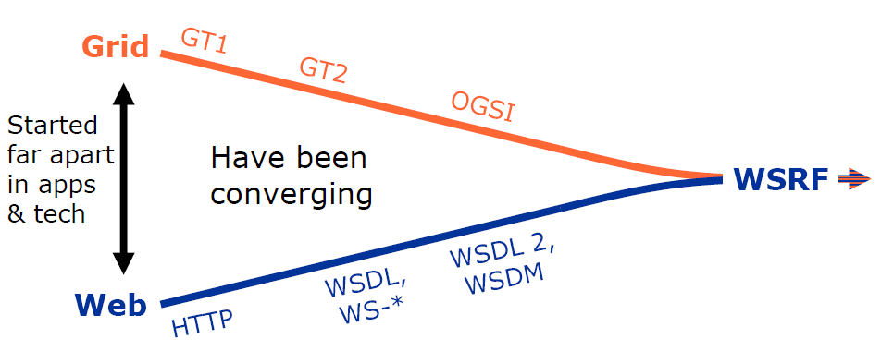
Evolving Grid Computing Standards
Carbon Cycle
GT4
“stateful resources”
[Adapted from Globus Toolkit “Ecosystem”
presentation at GGF11 by Lee Liming]

Slide 25
Evolving Grid Computing Standards
History of Scientific Computing as a Utility
  The Grid began as effort to tightly couple multiple super- or cluster computers together (e.g., Globus Toolkit v1 & v2).
  Needed job scheduling, submission, monitoring, steering, etc.
  SETI@HOME success
OGSI: Open Grid Services Infrastructure
  Globus v3.2 is open-source implementation using Java/C.
  A service is Grid-enabled by inheriting from Java class.
  Standard is complex and growing.
  Challenge: Ease of installation & use.
WS-Resource Framework (WSRF)
  Capabilities treated as storage or computing resources exposed on the web – “stateful resources”.
  Globus Toolkit v4, May 2005
Carbon Cycle

Slide 26
Globus Components
Security
  Grid Security Infrastructure (GSI)
  Community Authorization Service (CAS)
  MyProxy service (stores user credentials)
Monitoring & Discovery
  Monitoring and Discovery System (MDS)
  Index Service (stores grid status information)
  Trigger Service (resource change detection)
Grid Computing
  Globus Resource Allocation Manager (GRAM)
  GRAM Scheduler Plug-ins
Data Grid
  Metadata Catalog Service (MCS)
  Replica Location Service (RLS)
  Reliable File Transfer (RFT)
  GridFTP (multi-channel, fast ftp)

Slide 27
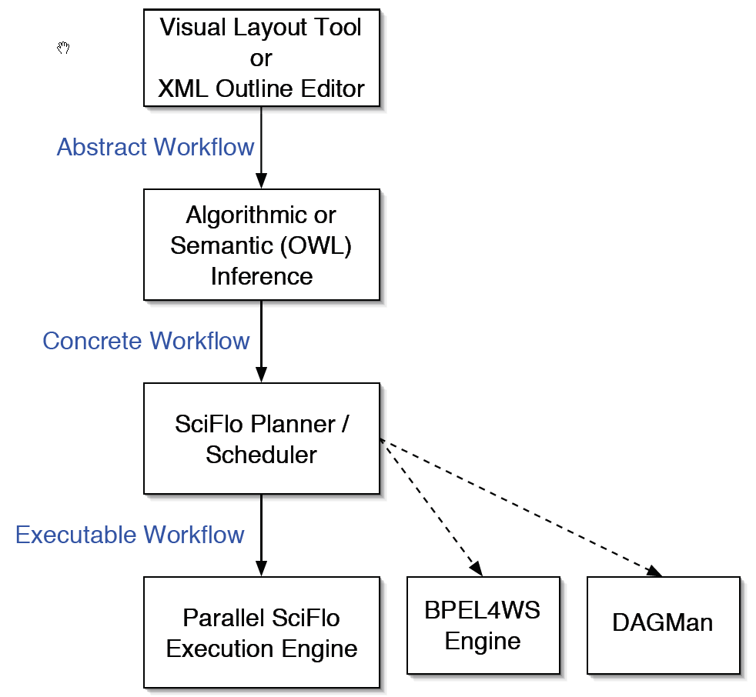
Elaborating Workflow Documents
Abstract (skeleton) Workflow is more easily authored.
  Trivial data format & unit conversions auto-inserted.
  As toolbox of known & reliable operators grows, even complex ops like regridding become trivial.
Could use other backends if desired (BPEL, DAGMan, Kepler).

Slide 28
Server Implementation
P2P Server Infrastructure
  Distributed catalogs of data sources and operator bundles.
  Permanent hierarchical names for data & operators.
  Data & operator movement handled automatically by server.
SciFlo Execution Steps:
  Validate: Parse & validate XML doc. against schema.
  Queue: Push flow into an execution queue if slaves busy.
  Embellish: Infer concrete workflow from abstract workflow; insert simple unit or format conversions, or more complex operators.
  Plan/Schedule: Construct execution plan & annotate flow document accordingly.
  Start Execution: Parallel execution using master & slave servers.
  Forward: Forward partially evaluated flow to another server for load balancing & locality optimization.
  Freeze/Thaw: Store execution state while waiting; wake up when long-running operators complete.
  Deliver: Return URLs pointing to results (or fault) to SciFlo client, which then pulls output files (via http, sftp, or GridFTP).
Carbon Cycle

Slide 29
Parallel, Asynchronous Dataflow Execution
Parallelism at many levels during execution:
  Create multiple processes on a single server node.
  Create multiple threads within each process to execute, monitor, & respond to status queries.
  Launch a sub-flow or operator on a slave node within the local computer cluster.
  Invoke a remote operator via a SOAP or http CGI call and wait for results.
  Redirect a flow or sub-flow to a server that can access a large data source locally.
  Partially evaluate a flow and then redirect.
  Launch a large, CPU-intensive operator on a Grid-enabled cluster or supercomputer (Globus GRAM).
  Invoke the same flow multiple times if the source operators(s) yield multiple input objects (implicit file parallelism).
  Switch execution between active flows while waiting for results from “frozen” flows.
Carbon Cycle

Slide 30
Data Access by Naming
Permanent Hierarchical Names (“Holy Grail”)
  Naming Authority assigned at each namespace level
  Distributed P2P namespace (P2P catalog lookup)
Proper Names
  AIRS Level2 Parameter Retrieval Dataset (granules):
  sciflo.data.EOS.AIRS.L2.atmosphericParameters (or metadata)
  Generic Point-To-Swath Co-registration Operator:
  sciflo.operator.EOS.coregistration.PointToSwath
Generic Names
  Atmospheric Temperature Data:
  sciflo.data.atmosphere.temperature.profile (or .grid)
  Name resolves to list of EOS datasets
  Semantics attached (3DGeoParameterGrid of temperature)
Carbon Cycle

Slide 31
SciFlo’s Strength Lies in Combining Many Elements into a Single Open-Source System
  Abstract XML dataflow documents translated to concrete flows.
  Parallel dataflow execution engine
  Semantic inference using XML metadata
  Move operators to the data.
  SOAP architecture, but also P2P functionality.
  Every node is both client & server; easy node replication.
  One-click installation onto server or desktop nodes.
  Initiate grid computations from your desktop.
Access data objects by naming them!
  P2P Distributed Namespace of data sources & operators
Server architecture
  Group of interacting SOAP services (replaceable modules)
  Implementation in XML, python, & C/C++ (not Java)
Strength in Numbers: Let a million nodes bloom!
Carbon Cycle

Slide 32
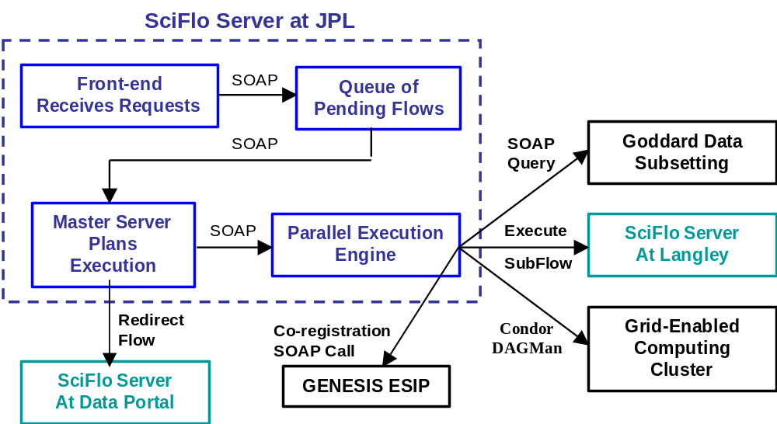
Distributed Computing Using SciFlo
Carbon Cycle
Inject data query or flow execution request
into SciFlo network from any node.

Slide 33
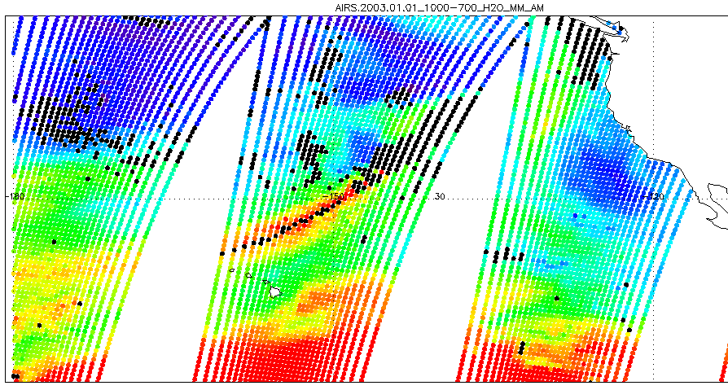
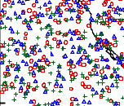
AIRS/GPS Co-registration: Point to Swath
Carbon Cycle
AIRS Level2
Swaths over Pacific
GPS Level2
Profile Locations

Slide 34
SciFlo SOAP Services
Time & Geolocation Querying for multiple datasets
  GeoRegionQuery(timeRange, latLonRegion)
  Same SOAP interface & web form for GPS, AIRS, MODIS, MISR
  Query returns a list of unique object ID’s (granules)
Redirection/Caching Server for multiple datasets
  GetDataById: Translates object ID’s into list of on-line locations in DataPools or any SciFlo node (FTP or OpenDAP URL’s)
  DataPools & SciFlo P2P network are “crawled” to update redirection tables
  No need to publish presence of data, continuously discovered
  Distributed cache for scientific datasets: SciFlo engine automatically moves & caches datasets as required during dataflow executions
  Can stage/cache input & generated datasets on local node

Slide 35
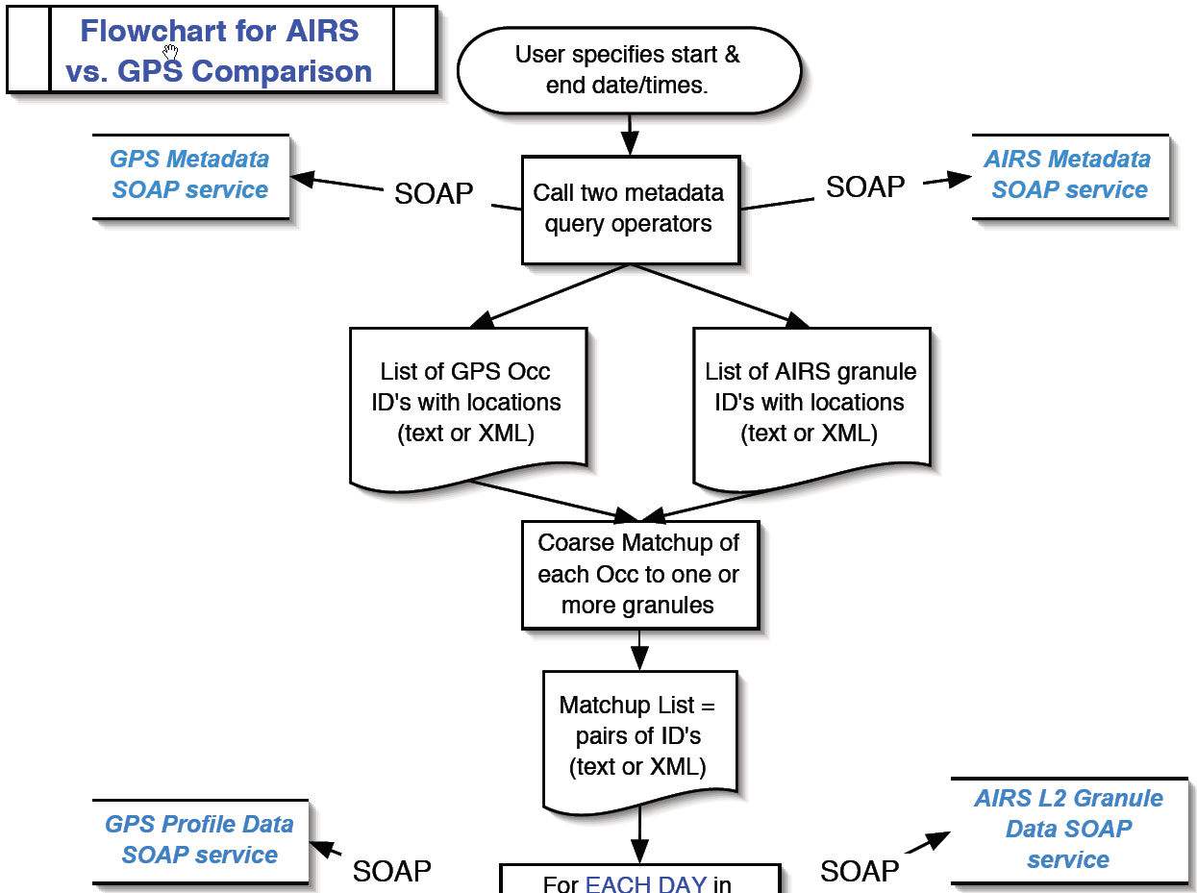
AIRS versus GPS Flowchart (part 1)

Slide 36
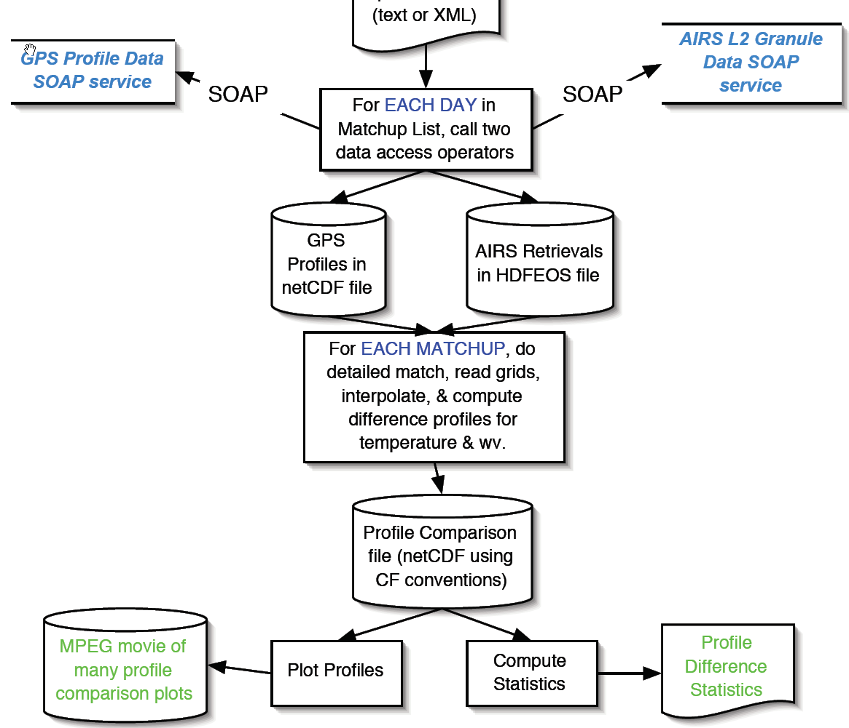
AIRS versus GPS Flowchart (part 2)

Slide 37
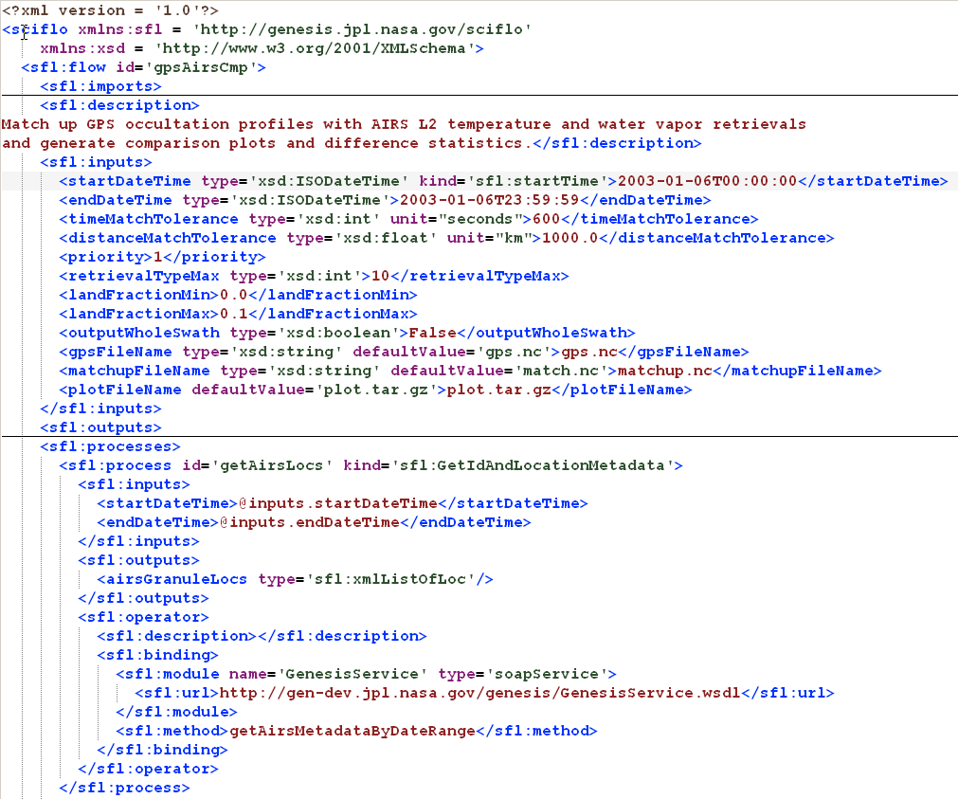
SciFlo Document

Slide 38
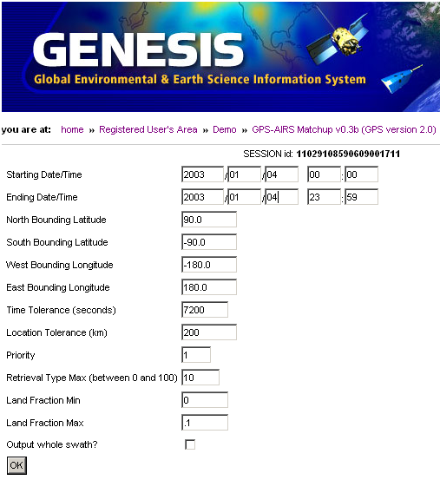
AIRS & GPS Retrievals Matchup Demo
Interface: HTML web form auto- generated from XML dataflow doc.
Input: User enters start/end time & other co-registration criteria.
Flow Execution: Calls 4 SOAP data query services & total of 15 operators on 4 computers.

Slide 39
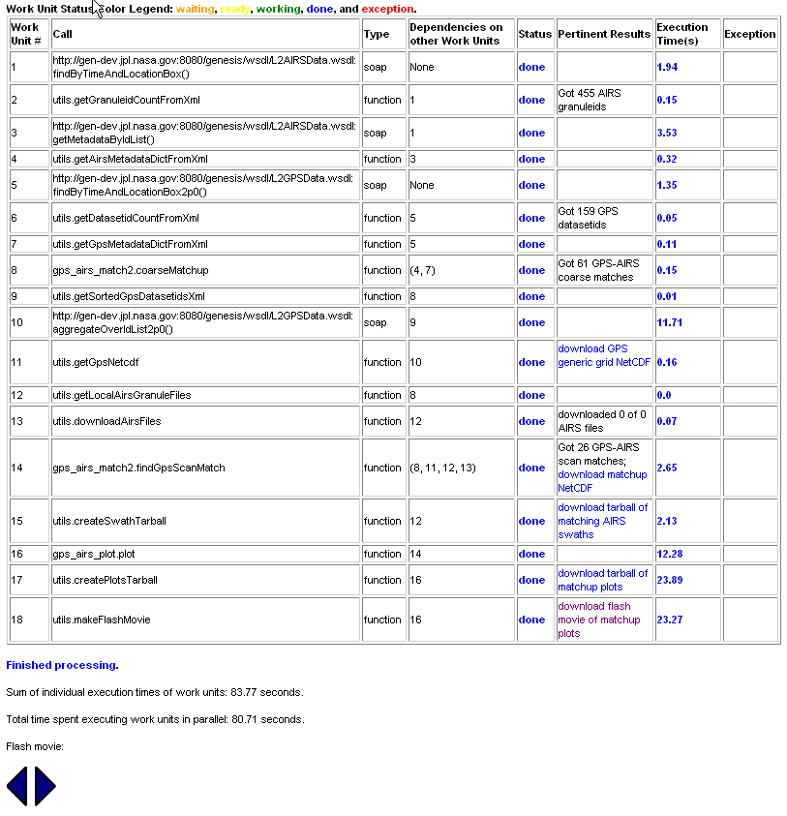
AIRS & GPS Retrievals Matchup Demo
Results Page: Shows status updates during execution and then final results.
Caching: Reuse intermediate data products or force recompute.
Results: Merged data in netCDF file & plots as Flash movie.

Slide 40
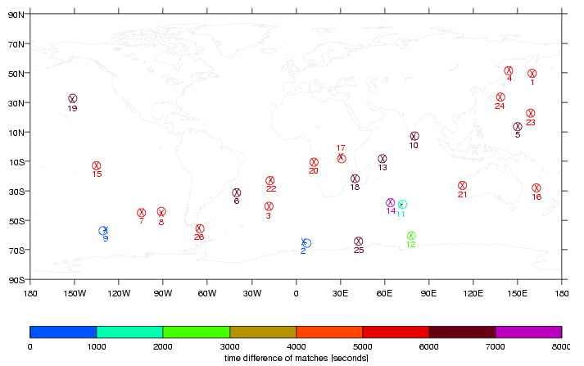
AIRS/GPS Matchups

Slide 41
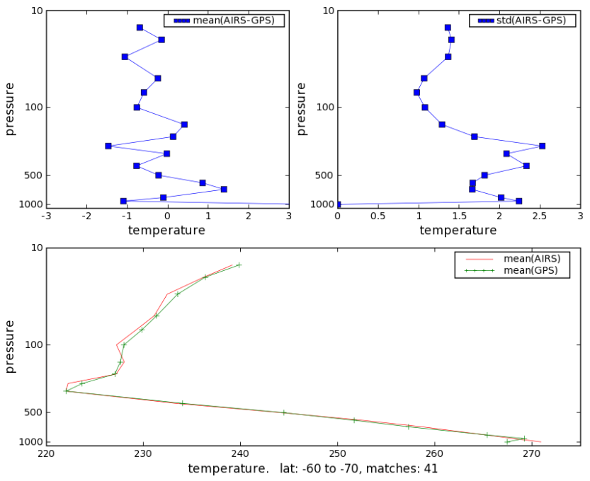
AIRS/GPS Temperature Difference Statistics
Mean temperature profile
for 41 matchups, latitude
region -60 to -70 deg.,
Jan-Apr, 2003

Slide 42
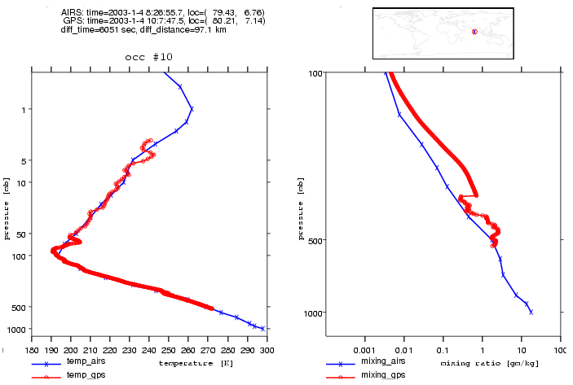
AIRS/GPS Temperature & Water Vapor Comparison Plots

Slide 43
Flexible Distributed Computing
Move data to the operators – Move entire AIRS granules from the Goddard DAAC to a local SciFlo server at JPL. Compare AIRS to GPS locally.
Move operators to the data – Move the comparison operators and the flow execution into a SciFlo server that has local access to the large AIRS granule archive.
Custom parameter subsetting – Subset the AIRS granules at the DAAC using a custom subsetting operator to generate tailored granules. Transfer the smaller files to a local SciFlo server.
On-demand OpenDAP Slicing – Leave the AIRS granules in the Goddard Data Pool and perform the comparison at JPL. Using OpenDAP, only grab the hand full of variables (temp, water vapor, etc.) from each granule that are needed for the comparison.

Slide 44
Open Data Access Protocol
www.opendap.org
  Use a one-line query URL to retrieve a slice of a variable grid from a netCDF or HDF file anywhere in the world
  Binary wire protocol for fine-grained data transfer
OpenDAP URL
  http://gen-dev.jpl.nasa.gov/genesis/cgi-bin/dods/nph-dods/
  genesis/data/airs/L2/20030113/airx2ret/AIRS.2003.01.13.171.L2.RetStd.hdf?temperature(1:3, 3:6, 4:17)
OpenDAP Servers (via CGI)
  netCDF, HDF, other file formats
  Easy to implement another server
OpenDAP clients
  Matlab and IDL, any web browser
  Python (Dominic Mazzoni)

Slide 45
Thinking in XML
Design the XML metadata and data representations first. Add an ontology.
  Then create objects in your favorite programming language.
  Then create objects in more languages for broader use.
4DRectilinearGrid datatype
  <4DRectilinearGrid>
  <Latitudes>
  <Series>-90, 90, 2
  <Longitudes>
  <URL>http://gsfc.nasa.gov/cgi-bin/dods/AIRS.hdf?Longitude
  <Altitudes>
  <Times>
  <Variable>
  <Name>
  <Unit>
  <MissingValueMarker>
  </Variable>
  <Grid>
  <URL>http://gsfc.nasa.gov/cgi-bin/dods/AIRSgranule.hdf?TAirStd
  </Grid>
  </4DRectilinearGrid>

Slide 46
New Paradigm for Scientific Computing
Use two or more channels
  XML Messaging on one
  Binary data protocol (like OpenDAP) on the other(s)
Two channels can use different transports
  XML Messaging over HTTP or dark P2P
  OpenDAP over LambdaRail or scalable P2P caching network
XML Messaging Channel for:
  Control, Service Chaining, Workflow, Metadata Exchange
  Configuration of Binary channel
Binary Data Channel(s)
  Out-of-band from XML point of view
  Bulk data transfer, replication, or caching
  Could be multi-protocol (OpenDAP, GridFtp, LambdaRail)

Slide 47
Future Plans
Version 1 of SciFlo available Fall 2005
  Deploy within major data centers
  Earth science: Goddard, Langley, JPL DAAC’s, AIRS team
  Aerosol virtual observatory (Amy Braverman, MISR team)
Apply SciFlo to planetary and space science data
  Bridge to OODT, Workflow for JPL’s Planetary Data System
  Large-scale Grid workflow as a LambdaRail “killer app”
Adopt Grid technologies as they mature (Globus)
  GridFTP, WS-Security, GRAM job submission
Add more Semantic Web Capabilities
  Ontology for operator types and geo-located data (Raskin)
World Domination: Thousands of Nodes

Slide 48
http://sciflo.jpl.nasa.gov
Summary
SciFlo’s Innovation Lies in Combining Many Elements into a Single Open-Source System
  Abstract XML dataflow documents
  Semantic inference using XML metadata
  Parallel dataflow execution engine
  Move operators to the data.
  Every node is both client & server; easy node replication.
  SOAP architecture, but also P2P functionality.
  Initiate grid computations from your desktop.
P2P Network:
  SciFlo nodes inside all Science Data Centers
  Personal science notebook for each scientist
Multi-Instrument Earth Science
  Multi-Instrument Science Portals
  Large-scale multivariate statistical studies and verification of weather/climate models.
Carbon Cycle

