Slide 1
Efficiently Supporting Structure Queries on Phylogenetic Trees
Presented by: Yifeng Zheng
Joint work with Susan B. Davidson and Junhyong Kim
Supported by the NSF-ITR CIPRES project.
University of Pennsylvania

Slide 2
Phylogenetic Trees
Representation of ancestor-descendant relationships among species.
  Estimate history.
  Trace the source of diseases.
Phylogenetic Database
  TreeBASE [http://www.treebase.org]
  Tree of life [http://tolweb.org]
Queries on Phylogenetic Trees
  Keyword Search
  Structured Queries

Slide 3

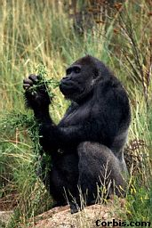
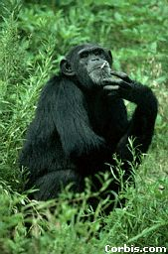

Sample Phylogenetic Tree
From the Tree of the Life Website,
University of Arizona
Orangutan
Gorilla
Chimpanzee
Human

Slide 4
Problem Space
Query type
Harel and Tarjan 84
Shan et al SSDBM02
Structure
Berkman et al 89
Nakhleh et al BIBE03
...
[http://www.treebase.org]
Keyword
[http://tolweb.org]
Data size
Small
Large

Slide 5
Outline
Structure Queries
Algorithms
Experiments

Slide 6
Structure Queries on Phylogenetic Trees
Least common ancestor
Minimal spanning clade
Tree projection
Tree pattern match

Slide 7
Least Common Ancestor (LCA)
LCA_{T}(v, m)
T
v
m
Notes:
First let me give the definition of LCA problem.
LCA is to find the lowest common ancestor of any two node in a tree.
For example, in this tree, the LCA of nodes u and v is the blue node.

Slide 8
Minimal Spanning Clade (MSC)
MSC_{T}(v, m)
T
v
m
Notes:
First let me give the definition of LCA problem.
LCA is to find the lowest common ancestor of any two node in a tree.
For example, in this tree, the LCA of nodes u and v is the blue node.

Slide 9
Tree Projection
Project_{T}({u,v,w,m})
T
w
u
v
m
Notes:
First let me give the definition of LCA problem.
LCA is to find the lowest common ancestor of any two node in a tree.
For example, in this tree, the LCA of nodes u and v is the blue node.

Slide 10
Tree Pattern Match (TPM)
TPM_{T}(P₁)= true
TPM_{T}(P₂)= false
P₁
m
w
v
u
T
P₂
w
u
v
m
u
w
v
m
Notes:
First let me give the definition of LCA problem.
LCA is to find the lowest common ancestor of any two node in a tree.
For example, in this tree, the LCA of nodes u and v is the blue node.

Slide 11
Outline
Structure Queries
Algorithms
Experiments

Slide 12
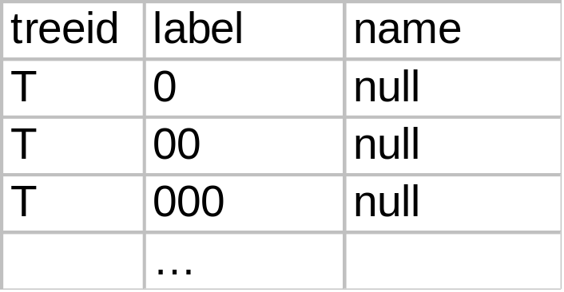
Dewey Labeling
0
01
010
011
00
0100
0111
000
001
0101
0110
0000
0001
01010
01011
01110
01111
Notes:
First let me give the definition of LCA problem.
LCA is to find the lowest common ancestor of any two node in a tree.
For example, in this tree, the LCA of nodes u and v is the blue node.

Slide 13
Least Common Ancestor (LCA)
lca=LCA_{T}(v, m)
⇔
label_{lca}=longest-common-prefix(label_{v}, label_{m})
00
1
000
2
5
001
0000
3
4
0001
Notes:
First let me give the definition of LCA problem.
LCA is to find the lowest common ancestor of any two node in a tree.
For example, in this tree, the LCA of nodes u and v is the blue node.

Slide 14
Minimal Spanning Clade (MSC)
Descendant(x,y) ⇔ label_{y}=prefix(label_{x})
MSC_{T}({v, m}) = {x | descendant(x, LCA_{T}(v,m))
00
1
000
2
5
001
0000
3
4
0001
Notes:
First let me give the definition of LCA problem.
LCA is to find the lowest common ancestor of any two node in a tree.
For example, in this tree, the LCA of nodes u and v is the blue node.

Slide 15
Tree Projection
Projection_{T}({u,v,w,m})
T
w
u
v
m
Notes:
First let me give the definition of LCA problem.
LCA is to find the lowest common ancestor of any two node in a tree.
For example, in this tree, the LCA of nodes u and v is the blue node.

Slide 16
Tree Projection
Sort nodes by their labels
  node n whose label follows m’s in order must appear on the right hand side of m
Build the tree projection
  insert nodes in order into an initially empty tree using labels to determine position along the rightmost path
label(u)=0000 label(v)=01011
label(w)=0110 label(m)=01110

Slide 17
Tree Projection
0
1
descendant(w,0) = T
descendant (w,v) = F
w
0110
0000
01011
u
v
Notes:
First let me give the definition of LCA problem.
LCA is to find the lowest common ancestor of any two node in a tree.
For example, in this tree, the LCA of nodes u and v is the blue node.

Slide 18
Tree Projection
0
1
descendant(m,2) =T
descendant(m,w) = F
01
2
m
01110
0000
01011
0110
u
v
w
Notes:
First let me give the definition of LCA problem.
LCA is to find the lowest common ancestor of any two node in a tree.
For example, in this tree, the LCA of nodes u and v is the blue node.

Slide 19
Tree Projection
0
0
01
1
011
2
0110
01110
0000
01011
u
v
w
m
Notes:
First let me give the definition of LCA problem.
LCA is to find the lowest common ancestor of any two node in a tree.
For example, in this tree, the LCA of nodes u and v is the blue node.

Slide 20
Complexity of Tree Projection
To insert a node, the number of comparisons is one more than the nodes removed from the rightmost path
Number of nodes in the tree is at most 2k, where k is the size of input node set
Totally we need at most 3k comparisons

Slide 21
Tree Pattern Match (TPM)
Separate locating related information and comparing similarity
  Efficiency
  Supporting exact match and approximate match
Algorithm
  Find the leaf sequence in the data tree that matches the query pattern
  Compute the tree projection of this leaf sequence
  Compare the pattern tree with projection tree

Slide 22
Tree Pattern Match (TPM)
TPM_{T}(P)= true
P
T
w
m
w
v
u
u
v
m
Notes:
First let me give the definition of LCA problem.
LCA is to find the lowest common ancestor of any two node in a tree.
For example, in this tree, the LCA of nodes u and v is the blue node.

Slide 23
Tree Pattern Match (TPM)
Projection_{T}({m,w,,v,u}) = P₁
T
P₁
w
u
v
w
m
u
v
m
Notes:
First let me give the definition of LCA problem.
LCA is to find the lowest common ancestor of any two node in a tree.
For example, in this tree, the LCA of nodes u and v is the blue node.

Slide 24
Tree Pattern Match (TPM)
Reroot P and P₁ to a node with same tag (m in this example)
m
m
P
P₁
w
v
u
u
v
w
Notes:
First let me give the definition of LCA problem.
LCA is to find the lowest common ancestor of any two node in a tree.
For example, in this tree, the LCA of nodes u and v is the blue node.

Slide 25
Tree Pattern Match (TPM)
Tagging and mapping
m
m
P
u
u
P₁
u
u
w
v
u
u
v
w
Notes:
First let me give the definition of LCA problem.
LCA is to find the lowest common ancestor of any two node in a tree.
For example, in this tree, the LCA of nodes u and v is the blue node.

Slide 26
Tree Pattern Match (TPM)
Rerooting take linear time
Tagging take linear time if fanout of node is limited by a constant
Mapping take linear time if fanout of node is limited by a constant

Slide 27
Outline
Structure Queries
Algorithms
Experiments

Slide 28
Experimental Setting
Test Data
  Generated by r8s [Sanderson]
Database
  DB2 (index on labels)
Comparing methods
  Transitive Closure (TC) [Nakhleh et al BIBE2003]
  Path Match (PM) [Shan et al SSDBM2002]
  Our method (LP)

Slide 29
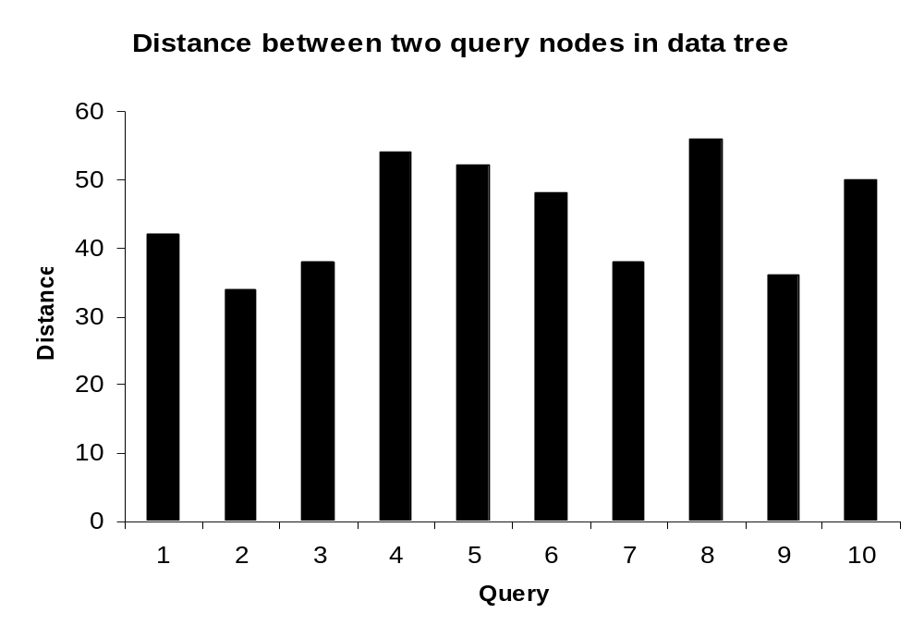
LCA: Data Statistics

Slide 30
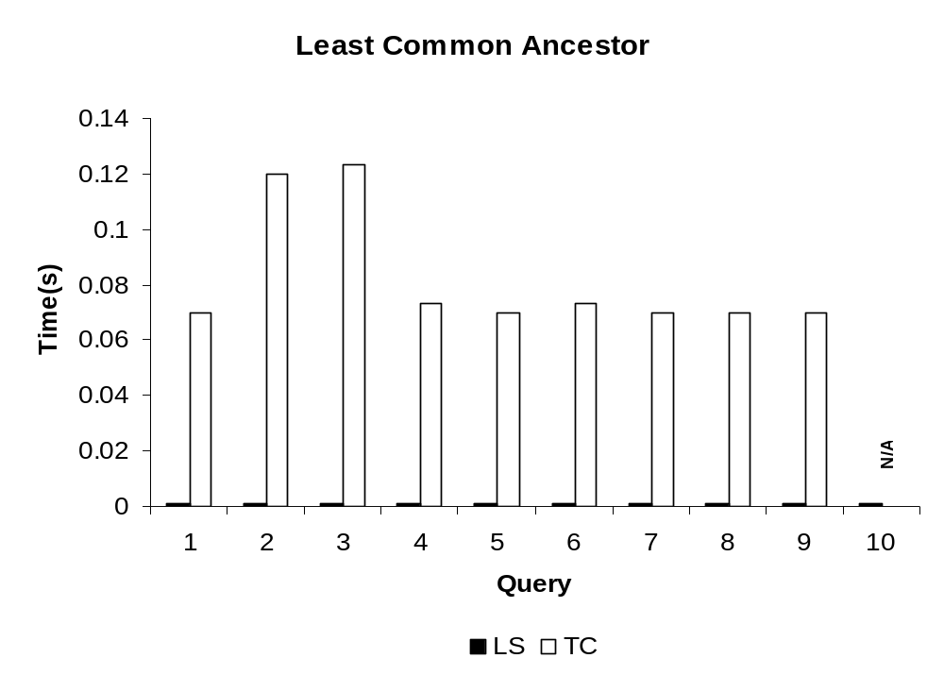
LCA: Running Time

Slide 31
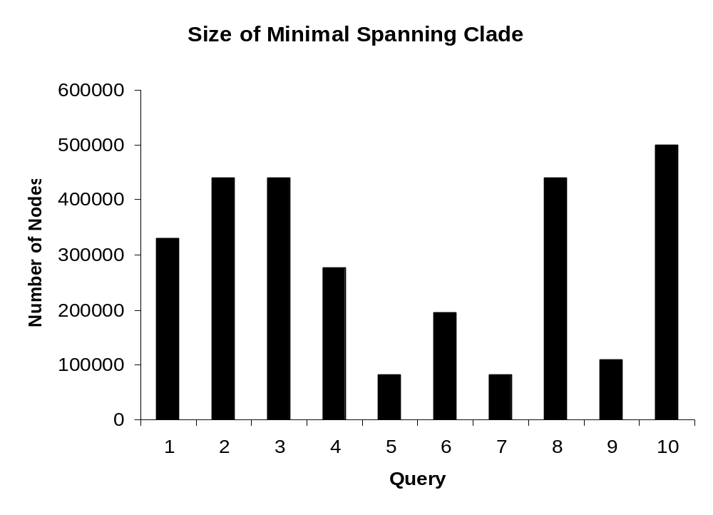
MSC: Data Statistics

Slide 32
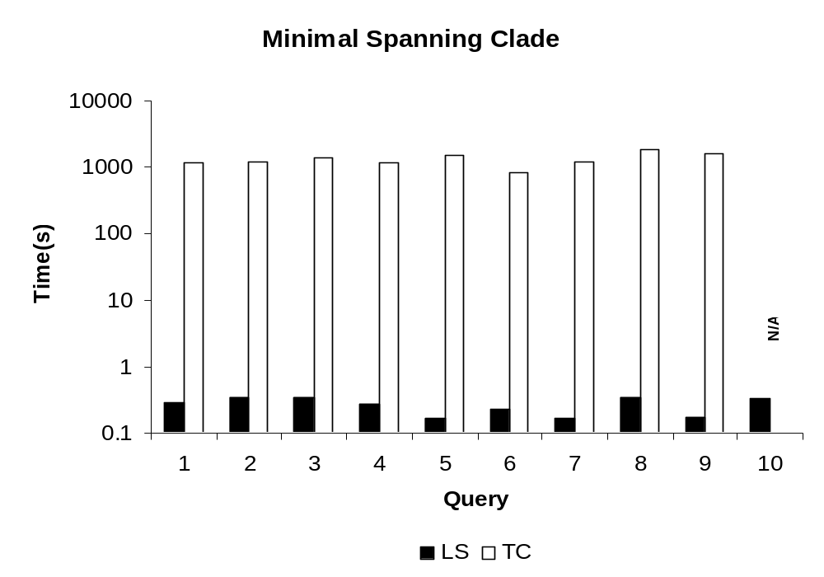
MSC: Running Time

Slide 33
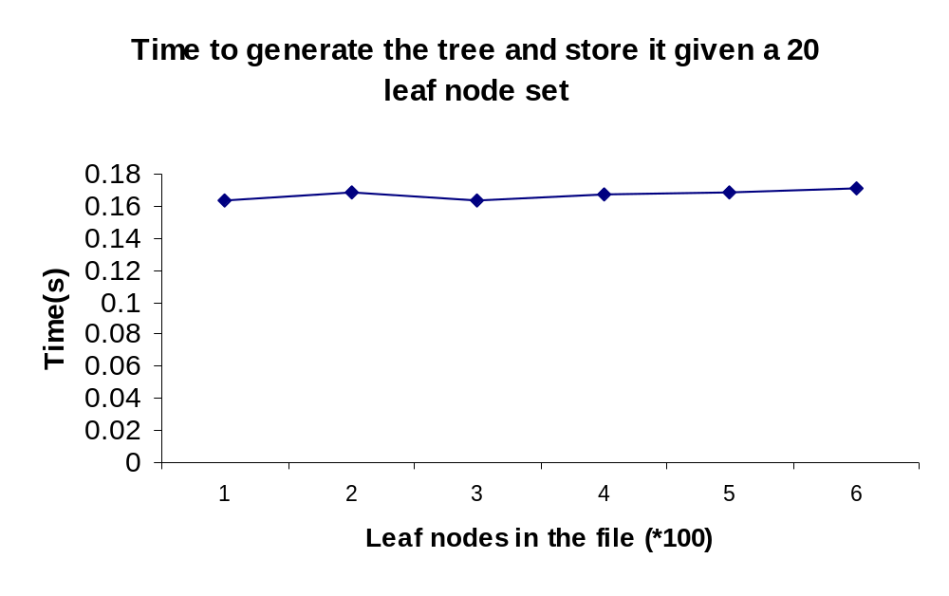
Projection: Running Time (1)

Slide 34
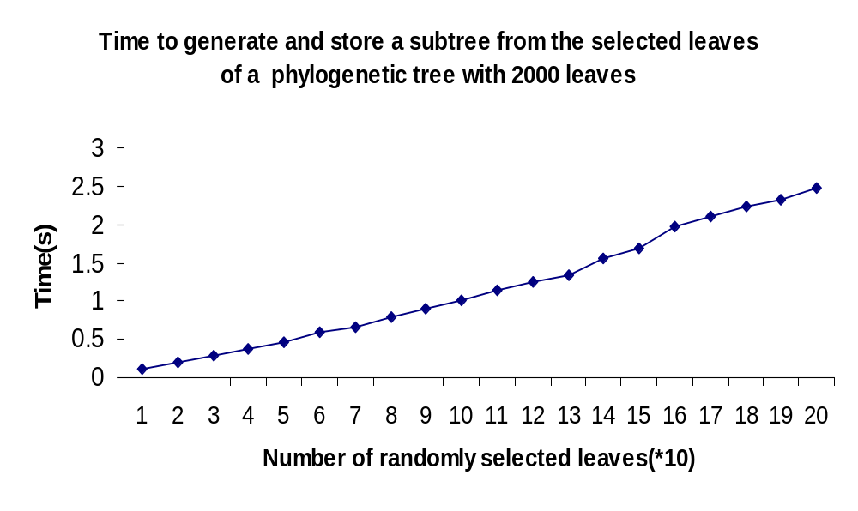
Projection: Running Time (2)

Slide 35
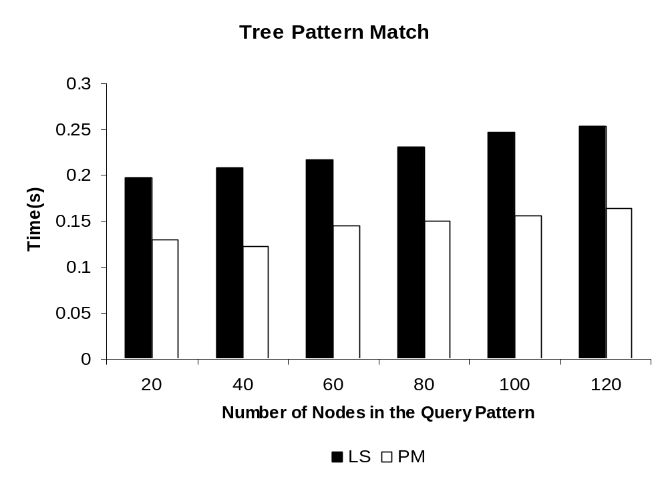
TPM: Running Time

Slide 36
Conclusion
Analyze several important structure queries on phylogenetic trees.
Propose a relational storage system based on the Dewey labeling scheme
Design and implement algorithm to evaluate structure queries efficiently
Demonstrate the efficiency of algorithm with various experiments

Slide 37
Thank you!
Any questions?

Slide 38
Outline
Structure Queries
Algorithms
Experiments

Slide 39
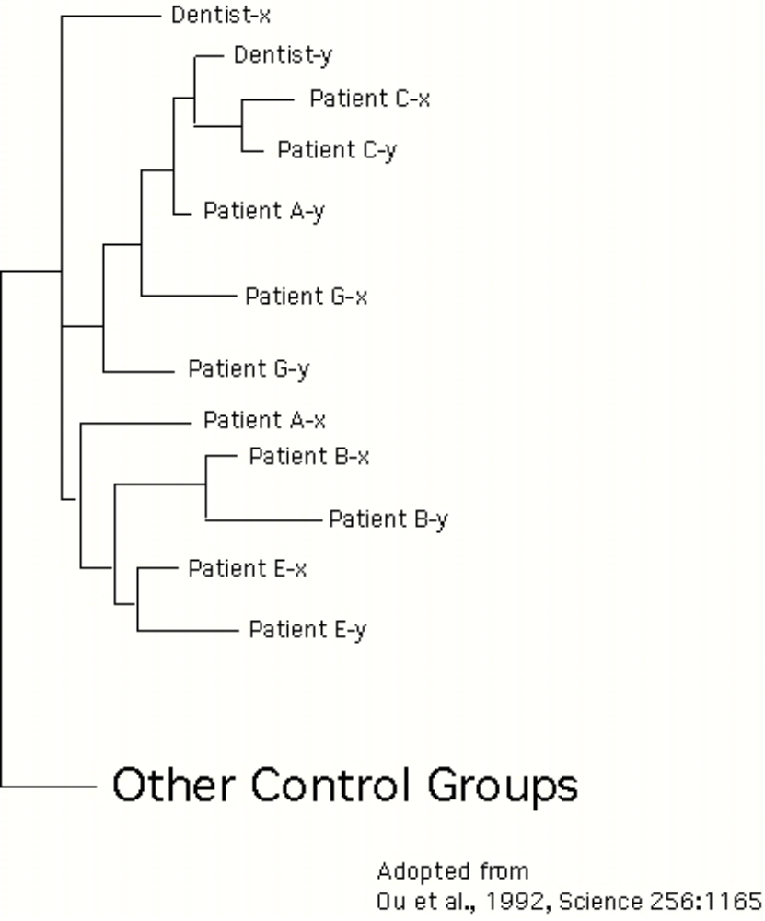
By estimating the phylogenetic tree of HIV virus, researchers found that a group of patients were infected by a single dentist.
Notes:
4

Slide 40
Tree Projection
LCA(u,v) != u
Parent(u) = null
v
0000
01011
u
Notes:
First let me give the definition of LCA problem.
LCA is to find the lowest common ancestor of any two node in a tree.
For example, in this tree, the LCA of nodes u and v is the blue node.

