Slide 1
  Co-Scheduling of Computation and Data on Computer Clusters
  Alex Romosan, Doron Rotem,
  Arie Shoshani and Derek Wright*
  Lawrence Berkeley National Laboratory
  *University of Wisconsin

Slide 2
Outline
Formulation of the problem
Architecture and information flow
Scheduling Algorithms
Experimental Results
Conclusions and future plans

Slide 3
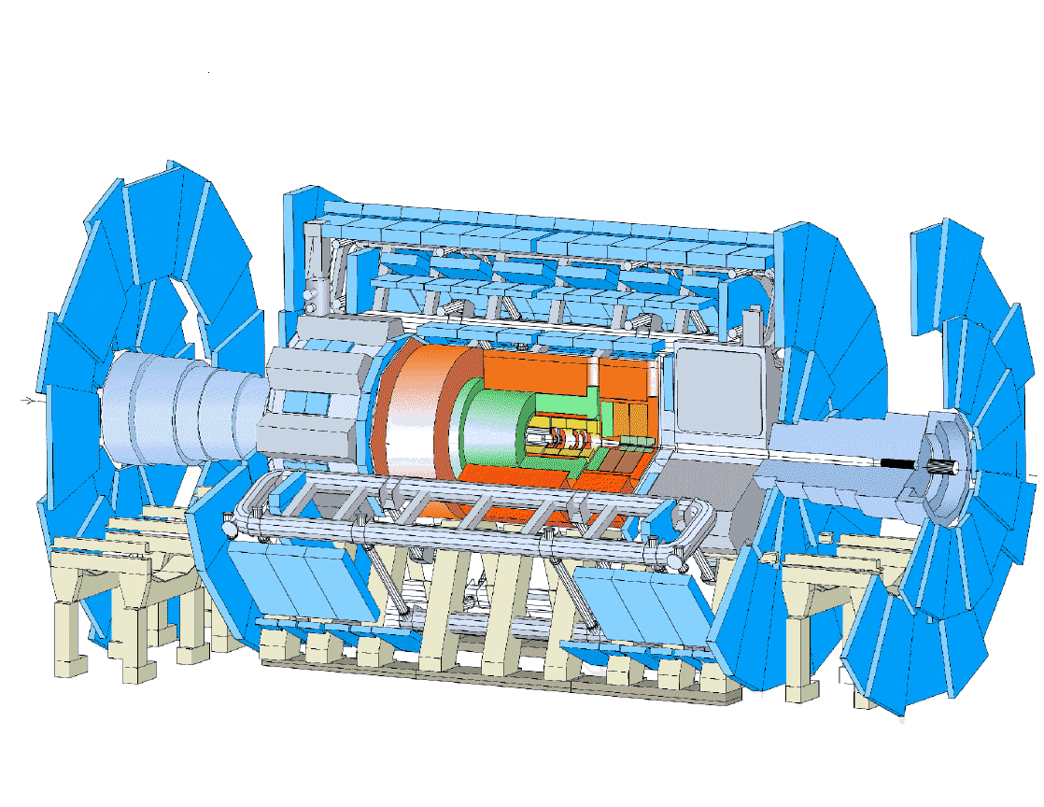

Motivation
Data Handling and Computation for Physics Analysis
detector
event filter
(selection &
reconstruction)
reconstruction
event
summary
data
processed
data
raw
data
event
reprocessing
batch
physics
analysis
analysis
analysis objects
(extracted by physics topic)
simulation
event
simulation
interactive
physics
analysis
les.robertson@cern.ch

Slide 4
Problem
Schedule a collection of jobs, each requiring one or more input files, to run on a group of servers, each server having one or more compute slots and a disk cache that can hold some fraction of the data
A job can be scheduled on a server if:
  the server has at least one available compute element
  all data files needed are available on the server's disk cache
Need to coordinate data movement with scheduling of computation

Slide 5
Goal
Automatically match each job to the machine that has the file needed for the job
  ability to schedule jobs and fetch files from tape
  need information on the content in each disk cache
Optimize parallel analysis on the cluster
  Minimize movement of files between cluster nodes
  Use node cluster as evenly as possible
  Automatic replication of hot files
  Automatic management of disk space
  Automatic removal of cold files
  (Automatic garbage collection)

Slide 6
Solution
Use existing software components:
  Condor for job scheduling
  Condor for matchmaking of slots and files
    open-ended description of what to match on (classAd)
  DRMs for disk management
    dynamic storage allocation
    ability to “pin” and “release” files
  HRMs for fetching files from tape
Develop “glue” component to achieve
co-scheduling

Slide 7
Condor
Matchmaking between jobs and resources
Class Ads
  Resource offers
  Resource requests
  Access policies
Notification of matches
Opportunistic scheduling
Checkpoint (save) job state
Restart job from checkpointed state
Condor Architecture
Startds (ownership of resources)
  implement owner's access control policy
Schedds (customers of the system)
  maintain persistent queue of resource requests
Manager
  collector: database of resources
  negotiator: matchmaker
  accountant: priority maintenance

Slide 8
Storage Resource Management (SRM)
Main concepts
  Allocate spaces
  Get/put files from/into spaces
  Pin files for a lifetime
  Release files and spaces
  Get files into spaces from remote sites
  SRMs communicate as peer-to-peer
Disk Resource Manager (DRM)
  Manages one or more disk resources
Tape Resource Manager (TRM)
  Manages access to a tertiary storage system (e.g. HPSS)
Hierarchical Resource Manager (HRM=TRM + DRM)
  An SRM that stages files from tertiary storage into its disk cache
DRM
TRM
+
Disk
Cache
HRM
MSS
Disk
Cache
MSS

Slide 9
Architecture
JDM – Job Decomposition
Module
HRM – Hierarchical
Resource Manager
JDM
schedd
Collector
FSM – File Scheduling
Module
FSM
DRM – Disk Resource
Manager
Negotiator
DRM
startd
DRM
startd
DRM
startd
DRM
startd
HRM
HPSS

Slide 10
Implementation
Small changes were required to accomplish the coordination between Condor and DRMs:
  We didn't modify Condor at all
    use native hook present in every startd to invoke script that generates the dynamic data to be inserted in the ClassAds (STARTD_CRON_JOBS)
    tune various configuration parameters for better response (system dependent: function of the average job length, number of cluster nodes, MSS response, etc.)
  Minor changes to DRM
    provide query interface so that the startd could get a list of the files in the cache
Develop the JDM and FSM

Slide 11
Scheduling coordination
Condor
Master Node
Job requests
JDM
schedd
1
7
Collector
FSM
Negotiator
ClassAd
file i
file j
.
.
.
file m
file 1
file 2
.
.
.
file n
requested
files
existing
files
6
5
2
3
startd
DRM
4
Worker Node

Slide 12
Detail actions (1)
JDM partitions jobs to tasks
  Job_{i}: [C_{i}, {F_{ij}}, O_{i} ] → {C_{i}, F_{ij}, O_{ij} }
JDM queues with Condor all tasks
JDM asks FSM to schedule all missing files
FSM probes all DRMs
  For files they have
  For missing files it can schedule requests to HRM
FSM checks with Condor periodically on status of tasks
  If a task is stuck it may choose to replicate the file
  (this is where smart algorithm can be used)
  File replication can be made from a neighbor node or from HRM

Slide 13
Detail actions (2)
  JDM constructs 2 files
    S(j) – set of tasks (jobs in Condor-speak)
    S(f) – set of files requested
    (Also keeps reference counts to files)
  JDM sends each startd the list of files it needs
  Startd checks with its DRM which of the needed files it has, and constructs a class-ad that lists all relevant files
  When startd runs a task, it requests DRM to pin file, run task, and release file

Slide 14
Experimental setup
8 single and 1 dual CPU 1.5GHz Athlons
  20GB disk cache and 2GB of RAM per node
Data from BaBar, a HEP experiment at SLAC
  over 1.3 petabytes stored in HPSS
  analysis jobs run on a cluster of hundreds of nodes
  persistent data accessed through a high performance data server
Trace logs taken from October 1-26, 2004
  504,493 submitted jobs
  2,028,541 requested files
  86,378 unique files

Slide 15
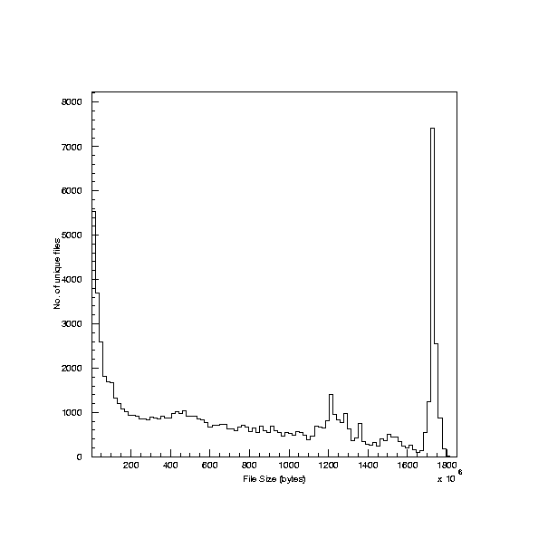
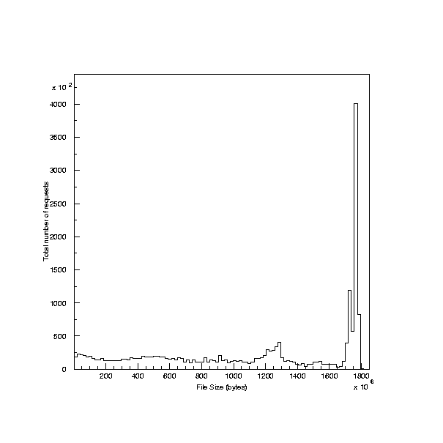
Workload characteristics
Size distribution for all files
Size distribution for requested files

Slide 16
Replication
Main scheduling decisions are made by FSM:
  if file already on cache, let CONDOR match it
  otherwise, request it on some DRM
  if jobs stuck in queue replicate file
Criteria for replication:
  Minimize total number of transfers from tape
  Maximize total utilization of cluster
  Minimize aggregate time jobs wait in queue
  etc.

Slide 17
Scheduling Algorithms
No-replication (minimize file transfers from MSS)
  at most one copy of a file on the cluster
  nodes selected in a round-robin fashion
  if file is purged from cache, re-fetch
With replication (reduce queue waiting times)
  select file according to weight function w(f_{i}) = ∑ T(j_{k})
    replicate file with maximal w(f_{i}) on free node
  most popular file (no. of jobs requesting it)
    replicate on the node with the lowest total popularity

Slide 18
Performance results
1500 jobs from the pool of jobs available
Simulate job by running 100 empty for-loops per byte requested
Jobs submitted at 60 second intervals
  match job arrival rate to job service rate
Each experiment took about 27 hours
Tune Condor configuration parameters
  lower resource matching negotiation cycle from 300 to 60

Slide 19
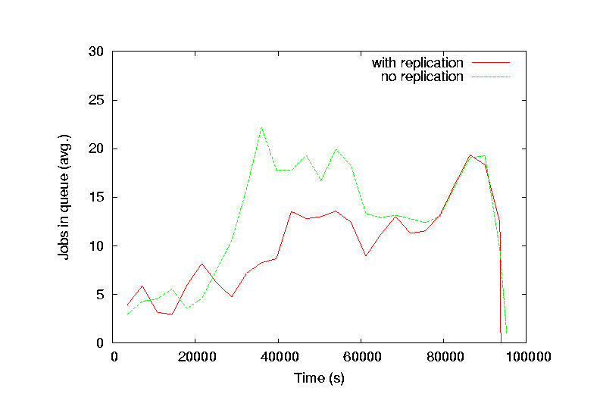
Average number of queued jobs

Slide 20
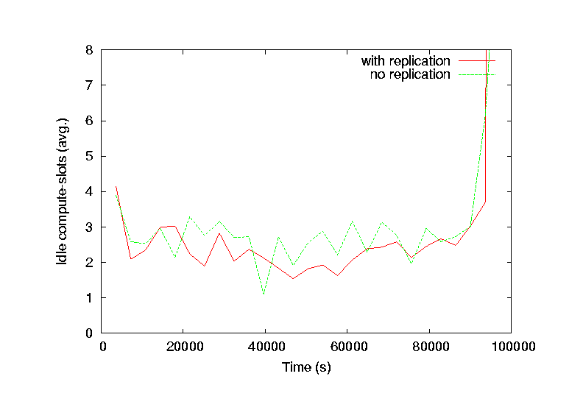
Average number of idle compute-slots

Slide 21
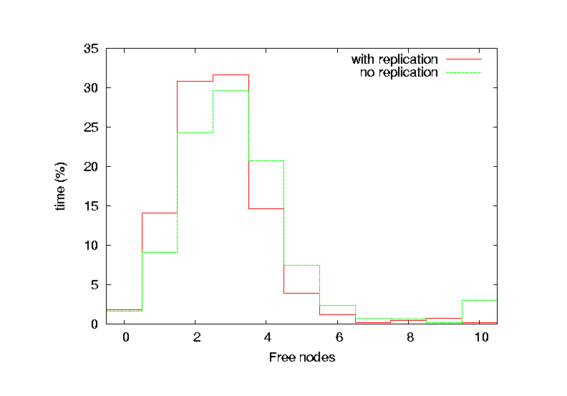
Number of free nodes

Slide 22
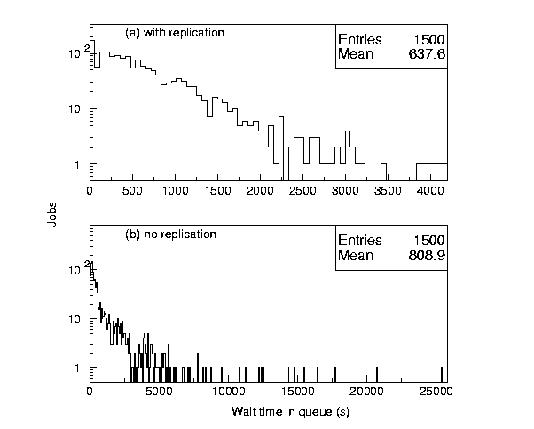
Wait time in queue

Slide 23
Questions (1)
What if a file was accidentally removed? Does DRM check its files?
  No. But in this case, if DRM does not find the file on its disk, then the task gets rescheduled
  Suggestion: DRMs should probably check the existence of files it thinks it has
How do you deal with output and merging of outputs?
  Need DRMs to be able to schedule durable space
  Moving files out of the compute node is the responsibility of the user (code)
  Maybe moving files to their final destination should be a service of this system

Slide 24
Questions (2)
Is it best to process as many files on a single system?
  e.g. one system has 4 files, but also the files are on 4 different systems. Which is better.
  Conjecture: if the overhead for splitting job is small, then splitting is optimized by matchmaking
What if I need file bundles?
  There are 2 kinds of job specification:
    The bundle files are specified
    At least some number of files are needed for the analysis to make sense
    This second type is important, an interesting optimization problem

Slide 25
Conclusions and future work
Ability to put together a co-scheduling system from existing Grid middleware components
  scheduling, executing, file movement and garbage collection performed by Condor and DRMs
  file replication is done by the FSM
The problem of optimizing the behaviour of the system is the task of the File Scheduler Module
  will study further file replication algorithms
  experiment with Condor's parameters settings to mitigate effects of unpredictable behaviour of network loads
Implement and test the co-scheduling system on Grid testbeds

