Slide 1


Optimizing In-Order Execution of Continuous Queries over Streamed
Sensor Data
Moustafa A. Hammad | Walid G. Aref & Ahmed K. Elmagarmid
University of Calgary Calgary, AB, Canada | Purdue University West Lafayette, IN., USA
Presented by: Moustafa A. Hammad

Slide 2
Introduction
Increasing number of applications currently deploy smart wireless sensor networks
Examples:
  Lightning sensor technology is widely used for forest-fire detection and prevention
  Forestry industry uses small number of optical sensors to identify wood species
  In the wildlife preservation and monitoring applications: tracking endangered species (grizzlies) for protection and for preventing fatal incidents (caused by problem grizzlies)
  Wireless sensor networks
    extensively investigated in logistics, supply chain, and architectural monitoring applications
  The potential market of wireless sensor applications is unlimited and
    will top 7 billion US$ by 2010 [ON World Inc.]

Slide 3

Introduction (Cont’d)
Various stream and sensor applications need:
  complex data management services
  near real-time query response
  access to infinite data sources (endless supply of data)
  continuous execution of persistent queries (e.g., monitoring queries)
Department Store S
Department Store T
Current streaming research & technology adopt sliding window for monitoring queries
RFID Tags
RFID Tags
  Monitor the count of items commonly sold by the department store S and the department store T in the last 10 minutes
Monitoring Query Engine

Slide 4
Outline
Motivating example and problem description
The proposed algorithms
  The Sync-Filter algorithm
  The Filter-Order algorithm
  The Adaptive algorithm
Performance study
Conclusion

Slide 5
Motivating example
Data items are time stamped at the sources
TimeStamp (<a_{k}>) =k
TimeStamp (<a_{i},a_{j}>) = max (i,j)
SELECT COUNT(DISTINCT S.ItemType)
FROM SensorReadings1 S,
SensorReadings2 T
WHERE S.ItemType = T.ItemType
WINDOW 10 minutes
w=6
d
2
c
4
b
6
a
8
S
Time
a
f
a
c
b
c
10
T
1
3
5
7
9
Time
<a ,
a >
8
5
<b ,
b >
^{Ordered}
6
9
<c ,
c >
COUNT
4
10
ª₈ ^{is delayed 3 time ticks}
DISTINCT
Delay
d
2
c
4
b
6
a
8
S
Time
a
1
f
3
a
5
c
7
b
9
c
10
T
Time
W
<a ,
a >
<b ,
b >
8
5
S
T
^{Unordered}
6
9
<c ,
c >
4
10

Slide 6
Why is ordered execution significant?
Application-side: Important applications over data streams require processing the input of their queries in-order
  e.g., Feedback control, periodicity detection, and trend prediction (patterns of continuous increase or decrease) in data streams
System-side: To maintain sliding window states of pipelined operators
  E.g., expiring an old tuple from a stored window of tuples in a sliding-window COUNT operation depends on receiving an ordered arrival of the input tuples. Otherwise, we may expire an old tuple early (i.e., potentially report an erroneous sequence of count values)

Slide 7
Outline
Motivating example and problem description
The proposed algorithms
  The Sync-Filter algorithm
  The Filter-Order algorithm
  The Adaptive algorithm
Performance study
Conclusion

Slide 8
The Sync-Filter algorithm
Processes tuple a_{i} from Stream S iff tuple a_{j} arrived in stream T and i ≤ j
Delay
d
2
c
4
b
6
a
a
12
S
8
Time
<a ,
a >
<b ,
b >
<c ,
c >
8
5
6
9
4
10
a
1
f
3
a
5
c
7
b
9
c
10
T
Time
^{Time}
Simple to implement
Guarantees ordered output
No need to check the window condition
Buffer tuples at the input
Window join blocks for inputs from both streams

Slide 9
The Filter-Order algorithm
Overlaps processing with waiting time
Delay
d
2
c
4
b
6
a
a
12
S
8
Time
<a ,
a >
<a ,
a >
<b ,
b >
<c ,
c >
8
5
8
5
6
9
4
10
a
f
a
c
b
9
c
10
<b ,
b >
T
1
3
5
7
6
9
Time
<c ,
c >
^{Time}
4
10
^{Min-heap}
Low response time (due to overlapped process time and wait time)
No blocking (process input tuples and buffer the result)
Buffers tuples at the output (+ if low join selectivity, - otherwise)
Maintains a Min-heap

Slide 10
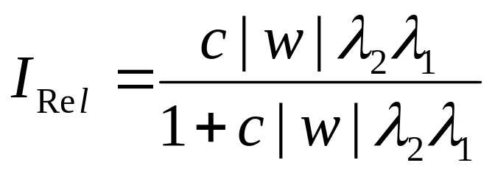
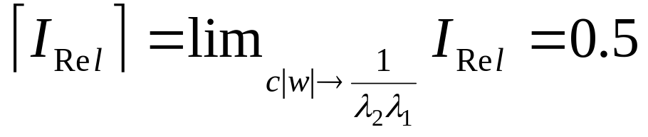
Relative improvement of Filter-Order over Sync-Filter
c | Time to process an input tuple by the window join
|w| | Window size (time units)
λ₁ | Average arrival rate at Stream S (tuples/second)
λ₂ | Average arrival rate at Stream T (tuples/second)
I_{Rel} | Relative improvement of Filter-Order over Sync-Filter in terms of average response time
[Details in the TR @ www.cpsc.ucalgary.ca/~hammad]

Slide 11
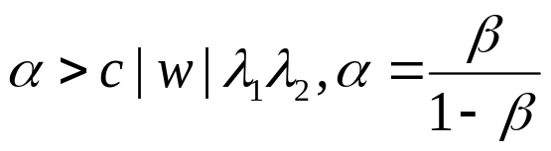
The Adaptive algorithm
Alternates between Sync-Filter and Filter-Order
  to achieve a targeted improvement, β, and
  based on variations in the input arrival rates
Steps
  Start with Sync-Filter
  Monitor λ₁λ₂
  If ( )
    Use Filter-Order
  Else
    Use Sync-Filter

Slide 12
Outline
Motivating example and problem description
The proposed algorithms
  The Sync-Filter algorithm
  The Filter-Order algorithm
  The Adaptive algorithm
Performance study
Conclusion

Slide 13
Performance study
Based on real implementation of the algorithms on Nile (a prototype stream data management system www.cs.purdue.edu/Nile)
Using synthetic data streams
Performance metric (average output response time)
Experimental settings
  Vary the number of concurrent queries
  Change the input rate (λ₁λ₂)
  α = 0.3 (i.e., switch to Filter-Order if the performance will improve by 0.3/(1+0.3) = 0.25)

Slide 14
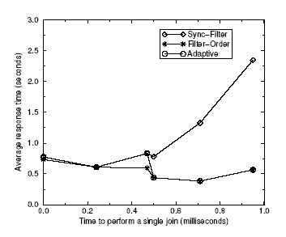
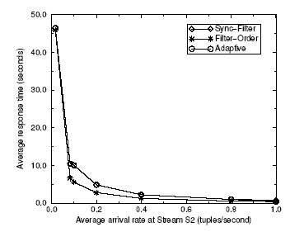
Results
Increase the level of multi-programming
Vary the arrival rate of one of the
input streams

Slide 15
Conclusion and future work
Conclusion
  Ordered execution is important in typical streaming applications
  Straightforward techniques such as Sync-Filter can block window operators and increase the response time
  We introduced the Filter-Order and Adaptive algorithms as better alternatives to the Sync-Filter algorithms
  We provided both analytical and experimental evaluations of the proposed algorithms
Future work
  Studying deep trees of binary joins
  Effect on other stateful operators (e.g., Distinct operator)

