Slide 1

Clustering Moving Objects via
Medoid Clusterings
Hans-Peter Kriegel, Martin Pfeifle
Ludwig-Maximilians-University Munich
Institute for Computer Science
SSDBM 2005, Santa Barbara (CA), USA
27. - 29. June, 2005

Slide 2
Outline
Introduction
Clustering Moving Objects with Uncertain Positions
Similarity Measures between Clusterings
Experimental Evaluation
Conclusions

Slide 3
Outline
Introduction
  Clustering · Clustering Moving Objects ·
  Uncertain Positions of Moving Objects
Clustering Moving Objects with Uncertain Positions
Similarity Measures between Clusterings
Experimental Evaluation
Conclusions

Slide 4
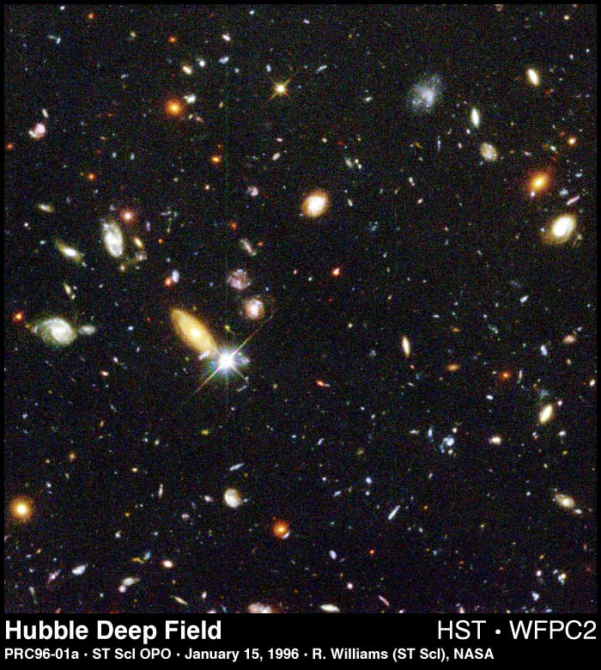

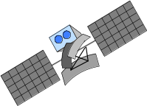
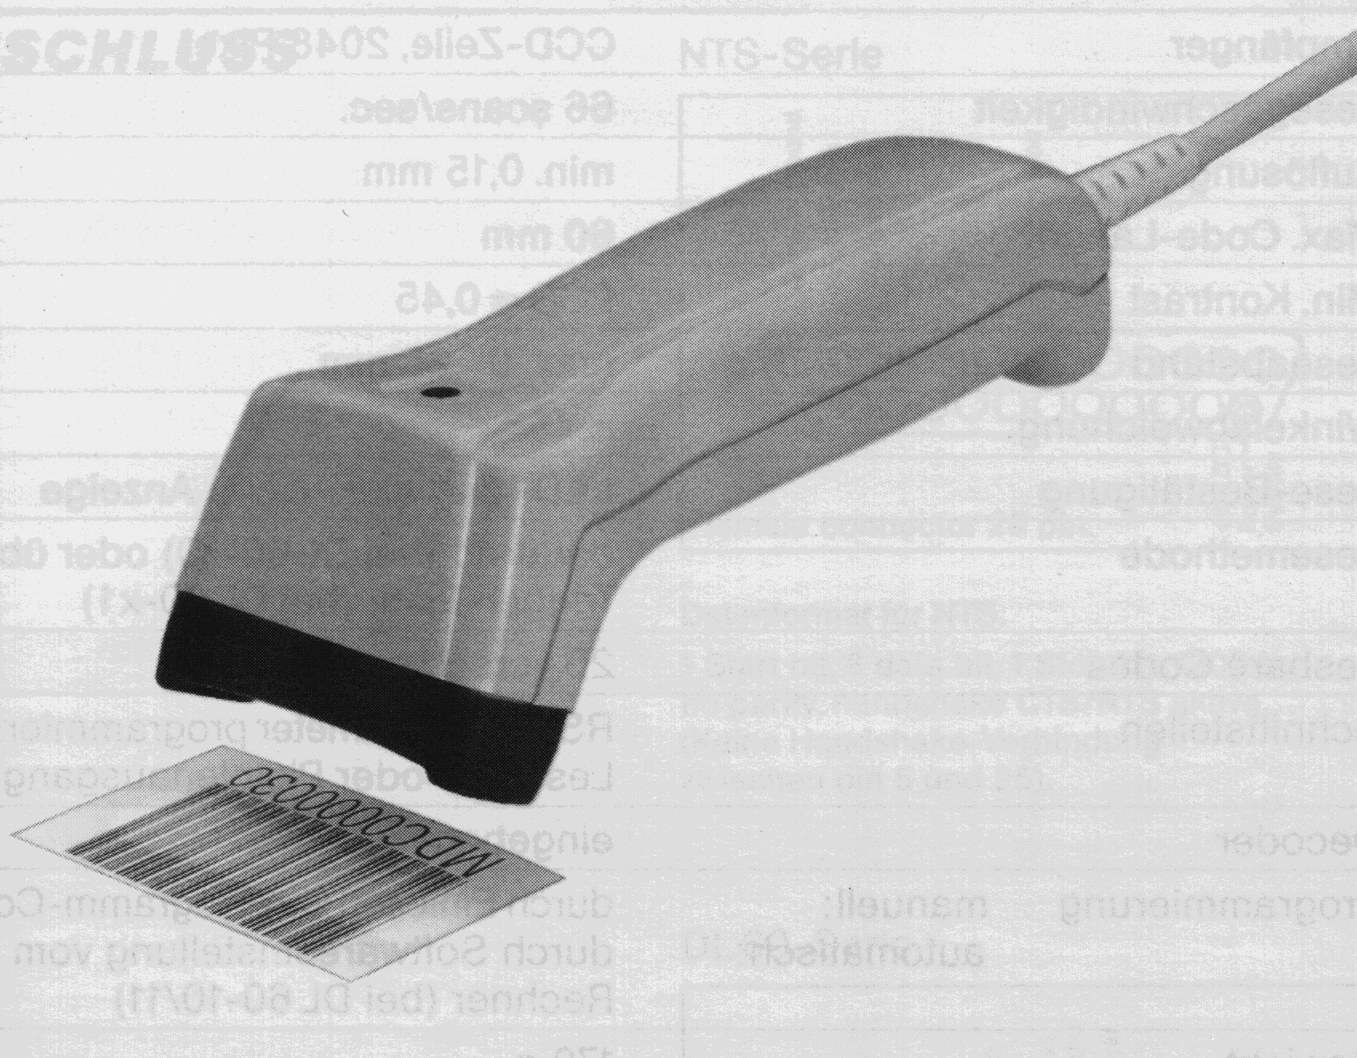
Data Mining
Larger and larger amounts of data collected automatically
Too large for humans to analyze manually
Tools to assist analysis necessary ⇒ KDD / Data Mining
Hubble Space Telescope
Telecommunication Data
Market-Basket Data

Slide 5
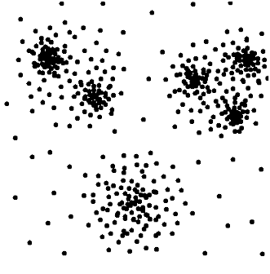
Clustering
Clustering
  Efficiently grouping the database into sub-groups (clusters) such that
    similarity within clusters maximized
    similarity between clusters minimized
  Flat Clustering
  one level of clusters
  Hierarchical Clustering
  nested clusters
  DBSCAN
  k-means
  OPTICS
  Single-Link

Slide 6
Clustering Moving Objects
Similarity between objects is equal to the distance between the objects
Application areas:
  jam detection
  animal migration
  ....
Related Work (selected papers):
  KDD 2004
  Clustering Moving Objects
  Li Y., Han J., Yang J.
  SIGMOD 2004
  Clustering Moving Objects on a Spatial Network
  Yiu M.L., Mamoulis N.
  ICDM 2002
  Clustering Spatial Data when Facing Physical Constraints
  Zaine O., Lee C.-H.
similarity = distance

Slide 7
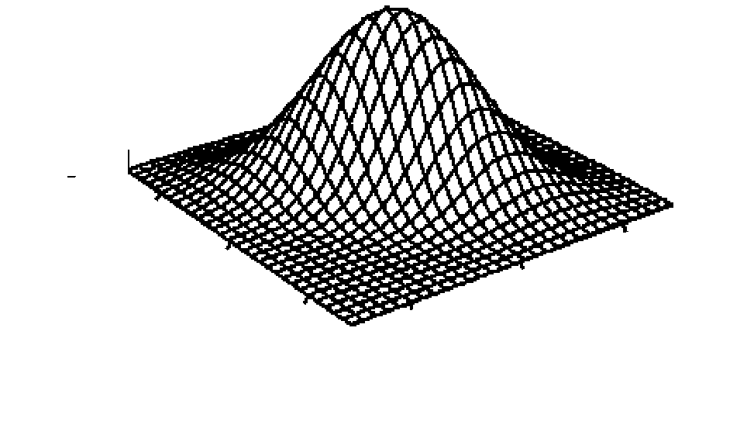
Query Processing on Uncertain Data
Uncertain Positions of Moving Objects
  outdated positional information
  inaccuracy of the GPS system
Related Work (selected papers)
  SSD 1999
  Capturing the Uncertainty of Moving-Object Representations
  Pfoser D., Jensen C.S.
  IEEE TKDE 2004
  Query Imprecise Data in Moving Object Environments
  Cheng R., Kalashnikov V., Prabhakar S.
  Distributed and Parallel Databases 1999
  Updating and Querying Databases that Track Mobile Units
  Wolfson O., Sistla A. P., Champerlain S., Yesha Y.
o (x, y)
y
possible exact
position of o
x

Slide 8
Outline
Introduction
Clustering Moving Objects with Uncertain Positions
  Single Sampling Approach
  Distance Expectation Value Approach
  Medoid Clustering Approach
Similarity Measures between Clusterings
Experimental Evaluation
Conclusions
x

Slide 9
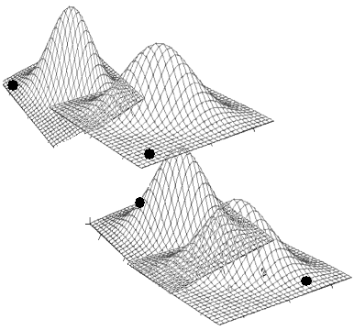
Single Sampling Approach
For each uncertain object, we choose an arbitrary position and carry out the clustering based on these sample positions.
o₁ (x, y)
o₂ (x, y)
Based on this sampling,
o₂ and o₃ are grouped together,
and o₁ and o₄ are assigned to noise.
o₃ (x, y)
o₄ (x, y)

Slide 10
Distance Expectation Approach
Distance between two objects is equal to the average value of all possible distances.
o₂ (x, y)
o₁ (x, y)
distance expectation value
E_{d}(o₂,o₁)
probability
probability density function
dist

Slide 11
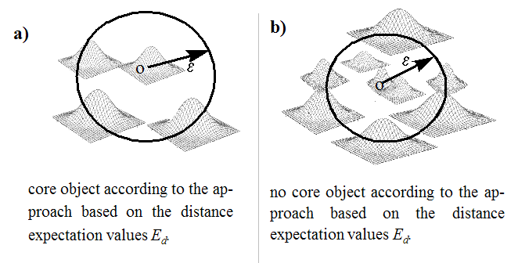
Limitations of the
Distance Expectation Approach
MinPts = 4

Slide 12
Medoid Clustering Approach I
Repeat single sampling clustering approach s times.
Compute the most average of these clusterings.
o₁
Cl₁= {{o₂,o₃}}
o₂
Cl₂= {{o₁,o₂}, {o₃,o₄}}
Cl₃= {{o₁,o₂}, {o₃,o₄}}
Cl₄= {}
o₄
o₃
most average clustering
Cl_{m}= Cl₂ = Cl₃

Slide 13
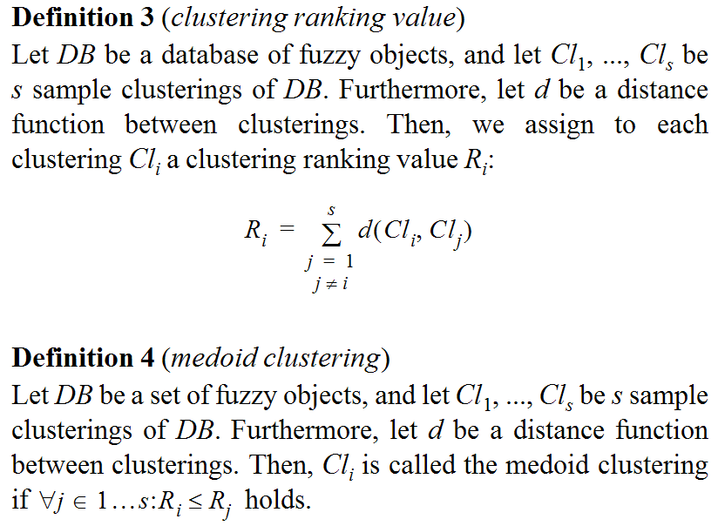
Medoid Clustering Approach II

Slide 14
Outline
Introduction
Clustering Moving Objects with Uncertain Positions
Similarity Measures between Clusterings
  Distance measure between clusters
  Distance measure between partitioning clusterings
  Distance measure between hierarchical clusterings
Experimental Evaluation
Conclusions

Slide 15
Representations of Clusterings
  Partitioning Clusterings
  one level of clusters
  Hierarchical Clusterings
  nested clusters
clustering = set of clusters
distance measure between sets
based on a
distance measure between clusters
clustering = tree of cluster
distance measure between trees
based on a
distance measure between clusters

Slide 16
Similarity between Clusters
Symmetric Set Difference:
Let C and C‘ be two clusters of a database DB.
symmetric set difference d_{Δ}: 2^{DB ×} 2^{DB} → [0..|DB|]
normalized symmetric set difference d_{Δ}^{norm}: 2^{DB ×} 2^{DB} → [0..1]
( )
d
Δ
C
,
C‘
=
C
∪
C‘
–
C
∩
C‘
C
∪
C‘
–
C
∩
C‘
norm
d
( )
Δ
C
,
C‘
=
C
C‘
∪
example
Cluster C
Cluster C‘
( )
d
Δ
C
,
C‘
= 4
norm
d
( )
Δ
C
,
C‘
= 4 / 7

Slide 17

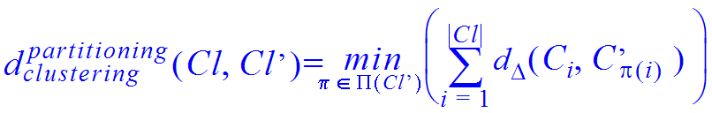
Similarity between Partitioning Clusterings
Partitioning Clustering Distance:
Let Cl and Cl‘ be two partitioning clusterings having the same number of clusters.
partitioning clustering distance : 2^{2DB} × 2^{2DB} → [0..2.|DB|]
example
Clustering Cl
Clustering Cl‘
d_{clustering} (Cl,Cl‘) = 5
C₁
3
C₂
2
partitioning
3
C‘₁
4
C‘₂

Slide 18

Quality measure Q_{APC} for
Approximative Partitioning Clusterings
Quality measure Q_{APC}:
Let Cl and Cl‘ be two partitioning clusterings having the same number of clusters
and ∅ an empty clustering consisting of | Cl | empty clusters.
Approximative Clustering Quality Q_{APC}: 2^{2DB} × 2^{2DB} → [0..1]
example
Clustering Cl
Clustering Cl‘
d_{clustering} (Cl,Cl‘) = 5
Q_{APC}(Cl,Cl‘) = 6/11
C₁
partitioning
C₂
2
3
C‘₁
C‘₂

Slide 19

Similarity between Hierarchical Clusterings
  Distance measure d_{clustering} between hierarchical clusterings
    Distance between nodes (clusters) based on the normalized symmetric set difference d_{Δ}^{norm}
    Distance between tree-structure based on the
    Degree-2 Edit Distanz d_{edit}
hierarchical
  Quality measure Q_{AHC}

Slide 20
Outline
Introduction
Clustering Moving Objects with Uncertain Positions
Similarity Measures between Clusterings
Experimental Evaluation
Conclusions

Slide 21
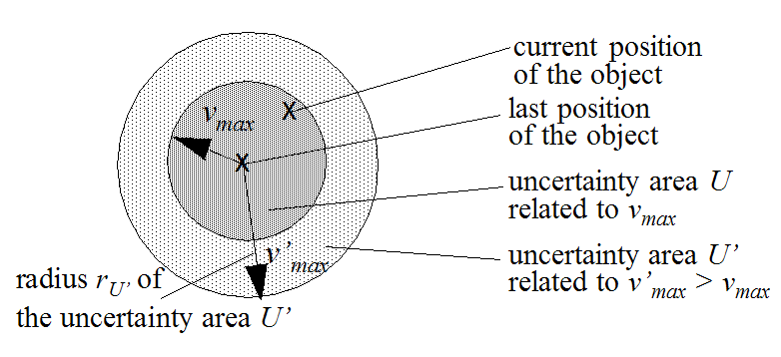
Test Data Set
cardinality of data set: 1,000 (effectivity) and 10,000 (efficiency)
clustering algorithms: DBSCAN, k-means, OPTICS, Single-Link
sample rate s=10

Slide 22
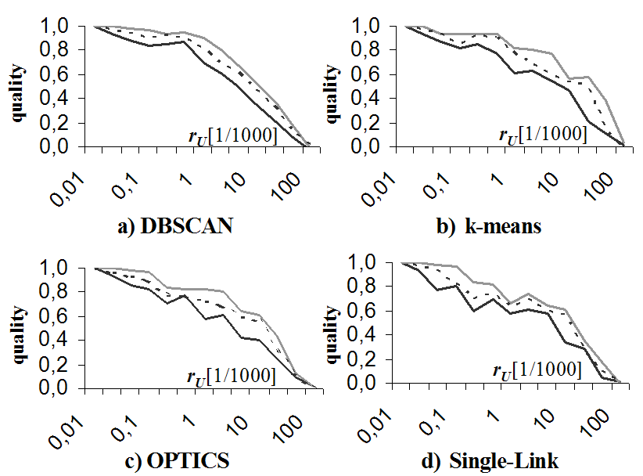
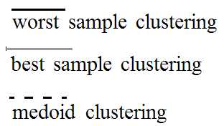
Sample Clusterings I all clustering approaches
Quality decreases for increasing uncertainty areas
Noteworthy quality difference between the best and the worst sample clustering
The quality of the medoid clustering is in between the qualities
of the best and worst sample clusterings, and very often close to the best one.

Slide 23
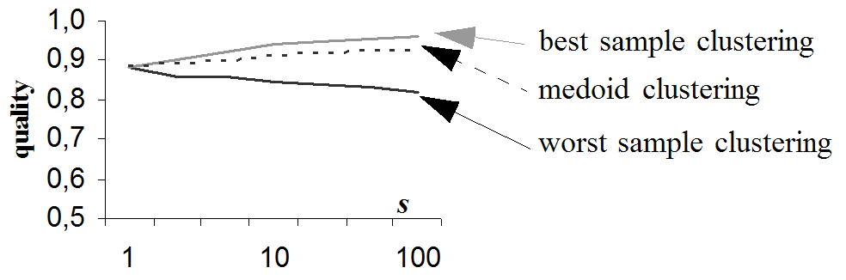
Sample Clusterings II
DBSCAN
Quality of the best sample clustering increases with an increasing sample rate
Quality of the worst sample clustering decreases with an increasing sample rate
The quality of the medoid clustering is in between the qualities
of the best and worst sample clusterings, and very often close to the best one.

Slide 24
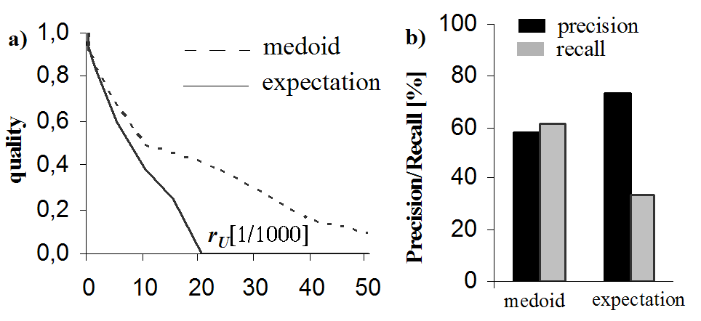
Distance Expectation Value
DBSCAN
quality
core-object classification
For large uncertainty areas, the quality of the medoid approach is much better
than the quality of the distance expectation approach.
For large uncertainty areas, the distance expectation approach often fails
to detect core-objects.

Slide 25
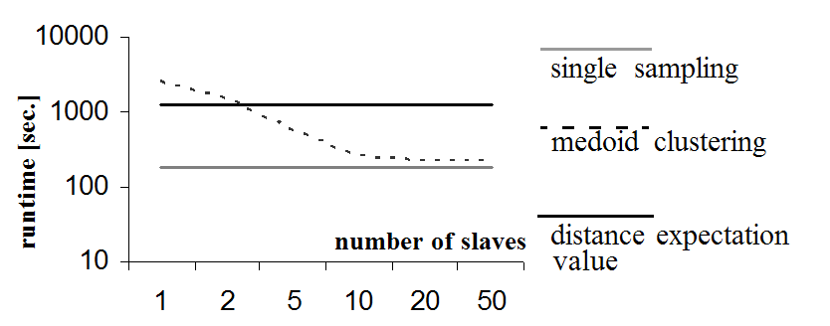
Efficiency
DBSCAN
Medoid approach can beneficially be parallelized.
If s slaves are available, the medoid approach is almost as efficient as
the single sampling approach.

Slide 26
Outline
Introduction
Clustering Moving Objects with Uncertain Positions
Similarity Measures between Clusterings
Experimental Evaluation
Conclusions

Slide 27
Conclusions and Future Work
  Conclusions
    Presentation of different approaches
    for clustering uncertain data.
    Introduction of the generally applicable concept of
    medoid clusterings
    Distance measure between partitioning clusterings
    Distance measure between hierarchical clusterings
  Future Work
    Developing specific algorithms for clustering uncertain data,
    e.g. partitioning clustering algorithms or density-based algorithms.

Slide 28
?
?
?
Questions?
?
?
?
?

