Slide 1
Optimizing Multiple
Topk-Queries over Joins
Computer Science Faculty,System Architecture, Database Technology Group
Dirk Habich, Wolfgang Lehner
Dresden University of Technology, Germany
Database Technology Group
Alexander Hinneburg
Martin-Luther University of Halle, Germany
Database and Data Mining Group

Slide 2
Outline
Introduction
1
SQL-Extension
2
Algorithms
3
Evaluation
4
Conclusion

Slide 3
Introduction
Top-k Query
  applying one ordering function f()
  only top-k objects interesting
  SELECT id, f()
  FROM …
  WHERE …
  ORDER BY f()
  FETCH FIRST k ROWS ONLY
Multiple Top-k Query
  applying various ordering functions on same data
  only top-k1 and top-k2 objects interesting
  SELECT x.id, x.pos1, x.pos2
  FROM (
  SELECT id,
  RANK() OVER (ORDER BY f1()) AS pos1,
  RANK() OVER (ORDER BY f2()) AS pos2
  FROM …
  WHERE … ) x
  WHERE x.pos1 ≤ :k1 OR x.pos2 ≤ :k2

Slide 4
Where do we need multiple top-k queries?
Example 1: Information Retrieval
  retrieving similar objects to a given query object
  computing user-specific result using user-feedback
  Kim and Chung [SIGMOD 2003] developed an approach based on multiple query points Q={Q₁,…, Q_{n}}
  k nearest neighbor for each Q_{i} using e.g. euclidean metrics
  SELECT x.id, x.pos1, x.pos2
  FROM (
  SELECT id,
  RANK() OVER (ORDER BY dist(p,Q₁)) AS pos1,
  RANK() OVER (ORDER BY dist(p,Q₂)) AS pos2
  FROM R) x
  WHERE x.pos1 ≤ :k1 OR x.pos2 ≤ :k2

Slide 5
Example 2 (Warehouse Environment)
ObjectID | fact1 | …
1 | 500
2 | 300
3 | 100
ObjectID | weight1 | weight2 | …
1 | 0.2 | 0.6
2 | 0.1 | 0.15
3 | 0.7 | 0.25
(a) fact table
(b) weighting table
f1 = fact1 * weight1 (top 2)
f2 = fact1 * weight2 (top 2)
ObjectID | fact1*weight1 | Rank fact1 * weight1 | fact1*weight2 | Rank fact1* weight2
1 | 100 | 1 | 300 | 1
2 | 30 | 3 | 45 | 2
3 | 70 | 2 | 25 | 3
ObjectID | fact1*weight1 | Rank fact1 * weight1 | fact1*weight2 | Rank fact1* weight2
1 | 100 | 1 | 300 | 1
2 | NULL | NULL | 45 | 2
3 | 70 | 2 | NULL | NULL
(c) result

Slide 6
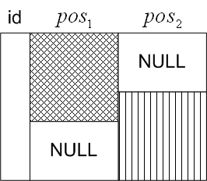
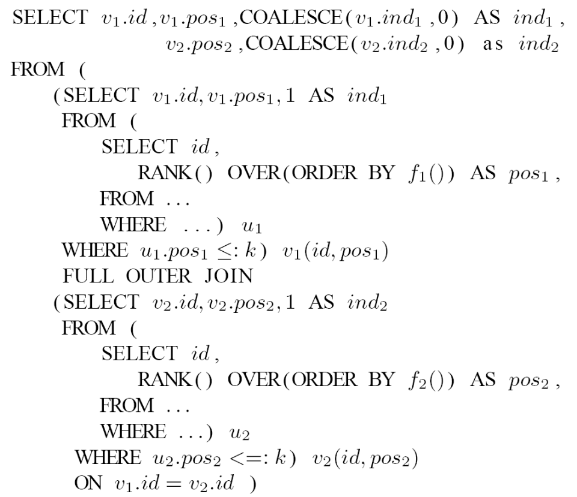
Multiple Top-k Queries (1)
vertical representation using full outer joins
  useful for correlated ranking functions
first top-k expression
concatenation
second top-k expression

Slide 7
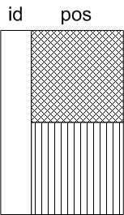
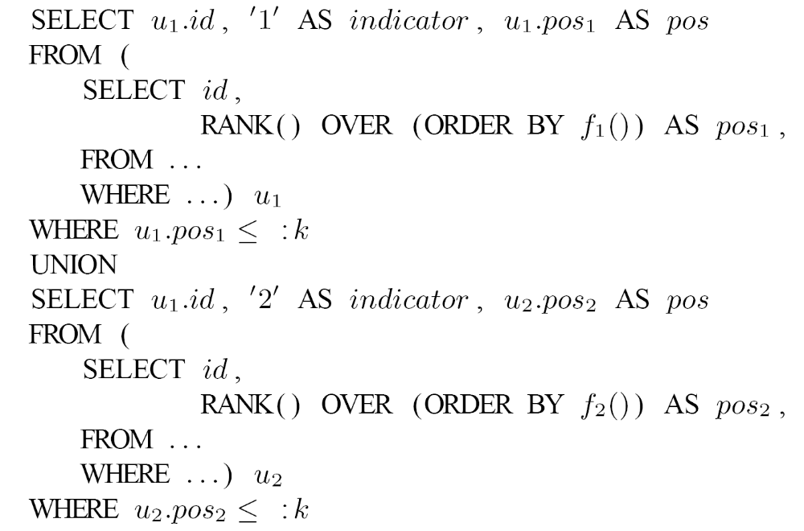
Multiple Top-k Queries (2)
horizontal representation using union operators
  useful for disjunctive rank functions
first top-k expression
concatenation
second top-k expression

Slide 8
Introduction (2)
Problems
  query structures are inadequate
  individual sub queries are computed separately
    using a full ordering of the data
  combining in a subsequent
    full outer join or union
Assumptions
  we consider ranking functions described by
f( g1(R.A1,R.A2,…) Θ g2(S.B1, S.B2,…) )
  f is monotonic in its two input parameters
  g1() and g2() might be any functions taking inputs from tables R and S

Slide 9
Outline
Introduction
1
SQL-Extension
2
Algorithms
3
Evaluation
4
Conclusion

Slide 10
The ORDERING SETS() - Operator
The ORDERING SETS()-Operator
  motivated by GROUPING SETS()-Operator
  same data sorted according to multiple ordering criteria
  SELECT id, f1(), f2()
  FROM …
  WHERE …
  ORDER BY ORDERING SETS (
  (f1()),(f2()) )
Additionally, LIMIT BY – Construct
  SELECT id, f1(), f2()
  FROM …
  WHERE …
  ORDER BY ORDERING SETS (
  (f1() LIMIT BY :k1),(f2() LIMIT BY :k2) )
id | f1() | f2()
1 | 4 | 11
2 | 3 | 22
3 | 2 | 33
3 | 2 | 33
2 | 3 | 22
1 | 4 | 11
f1()
f2()

Slide 11
The ORDERING SETS()-Operator()
ORDERING()-function
  according to GROUPING()-function
  indicates to which ordering set a tuple belongs
  SELECT id, f1(), f2(), ORDERING(f1()), ORDERING(f2())
  FROM …
  WHERE …
  ORDER BY ORDERING SETS (
  (f1() LIMIT BY 2),(f2() LIMIT BY 2) )
id | f1() | f2() | ORDERING(f1()) | ORDERING(f2())
1 | 4 | 11 | 1 | 0
2 | 3 | 22 | 1 | 0
3 | 2 | 33 | 0 | 1
2 | 3 | 22 | 0 | 1

Slide 12
LIMIT BY OVER-Clause Extension
current SQL query
SELECT x.id, x.pos1, x.pos2
FROM (
SELECT id,
RANK() OVER (ORDER BY f1()) AS pos1,
RANK() OVER (ORDER BY f2()) AS pos2
FROM …
WHERE … ) x
WHERE x.pos1 ≤ :k1 OR x.pos2 ≤ :k2
limitation of the output data is now close to the RANK() function
avoiding nested queries
SELECT id,
RANK() OVER (ORDER BY f1() LIMIT BY k1) AS pos1,
RANK() OVER (ORDER BY f2() LIMIT BY k2) AS pos2,
LIMIT() OVER (ORDER BY f1() LIMIT BY k1) AS indicator1,
LIMIT() OVER (ORDER BY f2() LIMIT BY k2) AS indicator2
FROM …
WHERE …

Slide 13
Outline
Introduction
1
SQL-Extension
2
Algorithms
3
Evaluation
4
Conclusion

Slide 14
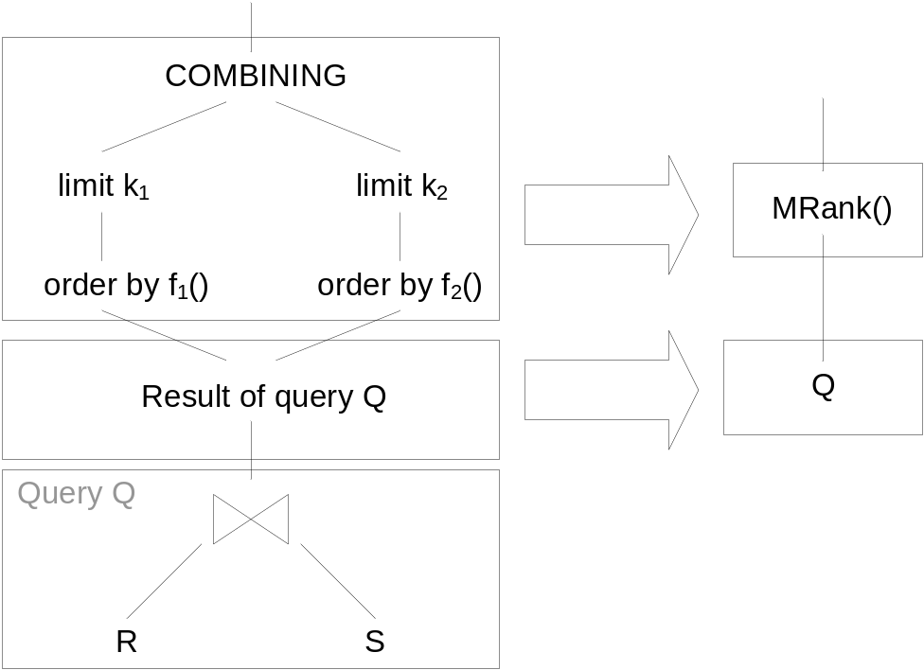
MRank Implementation
Simple implementation
  fully compute join
  multiple ordering functions
  F = {f1, …, fn}
MRank Algorithms
  main memory approach
Q
f1()
f2()
H1
H2
extended versions are also developed (e.g partition-based algorithms)
→ COMBI-Operator (Lehner et al. [VLDB 2003])
main memory

Slide 15
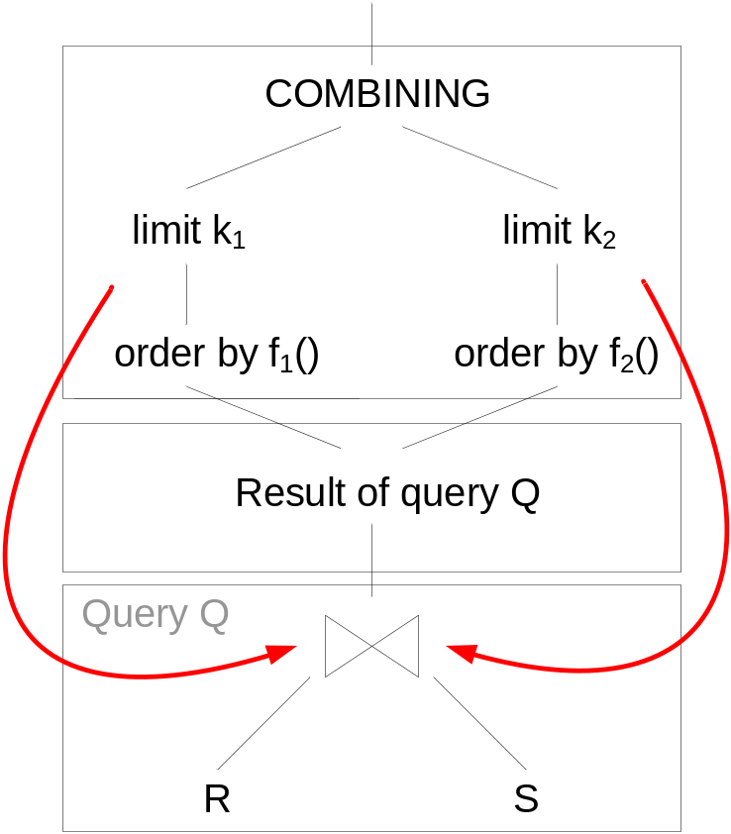
Optimizing Join Computation
Goal
  Algorithms, which do not
  perform the full join
Ilyas et al. [VLDB 2004] proposed
the RankJoin
  considered only single top-k
  queries
  Sort-Merge Join approach
  not applicable for multiple
  top-k
Hash-based approach
  f_{i}( g_{1,i}(R) Θ g_{2,i}(S) )
  g_{1,i}(R), g_{2,i}(S) → local scores
  f must be monotonic

Slide 16
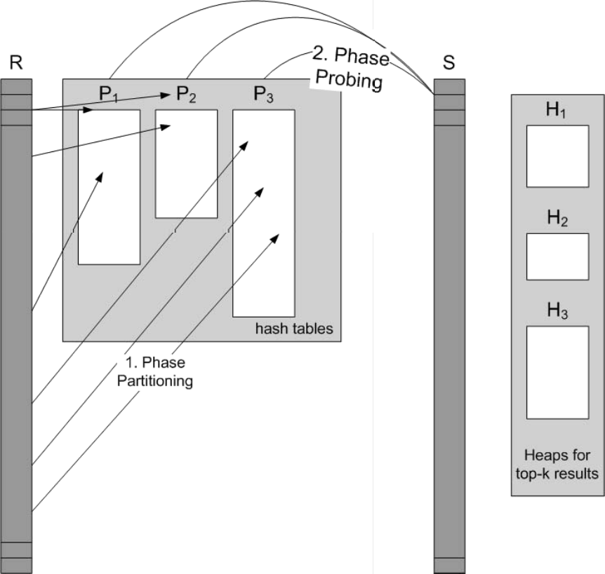
Early Stop in Hash Joins
Approach
  n hash tables P_{i} for n ranking
  functions
  Phase 1:
    partition the incoming data
    stream of one join partner
    according to the local scores
    select top-m_{i} tuples of R into
    each hash tables
  Phase 2 (Probing Phase):
    join partner are probed against the hash tables
  two phases repeated until:
    all tuples of R handled once in each hash table
    top-k computation can be stopped early
min_{i}
max
T_{i} = f_{i}(min(P_{i}), max(g_{2,i}(S) )
Cost Estimation
  Phase 1: linear Scan of R
  Phase 2: linear Scan of S
  → overall cost O( iter*(|R|+|S|) )

Slide 17
Outline
Introduction
1
SQL-Extension
2
Algorithms
3
Evaluation
4
Conclusion

Slide 18
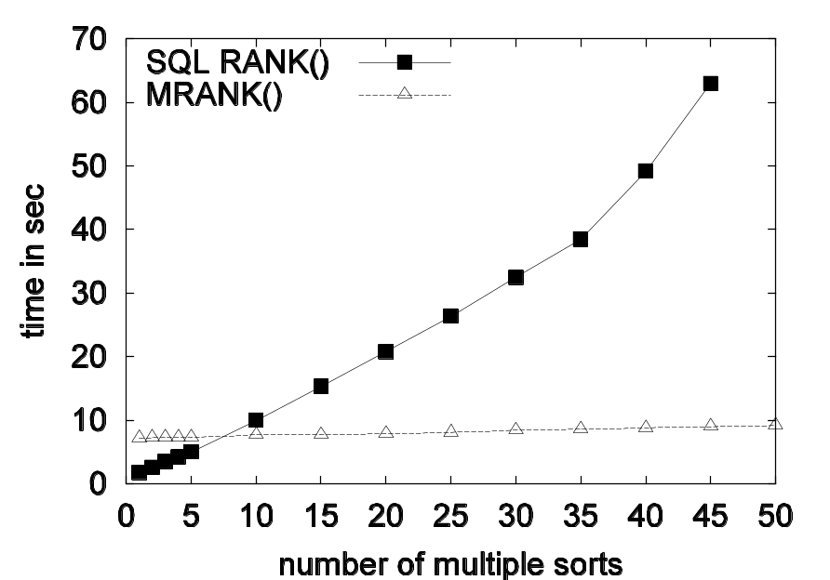
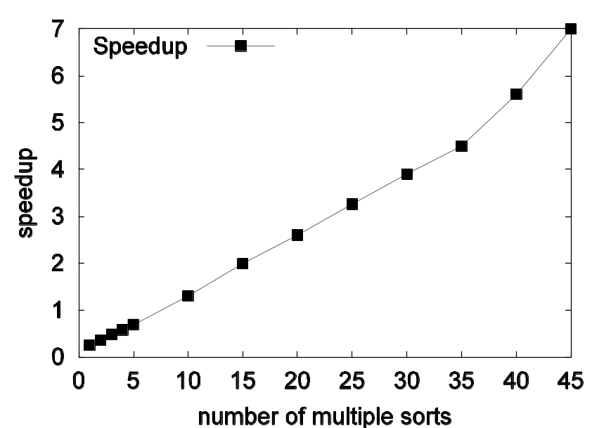
Evaluation
Simple Queries with Multiple Ranks
  image database
  Kim and Chung [SIGMOD 2003]

Slide 19
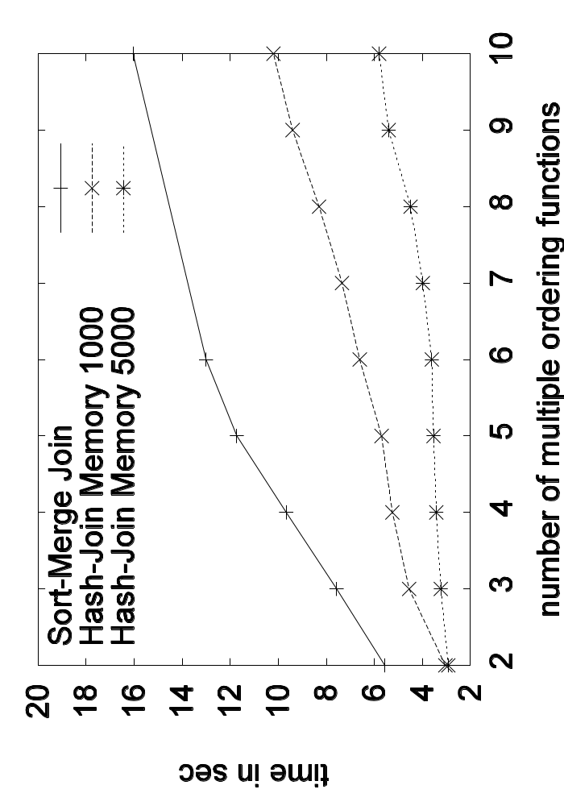
Evaluation (2)
Join Queries with Multiple Ranks
  two generated tables
  local scores independetly from join attributes

Slide 20
Summary and Conclusion
Summary
  supporting multiple top-k queries
  proposed a minimal SQL extension
  presented an efficient algorithm
Conclusion
  easy specification of multiple rankings within one SQL query
  demonstrated the feasibility of our approach
Thank you for your attention.
Questions?

Slide 21
Optimizing Multiple
Topk-Queries over Joins
Computer Science Faculty,System Architecture, Database Technology Group
Dirk Habich, Wolfgang Lehner
Dresden University of Technology, Germany
Database Technology Group
Alexander Hinneburg
Martin-Luther University of Halle, Germany
Database and Data Mining Group

Slide 22
Join Queries with Multiple Ranks
desirable: Algorithms, which do not compute the full join
Ilyas proposed the RankJoin, which is only applicable for only one ordering function
SELECT id, f(g1(R)+g2(S))
FROM R inner join S on R.id = S.id
ORDER BY f(g1(R)+g2(S))
FETCH FIRST 2 ROWS ONLY
S.id
g2(S)
RankJoin
D
10
10
18
18
17
A
14
24
22
22
21
Sort g1(R)
Sort g2(S)
C
15
25
23
23
22
B
20
30
28
28
27
R
S
10
8
8
7
g1(R)
A
C
B
C
R.id

