Slide 1
Using Multi-Scale Histograms to Answer Pattern Existence and Shape Match Queries
Lei Chen, University of Waterloo
M. Tamer Özsu, University of Waterloo
Vincent Oria, New Jersey Institute of Technology

Slide 2
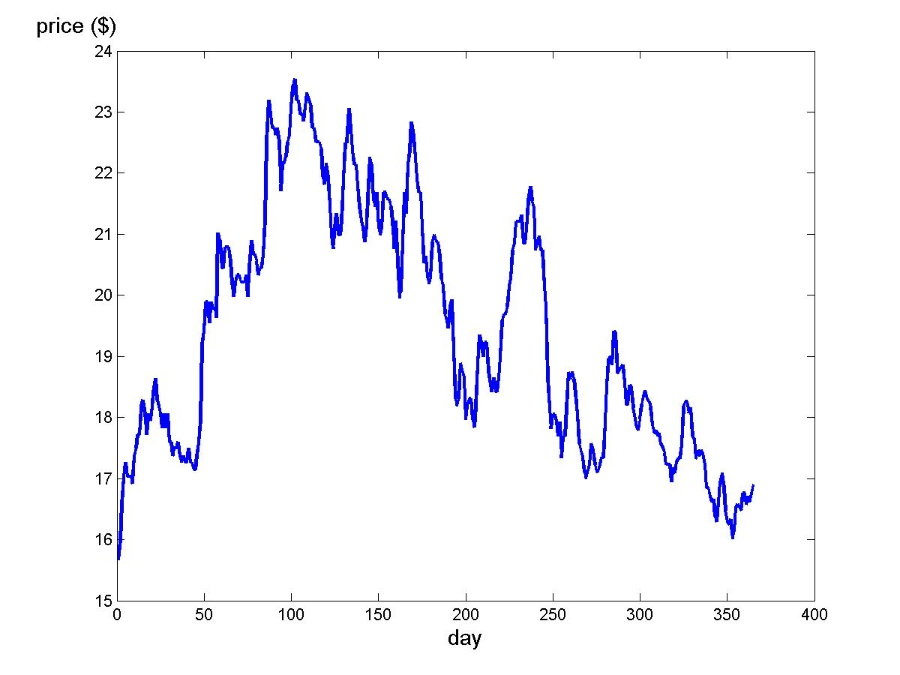
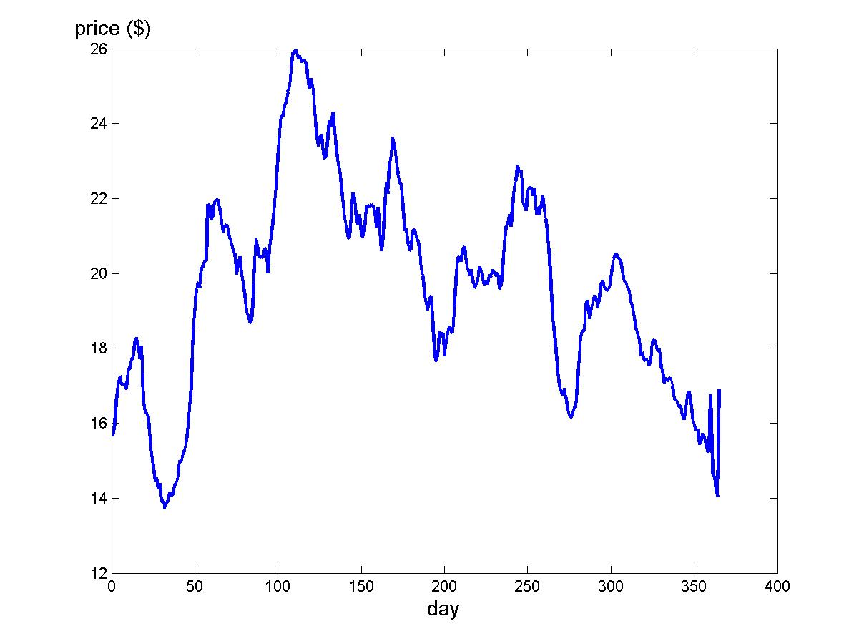
The Problem - In General …
Database
Query
Processor
Query time series/trajectory
“Similar”
time series/trajectories
Notes:
I first describe a general view of the problem that I want to solve.
Given a query time series or trajectory, a database that contains thousands or millions time series or trajectories. We want to find time series or trajectories from the database which are similar to the query time series or trajectories through some query processing. The solution of this problem can be used in many applications, For example…

Slide 3
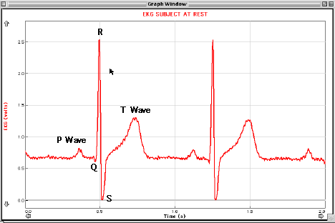
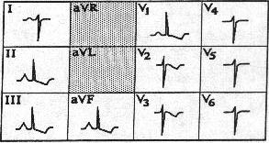
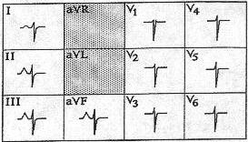
ECG Data Analysis
Medical
Database
Query
Processor
right ventricular enlargement
pulmonary disease
Notes:
In a medical information systems, given a ECG of a patient and a medical database which contains the ECG of different diseases. If we can find the given ECG of the patient is similar to the ECG pattern listed for a disease, the possibility that the patient have that diseases will be high, which can help doctors to diagnose disease.
The ECG shows cardiac waveforms generated by electrical activity of the heart muscle. The cyclical contraction and relaxation of the atria and ventricles involves polarisation and depolarisation of heart muscle fibres. This creates an electrical current that moves through the body, and which can be measured by electrodes attached to the skin.
Similarity-based time series retrieval can be used to detect patterns that appear in the ECG and predict possible disease..

Slide 4

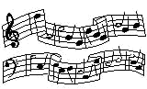

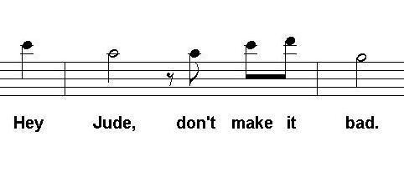
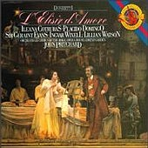

Query By Humming in Music Databases
Music
Database
Query
Processor
Notes:
Similarity-based time series retrieval can be used on music retrieval, for example, query by humming. User hums the query melody using a PC microphone with a single channel. The acoustic input is converted to a time series of the pitches. The music database consists of a collection of melodies; each melody is a sequence of pitches. The query processor will search the database and return a list of melodies that are closest to the user’s humming. The results are usually ranked according to their similarity scores.

Slide 5
Many Other Applications
Medical Information Systems
  Data Analysis
    “Detect abnormalities (patterns) of the cardiac objects”
  Gene Expression Time Series Clustering
    “Clustering the mRNA data”
Multimedia Information Systems
  Query-by-Humming
    “Find the songs that are like the song I am humming.”
  Query-by-Example Video
    “Find video clips that are similar to the example clip.”
Financial Information Systems
  Pattern Discovery
    “In the stock data of last month, find those that contain a head-and-shoulder pattern.”
  Data Correlation
    “Find all stocks whose price movements over the last two months are similar to IBM’s stock.”
Notes:
Similarity-based time series and trajectory retrieval can be applied to many domains, such as multimedia databases, financial databases and medical databases.
For multimedia databases, similarity-based time series retrieval can be applied to the applications such as query by humming and query by example video.
For financial databases, similarity-based time series retrieval can be used to fining interesting patterns from the stock data, such as “head and shoulder” patterns, it can be also used to find the correlations between two stock data.
For medical databases, similarity-based time series retrieval can be applied to data analysis, such as analysis of EKG (Echocardiogram) data.

Slide 6
Important Issues
What does “similar” mean?
  Distance function: A function determines how “far” two data points are away from each other
    Lp-norm (e.g., Euclidean distance), Dynamic Time Warping (DTW), Longest Common Subsequence (LCSS)
    Edit distance with Real Penalty (ERP), Edit distance on Real Sequence (EDR)
Efficient retrieval methods
    GEMINI framework
    Triangle Inequality
Notes:
Since the solution of the problem have many applications, which give us a good motivation solve the problem. The problem is not trivial to solve.
There are two key issues need to be resolved to answer queries over time series and trajectory data, which are: the definition of similarity and the methods to improve retrieval efficiency. As human being, we can tell the similarity between two objects through observation and processing of our brain. In order to make computer to identify whether two objects are similar or not, a distance function has to be used. Thus, the similarity between two objects are usually measured by distance functions, which determine how far two objects away from each other. For time series data, we measure the difference between each matched pair of elements and sum up the differences of all matched pair of elements between two sequences as the distances. Two approaches can be used to design a distance function. We can start from some specific applications, such as financial data analysis, and get the domain knowledge from experts to design a distance function specific for that application. We can also start from general application, get the common characteristics of data and design distance function to address those characteristics. In this work, we follow the second approach, since the first approach needs a lot of domain knowledge. A number of distance functions have been designed for time series and trajectory data, such as L_{p}-norm, Dynamic Time Warping and Longest Common Subsequences. In this work, we also propose two distance functions, named edit distance with Real Penalty and Edit distance on Real Sequence.
The total execution time of a query is determined by the time that is spent on computing distance functions and disk access time, therefore, how to reduce the number of distance computation, especially when the computation of distance function is expensive, is quite important to improve the retrieval efficiency. Basically, two approaches are used, GEMINI framework and triangle inequality.
1).The basic idea of GEMINI frame work is to lower bound the real distance and index on the lower bounds. The detail steps of GEMINI framework will be presented in the later slides.
2). Triangle inequality is the principle that most distance-based indexing structures follow. However, not all the distance functions follow triangle inequality; in this case, embedding the distance functions to some metric distance functions or pruning with sequential scan are solutions.

Slide 7
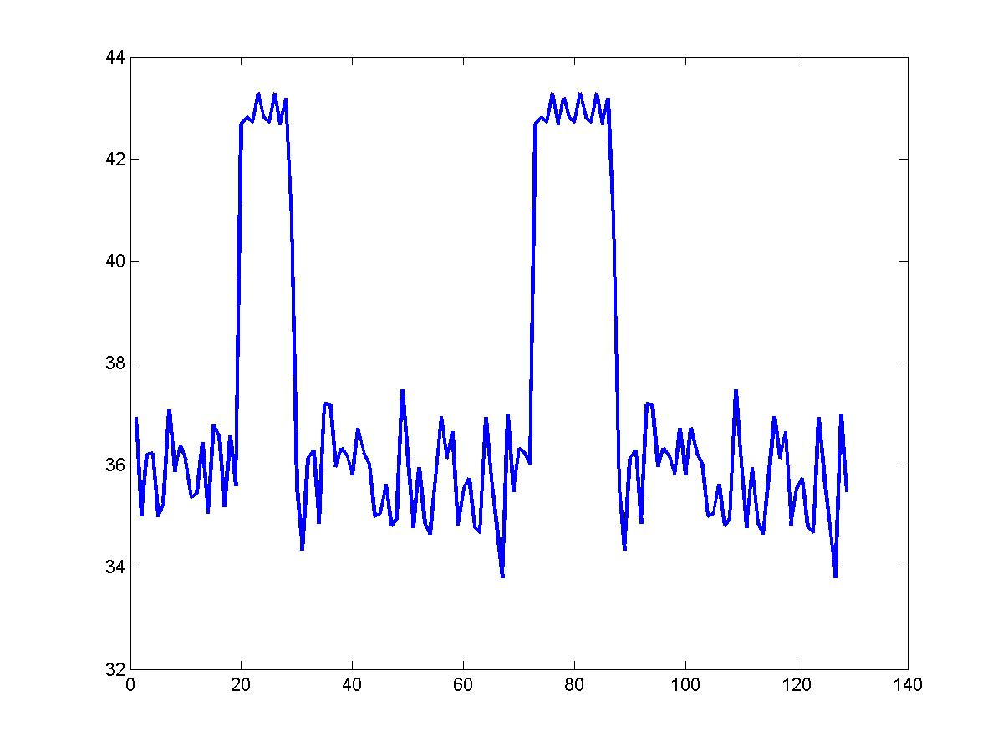
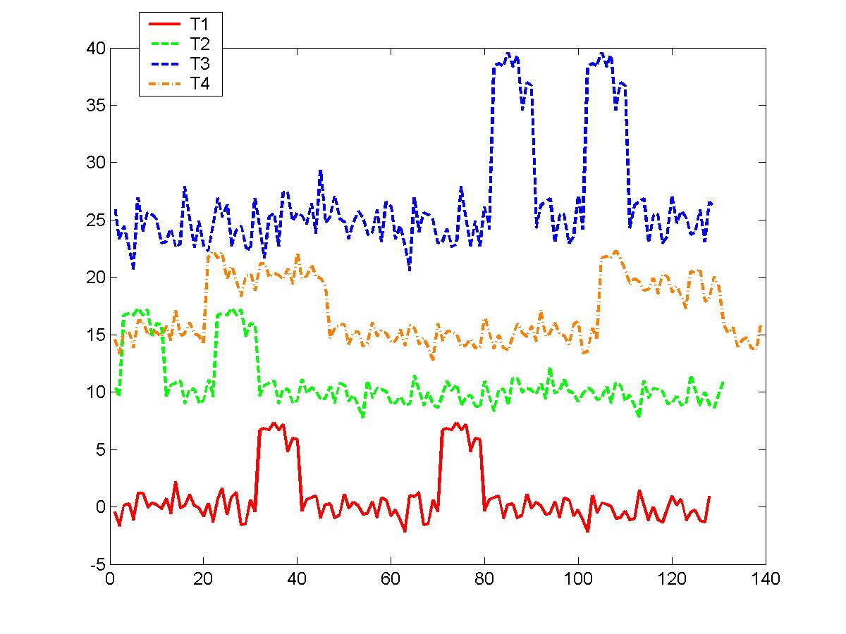
Classification of Queries
Pattern Existence Queries
  Checking the existence of a specific pattern, no matter when and how it appears
  E.g. “Give me all patient temperature data for the last 2 hours that have two peaks as shown in the example time series”

Slide 8
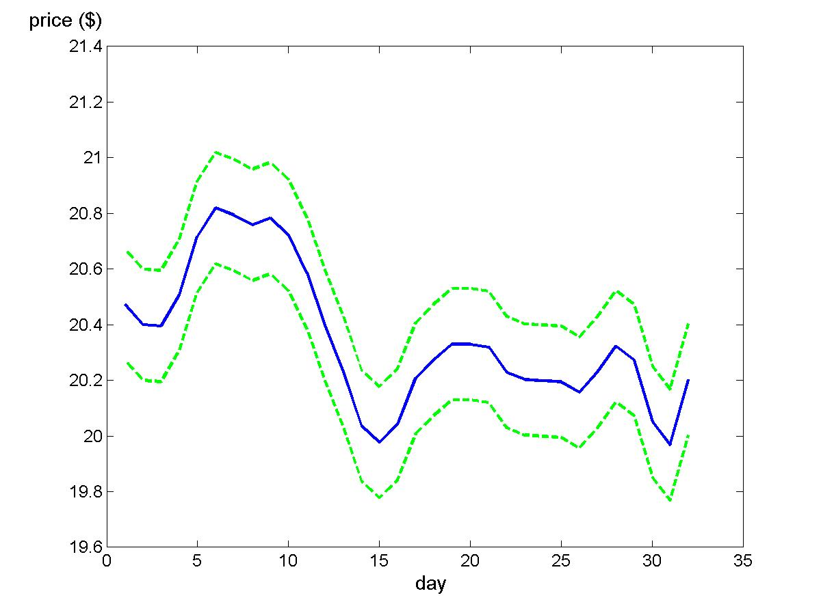
Classification of Queries
Shape Match Queries
  Searching the time series or trajectory data that contain similar movement shapes as those of the query data
  E.g. “Give me all stock data from last month that are similar to IBM’s stock data of last month”

Slide 9
Objectives
Design a uniform representation for time series data which can answer both pattern existence queries and exact match queries.
Select a suitable similarity model which is robust to noise.
Develop mechanism to improve the retrieval efficiency
Notes:
The concepts of local time shifting and noise will be illustrated in the later slides.

Slide 10
Outline
Introduction
Multi-scale Time Series Histograms
Experiment
Conclusions

Slide 11
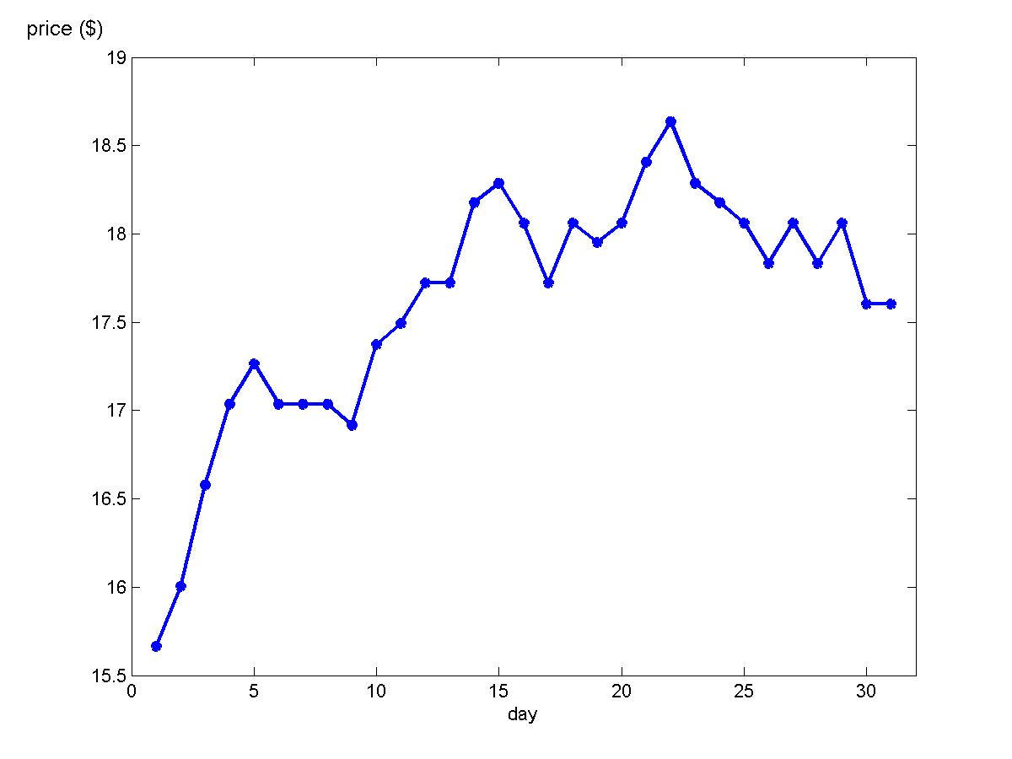
Time Series
A time series is defined as a sequence of pairs:
R = [(t₁, r₁), …, (t_{N}, r_{N})]
where N is the length of R, t_{i} is the sampling timestamp and r_{i} is a vector of arity d (d=1 for time series data)
Notes:
A time series is defined as a sequence of pairs, where t_{i} is a sampling timestamp and r_{i} is a sampled vector at sampling timestamp t_{i}. For time series data the arity of the sampling vector is usually equal to 1. An example of a time series is shown in the figure, which is a company’s stock close price over last 30 days

Slide 12
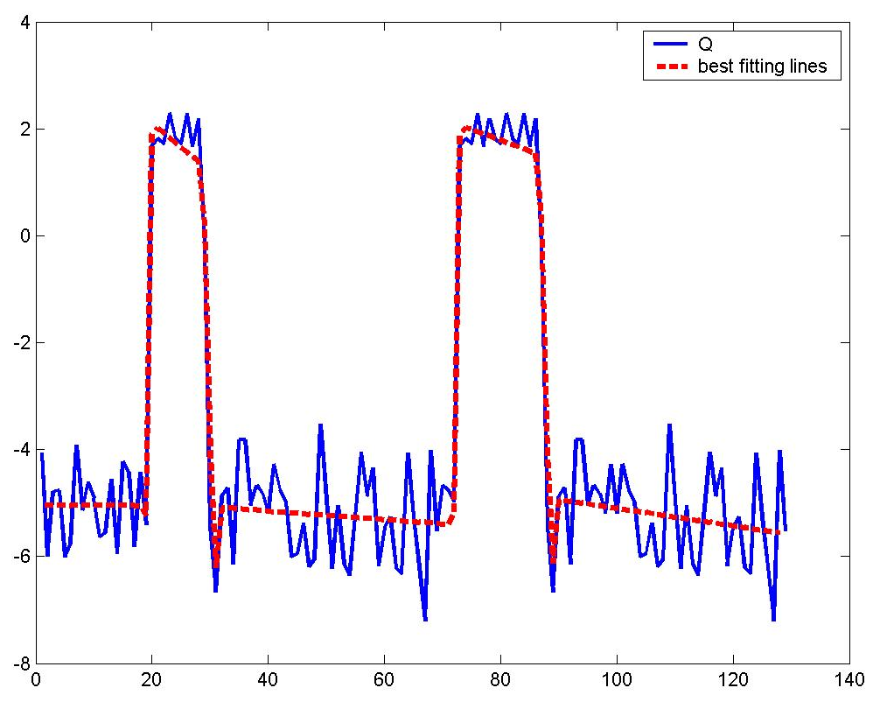
Symbolic Representation to Answer Pattern Existence Queries
Symbol | Slope Partition
F | (π/6, π/2)
U | [-π/6, π/6]
D | (-π/2, π/6)
Notes:
In these approaches, best line fitting algorithms have been used to convert a time series to a sequence of
linear approximations (as shown in Figure, the query time series Q is approximated by a sequences
of line segments). Then, the slope of each line segment is mapped into a symbol according
to a predefined mapping table (e.g. Table 1.1) and consecutive symbols are connected
together to form a word1. Finally, these words are checked to see whether they match
query pattern QP, which is specified by a regular expression. According to the example
of converted line segments and the mapping table, the regular expression of the query
example for retrieving time series that contain two peaks can be F¤U+D+F¤U+D+F¤.
However, the above transformation process is sensitive to noise. Furthermore, because
of the quantization of the value space for transforming time series data into strings, data
points located near the boundaries of two quantized subspaces may be assigned to different
symbols (e.g. given an arbitrary small value ε, tan(π/6)- ε and tan(π/6)+ ε are in two
different value ranges according to mapping table). As a consequence, they are considered to
be different by string comparison techniques.

Slide 13
Common Distance Functions
Lp-norm
  Sum of the point-by-point distance
Dynamic Time Warping (DTW)
  Allow sequences to stretch or squeeze to get the minimum sum of the point-by-point distance
Longest Common Subsequence (LCSS)
  Only count the number of “common” elements between two sequences

Slide 14
Efficient Computation
Mainly based on indexing and pruning
Alternatives
  GEMINI framework
    Reduce data dimensionality from N to n (n<<N)
    Define a distance function, dist, such that lower bounding lemma holds: dist_{indexspace}(Q,R) ≤ dist_{true}(Q,R).
    Plug dist into an off-the-shelf SAM.
  Triangle Inequality
    Given query point Q and data points a, b, c
      dist(Q,c) ≥ dist(Q,b) − dist(b,c)
    Store pair-wise distances of points in the database
    Use these to eliminate some distance computations: if dist(Q,a) ≤ dist(Q,b) − dist(b,c), don’t compute dist(Q,c)
    Only for metric distances (DTW and LCSS are not)

Slide 15
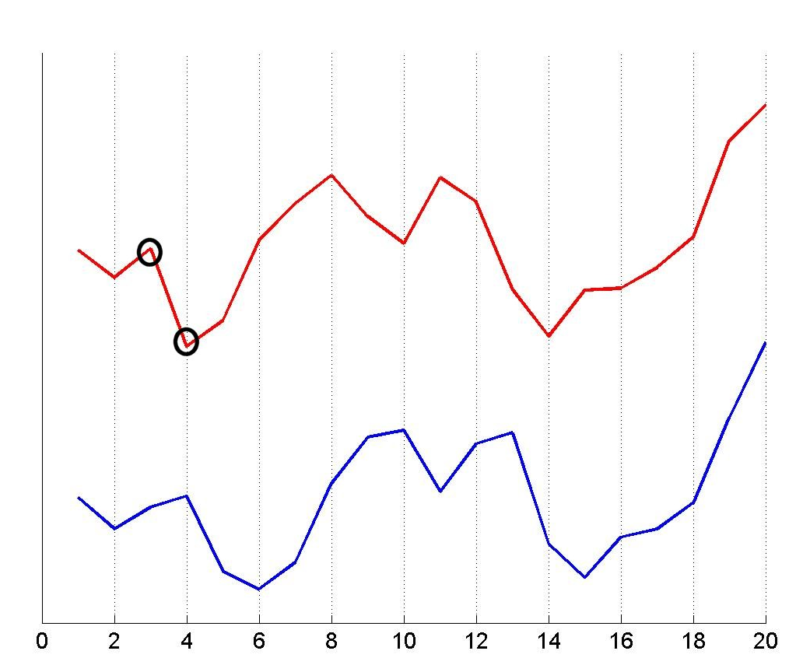
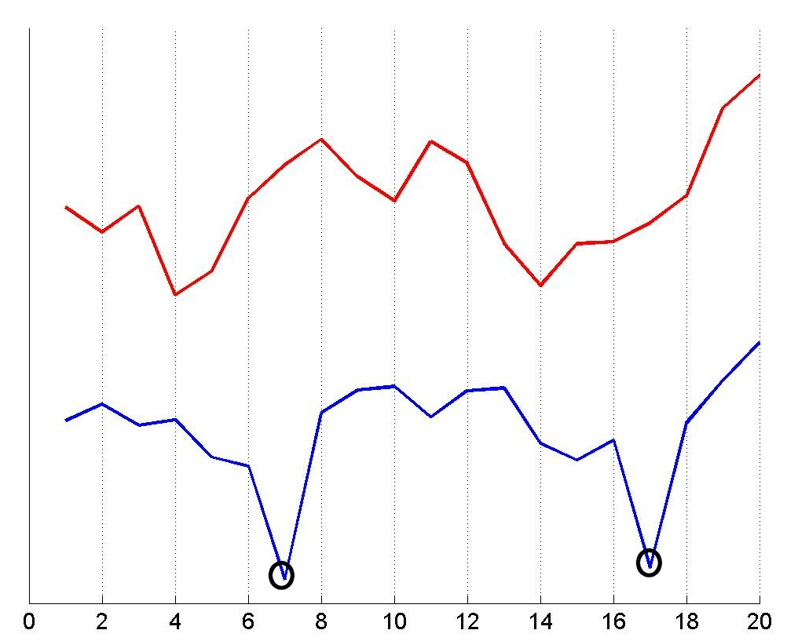
Characteristics of Data
Local time shifting
  Similar parts appear out of time phase
  Local time shifting is known to exist in real data
    [Yi et al. 1998], [Kim et al. 2001], [Keogh 2002] , [Zhu et al. 2003]
Noise
  Data points are “abnormal” compared to nearby data
  Noise is known to exist in real data
    [Das et al. 1997], [Vlachos et al. 2001]
Notes:
The time series and trajectory data that we study in this work have two properties, local time shifting and noise.
Local time shifting: as shown in top right figure (The x axis is the sampling time and y axis is the sampled value of time series data), the red curve is the query data and the blue curve is the matching time series (in this presentation, for clarity reason, only one dimensional time series are used in example figures). As shown in the figure, the query time series have to be shifted along the time axis to match the matching time sequence. However the shifting is not same for all the elements. For example, for the first point marked out by a circle has to be shifted right one position to find its corresponding point in the matching time sequence. For the second point marked out by a circle, it has to be shifted right two positions to find its matching point. Therefore, globally shifting all the elements of query time sequence by a constant value will not handle this problem. Thus, we call this problem as local time shifting. Local time shifting does exist in the real data, as discussed in many papers. For example, in the query by humming system, users may have different paces to hum and they may stop for a short time of period during the humming, all these factors can cause the pitch values of the humming time series have local time shifting.
The second characteristics of data is that they may contain noise. Here noise is defined as data points that are “abnormal” compared to nearby data. As shown in the bottom right figure, the data points that are marked out by circles are possible noise because they appear to be “abnormal” compared to the nearby data. Noise indeed exist in time series and trajectory data as discussed in many papers. Furthermore, due to lack of domain knowledge, it is not always possible to clean data. Therefore, we have to define a distance function to handle data that contain noise.

Slide 16
Outline
Introduction
Multi-scale Time Series Histograms
Experiment
Conclusions

Slide 17
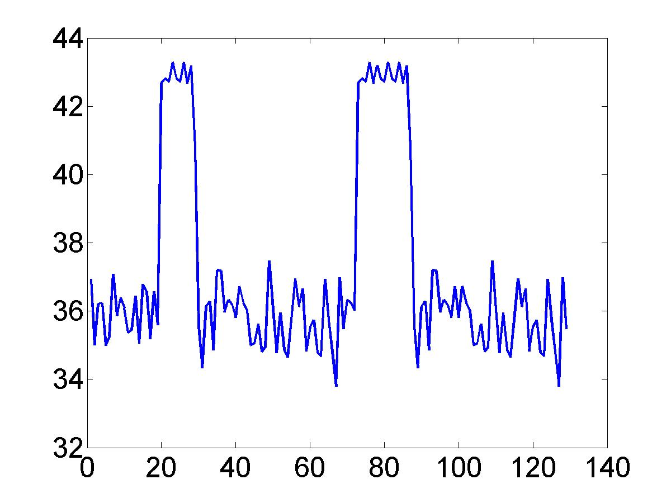
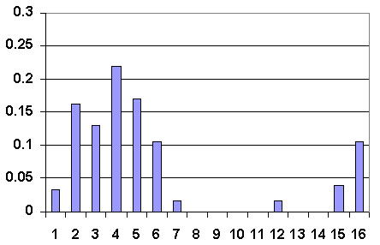
Pattern-to-Histogram Conversion
First Level
Notes:
based on the observation that data distributions can capture patterns of time series data, we propose a multi-scale
histogram-based representation to approximate time series data that is invariant to noise, amplitude shifting and scaling, and
time shifting. The multi-scale representation can answer both pattern existence queries and shape match queries and offers users
flexibility to search time series data with different precision levels (scales).

Slide 18
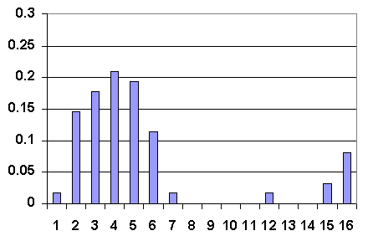
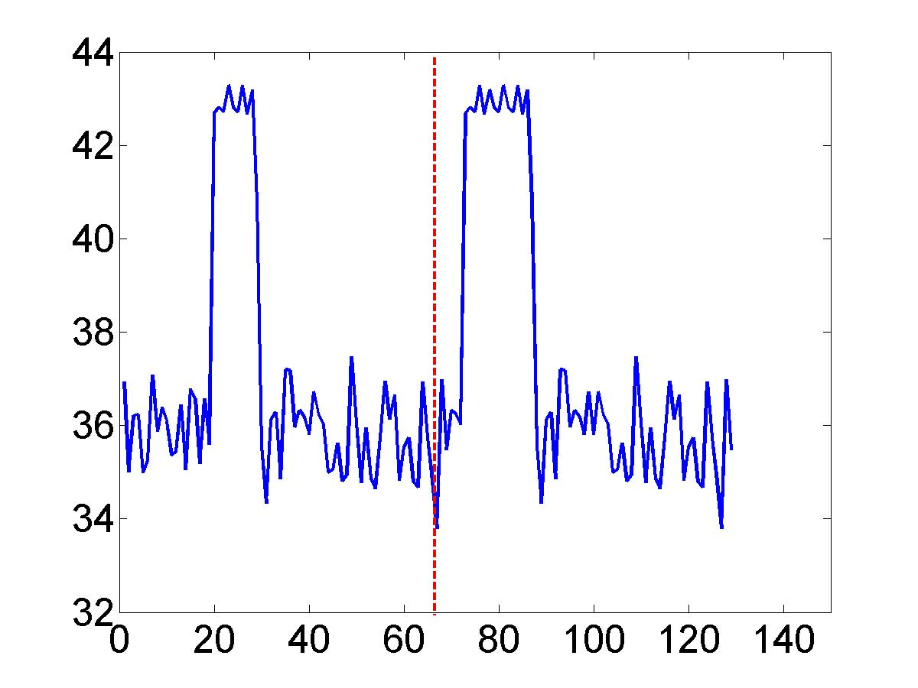
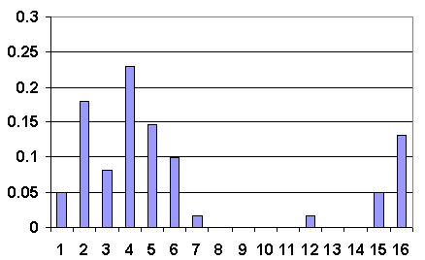
Multi-Scale Histograms
Second Level

Slide 19
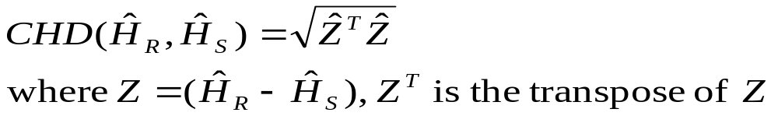
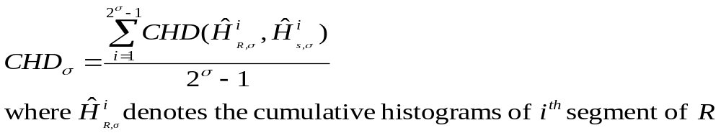
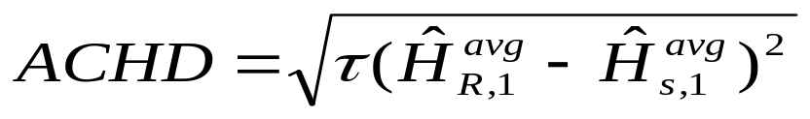

Distance Functions & Multi-Scale Pruning
Cumulative Histogram Distance:
Distance at scale δ
Distance on average histograms
Theorems:

Slide 20
Multi-Scale Time Series Histograms
Use multi-scale time series histograms to answer both pattern existence and shape match queries
  The first scale time series histograms are used to answer pattern existence queries
  Higher scales time series histograms are used to answer shape match queries
  Cumulative histogram distance is used with the consideration of bin similarity
  Multi-step pruning can be used on multi-scale histograms without introducing false dismissals

Slide 21
Multi-Scale Histograms vs Wavelets
Wavelet transformation transfers signal from time domain to time-frequency domain
Wavelet coefficients can be used to answer shape match queries without introducing false dismissals using Lp-norms as distance functions [Chan et al. ICDE 1999 and Popivanvo et al. ICDE 2002]
Wavelet coefficients are not suitable to answer pattern existence queries – not robust to time shifting.
With wavelet coefficients, the query and data sequences must have the same length that must be power of two.

Slide 22
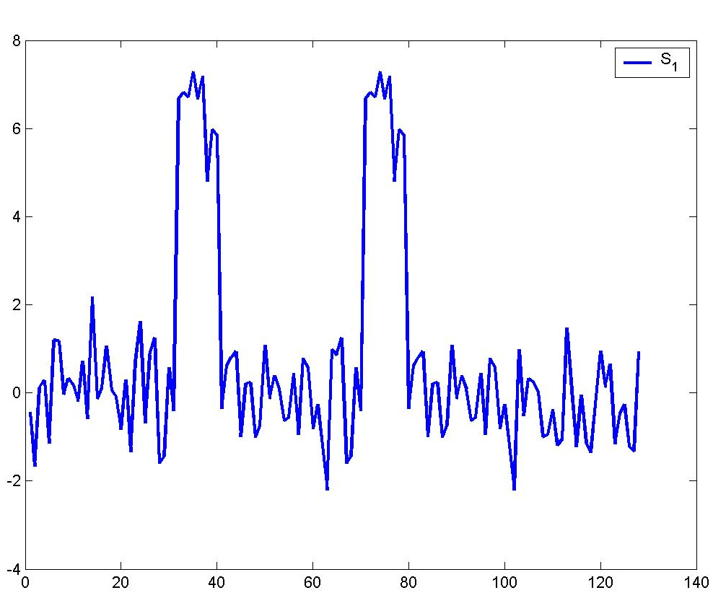
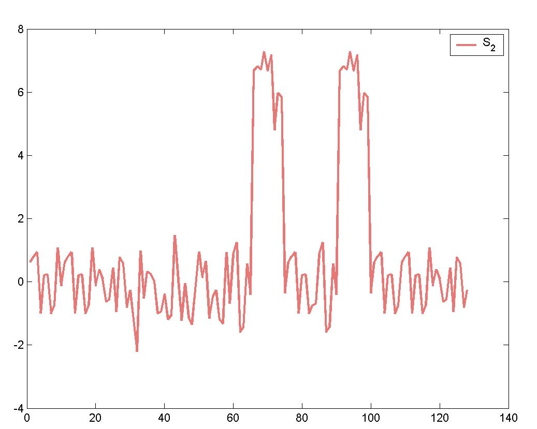
Examples on pattern existence
Two time series S₁ and S₂ contain “two peaks”

Slide 23
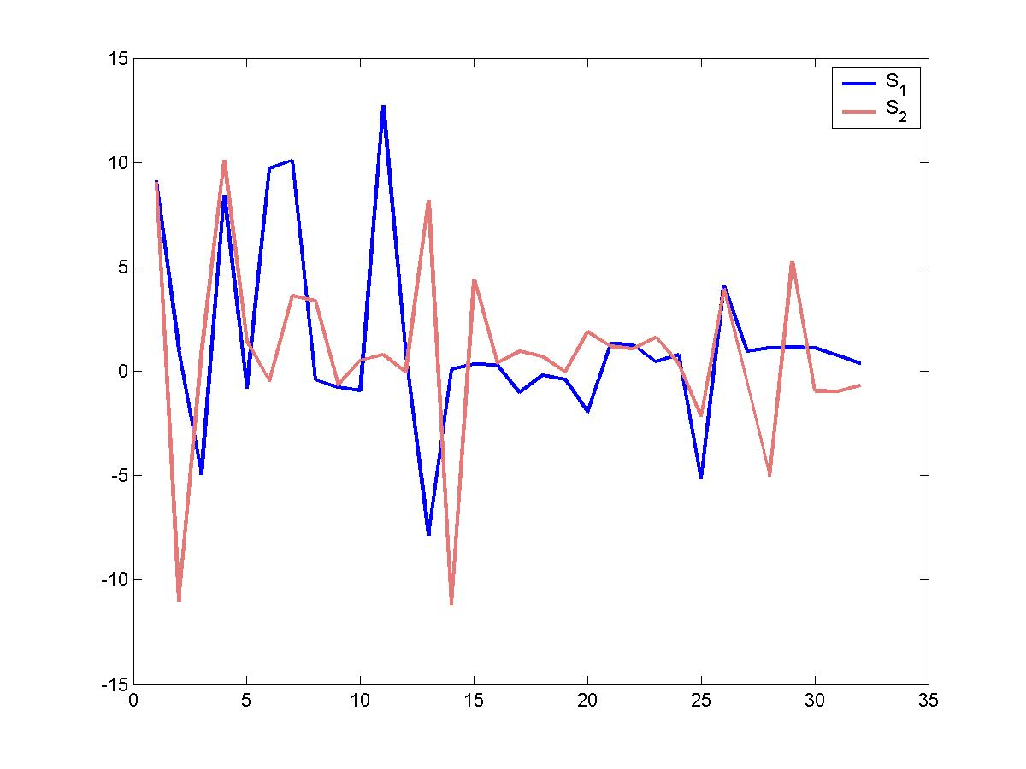
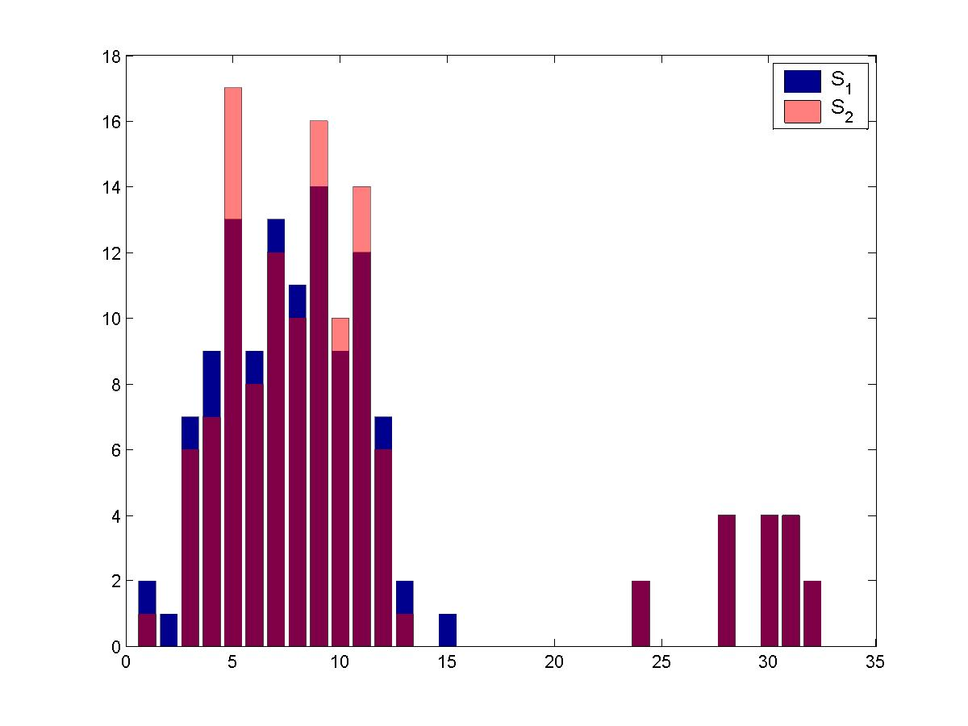
Wavelet Transform vs. Histogram
Notes:
The left figure shows that the wavelet coefficients of s1 is different from those of s2, especially, there exist a time shift between two sequences of coefficients, which leads to a large difference between them if we use Lp-norm to compute the distance. However, for the histograms, as shown in the right figure, most of the histogram bins match, which determines two time sequences similar.

Slide 24
Outline
Introduction
Multi-scale Time Series Histograms
Experiments
Conclusions

Slide 25
Efficacy Test by Classification on Labeled Data Sets
C₂
C₁
C₃
D
Notes:
We test the efficacy of a distance function by some objective test, which is carrying out classification on labeled data set. For example, given a data set with three classes, c1, c2 and c3. Randomly pick up a data from one class c1 and use 1-NN with the distance fuction to find its 1-NN. Since data are labeled, we can tell 1-NN is in which class, if its 1-NN is in c1, it is called a hit, else it is a miss. as the query data, it is called miss. Less miss tells that the distance function well capture the similarity of data set and make all the data that similar to each other goes to one class. We test three benchmark data sets and compare four distance functions, the results are shown as following

Slide 26
Performance Study Summary
Pattern Existence Queries
 | Cylinder |  | Bell
 | precision | recall | precision | recall
Reg. Exp | 81 | 44 | 75 | 31
Histogram | 81 | 90 | 85 | 87
Shape Match Queries
 | Error Rate
Distance Functions | ASL | Cameramouse
DTW | 0.11 | 0.08
LCSS | 0.29 | 0.25
CHD (s=2, b=32) | 0.04 | 0.02

Slide 27
Efficacy Test on Pattern Existence Queries (Histograms vs. Wavelets)
 | Cylinder |  | Bell
 | precision | recall | precision | recall
Reg. Exp | 81 | 44 | 75 | 31
Wavelet (c=8) | 49 | 97 | 48 | 96
Wavelet (c=32) | 40 | 44 | 37 | 40
his (bin=32) | 81 | 90 | 85 | 87

Slide 28
Efficacy Test on Shape Match Queries
 | L₂-norm | DTW | LCSS | Wavelet (c=64) | Histograms (s=2, b=32)
CC data | 0.21 | 0.12 | 0.16 | 0.21 | 0.07
Wavelet uses L₂-norm to measure the distance, which has the exact the same value as that of L₂-norm on raw data sequences. Therefore, they have the same error rates.

Slide 29
Efficiency of Multi-Step Pruning
 | number of comparison needed
threshold | scale 4 only | scale1 to scale 4 | all 4 scales
ε=0.5 | 11580 | 13498 | 17190
ε=0.2 | 11580 | 12760 | 7590
ε=0.1 | 11580 | 6838 | 3668
ε=0.05 | 11580 | 2356 | 2072

Slide 30
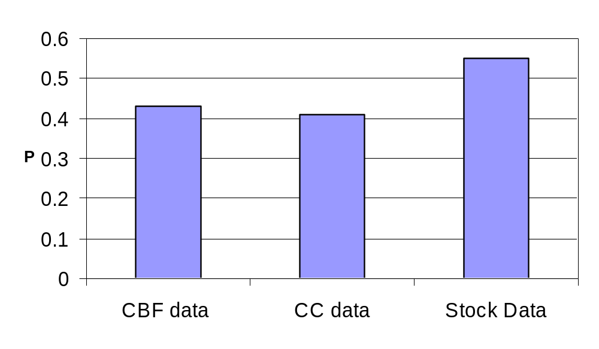
Pruning Power of Averages of Histograms

Slide 31
Outline
Introduction
Multi-scale Time Series Histograms
Experiments
Conclusions and Future Work

Slide 32
Conclusions
A novel representation of time series data is proposed with multi-scale histograms that can answer both pattern existence & exact match queries.
Time series histograms, together with cumulative histogram distances, are robust to noise in answering pattern existence queries.
Multi-step pruning can remove false candidates without introducing false dismissals in answering exact matching queries.
Distance between average histograms can be used to avoid quadratic distance computation.

Slide 33
Future Work
Probe the data and automatically select the optimal scale and number of bins.
Create an hierarchy indexing structure to fast access multi-scale histograms.
Extend the work to multi-dimensional time series data.

